Slide 1
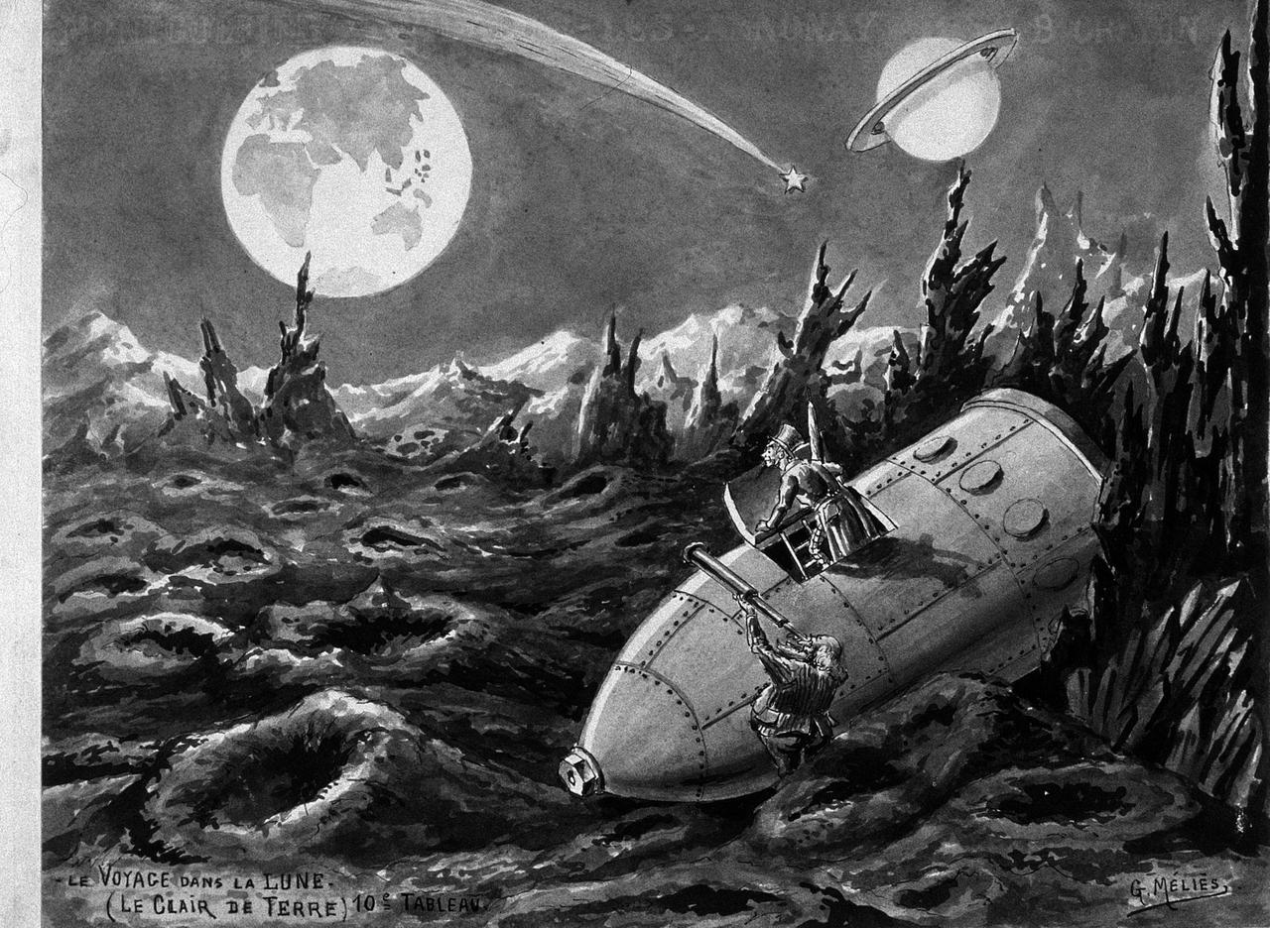
Introducing Web Fragments
An exploration of web archives beyond the webpages
Quentin Lobbé (LTCI, Télécom ParisTech & Inria Paris)
Medialab’s research seminar – October 17, 2017

Slide 2
> Let's start with a first leading question :
How can we go through an exploration of web archives over time ?
> To understand if and how :
The structure and content of the web can be permeable to the effects of
shocks and external events such as political and social mobilizations?

Slide 3
Summary
1/ The e-Diasporas Atlas : a collection of online migrant collectives
2/ Archiving the web ?
3/ Dealing with an exploration of a web archive corpus (related works and issues)
4/ Introducing Web Fragments
5/ Implementations and experimentations
6/ Further digital traces of migration, archives and studies

Slide 4
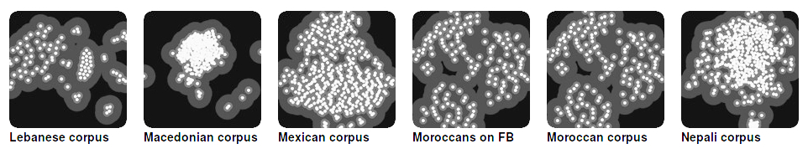
The e-Diasporas Atlas
> A collection of online migrant collectives
| marocainsdumonde.gov.ma
| larbi.org
A migrant web site is a website created or managed
by migrants and/or that deals with them
| yabiladi.com
An e-Diaspora is a directed network of migrant websites
linked by url (href)
| moroccoboard.com
10.000 migrant websites crawled, categorized and organized among 30 e-diasporas

Slide 5
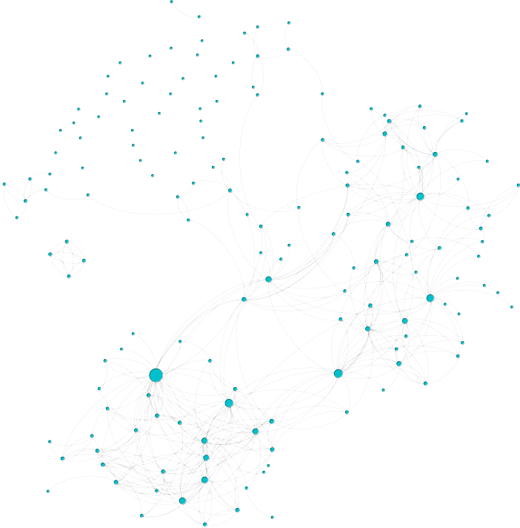
The e-Diasporas Atlas
> A tool for sociological analysis
yabiladi.com
> the Moroccan e-Diasporas

Slide 6
The e-Diasporas Atlas
> A tool for sociological analysis
Associations
yabiladi.com
Blogs
Institutions
> the Moroccan e-Diasporas

Slide 7



Facing the evolutions of e-Diasporas ...
> new website
> alternative spaces
of expression
yabiladi.com
> death of blogs
> new link
> the Moroccan e-Diasporas

Slide 8
… and all kinds of web site changes ...
> structural changes
move, copy, delete, inserte,
update …
> attribute changes
css, font …
> type changes
<div> to <p>
> semantic changes
For example : http://www.medialab.sciences-po.fr/fr/

Slide 9
… it was decided to start archiving the corpora
> To keep a trace of the evolutions of every website
page 1
page 2
page 1
page 2
page 3
> time 1
> time 2
record 1
record 2
As related works mainly focus on upstream web archive acquisition
we choose here to perform the exploration of an existing corpus

Slide 10
20 years of web archiving
> Saving the micro-history of the web
~ 1992 invention of the web
2003 Unesco & Digital Heritage
1996 Archive.org
2011 french « dépôt légal du web »
BNF
INA
Archive.org
Google
18,000 M
370 TB
43,000 M
420 TB
150,000 M
5500 TB
???

Slide 11
Unfortunately, whoever wants to go through an exploration of web archives
has to first brave diverse accessibility issues…

Slide 12
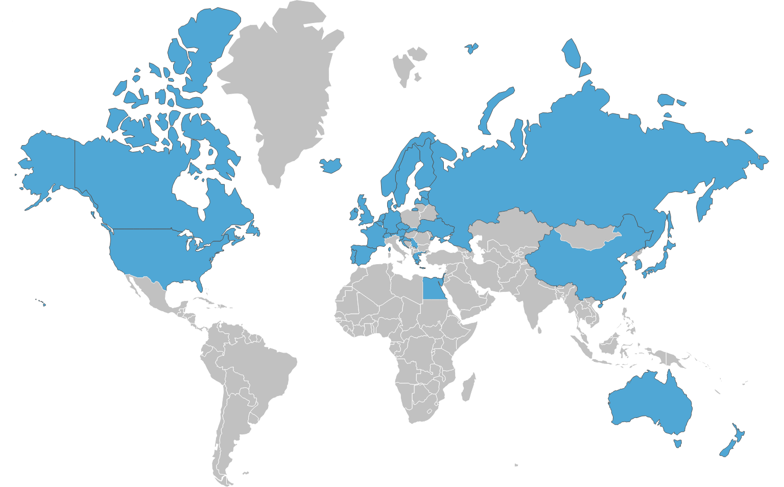




Consulting a corpus of web archives
> Accessibility & issues
> Online access :
But : - restricted search
- no strategy to focus
analysis
> Map of Web archiving initiatives worldwide (2017)
> Local access :
A 1h30 long journey to access the local consultation point

Slide 13
The e-Diasporas Atlas Archive
1030 M of webpages
70 TB
Crawled weekly or monthly, from April 2010 to September 2014
Hosted and performed by the INA
> The Moroccan archive
153 websites
From 09/2017 :
53 still alive > 34,6 %
38 no update > 25,8 %
62 dead > 40,5 %
blogs are the most impacted
> Look at the maps for a comparison between Archive.org, BNF and e-Diasporas corpora

Slide 14
Focusing on the particular case of yabiladi.com
a hub at the center of the network
an established and hybrid website
forum
videos
yabiladi.com
since 2002
news
dating
> 2.8 Millions of archived pages

Slide 15
As corpora of web archives are wide and sparse :
Is there a way to effectively guide a researcher through exploration of web archives ?
Like around a particular event
How can we follow and analyse the traces of an event and its genesis
by restoring it in the dual temporality of the web and the real?

Slide 16
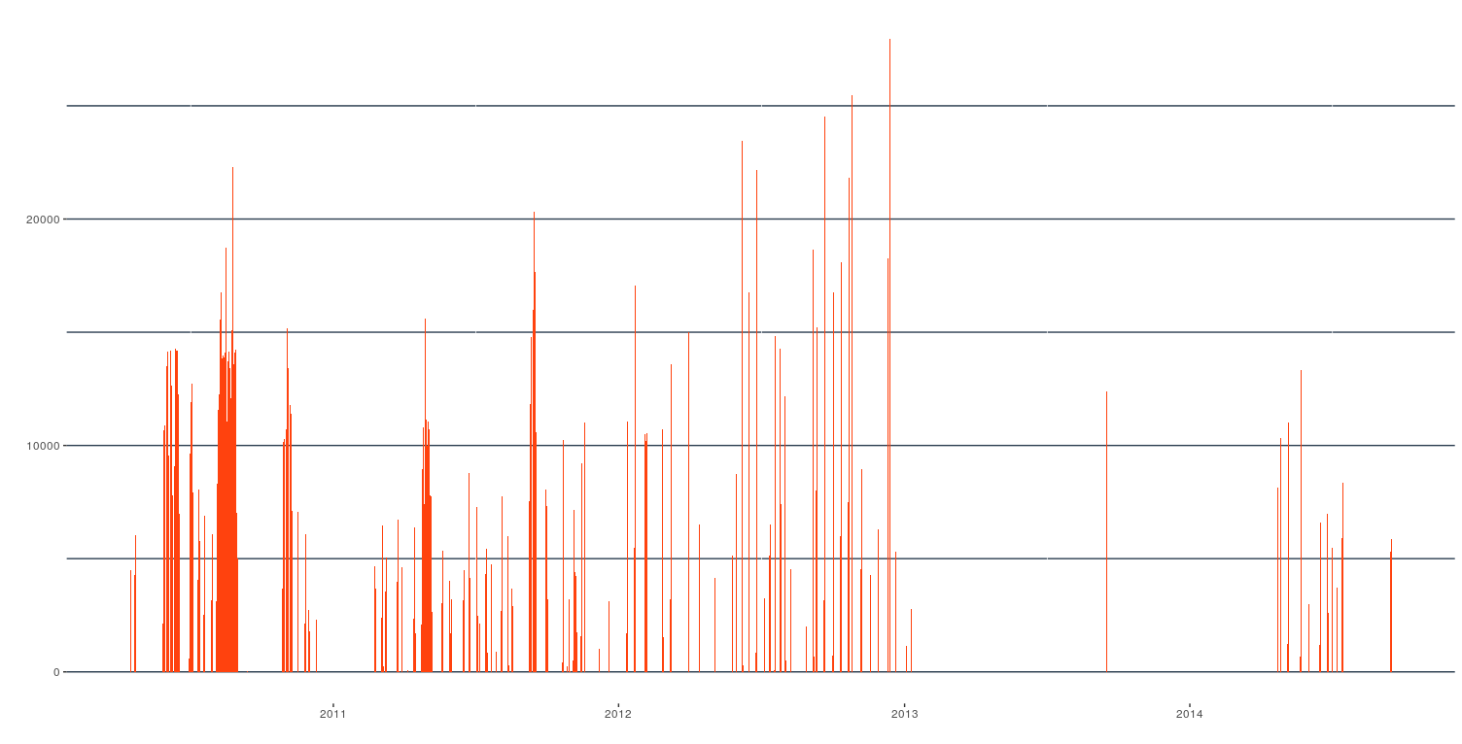
The naive approach
> considering all the archived pages as traces of activities on the website
Number of news archived pages by day on yabiladi
> Are those peaks and valleys relevant ?

Slide 17
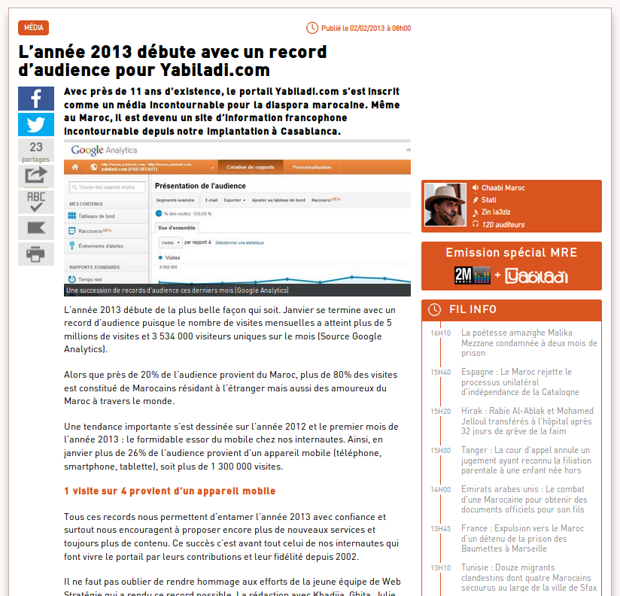
The naive approach
> considering all the archived pages as traces of activities on the website
No it's not relevant …
It's easy to find pages
edited in 2013
So what have we seen ?

Slide 18
Keep calm and ...
go back to the basics of the structure of a web archive corpus

Slide 19
Web archives are not direct traces of the web
> web archives should be considered as direct traces of the crawler
Continuous Web
Discrete Archives
download
date 1
download
date 2
download
date 3
> We saw what we call a crawl legacy effect

Slide 20
The original scale of web archives is the webpage
> what can we learn from the structure of web archives files?
.WARC
.DAFF
t1
t2
t1
t2
meta
meta
meta
meta
crawler date
crawler date
crawler date
crawler date
download date
download date
download date
download date
data
data
data
html content
html content
html content
> by definition, web archives are built on top of webpages

Slide 21
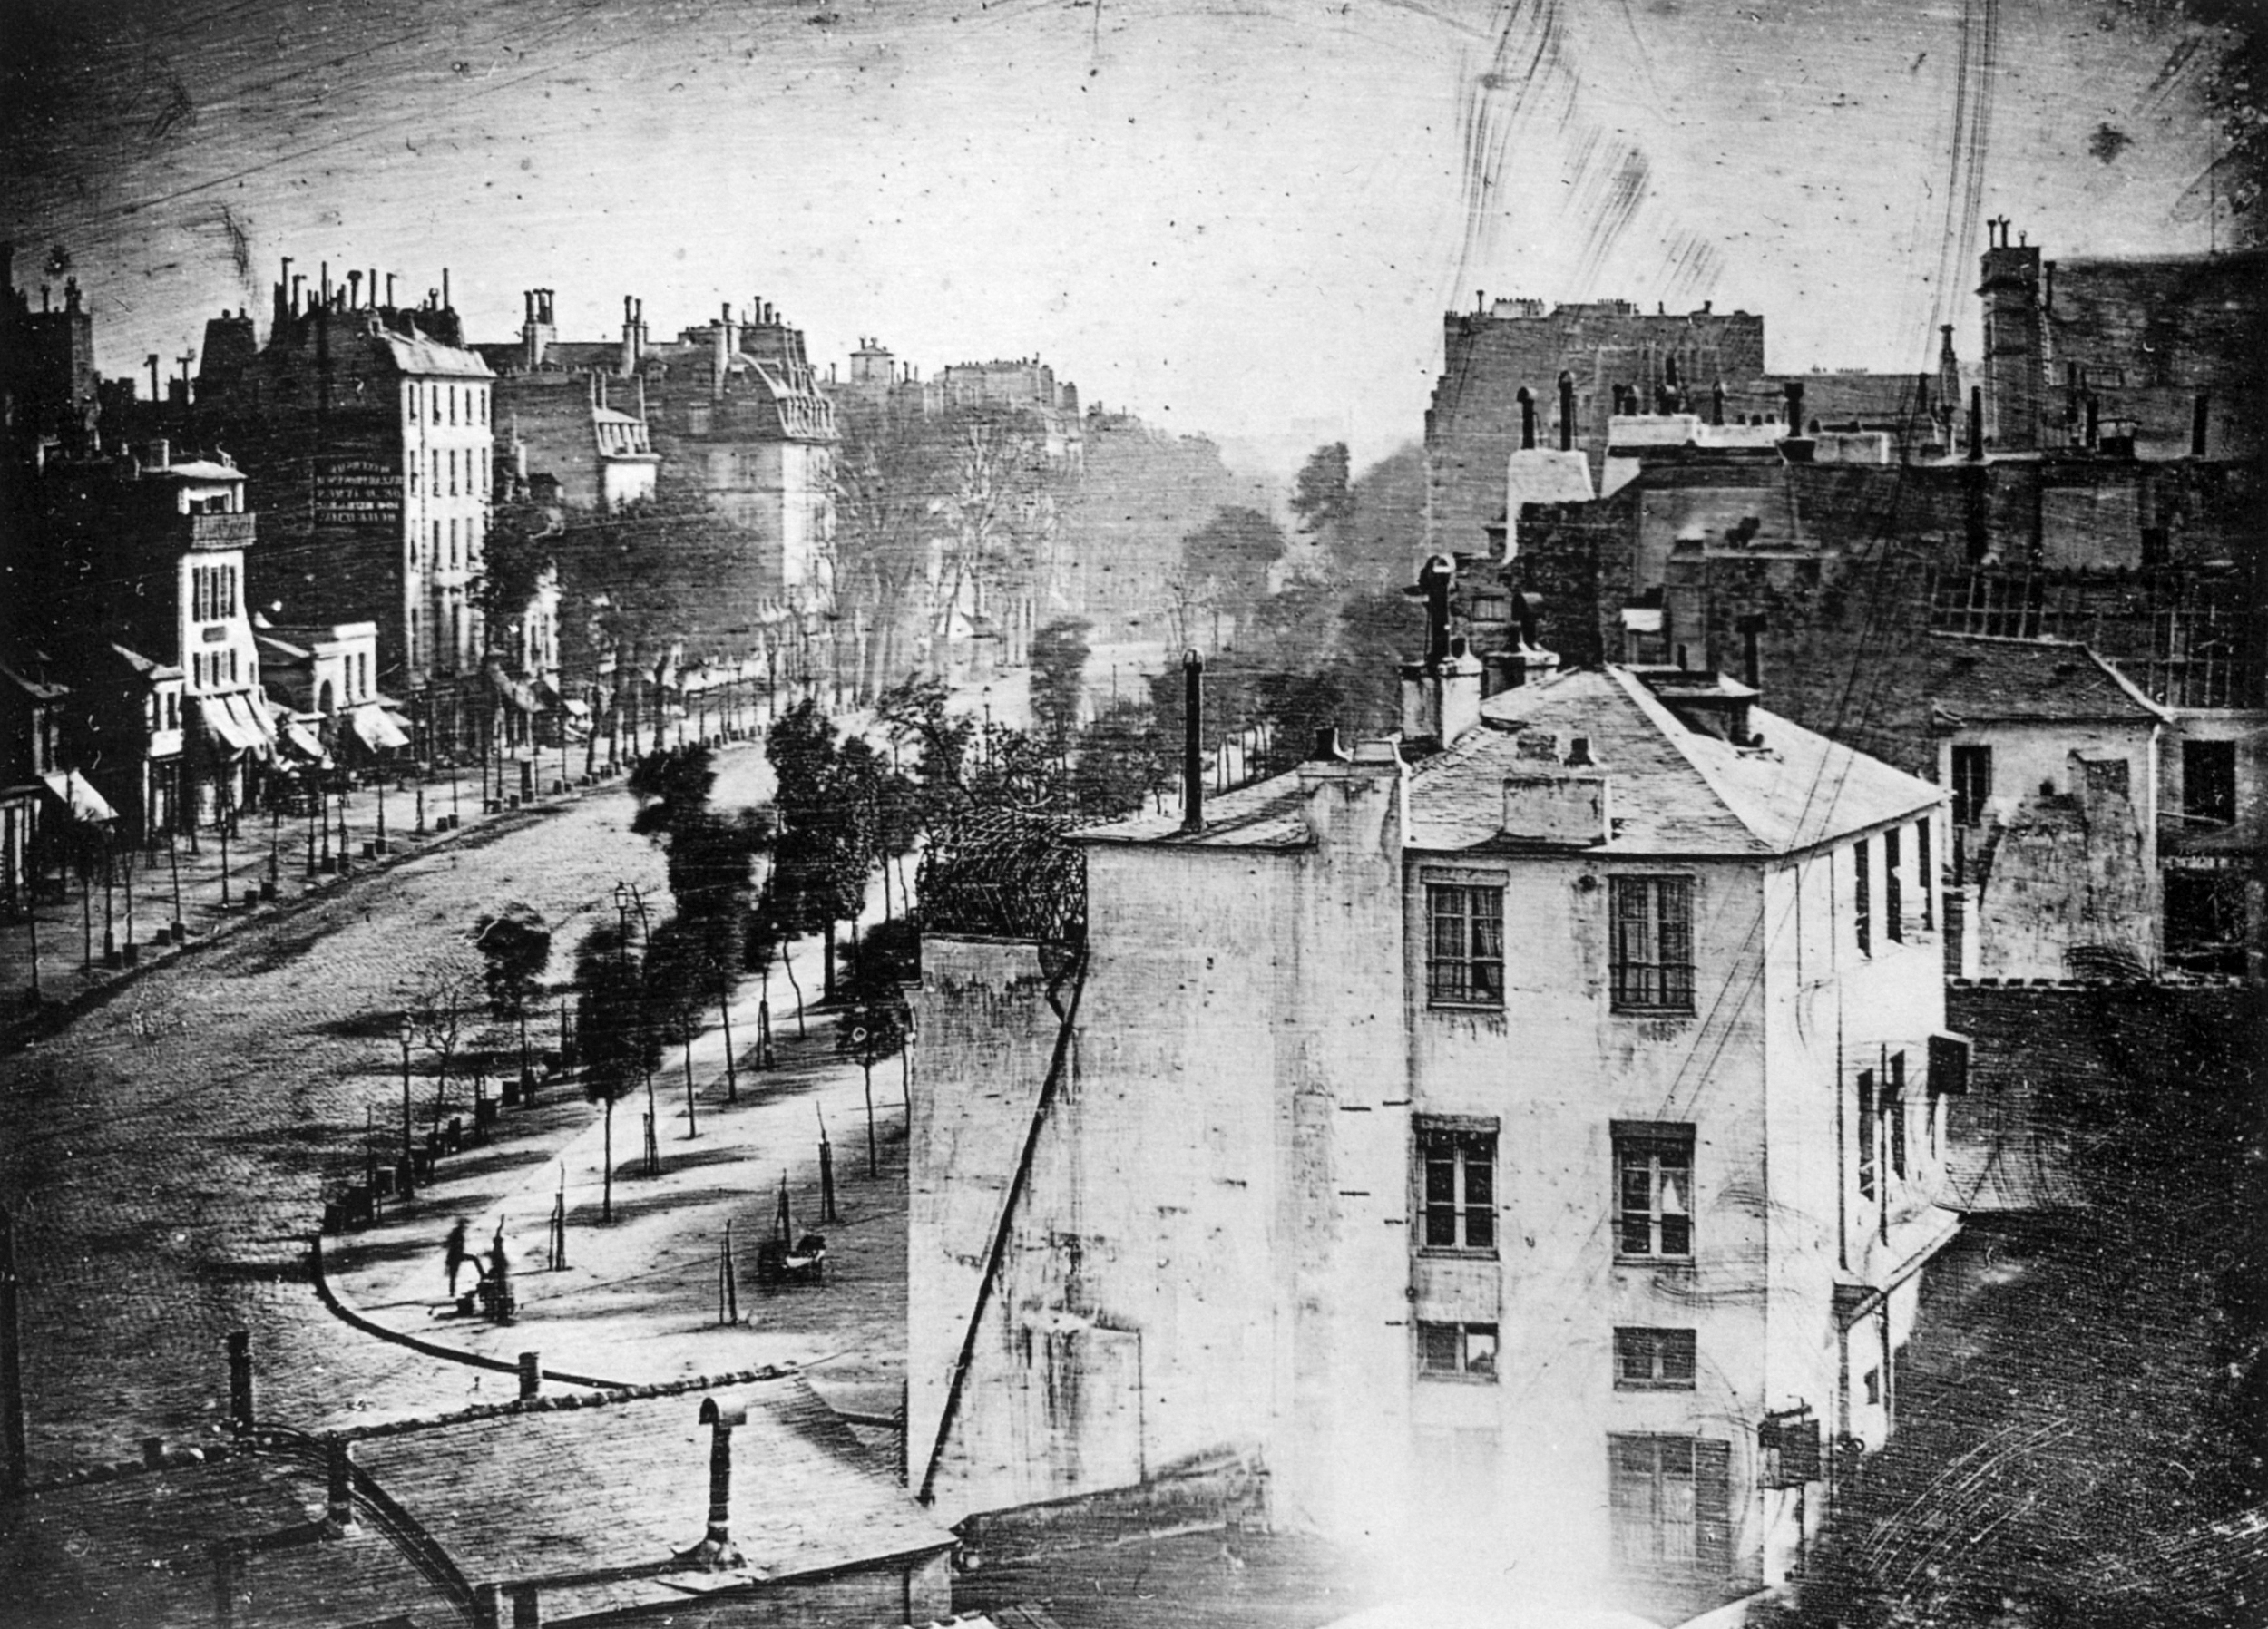
Archiving is all about selecting and destroying
> as webpages change over time
> "Boulevard du Temple", Louis Daguerre, 1838

Slide 22
Archiving on top of webpages goes with many challenges
> Crawler blindness and archive quality
edition dates
crawler dates
download dates
archived periods
> Web archiving goes with construction locks

Slide 23
Archiving on top of webpages goes with many challenges
> Archive consistency across pages
p1 changes
p2 changes
p1 & p2 archives
href ?
p1
p2
> Web archiving goes with navigation locks

Slide 24
Archiving on top of webpages goes with many challenges
> Pages with archive-like content
p1 changes
p1 archives
> Archiving goes with discrete and continuous interpretation locks

Slide 25
To face or reduce crawl legacy effects and effectivelly guide
researchers through exploration of web archives :
We introduce a new entity called web fragments
> related works for the extraction of
individual components out of webpages
Named entities
Dates
N-grams
Titles
Keywords
Text features
...
But mostly designed for for automatic large scale processes
We need an entity that can be equaly understood by computer scientists
sociologists or historians.

Slide 26
The web fragment
> Definition
Considering the webpage :
- as the unit of access and consulation to the web
- built using it's own writing modalities
Noticing that from the point of view of human perception, a webpage is the result of a logical
arrangement of distinct semantic components
> The web fragment is a semantic and syntactic subset of a given webpage …
… that deals with a web content and catches the way it has been written and
published online

Slide 27
The web fragment
> Definition
> It's a coherent set of textual, visual or audio content that can be understood on it's own
> There is a scale relationship between a webpage and its fragments
?
pure meta data
webpage
> Within the same webpage, two fragments cannot overlap

Slide 28
The web fragment
> Definition
> It goes with an associated set of extracted meta contents
Title
Author
Date ( edition date )
> It encompass the writing and sharing elements used for publishing and sharing its content
CMS widgets
Integrated text editor
Href links
Rss feed

Slide 29
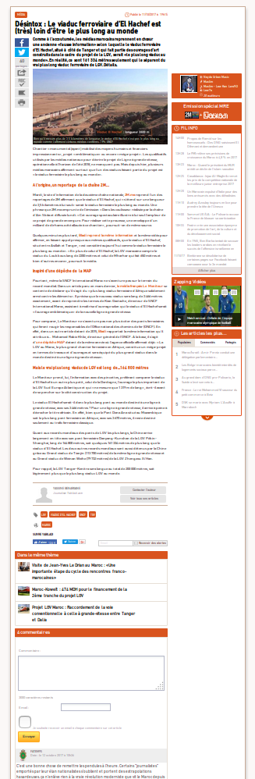
The web fragment
> Examples
an article
> Let's try the firefox module !
a news item
a comment

Slide 30
Finding web fragments
> Clean the page
boilerplate detection method
Kohlschütter & all. 2010.
Boilerplate Detection Using Shallow Text Features. (WSDM ’10).
ADS
tag-based method
Cf adblock

Slide 31
Finding web fragments
> Segmentation and extraction
vision-based method
Cai & all 2003. Vips: a vision-based
page segmentation algorithm. (2003).
tag-based method
Jatowt & all 2007. Detecting age of page content.
In Proceedings of the 9th annual ACM international workshop on Web
information and data management. ACM, 137–144.
ad-hoc rules
Title U Author U Text
distance score node by node
> Implementation inspired by readability & fathom from Mozilla

Slide 32
The web fragment
<field name="id" type="string"
<!-- archive fields -->
<field name="archive_active" type="boolean"
<field name="archive_corpus" type="string"
<field name="archive_mime_type" type="string"
<field name="archive_country" type="string"
<field name="archive_lang" type="string"
<!-- crawler fields -->
<field name="crawl_id" type="string"
<field name="crawl_date" type="date"
<field name="crawl_date_first" type="date"
<field name="crawl_date_last" type="date"
<!-- page fields -->
<field name="page_downl_id" type="string"
<field name="page_downl_date" type="date"
<field name="page_downl_date_first" type="date"
<field name="page_downl_date_last" type="date"
<field name="page_domain" type="string"
<field name="page_url" type="string"
<field name="page_url_id" type="string"
<field name="page_space" type="string"
<field name="page_title" type="string"
<field name="page_description" type="text"
<field name="page_published_date" type="date"
<field name="page_publisher" type="string"
<!-- fragment fields -->
<field name="frag_type" type="string"
<field name="frag_author" type="string"
<field name="frag_date" type="date"
<field name="frag_date_first" type="date"
<field name="frag_date_level" type="dateLevel"
<field name="frag_href" type="string"
<field name="frag_href_id" type="string"
<field name="frag_ratio" type="int"
<field name="frag_node" type="text"
<field name="frag_offset" type="int"
<field name="frag_text" type="text"
<field name="frag_text_id" type="string"
<field name="frag_text_shingle" type="shingle"
> New structure for web archives
meta
crawler date
meta page
download date
data frag
data frag
edition date
edition date
author
author
frag content
frag content

Slide 33
Rethinking archive challenges using web fragments
> Crawler blindness can be reduced and archive quality increased
download date
edition date 2
edition date 1
Yabiladi's older fragments go back to 2003
> We introduce a more permissive archive consistency based on fragments and user requests
stable fragment
href
stable fragment
page 1
new fragment
page 2

Slide 34
Rethinking archive challenges using web fragments
> Pages with archive-like content is no more a problem with web fragments
as a search unit base
Sharing the same id (sha256)
> Web fragments help us expanding web archives beyond web pages
Now let's see how we can concretely conduct an exploratory archive analysis ...

Slide 35
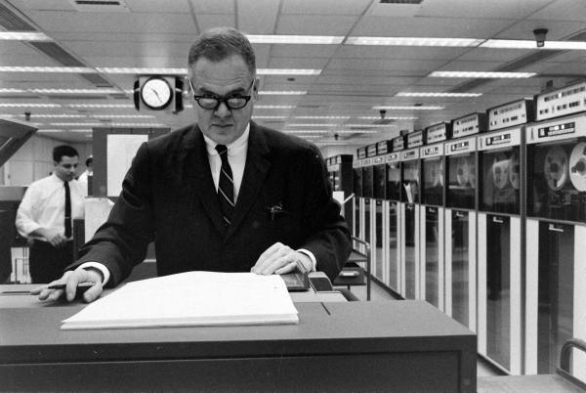
Exploratory analysis of Web archives
> Following John Wilder Tukey's work
An iterative process that is deliberately part of a
logic of observation, discovery and astonishment
Acquire
Parse
Filter
Mine
Represent
Refine
Interprete

Slide 36
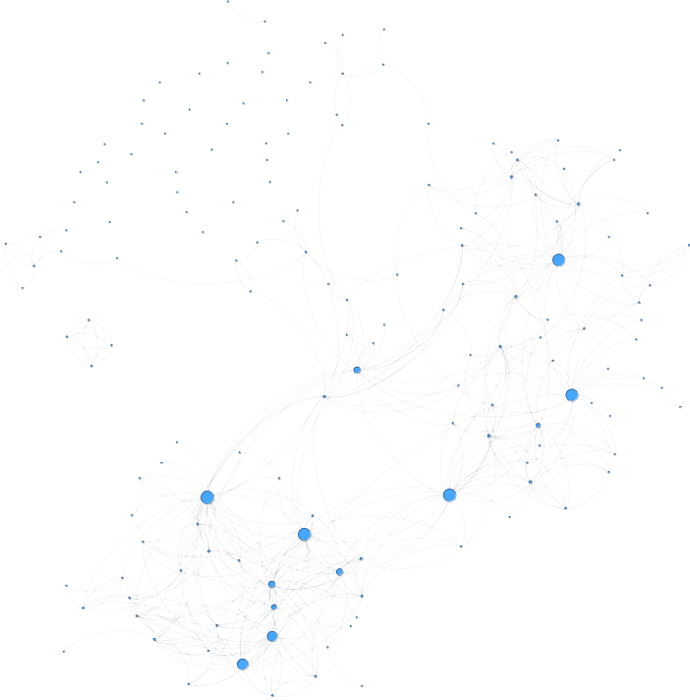
Archives extraction engine
Acquire
Parse
Filter
Mine
Represent
Refine
Interprete
> The Web Archives Explorer (part 1)
meta
Fragments
Extractor
crawler date
yabiladi.com
data page
Crawler
ArchiveMiner
download date
page content
.DAFF
External Resources
data frag
edition date
author
frag content

Slide 37
Archives exploration engine
Acquire
Parse
Filter
Mine
Represent
Refine
Interprete
> The Web Archives Explorer (part 2)
meta
crawler date
Index of Events
Index of Pages
& Fragments
Full text
Facet
Ngrams
data page
download date
ArchiveSearch
ArchiveViz
page content
data frag
edition date
author
frag content

Slide 38
Using web fragments
Acquire
Parse
Filter
Mine
Represent
Refine
Interprete
> Using an event detection system
2. identification with titles of news articles
3. fields and experts
interpretations
1. threshold-based detection
> Let's see the Web Archives Explorer in action
video presentation for CIKM2017

Slide 39
Using web fragments
> Work in progress
> Networks of fragments
Linked by href, semantic similarity, writings similarity
Evolving over time
event #1
event #1
related archived page #1
related archived page #2

Slide 40
End of part 1 !
Thank you
> e-Diasporas web archives are ''just'' one example among many of archived digital traces
of migration … ( let's go to part 2 )

Slide 41
Further studies
> Navigation logs at BPI
Free & anonymous wifi access,
no reservation, during 40 mn
Centre Pompidou
170 computers distributed on the 3 floors
among shared tables
Open from 12h - 22h every day except the
Tuesday
Experiments of up to 250 free access computers
without time limit
> May 2016
A precarious public ( homeless, migrant,
precarious intellectual … )
What is the role of the free Internet
in the daily life of the public of the BPI ?

Slide 42
Source Data
> web navigation logs
10.6.8.85 - PUB-2-INT-242 [23/02/2017 13:15:49] "GET https://www.google-analytics.com:443 HTTP/1.1" 200 - - 1000 -
10.6.6.218 - PUB-2-INT-239 [23/02/2017 13:15:47] "GET https://www.youtube-nocookie.com:443 HTTP/1.1" 200 - - 1207 -
10.6.6.218 - PUB-2-INT-239 [23/02/2017 13:15:45] "GET https://s.youtube.com:443 HTTP/1.1" 200 - - 1207 -
10.6.6.218 - PUB-2-INT-239 [23/02/2017 13:15:43] "GET https://s.ytimg.com:443 HTTP/1.1" 200 - - 1207 -
10.6.8.85 - PUB-2-INT-242 [23/02/2017 13:15:49] "GET https://www.google.com:443 HTTP/1.1" 200 - - 1000 -
10.6.6.218 - PUB-2-INT-239 [23/02/2017 13:15:47] "GET https://www.googleapis.com:443 HTTP/1.1" 200 - - 1000 -
10.6.6.218 - PUB-2-INT-239 [23/02/2017 13:15:47] "GET https://www.youtube.com:443 HTTP/1.1" 200 - - 1207 -
10.6.8.121 - PUB-1-INT-125 [23/02/2017 13:03:35] "GET http://www.bpe.europresse.com:443 HTTP/1.1" 200 - - 1000 -
...
10.6.8.121 - PUB-1-INT-125 [23/02/2017 13:43:27] "GET https://intensedebate.com:443 HTTP/1.1" 200 - - 1228 -
virtual ip
computer id
timestamp
url
code http
category
Around 2.000.000 logs / day

Slide 43
An exploration pipeline
> for extracting informations
Logstash
Elasticsearch
Kibana
Filter the logs
Drop ads, image, css …
Aggregate by session
Arround 200,000 cleaned logs / day
Search inside the logs :
Visualize the logs by fields
on the fly
| date
| url
| domain name
| extension (.com .fr .ru …)
| category ( olfeo )
| catégory ( bpi )
| session id
| stage #
| table #
| computer #
Can we clean everithing ?
The relation between what
we see on the screen and
what is recorded
With the participation of Chaima Berrachdi

Slide 44
First results
> From the fields and from the data
logs
Clustering users by category of url :
- Watching videos ( youtube, dailymotion )
- Social networks
- Google services
> What about the long tail ?
navigation profils ?
Traduction – Online Games – Regional news – Dating sites – Public services
> How to find structured and miningfull information out of an url ?
From lang 1 To lang 2 Word
http://www.linguee.fr/francais-anglais/search?source=auto&query=biblioteque
With the participation of Marie Pierru & George Legrady

Slide 45
Further studies
> Calm letters
> Calm letters
11892 form letters to the CALM ( Comme à la Maison ) program of Singa for hosting refugees
cp | age | Motivation | Type de logement | Taile | Parlez nous de vous | Enfant ? | Enseignement métier ? | Partage Réseau | Capacité d'accueil | Autres info
INT | INT | TEXT | TEXT | INT | TEXT | BOOL | BOOL | BOOL | BOOL | TEXT
From June 2015 to June 2017
V1
Hosting organized by
digital platforms
V2
The vocabulary of
hosting
csv
V3
The role of the media
With the participation of Students of Telecom ParisTech

Slide 46
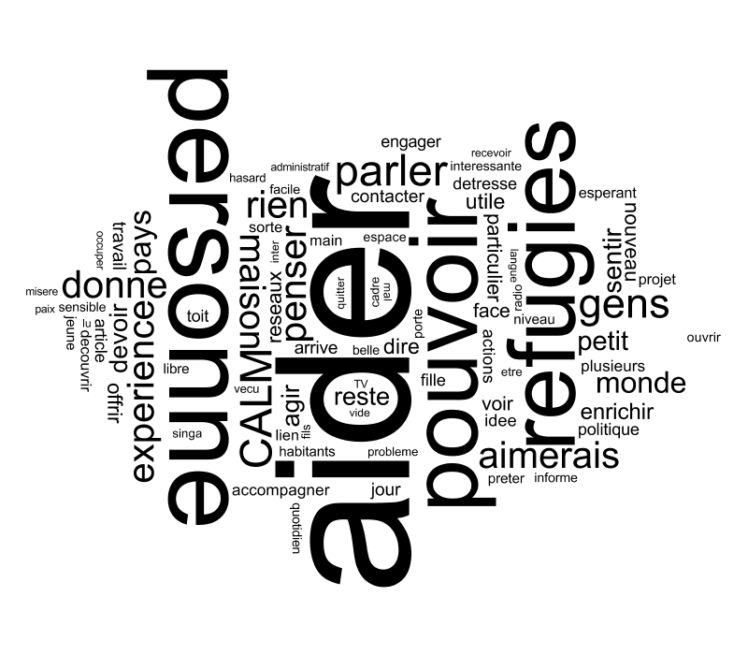
Furst Results
> Calm letters
> Calm letters
Demographic profil of the families : 30's & 50's year old – educated – working on education
care and cultural world
The relation with mediatic events :
The vocabulary :
1000
500
Sept 3
Sept 15
From Proposer to Partager
From Refugier to Personne
With the participation of Students of Telecom ParisTech

Slide 47
Thank you !
Questions ?

