Slide 1
Identifying Winners & Losers of NSF Funding with Clustering
By Erik Lopez

Slide 2
Are NSF Funding Trends Doing Disparate Impact?
Congressional District (CD) Level
Where’s more/less/same money going?
2010-2018

Slide 3
How can we group similarly funded CDs?
Datasets
Federal Reporter 2010-2018
Total NSF grant funding received each year per CD
CityLab Congressional Density Index
Congressional District (CD) Urban/Rural and Density splits
Clinton/Trump voting percentages
Congress.gov
Scraped for political party affiliation for each CD
UCLA CD Shapefiles
To visualize on a map
Methods:
KMeans Clustering
Features: Total funding 2010-2018
Normalized data
Principal Component Analysis (PCA)
Silhouette Scoring:
Score quality of clusters
Select best number of clusters
Descriptive Analysis of each cluster

Slide 4
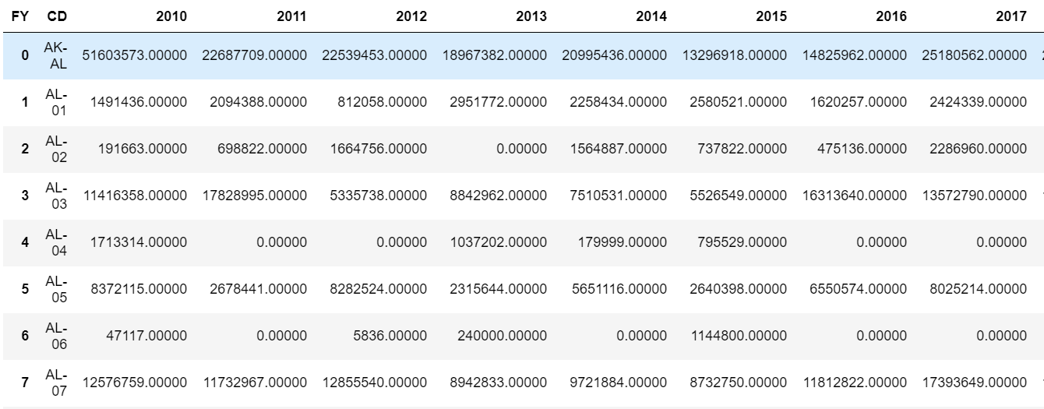
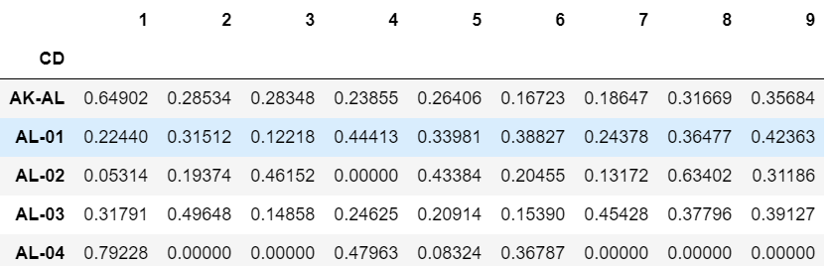
Grant funding data
After Dimensionality Reduction (PCA)

Slide 5
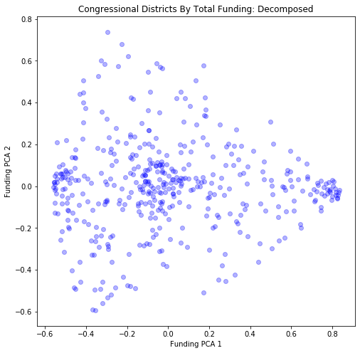
PCA Visualization
Using Components 1 & 2

Slide 6
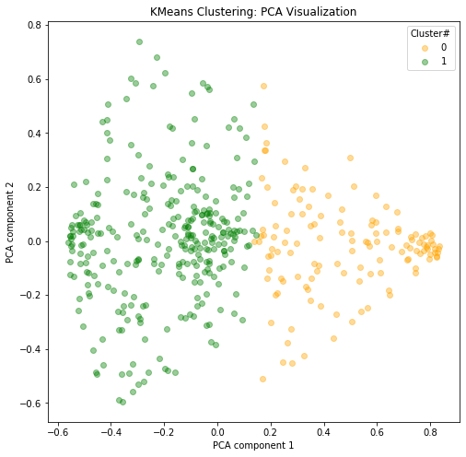
K Means Clustering Results
Silhouette Score = 0.27 / 1.00
Not the Best Score
Limitations of Kmeans Algorithm

Slide 7
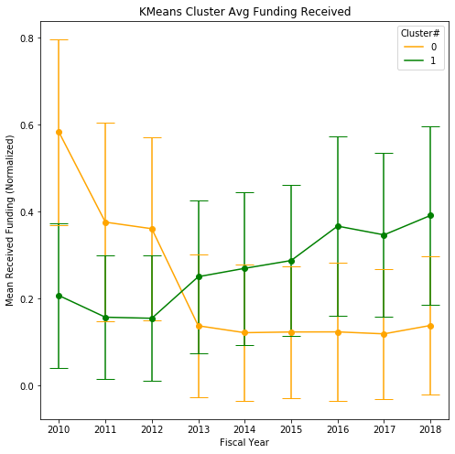
Results
Cluster 0:
Decrease in funding
Cluster 1:
Increase in funding
Confidence Intervals overlap!
Too much noise

Slide 8
But do the clusters share any characteristics?
How urban/rural are they?
How highly/lowly dense are they?
Differences in political lean?
Differences in 2016 voting records?

Slide 9
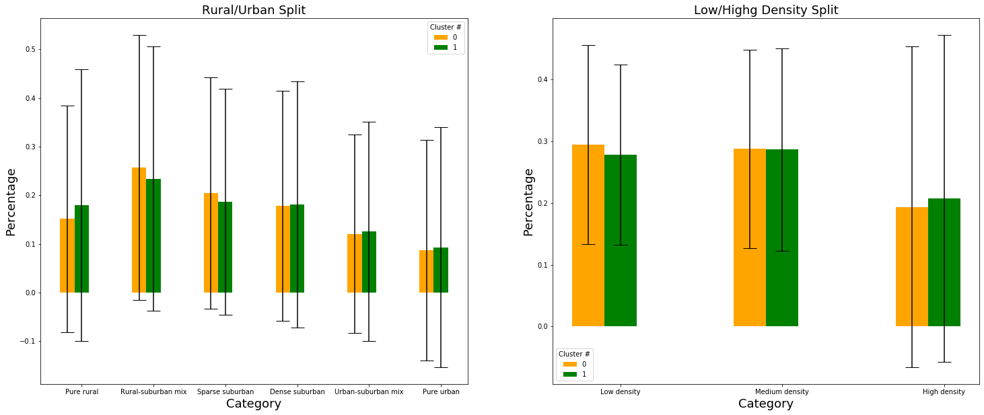
KMeans: Rural/Urban & Low/High Density

Slide 10
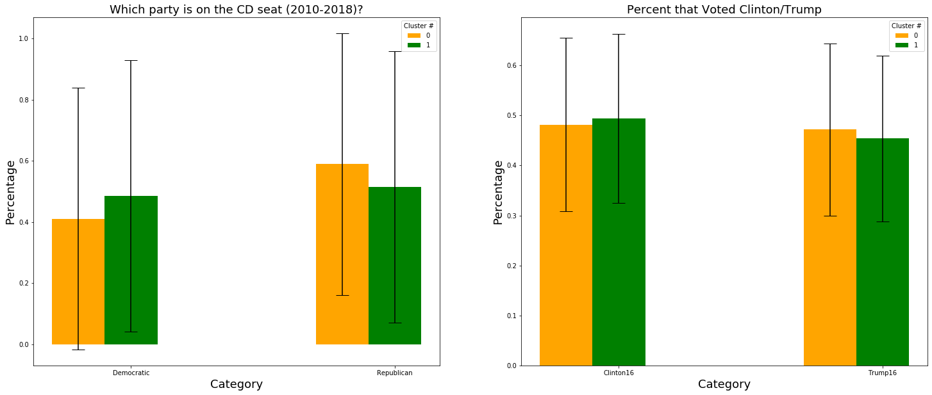
KMeans: Political Leanings

Slide 11
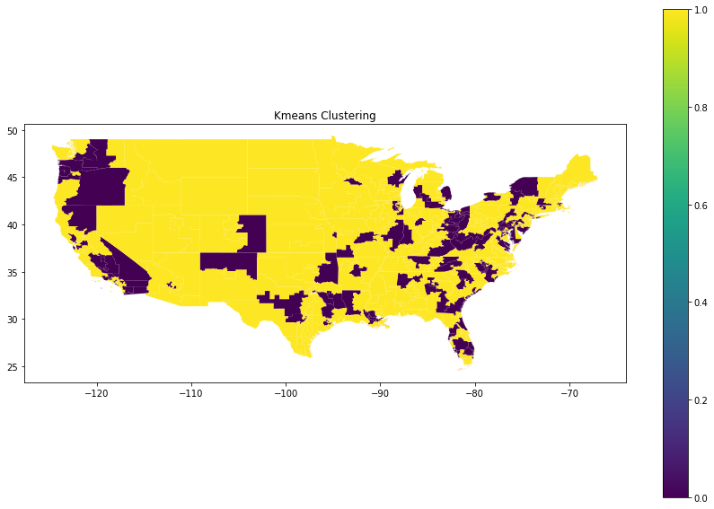
KMeans: Geo-visualized

Slide 12
Results & Policy Implications
Visually, distinct clusters exist
Too much noise
Increases variability
Decreases cluster accuracy
Need to filter out “noisy” CDs
Congressional District Unit not a great unit of analysis
Vary is size too much
There exist areas being “left behind”
Danger of stagnating innovation, education, local economies
Need different unit of analysis to properly describe them

Slide 13
Limitations
Static Data:
Demographics/Characteristics static between Census counts
Can’t account for population changes
Address unmatched funding records
Bad congress district code
Can’t be included
KMeans Algorithm
Best for circular clusters
Can’t handle noise
Try out Gaussian Mix, DBSCAN (can filter out noise)

Slide 14
Q&A

