Slide 1
Winners & Losers: Clustering Algorithms to Identify NSF Funding Trends
By Erik Lopez

Slide 2
Can we identify NSF grant funding changes from 2010-2018?
Congressional District Level
Who’s seen funding increases? Decreases? No-change?

Slide 3
So how can we group similarly funded CDs?
Clustering Algorithms:
Kmeans vs Gaussian Mixture
Features: Total funding received 2010-2018
Principal Component Analysis (PCA) to visualize clusters
Silhouette Scoring:
Used to score quality of clusters
Hyperparameter tuning
Number of Clusters to use
Datasets
Federal Reporter 2010-2018
NSF-specific grants
CityLab Congressional Density Index
Congressional District (CD) Urban/Rural and Density splits
Clinton/Trump voting percentages
Congress.gov
Scraped for political party affiliation for each CD
UCLA CD Shapefiles
To visualize on a map

Slide 4
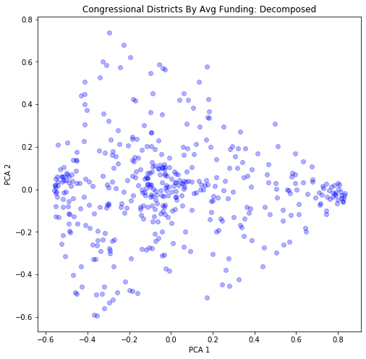
Data Prep
Data Normalization
Preferred when running clustering
PCA
Simple way to represent multi-dimensional data
Result is on the right
We can see some potential clusters already

Slide 5
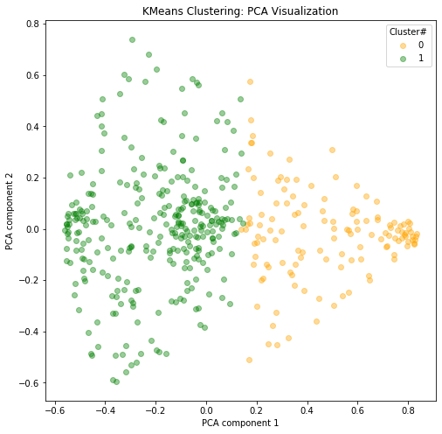
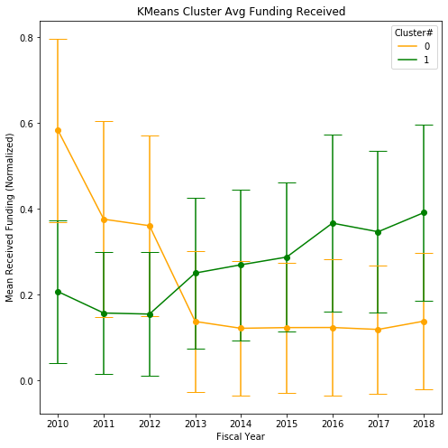
Results: KMeans, score: 0.27

Slide 6
But do the clusters share any characteristics?
How urban/rural are they?
How highly/lowly dense are they?
Differences in political lean?
Differences in 2016 voting records?

Slide 7
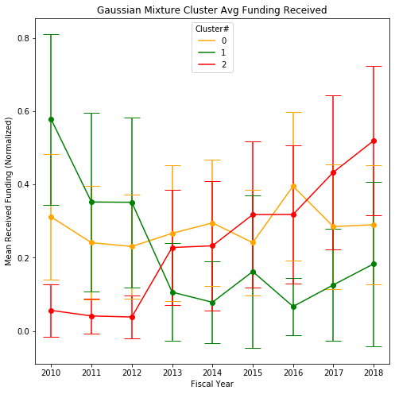
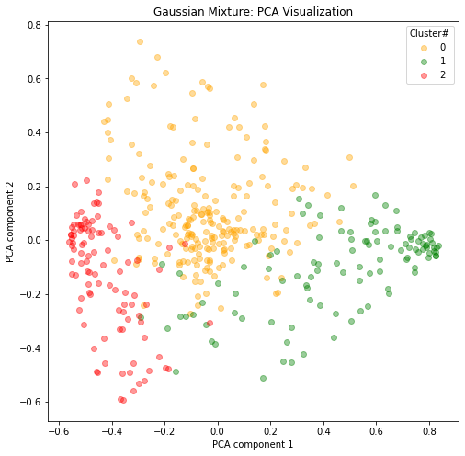
Results: Gaussian Mix, score: 0.17

Slide 8
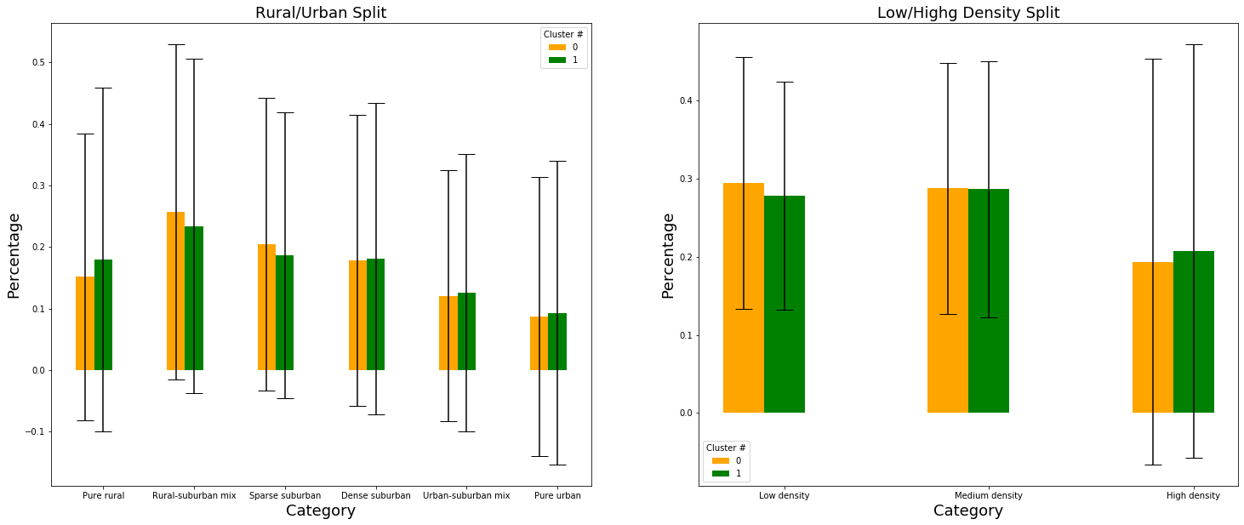
Kmeans: Rural/Urban & Low/High Density

Slide 9
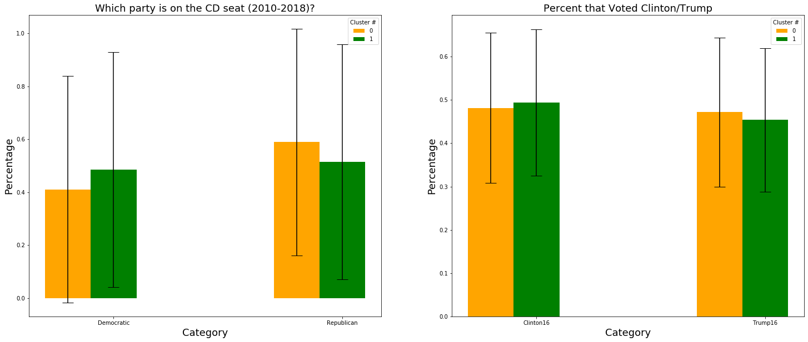
Kmeans: Political Leanings

Slide 10
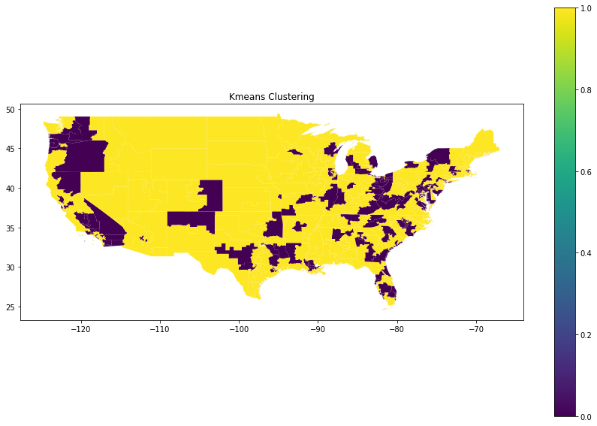
KMeans: Geo-visualized

Slide 11
No significant differences to report

Slide 12
Results/Implications
Visually, distinct clusters exist
Too much noise
Increases variability
Decreases accuracy of clusters
Need to filter out “noisy” CDs
No link between funding and:
Urban/rural split
Density
Political leaning
Funding changes due to other factors (maybe in combination)
Try out other clustering algos
Gaussian Mix
DBSCAN (can filter out noise)

Slide 13
Limitations
Assumptions:
Demographics/Characteristics static between Census
Accounting for redistricting
Address unmatched funding records
Bad congress district code
Excluded from analysis

Slide 14
Q&A

