Slide 1
Binning consistence between MetaBAT and MyCC
Combine all MetaBAT bins and MyCC bins, respectively.
Blast Combined MetaBAT bins against combined MyCC bins.
Filter blast results:
Query length = subject length = alignment length
Identity = 100
Plot cross-link between MetaBAT bins and MyCC bins.
Cross link between all bins (attached html file )
Cross link between bins without contamination (attached html file )

Slide 2
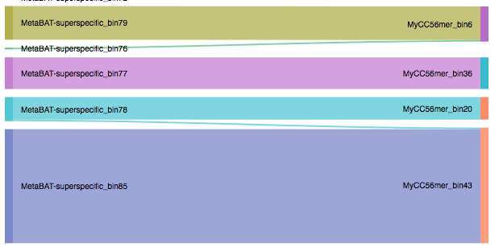
New_bin1
New_bin2
New_bin3
New_bin4
New_bin6
New_bin5
Please note:
MetaBAT-bin79 is most likely larger than New_bin1, as some contigs in MetaBAT-bin79 have no matches. This is also applied to all the rest new bins.
A filter step maybe needed to remove very small bins (like new_bin2 and New_bin5).

