Slide 1
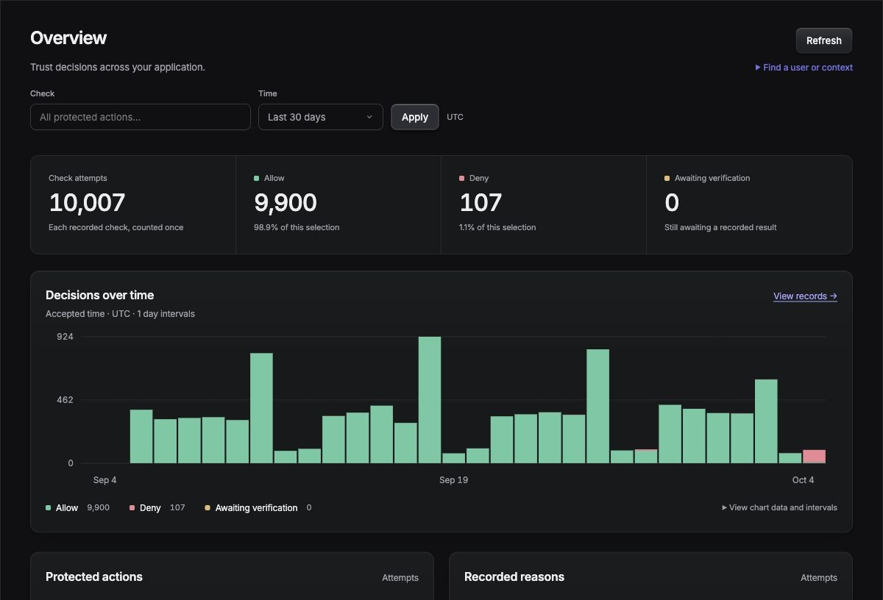
Krine
Self-hosted trust
decisions for
your application
Combine IP risk, activity and other evidence in one visual policy. Return Allow, Deny or a CAPTCHA request.
Open source · Customer-operated
Actual dashboard · 28 days of generated sample activity
01
Notes:
Krine is an open-source (ISC), self-hosted trust decision engine. The backend asks whether a named application action should be allowed. Krine combines backend events, browser evidence and optional provider observations, evaluates a versioned policy and records its reasons. Screenshot: the running local dashboard with a 28-day generated dataset, 10,000 synthetic decisions and 49,828 synthetic events, plus seven pre-existing local fixtures. Daily and weekly patterns, returning sessions, abuse bursts, provider failures and verification outcomes are generated. This is illustrative activity, not customer traction or a performance benchmark. Source: crates/krine-demo, .demo/pitch-history/manifest.json. Competition rules: https://mudnibfuppwadjkynscc.supabase.co/storage/v1/object/public/task-files/6f0f5e2e-246f-4078-a3f7-1aad9152e9f0/files/312cc8e5-48a3-4c4b-a9a1-9b28861995e9.pdf, maximum ten slides in PDF; detailed task is announced separately.

Slide 2
The gap between components and platforms
Open-source components
Managed platforms
A library such as FingerprintJS supplies a browser identifier. Teams still have to connect signals, write decision logic and build the investigation history.
Integrated services reduce that work. Deployment, available data regions and supported integrations still depend on the vendor’s offering.
Krine combines these signals and policies in a system the customer operates.
Examples: FingerprintJS library and Fingerprint managed API. Source links are included in the speaker notes.
02
Notes:
Market positioning, not a claim that all competitors lack these capabilities. FingerprintJS's open-source library generates a hashed browser identifier; a complete application decision system requires additional context, integration, policy and retained evidence. Fingerprint's commercial platform combines browser collection with server-side processing and exposes regional managed APIs. A regional API is not the same as operating the decision system and its stores oneself. Self-hosted security products exist, including CrowdSec. Krine's intended distinction is an integrated, customer-operated application decision layer with provider-independent metric contracts. Sources: https://github.com/fingerprintjs/fingerprintjs ; https://docs.fingerprint.com/reference/server-api ; https://docs.crowdsec.net/docs/configuration/crowdsec_configuration/ .

Slide 3
One check before your application acts
Example: before accepting a report, the backend asks can_submit_public_form.
01
02
03
Send evidence
Evaluate the policy
Act on the result
Your app sends activity events. Krine adds browser signals and data from enabled providers.
You choose metrics, thresholds and branches. Krine returns Allow, Deny or a CAPTCHA request.
Your backend follows the result. Krine stores the policy version and the evidence used.
A “check” is a named application action. The same engine can protect login, trials or submissions.
03
Notes:
The application owns authentication, business authorization and execution of the action. It emits authoritative backend events and asks Krine for a decision before executing a protected action. Browser observations are untrusted evidence, never proof of identity. TypeScript browser and server SDKs exist; the core is a Rust service. A check is an application-defined action name, not a built-in security feature. This example is a public incident-report form relevant to a reporting portal; it does not claim to validate the truth of a report. A CAPTCHA outcome is fulfilled by the application displaying the configured provider widget and continuing the pinned operation. Sources: docs/product/vision.md; docs/concepts/domain-model.md; packages/server/src/index.ts; packages/browser/src/turnstile.ts.

Slide 4
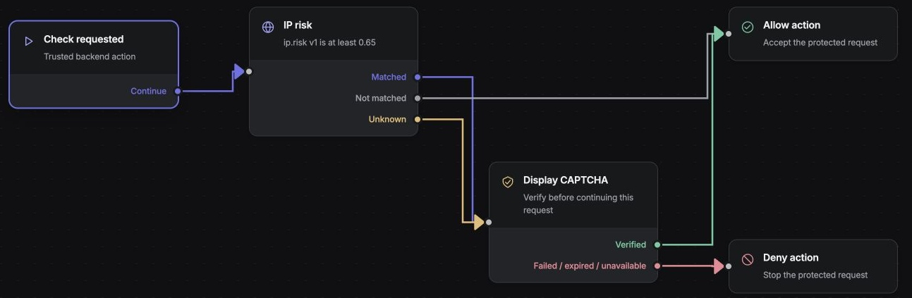
High IP risk triggers CAPTCHA
Low risk proceeds. High or missing risk requires verification before the request can continue.
Matched = risk ≥ 0.65 · Not matched = lower risk · Unknown = no usable risk value
04
Notes:
Actual screenshot of the local workflow editor and new can_submit_public_form draft. No backend authorization/input condition is present. Policy: ip.risk v1 >= 0.65 triggers CHALLENGE; below threshold ALLOW; unknown also CHALLENGE; on_verified ALLOW; failed, expired or unavailable verification DENY. The threshold is illustrative, not a calibrated production recommendation. IP risk is normalized to 0..1. Diagram connector routing has been corrected to avoid measured node rectangles. This example is deliberately simple enough to read without prior product knowledge. The editable graph also supports multiple conditions, explicit unknown paths, branch convergence and verification continuation. Draft is not published and no provider call occurs in the illustration.

Slide 5
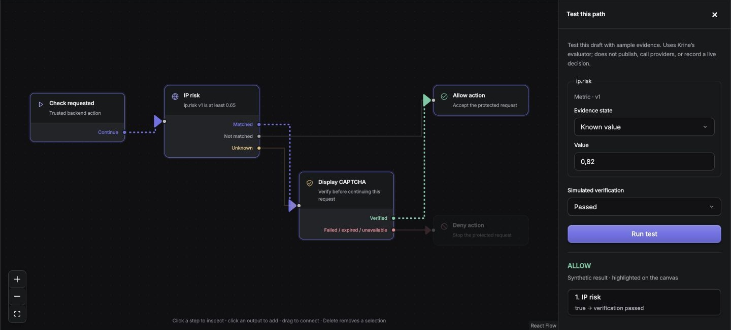
Test the path before publishing it
Sample: IP risk 0.82 + CAPTCHA passed → Allow. The highlighted path shows why.
Synthetic test inputs; real evaluator. Failed, expired or unavailable verification follows the Deny branch.
05
Notes:
Actual workflow Test path UI with ip.risk=0.82 and simulated verification=passed. The real Rust evaluator returns ALLOW and highlights the traversed path. A second UI test with the same risk and simulated verification=failed returned DENY. These tests do not call external providers, publish a policy or record live decisions. Missing IP risk follows the explicit unknown CAPTCHA path. Passing the configured verification continues the same protected operation in the implemented runtime. Sources: apps/dashboard/src/workflow/TestPanel.tsx; crates/krine-core/src/workflow.rs; crates/krine-server/src/admin.rs; screenshots/captcha-test.png and captcha-failed.png.

Slide 6
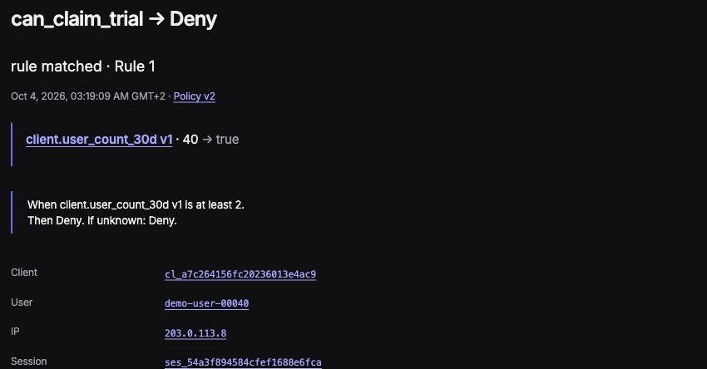
Investigate a decision from its evidence
See the result, the policy version and the evidence that caused it—together.
Why this trial was denied
40 accounts were linked to one browser client in 30 days. This policy denies a trial when the count reaches 2.
Policy v2 and the captured count remain available for review.
Recorded sample activity. The decision snapshot remains separate from today’s metric values.
06
Notes:
Actual captured decision from the generated activity dataset. All data in this screenshot is synthetic and belongs to the local demonstration. Krine preserves the evidence and policy used at evaluation time; current metrics do not silently replace the historical snapshot. An operator can follow linked users, clients and sessions and inspect policy versions. This supports diagnosing unexpected blocks and distinguishing a matched condition from unavailable evidence. Sources: screenshot/evidence-seeded.png; crates/krine-demo; apps/dashboard/src/CapturedReason.tsx; docs/engineering/storage.md.

Slide 7
Own the system that holds your evidence
Run the engine, dashboard and data stores in infrastructure you control.
Choose where data lives
Keep the decision history
Set the deployment region, database access, retention and backup policy. Core operation does not require a Krine cloud account.
Events, policies and explanations stay in your stores. Changing an external signal provider does not move that history to a new vendor.
PostgreSQL · configuration ClickHouse · history Valkey · realtime state
Enabled external providers receive their required request data. Self-hosting does not remove that boundary.
07
Notes:
Current core operation has no Krine-hosted cloud dependency. Customer operates Rust engine, dashboard, PostgreSQL, ClickHouse and Valkey. PostgreSQL stores configuration and durable operational state, ClickHouse analytical history, Valkey realtime/short-lived state. Ownership is operational and architectural: choose infrastructure/region, manage database access, retention and backups. This is not a legal claim of automatic regulatory compliance or universal legal ownership of third-party data. Optional integrations send the data their service requires. proxycheck receives IP queries; Turnstile uses its browser service and server-side verification. A local deployment using external services is not air-gapped. Sources: docs/engineering/storage.md; docs/engineering/protocol.md; docs/concepts/providers.md; LICENSE.

Slide 8
Choose the evidence your policy uses
Select metrics and thresholds in the policy. Configure their source separately.
Available now | What it contributes
Application events + browser SDK | Activity history, relationships and browser evidence
proxycheck | IP risk, proxy status and country
Cloudflare Turnstile | CAPTCHA verification and continuation
Next: more IP and CAPTCHA providers, local data sources, and email or device intelligence.
Provider adapters feed stable metric names such as ip.risk. Current external catalog: two adapters.
08
Notes:
Implemented adapters: proxycheck v3 IP intelligence and Cloudflare Turnstile verification. IP intelligence normalizes risk to 0..1 and exposes proxy/country evidence with explicit status and provenance. Policies depend on versioned Krine metrics rather than vendor-specific JSON. Replacing an adapter requires compatible semantics and testing; normalized scores are not automatically interchangeable. Broader provider coverage is product direction, not an already shipped catalog. Future priorities include additional IP/CAPTCHA vendors, local intelligence sources and email/device/custom signals. Sources: crates/krine-server/src/provider_http.rs; docs/concepts/providers.md; docs/decisions/0007-mvp-contract-defaults.md. Live providers were not called in these presentation screenshots.

Slide 9
A practical product for teams that need control
Start with one application
Commercial value
A reporting portal, SaaS trial or marketplace submission flow that needs its own decision rules and control of sensitive evidence.
Build the provider integration once.
Reuse policy tools across actions.
Keep history when vendors change.
Investigate from recorded evidence.
Proposed revenue
Next: a measured customer pilot
Deployment, support and maintained
integrations around an open-source core.
Connect live providers; measure setup
effort, false denials and investigation time.
Repository: github.com/localhost2137/krine
09
Notes:
Commercial positioning and next-step proposal; no measured ROI, market size or customer traction is claimed. Initial audience: platform/security teams needing application-specific abuse decisions and control of deployment/evidence, including sensitive public-service portals and businesses with data residency constraints. Commercial value hypothesis: reduce duplicated integration/policy work, preserve investigation history and enable provider replacement. Proposed monetization is paid deployment, support and maintained integrations around the ISC open-source core. Next step: pilot one real application, validate chosen live providers and measure integration effort, policy change time, false denials and investigation time. Production rollout additionally requires named operators/roles/admin audit, security review and target-environment load/recovery validation; these are not completed by creating this deck. Repository destination supplied by owner: localhost2137/krine, planned GitHub location https://github.com/localhost2137/krine; relocation is not asserted to be complete.

