Slide 1
First Things First
Take a moment to complete the pre-assessment form.
Gather your materials
Enjoy a bite to eat
Meet others in the class
We will begin in five minutes

Slide 2
Basics
Bathrooms
phones
exits
Smoking

Slide 3
The Other Side of Eating
Planning
Shopping
cooking

Slide 4

Who are we?

Slide 5
Who are you?
Your name
For whom do you make lunch?
Your reason for attending this class

Slide 6
Part 1
Planning
And
Shopping

Slide 7
Planning-How
How and when do you plan?
If you don’t plan, why not?
Notes:
Think, Pair, Share (explain the process for the “T3”: participants work in partners; one presenter can serve as a partner if there is an odd number of participants.) Partners first think and possibly jot down brief ideas, then they talk to their partners and finally share with the group. A group will generally provide a continuum of styles. Important to note the reasons for NOT planning, usually perceived time constraints.

Slide 8
Planning-What works?
What changes could you make in your planning?

Slide 9


Planning: Many GREAT Resources

Slide 10
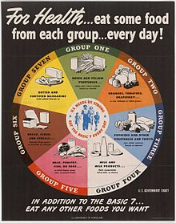
USDA's "Basic 7" food groups from 1943 to 1956:

Slide 11
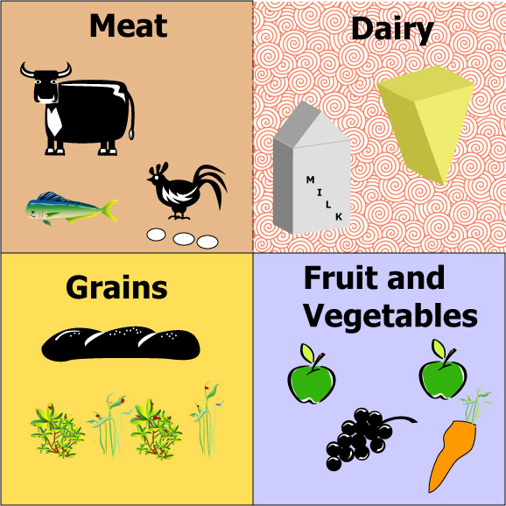
“Basic Four” food groups 1956 -1992

Slide 12
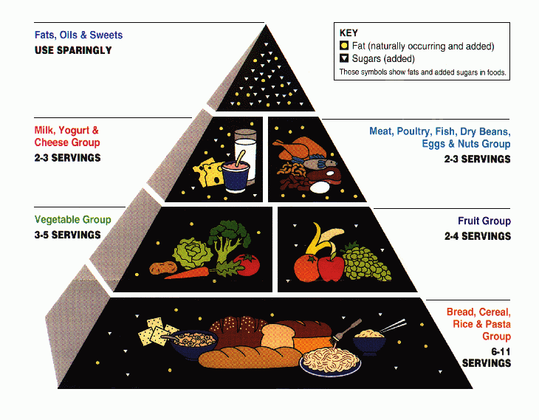
1992 Food Pyramid

Slide 13
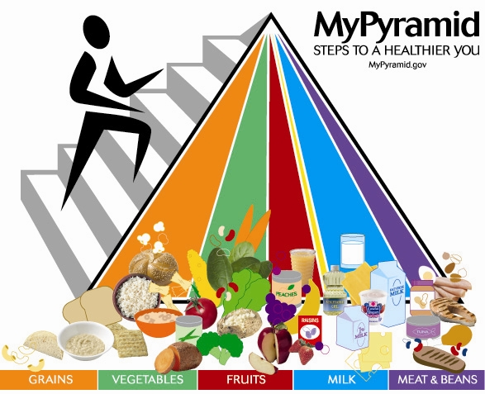
2005 MyPyramid

Slide 14
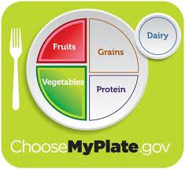
Now MyPlate

Slide 15
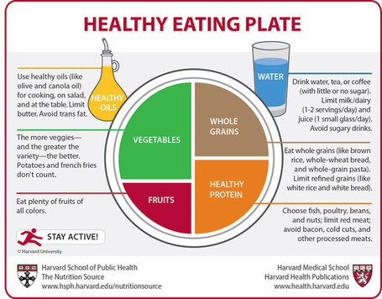
Harvard School of Public Health

Slide 16
Game of Categories
Let’s play with our food!
We will use MyPlate.
Grab a food card and put it on MyPlate.

Slide 17
LunchBox Envy Pages 8 and 9
What do you notice?

Slide 18
LunchBox Envy Pages 8 and 9
What are your questions?

Slide 19
LunchBox Envy Pages 8 and 9
Which lunches would work for you?

Slide 20
LunchBox Envy Page 8 and 9
Which are obstacles?
why?
How could we make them work?

Slide 21
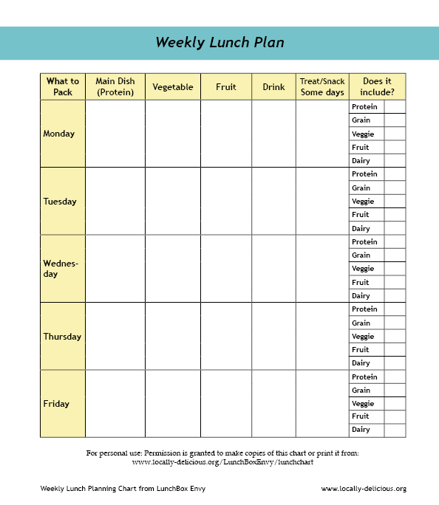
Using the Planning Grids
Please turn to page 10 in LunchBox Envy:

Slide 22
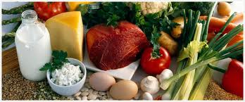
5 Minute Break!

Slide 23
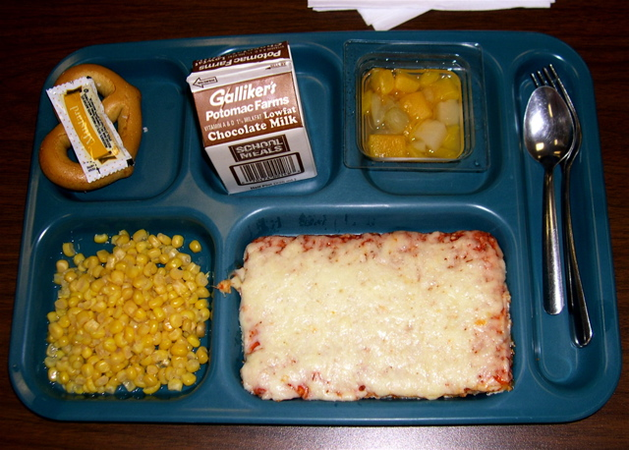
What about School Lunches?

Slide 24
School Lunches
Your rights as a parent/guardian
Your responsibilities as a citizen

Slide 25
Suggestions for Change:
Ask if you can have lunch with your child one day.
Organize caregivers to have an “Eat Lunch with Your Child Day”.
Be persistent and pleasant. You are the client; the school wants you to be happy.

Slide 26
But…
If you were to make1-3 lunches per week, it would make a huge difference in the child’s
Nutrition
Concentration
Behavior
Classroom performance

Slide 27
Planning Review:
Why plan?
The process
MyPlate
Looking at lunch plans
Creating a lunch plan

Slide 28
Where do YOU Get Food?
?

Slide 29
Where to Get Food
Grocery stores
Farmers’ markets
Food banks
Gardens

Slide 30
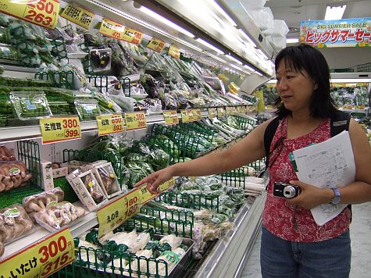
Grocery Stores
Shop the outside
walls
Buy in Season
Buy store brands

Slide 31
Grocery Stores
Buy on sale
Avoid eye-level products
Especially be wary of child’s-eye-level products
Buy in bulk

Slide 32
Why Buy in Bulk?
Less expensive
Fresher
Reduces packaging waste
Reduces food waste

Slide 33
Check Unit Price
Total price divided by units (ounces, pounds) equals unit price
Item #1 : 7.5 oz. for $7.99 = $1.07/oz.
Item #2: 5 oz. for $2.89 = $0.58/oz.

Slide 34
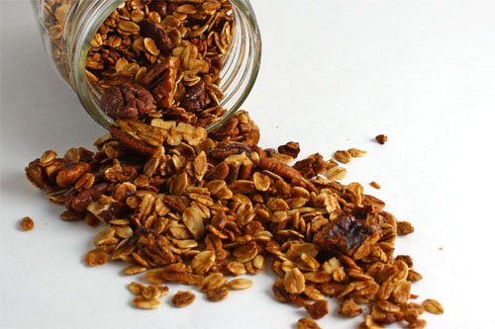
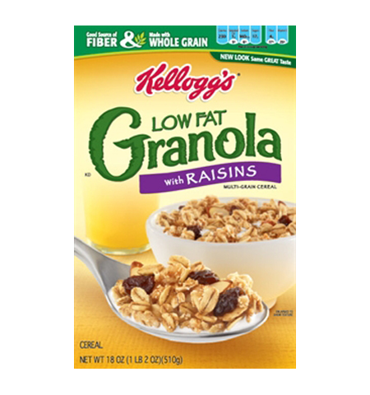
Cost Comparison: Granola
Bulk
Packaged
$0.27/oz.
$0.44/oz.

Slide 35
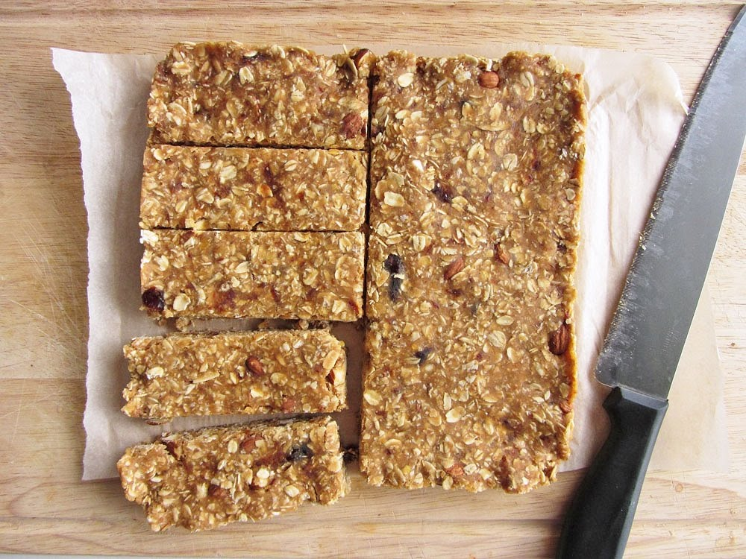
Homemade Granola Bars
Page 149 = $0.18/oz.

Slide 36
Have a Plan for Shopping
Have a plan
Look for organic
Buy only what you need
Or preserve [can, freeze or dry]
or share with friends/family

Slide 37
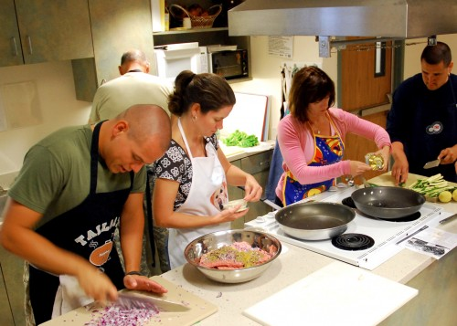
Cooking with Friends

Slide 38
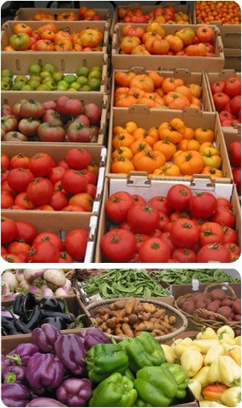
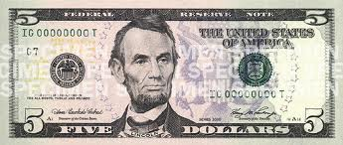
Shop the Farmers’ Markets
Supports local farmers: the money circulates HERE, which means JOBS
Most of the Big Box money leaves the area

Slide 39
Farmers’ Market Savings
Bargain with the farmers!
Prices reduced at end of day
Quantity discounts
Ask about damaged produce
Use WIC and CalFresh [SNAP]
Senior Food Vouchers

Slide 40
Farm Stands
Great experience for kids
Guaranteed fresh produce
Good prices
Pick your own produce

Slide 41
WIC and CalFresh
SNAP = CalFresh (EBT card)
Many organic choices
Use cards at Farmers’ Markets
Brings money to local economy
Easy to get: We have sign-up materials!

Slide 42
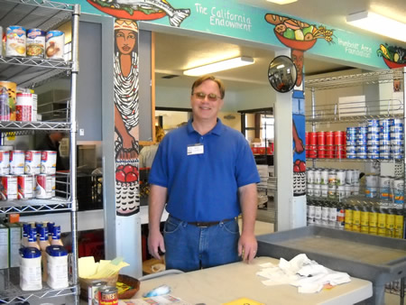
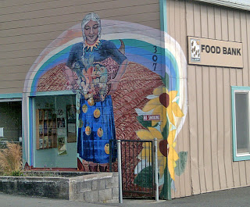
Food Banks
Free Food ☺
Meal planning help

Slide 43
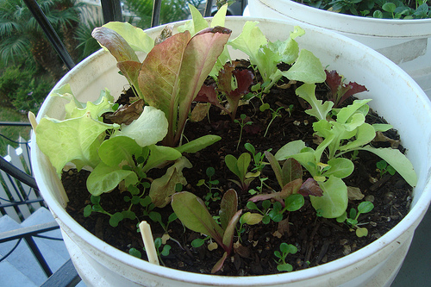
Grow Your Own
Most nutritious
Freshest
Tastes best
Less expensive
Doesn’t need lots of space
Kids can get involved
Kids eat what they grow
See chapter 6
Cilantro seeds to plant!

Slide 44
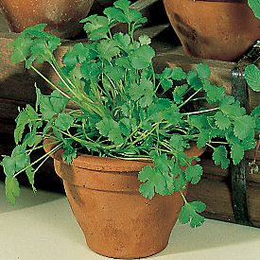
Cilantro

Slide 45
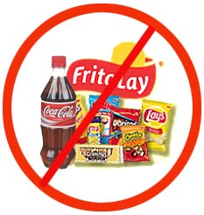
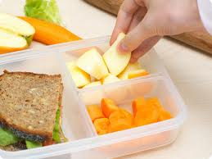
Real food for lunch!

