Slide 1
Part 2
Whole, Healthy Food

Slide 2
Agenda
Real Food discussion
How to use LunchBox Envy
CalFresh
Budgeting tips
Post-assessment form

Slide 3

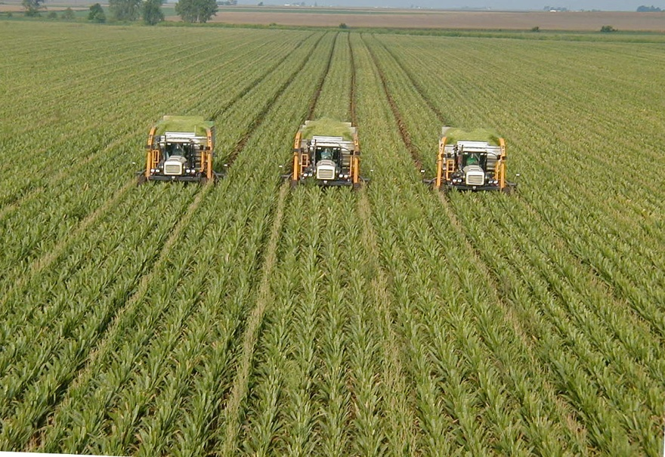
A Little History
Before 1940
After 1940

Slide 4
Farming After 1945
Plant Farming
Animal farming
Business oriented
Single crop
Pesticides
Chemical fertilizers
GMOs
CAFOs
Hormone use
Antibiotic use
Selective breeding/cloning

Slide 5

1953: Packaging

Slide 6
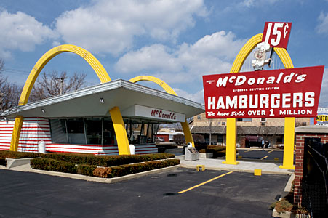
1955: Fast Food

Slide 7
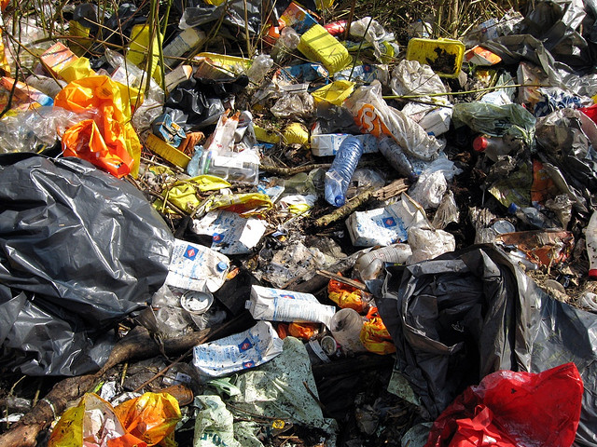
There is no “ … away.”

Slide 8

What IS Healthy Food?

Slide 9
What Do You Usually Eat?
?

Slide 10
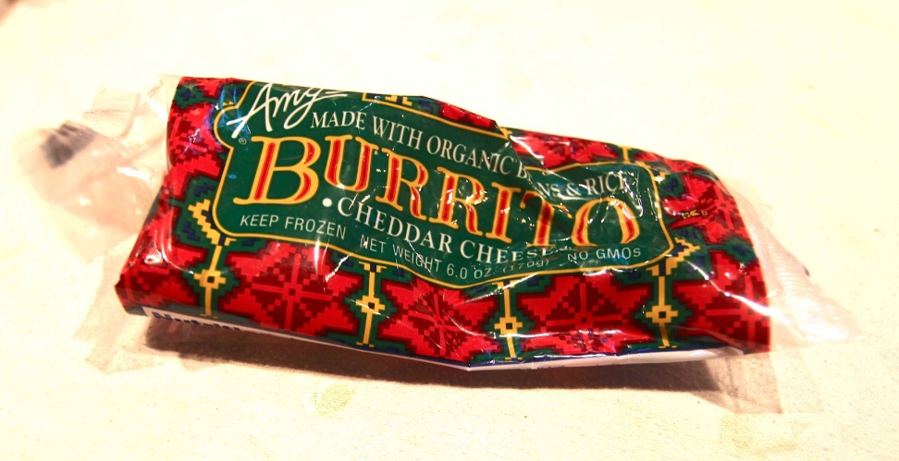
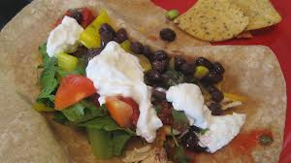
Whole and Unprocessed

Slide 11

Processed Foods
Peanut Butter #1
Peanut butter #2
Ingredients:
Roasted peanuts
Ingredients:
Roasted peanuts
Sugar
Hydrogenated vegetable oils [cottonseed, soy and canola]
Salt
Notes:
Look at ingredients for granola, yogurt, cheese, bread, most condiments and other foods with unnecessary additives not found in nature. Notice that additional ingredients tend to be salt, sugar and oil.
Read the labels! See page 190 and page 191 in LunchBox Envy.
Have enlarged, easy-to-read labels from the above-mentioned foods to hand out for participants to read.

Slide 12
Why extra ingredients?
Preservatives
Help product last longer on the shelf [see “use by” dates]
Extenders
Make product bulkier so it looks like more
Artificial colors
Make product appear fresh and appealing [and uniform]
Artificial flavors
Enhance the taste [guarantee uniformity]
Addictive: Sugar, salt and fat
Can create addictions

Slide 13

The Evil Trio
Sugar Salt Fat

Slide 14
Sugar, Salt & Fat are:
Addictive
Found in heavily-advertised products
Found in products aimed at kids
Found in cheaper products
Sold everywhere
Inexpensive for manufacturers due to government subsidies

Slide 15

Soda = Sugar

Slide 16

Rethink Your Drink!

Slide 17
Fresh and In-Season Food
Better tasting
More nutritious
Cheaper
Preserve for later
Freeze*
Can*
Dry: p. 174

Slide 18

“In Season” Means OUR Season

Slide 19
Protein from Meat and Poultry
Pasture -raised
Factory-farmed
Grass fed = normal diet
Meat = leaner
No antibiotics
No hormones
Protects environment
Protects farmers
Inappropriate diet
Meat fattier
Antibiotic residue
Hormone residue
Harms environment
Endangers workers
See “Yuck Factor” p. 3

Slide 20
How Can You Afford Meat?
Shopping
Cooking
Buy only what you need
Ask butcher for exact amount
Use meat as an ingredient (stew)
Fix smaller portions
Start “Meatless Mondays”
Roast meat with plans for leftovers

Slide 21
Other Protein Sources
Nuts and legumes
Tofu and tempeh
Eggs
Dairy products
Fish
Notes:
Vegans, who eat no animal products, get their protein from beans and nuts.

Slide 22
Dairy and Grain Products
Choose REAL dairy
Processed cheese is mostly oil
Make your own yogurt
Choose mainly WHOLE grains
Reduces risk of diabetes, obesity, heart disease, stroke, and cancer
Include wheat, organic corn, brown rice, oats, barley, spelt, and rye

Slide 23

Organic vs Natural

Slide 24

Beware “Natural” Ingredients!

Slide 25

Certified Organic

Slide 26
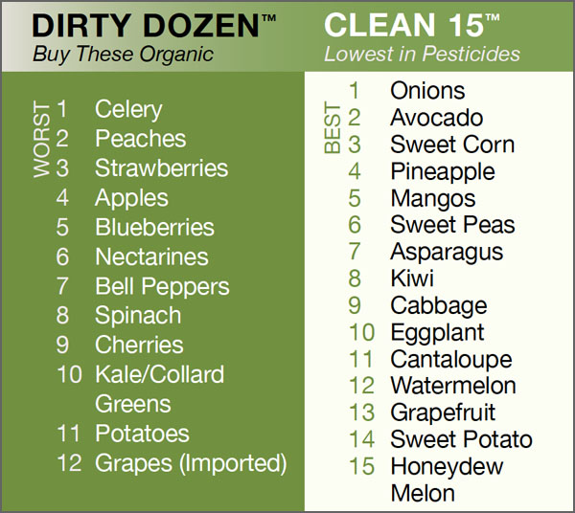
Must It Be Organic? p. 37

Slide 27
Avoiding Pesticide Exposure
Wash all produce well
Discard outer portions of leafy vegetables
Peel root vegetables
Peel conventional fruits
Buy produce grown in the U.S.
Notes:
Systemic pesticides cannot be washed off produce, so avoid the “dirty dozen” if at all possible, at least for young children.

Slide 28
Concerned about GMOs? Avoid…
Corn, cornstarch, corn oil, corn syrup, and high-fructose corn syrup
Cottonseed and canola oils
Soy and all soy products including soy oil and tofu
Beet sugar [use pure cane sugar]

Slide 29
How to Make a Change
http://www.ted.com/talks/birke_baehr_what_s_wrong_with_our_food_system.html

Slide 30

BREAK

Slide 31

Beginning to Cook

Slide 32
How to Use LunchBox Envy
Using the recipes
Being safe
Starting to cook
Involving children

Slide 33
Using the Recipes
Icons and Skill Levels

Slide 34
What’s in the Recipes?
Pages 54 -66:
Foundation Foods

Slide 35
Making It Easy
Page 67 - look for:
Low-prep/No-prep options
Formulas for each section

Slide 36
Kitchen Hygiene
Before you begin
Wear an apron
Tie back long hair
Wash your hands
Wash all surfaces with a mild vinegar solution
Wash all produce before peeling
Notes:
Ask for reason after each statement.
Is there anything else you can do?
Keep tissues nearby.
Wash hands as needed.

Slide 37
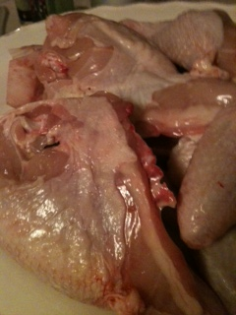
Meat and Poultry
Why is careful handling of raw meat and poultry important?
Notes:
See safe handling of chicken notes

Slide 38
Handling Meat and Poultry
Follow these guidelines to be sure your food handling methods won’t make your family sick! Meat must all be cooked once it has been thawed. Cooked meat can be refrozen; raw meat cannot.
Keep in refrigerator until ready to use
Use a separate cutting board for meat
Wash hands before and after handling meat
Sanitize (see handout) all surfaces that touch
Meat
Fish
ESPECIALLY poultry

Slide 39
Kitchen Safety
Knives: Keep a first-aid kit nearby!
Other safety tips:
Pot holders
Stool
Pot handles turned in
Dry hands
Fire extinguisher

Slide 40
The Process
Choose and read the recipe
Delegate tasks
Gather and prep ingredients
Notes:
.

Slide 41
The Process
Follow directions
Eat
Clean up
Notes:
To the kitchen…for food prep demo.

Slide 42
How Can Kids Help?
?

Slide 43
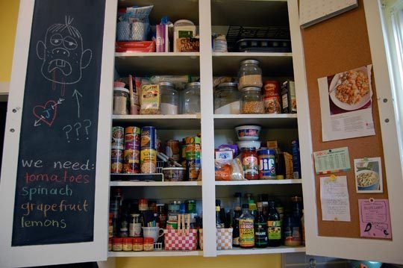
Basic Ingredients
Notes:
Everyone’s cupboard is different. See page 47 LunchBox Envy.

Slide 44
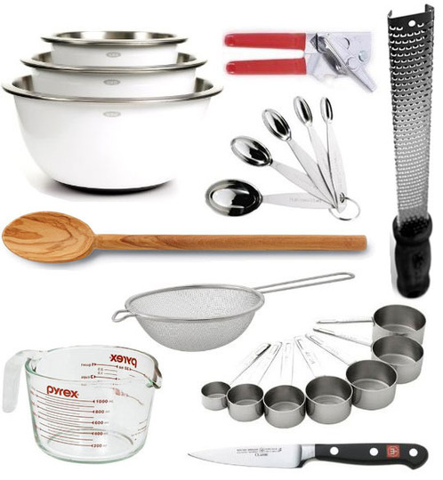
Basic Cooking Tools, pages 48-50
Notes:
Again, for discussion and fun!

Slide 45
CalFresh
The application is available online in English, Spanish, and other languages (this link goes to the English form):
http://www.calfresh.ca.gov/entres/forms/english/DFA285A1.PDF
Notes:
See page 21 of LunchBox Envy.

Slide 46
Affordability Tips
Market Match:
Once you’ve spent$10, you can get $5 more from the market manager
Notes:
Brainstorm, followed by summary on next slide. Calfresh materials should again be available. $5/market.

Slide 47
Budgeting Tips
Reduce waste
Shop sales and in season with a list
Preserve foods
Buy in bulk and share
Grow your own
Buy portion sizes
Use your EBT card at farmers’ markets
Buy organic and grass-fed
Buy nutrient-dense food, not calorie-dense food
Notes:
Discussion points.

Slide 48
Thank You!
To our sponsors
To our assistants
Most of all to you, the participants, for helping to spread the word about
The Other Side of Eating!

