Slide 1

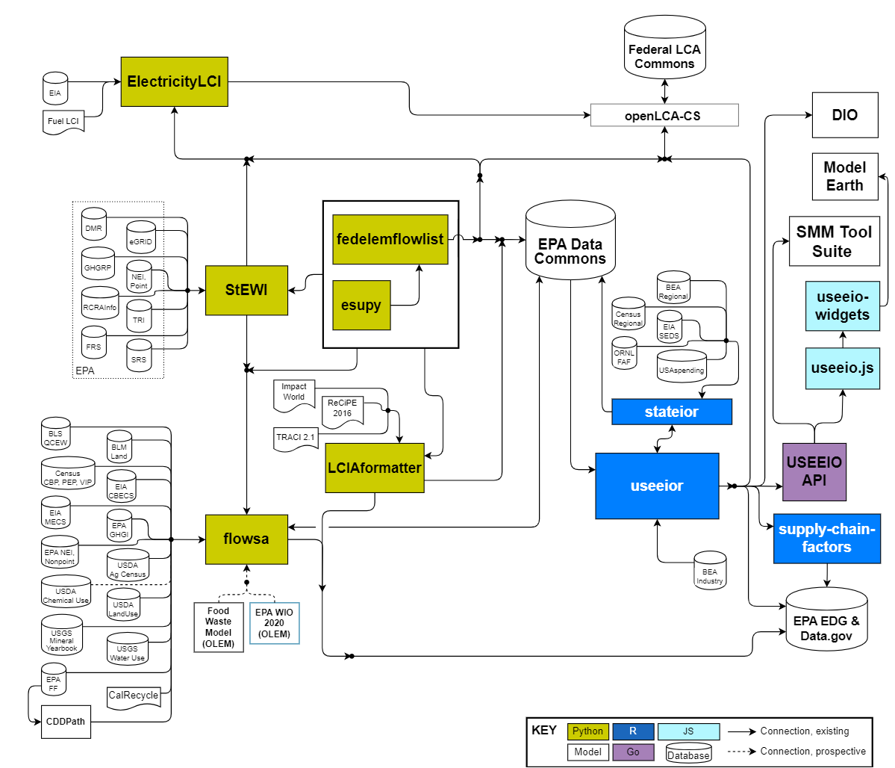
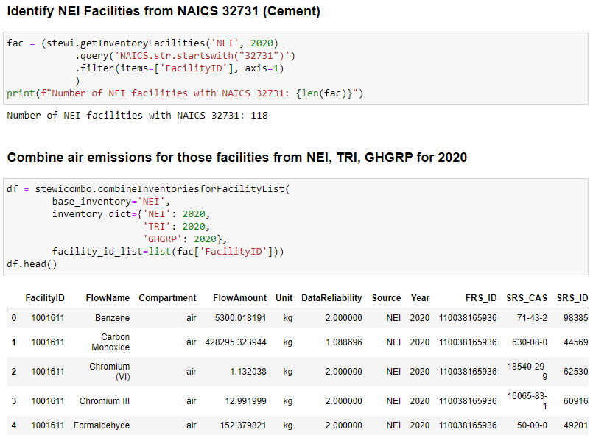
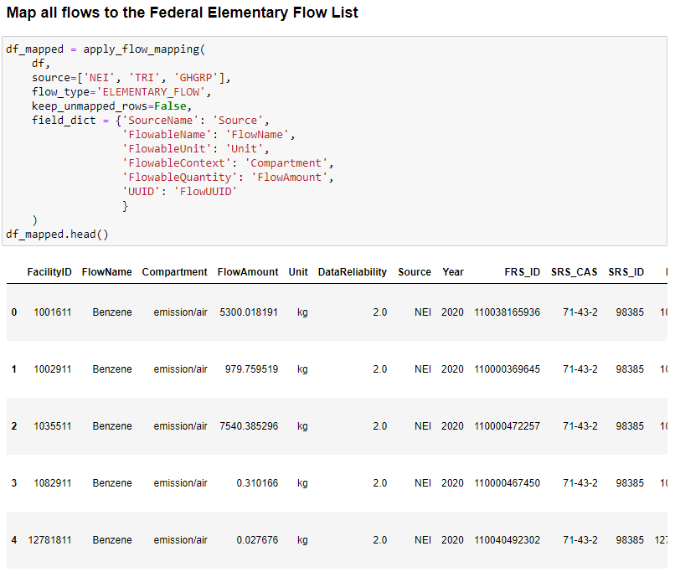
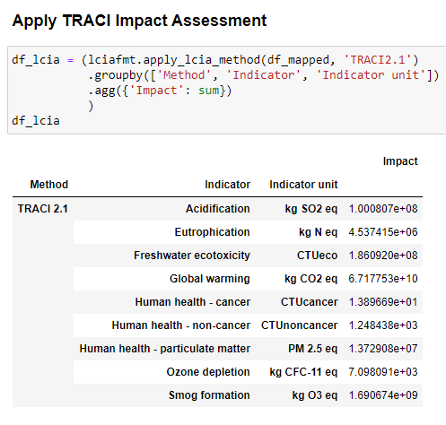
USEPA Tools for Industrial Ecology Modeling (TIEM)
Wesley Ingwersen¹, Ben Young², Catherine Birney¹, Mo Li^{3,4}, Michael Srocka⁵, Matthew Jamieson⁶,
Tapajyoti Ghosh⁷, Matthew Chambers⁸, Loren Heyns⁹, Andrew Beck², Jorge Vendries², Sarah Cashman²
¹ U.S. Environmental Protection Agency, Washington, DC, USA; ² Eastern Research Group, Concord, MA, USA. ³ GDIT, Falls Church, VA, USA. ⁴ Watershed, San Francisco, CA, USA.
⁵ GreenDelta, Berlin, Germany. ⁶ National Energy Technology Laboratory, Pittsburgh, PA, USA. ⁷ National Renewable Energy Laboratory, Golden, CO, USA.
⁸ Bureau of Economic Analysis, Washington, DC, USA. ⁹ Georgia Department of Economic Development, Atlanta, GA, USA U.S.
Center for Environmental Solutions
and Emergency Response
ceser@epa.gov
Benefits
Overview
Download, Discuss & Contribute
Access to large harmonized sets of environmental and economic data applicable across U.S. sectors.
Open-source modular design to foster transparency, reproducibility, metadata storage, and preservation of intermediate datasets.
Output is in standard tabular formats that can be written into spreadsheets.
Tools and tool results for released versions are EPA quality assured.
Users are encouraged to participate directly in TIEM’s development; new tool versions are released as enhancements are made and data are updated.
USEPA and partners develop and maintain open-source tools relevant in the realm of industrial ecology, collectively referred to as TIEM (Tools for Industrial Ecology Modeling). Tools are identified in colored boxes in Figure 1.
TIEM primarily provides either large U.S. industry-relevant environmental and economic datasets in standardized formats or constructs models including sector attribution, LCA, input-output, EEIO or related models. TIEM tools are primarily Python or R command-line programs or libraries.
All TIEM tools can be downloaded from USEPA GitHub pages and are free to use. Links can be found on the EPA TIEM web page.
On the Github pages users can also find documentation, ask questions via Discussions, report Issues, and contribute code updates using standard github practices for code contribution.
EPA TIEM web page
Example Applications
application in bold; tools used for application in dark blue
Federal Electricity Baseline The U.S. regionalized electricity life cycle inventory model provided by the Federal LCA Commons
ElectricityLCI StEWI fedelemflowlist
Federal LCA Commons Elementary Flow List (FEDEFL) Standardized list of elementary flows provided by the Federal LCA Commons fedelemflowlist
LCIA data for Federal LCA Commons LCIA datasets standardized to work with Federal LCA Commons data LCIAformatter fedelemflowlist
USEEIO model Widely-used EPA-maintained model to estimate potential impacts of U.S. goods and services model useeior stateior flowsa LCIAformatter StEWI
Sustainable Materials Management Prioritization Tool Suite (SMM Tool Suite) EPA life cycle-based tools to help users identify potential opportunities for environmental improvement USEEIO API
Model Earth Community Apps for LCA
Apps to explore community-level industry opportunities and potential impacts useeio-widgets
Figure 2: Sample code and output from TIEM.
Although the U.S. Environmental Protection Agency, through its Office of Research and Development, funded and conducted the research described herein under an approved Quality Assurance Project Plan (Quality Assurance Identification Number K-LRTD-0030017-QP-1-4), with the support of Eastern Research Group, Inc. through EPA Contract Number 68HERC21D0003, it does not necessarily reflect the views of the Agency, and no official endorsement should be inferred. Mention of trade names or commercial products does not constitute endorsement or recommendation for use.
Figure 1: Diagram of the TIEM’s connections to data sources and selected applications. TIEM tools are colored boxes.

