Slide 1

Relearning Java
Kedar Joshi
@kedar-joshi
@kedarjoshi

Slide 2
Motivation
Refresh basics
Bridge the gap in expectations –
Theory first or Hands-On first ?
Preparing for client interviews
Notes:
Difference in expectations.
Knowledge first or Experience first.

Slide 3
Rules
If you already know the answer, please let others figure it out first.
Notes:
Difference in expectations.
Knowledge first or Experience first.

Slide 4
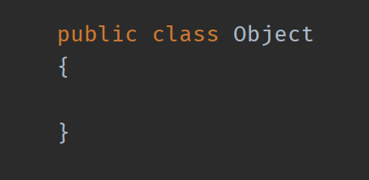
Let’s Get Started

Slide 5
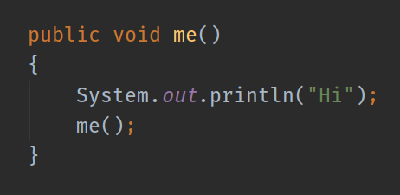


Slide 6

What is hash code ?
What does equals method do ?
When should hash code change?
Notes:
Performance

Slide 7
If a.equals(b) is true, then
a.hashCode() == b.hashCode() is ?

Slide 8
If a.equals(b) is false, then
a.hashCode() == b.hashCode() is ?

Slide 9
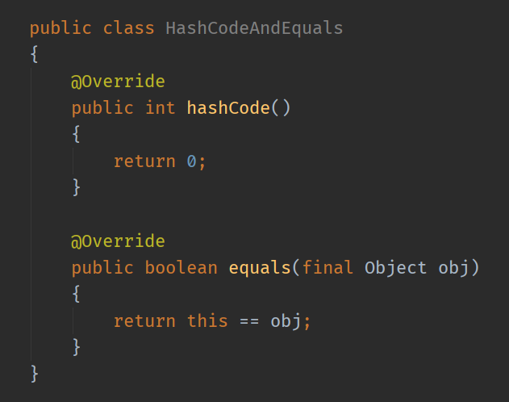
Hash Code and Equals

Slide 10
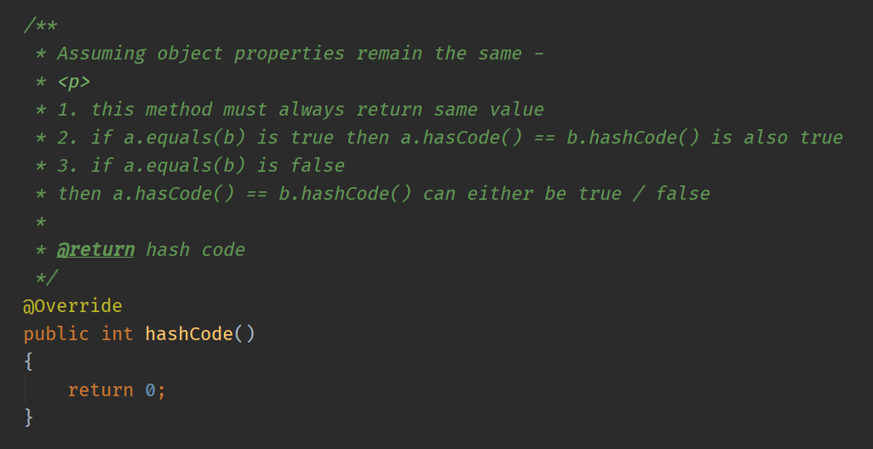
Notes:
Show equals afterwards with its principles

Slide 11
If a.equals(b) is true, then can
a.hashCode() == b.hashCode() be false ?

Slide 12
Can you implement hashCode() and equals()?
Let’s try.

Slide 13
How to implement hashCode() and equals() correctly ?
Notes:
Show code

Slide 14
Why always override hashcode() if overriding equals()?

Slide 15
What is Bloch pattern?
Effective Java by Josh Bloch
(see link in reference)
Notes:
Show code

Slide 16
How do you sort a collection ?
Notes:
Show code

Slide 17
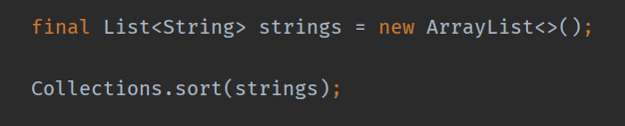
Notes:
Can you do this for any class ?

Slide 18
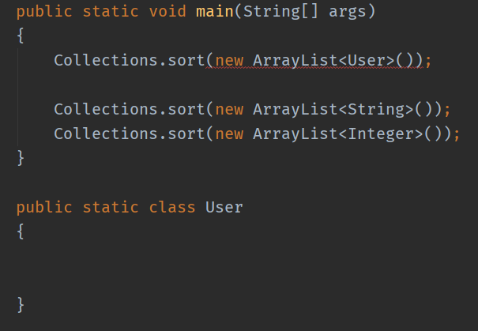
Notes:
What would it take to make user list sortable ?

Slide 19
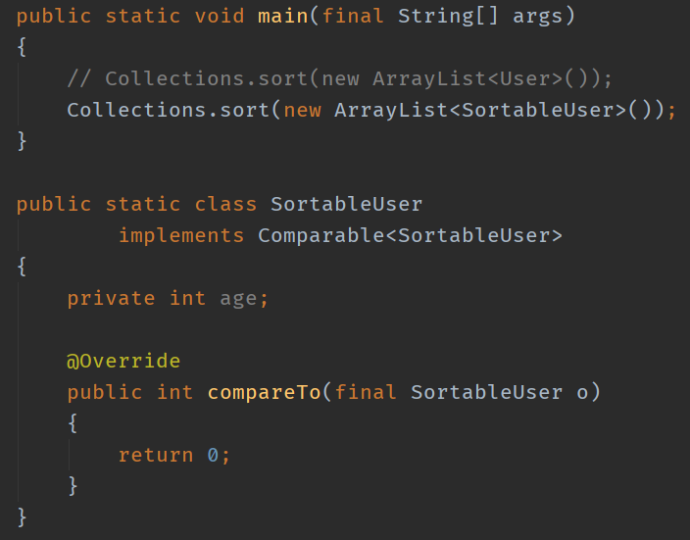
Notes:
It will compile but will it work correctly. ?

Slide 20
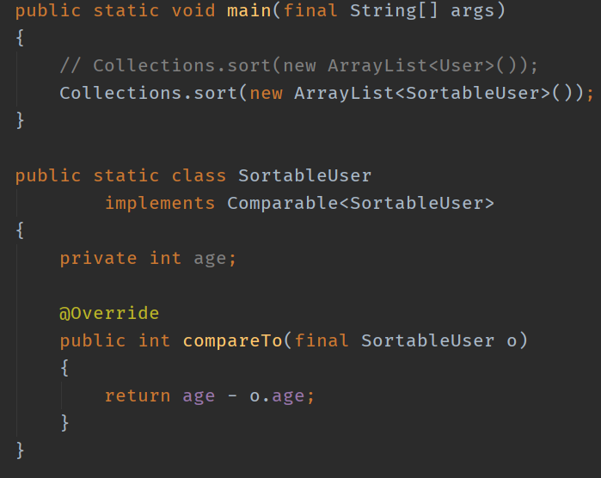
Notes:
It will compile but will it work correctly. ?

Slide 21
There is no syllabus for an interview.
It is about logically applying your knowledge to figure out the unknown.
Notes:
Show code

Slide 22
Can you reverse a list using sort method ?
If no, why ? If yes, how ?

Slide 23
Why String is Immutable ?

Slide 24
Why String is Immutable ?
Memory Efficiency
Consistency
Security
Thread Safety
See link in reference.

Slide 25
Why Integer / Long is Immutable ?

Slide 26
What is the difference between String, StringBuffer, and StringBuilder ?

Slide 27
How many strings will be in String pool in the below code?
String s = "abc";
String ss = "xyz";
String a = "as";
String b = new String("as");
s.append("www");

Slide 28
How many strings will be in String pool in the below code?
String s = "abc"; // 1
String ss = "xyz"; // 2
String a = "as"; // 3
String b = new String("as"); // 4
String c = s.concat("www"); // 5 and 6
Notes:
String intern

Slide 29
How we can create Immutable class using Builder design pattern ?
See link in reference.
Notes:
@Avitosh

Slide 30
Collections
Map
HashMap
LinkedHashMap
... etc
Notes:
Show code

Slide 31
Collections
Set
HashSet
TreeSet
... etc
Notes:
Show code

Slide 32
How HashSet works?
Notes:
@Avitosh

Slide 33
Have you used concurrent collection classes if yes then how it is used in project give an example?
Notes:
@Avitosh

Slide 34
Concurrent Collections –
ConcurrentHashMap
Collections.synchronizedMap()
Collections.synchronizedSet()
Collections.synchronized*()
Notes:
Show code

Slide 35
Streams –
Map
MapToInt
MapToDouble
Filter
Collectors
Notes:
Show code

Slide 36
When to use stream() vs parallelStream() ?
Notes:
@Avitosh

Slide 37
Compare Future and CompletableFuture.
Notes:
@Avitosh

Slide 38
How to ensure sequence of thread execution ?
Notes:
@Avitosh

Slide 39
Exception vs Error
Name most common errors which can occur in Java application ?
Notes:
@Avitosh

Slide 40
Checked vs Unchecked exceptions
When to throw ?
Which one should you catch ?
See link in reference.
Notes:
Checked exceptions : when a method cannot do what it should.

Slide 41
Modern take on checked exceptions.
“Make everything unchecked”.
Notes:
Checked exceptions : when a method cannot do what it should.

Slide 42
Can you catch an Error ?
Notes:
@Avitosh

Slide 43
Should you catch an Error ?
If no, why not ?
If yes, then when should you catch an Error ?
Notes:
@Avitosh

Slide 44
Why catching Throwable is considered a bad practice?

Slide 45
Reference
https://github.com/locationguru-solutions/java-concepts
https://stackoverflow.com/questions/18473071/how-caching-hashcode-works-in-java-as-suggested-by-joshua-bloch-in-effective-jav
https://stackoverflow.com/questions/5154970/how-do-i-create-a-hashcode-in-net-c-for-a-string-that-is-safe-to-store-in-a/5155015?noredirect=1#comment51056393_5155015

Slide 46
Reference
https://www.programcreek.com/2013/04/why-string-is-immutable-in-java/
https://www.journaldev.com/538/string-vs-stringbuffer-vs-stringbuilder
https://codepumpkin.com/create-immutable-class-java/
https://codepumpkin.com/immutable-class-with-mutable-member-fields-in-java/

Slide 47
Reference
https://www.mkyong.com/java8/java-8-collectors-groupingby-and-mapping-example/
https://howtodoinjava.com/java8/stream-flatmap-example/
https://www.mkyong.com/java8/java-8-flatmap-example/
https://howtodoinjava.com/java/exception-handling/checked-vs-unchecked-exceptions-in-java/

Slide 48

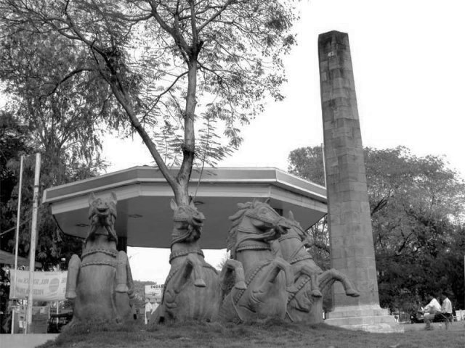
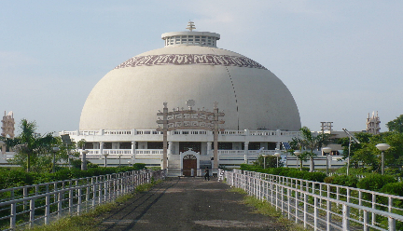
Thank You
Mumbai Office:
204A, B2 Wing, Boomerang,
Chandivali Farm Road, Chandivali,
Mumbai 400072 INDIA.
Ph: +91.22.2847.5705
Nagpur Office:
Lambent IT Park 46-48,
Harihar Nagar, Besa, P.O. Pipla,
Nagpur: 440034 INDIA.
Ph: +91.712 6604712
Fax: +91.7103 281364
Contact:
info@locationguru.com
www.locationguru.com

