Slide 1

Modern SQL
Kedar Joshi
@kedar-joshi
@kedarjoshi

Slide 2
Motivation
Approaching SQL features with a fresh perspective.
Focus on few tiny but important details.
Prepare for client interview questions.
Analytics is critical for our products.

Slide 3
Rules
If you already know the answer, please let others figure it out first.

Slide 4



Glossary
Beginner
Intermediate
Advance

Slide 5
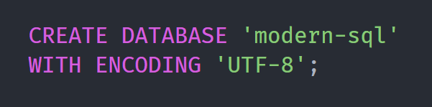
Let’s Get Started

Slide 6
Is this SQL statement correct ?
If yes, ok.
If no, why not ?

Slide 7
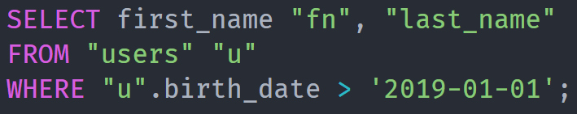
Quoting
Single quotes for ‘values’
Double quotes for database objects i.e. “tables” and “columns” (and aliases)
Notes:
Why quoting is needed ?

Slide 8

Charset vs Collation ?

Slide 9
Charset
Defines supported languages.

Slide 10
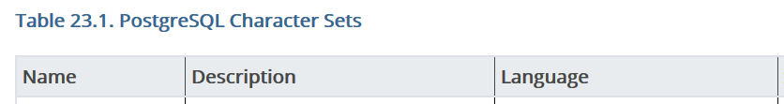
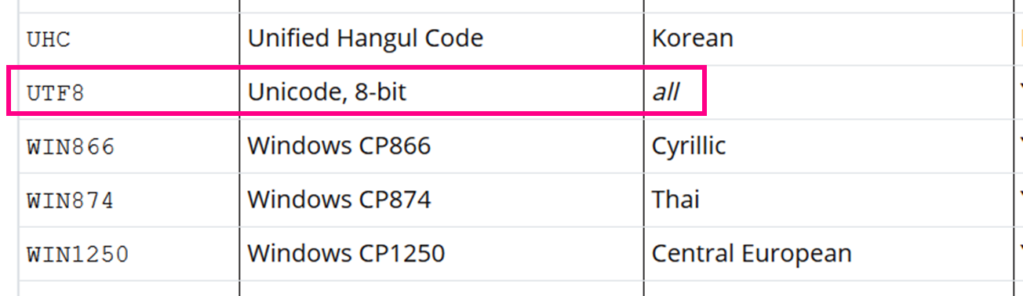
Why UTF-8 ?
Notes:
Why quoting is needed ?

Slide 11
Collation
Defines sorting rules for given language e.g.
अ before आ
अभय before आशीष
Aashish before Abhay

Slide 12
Textual Types
Char, Varchar and Text
e.g. char(10), varchar(100)

Slide 13
SQL
Structured Query Language
Notes:
Structured = Each record has Specific Columns and Column Types

Slide 14
SQL is a -
4th generation declaration language
domain-specific language
Notes:
Java = General Purpose Programming Language
1st generation : Machine code 2nd generation : Assembly language
3rd generation : C, C++, Java, Python and .Net

Slide 15
SQL was -
Developed by IBM in 1970s
Standardized by ANSI in 1986
Standardized by ISO in 1987.
Notes:
American National Standards Institute (ANSI)
International Organization for Standardization (ISO)

Slide 16
SQL subsets -
Data Definition Language (DDL)
Data Manipulation Language (DML)
Data Control Language (DCL)
Notes:
DCL : Access control (Grant, revoke etc.)

Slide 17
Difference between DELETE, TRUNCATE and DROP.
Notes:
What about transaction management ?

Slide 18
Explain Relational Model

Slide 19
Relational Model
Represents how data is stored i.e. using tables (relations), columns (attributes), and rows (tuples)

Slide 20
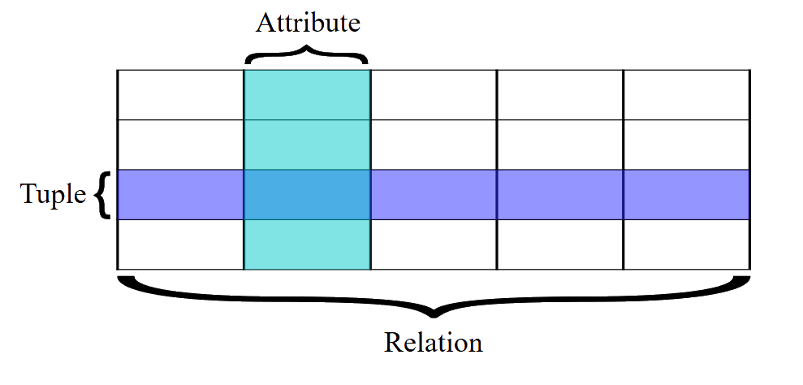

Slide 21
Relational Model Concepts
Table is a Relation
Column is an Attribute
Row is a Tuple
Table snapshot at a moment is Relation Instance

Slide 22
Relational Model Concepts
Number of columns in a table is Degree
Number of rows in a table is Cardinality

Slide 23
Joins
Inner Join
Left Join
Right Join
Full Join
Self Join
Cartesian Join

Slide 24
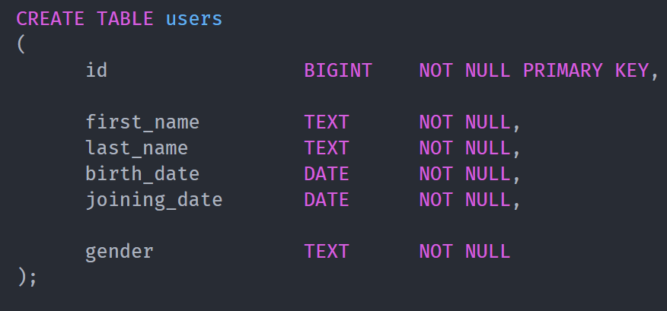

Slide 25
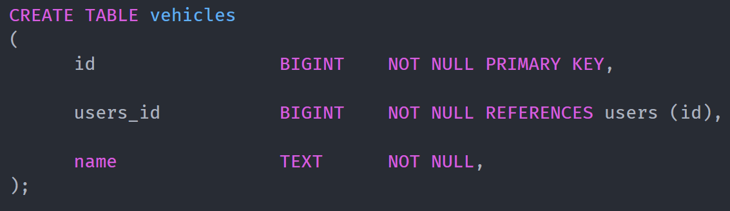

Slide 26
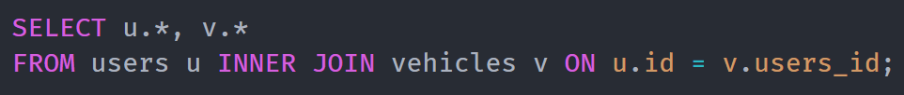
Inner Join

Slide 27
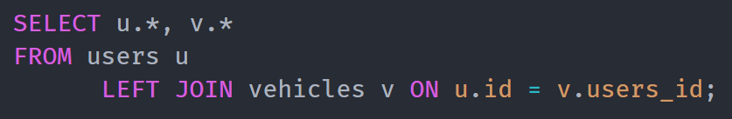
Left Join

Slide 28
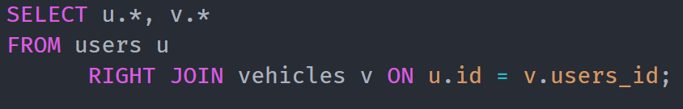
Right Join

Slide 29
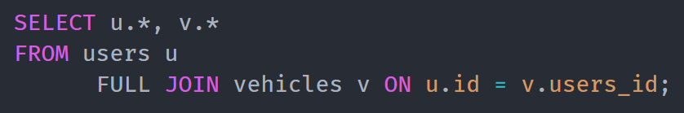
Full Join

Slide 30
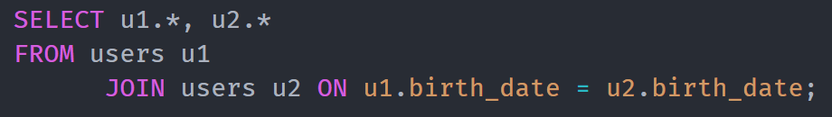
Self Join

Slide 31

Cartesian / Cross Join

Slide 32
Joins
Natural Join
Notes:
What is natural join ?

Slide 33
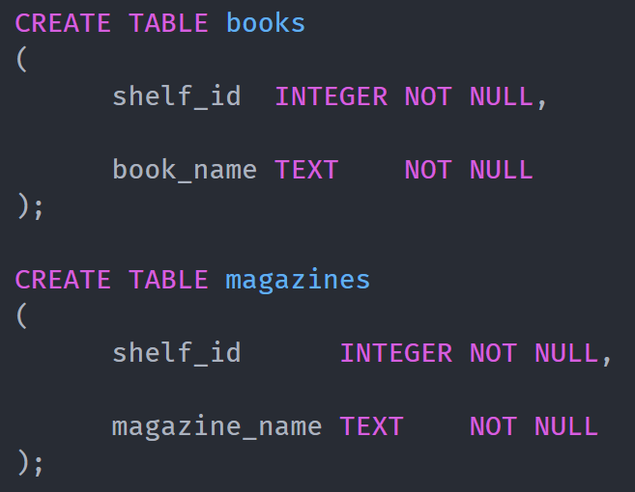

Slide 34
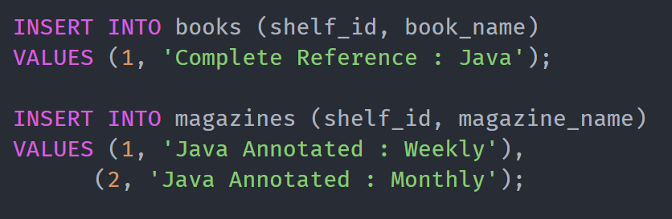

Slide 35
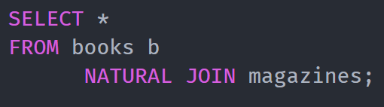
Natural Join

Slide 36
Where vs Having ?

Slide 37
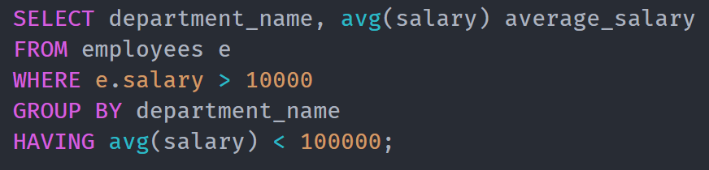
Where vs Having

Slide 38
Properties of Transaction
Atomicity − All or nothing.
Consistency − Ensures that the database properly changes states upon a successfully committed transaction.
Isolation − Multiple transactions at a time.
Durability − Ensures that the result or effect of a committed transaction persists in case of a system failure.

Slide 39
Types of Constraints
Null / Not Null
Default
Unique
Primary Key
Foreign Key
Index
Check

Slide 40
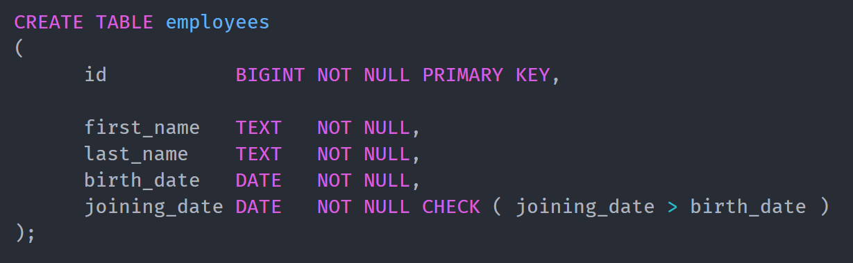
Check Constraint

Slide 41
Indexes
Simple Indexes
Unique Indexes
Implicit Indexes
Composite Indexes
Clustered Indexes

Slide 42
Top-N Queries
Find 3 oldest / newest users according to experience
Find oldest / newest male and female users according to experience

Slide 43
Top-N Queries
Find 3 oldest / newest male and female users according to experience

Slide 45

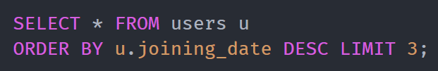
Find 3 oldest users according to experience
Find 3 newest users according to experience
Notes:
1. What will happen if two people have same joining date ? Unpredictable result.

Slide 46
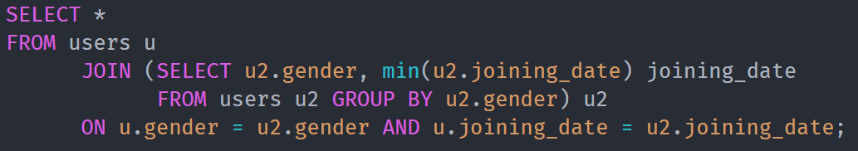
Find oldest male and female users according to experience
Notes:
Losing sight of what is going on.

Slide 47

Find newest male and female users according to experience
Notes:
Losing sight of what is going on.

Slide 48
What are window functions ?
row_number()
rank()
dense_rank()
Notes:
Special group by functions

Slide 49
Top-N Queries
with RANK()
with DENSE_RANK()
Notes:
Examples ?

Slide 50
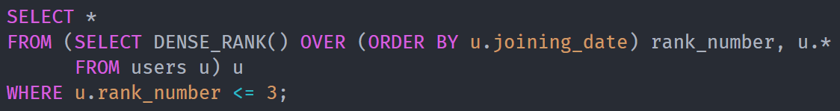
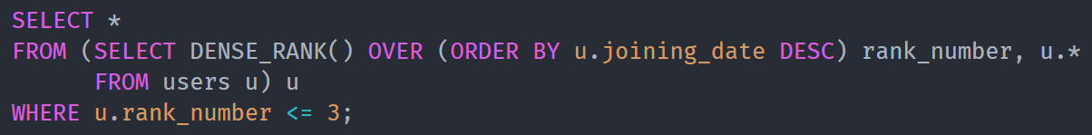
Find 3 oldest users according to experience
Find 3 newest users according to experience

Slide 51
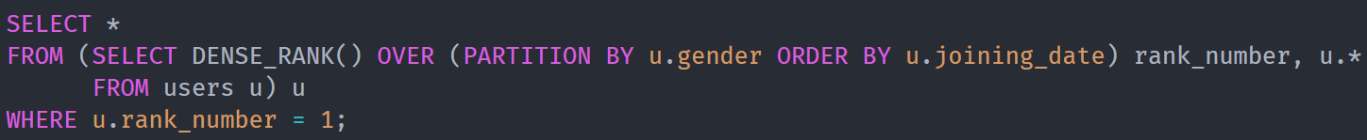
Find oldest male and female users according to experience
v/s
Notes:
Losing sight of what is going on.

Slide 52
Find newest male and female users according to experience
v/s
Notes:
Losing sight of what is going on.

Slide 53
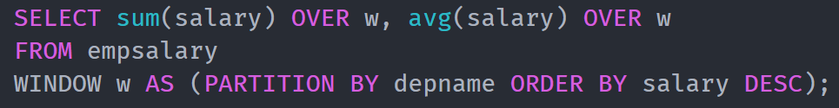
Reusable Window

Slide 54
What is Common Table Expression ?
Notes:
Examples ?

Slide 55
Common Table Expression (CTE)
Temporary named result set is called Common Table Expression

Slide 56
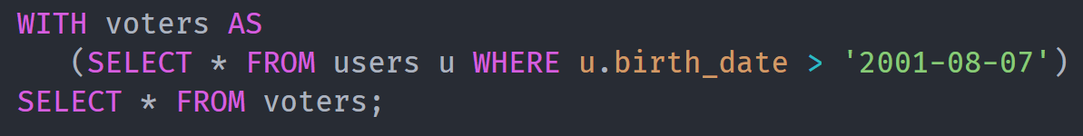
Simple CTE

Slide 57
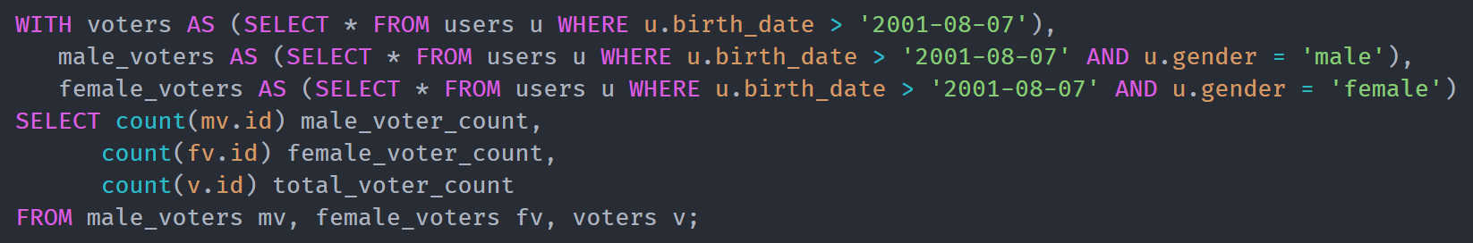
Multiple CTE

Slide 58
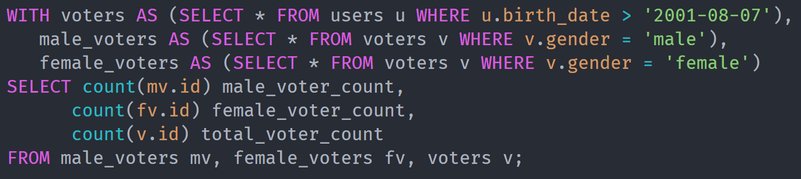
Self Referencing CTE

Slide 59
Recursive CTE
Common table expression that references itself till end condition is met

Slide 60
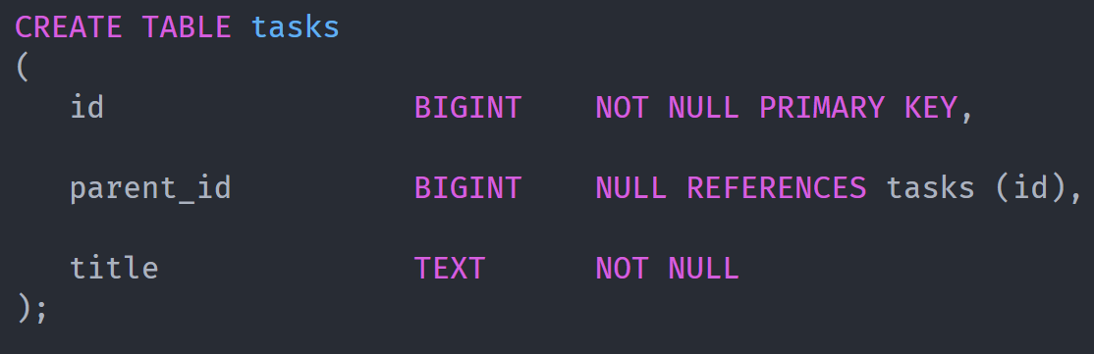

Slide 61
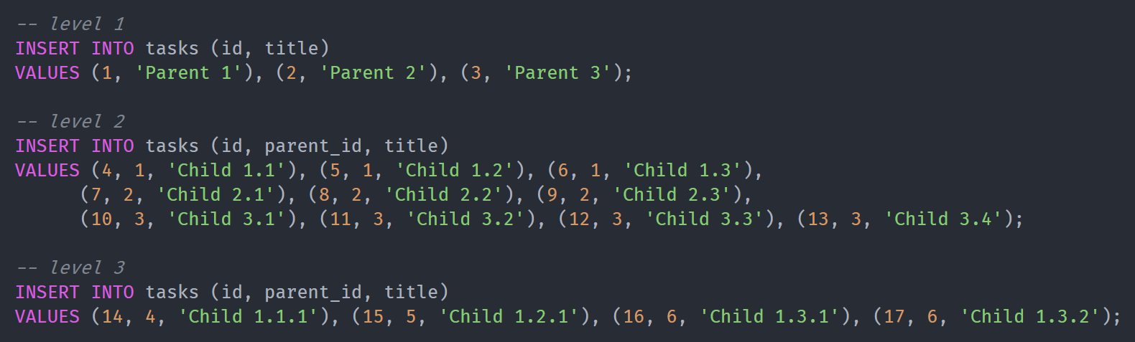

Slide 62
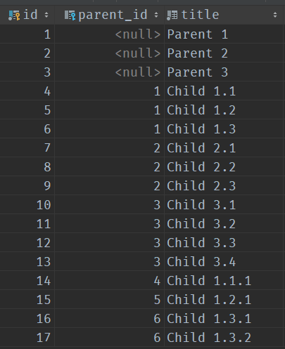

Slide 63
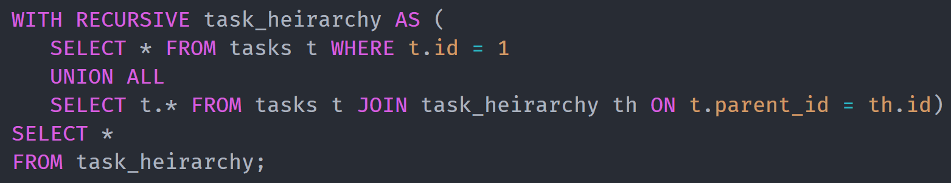
Recursive CTE : Querying Downstream
Finding Children of Children

Slide 64
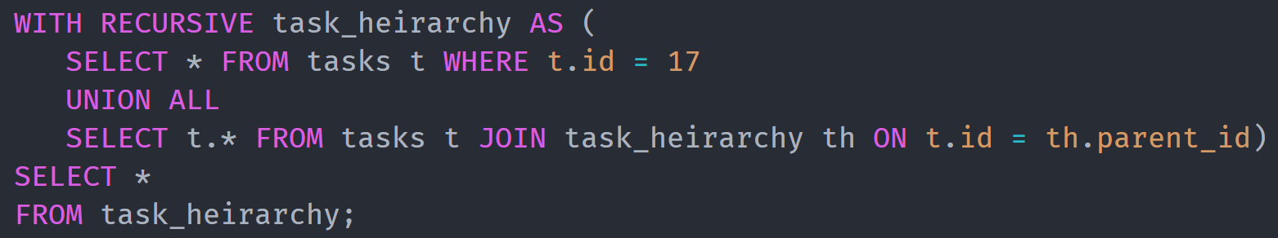
Recursive CTE : Querying Upstream
Querying parents of parents

Slide 65
Use cases for CTE in TeamPilot
Finding latest event for all tasks
Finding latest events of all types for a task
Reports and Dashboard

Slide 66
Analytics
Views
Materialized Views
Notes:
Views : Limit access, Convenience

Slide 67
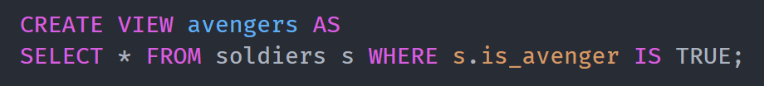
Views

Slide 68
Materialized Views

Slide 69
Query Optimization
Demonstration
Notes:
Views : Limit access, Convenience

Slide 70

Future of SQL
Generated Columns

Slide 71
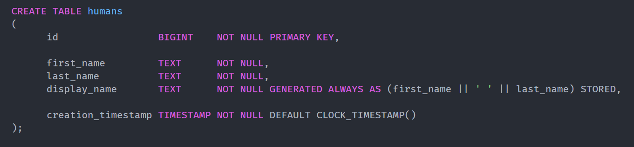
Generated Columns

Slide 72
Reference
SQL : https://en.wikipedia.org/wiki/SQL
Top 65 SQL Interview Questions and Answers : https://www.youtube.com/watch?v=-WEpWH1NHGU
Character Set Support : https://www.postgresql.org/docs/11/multibyte.html
Relational Model : https://www.geeksforgeeks.org/relational-model/
Window function : https://www.postgresql.org/docs/9.1/tutorial-window.html
Rank functions : http://www.postgresqltutorial.com/postgresql-rank-function/
Generated Columns : https://www.2ndquadrant.com/en/blog/generated-columns-in-postgresql-12/

Slide 73
Reference : Video Tutorials
Top 65 SQL Interview Questions and Answers : https://www.youtube.com/watch?v=-WEpWH1NHGU
SQL Full Course : https://www.youtube.com/watch?v=BPHAr4QGGVE
SQL Full Course : https://www.youtube.com/watch?v=HXV3zeQKqGY
SQL Tutorial for Beginners MySQL : https://www.youtube.com/watch?v=7S_tz1z_5bA
SQL Tutorial for Beginners : https://www.youtube.com/watch?v=JTDK6r1GuUU

Slide 74



Thank You
Mumbai Office:
204A, B2 Wing, Boomerang,
Chandivali Farm Road, Chandivali,
Mumbai 400072 INDIA.
Ph: +91.22.2847.5705
Nagpur Office:
Lambent IT Park 46-48,
Harihar Nagar, Besa, P.O. Pipla,
Nagpur: 440034 INDIA.
Ph: +91.712 6604712
Fax: +91.7103 281364
Contact:
info@locationguru.com
www.locationguru.com

