Slide 1

DESIGN AND EVALUATION OF LOW POWER SRAM
HO CHI MINH CITY UNIVERSITY OF TECHNOLOGY AND EDUCATION
FACULTY FOR INTERNATIONAL EDUCATION
SENIOR PROJECT 2 REPORT
Advisor: PhD. Pham Van Khoa
Student: Ngo Duy Loc – 20119140
Khong Thanh Dat - 20119123

Slide 2
Contents
OVERVIEW
THEORETICAL BASIS
SIMULATION
EVALUATION
CONCLUSION
DESIGN AND EVALUATION OF LOW POWER SRAM

Slide 3
1. OVERVIEW
Introduction:
Digital designs have taken the world by storm over the past decades and computer systems continue to develop every day. Faster and more complicated computers also result in higher power consumption.
One of the most commonly used computer architecture is the Von-Neumann architecture. The Von-Neumann architecture can have bottlenecks from too much data that couldn’t be processed in time.
DESIGN AND EVALUATION OF LOW POWER SRAM

Slide 4
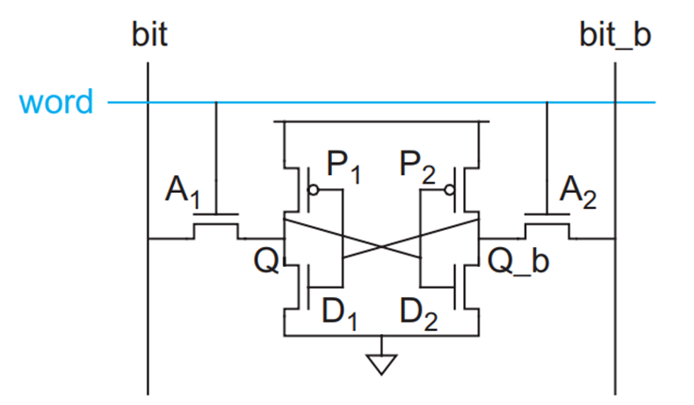
2. THEORETICAL BASIS
a. 6-Transistor (6T) SRAM
The 6-Transistor SRAM Cell essentially comprises of 2 Inverters (P1 + D1 and P2 + D2), each with their output connected to the other’s input, and 2 nMOS acting as Access ports for the SRAM Cell. The Bitlines bit and bit_b are the data to be written (by a Data Write Circuit) into the SRAM Cell, which is allowed to do so by having the Wordline word activated.
DESIGN AND EVALUATION OF LOW POWER SRAM

Slide 5
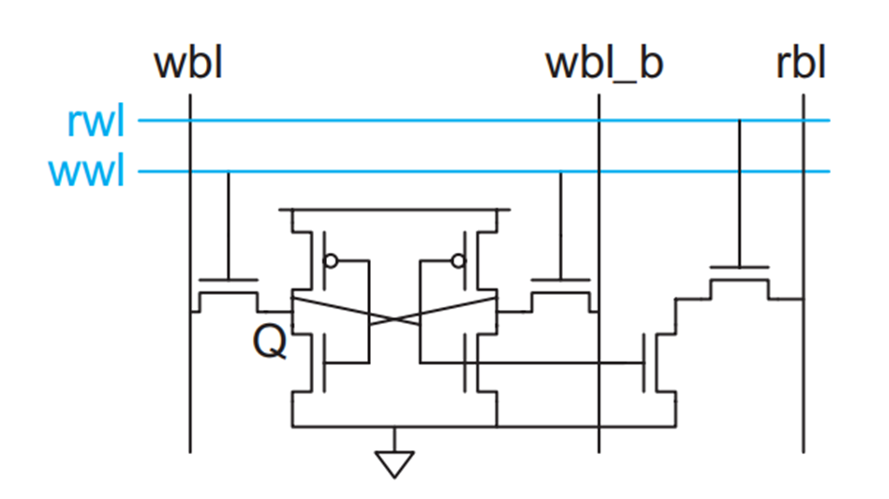
2. THEORETICAL BASIS
b. 8-Transistor (8T) SRAM
The 8T SRAM design is similar to that of the 6T SRAM, but with additional independent Read and Write ports which results in the operation of the 8T SRAM is also mostly similar to 6T SRAM, with a few differences
DESIGN AND EVALUATION OF LOW POWER SRAM

Slide 6
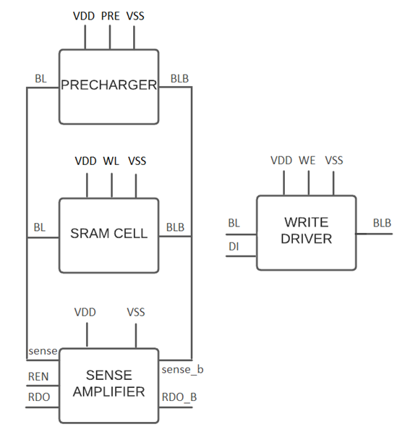
2. THEORETICAL BASIS
c.Block diadram of SRAM cell
The typical SRAM design consists of 4 blocks: Precharger to precharge the circuit, Sense Amplifier to sense and amplify signals on bitlines to read out data, Write Driver to write data onto the memory cell, and the SRAM Cell itself.
DESIGN AND EVALUATION OF LOW POWER SRAM

Slide 7
2. THEORETICAL BASIS
d.Read operation 6T SRAM
Initially, the Bitlines bit and bit_b will be floating high, then Wordline word is raised, activating the two Access transistors.
Assume Q is initially 0 (and Q_b is initially 1). Both bitlines are floating at high, and with Q = 0, the voltage at Q will be raised due to bit being pulled to GND with the current flowing through Q.
However, if Q, which is the input to the right Inverter, is raised above the threshold voltage of the nMOS, the Inverter will output logic 0 at Q_b and bit_b will be pulled to GND, causing an error in the Read operation
DESIGN AND EVALUATION OF LOW POWER SRAM

Slide 8
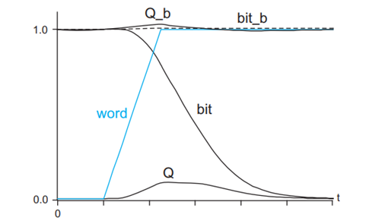
2. THEORETICAL BASIS
d.Read operation 6T SRAM
To counter this, the transistors D1 and D2 must be stronger (that is to say it can allow the current to pass through it more easily) than their respective Access transistors in order to have bit or bit_b being pulled to GND immediately without raising Q or Q_b which might cause bit-flippings that can lead to Read errors. This is called Read stability.
Finally, when one of the two bitlines have a voltage drop (means there are a difference in voltage between them), the bitlines will go through a Sense Amplifier which will sense the voltage difference and essentially “reads” the data stored inside individual SRAM Cells.
DESIGN AND EVALUATION OF LOW POWER SRAM

Slide 9
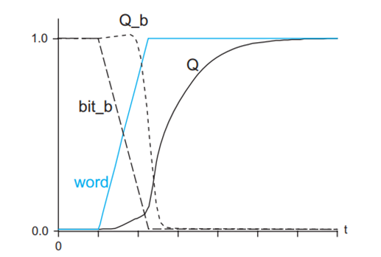
2. THEORETICAL BASIS
d.Write operation 6T SRAM
Assume that Q is initially 0 and a logic 1 is needed to be written into Q, meaning Q_b is at logic 1 and is needed to be pulled down to 0. Bitlines are not at floating high. Instead, the bitlines are charged by a Write Driver. Wordline is also raised
However, we know that Q_b cannot be pulled to 0 through D2 (established in Read operation). Instead, Q_b will be pulled down to 0 through A2 to bit_b.
When Q_b is pulled down to 0, it will turn on P1, which will raise Q to 1. In order for Q_b to be pulled down without causing errors, P2 will need to be much weaker than A2 (same to P1 and A1). This is called Write stability.
DESIGN AND EVALUATION OF LOW POWER SRAM

Slide 10
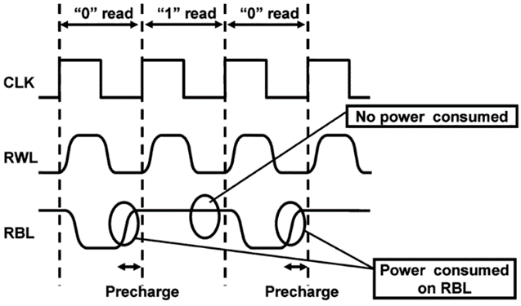
2. THEORETICAL BASIS
d.Read operation 8T SRAM
In a Read operation, the rbl bitline is precharged, then the rwl wordline is asserted. Write access transistors are isolated and the operation is only affected by the Read access transistors.
DESIGN AND EVALUATION OF LOW POWER SRAM

Slide 11
2. THEORETICAL BASIS
d.Write operation 8T SRAM
In Write operation, the data and its complement are applied to the wbl and wbl_b bitlines and the wwl wordline is raised to logic High.
DESIGN AND EVALUATION OF LOW POWER SRAM

Slide 12
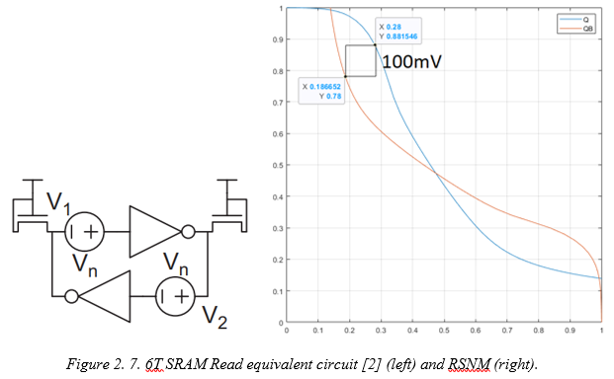
2. THEORETICAL BASIS
Read Stability of 6T SRAM
Read SNM (RSNM) shows the stability of the cell during Read operation. Reading operation is affected by the Access transistors. The pull-down transistors D1 and D2 must be stronger, or in other words, must have bigger sizes compared to those of the Access transistors A1 and A2 in order to counter bit-flipping during Read.
DESIGN AND EVALUATION OF LOW POWER SRAM

Slide 13
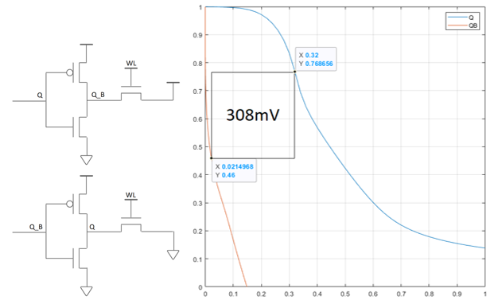
2. THEORETICAL BASIS
Write Stability of 6T SRAM
Write SNM (WSNM) shows the stability of the cell during Write operation. During Write operation, one of the two Bitlines will be pulled to Low through one of the pull-down transistors and the other Bitline is kept at High
DESIGN AND EVALUATION OF LOW POWER SRAM

Slide 14
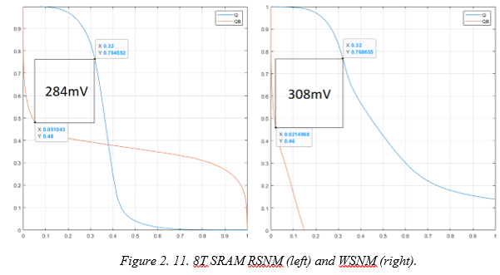
2. THEORETICAL BASIS
Read and Write Stability of 8T SRAM
The RSNM of the 8T SRAM is not affected by Write Access transistors, which results in a much higher RSNM value compared to that of the 6T SRAM. Meanwhile, The WSNM of the 8T SRAM stayed the same as the 6T due to having nearly no difference in Write operation equivalent circuit.
DESIGN AND EVALUATION OF LOW POWER SRAM

Slide 15
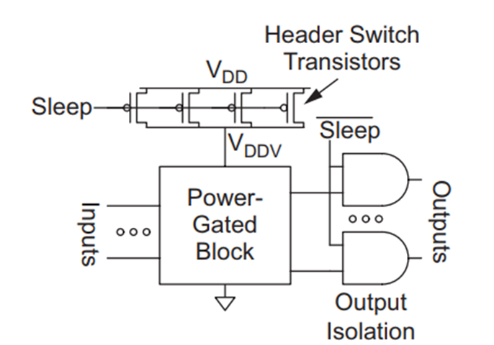
2. THEORETICAL BASIS
e.Power gating for SRAM
Power Gating is the easiest way to reduce static current. This method essentially puts the circuits into “sleep mode”, cutting off the power supply to said blocks when they are not operating, cutting down static power [2]. The Power Gating method can be illustrated by the figure .
The logic block gets its input power from a gated VDD rail, VDDV. When the block is turned ON, the header switch transistors are turned ON and connects VDDV to VDD. When the block is not operating, it will go to sleep by having the header switch transistors turned OFF, disconnecting VDDV from VDD and VDDV will be pulled to GND over time.
DESIGN AND EVALUATION OF LOW POWER SRAM

Slide 16
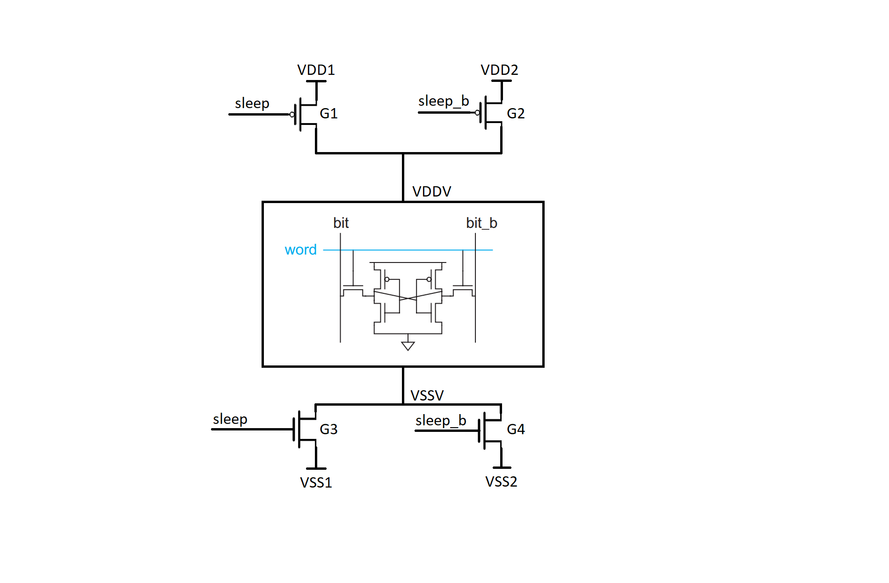
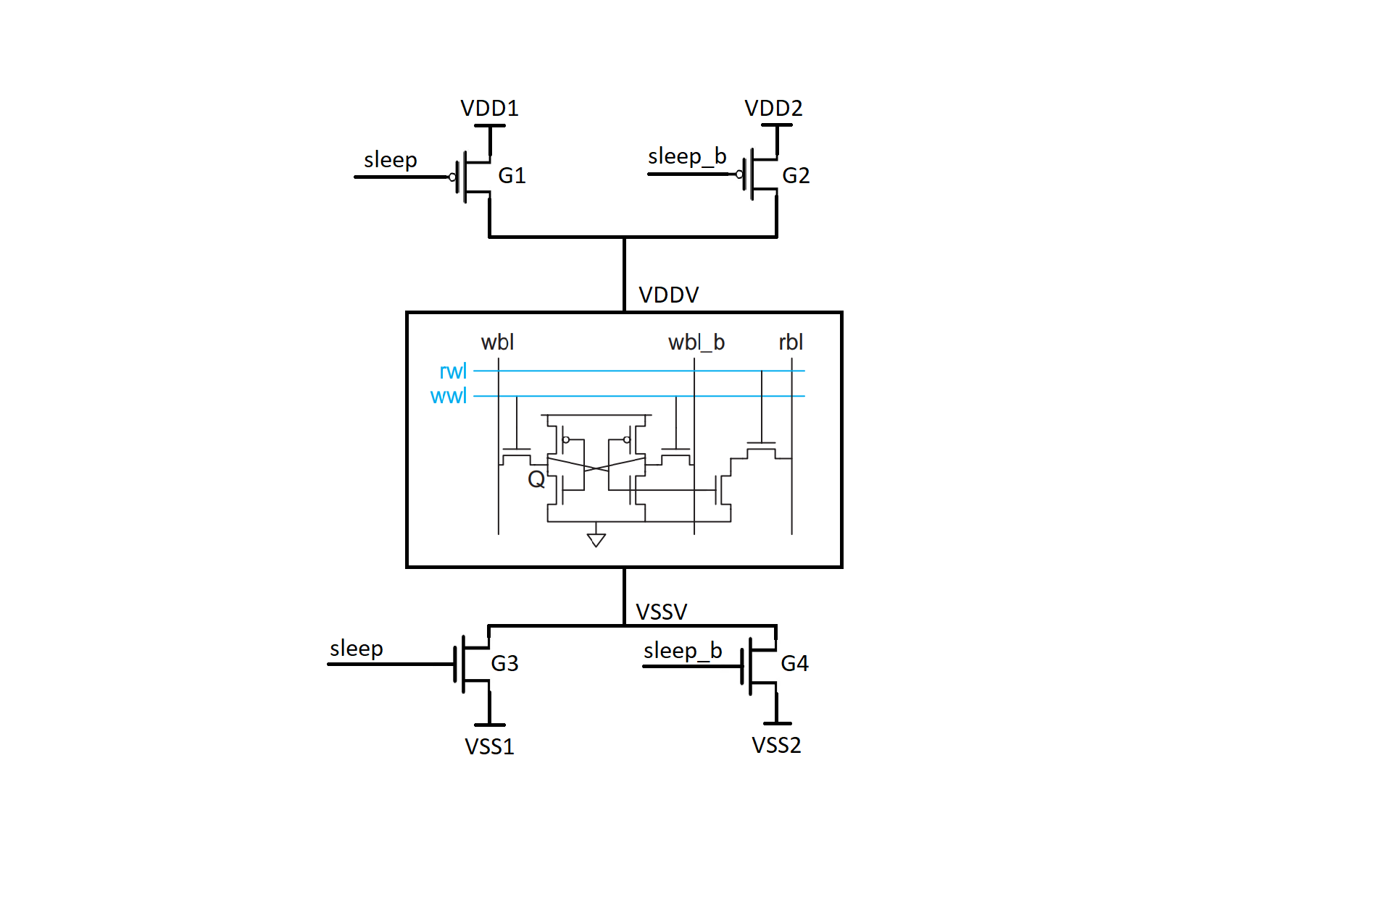
2. THEORETICAL BASIS
e.Proposed Power-gated SRAM Designs
VDDV and VSSV are virtual power supply for the power gated designs. The power supplied to the gated cell will be from the voltage VDDV – VSSV applied to the cell.
VDDV is provided by two Power gating transistor switches G1 and G2. VDD1 = 1V and VDD2 = 0.5V.
VSSV is provided by two Power gating transistor switches G3 and G4. VSS1 = 0V and VSS2 = 0.3V.
When the cell is selected for write or read operation, the voltage applied to the cell will be VDD1 – VSS1 = 1V. When the cell is not selected, the voltage applied to the cell will be VDD2 – VSS2 = 0.2V. The reason for the low voltage instead of 0V at hold state is to limit power leakage.
DESIGN AND EVALUATION OF LOW POWER SRAM

Slide 17
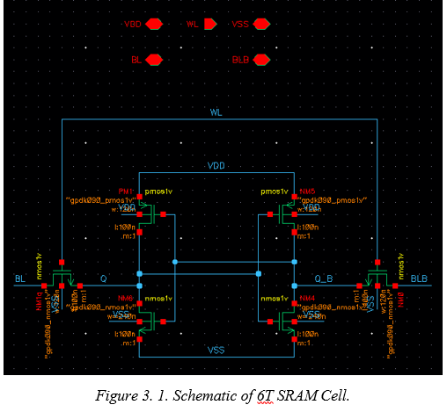
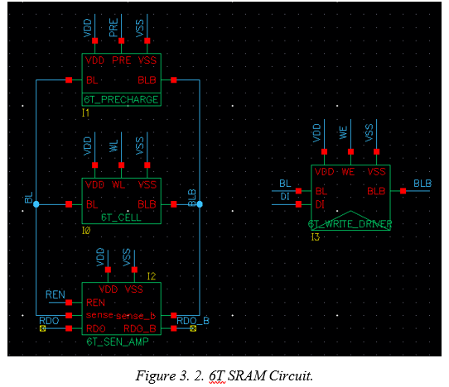
3. SIMULATION
1. Conventional 6T SRAM
DESIGN AND EVALUATION OF LOW POWER SRAM

Slide 18
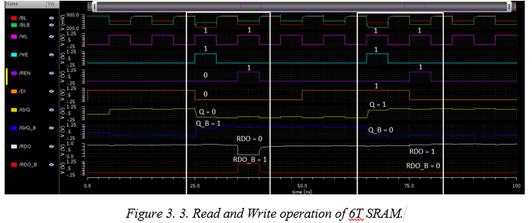
3. SIMULATION
1. Conventional 6T SRAM
DESIGN AND EVALUATION OF LOW POWER SRAM

Slide 19
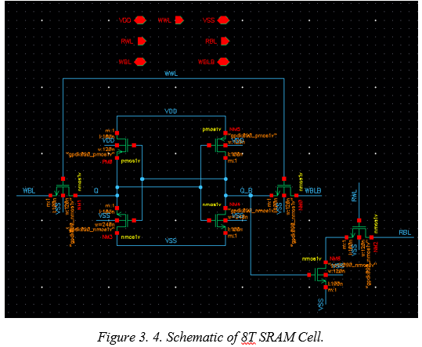
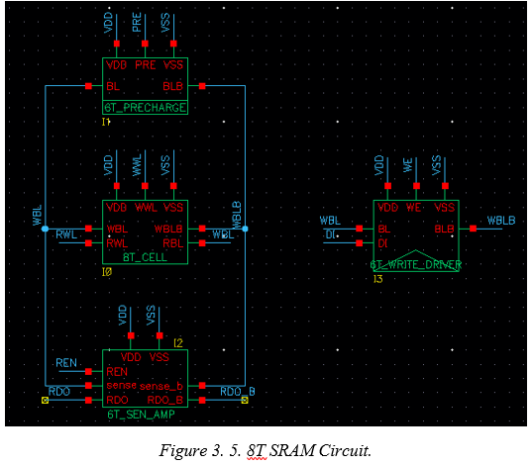
3. SIMULATION
2. Conventional 8T SRAM
DESIGN AND EVALUATION OF LOW POWER SRAM

Slide 20
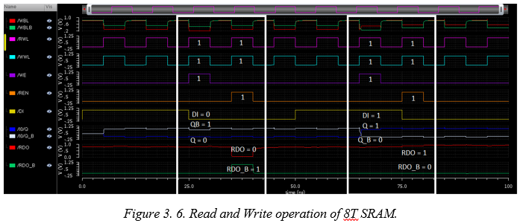
3. SIMULATION
2. Conventional 8T SRAM
DESIGN AND EVALUATION OF LOW POWER SRAM

Slide 21
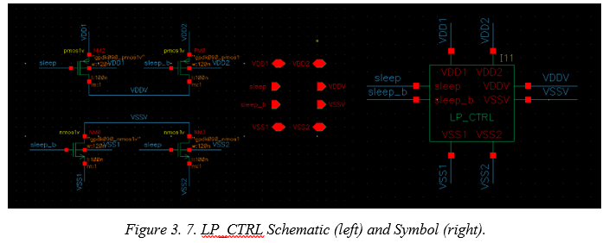
3. SIMULATION
3. Control Circuit
DESIGN AND EVALUATION OF LOW POWER SRAM

Slide 22
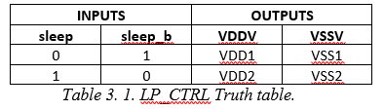
3. SIMULATION
3. Control Circuit
As presented in “Power Gating”, when the control circuit receives a sleep signal, it will isolate the SRAM Cell from the VDD = 1V and VSS = 0V power source and is instead connected to VDD2 = 0.5V and VSS2 = 0.3V to limit power dissipation. When there is no sleep signal, the SRAM is connected to VDD1 = 1V and VSS1 = 0V as usual.
DESIGN AND EVALUATION OF LOW POWER SRAM

Slide 23
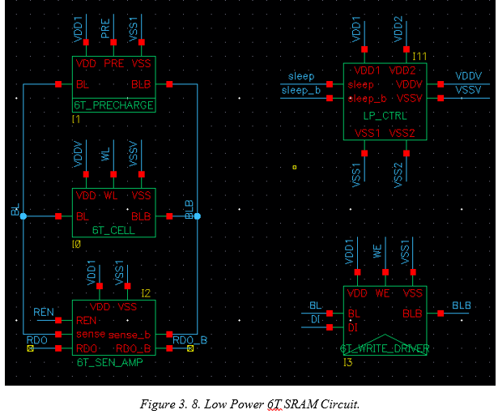
3. SIMULATION
4. Low Power 6T SRAM
DESIGN AND EVALUATION OF LOW POWER SRAM

Slide 24
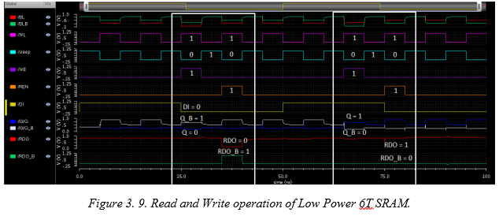
3. SIMULATION
4. Low Power 6T SRAM
DESIGN AND EVALUATION OF LOW POWER SRAM

Slide 25
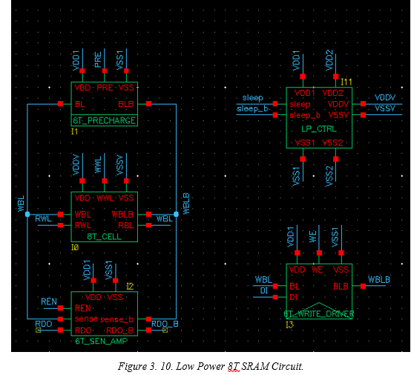
3. SIMULATION
5. Low Power 8T SRAM
DESIGN AND EVALUATION OF LOW POWER SRAM

Slide 26
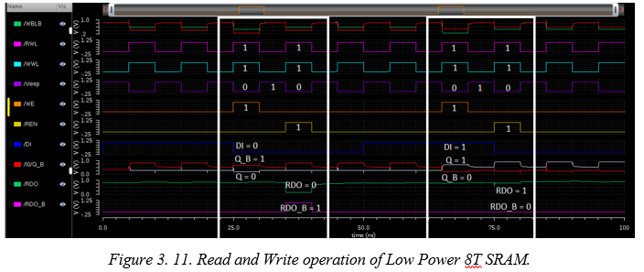
3. SIMULATION
5. Low Power 8T SRAM
DESIGN AND EVALUATION OF LOW POWER SRAM

Slide 27
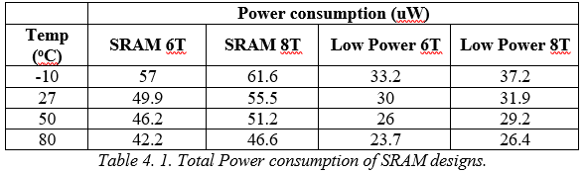
4. EVALUATION
1. Power consumption
Low Power designs of both the 6T and 8T SRAM proved to be very effective, nearly halving their total power. Especially Static power is lowered by a whole order of magnitude (E-05 of Conventional design to E-06 of Low Power design).
Very viable for implementation in real life work.
DESIGN AND EVALUATION OF LOW POWER SRAM

Slide 28
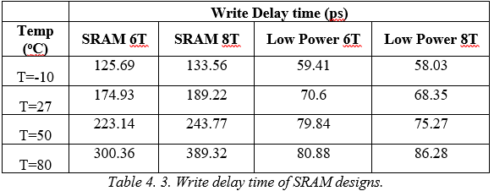
4. EVALUATION
2. Delay
Write delay:
Conventional 6T and 8T has the highest write delays.
Low power designs have significantly lower delay, a very big advantage.
DESIGN AND EVALUATION OF LOW POWER SRAM

Slide 29
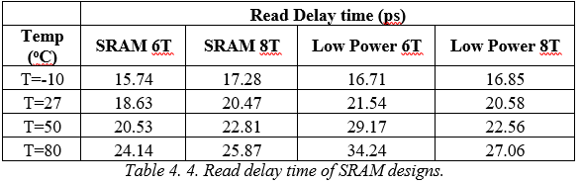
4. EVALUATION
2. Delay
Read delay:
- Low Power SRAM designs have much lower Write delay but slightly higher values in Read delay.
DESIGN AND EVALUATION OF LOW POWER SRAM

Slide 30
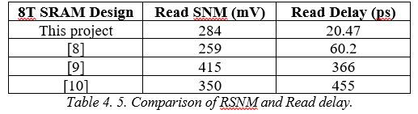
4. EVALUATION
3. Comparision with other works
The conventional 8T SRAM design of this project yielded both higher RSNM and lower Read delay time (3x lower than [8] and more than 15x lower than [9] and [10]).
This can be a very big advantage for computers that are utilized in applications such as image and video processing and decoding.
DESIGN AND EVALUATION OF LOW POWER SRAM

Slide 31
5. CONCLUSION
1. Conclusion and Evaluation
This project has presented designs of the 6T and 8T SRAM and their Low Power counterparts.
Read and Write operations simulated using the Cadence Virtuoso Design Suite on the 90nm TSMC process node.
Performance of the designs, which includes Power consumption and Delay, are evaluated under different temperatures.
This project concludes that the Low Power designs proved to be successful in:
Conserving power, cutting power dissipation by more than 2x.
Reducing Write and Read delay time.
Lower Read SNM and Read delay time compared to various other researches and papers.
DESIGN AND EVALUATION OF LOW POWER SRAM

Slide 32
5. CONCLUSION
2. Future development
Research and implement more SRAM cell variants like 4T, 7T, 9T, 10T, etc…
Develop entire memory array to be further implemented in other works such as CPU, DPU and other processes that utilize Cache memory.
Research on SRAM cell layout and area to properly assess area usage by different types of SRAM.
Utilize more power-saving techniques like Clock-gating, Dynamic Voltage Scaling, etc…
Implement designs on smaller technology nodes like 45nm, 22nm, 14nm, etc…
DESIGN AND EVALUATION OF LOW POWER SRAM

Slide 33
REFERENCES
William Stallings, “Computer Organization and Architecture – 11th Edition”- page 182, Pearson, 2022.
Neil H. E. Weste, David Money Harris, “CMOS VLSI Design, A Circuits and Systems Perspective – 4th Edition”, Pearson, 2010.
Sharma, V., Gopal, M., Singh, P., & Vishvakarma, S. K. (2018). A 220 mV robust read-decoupled partial feedback cutting based low-leakage 9T SRAM for Internet of Things (IoT) applications. AEU-International Journal of Electronics and Communications, 87, 144-157.
Fujiwara, H., Nii, K., Noguchi, H., Miyakoshi, J., Murachi, Y., Morita, Y., ... & Yoshimoto, M. (2008). Novel video memory reduces 45% of bitline power using majority logic and data-bit reordering. IEEE transactions on very large scale integration (VLSI) systems, 16(6), 620-627.
Singh, Jawar, et al. "A single ended 6T SRAM cell design for ultra-low-voltage applications." IEICE Electronics Express 5.18 (2008): 750-755.
Qazi, Masood, Mahmut Sinangil, and Anantha Chandrakasan. "Challenges and directions for low-voltage SRAM." IEEE design & test of computers 28.1 (2010): 32-43.
Singh, Vijay, Sanjay Kumar Singh, and Raman Kapoor. "Static noise margin analysis of 6T SRAM." 2020 IEEE International Conference for Innovation in Technology (INOCON). IEEE, 2020.
Khoa, P. V., & Thông, N. D. (2022) "Phân tích hiệu năng của các thiết kế SRAM trên công nghệ TSMC 90nm CMOS." Tạp chí Khoa học và Công nghệ-Đại học Đà Nẵng (2022): 26-31.
Mittal, Deepak, and V. K. Tomar. "Performance Evaluation of 6T, 7T, 8T, and 9T SRAM cell Topologies at 90 nm Technology Node." 2020 11th International Conference on Computing, Communication and Networking Technologies (ICCCNT). IEEE, 2020.
Sil, Abhijit, Soumik Ghosh, and Magdy Bayoumi. "A novel 90nm 8T SRAM cell with enhanced stability." 2007 IEEE International Conference on Integrated Circuit Design and Technology. IEEE, 2007.
DESIGN AND EVALUATION OF LOW POWER SRAM

Slide 34
END OF PRESENTATION

