Slide 1

HackFindr
Find every
event near you
AI-powered student event finder built with Gemma 4
Team Roblox
Rashmit Paroch · Naina Mishra · K. Lochan
Vivan Goel · Divyansh Bhandary

Slide 2

1
Scattered everywhere
Events live across Unstop, Devpost, WhatsApp groups and paper posters.
The Problem
2
No “near me” search
Why students miss events
No platform answers what is happening nearby, by distance.
3
Messy event pages
Eligibility and requirements are buried in long pages.
4
Posters stay offline
Events announced on posters never reach online platforms.

Slide 3






The Solution: CampusEvents
380+ events, one list
Map by distance
Gemma 4 summaries
Live events from Unstop and Devpost: hackathons, workshops, ideathons.
Enter a city and radius; nearby offline events appear as pins.
Long pages become a short summary, eligibility and requirements.
Poster to event
AI agent
Smart filters
Snap a poster; Gemma 4 reads it, you check, it lands on the map.
“Hackathons within 200 km of Raipur” → tool calls → register links.
Hackathons · Workshops · Free · This week · Open to 1st year.

Slide 4

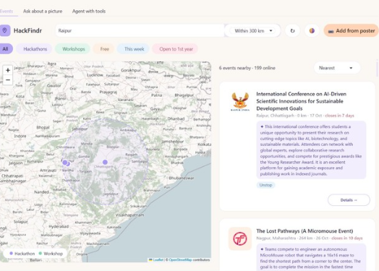


The Product
Poster to event
Map, list and details: on desktop and phone
The Gemma 4 vision feature
Snap the poster
Photo upload or phone camera
Gemma 4 reads it
Name, date, venue, eligibility, link
You review
Edit any field before saving
Added to the map
Geocoded and pinned for everyone

Slide 5






Technical Approach
Tech Stack
How data flows from sources to the student
AI model
Gemma 4 (26b-a4b-it) via Gemini API
Unstop + Devpost
public APIs
Normalize
one event schema
Geocode cities
Nominatim, cached
Backend
Python, requests, BeautifulSoup
Gemma 4: summarize details
summary · eligibility · requirements
UI
Gradio, desktop + phone
Maps
events.json
Folium / Leaflet + OSM
Geocoding
geopy + Nominatim, cached
Map + distance
haversine radius
AI agent
search_events · get_event_details
Poster upload
Gemma 4 vision → review → map
Reliability
Retries, cache, offline fallback

Slide 6
Feasibility and Viability
A working prototype already runs on one laptop
380
168
100
Challenge | How we handle it
APIs change or block | Each source fails alone; retries + saved-data fallback
AI rate limits and cost | Summaries cached, made once per event
AI misreads posters | User reviews and edits before saving
Geocoding 1 req/sec | City locations cached permanently
Fake or spam events | Moderation for poster uploads (planned)
events collected
pinned on the map
summarized by Gemma 4
Free and open tools
OpenStreetMap, open Gemma model, Python. No special hardware.
Scaling plan
Scheduled fetching, a database instead of JSON, summaries on first view, and a mobile app with push alerts.

Slide 7




Impact and Benefits
For students
Find nearby events in seconds. Tier-2/3 students (Raipur, Bhilai) stop missing out. Free and 1st-year filters widen access.
For colleges and organisers
Poster events get free online reach with one photo, and wider participation.
For society
Supports NEP 2020, Digital India and Startup India; narrows the metro vs non-metro awareness gap.

Slide 8
Research and References
Gemma 4 on the Gemini API
Unstop
ai.google.dev/gemma/docs/core/gemma_on_gemini_api
unstop.com
Devpost
OpenStreetMap / Nominatim
devpost.com
nominatim.org
Folium
Gradio
python-visualization.github.io/folium
gradio.app
Haversine formula
Project repo
Straight-line distance on Earth
github.com/lochan28/iit_bhilai

