Slide 1
An Analysis on Suicidal Tendencies Based on Socio-economic Information of Different
Cohorts Gathered From 1985 to 2016
Team - 404
Submitted By:
209323R Fernando M.L.M
209327H Gunarathna T. M. T .A
209324V Galagoda R.R.N.P.A.B.W.M.P.A

Slide 2
Objectives
Validating a trend of suicidal tendency by,
● Socio-economic status of different cohorts
● Different age groups and gender of victims
● Population of each country by year
● HDI of each country by year

Slide 3
Challenges
● Identifying inconsistencies in the dataset. (missing data in some countries for a certain period of time).
● Preprocessing and removing duplicate or redundant data in the dataset.
● Managing resources for processing and manipulating the dataset.
● Filling the gaps in missing features of the selected dataset.

Slide 4
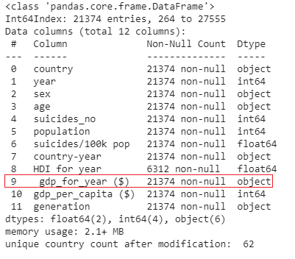
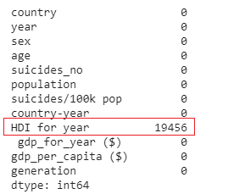
Data Pre Processing
Data Validity - Adhere to data type constraints - Converting the relevant columns correct format.
Data Completeness - Remove the columns with not enough data and remove countries having records less than the Q3 of the total number of records.

Slide 5
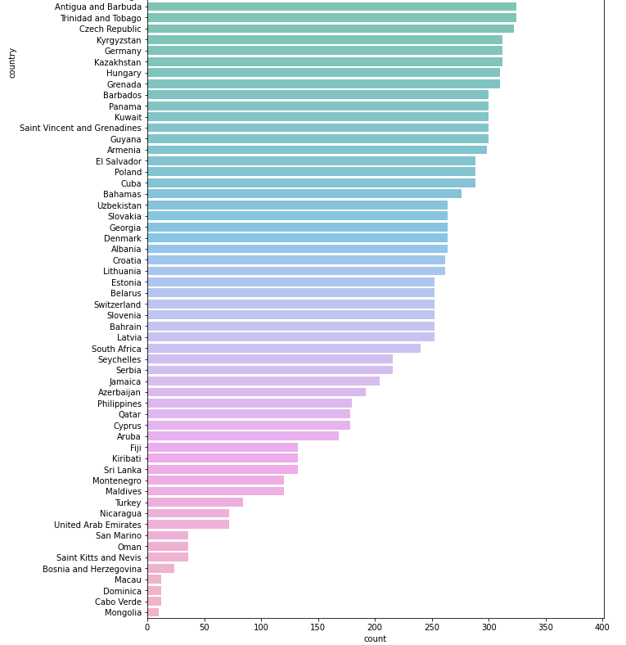
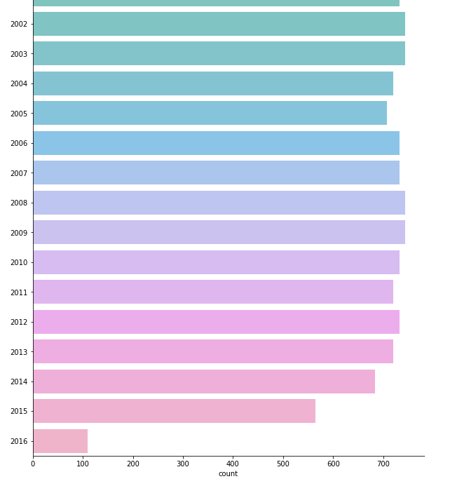

Slide 6
This analysis is based on Gartner’s Maturity model
Descriptive Analysis : Quartiles, Mean and Visualization
Diagnostic Analysis : Pearson's correlation coefficient and
Spearman's rank correlation coefficient
Predictive Analysis : Historical value based prediction and ARIMA forecast model
Let Us Look at Each Type of Analysis....

Slide 7
Descriptive Analysis

Slide 8
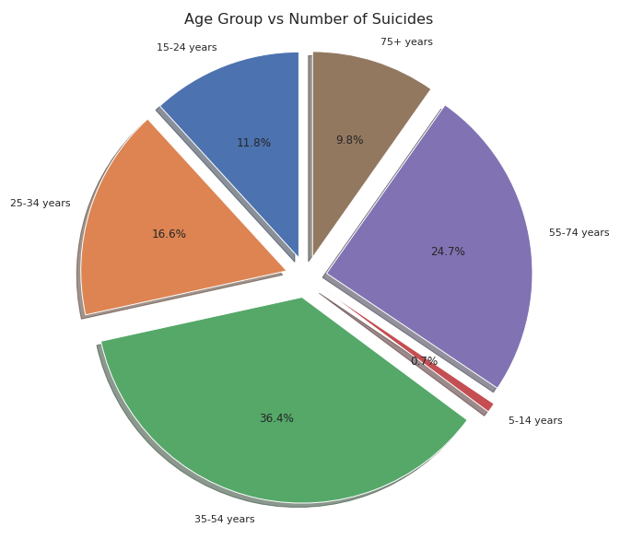
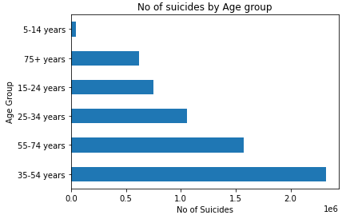
Number of Suicides Vs Age Group
Reflection : Most victims are from the age group 35 - 54 years

Slide 9
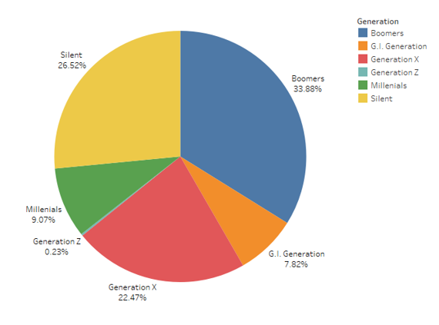
Suicidal Tendencies with Victim’s Generation
Generations vs Number of Suicides
G.I. Generation - Born between 1901 and 1927
Silent - Roughly from the mid-1920s to the mid-1940s
Boomers - Born between 1946 and 1964
Generation X - Early 1960s to late 1970s
Generation Z – Born 1995 to 2010
Millennials - Reaching young adulthood in the early 21st century
Reflection : Most victims are from the Boomers Generation

Slide 10
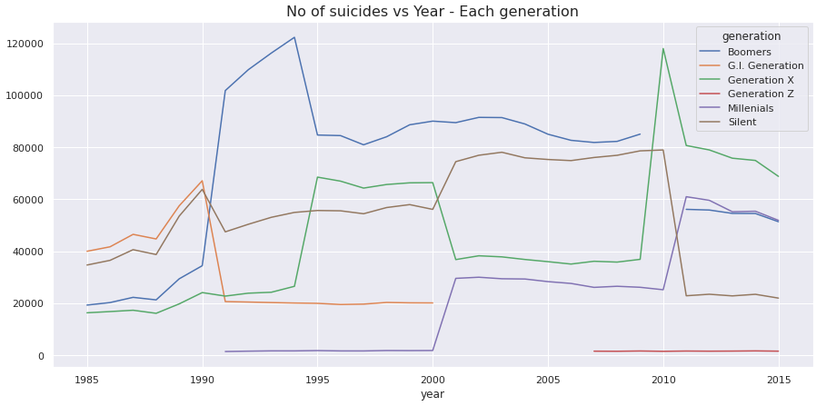
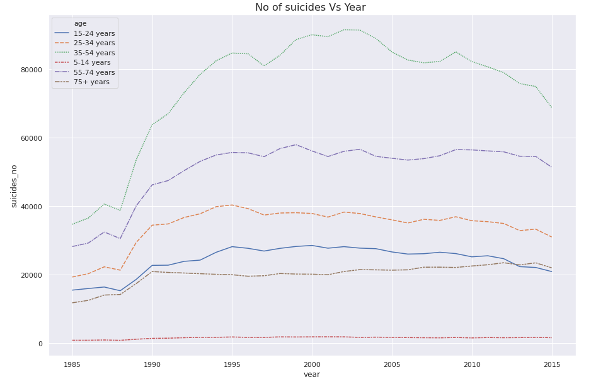
Reflection : During 90 - 95 boomer suicidal rate has been increase significantly
Reflection : All the age groups have similar patterns in suicidal rates except for category 35-54

Slide 11
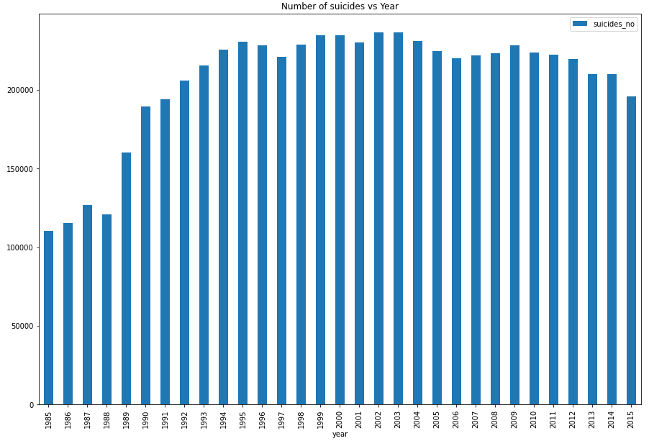
Number of Suicides vs Year
Reflection : No dramatic change in total number suicides across the world

Slide 12
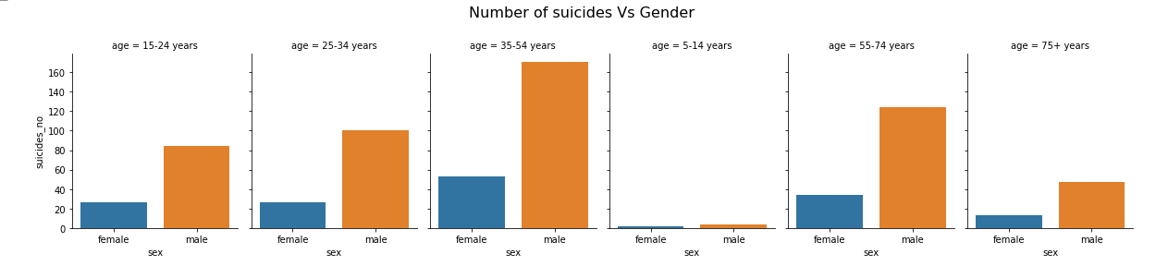
Suicidal Rates Vs Gender
Reflection : Suicide is more prevalent among men, whereas nonfatal suicidal behaviors are more prevalent among women
Notes:
Add another point

Slide 13
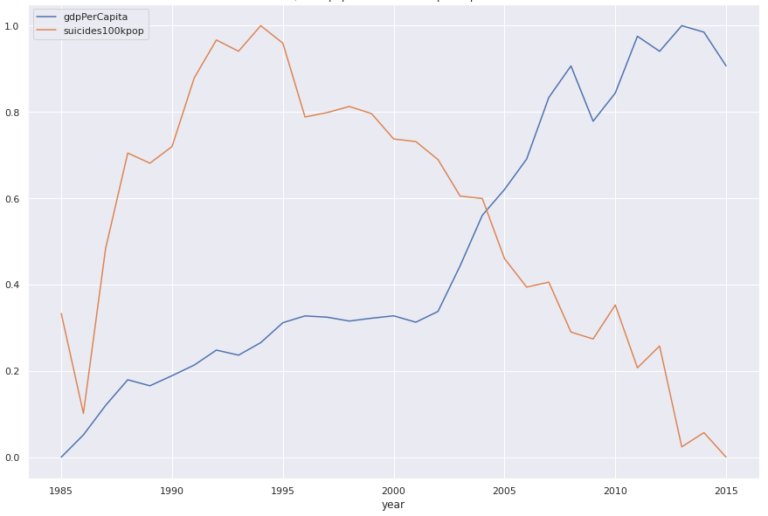
How Gross Domestic Product Effected on Number of Suicides/100K Population
Reflection : GDP Per Capita and Suicides seems to be correlated ,
this will be verified through diagnostic analysis

Slide 14
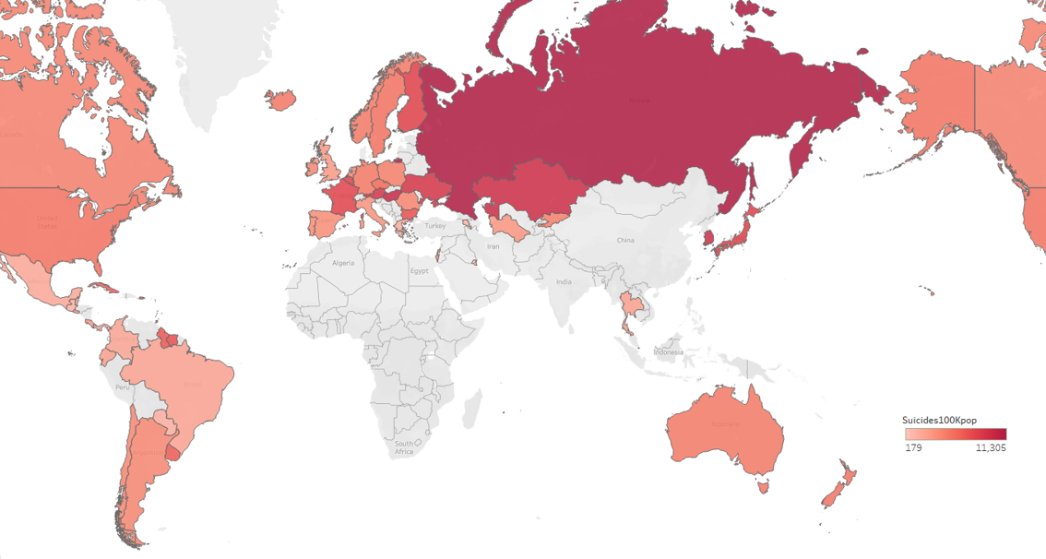
Heat Map For Country Vs Suicides/100K per population

Slide 15
Diagnostic Analysis

Slide 16
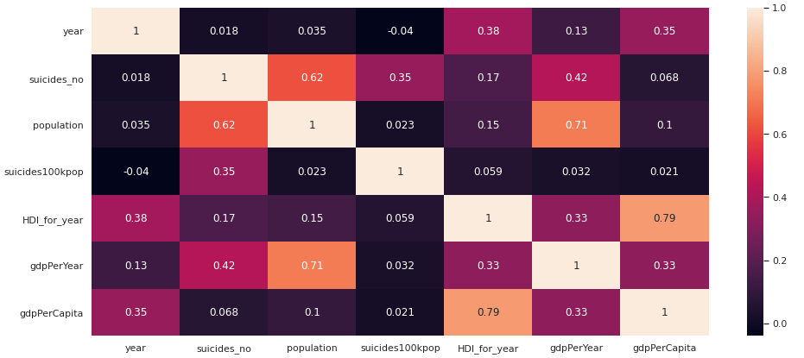

Slide 17
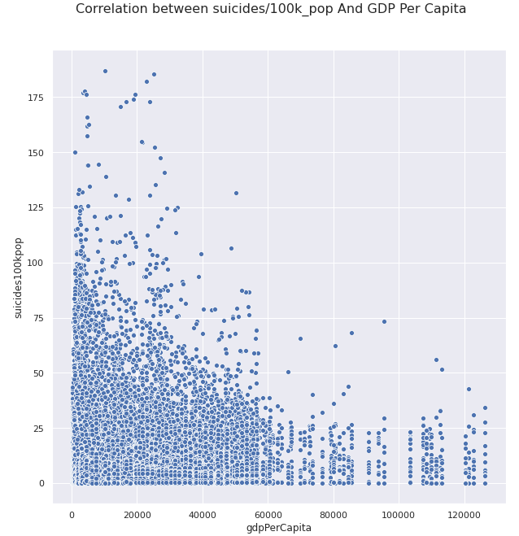
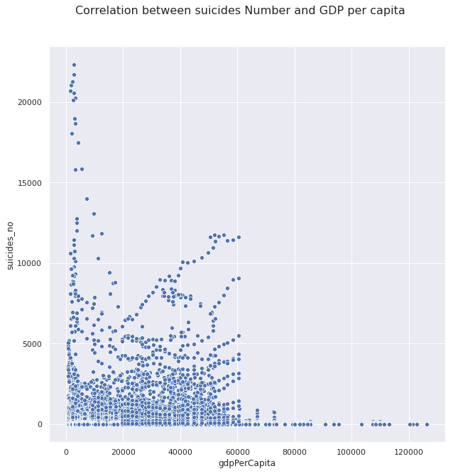
Reflection : GDP Per Capita and Suicides seems to be correlated ,
this will be verified through diagnostic analysis

Slide 18
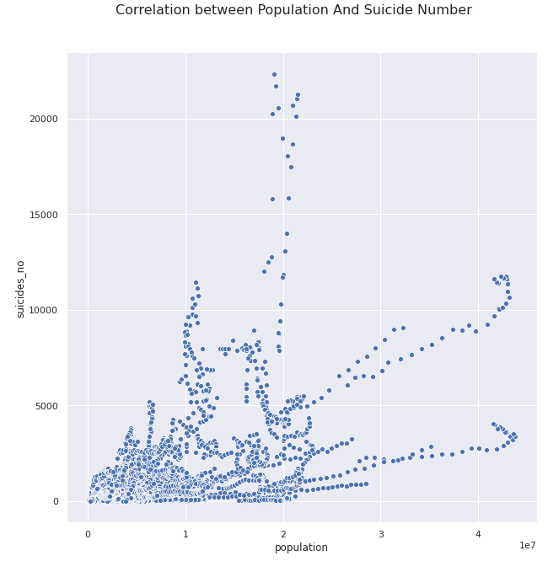
gdp_per_capita & suicide_no
Pearsons correlation: 0.068
Spearmans correlation: 0.149
gdp_per_capita & suicides100kpop
Pearsons correlation: 0.021
Spearmans correlation: 0.088
population & suicide_no
Pearsons correlation: 0.619
Spearmans correlation: 0.789
Reflection : GDP Per Capita and Suicides are not correlated as we expected but population and suicides shows a positive correlation

Slide 19
Predictive Analysis

Slide 20
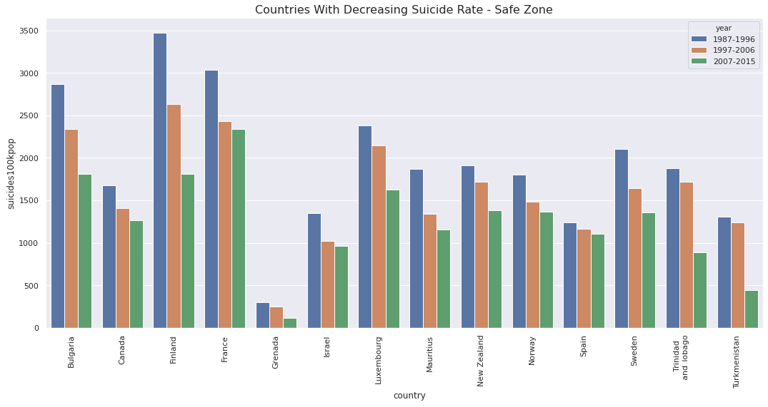
As the last part of our analysis we predict two sets of countries as Safe Zone countries and Danger Zone countries.
The safe zone countries are the countries having a decreasing rate of suicides over the last three decades.

Slide 21
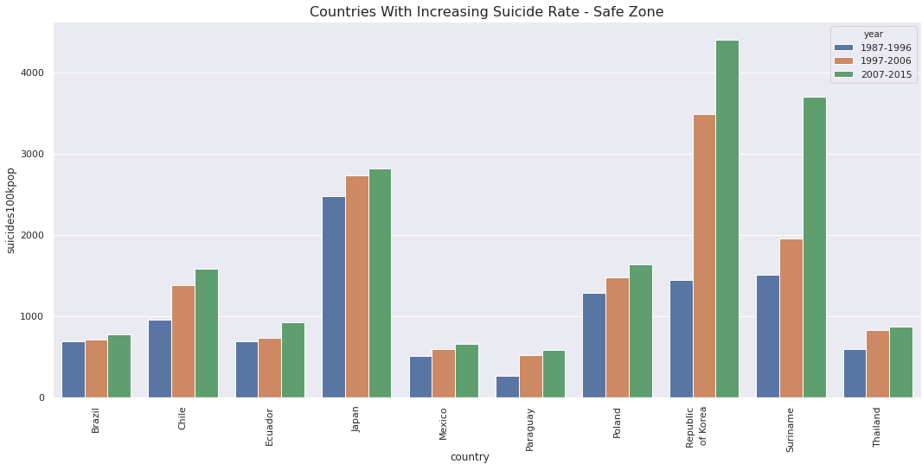
The countries with an increasing suicidal rate for three successive decades are grouped as danger zone countries.

Slide 22
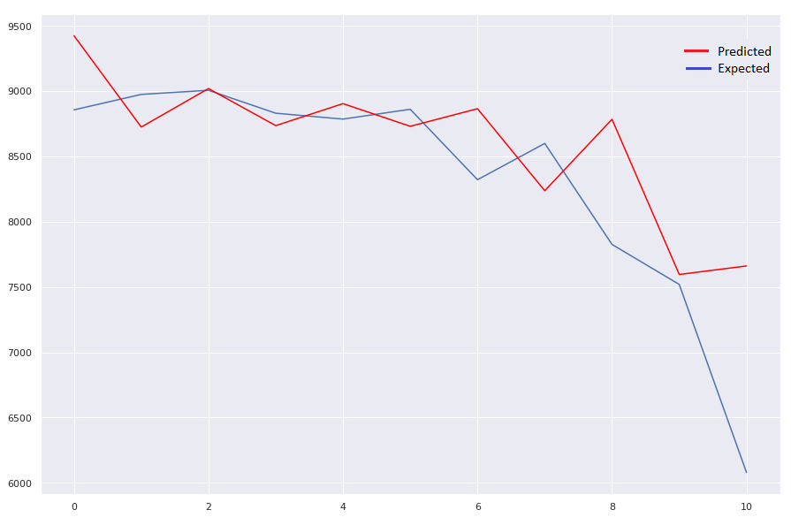
To predict the number of suicides in the coming years, we have used a Auto Regressive Integrated Moving Average (ARIMA)
The mean squared error of the predictions was 388684.863.

Slide 23
Conclusions
Suicide is more prevalent among men, whereas nonfatal suicidal behaviors are more prevalent among women.
Most victims are from the age group 35 - 54 years
Most victims are from the Boomers Generation
No positive correlation was observed between GDP and the suicides, but observed that the population and the suicides are correlated
HDI was not used for the analysis due to incompleteness.
Predictions about suicidal rate can be made by using forecate models.
Eg: time series analysis by using ARIMA, with a mean squared error of 388684.863 wrt our example.

Slide 24
Thank You

