Slide 1
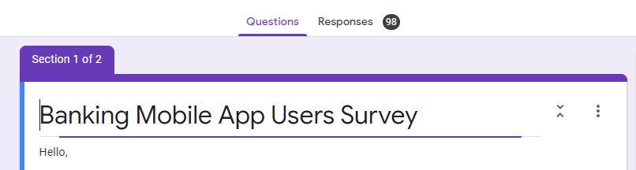
Mobile Banking App User Survey
M.L.M Fernando - 209323R

Slide 2
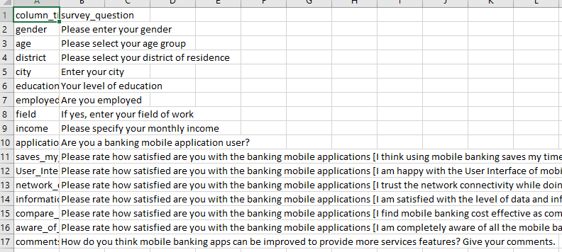
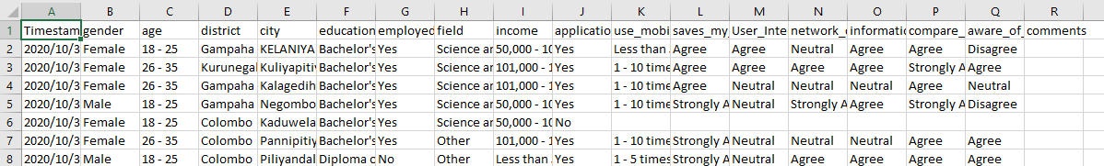
Collecting data from users
98 Responses
Descriptive analysis

Slide 3
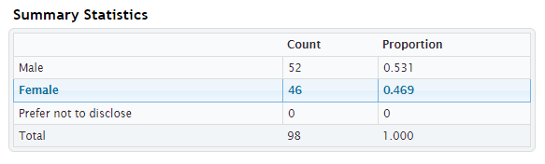

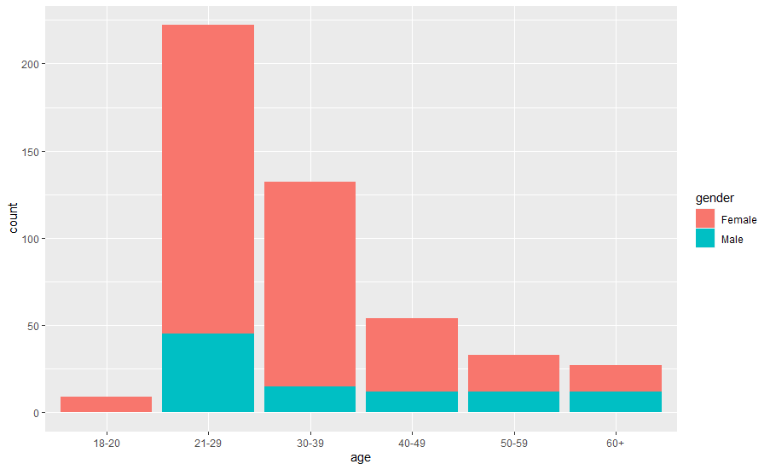
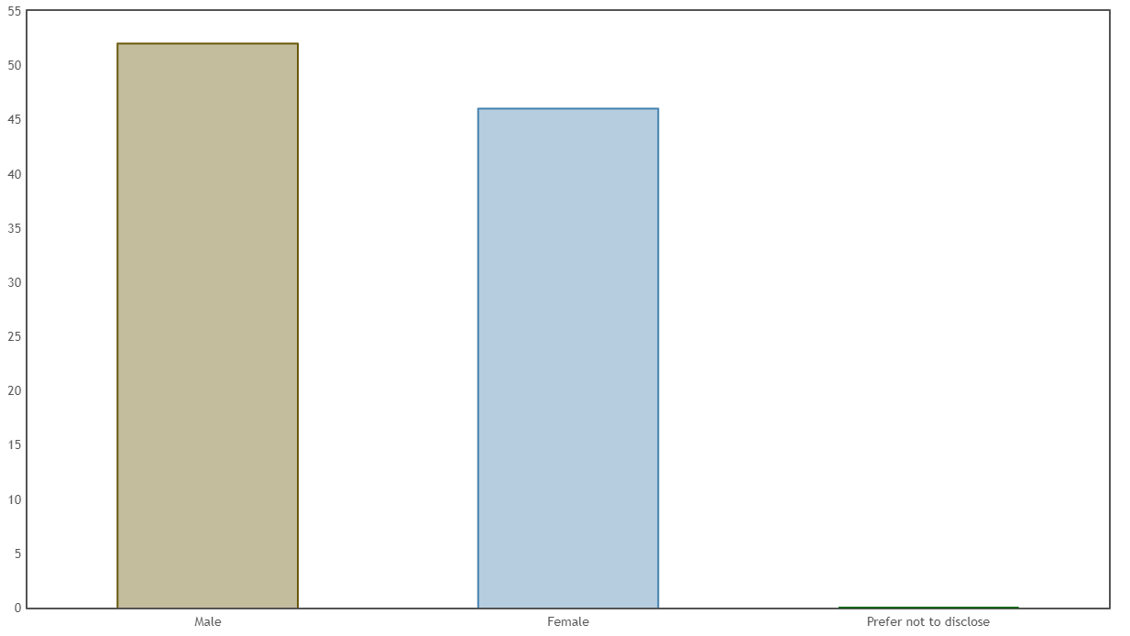
Exploratory Data Analysis

Slide 4
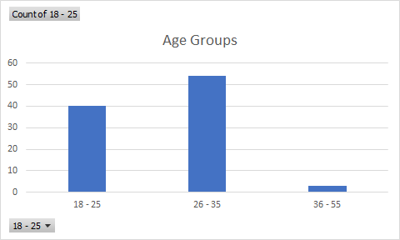
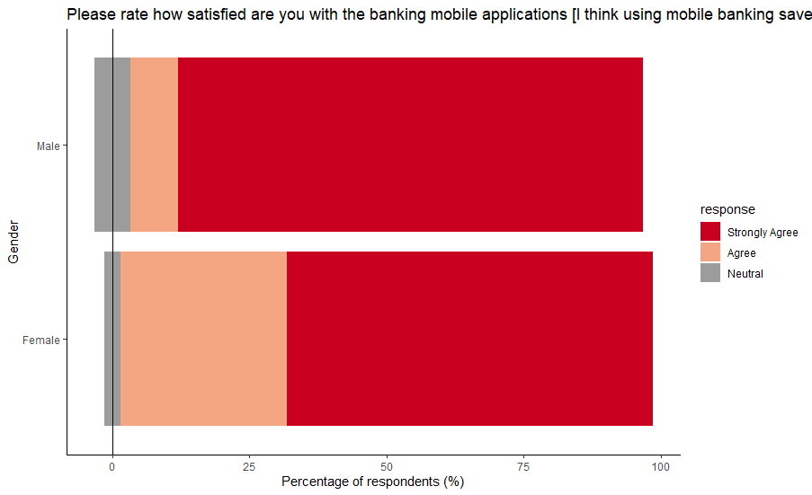
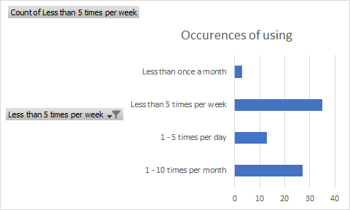

Slide 5
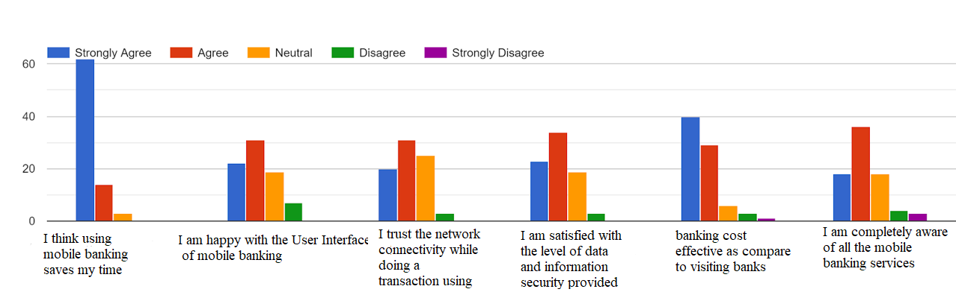

Slide 6
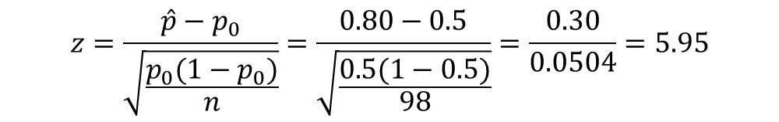
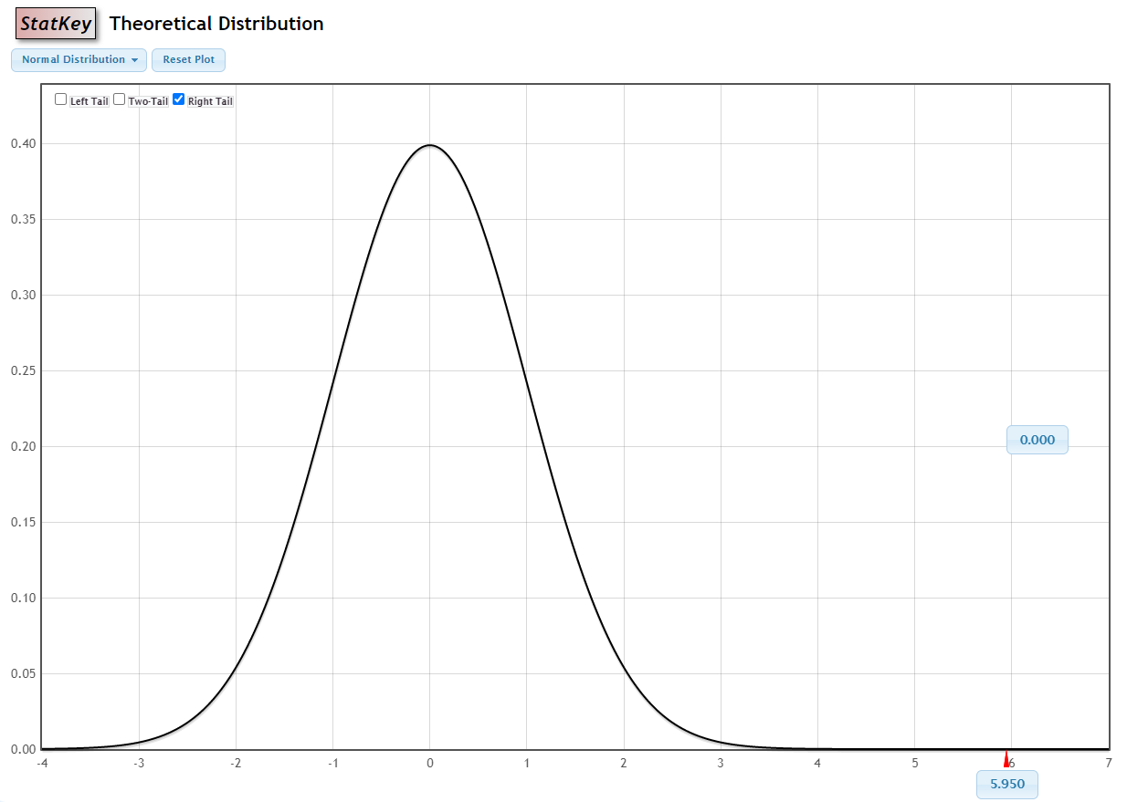
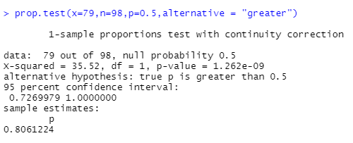
Conducted survey of 98 individuals and found that 80% responded yes to using of mobile bank applications. If we consider 98 individuals as a representative sample of all individuals in Sri Lanka context, is this evidence the using 50% of mobile bank application by individual
Test for a single proportion
H₀ : P = 0.5
H_{A} : P > 0.5
Since the P-value (0.00001) is less than the significance level (0.05), we cannot accept the null hypothesis.
Based on this data, there is more than 50% of chance an individual using mobile bank application.

Slide 7
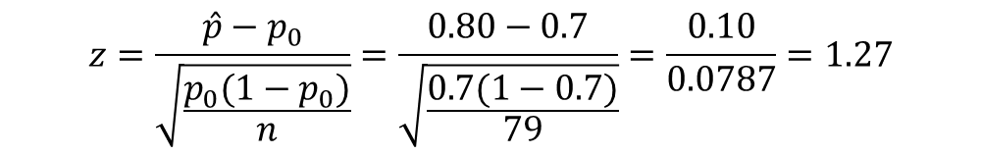
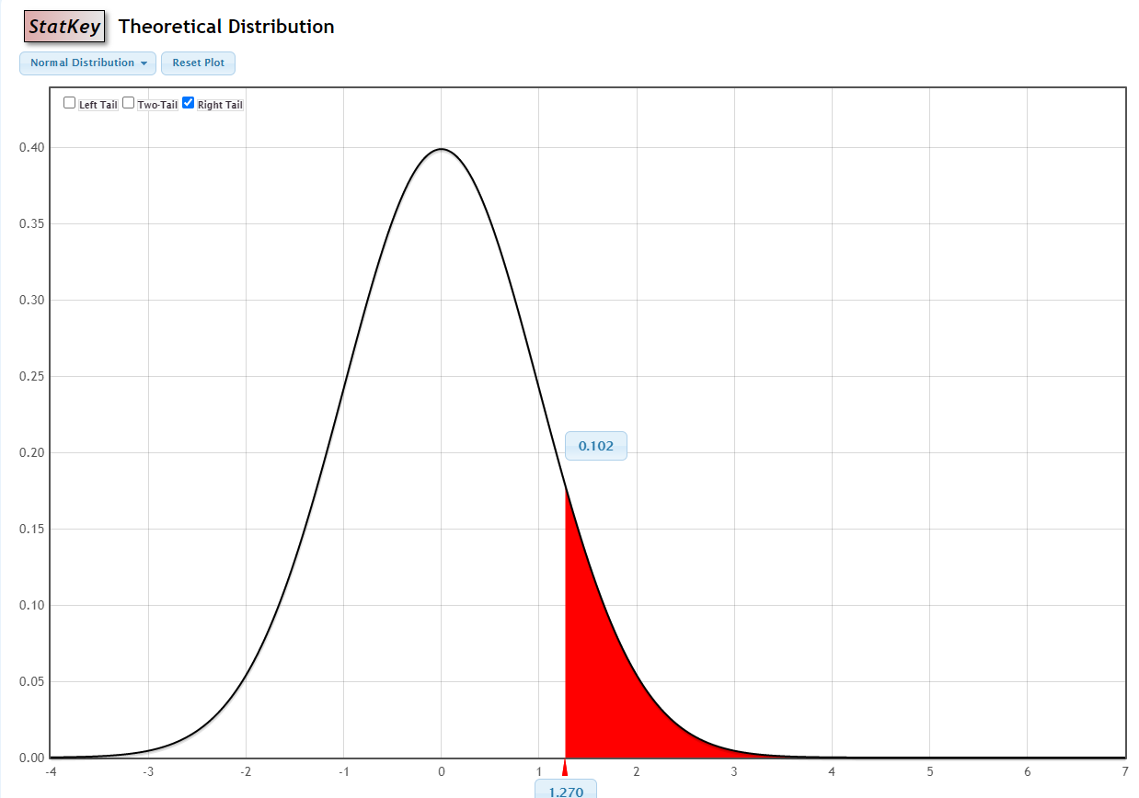
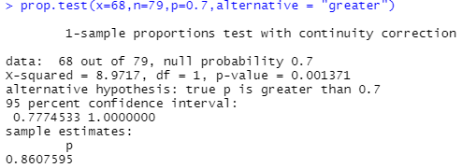
Conducted survey of 79 individuals who using mobile bank applications and found that 86% responders are employed. If we consider 79 individuals as a representative sample of all individuals in Sri Lanka context, is this evidence the using 70% of mobile bank application by employed individual
H₀ : p = 0.7
H_{a} : p > 0.7
Since the P-value (0.102042) is greater than the significance level (0.05), we can accept the null hypothesis.
Based on this data, there is 70% of chance a Sri Lankan using mobile bank application being employed.

Slide 8

Chi-squared
To test if there is a statistically significant correlation between gender and saving time (likert scale)
chisq.test(sust_data$gender, sust_data$sustainability_daily_think)
Pearson's Chi-squared test
data: sust_data$gender and sust_data$saves_my_time
X-squared = 6.3416, df = 2, p-value = 0.04197
The output value can be used to interpret the outcome of the chi-squared test, with a lower p-value indicating a greater probability that the two variables are dependent on each other. In this case, p = 0.04197, which is lower than the conventional threshold of 0.05, meaning we can reject the null hypothesis that gender does not correlate with the frequency at which people think about saving the time.
H0 : saving time using mobile application is not associated with gender
Ha : saving time using mobile application is associated with gender

Slide 9
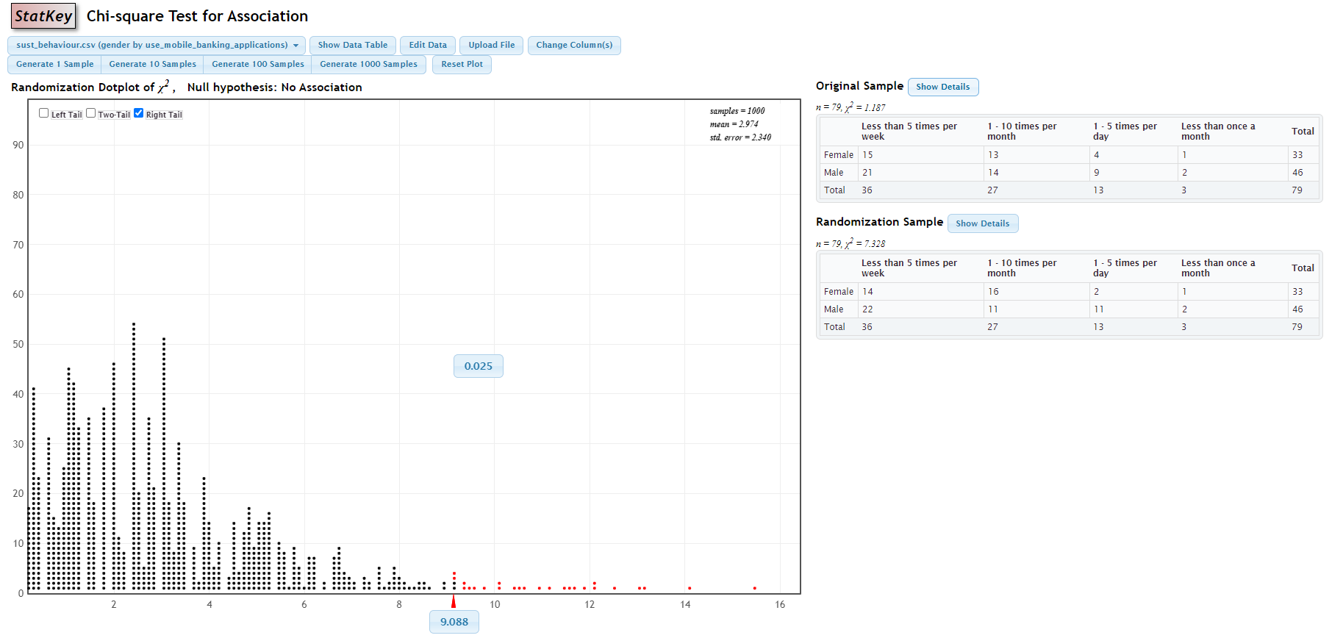

Slide 10
User Comments
UI and customer convenience has to improve drastically in the context of Sri Lankan banking industry
Has to improve user friendly interface and the security
Mobile banking apps can use biometrics to access the application. It can allow users to personalize their application and have more shortcuts to access the main functionalities in the application.
They Should add all the banks and all the service.

Slide 11
Thank You

