Slide 1

Distribution-free Lifetime Estimation Method for Highly Reliable Products with Random Effects
Lochana Palayangoda, PhD
Assistant Professor of Data Science and Statistics
Department of Mathematical and Statistical Sciences
University of Nebraska at Omaha
October 2024
ICONEST 2024

Slide 2





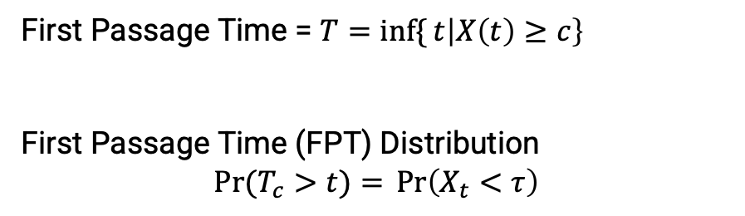


Highly reliable products last for long time but their performance subject to degradation over time
Year 0
Year 1
Year 2
Year 3
Degradation Data ➔ Estimate the Lifetime
First Passage Time = $T=\inf{\{}t\left|X\left(t\right)≥c\right\}$
First Passage Time (FPT) Distribution
$$\operatorname{Pr}{(T_{c}>t)}={\operatorname{Pr}\left(X_{t}<τ\right)}$$
Threshold ($τ$)
Light Output Degradation ($X_{t}$)
Experiment limit
$$T_{c}$$
Time
2
2

Slide 3
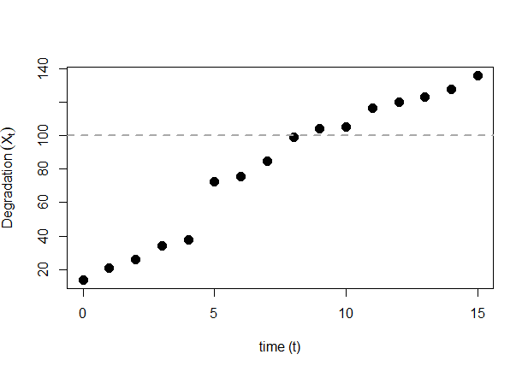


Parametric Lévy process based stochastic models are generally used for degradation modeling
Gamma process
$$X_{t}\text{\sim } \text{Gamma}\text{(}αt,ν\text{) }$$
𝑋_𝑡 "~ Gamma(" α𝑡,ν") "
Inverse Gaussian (IG) process
$$X_{t}\sim \text{Inverse} \text{Gaussian}\text{(}μt, λt^{2}\text{)}$$
𝑋_𝑡~" Inverse Gaussian(" μ𝑡, λ𝑡^2 ")"
$$ΔX_{t}$$
$$Δt_{0}$$

Slide 4
Fixed Effect versus Random Effect Random effect (heterogeneity) modeling accounts for unit-to-unit variability
Degradation
Degradation
Time
Unit 1
Time
Fixed Effect
Random Effect
Unit 2

Slide 5
Studies on Degradation Data with Random effects
Gamma Process with Random effects
Inverse Gaussian Process with Random Effects
Nonparametric methods with Random Effects
Lawless and Crowder (2004); Tsai et al. (2012)
Peng (2015)
Balakrishnan and Qin (2020)

Slide 6
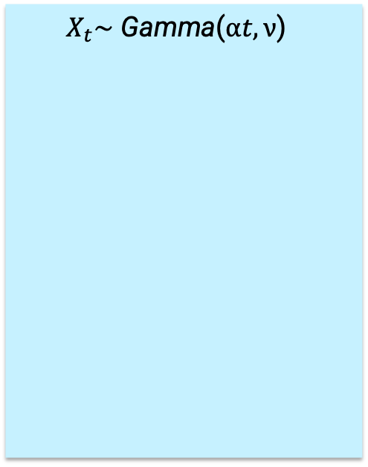
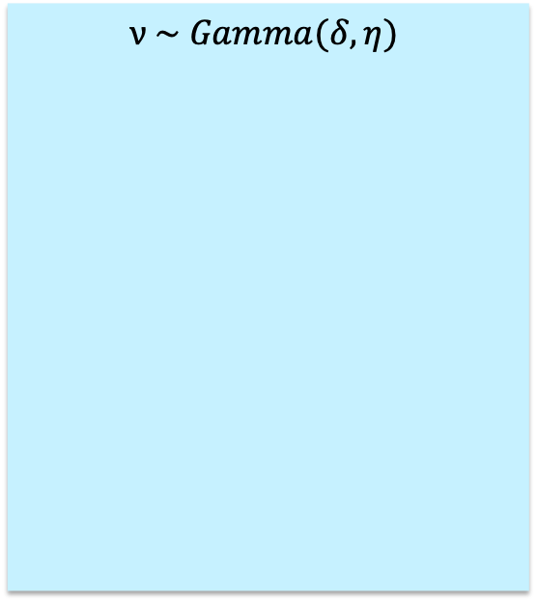

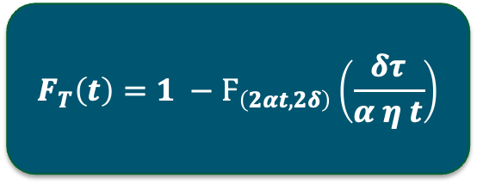

Gamma Degradation Process with Random Effects
$$X_{t}\text{\sim } \text{Gamma}\text{(}αt,ν\text{) }$$
$$ν \sim Gamma(δ, η)$$
First Passage Time (Failure Time) Distribution with Threshold Level $τ$
Gamma Process
Assume the rate parameter follows a probability distribution
$$F_{T}\left(t\right)=1 −Ϝ_{\left(2αt, 2δ\right)}\left(\frac{δτ}{α η t}\right)$$
Notation:
$Ϝ_{\left(a, b\right)}$ is the F-distribution with degrees of freedom a and b
Lawless and Crowder (2004); Tsai et al. (2012)

Slide 7
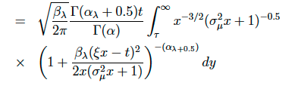
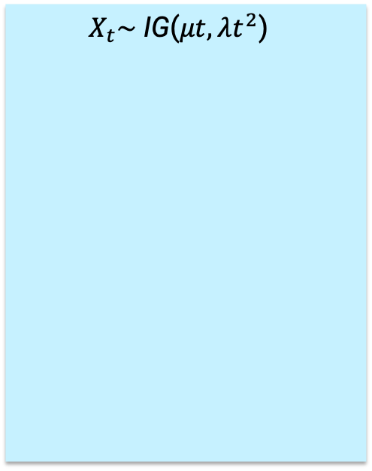
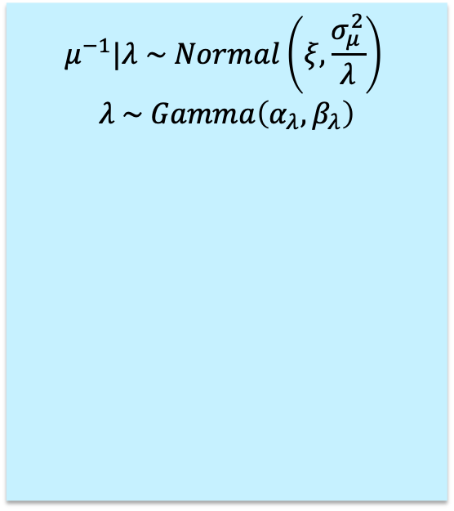

IG Degradation Process with Random Effects
$$X_{t}\text{\sim } \text{IG}\text{(}μt,λt^{2}\text{) }$$
$$μ^{−1}|λ \sim Normal\left(ξ,\frac{σ_{μ}^{2}}{λ}\right)$$
$$λ \sim Gamma\left(α_{λ},β_{λ}\right)$$
First Passage Time (Failure Time) Distribution with Threshold Level $τ$
$$F_{T}\left(t\right)=$$
Gamma Process
Assume that both mean and shape parameters follow a probability distribution
Peng (2015)

Slide 8
Random Effects with Empirical Saddlepoint Approximation Method (ESA Method)
Propose a distribution-free
random effect method
Simulations
Applications

Slide 9
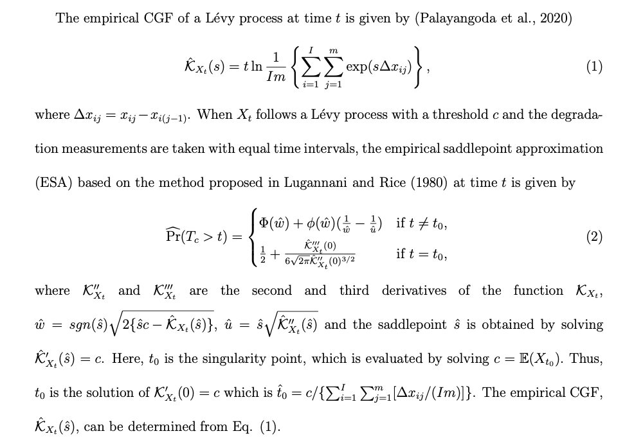
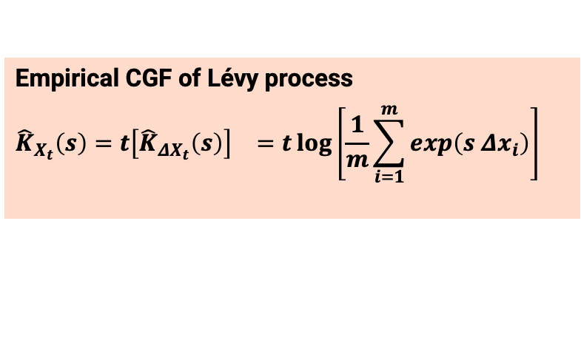
ESA Method enables to estimate of the FPT distribution without any distributional assumptions
Balakrishnan and Qin (2019), Palayangoda et al. (2020)
Saddlepoint Approximation
FPT Distribution
Degradation Data
Empirical Cumulant Generating Function of $X_{t}$
Empirical Cumulant Generating Function of 𝑋_𝑡
Empirical CGF of Lévy process
$${\hat{K}}_{X_{t}}\left(s\right)={t\left[{\hat{K}}_{ΔX_{t}}\left(s\right)\right]}^{}={t\log\left[\frac{1}{m}\sum_{i=1}^{m}{\exp\left(s {Δx}_{i}\right)}\right]}^{}$$
ESA method is a robust approach that can be used to avoid model misspecification errors (Palayangoda et al., 2020)

Slide 10
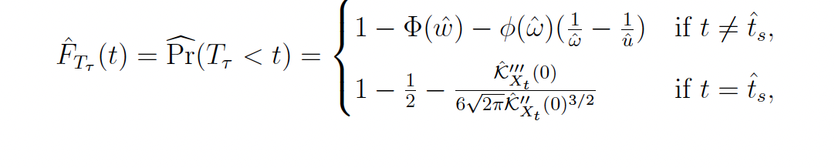
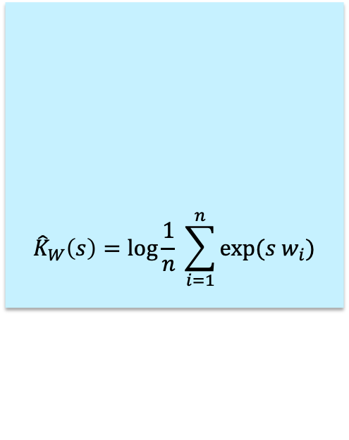
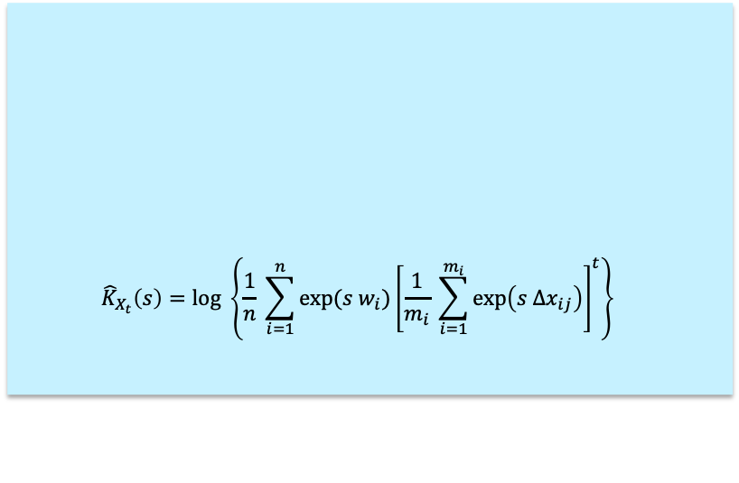
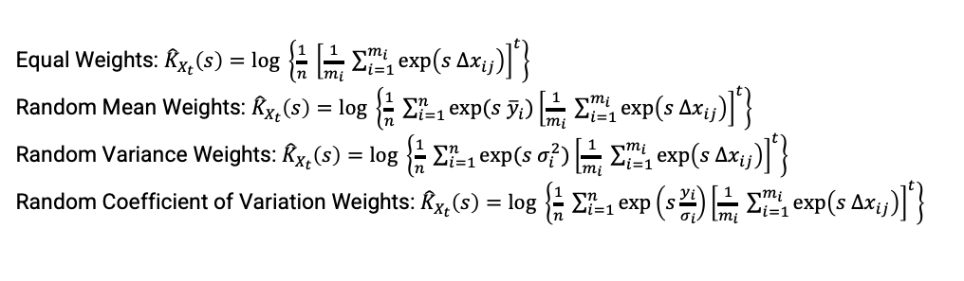
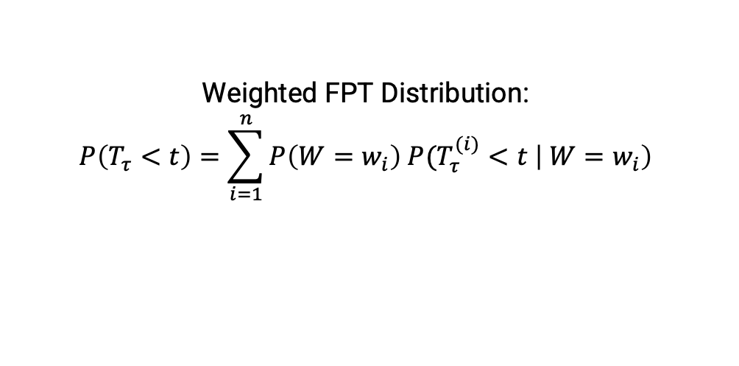
ESA Method with Random Effects
Weighted FPT Distribution:
$$P\left(T_{τ}<t\right)=\sum_{i=1}^{n}{P\left(W=w_{i}\right) P(T_{τ}^{(i)}}<t \left| W=w_{i}\right)$$
$${\hat{K}}_{W}\left(s\right)=\log{\frac{1}{n} \sum_{i=1}^{n}{exp⁡(s w_{i})}}$$
$${\hat{K}}_{X_{t}}\left(s\right)=log \left\{\frac{1}{n} \sum_{i=1}^{n}{exp⁡(s w_{i})}{\left[\frac{1}{m_{i}} \sum_{i=1}^{m_{i}}{\exp\left(s Δx_{ij}\right)}\right]}^{t}\right\}{}$$
Empirical Cumulant Generating Function of Weights
Weighted Empirical Cumulant Generating Function of Data
ESA use to obtain the FPT Distribution
Equal Weights: ${\hat{K}}_{X_{t}}\left(s\right)=log \left\{\frac{1}{n} {\left[\frac{1}{m_{i}} \sum_{i=1}^{m_{i}}{\exp\left(s Δx_{ij}\right)}\right]}^{t}\right\}{}$
Random Mean Weights: ${\hat{K}}_{X_{t}}\left(s\right)=log \left\{\frac{1}{n} \sum_{i=1}^{n}{exp⁡(s {\overline{y}}_{i})}{\left[\frac{1}{m_{i}} \sum_{i=1}^{m_{i}}{\exp\left(s Δx_{ij}\right)}\right]}^{t}\right\}$
Random Variance Weights: ${\hat{K}}_{X_{t}}\left(s\right)=log \left\{\frac{1}{n} \sum_{i=1}^{n}{exp⁡(s σ_{i}^{2})}{\left[\frac{1}{m_{i}} \sum_{i=1}^{m_{i}}{\exp\left(s Δx_{ij}\right)}\right]}^{t}\right\}$
Random Coefficient of Variation Weights: ${\hat{K}}_{X_{t}}\left(s\right)=log \left\{\frac{1}{n} \sum_{i=1}^{n}{\exp\left(s\frac{{\overline{y}}_{i}}{σ_{i}}\right)}{\left[\frac{1}{m_{i}} \sum_{i=1}^{m_{i}}{\exp\left(s Δx_{ij}\right)}\right]}^{t}\right\}$

Slide 11
Monte Carlo Simulations

Slide 12
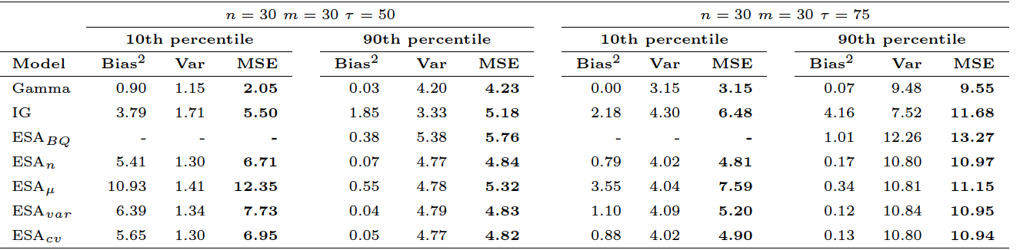
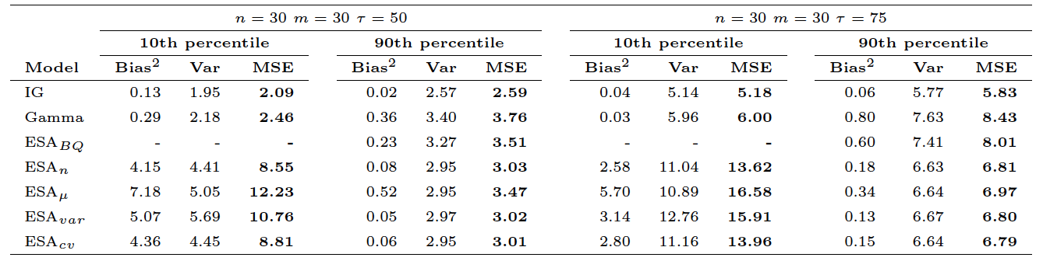
Simulation Results shows that we can eliminate the model misspecification errors with ESA method for higher percentiles
Data Generated from Gamma
Data Generated from Inverse Gaussian

Slide 13
Applications

Slide 14
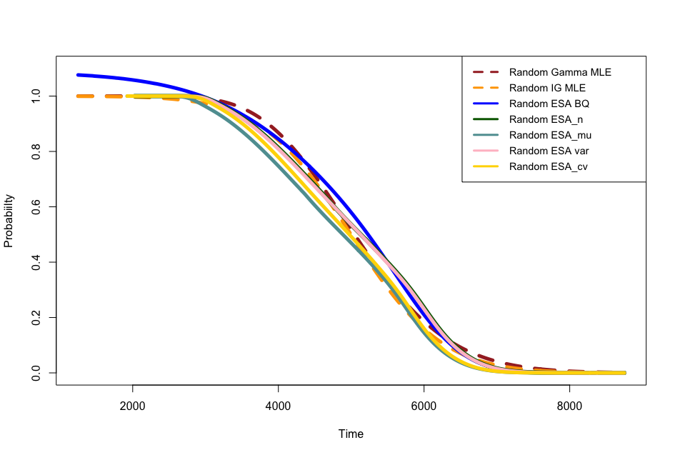
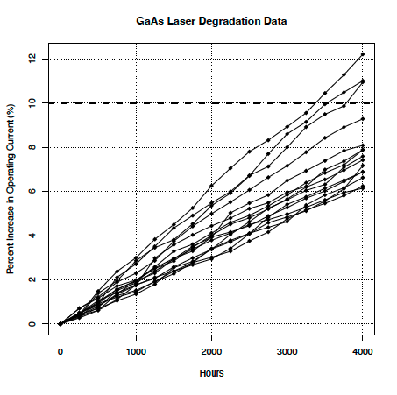
GaAs Laser Data Set in Meeker and Escobar (1998)
 | Random Gamma | Random IG | ESA Random BQ | ESA Equal Weight | ESA Mean | ESA Variance | ESA CV
10-th Percentile | 3858 | 3702 | - | 3617 | 3370 | 3602 | 3595
90-th Percentile | 6448 | 6296 | 6380 | 6414 | 6159 | 6402 | 6383

Slide 15
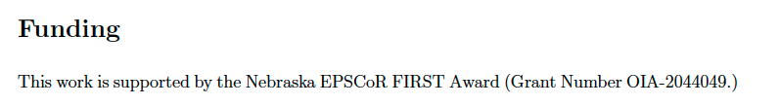
A novel distribution-free approach is proposed to obtain the first passage time distribution with random designs for degradation data
The Distribution-free ESA method is proposed to obtain the FPT with Random Effect
Monte-Carlo simulations show that the ESA method works well particularly for 10-th percentile and MTTF
The GaAs data set (Meeker and Escobar (1998)) is used to model with the proposed approach
Thank you! Questions

Slide 16
