Slide 1

Goodness of Fit Testing with Saddlepoint Approximation for Degradation Data
Lochana Palayangoda, PhD
Assistant Professor of Data Science and Statistics
Department of Mathematical and Statistical Sciences
University of Nebraska at Omaha
June 2025
IISA 2025

Slide 2





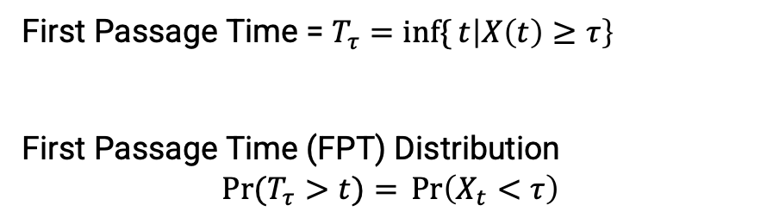


Highly reliable products last for long time but their performance subject to degradation over time
Year 0
Year 1
Year 2
Year 3
Degradation Data ➔ Estimate the Lifetime
First Passage Time = $T_{τ}=\inf{\{}t\left|X\left(t\right)≥τ\right\}$
First Passage Time (FPT) Distribution
$$\operatorname{Pr}{(T_{τ}>t)}={\operatorname{Pr}\left(X_{t}<τ\right)}$$
Threshold ($τ$)
Light Output Degradation ($X_{t}$)
Experiment limit
$$T_{τ}$$
Time
2
2

Slide 3
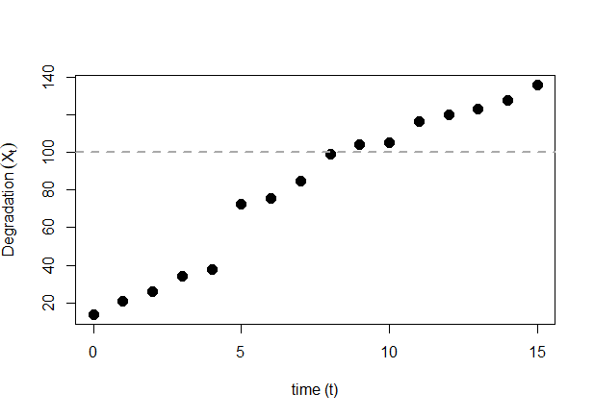


Parametric Lévy process based stochastic models are generally used for degradation modeling
Gamma process
$$ΔX_{t}\text{\sim } \text{Gamma}\text{(}α Δt,ν\text{) }$$
Δ𝑋_𝑡 "~ Gamma(" α Δ𝑡,ν") "
Inverse Gaussian (IG) process
$${ΔX}_{t}\sim \text{Inverse} \text{Gaussian}\text{(}μΔt, λt^{2}\text{)}$$
〖Δ𝑋〗_𝑡~" Inverse Gaussian(" μΔ𝑡, λ𝑡^2 ")"
Wiener Process
$${ΔX}_{t}\sim \text{Normal}\text{(}μΔt, σ^{2}t\text{)}$$
〖Δ𝑋〗_𝑡~" Normal(" μΔ𝑡, 𝜎^2 𝑡")"
$$ΔX_{t}$$
$$Δt_{0}$$

Slide 4
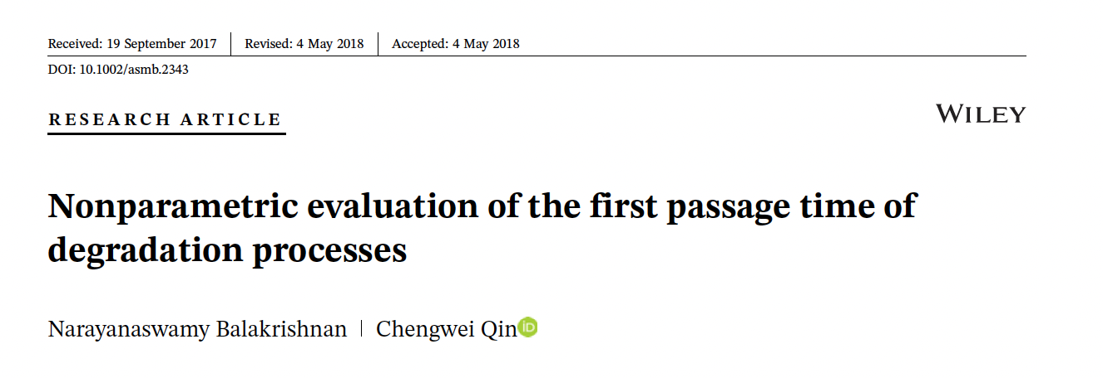
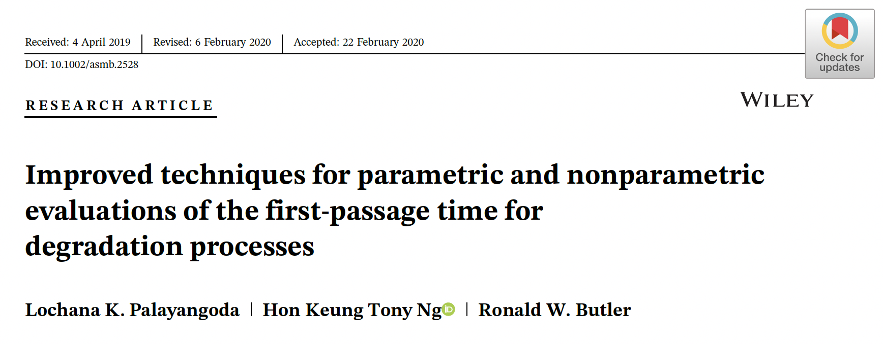
Studies on empirical saddlepoint approximation (ESA)
Develop an ESA approach to estimate the FPT distribution
Introduced procedures for both fixed and random effects
Effective mainly for the estimation of upper-percentiles
Improved the ESA method by Balakrishnan and Qin (2017)
Developed for only degradation data with fixed effects
Maintain the accuracy of the full FPT distribution.
Introduced the Conditional Random Imputation (CRImp) technique to apply the ESA with unequally spaced measurements

Slide 5
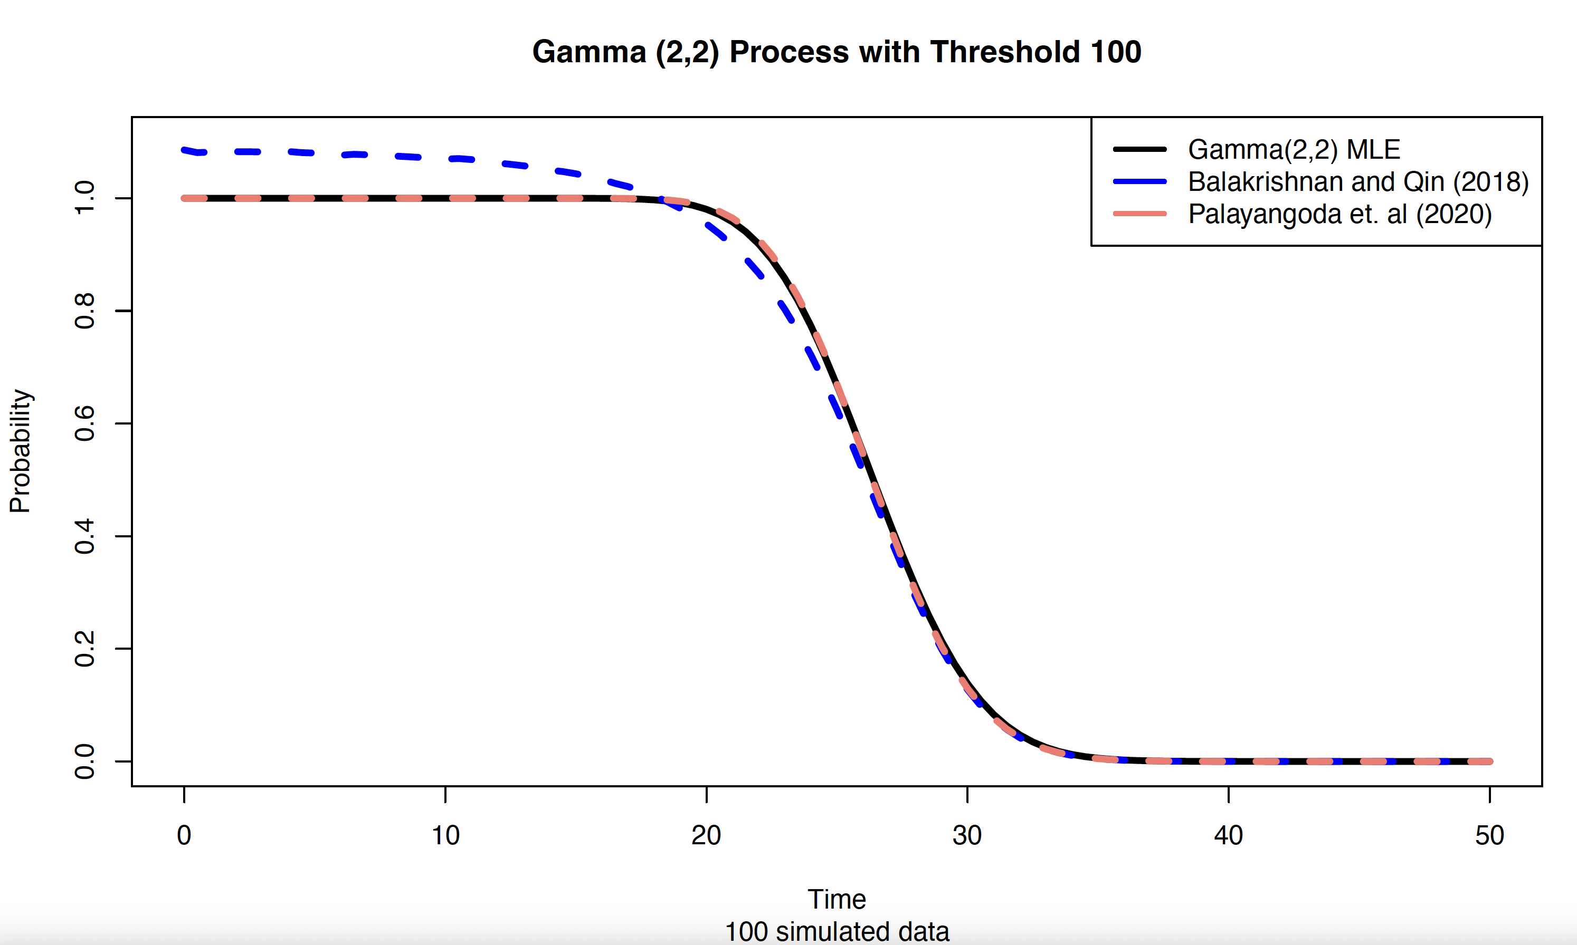
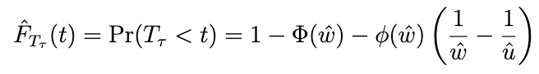

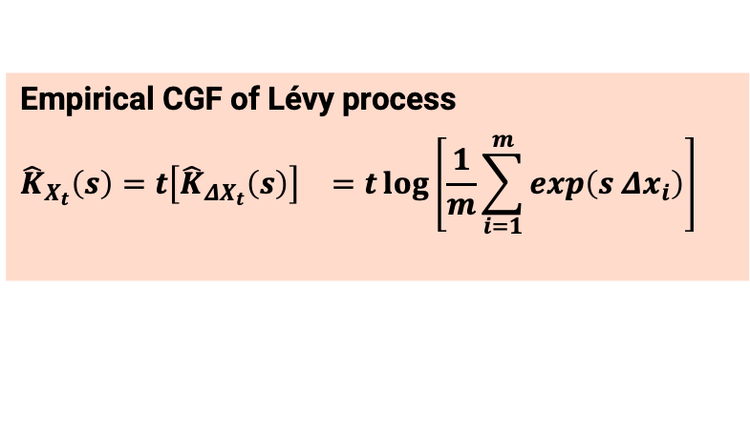

ESA method enables the estimation of the FPT distribution without any probability distribution assumptions
Balakrishnan and Qin (2019), Palayangoda et al. (2020)
Saddlepoint Approximation
FPT Distribution
Degradation Data
Empirical Cumulant Generating Function of $X_{t}$
Empirical Cumulant Generating Function of 𝑋_𝑡
Empirical CGF of Lévy process
$${\hat{K}}_{X_{t}}\left(s\right)={t\left[{\hat{K}}_{ΔX_{t}}\left(s\right)\right]}^{}={t\log\left[\frac{1}{m}\sum_{i=1}^{m}{\exp\left(s {Δx}_{i}\right)}\right]}^{}$$
$\hat{s}$ is determined by solvingthe saddlepoint equation:
$$K_{X_{t}}^{′}\left(s\right)=τ$$
ESA method is a robust approach that can be used to avoid model misspecification errors (Palayangoda et al., 2020)

Slide 6
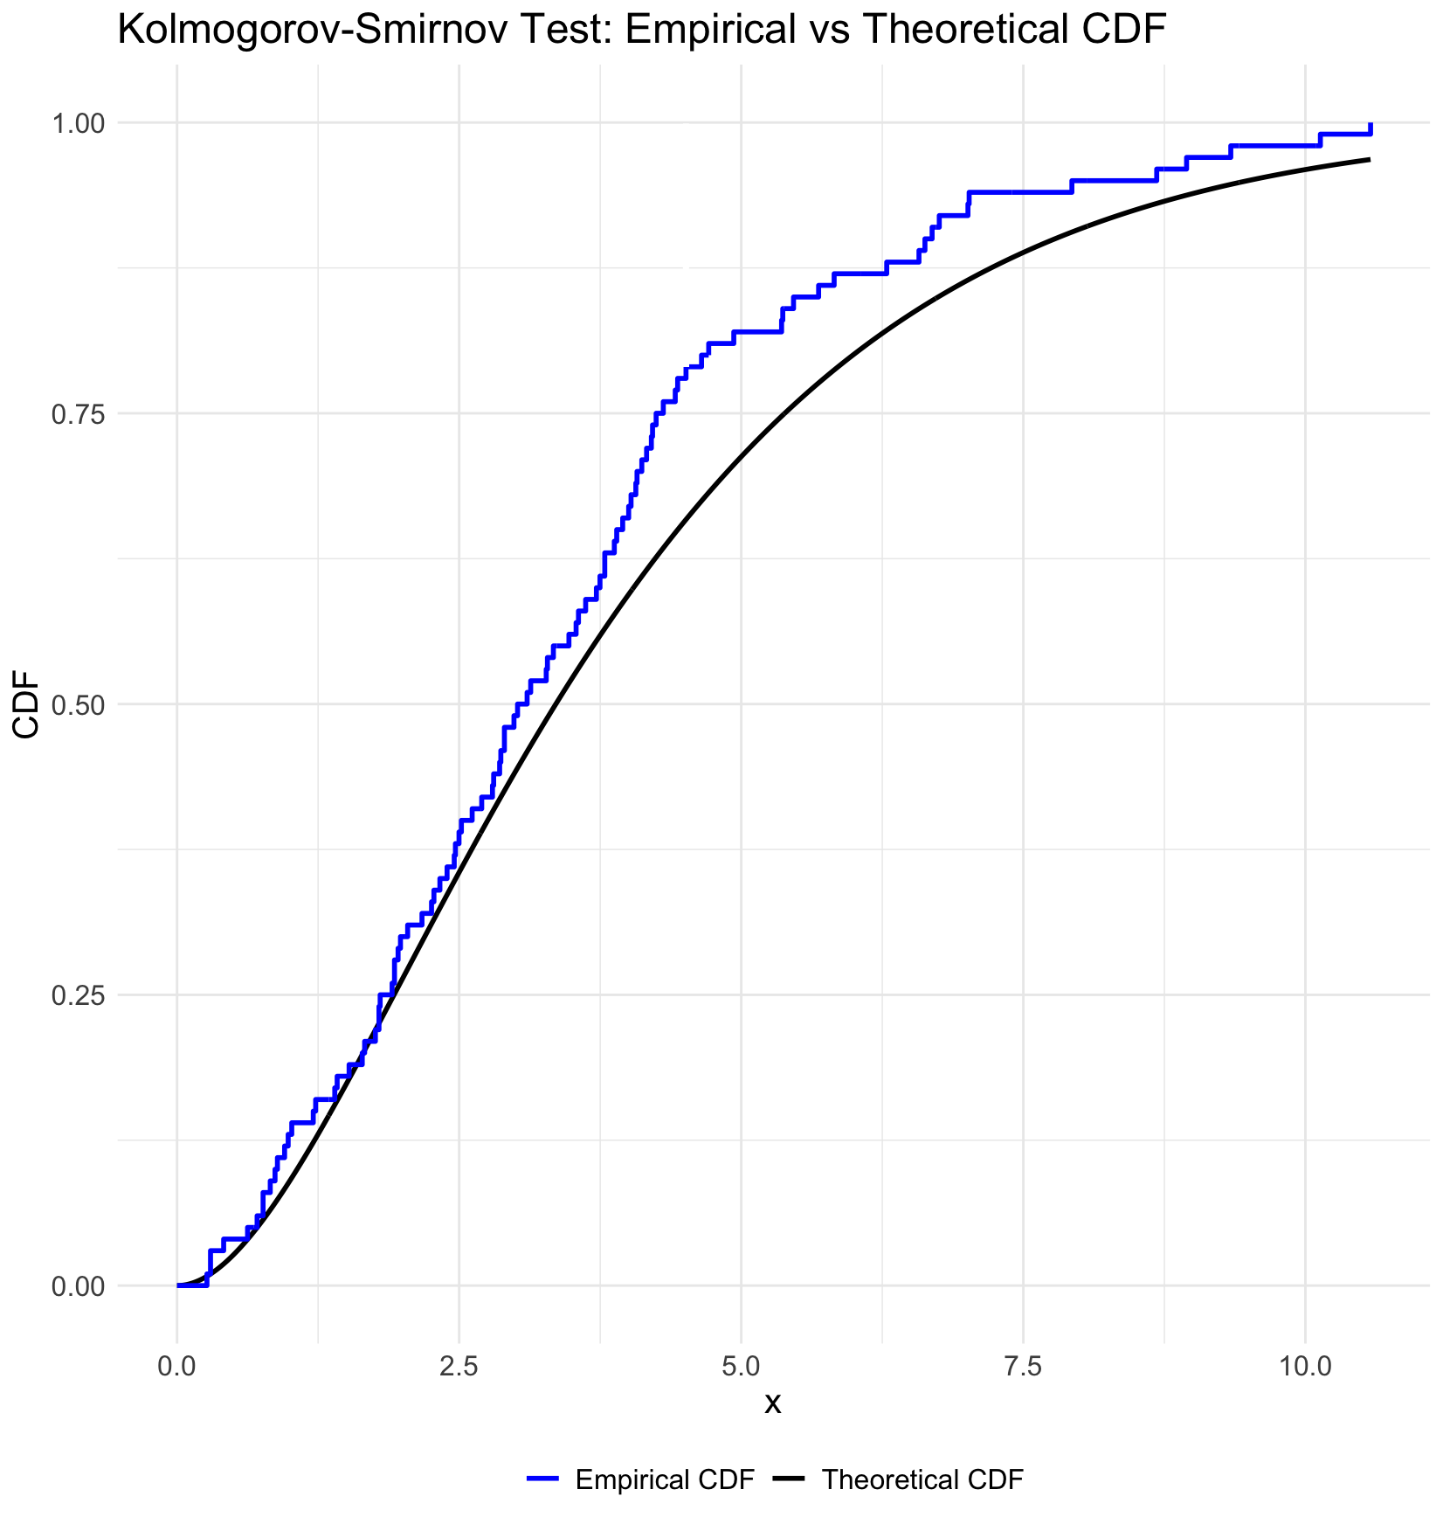
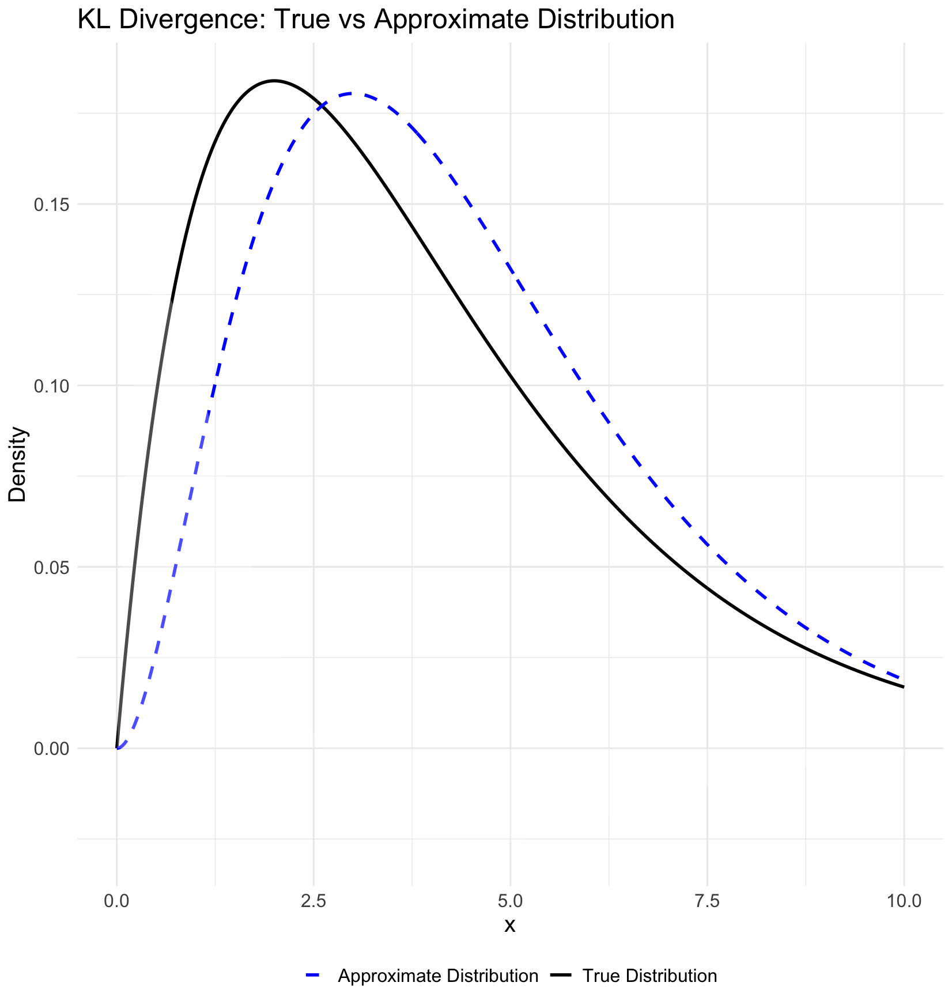
Goodness-of-fit testing is used to identify the underlying distribution of data
Kolmogorov-Smirnov Test
Cramér-von Mises Test
Anderson-Darling Test
Kullback-Leibler Divergence

Slide 7

Identifying the underlying process is essential for accurate estimations of the first passage time
Null Hypothesis: Data follows Degradation Process $℘$
Alternative Hypothesis: Data does not follow Degradation Process $℘$
However, the data shall be
Independent
Identical → data shall follow the same distribution with the same parameter setting
Degradation data are not identical when they are measured in unequal time intervals
Therefore, traditional Goodness-of-Fit tests can not be applied to nonidentical degradation data
$${ΔX}_{t}\text{\sim } \text{Gamma}\text{(}α Δt,ν\text{) }$$

Slide 8
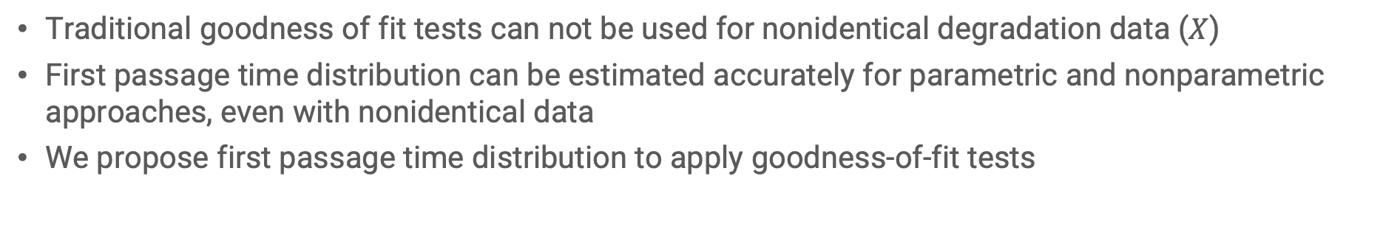
Goodness of fit testing for first passage time distribution of the degradation processes is proposed
Degradation Data
First Passage Time
1-1 Function
Goodness-of-Fit Test
Traditional goodness of fit tests can not be used for nonidentical degradation data ($X$)
First passage time distribution can be estimated accurately for parametric and nonparametric approaches, even with nonidentical data
We propose first passage time distribution to apply goodness-of-fit tests

Slide 9
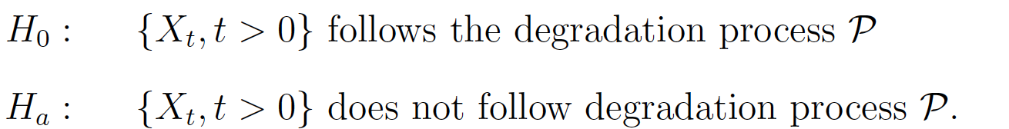
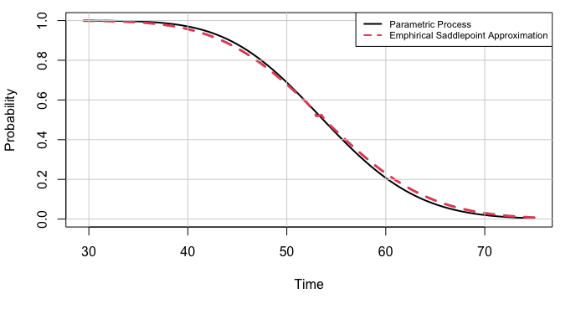
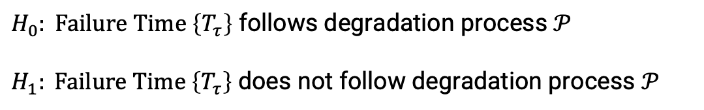
Proposed Goodness of Fit Method: First Passage Time Distributions with Parametric and Empirical Saddlepoint Approximation are compared
$H_{0}: Failure Time \left\{T_{τ}\right\}$ follows degradation process $𝒫$
$H_{1}: Failure Time \left\{T_{τ}\right\}$ does not follow degradation process $𝒫$

Slide 10
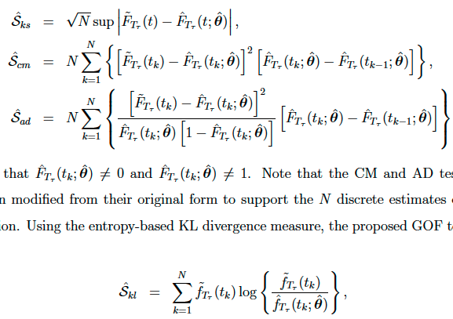

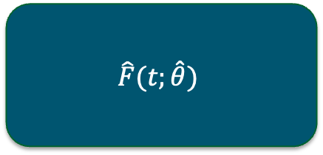
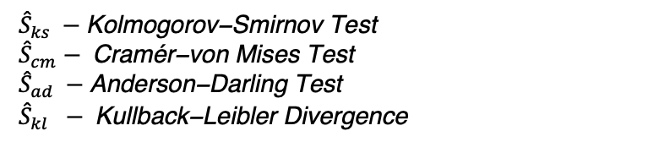
Proposed Goodness of Fit Test Procedure Step 1: Obtain Observed Test Statistics
Estimate the First Passage Time Distribution with Hypothesized Process
Estimate the Empirical Distribution with ESA
Obtain the Observed Test Statistics
$$\hat{F}(t;\hat{θ})$$
$$\tilde{F}(t)$$
${\hat{S}}_{ks} −\text{Kolmogorov}\text{−}\text{Smirnov} \text{Test}$
${\hat{S}}_{cm}− \text{Cram}\text{é}\text{r}\text{−}\text{von} \text{Mises} \text{Test}$
${\hat{S}}_{ad} −\text{Anderson}\text{−}\text{Darling} \text{Test}$
${\hat{S}}_{kl} − \text{Kullback}\text{−}\text{Leibler} \text{Divergence}$
GOF – Goodness of Fit
ESA – Empirical Saddlepoint Approximation

Slide 11
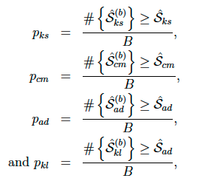
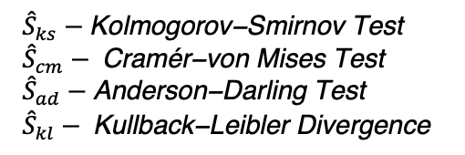
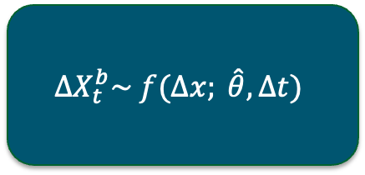

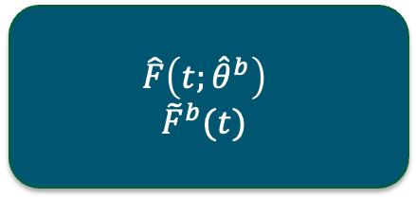
Proposed Goodness of Fit Test Procedure Step 2: Obtain the Distribution of the Test Statistic under the Null
Apply parametric bootstrap to obtain Bootstrap Samples of Degradation Data
Obtain parametric and empirical estimates of the first passage time distribution
Evaluate Test Statistics for each Bootstrap Sample
Find the Statistical Significance by Evaluating the P-values
$${\hat{S}}_{ks}^{b}$$
$${\hat{S}}_{cm}^{b}$$
$${\hat{S}}_{ad}^{b}$$
$${\hat{S}}_{kl}^{b}$$
$$ΔX_{t}^{b}\sim f(Δx; \hat{θ}, Δt)$$
$$\hat{F}\left(t;{\hat{θ}}^{b}\right)$$
$${\tilde{F}}^{b}(t)$$
GOF – Goodness of Fit
ESA – Empirical Saddlepoint Approximation
${\hat{S}}_{ks}−\text{Kolmogorov}\text{−}\text{Smirnov} \text{Test}$
${\hat{S}}_{cm}− \text{Cram}\text{é}\text{r}\text{−}\text{von} \text{Mises} \text{Test}$
${\hat{S}}_{ad}−\text{Anderson}\text{−}\text{Darling} \text{Test}$
${\hat{S}}_{kl}− \text{Kullback}\text{−}\text{Leibler} \text{Divergence}$

Slide 12
Monte Carlo Simulations

Slide 13
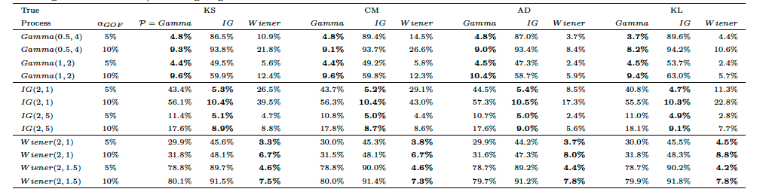
Simulation Results show that the proposed test maintains the false-positive error probability and has higher power for misspecified distributions
True process is Gamma and
Model with Gamma
Type–1 Error
True process is Gamma
and
Model with IG/Wiener
Power
I = 5, m = 9, time gaps = {1, 3, 5}, $τ=70$, no. of simulations = 1000

Slide 14
Simulation Results show the proposed test maintains the false-positive error probability and higher power for misspecified distributions
I = 5, m = 9, time gaps = {1, 3, 5}, $τ=70$, no. of simulations = 1000

Slide 15
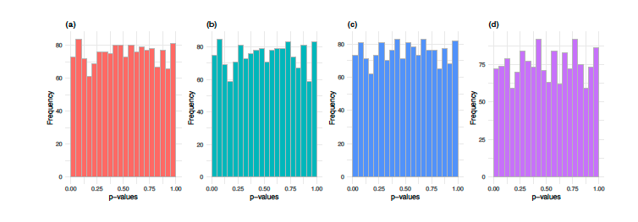
P-values under the null hypothesis in the simulations are approximately follows Uniform(0,1) distribution

Slide 16
Applications

Slide 17
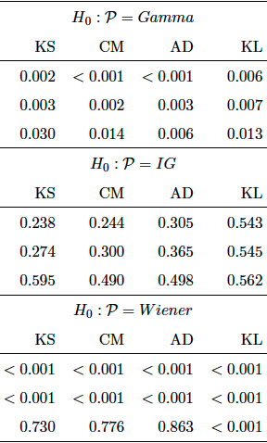
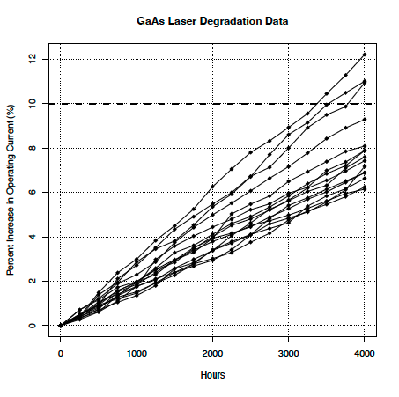
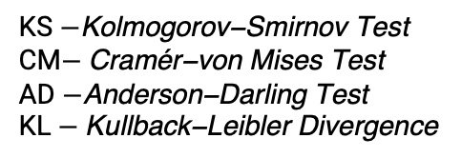
GaAs Laser Data Set in Meeker and Escobar (1998)
P-values
KS $−\text{Kolmogorov}\text{−}\text{Smirnov} \text{Test}$
CM$− \text{Cram}\text{é}\text{r}\text{−}\text{von} \text{Mises} \text{Test}$
AD $−\text{Anderson}\text{−}\text{Darling} \text{Test}$
KL $− \text{Kullback}\text{−}\text{Leibler} \text{Divergence}$

Slide 18
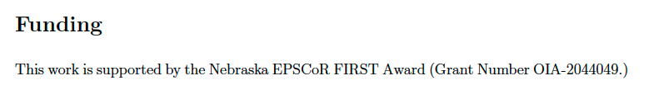
A novel goodness of fit approach is proposed to test the underlying degradation process
Four Goodness-of-Fit test procedures are proposed
Monte-Carlo simulations show that proposed tests maintain the false-positive error rate and power
The GaAs laser data set is used to apply the proposed tests
Thank you! Questions

