Slide 1


21CSA699A – Minor Project
DATE : 13-08-2026
INTRODUCTION
FOR NEW EMPLOYEES

Slide 2
Project Title: AI‑Based Smart Attendance System Using Face Recognition
Student Name: Mommineedi Lochana
Register Number: AA.SC.P2MCA24074047
Program: MCA in AI
Semester: 4th
Department & Institution: Amrita Vishwa Vidyapeetham

Slide 3
Introduction:
Background of the Domain :
In schools and colleges, attendance is usually taken by hand — calling names or signing registers.
This takes time, can cause mistakes, and sometimes students even mark attendance for friends.
With new technology like AI and computer vision, we can now use cameras to recognize faces automatically.
Motivation for Choosing the Project :
I wanted to solve a real problem that teachers and students face every day.
Manual attendance wastes class time and is not always fair.
By using face recognition, attendance can be fast, accurate, and secure.
It also gave me a chance to learn and apply Python, OpenCV, and machine learning in practice.
Real‑World Relevance :
This system can save teachers valuable time and reduce errors.
It prevents proxy attendance because only the real student’s face is accepted.
It’s contactless, which is safer and more convenient.
Beyond classrooms, the same idea can be used in offices, events, or security systems.

Slide 4
Problem Statement:
In most classrooms, attendance is still taken by hand, which wastes time and often leads to mistakes. Students can even mark attendance for friends, causing proxy issues. Systems like RFID cards can be misused, and fingerprint scanners need special devices and physical contact, which is not always convenient. Many advanced solutions are also too costly or complicated for schools to use. Because of these problems, there is a need for a simple, low‑cost, and contactless system that can automatically recognize students’ faces and record their attendance with date and time. This would save time, improve accuracy, and prevent misuse.

Slide 5
Objectives:
To build an automatic attendance system using face recognition.
To detect and recognize students in real time with a webcam.
To record attendance with the exact date and time in a CSV file.
To reduce manual work for teachers and avoid proxy attendance.
To improve accuracy and make attendance faster and more reliable.

Slide 6
Scope of the Project:
This project is designed mainly for classrooms where students’ images are already registered. It includes collecting student photos, training the model, detecting faces, recognizing them, and storing attendance with date and time in a CSV file. It does not cover large‑scale deployment, mobile apps, or cloud integration at this stage. The system assumes proper lighting conditions and that each student’s face is unique. Overall, the scope is to provide a simple, low‑cost, and contactless attendance solution that works reliably in a controlled classroom environment.

Slide 7
Literature Review/ Existing System:
Manual registers → slow, time‑consuming, prone to mistakes.
RFID cards → faster but can be misused by swapping cards (proxy attendance).
Fingerprint systems → secure but need special devices and physical contact.
Face recognition systems → contactless and automatic, but many existing ones require costly hardware or complex software.
Gap identified → need for a simple, affordable, and classroom‑friendly solution using basic tools like a webcam and laptop.

Slide 8
Proposed System:
The system uses pre‑collected student photos (4–5 images per student) as the dataset.
These photos are used to train the recognition model.
Haar Cascade algorithm is applied to detect faces in the images.
LBPH (Local Binary Pattern Histogram) algorithm is used to recognize which student the face belongs to.
During testing, a single photo of a student is given, and the system matches it against the dataset.
If recognized, the student’s name, date, and time are automatically saved in a CSV file as attendance.
Provides a low‑cost, contactless, and reliable solution that avoids proxy attendance and reduces manual effort.

Slide 9
Architecture:
Dataset Layer → Stores 4–5 photos of each student for training.
Face Detection Module → Uses Haar Cascade algorithm to detect faces in images.
Face Recognition Module → Applies LBPH algorithm to identify which student the face belongs to.
Attendance Logging Layer → Saves recognized student’s name, date, and time into a CSV file.
Data Flow → Input photo → Detection → Recognition → Attendance record.

Slide 10
Methodology/Algorithms:
Step‑by‑step workflow :
Collect 4–5 photos of each student and store them in the dataset.
Train the model using these images.
During testing, input a single photo of a student.
Detect the face using the Haar Cascade algorithm.
Recognize the student using the LBPH algorithm.
Log the recognized student’s name, date, and time into a CSV file.
Algorithms used :
Haar Cascade → For face detection.
LBPH → For face recognition.
Justification for selection :
Haar Cascade is lightweight and efficient for detecting faces in images.
LBPH is simple, effective, and works well with small datasets (like 4–5 photos per student).
Together, they provide a reliable, low‑cost solution suitable for classroom attendance.

Slide 11
Implementation Details:
Dataset description → 4–5 photos of each student were collected and stored in folders for training.
Key modules →
Face Detection using Haar Cascade algorithm.
Face Recognition using LBPH algorithm.
Attendance Logging that saves recognized student’s name, date, and time into a CSV file.

Slide 12
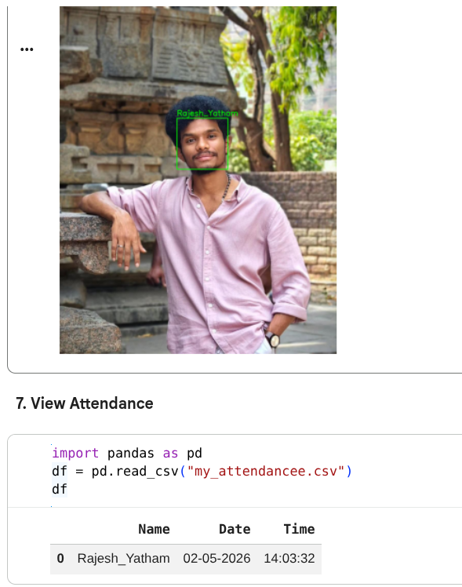
Results & Output
Attendance Record Example →
Name: Rajesh_Yatham
Date: 02‑05‑2026
Time: 14:03:32
Performance Metrics → Recognition accuracy (e.g., percentage of correct matches) and error rate.

Slide 13
Testing & Validation
Types of testing performed
Unit Testing → Verified dataset loading, face detection, recognition, and CSV logging modules individually.
Functional Testing → Checked that the system correctly recognized students and marked attendance.
Validation Testing → Tested with new/unseen student photos to confirm recognition accuracy.
Test cases and outcomes
Input: Registered student photo → Output: Correct recognition, attendance logged.
Input: Unregistered student photo → Output: No match, attendance not logged.

Slide 14
Conclusion and Future enhancements
Summary of work done:
Built a photo‑based face recognition attendance system.
Used Haar Cascade for face detection and LBPH for face recognition.
Stored attendance records (name, date, time) in a CSV file.
Tested with multiple student photos and achieved reliable recognition.
Achievement of objectives:
Automated attendance marking without manual registers.
Reduced chances of proxy attendance compared to RFID or manual methods.
Delivered a low‑cost, contactless solution suitable for classrooms.
Future enhancements:
Expand dataset with more photos per student for higher accuracy.
Add a user interface for easier operation.
Integrate with databases or cloud storage for scalability.
Explore real‑time recognition using webcam/live feed.

Slide 15
THANK YOU
onlineamrita.com

