Slide 1
CS 193G
Lecture 1: Introduction to Massively Parallel Computing

Slide 2

Course Goals
Learn how to program massively parallel processors and achieve
  High performance
  Functionality and maintainability
  Scalability across future generations
Acquire technical knowledge required to achieve above goals
  Principles and patterns of parallel programming
  Processor architecture features and constraints
  Programming API, tools and techniques

Slide 3
People
Lecturers
  Jared Hoberock: jaredhoberock at gmail.com
  David Tarjan: tar.cs193g at gmail.com
  Office hours: 3:00-4:00 PM, Tu Th, Gates 195
Course TA
  Niels Joubert: njoubert at cs.stanford.edu
Guest lecturers
  Domain experts

Slide 4
Web Resources
Website:
  http://stanford-cs193g-sp2010.googlecode.com
  Lecture slides/recordings
  Documentation, software resources
  Note: while we’ll make an effort to post announcements on the web, we can’t guarantee it, and won’t make allowances for people who miss things in class
Mailing list
  Channel for electronic announcements
  Forum for Q&A – Lecturers and assistants read the board, and your classmates often have answers
Axess for Grades

Slide 5
Grading
This is a lab oriented course!
Machine problems: 50%
  Correctness: ~40%
  Performance: ~35%
  Report: ~25%
Project: 50%
  Technical pitch: 25%
  Project Presentation: 25%
  Demo: 50%

Slide 6
Bonus Days
Every student is allocated two bonus days
  No-questions asked one-day extension that can be used on any MP
  Use both on the same thing if you want
  Weekends/holidays don’t count for the number of days of extension (Friday-Monday is just one day extension)
Intended to cover illnesses, interview visits, just needing more time, etc.
Late penalty is 10% of the possible credit/day, again counting only weekdays

Slide 7
Academic Honesty
You are allowed and encouraged to discuss assignments with other students in the class. Getting verbal advice/help from people who’ve already taken the course is also fine.
Any reference to assignments from previous terms or web postings is unacceptable
Any copying of non-trivial code is unacceptable
  Non-trivial = more than a line or so
  Includes reading someone else’s code and then going off to write your own.

Slide 8
Course Equipment
Your own PCs with a CUDA-enabled GPU
NVIDIA GeForce GTX 260 boards
  Lab facilities: Pups cluster, Gates B21
  Nodes 2, 8, 11, 12, & 13
  New Fermi Architecture GPUs?
    As they become available

Slide 9
Text & Notes
Course text:
  Kirk & Hwu. Programming Massively Parallel Processors: A Hands-on Approach. 2010.
References:
  NVIDIA. The NVIDIA CUDA Programming Guide. 2010.
  NVIDIA. CUDA Reference Manual. 2010.
Lectures will be posted on the class website.

Slide 10
Schedule
Week 1:
  Tu: Introduction
  Th: CUDA Intro
  MP 0: Hello, World!
  MP 1: Parallel For
Week 2
  Tu: Threads & Atomics
  Th: Memory Model
  MP 2: Atomics
Week 3
  Tu: Performance
  Th: Parallel Programming
  MP 3: Communication
Week 4
  Tu: Project Proposals
  Th: Parallel Patterns
  MP 4: Productivity
Week 5
  Tu: Productivity
  Th: Sparse Matrix Vector
Week 6
  Tu: PDE Solvers Case Study
  Th: Fermi
Week 7
  Tu: Ray Tracing Case Study
  Th: Future of Throughput
Week 8
  Tu: AI Case Study
  Th: Advanced Optimization
Week 9
  Tu: TBD
  Th: Project Presentations
Week 10
  Tu: Project Presentations

Slide 11
Moore’s Law (paraphrased)
“The number of transistors on an integrated circuit doubles every two years.”
  – Gordon E. Moore
Notes:
Gordon Moore, co-founder of Intel
ca. 1965 in a paper

Slide 12

Moore’s Law (Visualized)
GF100
Data credit: Wikipedia
Notes:
Note different market demands will produce a deviation, e.g., Atom

Slide 13
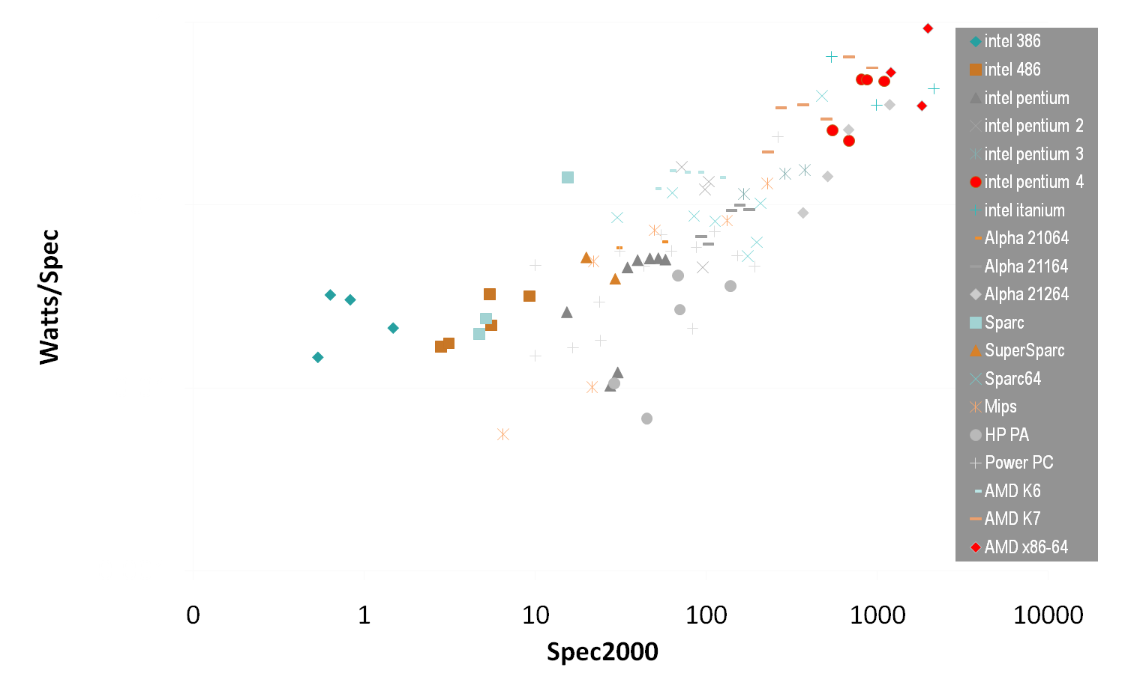
Buying Performance with Power
Power
Performance
(courtesy Mark Horowitz and Kevin Skadron)
Notes:
This graphs W/! (watts per bang) over several different single core CPU architectures
Y-axis graphs Watts per bench (lower is better)
With the progression of faster single core CPUs, this ratio has grown higher & higher.
You can buy performance with power, but unfortunately the ratio is not linear. Since the days of the 386, we’ve seen a trend of decreasing gains.
Spec2000: industry CPU benchmark, www.spec.org

Slide 14
Serial Performance Scaling is Over
Cannot continue to scale processor frequencies
  no 10 GHz chips
Cannot continue to increase power consumption
  can’t melt chip
Can continue to increase transistor density
  as per Moore’s Law
Notes:
The upshot of the power trend is that the epoch of serial performance scaling is over.
A glance across the CPU landscape reveals that single cores aren’t getting any faster: no architect has found a way to design 10 GHz chips.
We have to design underthe annoying constraint that the processor cannot melt once you flip the power switch.
So what can we do: transistors can continue to shrink, so we can increase transistor density. That is, we can fit more and more transistors onto a single chip.

Slide 15
How to Use Transistors?
Instruction-level parallelism
  out-of-order execution, speculation, …
  vanishing opportunities in power-constrained world
Data-level parallelism
  vector units, SIMD execution, …
  increasing … SSE, AVX, Cell SPE, Clearspeed, GPU
Thread-level parallelism
  increasing … multithreading, multicore, manycore
  Intel Core2, AMD Phenom, Sun Niagara, STI Cell, NVIDIA Fermi, …
Notes:
The challenge for architects is how to best utilize these additional transistors? The solution has been to embrace parallelism at all scales.
Traditionally, CPU architects have allocated additional transistors to logic which exploits instruction-level parallelism. The problem with this approach is that there are vanishing opportunities for ILP, both because of the limited application of ILP to general single-threaded code, and again, the power envelope.
Architects have also turned to data-level parallelism by introducing vector units and SIMD execution into chip designs. This has resulted in a proliferation of instruction set extensions such as SSE and Altivec, as well as entire platforms built around SIMD, such as Cell and various GPU architectures.
At an even coarser scale is thread-level parallelism. We see a proliferation of architectures here as well.
Niagara2 = 8 cores * 8 thread/core = 64 threads/chip

Slide 16
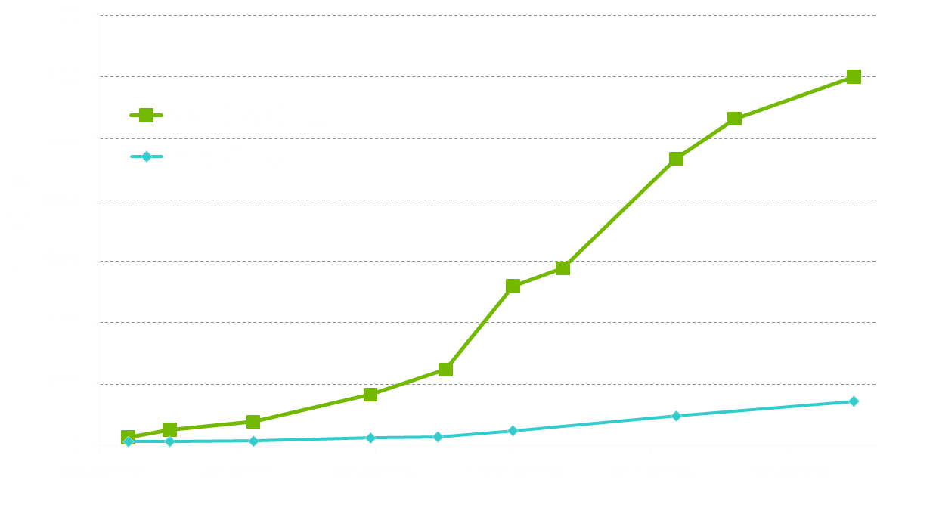
Why Massively Parallel Processing?
A quiet revolution and potential build-up
  Computation: TFLOPs vs. 100 GFLOPs
  GPU in every PC – massive volume & potential impact
T12
GT200
G80
G70
3GHz Xeon Quad
Westmere
NV40
3GHz Core2 Duo
NV30
3GHz Dual Core P4

Slide 17
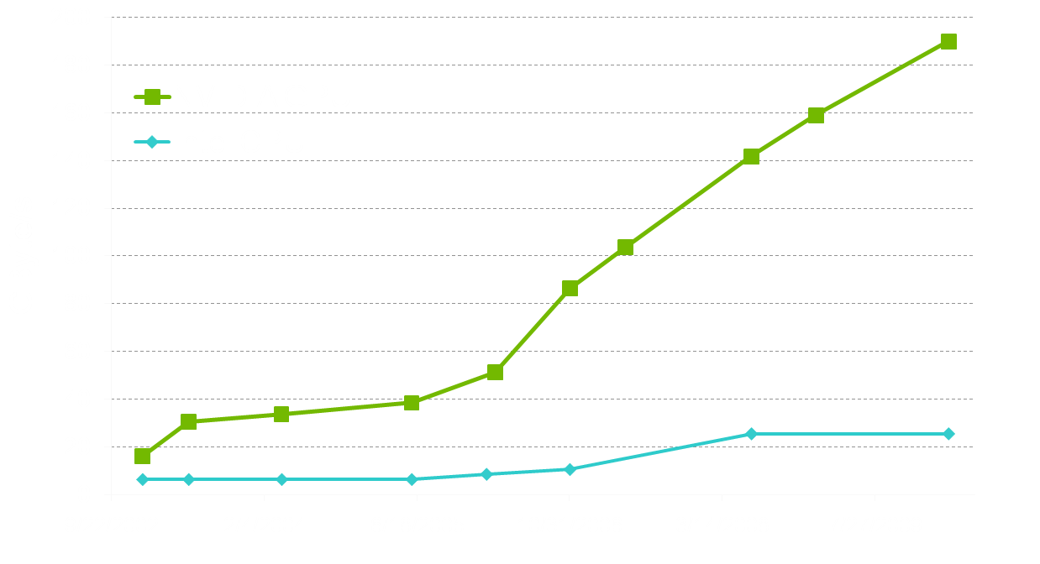
Why Massively Parallel Processing?
A quiet revolution and potential build-up
  Bandwidth: ~10x
  GPU in every PC – massive volume & potential impact
T12
GT200
G80
NV40
G70
3GHz Xeon Quad
Westmere
NV30
3GHz Core2 Duo
3GHz Dual Core P4

Slide 18
The “New” Moore’s Law
Computers no longer get faster, just wider
You must re-think your algorithms to be parallel !
Data-parallel computing is most scalable solution
  Otherwise: refactor code for 2 cores
  You will always have more data than cores –
  build the computation around the data
4 cores
8 cores
16 cores…
Notes:
The tide of commodity technology is rising in a different direction.
To first order, computers have stopped getting faster (higher clock speeds), they just get wider (more parallel)
If you work on an interesting problem, you *must* re-think your algorithms to be parallel
* Otherwise, if your serial algorithm isn't fast enough today it never will be fast enough
Data-parallel computing is the most scalable solution
* Another option is to tease your code apart, move this task (say I/O) to one core and that task (compute) to another core, oh wait now there's 4 cores, um, let's put mouse and keyboard handing on one core and split compute into database access and the linear algebraic solver, oops now there's 8 cores lets split up the solver into LU decomposition and .... you get the idea
* if your problem is of interesting size the data will always outnumber the cores, so organize the computation around the data

Slide 19








Generic Multicore Chip
Processor
Memory
Processor
Memory
Global Memory
Handful of processors each supporting ~1 hardware thread
On-chip memory near processors (cache, RAM, or both)
Shared global memory space (external DRAM)
Notes:
One instance of this idea is the current wave of multicore CPUs.
In this generic design, you’ve got a few processors which each support around one thread in hardware. Paired with each hardware thread, you’ve also got relatively lots of on-chip memory near the processors for local computation. Farther out, you’ve got a shared global memory space which the processors can communicate through to enable cooperation on

Slide 20
Generic Manycore Chip
Processor
Memory
Processor
Memory
• • •
Global Memory
Many processors each supporting many hardware threads
On-chip memory near processors (cache, RAM, or both)
Shared global memory space (external DRAM)
Notes:
Alternatively, a manycore parallel architecture replicates many processor cores, each hosting several lightweight hardware threads. Like a multicore architecture, each processor is paired with a dedicated on-chip memory, but per-thread memory resources are relatively smaller.
Because the on-chip memory is shared among a processor’s threads, it serves as a convenient venue for thread communication/cooperation
Again, the shared global memory space serves as a forum for inter-core communication/cooperation (threads in differing processors may communicate here)

Slide 21
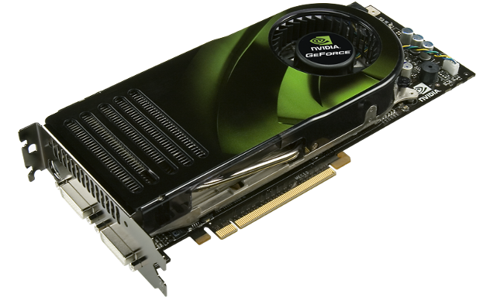
Enter the GPU
Massive economies of scale
Massively parallel
Notes:
In fact, manycore NVIDIA GPUs make parallel processing a commodity technology
GPUs are mass-market commodity products sold at tremendous economies of scale. We sell around 1 million GPUs per week! That’s about 100 per minute.
GPUs are massively parallel devices. Our high-end GPUs have 240 heavily multithreaded thread processors and support over 30,000 concurrent threads in flight.
Upshot: Massively parallel computing has become a commodity technology!

Slide 22
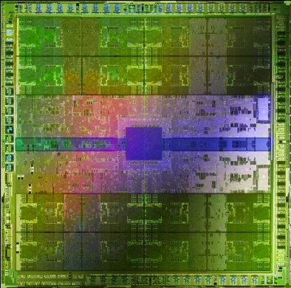
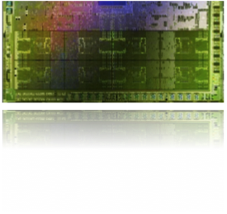






GPU Evolution
High throughput computation
  GeForce GTX 280: 933 GFLOP/s
High bandwidth memory
  GeForce GTX 280: 140 GB/s
High availability to all
  180+ million CUDA-capable GPUs in the wild
“Fermi”
3B xtors
GeForce 8800
681M xtors
GeForce FX
125M xtors
GeForce 3
60M xtors
GeForce® 256
23M xtors
RIVA 128
3M xtors
1995
2000
2005
2010
Notes:
Tesla C1060 @ 1.296 GHz: 933 GFLOP/s (78 double) and 102 GB/s (peak)
Since GeForce 256 in 1999, Moore’s Law has enabled us to more or less double our transistor count with each architecture
Details of FLOP/s computation:
clock rate times flops times # SMs
If you assume you can get true dual issue, then assume you get 8 MAD + 8 MUL + “hidden” MUL triples -> 3 flops per SM per cycle
GT200 has 30 SMs

Slide 23
Lessons from Graphics Pipeline
Throughput is paramount
  must paint every pixel within frame time
  scalability
Create, run, & retire lots of threads very rapidly
  measured 14.8 Gthread/s on increment() kernel
Use multithreading to hide latency
  1 stalled thread is OK if 100 are ready to run
Notes:
Building bigger & better graphics processors has revealed the following lessons:
Video games have strict time requirements:
bare minimum: 2 Mpixels * 60 fps * 2 = 240 Mthread/s
throughput is paramount
The scale of these demands dictate that threads must be incredibly lightweight
On recent architectures, we’ve observed 15 billion threads created/run/destroyed per second
Also dictates multithreading/timesharing to hide latency: it’s okay if one thread stalls if it means that 100 more are allowed to run immediately

Slide 24
Why is this different from a CPU?
Different goals produce different designs
  GPU assumes work load is highly parallel
  CPU must be good at everything, parallel or not
CPU: minimize latency experienced by 1 thread
  big on-chip caches
  sophisticated control logic
GPU: maximize throughput of all threads
  # threads in flight limited by resources => lots of resources (registers, bandwidth, etc.)
  multithreading can hide latency => skip the big caches
  share control logic across many threads
Notes:
You may ask “Why are these design decisions different from a CPU?”
In fact, the GPU’s goals differ significantly from the CPU’s
GPU evolved to solve problems on a highly parallel workload
CPU evolved to be good at any problem whether it is parallel or not
For example, the trip out to memory is long and painful
The question for the chip architect: How to deal with latency?
One way is to avoid it: the CPU’s computational logic sits in a sea of cache. The idea is that few memory transactions are unique, and the data is usually found quickly after a short trip to the cache.
Another way is amortization: GPUs forgo cache in favor of parallelization. Here, the idea is that most memory transactions are unique, and can be processed efficiently in parallel. The cost of a trip to memory is amortized across several independent threads, which results in high throughput.

Slide 25




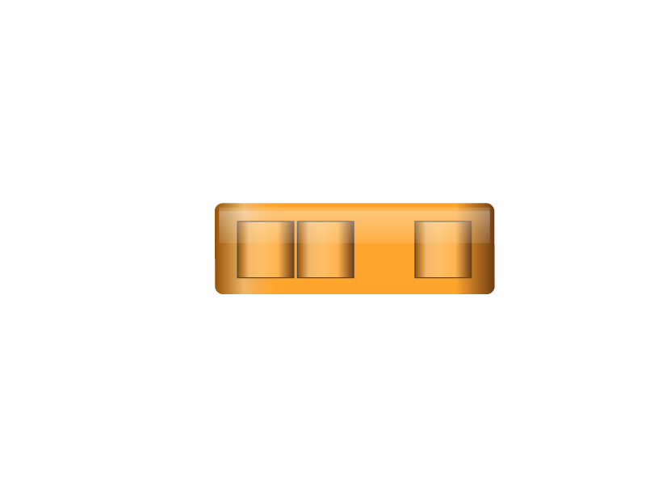
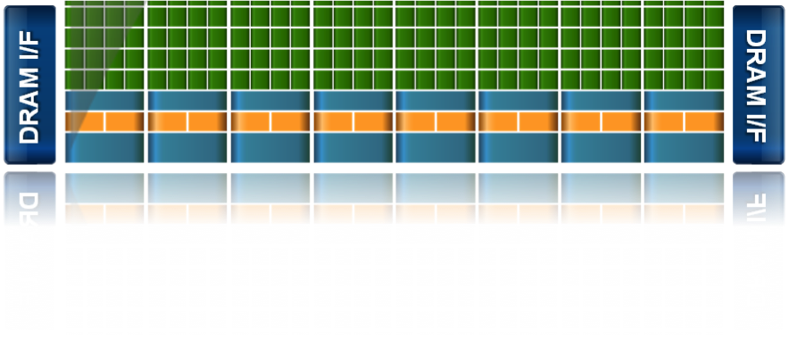
NVIDIA GPU Architecture
Fermi GF100
DRAM I/F
DRAM I/F
HOST I/F
DRAM I/F
L2
Giga Thread
DRAM I/F
DRAM I/F
DRAM I/F
Notes:
Sea of green scalar cores (literally hundreds), thin layer of blue on-chip memory, sandwiches blue communication fabric out to memory
With some additional fixed function logic specific to support graphics algorithms (ie, rasterization)

Slide 26
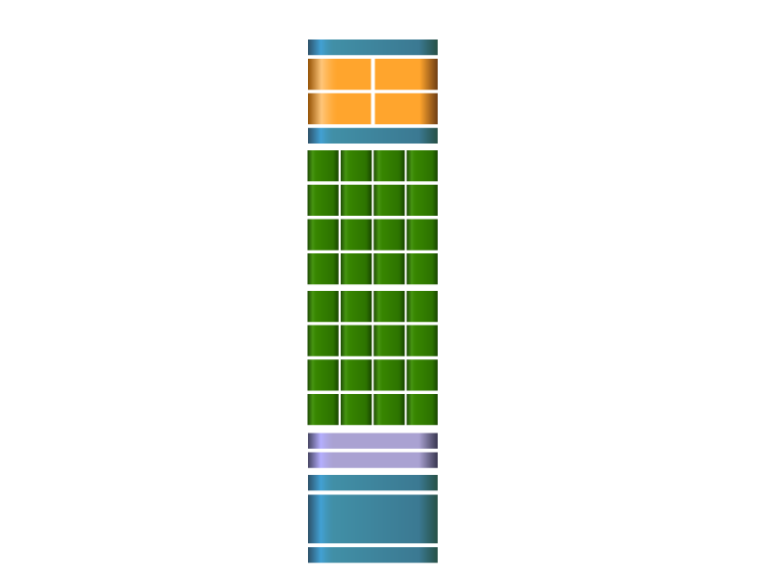
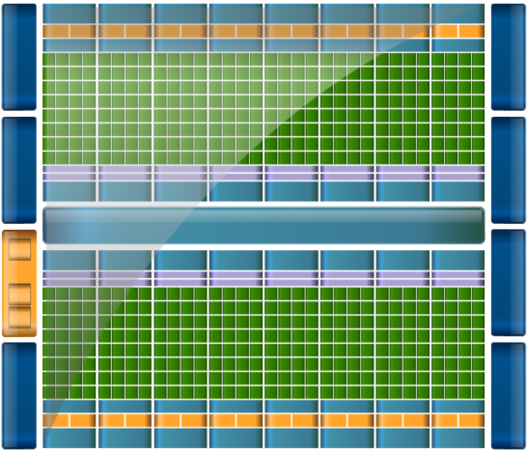

SM Multiprocessor
Instruction Cache
32 CUDA Cores per SM (512 total)
8x peak FP64 performance
  50% of peak FP32 performance
Direct load/store to memory
  Usual linear sequence of bytes
  High bandwidth (Hundreds GB/sec)
64KB of fast, on-chip RAM
  Software or hardware-managed
  Shared amongst CUDA cores
  Enables thread communication
Scheduler
Scheduler
Dispatch
Dispatch
Register File
Core
Core
Core
Core
Core
Core
Core
Core
Core
Core
Core
Core
Core
Core
Core
Core
Core
Core
Core
Core
Core
Core
Core
Core
Core
Core
Core
Core
Core
Core
Core
Core
Load/Store Units x 16
Special Func Units x 4
Interconnect Network
64K Configurable
Cache/Shared Mem
Uniform Cache
Notes:
SM at the heart of the NVIDIA GPU architecture
The individual scalar cores from the last slide are assembled into groups of 32 in an SM
SM = Streaming Multiprocessor
SP = Streaming Processor

Slide 27
Key Architectural Ideas
Instruction Cache
SIMT (Single Instruction Multiple Thread) execution
  threads run in groups of 32 called warps
  threads in a warp share instruction unit (IU)
  HW automatically handles divergence
Hardware multithreading
  HW resource allocation & thread scheduling
  HW relies on threads to hide latency
Threads have all resources needed to run
  any warp not waiting for something can run
  context switching is (basically) free
Scheduler
Scheduler
Dispatch
Dispatch
Register File
Core
Core
Core
Core
Core
Core
Core
Core
Core
Core
Core
Core
Core
Core
Core
Core
Core
Core
Core
Core
Core
Core
Core
Core
Core
Core
Core
Core
Core
Core
Core
Core
Load/Store Units x 16
Special Func Units x 4
Interconnect Network
64K Configurable
Cache/Shared Mem
Uniform Cache
Notes:
SIMT – “software” threads are assembled into groups of 32 called “warps” which time share the 32 hardware threads (CUDA cores)
Warps share control logic (such as the current instruction), so at a HW level, they are executed in SIMD. However, threads are also allowed to diverge, and resolving divergence is also automatically handled by the HW
I say “software” threads but in fact the hardware manages multithread allocating and scheduling, as well as handling divergence through a HW-managed stack
Because threads have all the resources they need to run threads can launch and execute basically for free

Slide 28
Enter CUDA
Scalable parallel programming model
Minimal extensions to familiar C/C++ environment
Heterogeneous serial-parallel computing
Notes:
How should a programmer make sense of all this? Enter CUDA -
Point of this slide is to decouple CUDA from GPUs. CUDA is a parallel programming model for the future, and a good way to write scalable code. GPUs accelerate it (enormously) but it is broader than a “language for GPUs”.

Slide 29
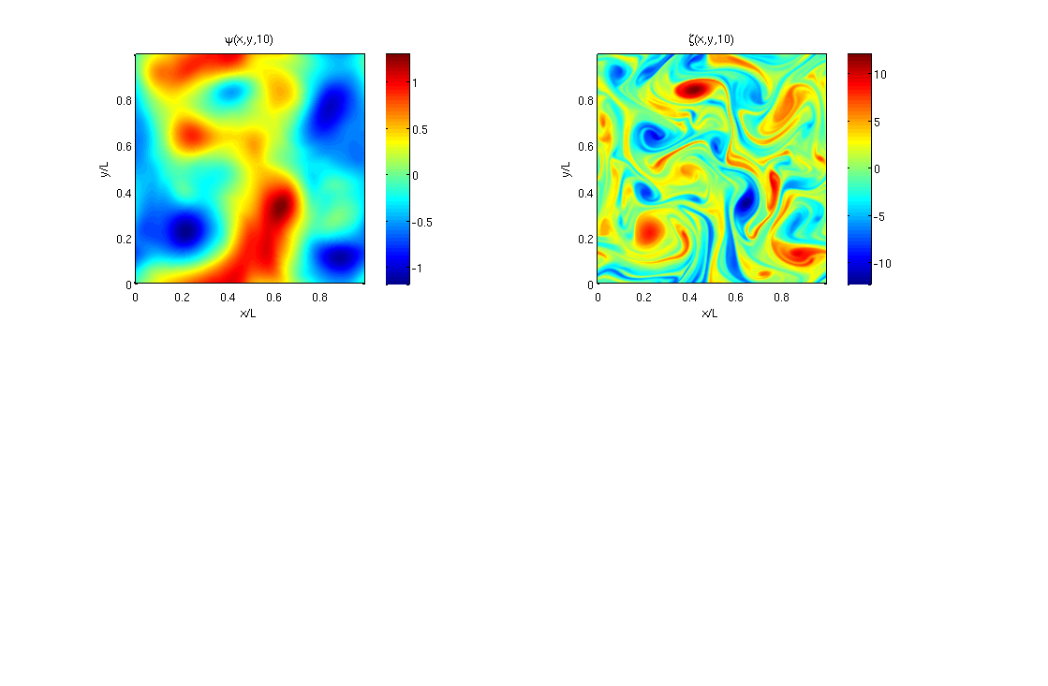
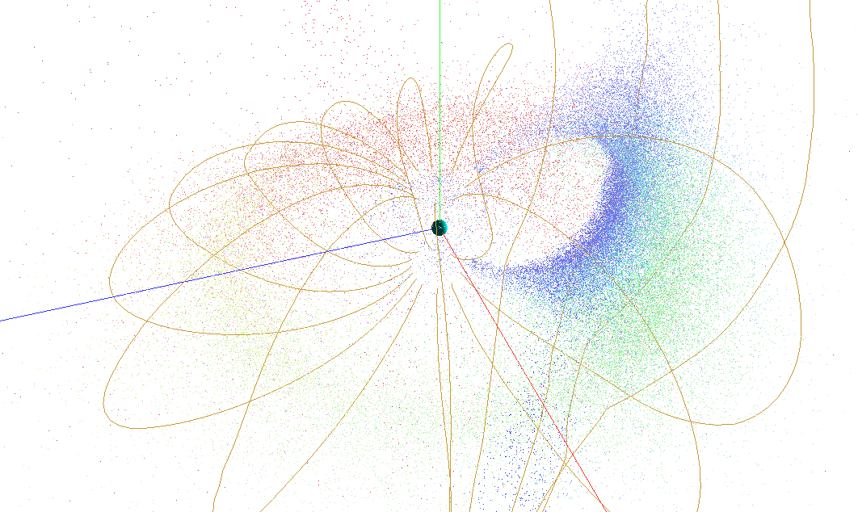

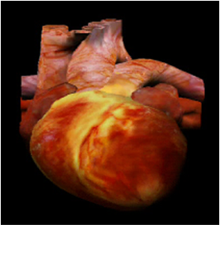

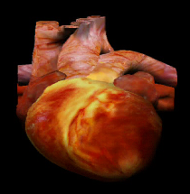

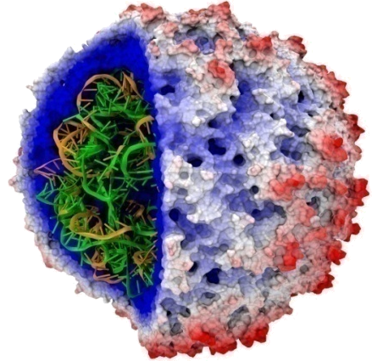

17X
45X
100X
13–457x
Motivation
110-240X
35X
Notes:
All results are speedups reported by non-NVIDIA folks over their own optimized CPU codes. In some sense it doesn’t matter whether these speedups are due to better programming model (CUDA is easier than SSE), or what kind of CPU is being compared too – this is what external scientists and engineers *experience* when they port their own code to CUDA. The exception is the Matlab plugin, but note that we didn’t modify the code – this is straight off a class web site at U. Washington, accelerated without modification by using Massimiliano’s MEX plugin.
Idea is to *quickly* go over these, pausing just long enough to rattle off what each picture represents, and use the last one (the heart) to say, “and, closer to home, this image is intended advanced MRI reconstruction …”
electromagnetic simulation for cell phone safety simulations. FDTD (finite-difference time-difference?) EM propagation code.
Matlab fluid mechanics code – a spectral solver for a vorticity-turbulence simulation I believe – accelerated transparently via M’s MEX plugins that call CUFFT instead of MATLAB’s built-in FFT routines.
nbody astrophysics - I believe this number comes from R. G. Belleman, J. Bédorf and S. F. Portegies, “High Performance Direct Gravitational N-body Simulations on Graphics Processing Units II: An implementation in CUDA,” arXiv:0707. 0438v2 [astro-ph], Jul 2007 (Accepted to New Astronomy). We beat the GRAPE custom simulation computer in both performance and price/performance - cheaper and faster.
Gene sequency matching with CMATCH – I dunno anything more than this unfortunately. Feel free to erase if it makes you nervous.
VMD cionize ion placement tool. 240x is the best they’ve observed and 110x is the more conservative number they went with in: J. Stone, J. Phillips, D. Hardy, P. Freddolino, L. Trabuco, K. Schulten. “Accelerating molecular modeling applications with graphics processors,” Journal of Computational Chemistry, Vol. 28, No. 16 , pp 2618 – 2640, 25 Sep 2007.
Speeding up advanced (non-Cartesian) MRI reconstruction through work at UIUC. Heart = marketing image. Oval images show why you care. Top image is traditional MRI reconstruction of noisy data - 47% error. Bottom is advanced non-Cartesian reconstruction – 16% error. But advanced recon is too slow for clinical use: Quadcore CPU takes 23 minutes. A GPU takes 99 seconds. The 13x faster is whole-application, the 457x is for one of the bottleneck kernels they ported. This is from the headliner on the next slide: S. Stone, J. Haldar, S. Tsao, W. Hwu, Z. Liang, B. Sutton. “Accelerating Advanced MRI Reconstructions on GPUs”, ACM Frontiers in Computing, Ischia, Italy, 2008.

Slide 30
CUDA: Scalable parallel programming
Augment C/C++ with minimalist abstractions
  let programmers focus on parallel algorithms
  not mechanics of a parallel programming language
Provide straightforward mapping onto hardware
  good fit to GPU architecture
  maps well to multi-core CPUs too
Scale to 100s of cores & 10,000s of parallel threads
  GPU threads are lightweight — create / switch is free
  GPU needs 1000s of threads for full utilization

Slide 31
Key Parallel Abstractions in CUDA
Hierarchy of concurrent threads
Lightweight synchronization primitives
Shared memory model for cooperating threads

Slide 32
Hierarchy of concurrent threads
Parallel kernels composed of many threads
  all threads execute the same sequential program
Threads are grouped into thread blocks
  threads in the same block can cooperate
Threads/blocks have unique IDs
Thread t
Block b
t0 t1 … tB

Slide 33








CUDA Model of Parallelism
Block
Memory
Block
Memory
• • •
Global Memory
CUDA virtualizes the physical hardware
  thread is a virtualized scalar processor (registers, PC, state)
  block is a virtualized multiprocessor (threads, shared mem.)
Scheduled onto physical hardware without pre-emption
  threads/blocks launch & run to completion
  blocks should be independent

Slide 34


NOT: Flat Multiprocessor
Processors
Global Memory
Global synchronization isn’t cheap
Global memory access times are expensive
cf. PRAM (Parallel Random Access Machine) model

Slide 35





NOT: Distributed Processors
Processor
Memory
Processor
Memory
• • •
Interconnection Network
Distributed computing is a different setting
cf. BSP (Bulk Synchronous Parallel) model, MPI

Slide 36








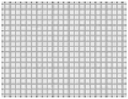

Heterogeneous Computing
Multicore CPU

Slide 37
C for CUDA
Philosophy: provide minimal set of extensions necessary to expose power
Function qualifiers:
  __global__ void my_kernel() { }
  __device__ float my_device_func() { }
Variable qualifiers:
  __constant__ float my_constant_array[32];
  __shared__ float my_shared_array[32];
Execution configuration:
  dim3 grid_dim(100, 50); // 5000 thread blocks
  dim3 block_dim(4, 8, 8); // 256 threads per block
  my_kernel <<< grid_dim, block_dim >>> (...); // Launch kernel
Built-in variables and functions valid in device code:
  dim3 gridDim; // Grid dimension
  dim3 blockDim; // Block dimension
  dim3 blockIdx; // Block index
  dim3 threadIdx; // Thread index
  void __syncthreads(); // Thread synchronization
Notes:
With C for CUDA, our philosophy has been to provide the minimal set of extensions to the C programming language to enable the programmer to succinctly describe a parallel problem such that it can take advantage of the power of massively parallel platforms
__global__ keyword tags a function as an entry point to a program that will run on a parallel compute device – think of this as the program’s main() function
__device__ keyword tags a function to tell the compiler that the function should execute on the GPU
__constant__ declares a read-only variable or array that lives in the GPU’s memory space
__shared__ provides read-write access to a variable or array that lives in on-chip memory space. Neighboring threads in a block are allowed to communicate through such variables
To launch a program, you call a function declared with the __global__ keyword and configure the “shape” of the computation. It may be convenient to describe the computation as a 1D (working on a linear array), 2D problem (think of doing some work on the pixels of an image), or 3D (think of doing some work on the voxels of a volume grid)
While in a __global__ or __device__ function, threads need to know their “location” in the computation, and that is provided by built-in variables:
gridDim & blockDim specify the shape of the current launch configuration, and blockIdx and threadIdx uniquely identify each thread in the grid
Finally, the built-in function __syncthreads() provides a synchronization barrier for all threads operating in a block – all computation halts until all threads in a block have reached the barrier. This comes in handy when threads want to pass messages to each other to cooperate on a problem

Slide 38
Example: vector_addition
Device Code
// compute vector sum c = a + b
// each thread performs one pair-wise addition
__global__ void vector_add(float* A, float* B, float* C)
{
int i = threadIdx.x + blockDim.x * blockIdx.x;
C[i] = A[i] + B[i];
}
int main()
{
// elided initialization code
...
// Run N/256 blocks of 256 threads each
vector_add<<< N/256, 256>>>(d_A, d_B, d_C);
}

Slide 39
Example: vector_addition
// compute vector sum c = a + b
// each thread performs one pair-wise addition
__global__ void vector_add(float* A, float* B, float* C)
{
int i = threadIdx.x + blockDim.x * blockIdx.x;
C[i] = A[i] + B[i];
}
int main()
{
// elided initialization code
...
// launch N/256 blocks of 256 threads each
vector_add<<< N/256, 256>>>(d_A, d_B, d_C);
}
Host Code

Slide 40
Example: Initialization code for vector_addition
// allocate and initialize host (CPU) memory
float *h_A = …, *h_B = …;
// allocate device (GPU) memory
float *d_A, *d_B, *d_C;
cudaMalloc( (void**) &d_A, N * sizeof(float));
cudaMalloc( (void**) &d_B, N * sizeof(float));
cudaMalloc( (void**) &d_C, N * sizeof(float));
// copy host memory to device
cudaMemcpy( d_A, h_A, N * sizeof(float), cudaMemcpyHostToDevice) );
cudaMemcpy( d_B, h_B, N * sizeof(float), cudaMemcpyHostToDevice) );
// launch N/256 blocks of 256 threads each
vector_add<<<N/256, 256>>>(d_A, d_B, d_C);

Slide 41
Previous Projects from UIUC ECE 498AL
Application | Description | Source | Kernel | % time
H.264 | SPEC ‘06 version, change in guess vector | 34,811 | 194 | 35%
LBM | SPEC ‘06 version, change to single precision and print fewer reports | 1,481 | 285 | >99%
RC5-72 | Distributed.net RC5-72 challenge client code | 1,979 | 218 | >99%
FEM | Finite element modeling, simulation of 3D graded materials | 1,874 | 146 | 99%
RPES | Rye Polynomial Equation Solver, quantum chem, 2-electron repulsion | 1,104 | 281 | 99%
PNS | Petri Net simulation of a distributed system | 322 | 160 | >99%
SAXPY | Single-precision implementation of saxpy, used in Linpack’s Gaussian elim. routine | 952 | 31 | >99%
TPACF | Two Point Angular Correlation Function | 536 | 98 | 96%
FDTD | Finite-Difference Time Domain analysis of 2D electromagnetic wave propagation | 1,365 | 93 | 16%
MRI-Q | Computing a matrix Q, a scanner’s configuration in MRI reconstruction | 490 | 33 | >99%

Slide 42
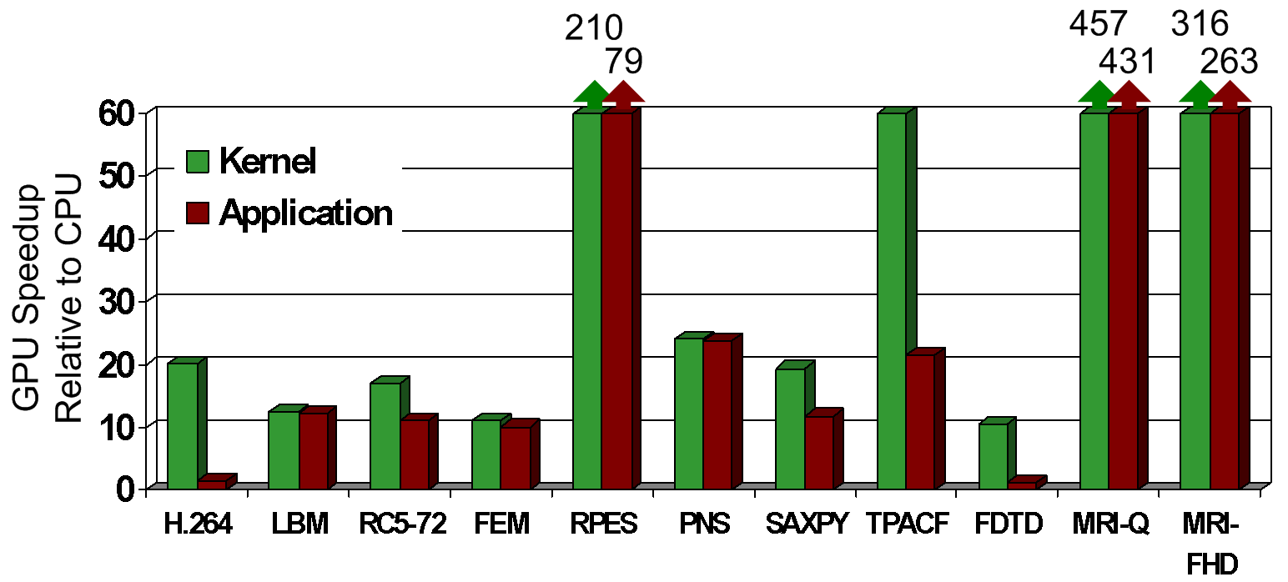
Speedup of Applications
GeForce 8800 GTX vs. 2.2GHz Opteron 248
10× speedup in a kernel is typical, as long as the kernel can occupy enough parallel threads
25× to 400× speedup if the function’s data requirements and control flow suit the GPU and the application is optimized

Slide 43
Final Thoughts
Parallel hardware is here to stay
GPUs are massively parallel manycore processors
  easily available and fully programmable
Parallelism & scalability are crucial for success
This presents many important research challenges
  not to speak of the educational challenges

Slide 44
Machine Problem 0
http://code.google.com/p/stanford-cs193g-sp2010/wiki/GettingStartedWithCUDA
Work through tutorial codes
  hello_world.cu
  cuda_memory_model.cu
  global_functions.cu
  device_functions.cu
  vector_addition.cu

