Slide 1
The Fermi Architecture
Michael C. Shebanow
Principal Research Scientist,
NV Research
mshebanow@nvidia.com

Slide 2


Fermi GF100 Overview

Slide 3
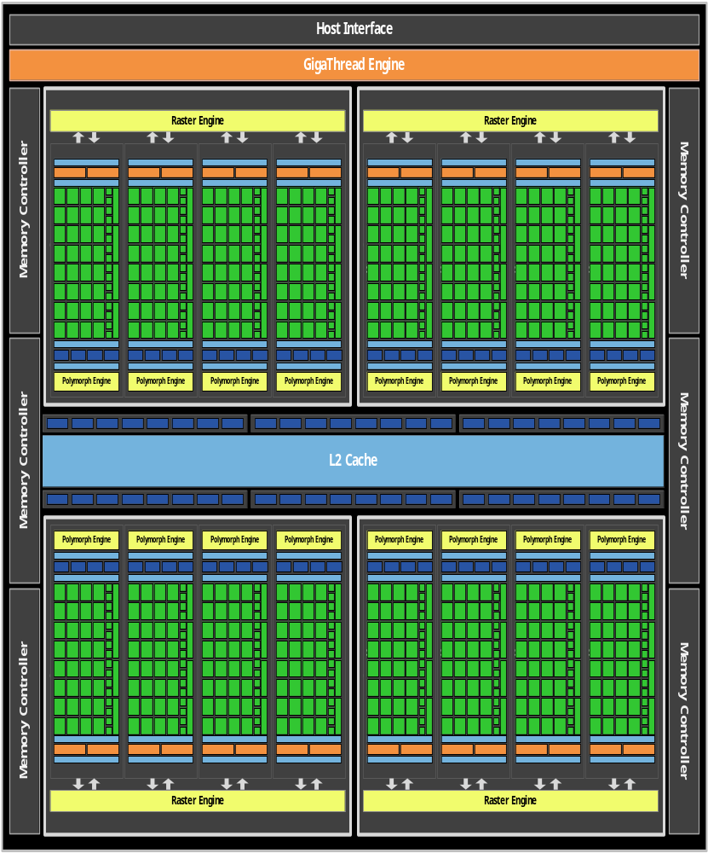
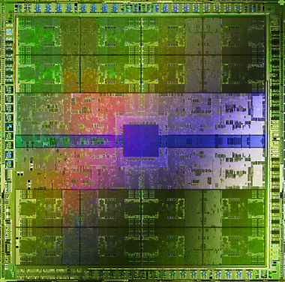
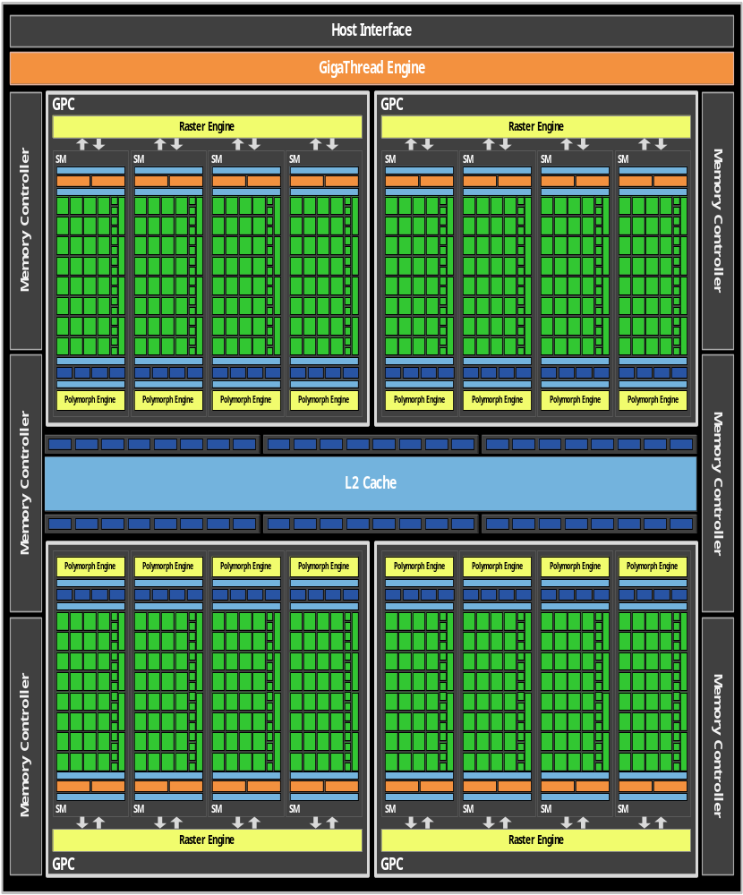
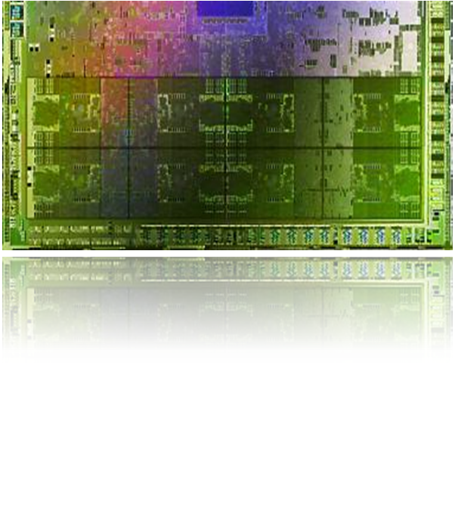
Fermi GF100 GPU

Slide 4
Comparing Fermi with GT200 & G80
GPU | G80 | GT200 | GF100
Transistors | 681 million | 1.4 billion | 3.0 billion
CUDA Cores | 128 | 240 | 512
Double Precision Floating Point | None | 30 FMA ops / clock | 256 FMA ops /clock
Single Precision Floating Point | 128 MAD ops/clock | 240 MAD ops / clock | 512 FMA ops /clock
Special Function Units / SM | 2 | 2 | 4
Warp schedulers (per SM) | 1 | 1 | 2
Shared Memory (per SM) | 16 KB | 16 KB | Configurable 48 KB or 16 KB
L1 Cache (per SM) | None | None | Configurable 16 KB or 48 KB
L2 Cache | None | None | 768 KB
ECC Memory Support | No | No | Yes
Concurrent Kernels | No | No | Up to 16
Load/Store Address Width | 32-bit | 32-bit | 64-bit

Slide 5

Soul of Fermi
Expand performance sweet spot of the GPU
  Caching
  Concurrent kernels
  FP64
Bring more users, more applications to the GPU
  C++
  Visual Studio Integration
  ECC

Slide 6
Fermi Focus Areas
Improved peak performance
Improved efficiency throughput
Broader applicability
Full integration within modern software development environment

Slide 7
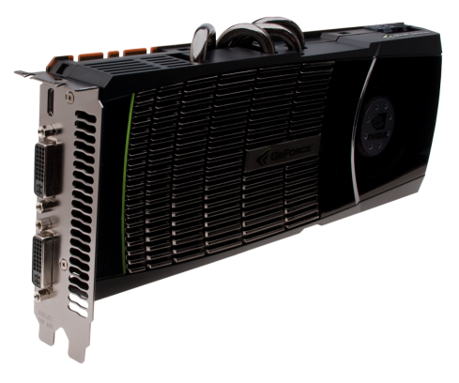
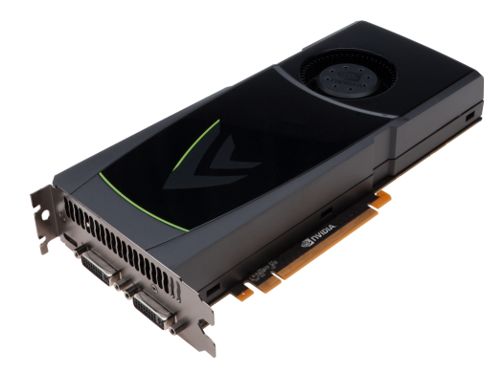
GeForce GTX 480
GeForce GTX 470
Memory | 1536MB / 384-bit GDDR5
Cores | 480
Gfx / Proc / Mem Clock | 700 / 1401 / 1848 MHz
Power Connectors | 6-pin + 8-pin
Power | 250W
SLI | 3-way
Length | 10.5 inches
Thermal | Dual Slot Fansink
Outputs | DL-DVI DL-DVI mini-HDMI
Memory | 1280MB / 320-bit GDDR5
Cores | 448
Gfx / Proc / Mem Clock | 607 / 1215 / 1674 MHz
Power Connectors | 2x 6-pin
Power | 215W
SLI | 3-way
Length | 9.5 inches
Thermal | Dual Slot Fansink
Outputs | DL-DVI DL-DVI mini-HDMI
Notes:
Add # of cores

Slide 8



Improving Geometric Realism: Tessellation
State of the Art in Games
State of the Art in Film
© Disney Enterprises, Inc. and Jerry Bruckheimer, Inc.
All rights reserved. Image courtesy Industrial Light & Magic.
Notes:
GF100 added two principal features: tessellation and caches

Slide 9
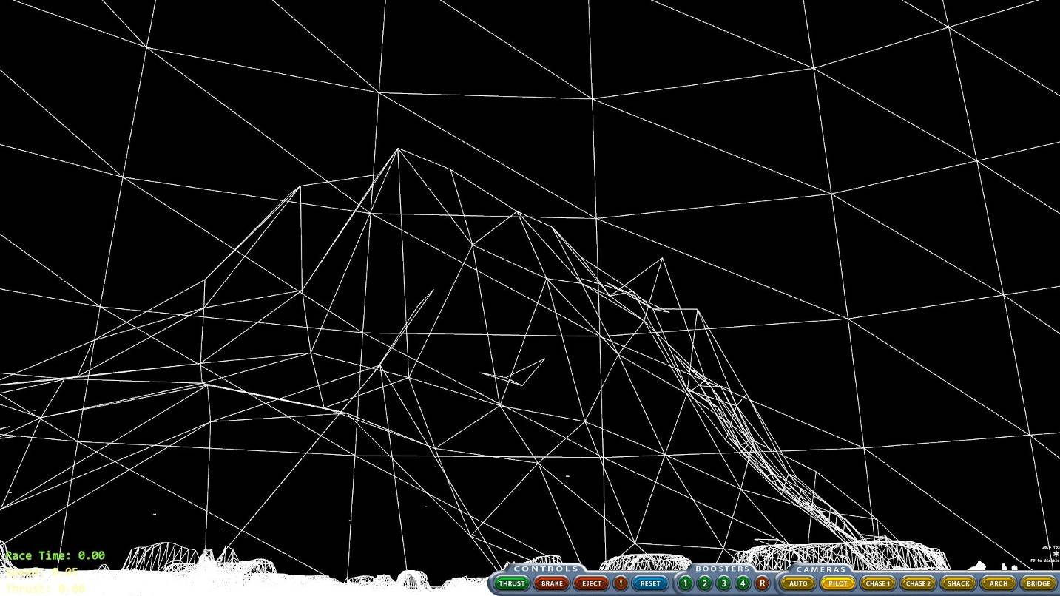

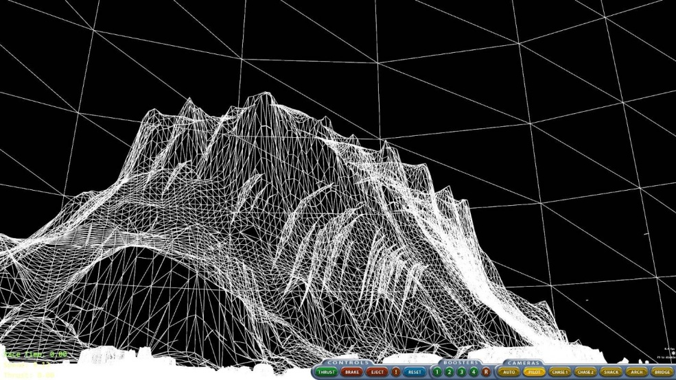

What is Tessellation?

Slide 10
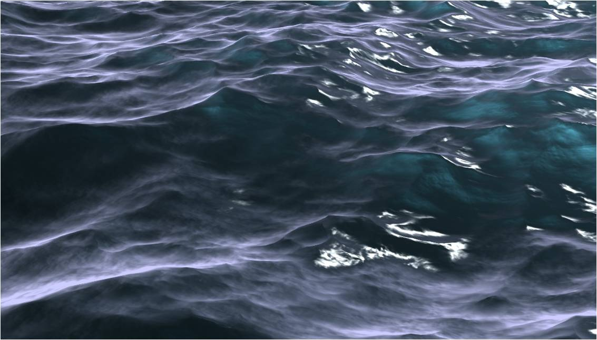


Tessellation Applications
Realistic water: Up to 1.6e9 triangles/sec
Hair: 18,000 hair strands
(~4x vs. prior demos)
Notes:
Run water demo here

Slide 11




Tessellation Off/On

Slide 12
Much Better Compute
Programmability
  C++ Support
  Exceptions/Debug support
Performance
  Dual issue SMs
  L1 cache
  Larger Shared
  Much better DP math
  Much better atomic support
Reliability: ECC
 | GT200 | GF100 | Benefit
L1 Texture Cache (per quad) | 12 KB | 12 KB | Fast texture filtering
Dedicated L1 LD/ST Cache | X | 16 or 48 KB | Efficient physics and ray tracing
Total Shared Memory | 16KB | 16 or 48 KB | More data reuse among threads
L2 Cache | 256KB (TEX read only) | 768 KB (all clients read/write) | Greater texture coverage, robust compute performance
Double Precision Throughput | 30 FMAs/clock | 256 FMAs/clock | Much higher throughputs for Scientific codes

Slide 13
Fermi SM Architecture

Slide 14
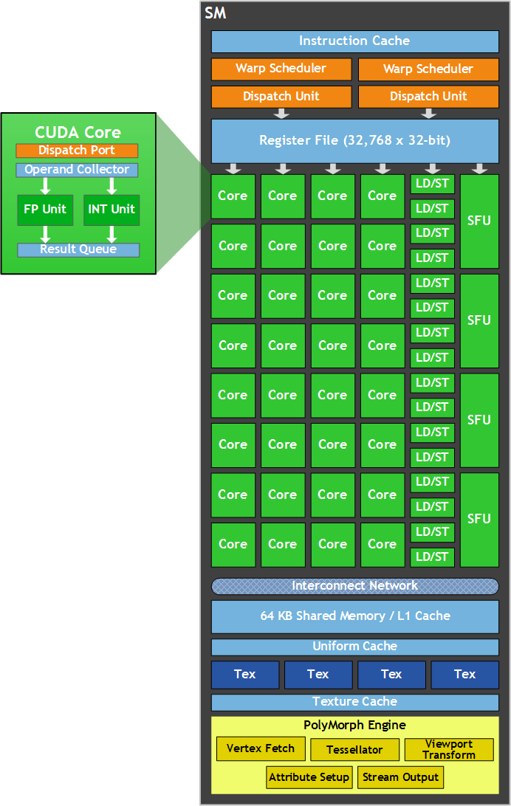
Fermi SM
Objective – DX11 support
  Polymorph engine
Objective – Optimize for GPU computing
  New ISA
  Revamp issue / control flow
  New CUDA core architecture
32 cores per SM
(512 cores total)
64KB configurable
L1$ / shared memory
 | FP32 | FP64 | INT | SFU | LD/ST
Ops / clk | 32 | 16 | 32 | 4 | 16
Notes:
FP64 from 60 to 512 ops/clk

Slide 15
CUDA Core Architecture
Decoupled FP32 and integer execution datapaths
Double precision throughput increased: now 50% of single precision peak
Integer operations optimized for extended precision
  64 bit and wider data element size
Predication field for all instructions
Fused multiply add FP datapath

Slide 16
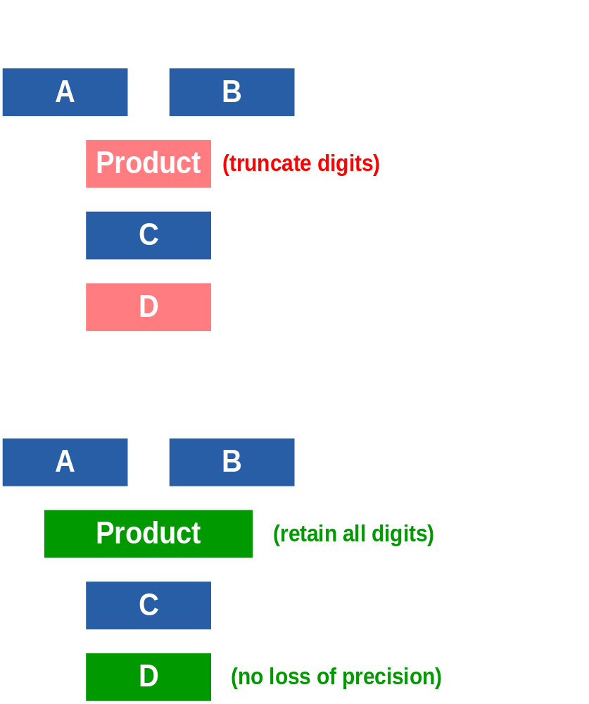
IEEE 754-2008 Floating Point
IEEE 754-2008 results
  64-bit double precision
  32-bit single precision
  Rounding, subnormals
  NaNs, +/- Infinity
IEEE 754-2008 rounding:
nearest even, zero, +inf, -inf
Full-speed subnormal operands and subnormal results
IEEE 754-2008 Fused Multiply-Add (FMA)
  D = A*B + C;
  No loss of precision
  IEEE divide & sqrt use FMA

Slide 17
Instruction Set Architecture
Enables C++ : virtual functions, new/delete, try/catch
Unified load/store addressing
64-bit addressing for large problems
Optimized for CUDA C, OpenCL & Direct Compute
  Native (x,y)-based LD/ST operations with format conversion
Enables system call functionality – stdio.h, etc.

Slide 18
Multiple Memory Scopes
Per-thread private memory
  Each thread has its own local memory
  Stacks, other private data
Per-thread-block shared memory
  Small memory close to the processor, low latency
  Allocated per thread block
Main memory
  GPU frame buffer
  Can be accessed by any thread in any thread block
Thread
Per-thread
Local Memory
Block
Per-block
Shared
Memory
Kernel 0
Per-device
Global
Memory
Sequential
Blocks
. . .
Kernel 1
. . .
Notes:
Emphasize threads have their own registers

Slide 19
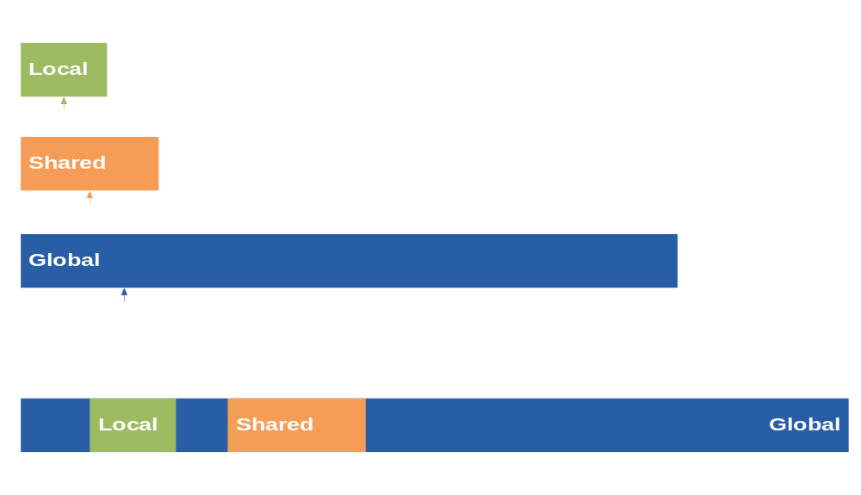
Unified Load/Store Addressing

Slide 20
Atomic Operations
(Read / Modify / Writes)
Fast inter-block, thread-safe communication
  Significantly more efficient chip-wide synchronization
  Much faster parallel aggregation
    Faster ray tracing, histogram computation, clustering and pattern recognition, face recognition, speech recognition, BLAS, etc
  Accelerated by cached memory hierarchy
Fermi increases atomic performance by 5x to 20x

Slide 21
ECC
All major internal memories are ECC protected
  Register file, L1 cache, L2 cache
DRAM protected by ECC
  ECC supported for GDDR5 as well as SDDR3 memory configurations
ECC is a must have for many computing applications
  Clear customer feedback

Slide 22
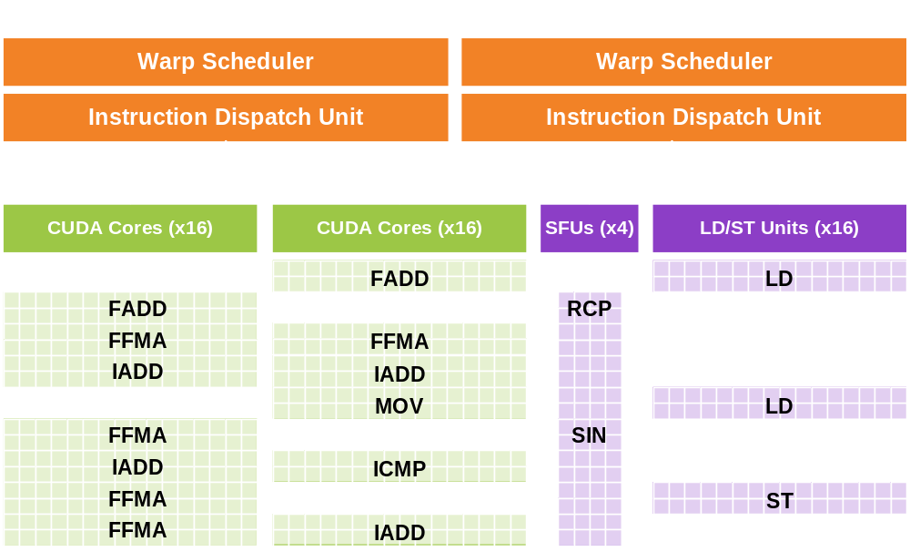
SM Operational Block Diagram

Slide 23
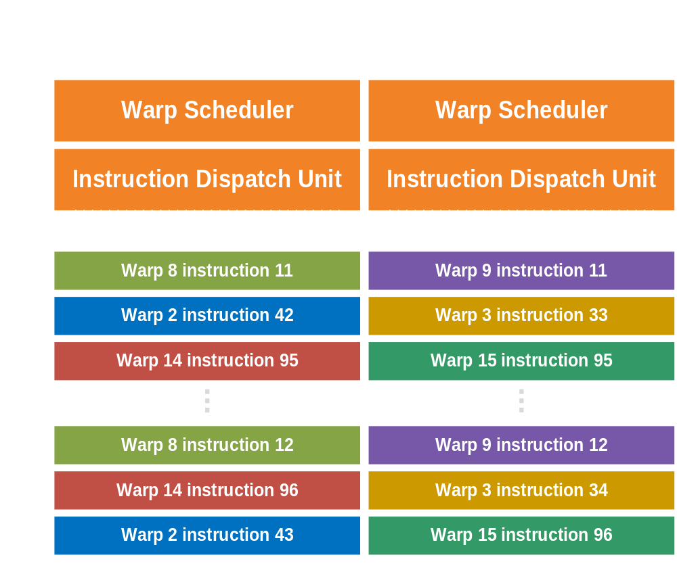
Instruction Issue and Control Flow
Decouple internal execution resources
  Deliver peak IPC on branchy / int-heavy / LD-ST - heavy codes
Dual issue pipelines select two warps to issue

Slide 24
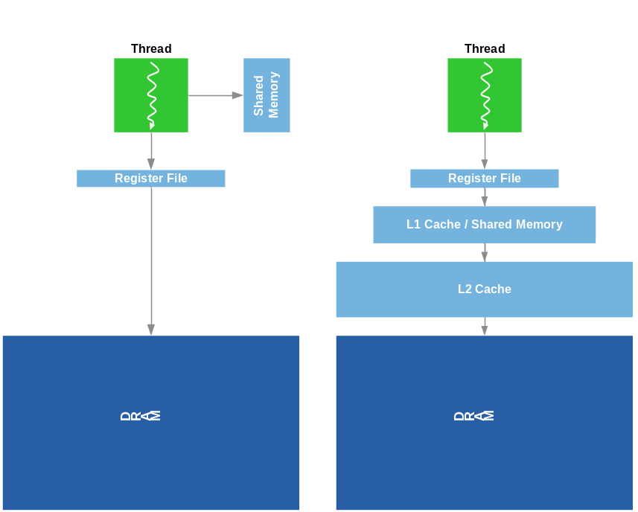
Caches
Configurable L1 cache per SM
  16KB L1$ / 48KB Shared Memory
  48KB L1$ / 16KB Shared Memory
Shared 768KB L2 cache
Compute motivation:
  Caching captures locality, amplifies bandwidth
  Caching more effective than Shared Memory RAM for irregular or unpredictable access
    Ray tracing, sparse matrix multiply, physics kernels …
  Caching helps latency sensitive cases

Slide 25
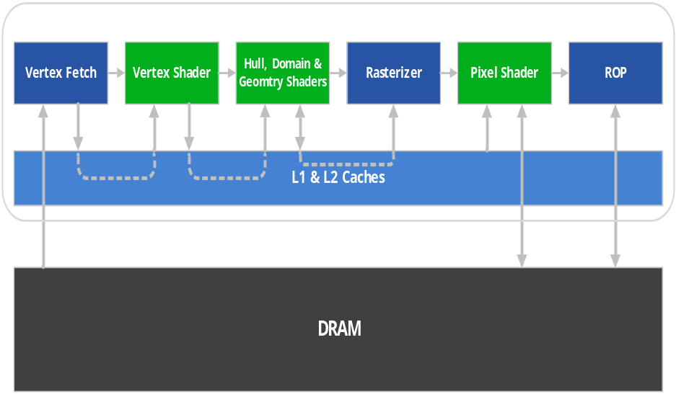


Cache Usage: Graphics
Data stays on die
L1 cache
  Register spilling
  Stack ops
  Global LD/ST
L2 Cache
  Vertex, SM, Texture and ROP Data
Notes:
NVIDIA vs. AMD Cache – are there cases where unified/large cache helps us?
Using L2 as output buffer for tessellation
ROP with high depth/geometric complexity
Emmett – look for high hit rate statistics

Slide 26
Fermi Application Tuning

Slide 27
GPU Computing Key Concepts
Hardware (HW) thread management
  HW thread launch and monitoring
  HW thread switching
  Tens of thousands of lightweight, concurrent threads
  Real threads: PC, private registers, …
SIMT execution model
Multiple memory scopes
  Per-thread private memory
  Per-thread-block shared memory
  Global memory
Using threads to hide memory latency
Coarse grain thread synchronization
Notes:
Lookup Bulk syncronization

Slide 28
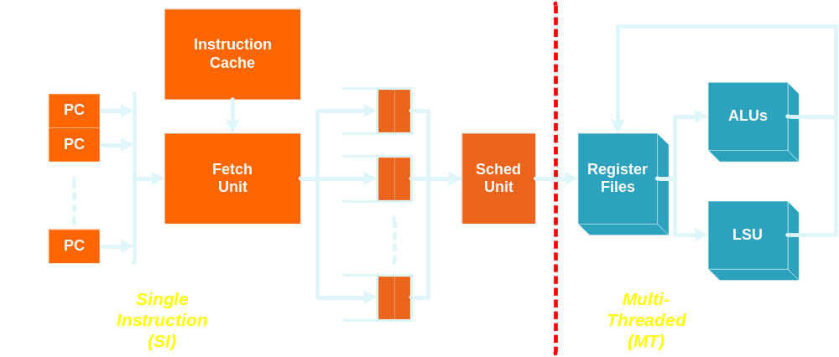
SM Limiter Theory Block Diagram

Slide 29

Limiter Theory
SM a form of queuing system
Use “limiter theory” to predict SM performance
  Supply vs. Demand
There are three types of limits on the performance of the SM:
  Bandwidth resource limiters
  Per-thread-block space limiters
  Per-thread space limiters
The most constraining limiter is called the critical limiter
  = min(all limiters)

Slide 30
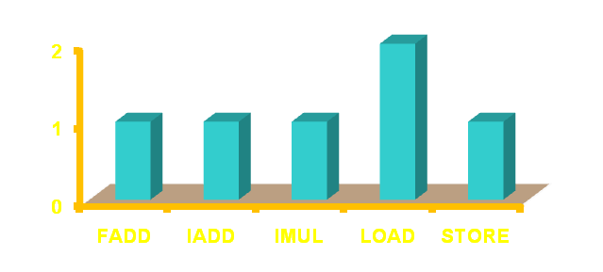
Bandwidth Limiters
Thread blocks arrive at some rate λ_{TB}
Threads composed of some distribution of operations (FMUL, FADD, LD, etc.)
  Each arriving thread block of S threads contributes to a distribution of operations to be performed
Per operation type, the offered load, or BW “demand”, is the product of:
  Thread block arrival rate λ_{TB}
  # of threads S in a block
  Operation count N_{op} in each thread
BW “supply” λ_{op}
  Throughput available for some operation type “op”
BW limiter equation:
      (λ_{TB} x S x N_{op}) ≤ λ_{op} ⇒ λ_{TB} ≤ λ_{op} / ( S x N_{op})
      BW “supply” is an upper bound on throughput
Demand
Supply
BW Limiter Equation
// Compute vector sum C = A+B
// Each thread performs one pair-wise addition
__global__ void vecAdd(float* A, float* B, float* C)
{
int i = threadIdx.x + blockDim.x * blockIdx.x;
C[i] = A[i] + B[i];
}
Notes:
Focus is generally on BW, not latency
Demand vs. Capacity: For example, a thread might have to execute 10 FMULs during its lifetime
If the thread takes time T to execute, then the offered load of FMULs is 10/T – this is a BW demand
HW has a finite capacity for each type of resource
Demand will be constrained to capacity

Slide 31
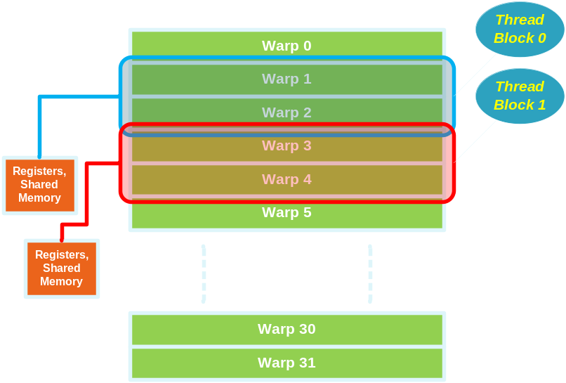
Space Limiters
SM also has space resources. Examples:
  Finite limit on warp count
  Finite limit on register file space
  Finite limit on shared memory size
Space resources:
  Allocated on thread block launch
  Deallocated on thread block completion
  Consumption computed using Little’s Law
Thread Latency (L)
  Complex computation
  Varies with memory behavior
Little’s Law:
  N = λ L
  N = number “in flight”
  λ = arrival rate (throughput)
  L = service latency
Inverted:
  λ ≤ N / L

Slide 32
Implications of Limiter Theory
Limiter theory assumes uniform workloads
  Breaks down if “traffic jam” behavior
  Limiter theory is an ok 1st order approximation
Kernel code has to pay careful attention to operation “mix”
  Math-to-memory operation ratios for example
  Do not want to bottleneck on one function unit leaving other units idling
  Ideal: all units equally critical
Don’t “traffic jam” kernel code
  Making thread blocks too large so that only a few execute on the SM at a time a bad idea
  “Bunching” operations of a similar type in one section of a kernel will aggravate the problem
  Ideal: lots of small thread blocks with uniform distribution of operation densities
Focus on space resource consumption
  Ideal: use as few resources necessary to “load the SM”

Slide 33
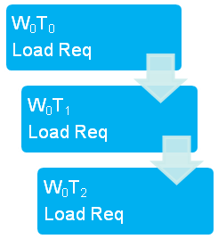
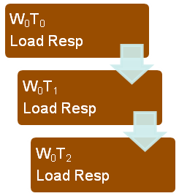


Hiding LD Latency
Principle:
  Little’s Law again:
  N = “number in flight”
  λ = arrival rate
  L = memory latency
Arrival Rate product of:
  Desired execution rate (IPC)
  Density of LOAD instructions (%)
N = # of threads needed to cover latency L
Time

Slide 34
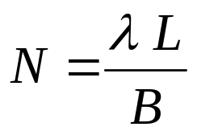
Hiding LOAD Latency w/ Fewer Threads
Use batching
Group independent LDs together
Modified law:
  B = batch size
// batch size 3 example
float *d_A, *d_B, *d_C;
float a, b, c, result;
a = *d_A; b = *d_B; c = *d_C;
result = a * b + c;
The values ‘a’, ‘b’, and ‘c’ are loaded independently before being used
Implication is that we can execute 3 loads from one thread before the first use (‘a’ in this case) causes a stall

Slide 35
Final Performance Tuning Thoughts
Threads are free
  A common mistake in GPU Computing kernels is to make threads do too much
  Keep them short, sweet , & balanced
    Example: one thread per vector element
  HW provides LOTs of them (10s of thousands)
  HW launch => near zero overhead to create them
  HW context switching => near zero overhead scheduling
Barriers are cheap
  Single instruction
  HW synchronization of thread blocks
  Partition kernel code into producer-consumer
  DON’T use spin locks!
Partition on results, not sources

Slide 36
