Slide 1
Stanford CS 193G
Lecture 15:
Optimizing Parallel GPU Performance
2010-05-20
John Nickolls

Slide 2

Optimizing parallel performance
Understand how software maps to architecture
Use heterogeneous CPU+GPU computing
Use massive amounts of parallelism
Understand SIMT instruction execution
Enable global memory coalescing
Understand cache behavior
Use Shared memory
Optimize memory copies
Understand PTX instructions

Slide 3
CUDA Parallel Threads and Memory
Block
Thread
Registers
Per-block
Shared
Memory
Per-thread Private
Local Memory
float LocalVar;
__shared__ float SharedVar;
Grid 0
Sequence
Per-app
Device
Global
Memory
. . .
Grid 1
. . .
__device__ float GlobalVar;

Slide 4



Using CPU+GPU Architecture
Heterogeneous system architecture
Use the right processor and memory for each task
CPU excels at executing a few serial threads
  Fast sequential execution
  Low latency cached memory access
GPU excels at executing many parallel threads
  Scalable parallel execution
  High bandwidth parallel memory access
GPU
CPU
Cache
Cache
Host Memory
Bridge
Device Memory
PCIe

Slide 5



CUDA kernel maps to Grid of Blocks
kernel_func<<<nblk, nthread>>>(param, … );
Host Thread
Grid of Thread Blocks
. . .
GPU
SMs:
CPU
Cache
Cache
Host Memory
Bridge
Device Memory
PCIe

Slide 6
Thread blocks execute on an SM
Thread instructions execute on a core
float myVar;
__shared__ float shVar;
__device__ float glVar;
Thread
Block
Registers
Per-app
Device
Global
Memory
Per-block
Shared
Memory
Per-thread
Local Memory
GPU
SMs:
CPU
Cache
Cache
Host Memory
Bridge
Device Memory
PCIe

Slide 7



CUDA Parallelism
CUDA virtualizes the physical hardware
  Thread is a virtualized scalar processor (registers, PC, state)
  Block is a virtualized multiprocessor (threads, shared mem.)
Scheduled onto physical hardware without pre-emption
  Threads/blocks launch & run to completion
  Blocks execute independently
Host Thread
Grid of Thread Blocks
. . .
GPU
SMs:
CPU
Cache
Cache
Host Memory
Bridge
Device Memory
PCIe

Slide 8
Expose Massive Parallelism
Use hundreds to thousands of thread blocks
  A thread block executes on one SM
  Need many blocks to use 10s of SMs
  SM executes 2 to 8 concurrent blocks efficiently
  Need many blocks to scale to different GPUs
  Coarse-grained data parallelism, task parallelism
Use hundreds of threads per thread block
  A thread instruction executes on one core
  Need 384 – 512 threads/SM to use all the cores all the time
  Use multiple of 32 threads (warp) per thread block
  Fine-grained data parallelism, vector parallelism, thread parallelism, instruction-level parallelism
Notes:
Common sources of poor CUDA performance is using too few CTAs – and using two few threads per CTA.

Slide 9
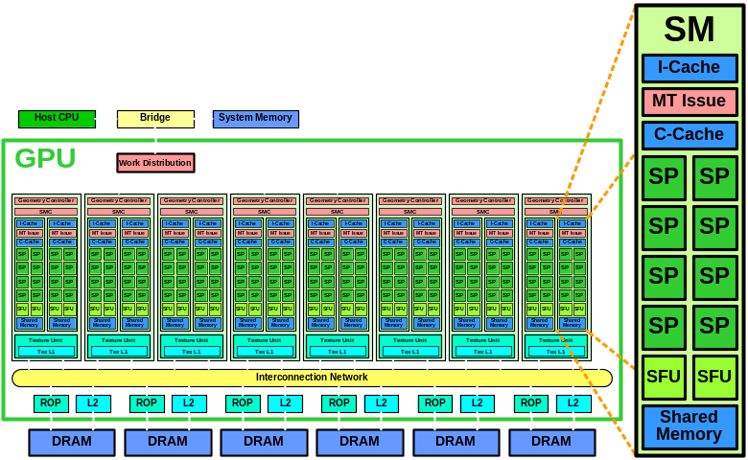
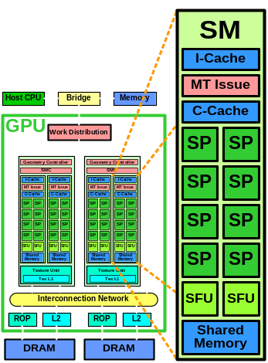
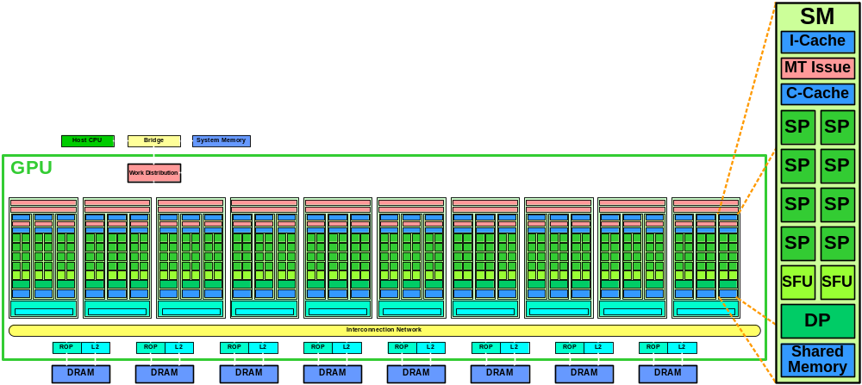
Scalable Parallel Architectures run thousands of concurrent threads
32 SP cores
3,072 threads
128 SP cores
12,288 threads
240 SP cores
30,720 threads

Slide 10
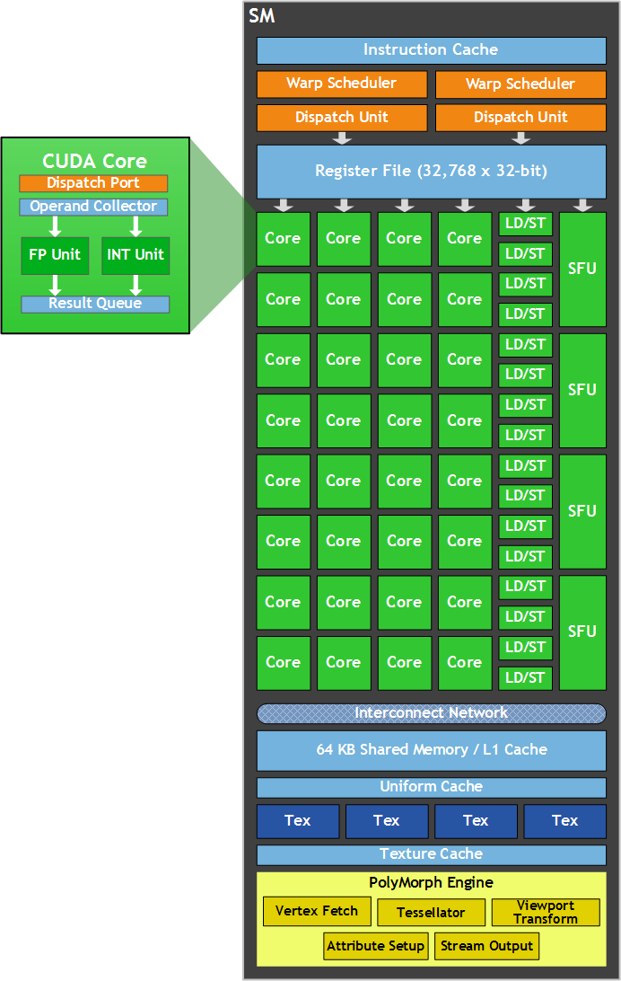
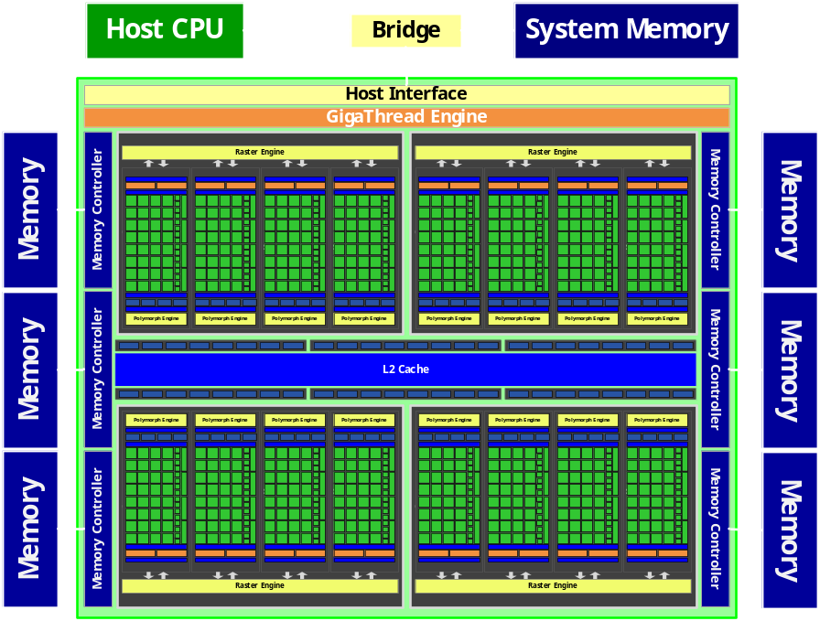
Fermi SM increases instruction-level parallelism
512 CUDA Cores
24,576 threads
CUDA
Core
SM

Slide 11
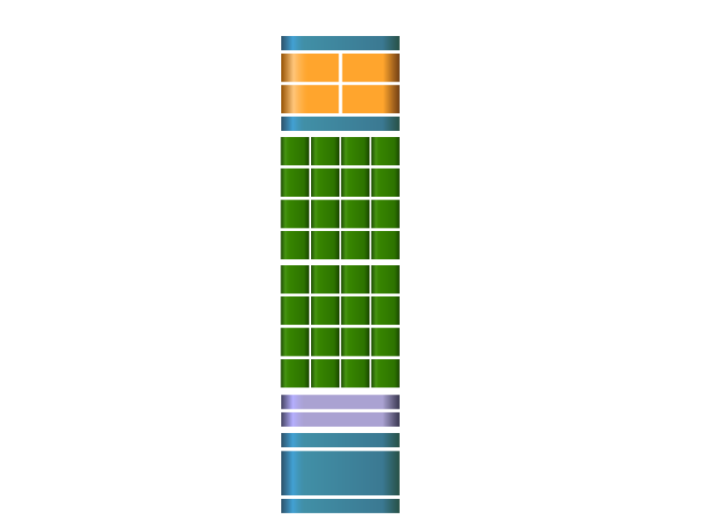

SM parallel instruction execution
Instruction Cache
SIMT (Single Instruction Multiple Thread) execution
  Threads run in groups of 32 called warps
  Threads in a warp share instruction unit (IU)
  HW automatically handles branch divergence
Hardware multithreading
  HW resource allocation & thread scheduling
  HW relies on threads to hide latency
Threads have all resources needed to run
  Any warp not waiting for something can run
  Warp context switches are zero overhead
Scheduler
Scheduler
Dispatch
Dispatch
Register File
Core
Core
Core
Core
Core
Core
Core
Core
Core
Core
Core
Core
Core
Core
Core
Core
Core
Core
Core
Core
Core
Core
Core
Core
Core
Core
Core
Core
Core
Core
Core
Core
Load/Store Units x 16
Special Func Units x 4
Interconnect Network
64K Configurable
Cache/Shared Mem
Uniform Cache
Notes:
SIMT – “software” threads are assembled into groups of 32 called “warps” which time share the 32 hardware threads (CUDA cores)
Warps share control logic (such as the current instruction), so at a HW level, they are executed in SIMD. However, threads are also allowed to diverge, and resolving divergence is also automatically handled by the HW
I say “software” threads but in fact the hardware manages multithread allocating and scheduling, as well as handling divergence through a HW-managed stack
Because threads have all the resources they need to run threads can launch and execute basically for free

Slide 12
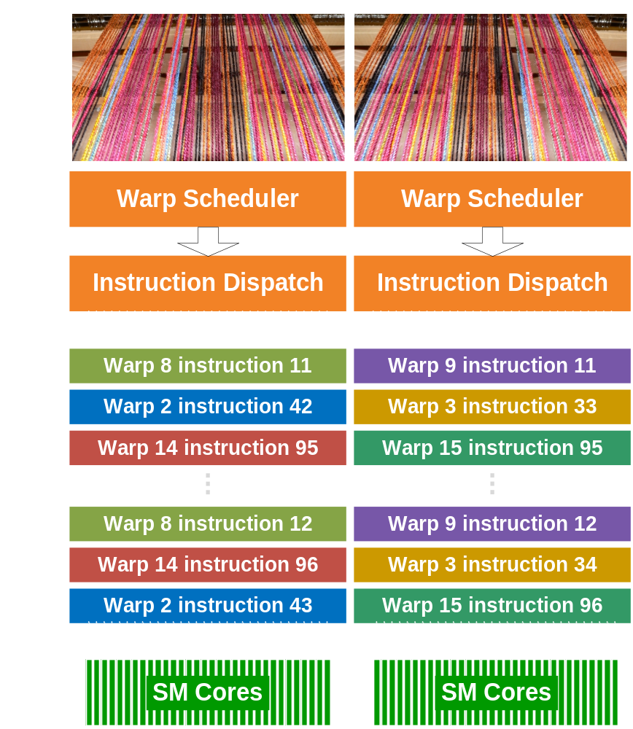
SIMT Warp Execution in the SM
Warp: a set of 32 parallel threads
that execute an instruction together
SIMT: Single-Instruction Multi-Thread
applies instruction to warp of independent parallel threads
SM dual issue pipelines select two warps to issue to parallel cores
SIMT warp executes each instruction for 32 threads
Predicates enable/disable individual thread execution
Stack manages per-thread branching
Redundant regular computation faster than irregular branching

Slide 13
Enable Global Memory Coalescing
Individual threads access independent addresses
A thread loads/stores 1, 2, 4, 8, 16 B per access
LD.sz / ST.sz; sz = {8, 16, 32, 64, 128} bits per thread
For 32 parallel threads in a warp, SM load/store units coalesce individual thread accesses into minimum number of 128B cache line accesses or 32B memory block accesses
Access serializes to distinct cache lines or memory blocks
Use nearby addresses for threads in a warp
Use unit stride accesses when possible
Use Structure of Arrays (SoA) to get unit stride

Slide 14
Unit stride accesses coalesce well
__global__ void kernel(float* arrayIn,
float* arrayOut)
{
int i = blockDim.x * blockIdx.x
+ threadIdx.x;
// Stride 1 coalesced load access
float val = arrayIn[i];
// Stride 1 coalesced store access
arrayOut[i] = val + 1;
}

Slide 15
Example Coalesced Memory Access
16 threads within a warp load 8 B per thread:
LD.64 Rd, [Ra + offset] ;
16 individual 8B thread accesses fall in two 128B cache lines
LD.64 coalesces 16 individual accesses into 2 cache line accesses
Implements parallel vector scatter/gather
Loads from same address are broadcast
Stores to same address select a winner
Atomics to same address serialize
Coalescing scales gracefully with the number of unique cache lines or memory blocks accessed
Address 112
Address 120
Thread 0
Address 128
Thread 1
Address 136
Thread 2
Address 144
Thread 3
Address 152
Thread 4
Address 160
Thread 5
Address 168
Thread 6
Address 176
Thread 7
Address 184
128B cache line
Thread 8
Address 192
Thread 9
Address 200
Thread 10
Address 208
Thread 11
Address 216
Thread 12
Address 224
Thread 13
Address 232
Thread 14
Address 240
Thread 15
Address 248
Address 256
Address 264

Slide 16
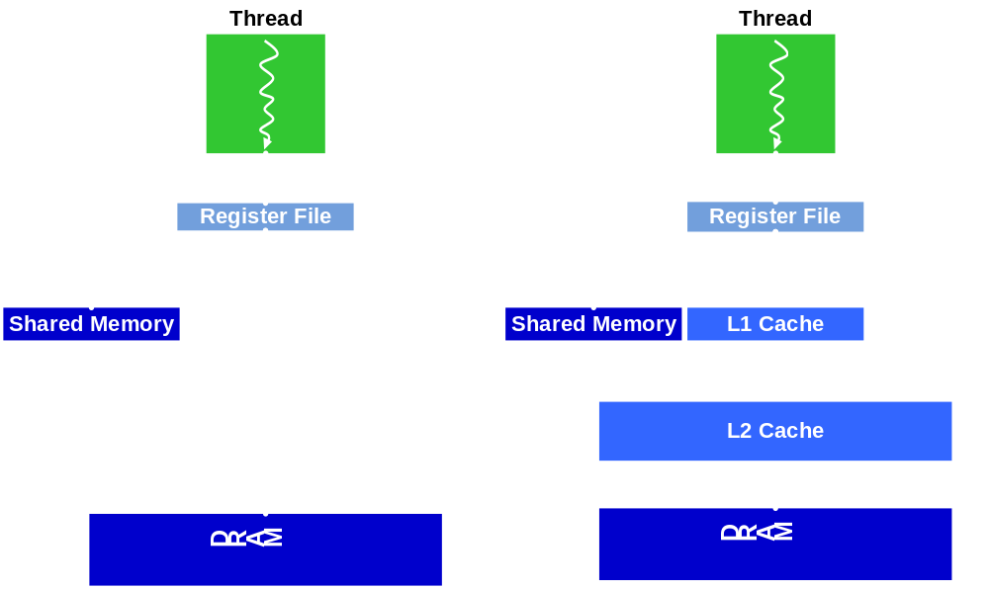
Memory Access Pipeline
Load/store/atomic memory accesses are pipelined
Latency to DRAM is a few hundred clocks
Batch load requests together, then use return values
Latency to Shared Memory / L1 Cache is 10 – 20 cycles

Slide 17
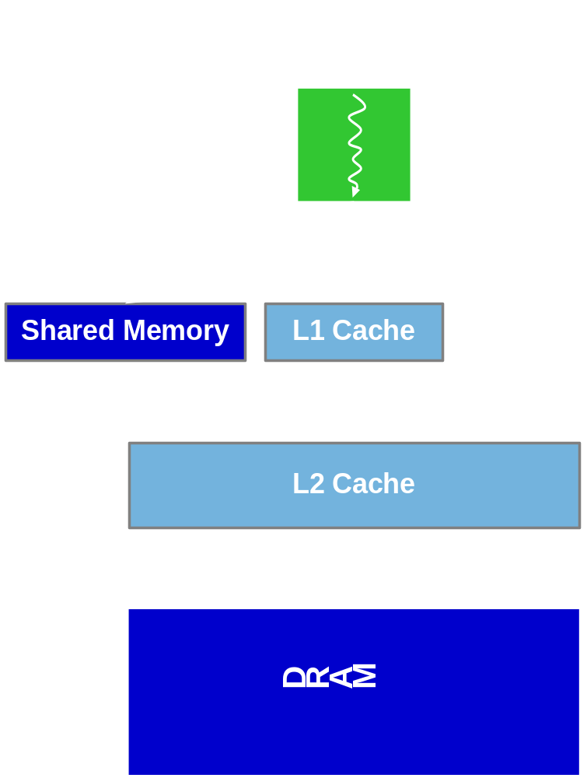
Fermi Cached Memory Hierarchy
Configurable L1 cache per SM
  16KB L1$ / 48KB Shared Memory
  48KB L1$ / 16KB Shared Memory
L1 caches per-thread local accesses
  Register spilling, stack access
L1 caches global LD accesses
Global stores bypass L1
Shared 768KB L2 cache
L2 cache speeds atomic operations
Caching captures locality, amplifies bandwidth, reduces latency
Caching aids irregular or unpredictable accesses

Slide 18
Use per-Block Shared Memory
Latency is an order of magnitude lower than L2 or DRAM
Bandwidth is 4x – 8x higher than L2 or DRAM
Place data blocks or tiles in shared memory when the data is accessed multiple times
Communicate among threads in a block using Shared memory
Use synchronization barriers between communication steps
  __syncthreads() is single bar.sync instruction – very fast
Threads of warp access shared memory banks in parallel via fast crossbar network
Bank conflicts can occur – incur a minor performance impact
Pad 2D tiles with extra column for parallel column access if tile width == # of banks (16 or 32)

Slide 19

Using cudaMemCpy()
CPU
Host Memory
Bridge
Device Memory
PCIe
cudaMemcpy()
cudaMemcpy() invokes a DMA copy engine
Minimize the number of copies
Use data as long as possible in a given place
PCIe gen2 peak bandwidth = 6 GB/s
GPU load/store DRAM peak bandwidth = 150 GB/s

Slide 20




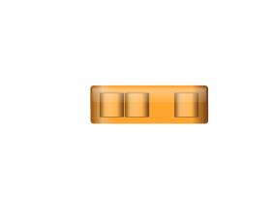



Overlap computing & CPU⬄GPU transfers
cudaMemcpy() invokes data transfer engines
  CPU→GPU and GPU→CPU data transfers
  Overlap with CPU and GPU processing
Pipeline Snapshot:
Kernel 0
CPU
cpy =>
GPU
cpy <=
Kernel 1
CPU
cpy =>
GPU
cpy <=
Kernel 2
CPU
cpy =>
GPU
cpy <=
Kernel 3
CPU
cpy =>
GPU
cpy <=

Slide 21
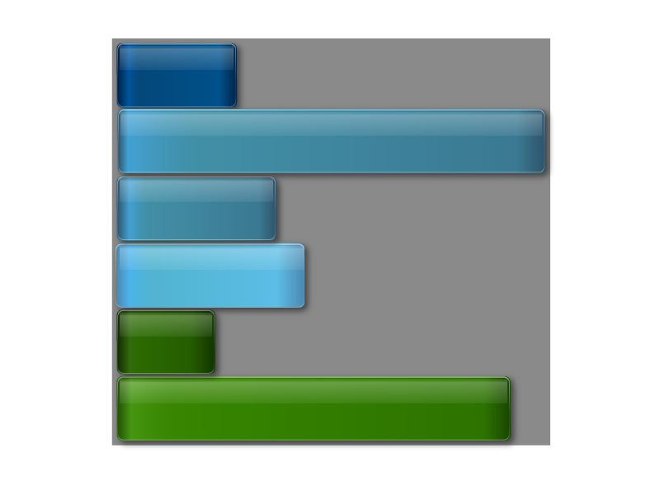




Fermi runs independent kernels in parallel
Concurrent Kernel Execution + Faster Context Switch
Kernel 1
Kernel 1
Kernel 2
Kernel 2
Kernel 2
Kernel 3
Ker
4
Kernel 2
nel
Kernel 5
Time
Kernel 3
Kernel 4
Kernel 5
Serial Kernel Execution
Parallel Kernel Execution

Slide 22
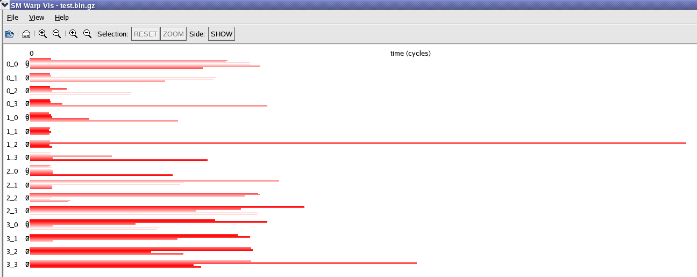
Minimize thread runtime variance
Long running warp
SMs
Time:
Warps executing kernel with variable run time

Slide 23
PTX Instructions
Generate a program.ptx file with nvcc –ptx
http://developer.download.nvidia.com/compute/cuda/3_0/toolkit/docs/ptx_isa_2.0.pdf
PTX instructions: op.type dest, srcA, srcB;
  type = .b32, .u32, .s32, .f32, .b64, .u64, .s64, .f64
  memtype = .b8, .b16, .b32, .b64, .b128
PTX instructions map directly to Fermi instructions
  Some map to instruction sequences, e.g. div, rem, sqrt
  PTX virtual register operands map to SM registers
Arithmetic: add, sub, mul, mad, fma, div, rcp, rem, abs, neg, min, max, setp.cmp, cvt
Function: sqrt, sin, cos, lg2, ex2
Logical: mov, selp, and, or, xor, not, cnot, shl, shr
Memory: ld, st, atom.op, tex, suld, sust
Control: bra, call, ret, exit, bar.sync

Slide 24
Optimizing Parallel GPU Performance
Understand the parallel architecture
Understand how application maps to architecture
Use LOTS of parallel threads and blocks
Often better to redundantly compute in parallel
Access memory in local regions
Leverage high memory bandwidth
Keep data in GPU device memory
Experiment and measure
Questions?

