Slide 1
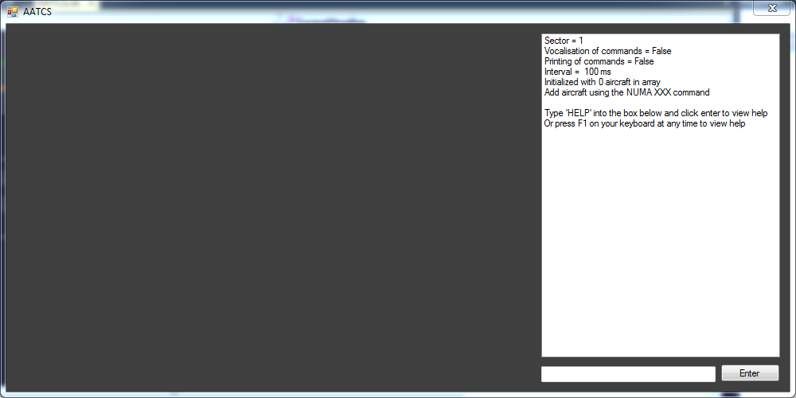
Using a command to change the number of aircraft
Click on input box to enter the command “NUMA 009” to change the number of aircraft to 009.

Slide 2
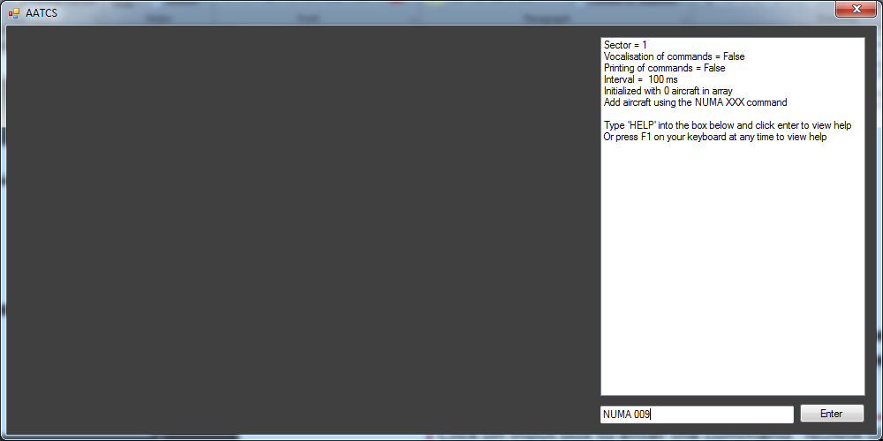
Using a command to change the number of aircraft
Click on the enter button to execute the command

Slide 3
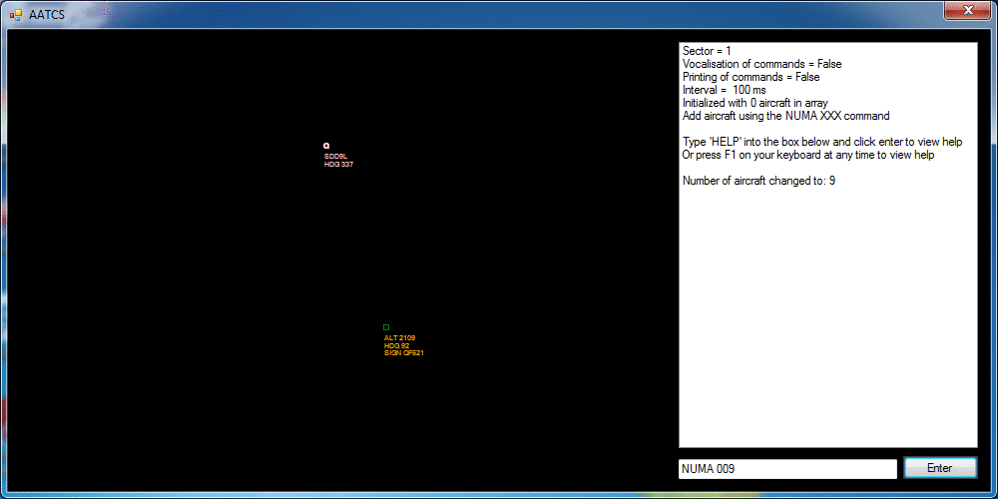
Using a command to change the number of aircraft
The number of aircraft is changed to 9 (shown in the list box) and the simulation now runs.
Please refer to the user guide for more information on reading the display, using commands and editing files.

