Slide 1
Sonli ketma-ketlik
Matematik analiz

Slide 2
R e j a
1.Sonli ketma-ketlik tushunchasi
2.Ketma-ketlikning berilish usullari
3.Ketma-ketlik limitining ta’rifi

Slide 3

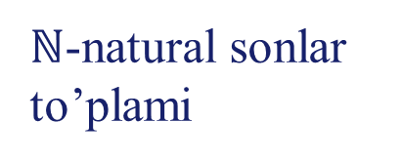


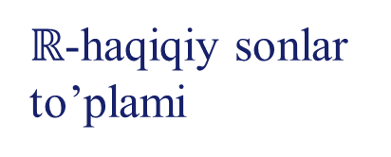







Sonli ketma-ketlik tushunchasi
$$f:n→x_{n}$$
Agar har bir natural son $n$ ga biror haqiqiy $x_{n}$ soni mos qo‘yilgan bo‘lsa, u holda
$x_{1}, x_{2},x_{3},…,x_{n},…$
ketma-ketlik (sonli ketma-ketlik) berilgan deyiladi.
$$1→x_{1}$$
$$2→x_{2}$$
$$3→x_{3}$$
$$4→x_{4}$$
$$f:ℕ→ℝ$$
$$5→x_{5}$$
$$……$$
$ℕ$-natural sonlar to’plami
$ℝ$-haqiqiy sonlar to’plami
$$n→x_{n}$$
$$…..$$

Slide 4







Sonli ketma-ketlik tushunchasi
$$x_{1}$$
$$x_{3}$$
$$x_{5}$$
$$….$$
$$x_{2}$$
$$x_{6}$$
$$x_{8}$$
$$….$$
$$=−1$$
$$x_{n}={\left(−1\right)}^{n}$$
$$=1$$
Ketma-ketlikning qiymatlari to‘plami CHEKLI yoki CHEKSIZ, hadlari to‘plami hamma vaqt cheksiz to‘plamdir
$$x_{1}=1$$
$$x_{2}=4$$
$$x_{3}=9$$
$$….$$
$$x_{n}=n^{2}$$

Slide 5
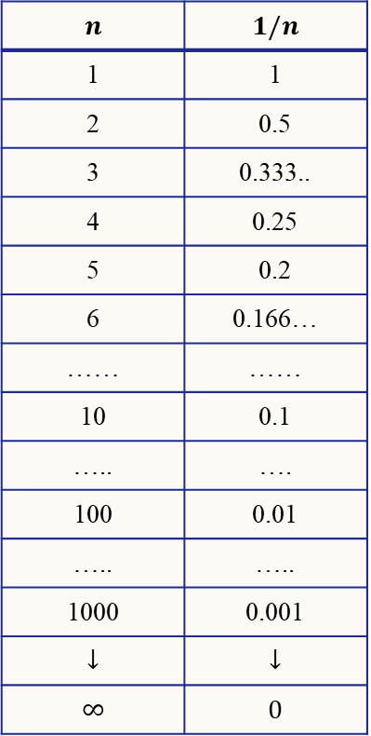
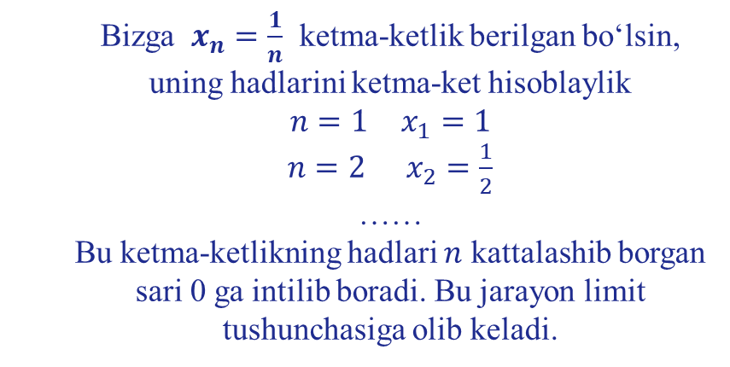
Ketma-ketlikNING limiti
$$n$$ | $$1/n$$
1 | 1
2 | 0.5
3 | 0.333..
4 | 0.25
5 | 0.2
6 | 0.166…
…… | ……
10 | 0.1
….. | ….
100 | 0.01
….. | …..
1000 | 0.001
$$↓$$ | $$↓$$
$$∞$$ | $$0$$
Bizga $x_{n}=\frac{1}{n}$ ketma-ketlik berilgan bo‘lsin, uning hadlarini ketma-ket hisoblaylik
$n=1$ $x_{1}=1$
$n=2$ $x_{2}=\frac{1}{2}$
……
Bu ketma-ketlikning hadlari $n$ kattalashib borgan sari 0 ga intilib boradi. Bu jarayon limit tushunchasiga olib keladi.

Slide 6
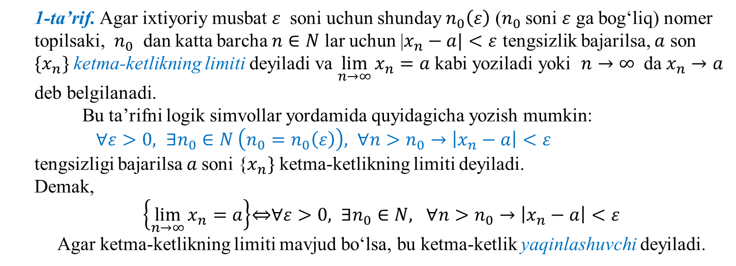
Ketma-ketlik limitining ta’rifi
1-ta’rif. Agar ixtiyoriy musbat $ε$ soni uchun shunday $n_{0}\left(ε\right)$ ($n_{0}$ soni $ε$ ga bog‘liq) nomer topilsaki, $n_{0}$ dan katta barcha $n∈N$ lar uchun |$x_{n}−a|<ε$ tengsizlik bajarilsa, $a$ son $\{x_{n}\}$ ketma-ketlikning limiti deyiladi va $\lim_{n→∞}{x_{n}=a}$ kabi yoziladi yoki $n→∞$ da $x_{n}→a$ deb belgilanadi.
Bu ta’rifni logik simvollar yordamida quyidagicha yozish mumkin:
$∀ε>0, ∃n_{0}∈N \left(n_{0}=n_{0}\left(ε\right)\right), ∀n>n_{0}→\left|x_{n}−a\right|<ε$
tengsizligi bajarilsa $a$soni {$x_{n}\}$ ketma-ketlikning limiti deyiladi.
Demak,
$\left\{\lim_{n→∞}{x_{n}}=a\right\}$⇔$∀ε>0, ∃n_{0}∈N, ∀n>n_{0}→\left|x_{n}−a\right|<ε$
Agar ketma-ketlikning limiti mavjud bo‘lsa, bu ketma-ketlik yaqinlashuvchi deyiladi.

Slide 7
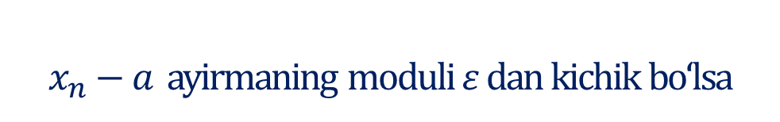




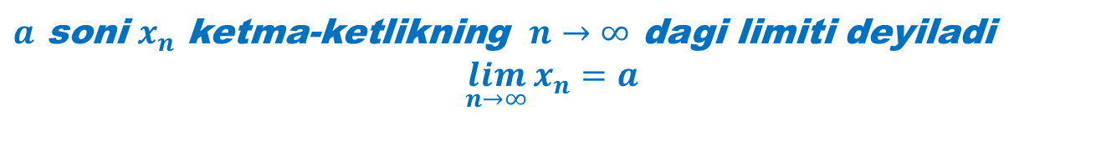


Ketma-ketlik limitining ta’rifini belgilashlar orqali yozishni o‘rganamiz
Agar ixtiyoriy $ε$ musbat soni olinganda ham
$$∀ε>0$$
Shunday $n_{0}$ ($ε$ ga bog‘liq) nomer topilsaki
$$∃n_{0}(ε)∈N$$
$n_{0}$ dan katta barcha $n$ lar uchun
$$∀n>n_{0}$$
$x_{n}−a$ ayirmaning moduli $ε$ dan kichik bo‘lsa
$$\left|x_{n}−a\right|<ε$$
$a$ soni $x_{n}$ ketma-ketlikning $n→∞$ dagi limiti deyiladi
$$\lim_{n→∞}{x_{n}=a}$$

Slide 8











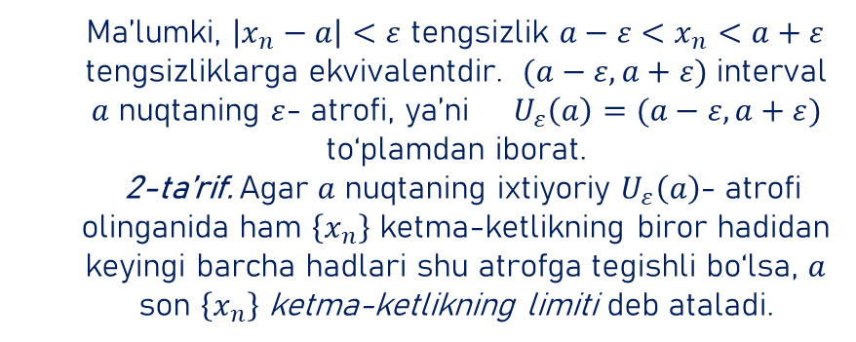
2-ta’rif
$$x_{n}$$
Ma’lumki, $\left|x_{n}−a\right|<ε$ tengsizlik $a−ε<x_{n}<a+ε$ tengsizliklarga ekvivalentdir. $(a−ε,a+ε)$ interval $a$ nuqtaning $ε$- atrofi, ya’ni $U_{ε}\left(a\right)=(a−ε,a+ε)$ to‘plamdan iborat.
2-ta’rif. Agar $a$ nuqtaning ixtiyoriy $U_{ε}\left(a\right)$- atrofi olinganida ham $\left\{x_{n}\right\}$ ketma-ketlikning biror hadidan keyingi barcha hadlari shu atrofga tegishli bo‘lsa, $a$ son $\left\{x_{n}\right\}$ ketma-ketlikning limiti deb ataladi.
$$a+ε$$
$$a$$
$$a−ε$$
$$n$$
$$1$$
$$2$$
$$3$$
$$…$$
$$n_{0}$$
$$n$$

Slide 9
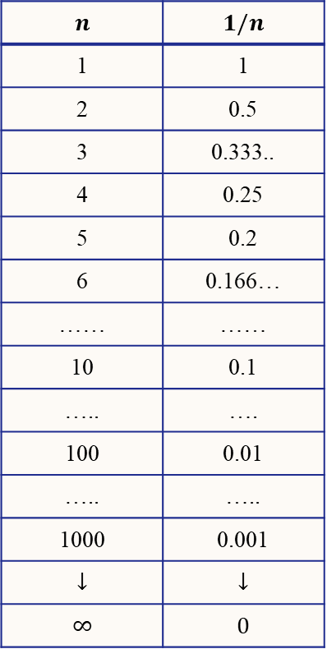
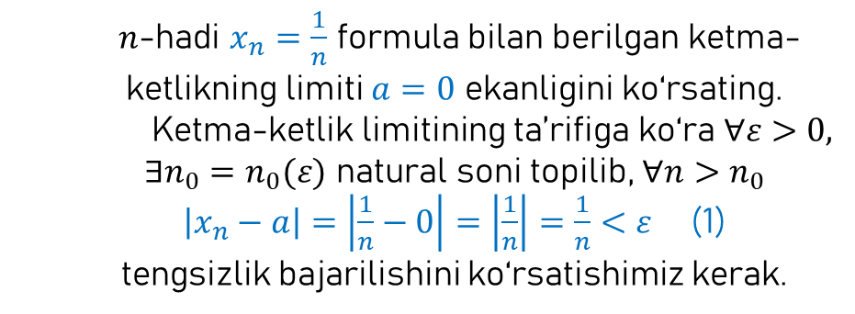
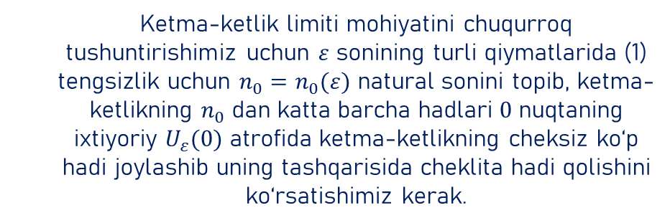
1-misol
$$n$$ | $$1/n$$
1 | 1
2 | 0.5
3 | 0.333..
4 | 0.25
5 | 0.2
6 | 0.166…
…… | ……
10 | 0.1
….. | ….
100 | 0.01
….. | …..
1000 | 0.001
$$↓$$ | $$↓$$
$$∞$$ | $$0$$
$n$-hadi $x_{n}=\frac{1}{n}$ formula bilan berilgan ketma-ketlikning limiti $a=0$ ekanligini ko‘rsating.
Ketma-ketlik limitining ta’rifiga ko‘ra $∀ε>0, ∃n_{0}=n_{0}(ε)$ natural soni topilib, $∀n>n_{0}$
$\left|x_{n}−a\right|=\left|\frac{1}{n}−0\right|=\left|\frac{1}{n}\right|=\frac{1}{n}<ε$ (1)
tengsizlik bajarilishini ko‘rsatishimiz kerak.
Ketma-ketlik limiti mohiyatini chuqurroq tushuntirishimiz uchun $ε$ sonining turli qiymatlarida (1) tengsizlik uchun $n_{0}=n_{0}(ε)$ natural sonini topib, ketma-ketlikning $n_{0}$ dan katta barcha hadlari $0$ nuqtaning ixtiyoriy $U_{ε}(0)$ atrofida ketma-ketlikning cheksiz ko‘p hadi joylashib uning tashqarisida cheklita hadi qolishini ko‘rsatishimiz kerak.

Slide 10







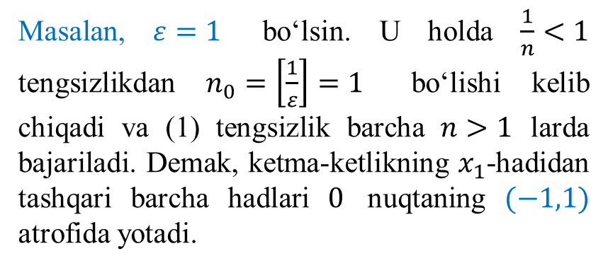









Masalan, $ε=1$ bo‘lsin. U holda $\frac{1}{n}<1$ tengsizlikdan $n_{0}=\left[\frac{1}{ε}\right]=1$ bo‘lishi kelib chiqadi va (1) tengsizlik barcha $n>1$ larda bajariladi. Demak, ketma-ketlikning $x_{1}$-hadidan tashqari barcha hadlari $0$ nuqtaning $(−1,1)$ atrofida yotadi.
$$x_{n}$$
……………………………...........
$$1$$
$$x_{1}$$
$$x_{2}$$
$$x_{3}$$
$$x_{4}$$
$$x_{5}$$
$$x_{100}$$
$$0$$
……….
$$1$$
$$2$$
3
$$4$$
$$5$$
$$100$$
$$n$$
……………………………...........
$$−1$$

Slide 11






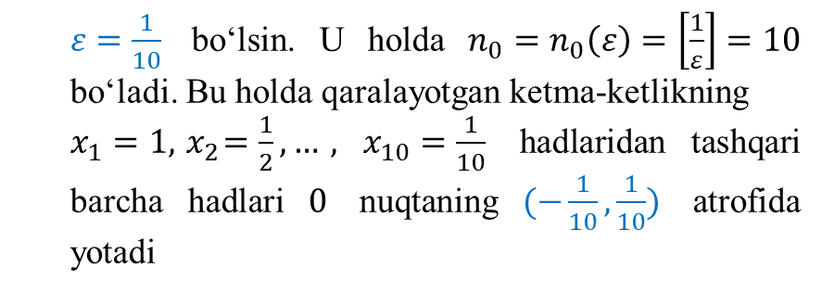










$$x_{n}$$
$ε=\frac{1}{10}$ bo‘lsin. U holda $n_{0}=n_{0}\left(ε\right)=\left[\frac{1}{ε}\right]=10$ bo‘ladi. Bu holda qaralayotgan ketma-ketlikning
$x_{1}=1, { x}_{2}=\frac{1}{2},…, x_{10}=\frac{1}{10}$ hadlaridan tashqari barcha hadlari $0$ nuqtaning $(−\frac{1}{10},\frac{1}{10})$ atrofida yotadi
$$x_{1}$$
$$x_{2}$$
$$x_{3}$$
$$x_{4}$$
$$x_{5}$$
$$x_{6}$$
$$x_{7}$$
$$x_{8}$$
$$\frac{1}{10}$$
$$x_{9}$$
……………………………...........
$$x_{10}$$
$$x_{11}$$
$$x_{12}$$
$$x_{100}$$
$$0$$
$$n$$
$$−\frac{1}{10}$$
……………………………...........

Slide 12


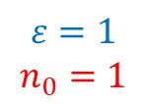





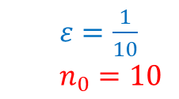












$$ε=1$$
$$n_{0}=1$$
$ε=\frac{1}{10}$
$n_{0}=10$
$$x_{n}$$
$$x_{n}$$
$$x_{1}$$
$$x_{2}$$
……………………………...........
$$1$$
$$x_{1}$$
$$x_{3}$$
$$x_{2}$$
$$x_{4}$$
$$x_{3}$$
$$x_{5}$$
$$x_{6}$$
$$x_{4}$$
$$x_{7}$$
$$x_{8}$$
$$x_{5}$$
$$\frac{1}{10}$$
$$x_{9}$$
……………………………...........
$$x_{100}$$
$$x_{10}$$
$$0$$
……….
$$x_{11}$$
$$1$$
$$2$$
3
$$4$$
$$5$$
$$100$$
$$n$$
$$x_{12}$$
$$x_{100}$$
$$0$$
$$n$$
……………………………...........
$$−\frac{1}{10}$$
……………………………...........
$$−1$$

Slide 13



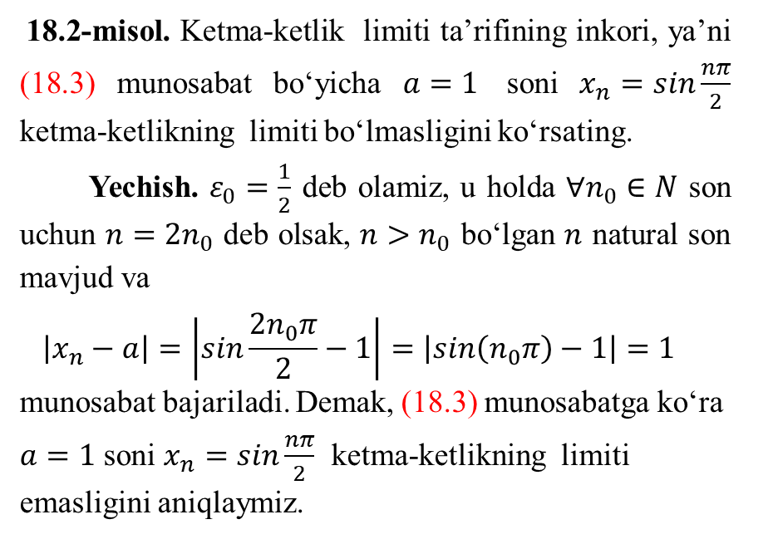




18.2-misol. Ketma-ketlik limiti ta’rifining inkori, ya’ni (18.3) munosabat bo‘yicha $a=1$ soni $x_{n}=sin\frac{nπ}{2}$ ketma-ketlikning limiti bo‘lmasligini ko‘rsating.
Yechish. $ε_{0}=\frac{1}{2}$ deb olamiz, u holda $∀n_{0}∈N$ son uchun ${n=2n}_{0}$ deb olsak, ${n>n}_{0}$ bo‘lgan $n$ natural son mavjud va
$$\left|x_{n}−a\right|=\left|sin\frac{{2n}_{0}π}{2}−1\right|=\left|sin\left(n_{0}π\right)−1\right|=1>\frac{1}{2}$$
munosabat bajariladi. Demak, (18.3) munosabatga ko‘ra $a=1$ soni $x_{n}=sin\frac{nπ}{2}$ ketma-ketlikning limiti emasligini aniqlaymiz.
$$x_{n}$$
……………………………...........
$$\frac{3}{2}$$
$$1$$
$$x_{1}$$
$$x_{5}$$
$$\frac{1}{2}$$
……………………………...........
$$0$$
$$x_{2}$$
$$x_{4}$$
$$x_{6}$$
$$1$$
$$2$$
3
$$4$$
$$5$$
$$6$$
$$100$$
$$n$$
$$−1$$
$$x_{3}$$

