Slide 1
MicroPython

Slide 2
Contents
Introduction to Micropython
Features of Micropython
Setting up micropython on microcontroller
Requirements
Setting up MicroPython Environment
Flashing MicroPython firmware on STM32 NUCLEO board
Opening MicroPython interactive shell
Resetting the board
Toggling LED
User push button
UART
Other Example codes

Slide 3
Introduction to MicroPython
MicroPython is an efficient implementation of the Python 3 programming language that is designed to run on microcontrollers
MicroPython provides built-in modules of the Python standard library (e.g. os, time etc), as well as MicroPython-specific modules which give programmer to access low-level hardware (e.g. pyb, machine etc).
It brings the power and simplicity of Python to embedded systems, making it easier to develop, test, and deploy code on a wide range of hardware platforms.

Slide 4
Features of MicroPython
Python3 Syntax: MicroPython supports Python 3 syntax and many of its features, making it easy to write code for embedded systems .
Small Footprint: Designed to run on microcontrollers with as little as 256 KB of flash memory
REPL (Read-Eval-Print Loop): Interactive prompt that allows for immediate feedback and quick testing of code.
Cross-Platform: Runs on various microcontroller platforms, including STM32, ESP8266, ESP32, and more.
Extensive Libraries: Includes libraries for handling hardware-specific functions like GPIO, UART etc.

Slide 5
Setting up MicroPython on Microcontroller
Requirements
● Computer with Linux installed, e.g. Ubuntu
● STM32 Nucleo F401RE microcontroller board
● STM32Cube Programmer
● Serial communication utility software such as PuTTY
● Micro-USB cable

Slide 6
Contd…
Setting up MicroPython Environment
In Linux machine, install git, make, gcc, and gcc-arm-none-eabi by going to the command terminal and executing the following command
sudo apt-get install git make gcc gcc-arm-none-eabi
Clone the MicroPython source repository by calling
git clone https://github.com/micropython/micropython/
Go to the MicroPython directory by calling
cd micropython
Go to the port directory and update STM32 submodules by calling
cd ports/stm32
Build the STM32 firmware for a specific board by calling
Syntax : make BOARD={your-board-model-here}
make BOARD=NUCLEO_F401RE

Slide 7
Contd…
The Makefile is a text file that automates the process of compiling and linking the code into executable and binary files.
The Makefile uses GNU toolchain utilities, including ‘arm-none-eabi-gcc’ for compiling C source files and converts the final ELF executable to HEX and binary formats.
After compiling all source files, link them into an executable, and generate .hex and .bin files in the build/ directory.
build- NUCLEO_F401RE/firmware.elf
GEN build-NUCLEO_F401RE/firmware0.bin
GEN build-NUCLEO_F401RE/firmware1.bin
GEN build-NUCLEO_F401RE/firmware.dfu
GEN build-NUCLEO_F401RE/firmware.hex

Slide 8
Contd…
Flashing MicroPython firmware on STM32 NUCLEO board
Connect the board to the computer through a micro USB cable
Open the STM32Cube Programmer → select the option ST-link near the top right corner to get details of our connected STM board → press Connect button
Under Erase and programming, browse for firmware.hex file.(A .hex file is a common format used for firmware files that are ready to be flashed onto microcontrollers ,it includes both the binary data (firmware) and additional information like memory addresses.)
Flash the file by pressing the Start Programming button.

Slide 9
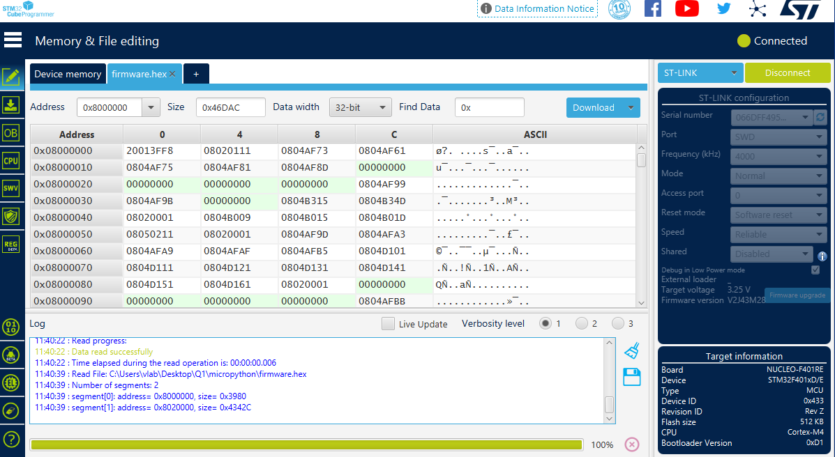

Slide 10
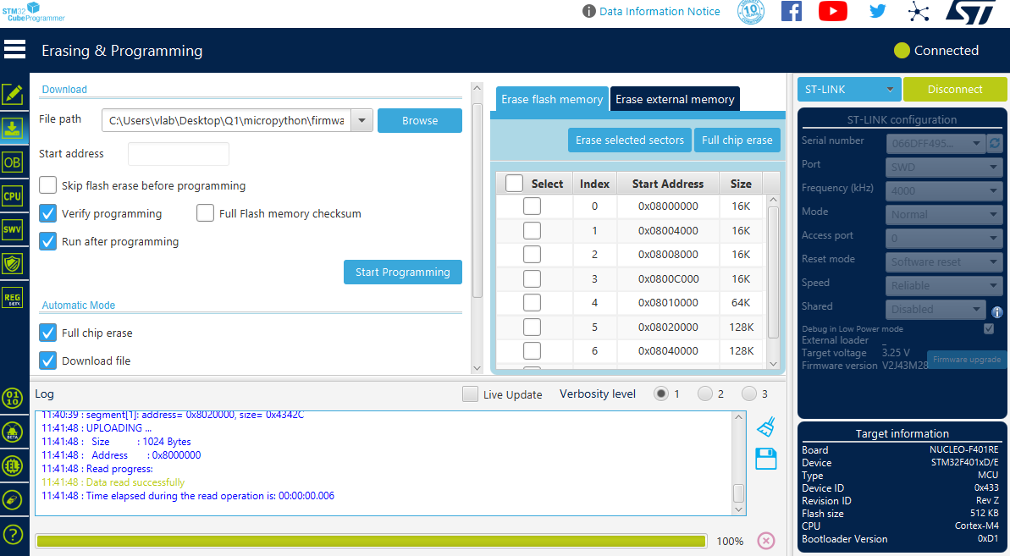

Slide 11
Opening MicroPython Interactive Shell
On a Windows Computer, open Windows Device Manager.
Expand “Ports” → Look for the ST-Link Virtual COM Port entry and record the COM port. In my case, my COM port to the STM32 board connected is COM7.
Open a serial communication utility software such as PuTTY.
Select “Serial” under Connection Type → Enter the COM7 port you recorded into the Serial Line field → Enter 115200 for speed (baud rate) → Click Open
Click reset (push button) to get the micropython REPL

Slide 12
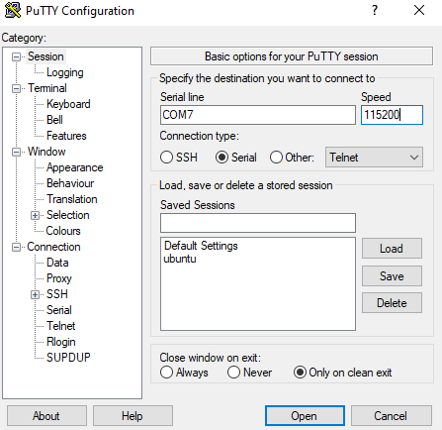
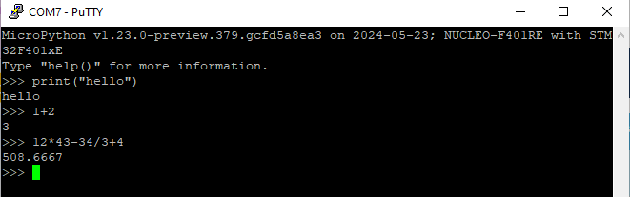

Slide 13
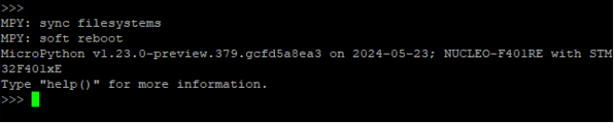
Resetting the Board
If something goes wrong, you can reset the board in two ways.
The first is to press CTRL-D at the MicroPython prompt, which performs a soft reset
If that isn’t working you can perform a hard reset by pressing the RST switch. This will end your session, disconnecting whatever program that you used to connect to the board

Slide 14
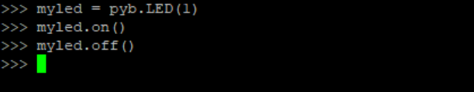
Toggling LED
Method-1: Using REPL shell
The easiest way to turn on and off LED attached to the board is using REPL interactive shell.
Connect the board, We will start by turning LED on and off using following commands

Slide 15
Contd…
Method-2 : Using Python files
To run the code by using any “.py” file .
Open the pycharm and write the required code to toggle the LED
To run that script file on MicroPython-enabled boards we need adafruit-ampy which is a python package.
It simplifies the process of interacting with the board's filesystem, uploading and downloading files, and executing scripts
Install the ampy using “pip install adafruit-ampy” in the terminal of the venv of pycharm
Syntax : “ampy --port <port> run <script.py>”
“ampy –port COM7 run led.py”

Slide 16
Contd…
Using on() and off() functions :
from machine import Pin
import time
# Define the GPIO pin connected to the LED
led_pin = Pin('PA5', Pin.OUT)
# Main loop to toggle the LED
while True:
led_pin.on() # Turn the LED on
time.sleep(1) # Delay for 1 second
led_pin.off() # Turn the LED off
time.sleep(1) # Delay for 1 second

Slide 17
Contd…
The machine module contains specific functions related to the hardware on a particular board. Most functions in this module allow to achieve direct access and control of hardware blocks on a system (like CPU, timers, buses, etc.)
A pin object is used to control I/O pins (also known as GPIO - general-purpose input/output).
The pin class has methods to set the mode of the pin (IN, OUT, etc) and methods to get and set the digital logic level.
Pin.on() : Set pin to “1” output level.
Pin.off() : Set pin to “0” output level.

Slide 18
Contd…
Using high() and low() functions :
from machine import Pin
import time
# Define the GPIO pin connected to the LED
led_pin = Pin('PA5', Pin.OUT)
# Main loop to toggle the LED
while True:
led_pin.high() # Turn the LED on
time.sleep(1) # Delay for 1 second
led_pin.low() # Turn the LED off
time.sleep(1) # Delay for 1 second

Slide 19
Contd…
Using toggle function :
led = pyb.LED(1)
while True:
led.toggle()
pyb.delay(1000)
Pyb module :
The pyb module contains functions related to the specific board.
pyb.delay(ms) : Delay for the given number of milliseconds.
class pyb.LED(id) : Create an LED object associated with the given LED
id is the LED number → (1 - 4).
As STM32F401re has only one LED the id by default corresponds to value 1.

Slide 20
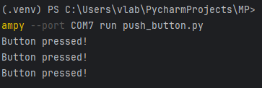
User Push Button
Method-1 : Using Pin class of machine module
import machine
import time
# Configure PA1 as an input
button = machine.Pin('PC13', machine.Pin.IN,machine.Pin.PULL_DOWN)
while True:
if button.value() == 0:
print("Button pressed!")
time.sleep(0.1) # Debounce delay

Slide 21
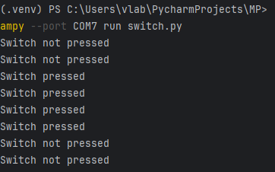
Contd…
Method-2 : Using Switch function()
class Switch – A Switch object of pyb constructor , used to control a push-button switch.
import pyb
# Initialize the switch
sw = pyb.Switch()
while True:
if sw(): # Check if the switch is pressed
print("Switch pressed")
else:
print("Switch not pressed")
pyb.delay(1000)
(or)
sw = pyb.Switch()
while True:
sw.callback(lambda:print('Switch pressed'))
pyb.delay(1000)

Slide 22
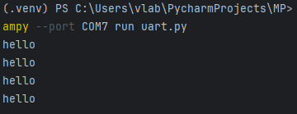
UART
UART implements the standard UART/USART duplex serial communications protocol.
import machine
import time
# Initialize UART (use UART2 which is available on the Nucleo-F401RE)
uart = machine.UART(2, baudrate=115200)
# Main loop to send "hello" over UART
while True:
uart.write('hello\n') # Send the message "hello"
time.sleep(1) # Wait for 1 second
if uart.any(): # Check if there is any incoming data
msg = uart.read() # Read the received data
print(msg)

Slide 23
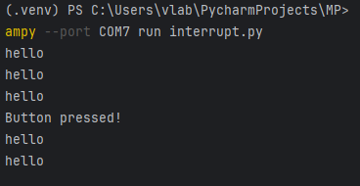
Interrupt Handling
Pin.irq() : It is a method of class Pin of the constructor machine, configure an interrupt handler to be called when the trigger source of the pin is active.
import machine
import time
# Define a function to be called when the interrupt occurs
def button_pressed(b):
print("Button pressed!")
# Initialize the button pin as an input with pull-down resistor
button = machine.Pin('PC13', machine.Pin.IN, machine.Pin.PULL_DOWN)
uart = machine.UART(2, baudrate=115200)
# Attach an interrupt to the button pin
button.irq(trigger=machine.Pin.IRQ_RISING, handler=button_pressed)
# Main loop
while True:
uart.write('hello\n') # Send the message "hello"
time.sleep(1) # Wait for 1 second
if uart.any(): # Check if there is any incoming data
msg = uart.read() # Read the received data
print(msg)

Slide 24
Timer
Each timer consists of a counter that counts up at a certain rate. The rate at which it counts is the peripheral clock frequency (in Hz).
When the counter reaches the timer period it triggers an event, and the counter resets back to zero. By using the callback method, the timer event can call a Python function.
import pyb
led = pyb.LED(1)
# Define the callback function to toggle the LED
def toggle_led(timer):
led.toggle()
# Initialize Timer 1 with a frequency of 0.2 Hz (1 cycle every 5 seconds)
tim1 = pyb.Timer(1, freq=0.2)
# Set the callback function for Timer 1
tim1.callback(toggle_led)

Slide 25
Toggle LED when push is button is pressed
import pyb
sw = pyb.Switch()
#method1
while True:
sw.callback(lambda:pyb.LED(1).toggle())
#method 2
def led():
pyb.LED(1).toggle()
while True:
sw.callback(led)

Slide 26
Control LED brightness using PWM
from pyb import Pin, Timer
import time
# Define the pin connected to the LED (PA5 for STM32F401)
led_pin = Pin('PA5')
# Create a Timer object using pyb module
tim = Timer(2, freq=1000) # Timer 2, 1 kHz frequency
# Configure the Timer channel for PWM using pyb module
ch = tim.channel(1, Timer.PWM, pin=led_pin)
# Function to ramp up and down the PWM duty cycle
def ramp_pwm():
try:
for duty_cycle in range(0, 101, 5):
# Ramp up from 0% to 100%
ch.pulse_width_percent(duty_cycle)
time.sleep(0.1)
for duty_cycle in range(100, -1, -5):
# Ramp down from 100% to 0%
ch.pulse_width_percent(duty_cycle)
time.sleep(0.1)
# Execute the ramp_pwm function continuously
while True:
ramp_pwm()
# Cleanup (though it won't be reached in this script)
tim.deinit()

Slide 27
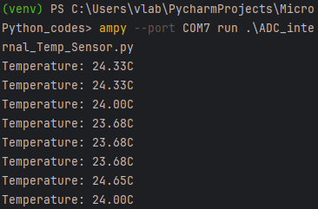
Reading Internal Temperature Sensor value using ADC
from pyb import ADC
import time
# Initialize the ADC on the internal temperature sensor channel (typically ADC channel 16)
temp_sensor = ADC(16)
# Function to convert raw ADC value to temperature
def raw_to_temperature(raw_value):
# STM32 internal temperature sensor calibration values
V25 = 0.76 # Voltage at 25 degrees Celsius (in Volts)
Avg_Slope = 2.5 # Average slope (in mV/degree Celsius)
V_ref = 3.3 # Reference voltage (in Volts)
# Convert the raw ADC value to a voltage
voltage = (raw_value / 4095) * V_ref
# Calculate temperature in Celsius
temperature = (voltage - V25) / (Avg_Slope / 1000) + 25
return temperature
# Continuously read and print the temperature
while True:
raw_value = temp_sensor.read()
temperature = raw_to_temperature(raw_value)
print("Temperature: {:.2f}C".format(temperature))
time.sleep(1) # Delay for 1 second between readings

Slide 28
Thank You

