Slide 1
Device Drivers in NuttX & SDIO Protocol
R. Sainath
05/03/2025

Slide 2

What is NuttX OS?
NuttX is a real-time operating system (RTOS) with an emphasis on standards compliance and small footprint. Scalable from 8-bit to 64-bit microcontroller environments, the primary governing standards in NuttX are POSIX and ANSI standards. Additional standard APIs from Unix and other common RTOS’s (such as VxWorks) are adopted for functionality not available under these standards, or for functionality that is not appropriate for deeply-embedded environments (such as fork()).

Slide 3
Key Features of NuttX OS
Small Footprint.
Rich Feature OS Set.
Real-Time Fully pre-emptible; fixed priority, round-robin, and “sporadic” scheduling .
Totally Open source.
Highly Scalable.
POSIX and ANSI Standards Compliance.
Virtual file system (VFS) supports drivers and mountpoints.
Device Drivers.

Slide 4
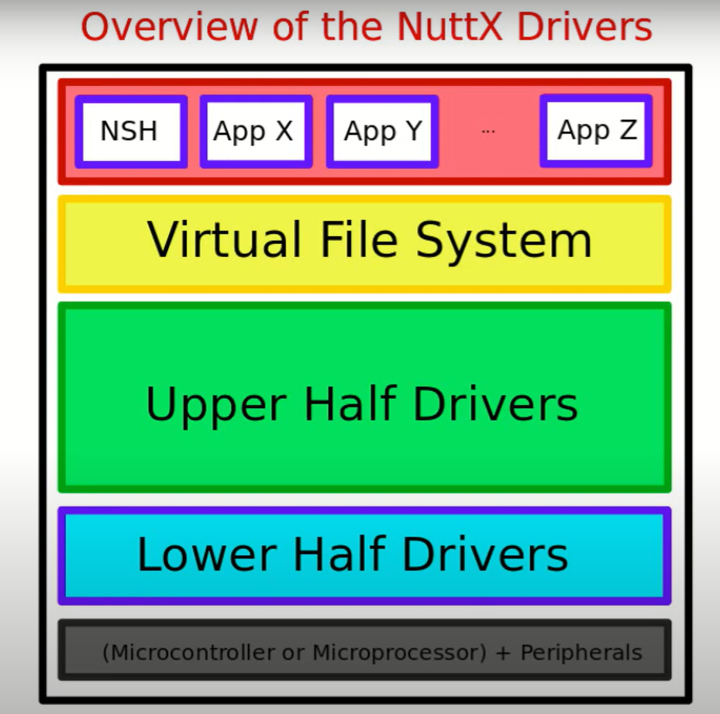
Device Drivers Architecture in NuttX
Drivers in NuttX generally work in two distinct layers:
An “ upper half ” which registers itself to NuttX using
a call such as register_driver() or register_blockdriver()
and implements the corresponding high-level interface (read, write, close, etc.).This upper half calls into the
lower half via callbacks.
A “lower half” which is typically hardware-specific.
This is usually implemented at the architecture or board
level

Slide 5
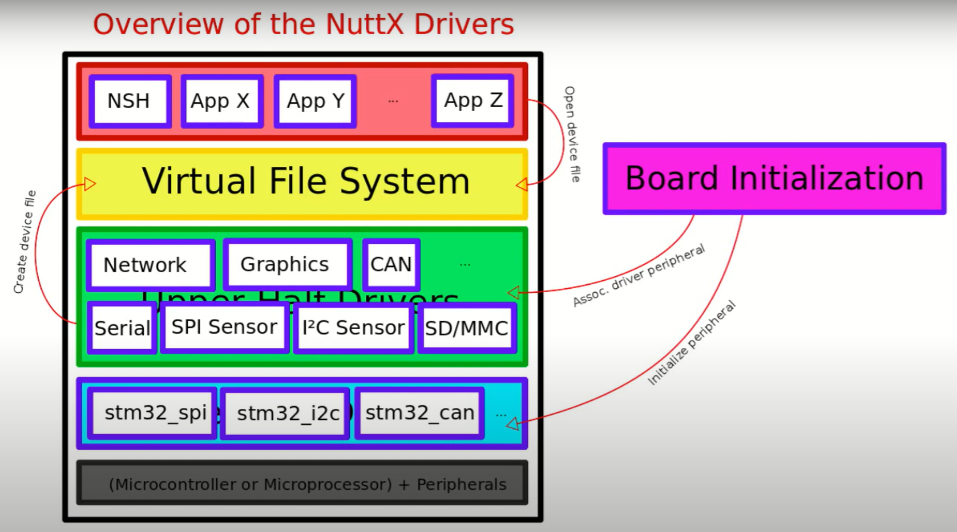
Device Driver Architecture in NuttX (Contd…)
Binding
In NuttX, the binding process connects the lower-half driver (hardware-specific implementation) with the upper-half driver (generic driver). This allows hardware-independent operations like file I/O to be performed on any supported SDIO device, regardless of the underlying hardware.
The binding should be done at the time of board initialization.

Slide 6
Types of device drivers in NuttX
NuttX supports a variety of device drivers, which can be broadly divided in three classes:
Character Device Drivers
Block Device Drivers
Specialized Device Drivers

Slide 7
Types of device drivers in NuttX (Contd…)
Character Device Drivers
Character device drivers manage devices that handle data one character at a time, for example keyboards, mouse, and serial ports.
Each character device driver must implement an instance of struct file_operations.
In NuttX each character driver registers itself by calling register_driver().
int register_driver(const char *path, const struct file_operations *fops, mode_t mode, void *priv);
The path parameter will represent where the driver will appear in the pseudo file system, and it’s initialized instance of struct file_operations.
After it has been registered, the character driver can be accessed by user code using the standard driver operations including open(), close(), read(), write(), etc.

Slide 8
Types of device drivers in NuttX (Contd…)
Block Device Drivers
Block device drivers manage devices that handle data in fixed-size blocks.
Each block device driver must implement an instance of struct block_operations.
In NuttX each character driver registers itself by calling register_blockdriver().
int register_blockdriver(const char *path, const struct block_operations *bops, mode_t mode, void *priv);
The path parameter will represent where the driver will appear in the pseudo file system, and it’s initialized instance of struct file_operations.
Users do not normally access block drivers directly, rather, they access block drivers indirectly through the mount() API. The mount() API binds a block driver instance with a file system and with a mountpoint. Then the user may use the block driver to access the file system on the underlying media.

Slide 9
Types of device drivers in NuttX (Contd…)
Specialized Device Drivers
All device drivers that are accessible to application logic are either:
Character device drivers that can be accessed via the standard driver operations (open(), close(), read(), write(), etc.).
Block drivers that can be accessing only as part of mounting a file system.
The specialized drivers can be used only within the OS logic itself and are not accessible to application logic.
While special drivers are internal, in some cases there are also character/block drivers that sit on top of these special drivers and thus expose them to applications.
In NuttX device drivers like I2C Device Drivers, I3C Device Drivers, SPI Device Drivers, SDIO Device Drivers, USB Device-Side Drivers, USB Host-Side Drivers, PCI(e) Bus Drivers, Ethernet Device Drivers, etc. fall under this category.

Slide 10
Introduction to SDIO Protocol
What is SDIO?
The SDIO (Secure Digital Input Output) is an expansion interface based on the SD card standard.
It supports both memory storage and external device connectivity.
SDIO vs SD Card:
SDIO retains the SD card read/write protocol but introduces CMD52(for single register I/O) & CMD53(for block data transfers) I/O operations.
Unlike SD cards, SDIO supports low-speed devices with minimal hardware. Full-speed SDIO devices support networking, TV tuners, and combo cards(Memory + SDIO).
Applications of SDIO:
GPS receivers, Wi-Fi and Bluetooth adapters.
Modems, LAN adapters, barcode scanners, TV tuners.

Slide 11
SDIO features
Targeted for portable and stationary applications
Minimal or no modification to SD Physical bus is required.
Plug and play (PnP) support
Multi-function support including multiple I/O and combined I/O and memory
Up to 7 I/O functions plus one memory supported on one card.
Allows card to interrupt host
Supply Voltage: 2.7 to 3.6V

Slide 12
SDIO Card Types and Transmission Modes
Full-Speed SDIO Cards
Supported modes
SPI, 1-bit SD, and 4-bit SD.
Clock Range
0-25MHz.
Low-Speed SDIO Cards
Supported modes
SPI and 1-bit SD
(4-bit support is optional).
Clock Range
0-400KHz.
Data Transfer Rate
Over 100 Mb/s(~10MB/s).
Mandatory for Combo cards.
Target Applications
Ideal for low-speed I/O devices(e.g., modems, barcode scanners, GPS receivers).

Slide 13
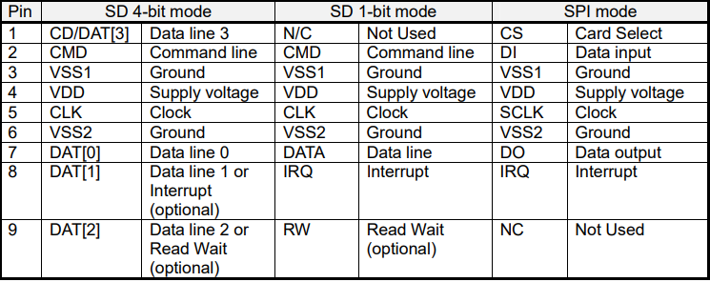
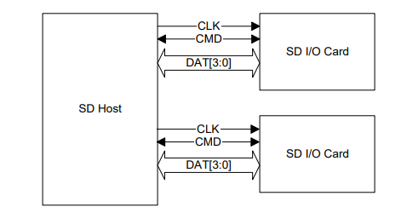
Pin Description of SDIO

Slide 14
Host Requirements for SDIO
For a host to completely support all the capabilities of the SDIO cards, some signal connections must be supported:
Interrupt Support:
Pin 8 Connection: Must connect the SDIO card’s pin 8 to the host for interrupt signaling.
This connection is mandatory even if SPI or 1-bit SD mode is supported.
Multi-Slot System Considerations:
Separate Routing: For systems with more than one card, route CMD and DAT[0:3] lines separately(i.e., not bussed together) to avoid interference, This allows different card types to operate simultaneously without signal conflict.
Unified CMD Option: After initialization, the SD memory and SDIO specifications permit “unifying” the CMD lines. This means that while separate routing is recommended for initialization, we can connect them together later.

Slide 15
SDIO Initialization
Before an SDIO device can be used, it must go through an initialization sequence.
A host that is SDIO-aware will send CMD5 to detect and initialize the I/O functions of the card.
If CMD5 is not sent, the SDIO portion remains inactive, and a combo card operates as a memory-only card.
Key Initialization commands:
CMD5 (IO_SEND_OP_COND): Used to get OCR(Operating Conditions Register) and detect the presence of SDIO functions.
CMD55/ACMD41 (SD Memory Initialization): Used for initializing SD memory (if present in a combo card).
CMD3 (SEND_RELATIVE_ADDR): Assigns a Relative Card Address(RCA) to the card.
CMD15 (GO_INACIVE_STATE): Used for putting the card into an inactive state.

Slide 16
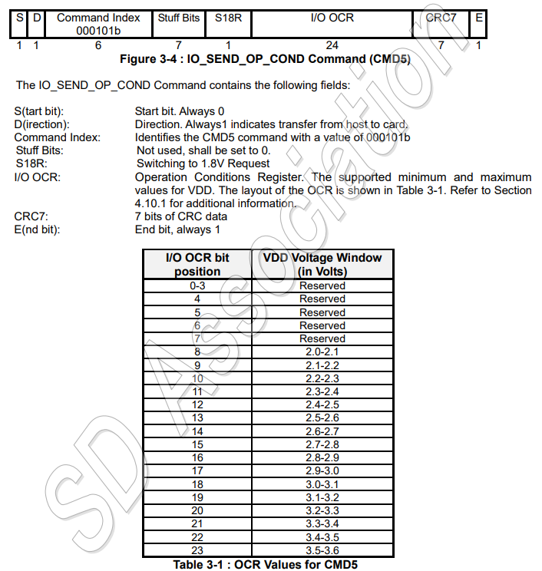
SDIO Initialization (Contd…)
The IO_SEND_OP_COND Command (CMD5)
The function for CMD5 for SDIO cards is similar to the operation of ACMD41 for SD memory cards.
It is used to inquire about the voltage range needed by the I/O card.
The normal response for CMD5 is R4 in either SD or SPI format.
Notes:
In I/O OCR[24 bits] the host sends the voltage range it supports

Slide 17
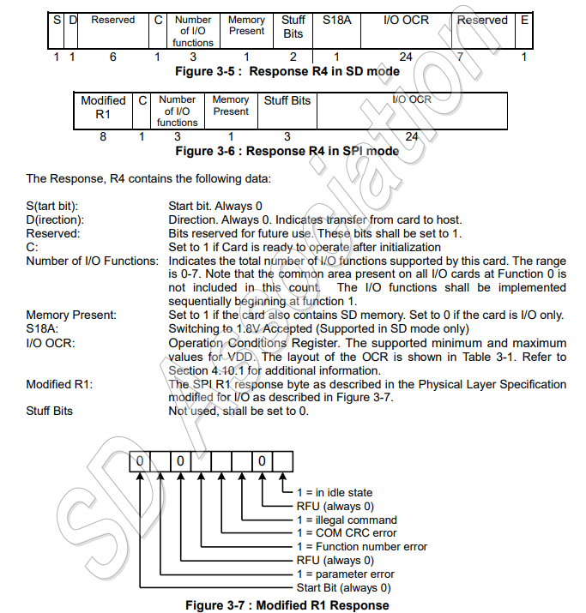
SDIO Initialization (Contd…)
The IO_SEND_OP_COND Response (R4)
Notes:
Here the I/O OCR tells the voltage range the card suports

Slide 18
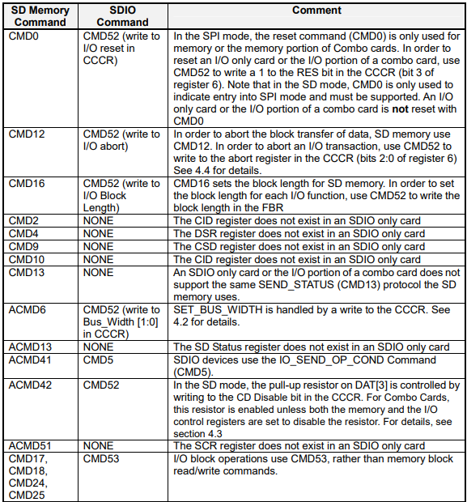
Unsupported SD Memory commands

Slide 19
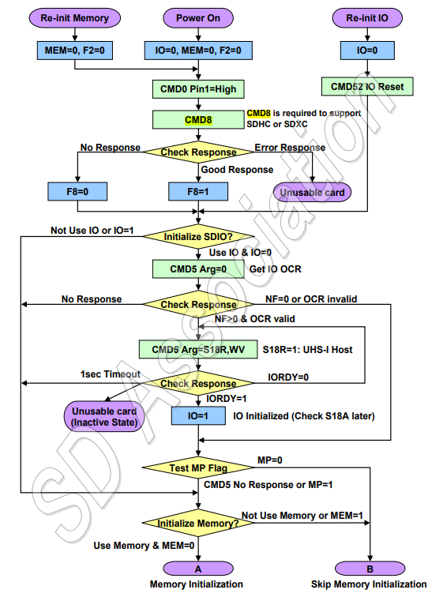
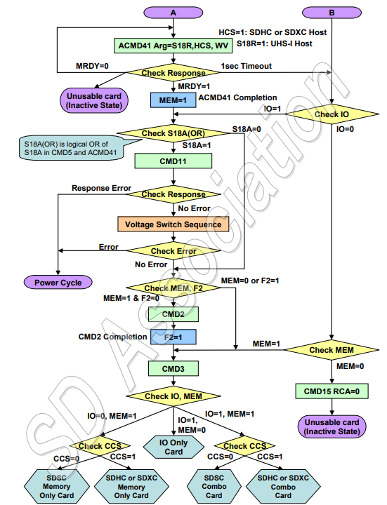
SDIO Initialization (Contd…)
Card Initialization flow in SD mode (SDIO Aware host)
Notes:
SDSC – SD Standard Capacity (0 to 2GB)
SDHC – SD High Capacity (2Gb to 32GB)
SDXC – SD Extended Capacity (64GB to 2TB)
CMD8(R7) – used by host to check if the SD card supports SDHC/SDXC (Not used in SDIO only card)
CMD11 – Voltage switching
CMD2 – Retrieves the CID(Card identification register) only supported in SD memory
CMD3(R6) – assign or request the Relative Card Address(RCA)
HCS – Host Capacity Support (ACMD41 argument)
CCS – Card Capacity Support (ACMD41 response)

Slide 20
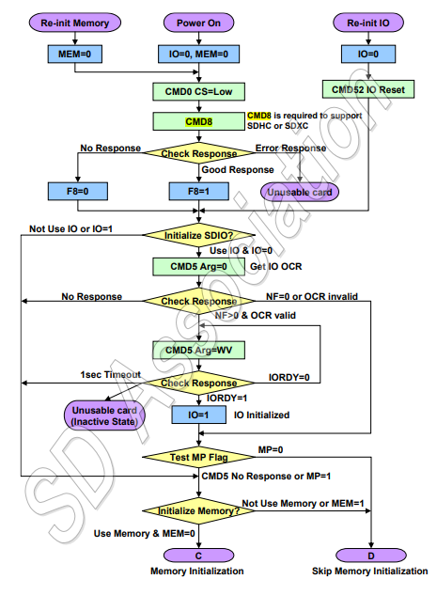
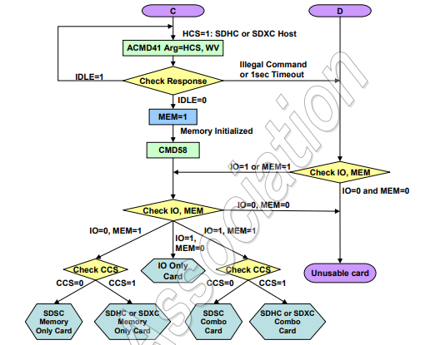
SDIO Initialization (Contd…)
Card Initialization flow in SPI mode (SDIO Aware host)
Notes:
CMD 0 with CS=low to enter the SPI mode
Difference is, the SPI mode only supports 1-bit mode hence UHS-I is not supported
In SDIO init the argument S18R is not for CMD5 and ACMD 41
S18A is not checked
CMD58 – Used to get OCR register
No need for CMD3 i.e ., RCA because in SPI mode the bus is point to point, the card is selected using the chip select
No need for CMD2 i.e., CID because we use CS here

Slide 21
CIA(Common Information Area)
After the host has initialized the I/O portion of the card, it then reads the Common Information Area (CIA) of the card.
The CIA is accessed by the host by issuing a read command, starting with the byte at address 00h, of I/O function 0.
Within the CIA there are 3 specific elements:
Card Common Control Registers(CCCR)
Function Basic Registers(FBR)
Card Information Structure(CIS)

Slide 22
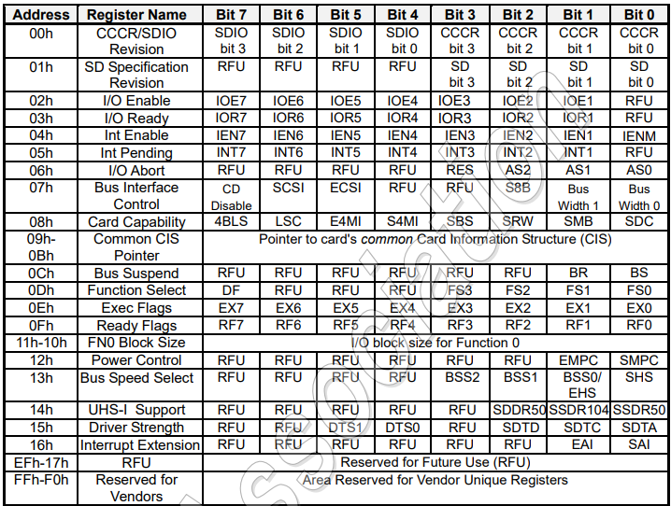
CIA(Common Information Area) (Contd…)
Card Common Control Registers(CCCR)
Card Common Control Registers provide quick host checking and control of I/O cards enable or interrupt on a per-function basis.
Bits in CCCR are mixed R/W and Read Only.
Access to CCCR can be achieved via I/O Read/Write commands i.e., CMD52 and CMD53.
Notes:
It is mentioned that Embedded SDIO supports 8-bit mode, but specifications are unclear as of now
In register 07h – The bus width bits[0:1] , 00->1-bit, 01->res,10->4 bit, 11-> 8bit(only for Embedded SDIO)
s8B[2]; 8-bit mode support
CD[7] ; Card detect

Slide 23
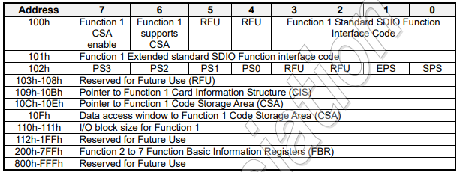
CIA(Common Information Area) (Contd…)
Function Basic Registers(FBR)
Each SDIO function has 256 bytes of registers under FBR that are used for function-specific configurations.
This allows the host to quickly determine the abilities and requirements of each function.
The address of this area is from 00n00h to 00nFFh, where n is the function number(0 to 7).
Notes:
SDIO provides a recommended standard interface for each function which can be configured in FBR 100h [0:3]; if this value is set of 0Fh then byte 101h identifies the standard SDIO interface type.
101h – This byte is valid only if 100h[0:3] if 0Fh , otherwise it is 0h
10Fh – Provides window access o CSA, the CSA may be large area so it provides a window –based approach to access only the necessary portions of CSA instead of entire CSA
110h – 111h -> If card does not support block I/O operations, the value is 0h, if supports Max block size is 2048(0800h) and min is 1(0001h).

Slide 24
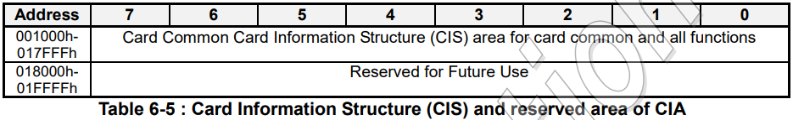
CIA(Common Information Area) (Contd…)
Card Information Structure(CIS)
The Card Information Structure provides more complete information about the card and the individual functions.
The CIS is the common area to read information about all I/O functions that exist in a card.
All cards that support I/O shall have a common CIS and a CIS for each function.

Slide 25
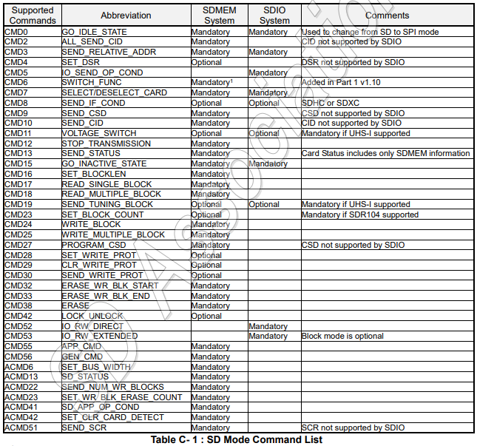
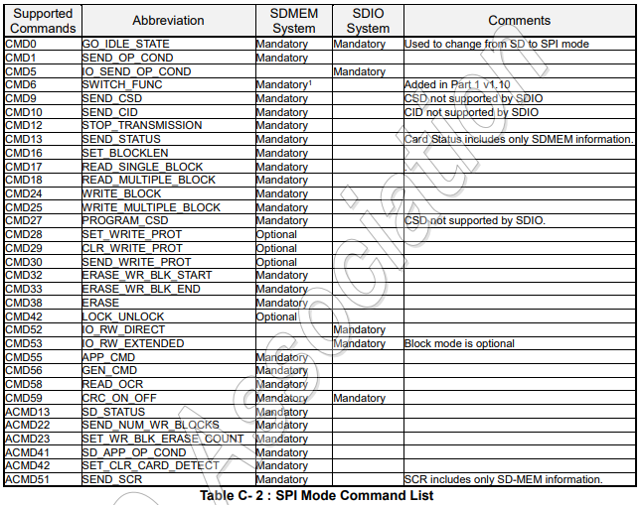
Command List

Slide 26
Adding SDIO driver for a new platform in NuttX
All structures and APIs needed to work with SDIO drivers are provided in include/nuttx/sdio.h header file.
Each SDIO device driver must implement an instance of struct sdio_dev_s. That structure defines a call table with the following methods:
Mutual exclusion
Initialization/setup
Command/Status/Data Transfer
Event/Callback support
DMA support

Slide 27
Adding SDIO driver for a new platform in NuttX (Contd…)
Directory Structure
nuttx/
├── arch/arm/src/myplatform/
│ ├── myplatform_sdio.c (SDIO driver implementation)
│ ├── myplatform_sdio.h (SDIO register definitions)
│
├── boards/arm/myboard/
│ ├── src/
│ │ ├── myboard_sdio.c (SDIO initialization and binding)
│ │ ├── myboard_init.c (Peripheral initialization)
│ │ ├── CmakeLists.txt
| │ ├── Make.defs
| ├── configs/myconfig/defconfig (Board configuration)
| ├── CmakeLists.txt
| ├── Kconfig

Slide 28
Adding SDIO driver for a new platform in NuttX (Contd…)
Binding
Binding connects the lower-level SDIO driver with the MMC/SD stack in NuttX.
API used for Binding: int mmcsd_slotinitialize(int minor, FAR struct sdio_dev_s *dev)
This API registers an SDIO slot and binds it.
Parameters
minor – The minor device number (e.g., /dev/mmcsdX).
sdio – A pointer to the lower-level SDIO driver structure
This API is typically called at the time of board-specific initialization

Slide 32
Device Driver Architecture in NuttX
Drivers in NuttX generally work in two distinct layers:
An “ upper half ” which registers itself to NuttX using
a call such as register_driver() or register_blockdriver()
and implements the corresponding high-level interface (read, write, close, etc.).This upper half calls into the
lower half via callbacks.
A “lower half” which is typically hardware-specific.
This is usually implemented at the architecture or board
level

Slide 33
Adding SDIO driver for a new platform in NuttX
Before implementing the SDIO driver, it’s important to understand where different files reside in NuttX.
Upper-Level Files (Already in NuttX)
These files provide the common SDIO interface that interacts with the lower-level driver.
nuttx/include/nuttx/sdio.h → Defines the SDIO driver interface.
Lower-Level Files (Newly Added for Cortex-R82)
These files implement platform-specific SDIO register handling.
nuttx/arch/arm/src/myplatform/ myplatform _sdio.c → Implements the hardware-specific SDIO operations.
nuttx/arch/arm/src/ myplatform / myplatform _sdio.h → Header file containing SDIO register definitions.
nuttx/boards/arm/myboard/src/board_sdio.c → SDIO initialization and binding.

Slide 34
