Slide 1
Workshop Energy Plus

Slide 2
Objectives of the workshop
To provide first steps to use EnergyPlus by focusing on the thermal simulation.
To show the multiple choices of simulation given by EnergyPlus
To be able to use the good simulation methods considering its own application
To be aware of the simulation ability of EnergyPlus

Slide 3
Reminder of the thermal concepts
EnergyPlus is a building energy simulation (BES) software developed by DOE
It is based on the nodal approach ➔ coarse discretization approach
Assuming the uniformity of the state variables :
A zone is modelled by a point
A wall layer is modelled by a unique point
Importance to be aware of the limitations and advantages of the software
PhD M. Trocmé

Slide 4
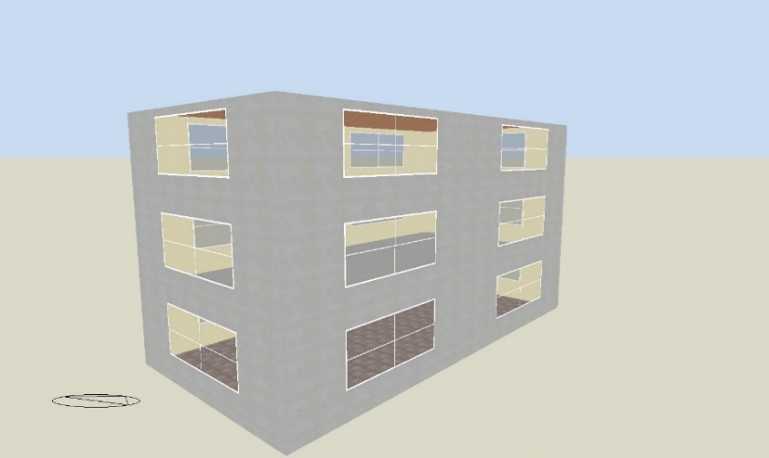
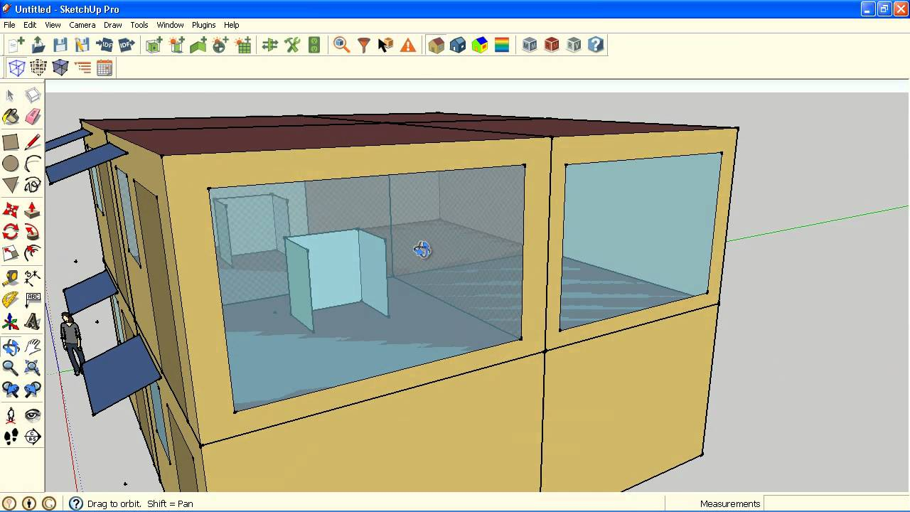
EnergyPlus File : IDF (input data file)
IDF file is the EnergyPlus format
Text file ➔ easy to modify automatically
Contains all the input data presented as objects.
No friendly graphical interface
Some external interfaces allow to generate automatically the idf file from a 3D model
Sketch Up/ OpenStudio
Design Builder
Virtual Environment
…

Slide 5
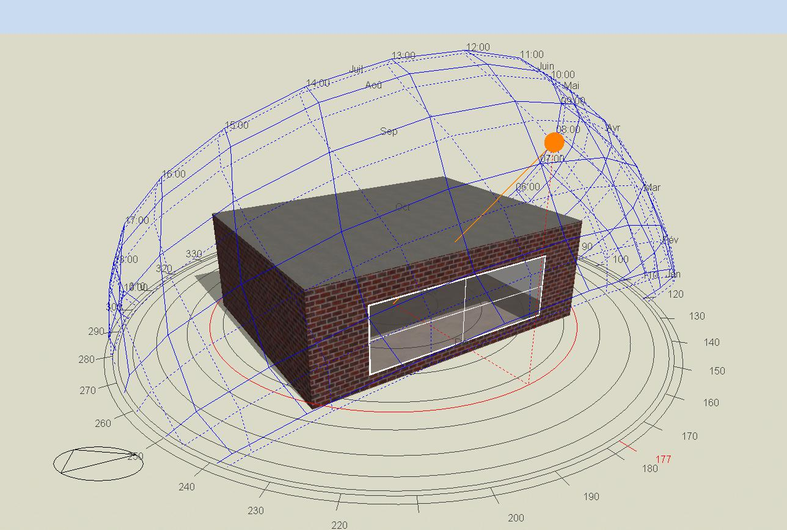
How to use EnergyPLus?
Download EnergyPlus software ➔ it is always in development, new versions are often published : transition tools is provided by the latest version.
Open the EP-Launch (that can be find on the repertory energy-plusV8-6-0 in the C:\\ disk).
An IDF in EnergyPlus V8.6 file has been given : one unique zone with one unique South window.

Slide 6
Weather conditions
Weather data must be given in EPW format (EnergyPlus Weather). The main data used in E+ is :
Outdoor temperature (drybulb and dewpoint)
Outdoor humidity
Radiation (Global horizontal, direct, diffuse)
Wind speed
Wind direction
EnergyPlus proposes a tool allowing converting TMY files (and other format) into EPW files.
Where can we find weather data?
EnergyPlus provides few weather data file of US.
Meteonorm is a software allowing generating a statistical weather data file (usually 10 years)
Some website provide some weather data file : http://re.jrc.ec.europa.eu/pvg_tools/fr/tools.html

Slide 7
Visualization and outputs
Many different outputs are available on EnergyPlus ➔ among them, the Output:Variable object gives the temporal series.
A list is provided in the rdd file of EnergyPlus.
Several output formats are available. Some examples probably mainly used:
csv : can be analyzed in excel
sql : data basis file (for example, openstudio results viewer allows opening it)
eso : data basis file (for example, designbuilder results viewer allows opening it)
EnergyPlus can also provide a HTML file summing up all the scalar results (as the energy consumption) and some global input data (as the volume or the surface of the zones).

Slide 8
Different levels to model the radiation
EnergyPlus provides different ways to model the radiation inside the building (object Building - Solar Distribution)
Level 1 (called MinimalShadowing) : All the beam solar radiation is assumed to fall on the floor and is absorbed. The diffuse radiation is assumed to be uniformly distributed on all interior surfaces. The shadows are not taken into account
Level 2 (called FullExterior) : idem Level 1 except the fact that shadiw are taken into account
Level 3 (called FullInteriorExterior) : idem Level 2 except the fact that the amount of beam solar radiation on each surfaces (floor, walls and windows) is calculated by projecting the sun’s rays through the exterior windows
EnergyPlus allows also taking into account the reflection inside the building.
The choice of the method depends mainly on the application and the objectives of the building simulation

Slide 9
Run period and timestep
EnergyPlus allows to choose the duration of the simulation by giving a run period (object RunPeriod).
Possibility to run the simulation for one year without necessarily beginning by January
Possiblity to run the simulation for less than one year
EnergyPlus allows also to simulate several years (object RunPeriod - Number of Times Runperiod to be repeated).
The timestep can be moved from 1 min to 1 hour (object Timestep)

Slide 10
Material and wall construction
Each wall of the building has its own composition.
To construct the wall composition, different successive steps need to be proceed :
Step 1 : Create the material in the Material object ➔ Information on the material characteristics (thickness, conductivity, density, specific heat, …)
Step2 : Create the material assembly in the Construction object ➔ Assembly the different layers from outdoor to indoor faces of the wall
Step 3 : Apply the construction to the building surface in BuildingSurface:Detailed object - Construction Name ➔ Boundary conditions are also given for each building surface in BuildingSurface:Detailed object - Outside Boundary Condition/Sun Exposure/Wind Exposure)
A material without mass can also be declared in Material:NoMass object
As an example, to model a resistance for a ventilated air space.

Slide 11
Exercice 1
Run the initial_case_v1.idf file (it will serve as a reference case).
Rename the idf file by the following name Exo1.idf
Choose the weather file of Toulouse.
Modify the insulation thickness at 20 cm of the vertical exterior walls and visualize the effect on the air temperature and compare it with the initial case

Slide 12
Window
The global process is the same as the opaque wall with the successive steps
Step 1 : Create the material of the glazing. Several methods are provided by EnergyPlus to model the glazing. The most used are :
Object WindowMaterial:SimpleGlazingSystem (do not confuse with a simple glazing, here it is only the method that is simple) for very limited input information
U-factor considering film coefficients (be careful of the norm used for the calculation of the global thermal coefficient U)
SHGC (taken into account both the transmitted solar radiation and the radiation absorbed by the wall. So it is different from the conventional solar factor (at least in France) ➔ solar factor = 0.86 SHGC)
visible transmissivity.
Object WindowMaterial:Glazing ➔ Each layer of the window is detailed. Gas layer are given in the WindowMaterial:Gas object.

Slide 13
Window
Step 2 : Create the assembly in the Construction object➔ From outdoor to indoor
Step 3 : Affect the assembly to the window in the FenestrationSurface:Detailed
A software called WINDOW 7.6 provides characteristics of glazing.
The choice of the method depends again of the objectives of the study (ex: if you want to study the effect of a low-e glazing, you absolutely need to use the 2nd method) ➔ as much as possible, try to not use the SimpleGlazingSystem (but it is really dependent of the availability of input data).

Slide 14
Frame and divider
Frame and dividers can be included ➔ WindowProperty:FrameAndDivider object
Thermal coefficient has to be given without film coefficients
When they are included, their surface are subtracted from the geometrical area of the window.
The software WINDOW 7.6 informs also on the frame and divider characteristics.

Slide 15
Exercice 2
Rename the idf by the following name Exo2.idf
Modify the emissivity of the low-e layer by an emissivity of 4% and replace the gas by 16 mm of Argon.
Visualize the results in term of indoor temperature and compare them with those of the initial case.
Modifiy then the thermal coefficient of the frame by a value of 1,4 W/m²/K
Visualize the results and compare them with the initial case.

Slide 16
Blind and shade
Blind and shade can be included. Mainy different objects are provided. The mainly used are WindowMaterial:Shade and WindowMaterial:Blind.
Optical properties
For blind, possibility to model the effects of the slat angle and of their moving
Their control is also possible. Several different monitoring are provided by EnergyPlus.
EnergyPlus does not modelled a partially open shade➔ totally open or totally closed.
Shade place is given in the Construction object
A new object is created describing the window construction and the place of the shade.

Slide 17
Exercice 3
Rename the idf file by the following name Exo3.idf
Add a monitoring of the shade considering the solar radiation on window. Assume a setpoint of 120 W/m².
Visualize the results and compare them with the initial case.

Slide 18
Ventilation and infiltration
Several methods are provided to model the infiltration and the ventilation
The simpler method consists in assuming a constant flow rate ➔ ZoneVentilation:DesignFlowRate and ZoneInfiltration:DesignFlowRate
A bit more detailed method consists in taking into account the effect of the stack effect and the wind effect through the wind velocity and the tempertaure difference without pressure considerations ➔ ZoneVentilation:WindAndStackOpenArea and ZoneInfiltration:EffectiveLeakageArea
The AirFlow Network (AFN) consists in modelling the pressure on an aeraulic scheme.
Both mechanical or natural ventilation can be considered.
Several methods of design flow rate are available :
Per zone
Per person
Per m²
Air changes per hour

Slide 19
Exercice 4
Rename the idf file by the following name Exo4.idf
Assume the infiltration flow rate at 0,5 ach.
Visualize the results and compare them with the initial case.
Assume then a ventilation flow rate at 3 ach.
Visualize the results and compare them with the initial case.

Slide 20
Internal gains
Internal gains can be taken into account through the heat power of :
People
Electric equipment
Lighting
…
For people, a schedule of the activity can be considered.
For each internal gains, several methods of calculation are available ➔ the objective is to be compatible with major international references.

Slide 21
Schedules
Several ways to declare a schedule are provided:
Daily schedule
Weekly schedule
Detailed schedule (hour per hour, minute per minute) ➔ Schedule:Compact
For Schedule: Compact, really specific syntax is required.

Slide 22
Exercice 5
Rename the idf file by the following name Exo5.idf
Create an occupation schedule (as a fraction between 0 and 1 applied to a maximal number of occupants) via Schedule:Compact showing a complete occupation between 00:00 a.m and 8:00 a.m and then again from 6:00 p.m and 00:00 p.m
Apply 4 persons
Visualize the results and compare them with the initial case.

Slide 23
Thermal bridges
EnergyPlus does not provide a object dedicated to thermal bridges.
Several methods allow taking into account the thermal bridges. Among them :
To count the thermal bridges on the infiltration (but the physical interpretation is false. So the phenomenon is badly taken into account)
To add a fictive only deperditive wall without mass in the zone ➔ Wall:Exterior
It is quite hard to take into account the singular thermal bridges except by the way to add them on the global deperditive wall.

Slide 24
Heating and cooling
EnergyPlus provides many different modelisation of HVAC system but it is not dedicated to that.
The basic method considers the calculation of needs ➔ ZoneHVAC:IdealLoadsAirSystem
It deals with an all-air system that is totally instantaneous
It furnishes the exact heating or cooling power needed to reach the temperature setpoint ➔ during the functioning of the system, the setpoint temperature is exactly reached.
The temperature setpoint is given in the ThermostatSetpoint:DualSetPoint.
The control of the system can be done on the operative temperature, the air temperature or radiant temperature ➔ the better choice depends on the application, notably the type of system.

Slide 25
Exercice 6
Rename the idf file by the following name Exo6.idf
Apply a permanent functioning of the heating and the cooling system.
Visualize the results.

Slide 26
other functions
EnergyPlus provides also (briefly) :
A function taking into account the effect of pollutants and their propagation. Differents levels of models are available with more or less needed input data.
The opportunity to add its own program in order to monitor a specific function of EnergyPlus. We called it the Energy Management System (EMS)
The opportunity to model an aeraulic scheme via the Airflow Network AFN(idem to COMIS)
The opportunity to cosimulation via BCVTB or the FMU.
An HAMT (Heat and Air Moisture Transfer) model is provided by EnergyPlus.
…

Slide 27
MERCI POUR VOTRE ATTENTION
THANKS FOR YOUR ATTENTION

