Slide 1
Hygrothermal properties of materials

Slide 2
SORPTION ISOTHERMS
T°C
1
2
3
4
5
Initial state =
Dry or 58%RH
m0
KOH 8,2%RH
MgCl₂ 32,7%RH
NaBr 56,8%RH
NaCl 75,2%RH
K₂SO₄ 97,1%RH
9
8
7
6
5
At each RH level, weigh the sample until constant mass («change of mass between three
consecutive weighings, each made at least 24h apart, differs by less than 0,1 % of the
total mass» for sample with m < 20g )
Calculate (m – m0) / m0. It is the moisture content if initial state is dry and the
moisture content variation if initial sample is conditionned at 58%RH
Draw the curve (m – m0) / m0 = f(RH). It is the sorption isotherm curve

Slide 3
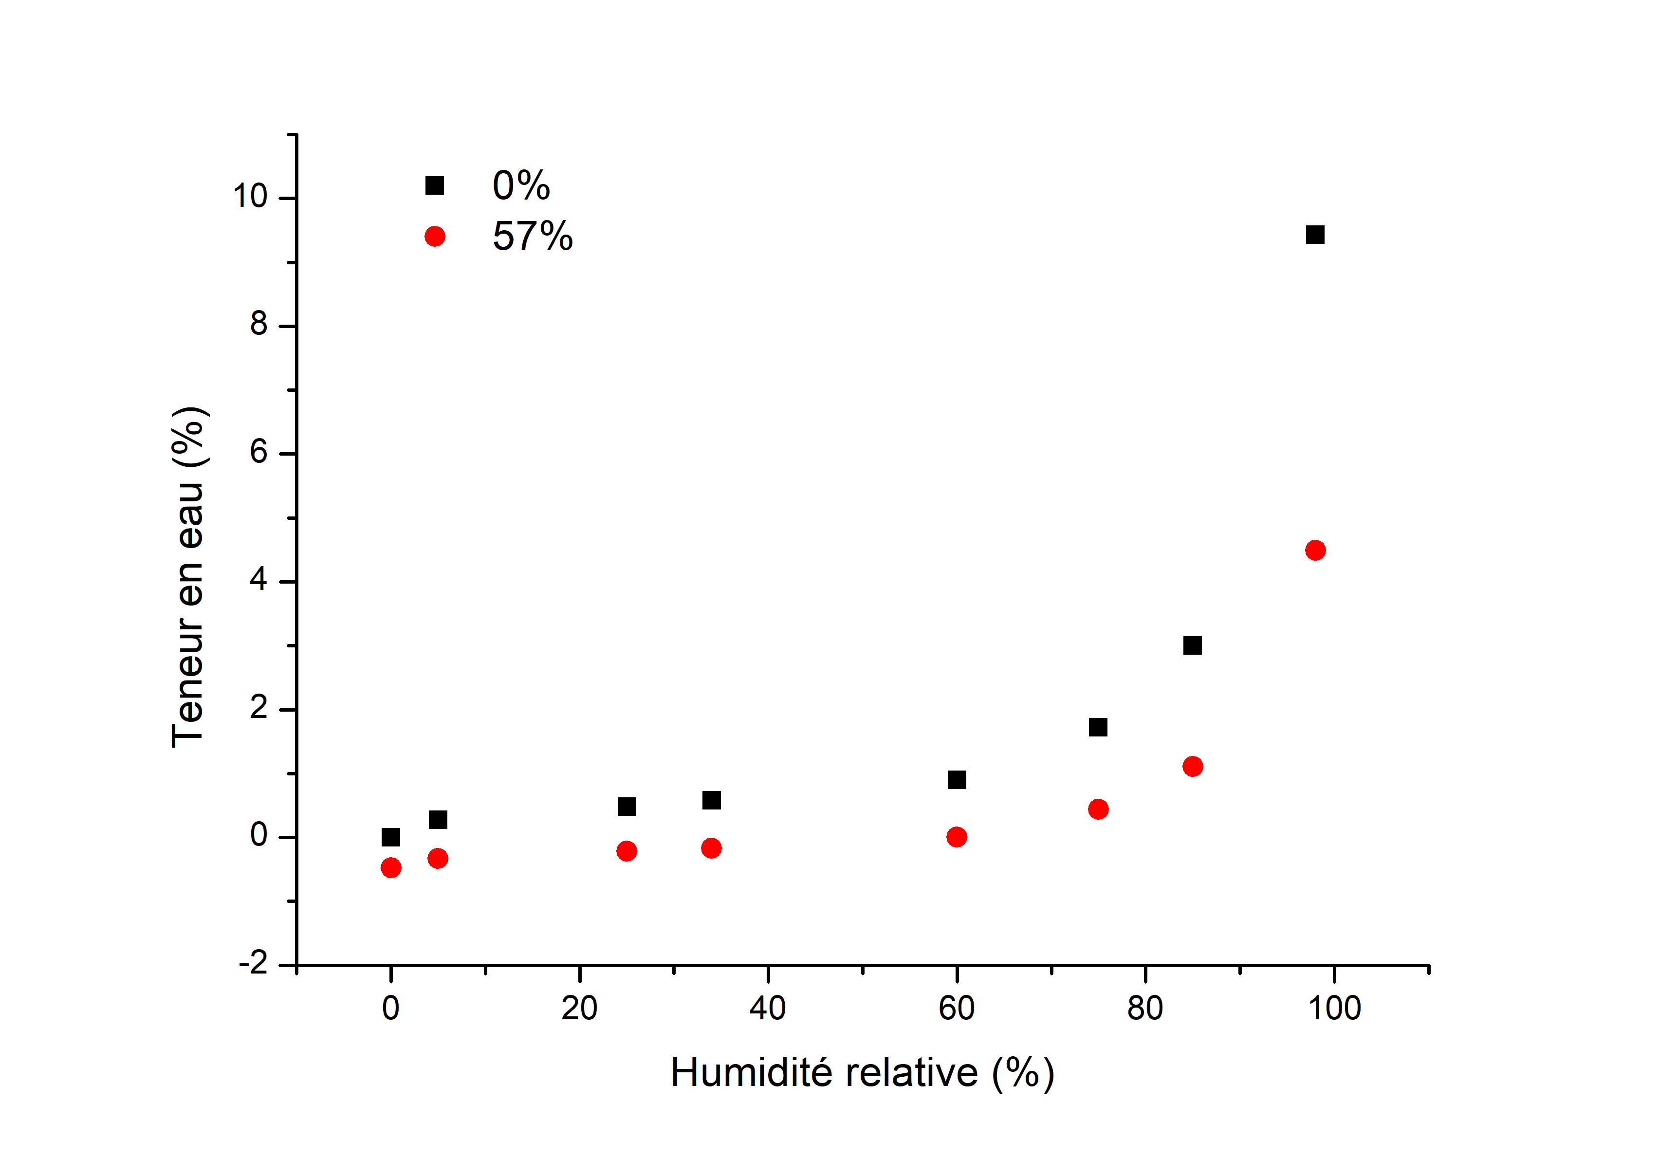
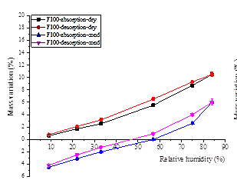
Argile cuit 800°C

Slide 4
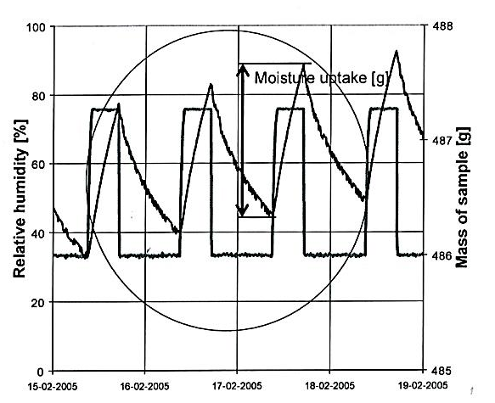
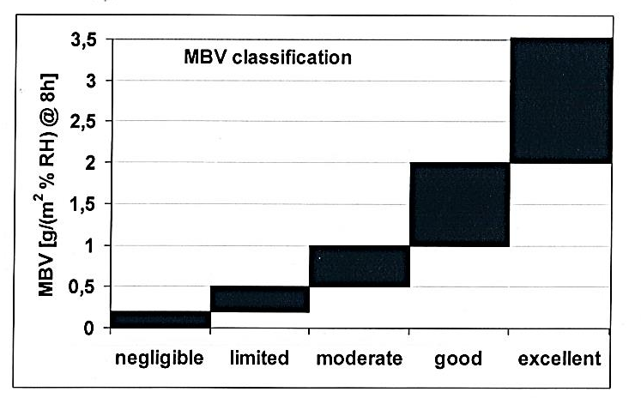
MOISTURE BUFFER VALUE = MBV
Rode 2005- ISBN 87-7877-195-1
“The practical Moisture Buffer Value indicates the amount of water that is transported in or out of a material per open surface area, during a certain period of time, when it is subjected to variations in relative humidity of the surrounding air.”
23°C, monodimensionnal flow (only 1 exchange side, area=A)
Conditionned at 58% RH before testing
Δm
Δm
MBV =
A . ΔRH
(Rode2007)

Slide 5
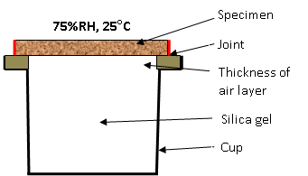
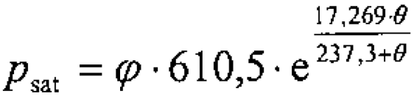
ISO 12572
VAPOR PERMEABILITY
Conditionning at 58% RH
1- slope of the curve weight = f (time) during the steady-state period (G).
2- permeability
Salt solution
d = thickness of sample, W = perméance
3 -
Correction due to the
resistance of air gap
between sample and
salt solution
d_{a} = thickness of the air gap (m)
δ_{a} = water vapor permeability of air
(kg/(m.s.Pa))
A = sample area (m²)
P_{v} = water vapor pressure
P_{sat} = saturated water vapor pressure
P₀ = atmospheric pressure = 101325 Pa
P, T = pressure and temp. of experiment
R_{v} = specific gas constant of water vapor
=462 J/(kg.K)
A
G
P_{v} = P_{sat} x RH
2,306 10⁻⁵ P₀
T
1,81
δa =
R_{v} T P
273
for very hygroscopic material , resistance between ouside and sample must be considered

Slide 6

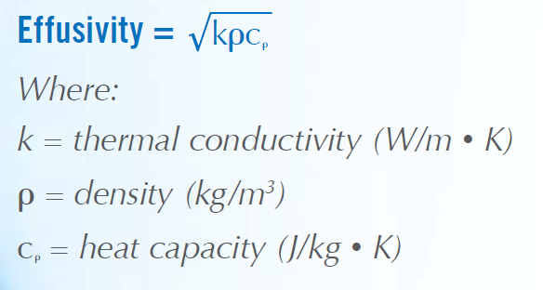
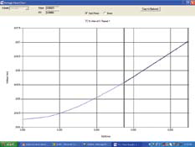
THERMAL CONDUCTIVITY
modified transient plane source technique.
A current is applied to the sensor’s heating element providing a small amount of heat.
The heat provided results in a rise in temperature at the interface between the sensor and the sample, typically less than 2º C.
This temperature rise at the interface induces a change in the voltage of the sensor element. The thermo-physical properties of the sample material are inversely proportional to the rate of increase in the sensor voltage.
The more thermally insulative the material is, the steeper the voltage rise.

Slide 7
WATER ABSORPTION COEFFICIENT
ISO15148
“The water absorption by partial immersion is determined by measuring the change in mass of the test specimen, the bottom surface of which is in contact with water.
The water adhering to the surface and not absorbed by the product is completely removed by, for example, blotting with a sponge before the specimen is weighed.”
“The sides of a solid specimen shall be sealed with a water and vapour tight sealant that does not react chemically with it or significantly penetrate the pores of the product.”
A_{w} describes the time dependent absorption of water while the material is in contact with it.
[kg/(m².h^{0,5})]
A= area of the base (m²)

