Slide 1
CSC 453 Database Systems
Lecture
Tanu Malik
College of CDM
DePaul University

Slide 2
Last time
Relational Model
  Primary Keys
  Foreign Keys
  Alter table
  Cascade

Slide 3
Relational Model: Review
Orders(CustomerId, OrderDate)
Products(UPC, Name)
Specify the keys for the relations
Declare relationship attributes between tables

Slide 4
Possible Relationship?
Orders(CustomerId, OrderDate, UPC)
Products(UPC, Name, CustId)

Slide 5
Many-many relationship
Orders(CustomerId, OrderDate)
OrderLines(CustId, OrderDate, UPC, status)
Products(UPC, Name)

Slide 6
Today
SQL
  Basic SQL on single table
  Basic SQL on two tables
  Nested subqueries

Slide 7
SQL: Structured Query Language

Slide 8
SQL
Structured Query Language (SQL) is the industry standard for relational databases
Used to be known as SEQUEL (Structured English Query Language), developed at IBM
All major DBMSs support some version of SQL (SQL-99 is the one you are likely to see)

Slide 9
Classes of SQL Commands
Data Definition Language (DDL)
  Create schemas, tables, constraints, views
Data Manipulation Language (DML)
  Modify and update tables, retrieve information
Data Control Language (DCL)
  Grant and revoke access to parts of database
Most users will only have access to the DML – we will use both the DDL and the DML

Slide 10
SQL-DDL
Create a table
Insert values into it
create table student (
LastName varchar(40),
FirstName varchar(40),
SID number(5),
SSN number(9),
Career varchar(4),
Program varchar(10),
City varchar(40),
Started number(4)
);
insert into student
values ( 'Brennigan', 'Marcus', 90421, 987654321, 'UGRD', 'COMP-GAM', 'Evanston', 2010 );

Slide 11
Classes of SQL Commands
Data Definition Language (DDL)
  Create schemas, tables, constraints, views
Data Manipulation Language (DML)
  Modify and update tables, retrieve information
Data Control Language (DCL)
  Grant and revoke access to parts of database
Most users will only have access to the DML – we will use both the DDL and the DML

Slide 12
SQL is declarative
SQL describes WHAT to do
Not HOW to do it.

Slide 13
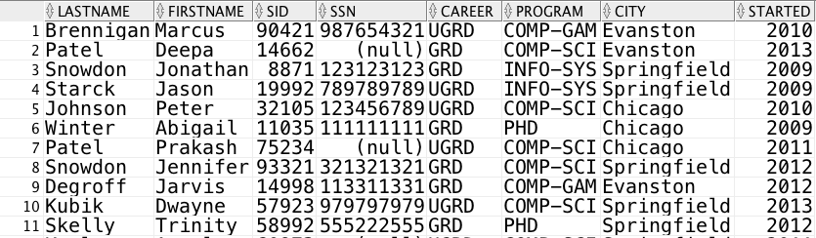
Student Table
Query the table:
Find all students who live in Chicago

Slide 14
Student Table
Query the table:
Find all students who live in Chicago
SELECT *
FROM Student
WHERE city = ‘Chicago’
Star means all attributes

Slide 15
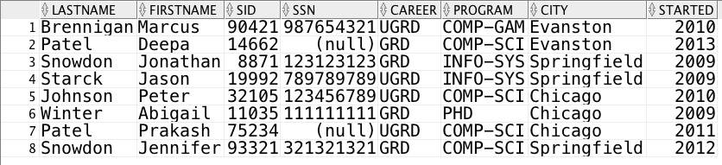
Student Table
Query the table:
Find IDs of students who live in Chicago
SELECT SID, City
FROM Student
WHERE city = ‘Chicago’
This is the WHERE clause.
The WHERE clause is evaluated for each row in the table

Slide 16
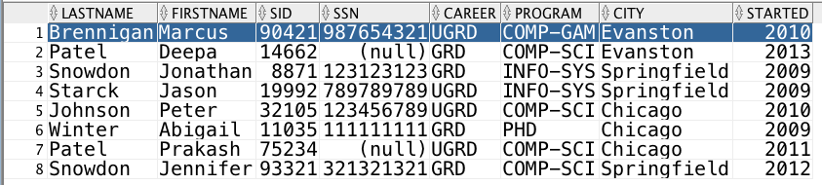
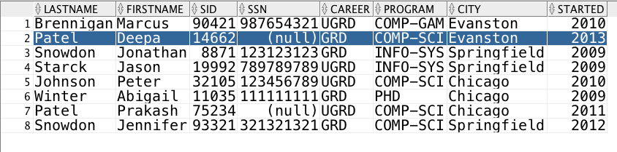
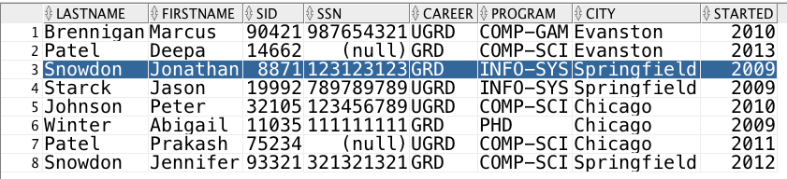
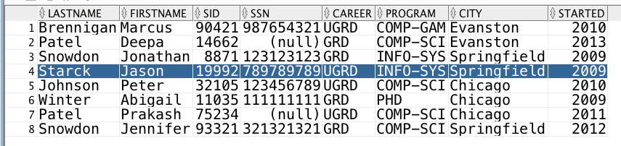
No
No
No
No

Slide 17
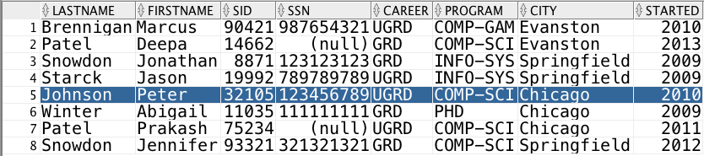
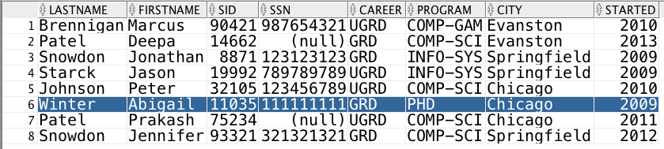
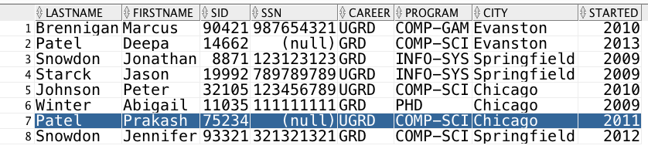
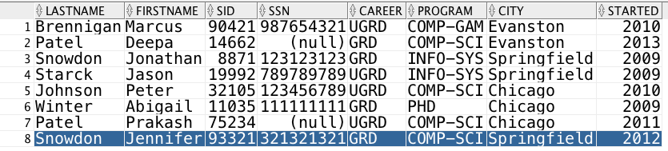
Yes
Yes
Yes
No
Temporary Query Result Table

Slide 18

Query the table:
Find Ids of students who live in Chicago
SELECT SID, City
FROM Student
WHERE city = ‘Chicago’
Find Ids of students who live in Chicago
SELECT SID, City
FROM Student
WHERE city = ‘Chicago’

Slide 19

Query the table:
Find Id and Last Name of students
who live in Chicago
SELECT SID, City
FROM Student
WHERE city = ‘Chicago’
Query the table:
Find Id and Last Name of students
who live in Chicago
SELECT SID, LName
FROM Student
WHERE city = ‘Chicago’

Slide 20
SQL: WHERE
WHERE condition
Each tuple is tested against the condition, and only those that satisfy it are returned by the query
Condition expression can contain:
  comparisons
  expressions with wildcards (for strings)
  boolean operations

Slide 21
Comparisons
Put numerical or string value on each side, each comparison returns true or false
  = is equal to
  != or <> is not equal to
  > is greater than
  >= is greater than or equal to
  < is less than
  <= is less than or equal to

Slide 22
Wildcards
Using LIKE, we can compare character strings to strings that include wildcard characters that match anything:
  _ matches any single character
  % matches any consecutive set of characters
For example:
  ‘b_d’ will match ‘bad’, ‘bed’, but not ‘band’
  ‘bat%’ will match ‘bat’, ‘bath’, ‘battery’…

Slide 23
Practice
Select all graduate students
Select students whose last initial is ‘B’ or ‘Y’

Slide 24
SQL: WHERE
WHERE condition
Each tuple is tested against the condition, and only those that satisfy it are returned by the query
Condition expression can contain:
  comparisons
  expressions with wildcards (for strings)
  boolean operations

Slide 25
Boolean Expressions
List students who live in ‘Evanston’ and started in ‘2010’

Slide 26
Yes AND Yes
Yes AND No
No AND No
No AND No

Slide 27
No AND Yes
No AND No
No And No
No AND No
SELECT * FROM Student WHERE City = ‘Evanston’ AND Started = 2010

Slide 28

Boolean Expressions
Yes | Yes | Yes
Yes | No | No
No | No | No
No | No | No
No | Yes | No
No | No | No
No | No | No
No | No | No
Temporary Query Result Table

Slide 29

Boolean Expressions
List students who live in ‘Evanston’ or started in ‘2010’
Yes | Yes | Yes
Yes | No | Yes
No | No | No
No | No | No
No | Yes | Yes
No | No | No
No | No | No
No | No | No
SELECT * FROM Student WHERE City = ‘Evanston’ OR Started = 2010

Slide 30
Boolean Expressions
List students in ‘COMP-GAM’ and ‘INFO-SYS’
✓
⤬
✓
✓
⤬
✓
⤬
⤬
SELECT * FROM Student WHERE Program = ‘COMP-GAM’ OR Program = ‘INFO-SYS’

Slide 31
Boolean Operators
Simple conditions can be combined into more complicated conditions
  X AND Y is satisfied by a tuple if and only if both X and Y are satisfied by it
  X OR Y is satisfied by a tuple if and only if at least one of X and Y is satisfied by it
  NOT X is satisfied by a tuple if and only if X is not satisfied by it

Slide 32
SQL: SELECT FROM
SELECT list of attributes
FROM list of tables
SELECT gives which attributes to include
  give a single attribute, or a list
  * for all attributes
FROM gives the table(s) to get tuples from
  for now, just a single table

Slide 33
Extensions to SELECT: Distinct
SELECT City
FROM Student
WHERE city = ‘Chicago’
SELECT DISTINCT City
FROM Student
WHERE city = ‘Chicago’

Slide 34
Extensions to SELECT: Distinct
SQL does not remove duplicates by default
The first query does not eliminate duplicate rows from the answer.
The second query eliminates duplicate rows.
The query writer chooses whether duplicates are eliminated.

Slide 35
More SELECT Extensions
The SELECT clause list can also include simple arithmetic expressions using +, -, *, and /.
We can use aggregate operators in the SELECT clause: COUNT, SUM, MIN, MAX, and AVG
  If one aggregate operator appears in the SELECT clause, then ALL of the entries in the select clause must be aggregate operators
Operators can be composed together

Slide 36
Examples
SELECT avg(started), max(started), min(started) FROM student;
SELECT max(started), min(started) FROM student WHERE career = ‘GRD’;
SELECT count(*) AS GraduateStudents
FROM student WHERE career = ‘GRD’;
SELECT count(distinct presidentID)
FROM studentgroup;

Slide 37
Rename Columns and Tables
SQL aliases are used to give a table, or a column in a table, a temporary name.
Aliases are often used to make column names more readable.
An alias only exists for the duration of the query.
SELECT column_name AS alias_name
FROM table_name;
SELECT column_name(s)
FROM table_name AS alias_name;

Slide 38
Order Query Result
Ordering tuples
SELECT SID, Started
FROM Student
WHERE city = ‘Chicago’
ORDER BY Started
By default ASC order
DESC for descending order

Slide 39
SQL Queries
General form of a query:
1. SELECT list of attributes to report
2. FROM list of tables
3. [WHERE tuple condition]
4. [ORDER BY list of ordering attributes] ;
Result is an ordered set of ordered tuples

Slide 40
Order of Operations
In what order are these clauses applied?
  FROM: Chooses a table
  WHERE: Chooses a set of tuples
  SELECT: Chooses what values to display
  ORDER BY: Chooses the order to display them

Slide 41


Grouping and Selective Grouping
Count(Student) > 2

Slide 42
GROUP BY
GROUP BY list of grouping attributes
We can combine the tuples returned by a query into sets based on the value of some attribute(s), and report the value(s) of this attribute(s) and aggregate information for each group
Once we group, we cannot look at the values in the individual tuples anymore…

Slide 43
HAVING
HAVING group condition
Once tuples are grouped and some aggregate function is computed, we can choose to display the result for only those groups that satisfy the expression
Can use all the same comparisons and boolean operators as WHERE

Slide 44
Examples
List courses and their total enrollment by quarter.
List courses in which at least two students are enrolled

Slide 46
SQL Queries
General form of a query:
1. SELECT list of attributes to report
3. FROM list of tables
2. [WHERE tuple condition]
5. [GROUP BY list of grouping attributes]
6. [HAVING group condition]
4. [ORDER BY list of ordering attributes] ;
Result is an ordered set of ordered tuples

Slide 47
Order of Operations
In what order are these clauses applied?
  FROM: Chooses a table
  WHERE: Chooses a set of tuples
  GROUP BY: Partitions them into groups
  HAVING: Chooses some subset of the groups
  SELECT: Chooses what values to display
  ORDER BY: Chooses the order to display them

Slide 48
What if the tuple is NULL?
Reasons for being NULL:
value exists but we don’t know the value
  e.g. birthdate
value isn’t applicable; no value exists
  e.g. SSN is null
we don’t know whether value is applicable
  e.g. SSN is null because of privacy reasons

Slide 49
NULL value
NULL is not a value
  All NULLs are distinct
  Don’t use ‘=‘ to check explicitly for NULLs, use IS NULL or IS NOT NULL instead
<number>_
Notes:
Null in operations
Null in functions

Slide 50
NULL comparison
Any comparison involving NULL will yield a result of UNKNOWN
  An end result of UNKNOWN does not satisfy a WHERE (only TRUE does!)
<number>_
Notes:
Null in operations
Null in functions

Slide 51
Two-valued logic
p | q | p OR q | p AND q
True | True | True | True
True | False | True | False
False | True | True | False
False | False | False | False

Slide 52
Three-valued Logic
p | q | p OR q | p AND q
True | True | True | True
True | Unknown | True | Unknown
True | False | True | False
Unknown | True | True | Unknown
Unknown | Unknown | Unknown | Unknown
Unknown | False | Unknown | False
False | True | True | False
False | Unknown | Unknown | False
False | False | False | False

Slide 53
Null in operations and functions
Null in Operations
  if x has value NULL then 3 ○ x = NULL (○ operation like +, -, *, /, etc.)
Null in Functions
  f(…, null, …) = null (for most functions )
  Exception string concatenation: ||

Slide 54
Example
List student groups without presidents.

Slide 55
Today
SQL
  Basic SQL on single table
  Basic SQL on two tables
  Nested subqueries

Slide 56
SQL: SELECT FROM
SELECT list of attributes
FROM list of tables
SELECT gives which attributes to include
  give a single attribute, or a list
  * for all attributes
FROM gives the table(s) to get tuples from
  Considering 2 tables

Slide 57
SQL Query Using Two (or more) Tables
List names of students who are enrolled in courses.
How does this work?
Which rows, from which tables, are evaluated in the WHERE clause?

Slide 58
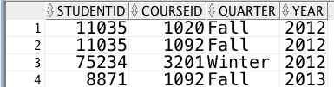
We must check every combination of one row from Student with one row from Enrolled.
SELECT FirstName, LastName
FROM Student S, Enrolled E
WHERE S.SID = E.StudentID

Slide 59
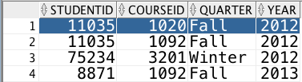
No
No
No
No
No
Yes
No
No

Slide 60
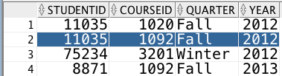
No
No
No
No
No
Yes
No
No

Slide 61
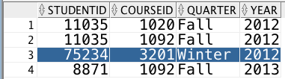
No
No
No
No
No
No
Yes
No

Slide 62
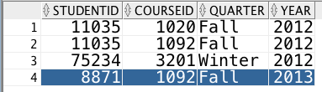
No
No
Yes
No
No
No
No
No

Slide 63
SELECT FirstName, LastName, CID
FROM Student S, Enrolled E
WHERE S.SID = E.StudentID AND Year >= 2013
We must check every combination of one row from Student with one row from Enrolled along with additional clauses

Slide 64
No
No
No
No
No
Yes AND No = No
No
No

Slide 65
No
No
No
No
No
Yes AND No = No
No
No

Slide 66
No
No
No
No
No
No
Yes AND No = No
No

Slide 67
No
No
Yes AND Yes = Yes
No
No
No
No
No

Slide 68
Result

Slide 69
Join Operator
Combines data distributed among linked tables into a single set of tuples using a join condition.
The tables are linked via foreign key references.
Different types joins, based on join condition.

Slide 70
Different Types of Joins
Cross-join: no join condition for combining tuples
Inner joins: equality condition for combining tuples
  equi-join, natural join
Theta joins: custom/user-defined criteria for combining tuples

Slide 71
Inner Join vs. Outer Join
An inner join requires that tuples in the tables match in the specified attribute to create a tuple in the result.
An outer join does not: a tuple in the result may be either
  the combination of two tuples that match in the specified attribute (matching tuple)
  a tuple that does not match anything, combined with an all-NULL tuple (non-matching tuple)

Slide 72
Outer Join
SELECT *
FROM student
LEFT OUTER JOIN enrolled ON sid = studentid

Slide 73
SELECT *
FROM student S
LEFT OUTER JOIN enrolled E ON
S.sid = E.studentid
Null

Slide 74
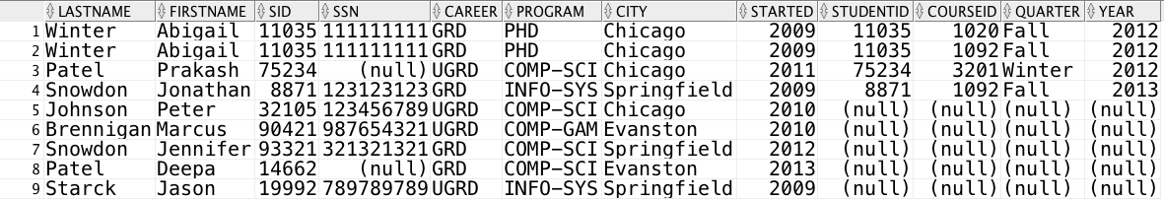

Slide 75
Left Outer Join
Includes all matching tuples, plus a tuple for each tuple in the first table that has no match
… TABLE1 LEFT OUTER JOIN TABLE2
ON TABLE1.Attribute = TABLE2.Attribute;

Slide 76
Right Outer Join
Includes all matching tuples, plus a tuple for each tuple in the second table that has no match
… TABLE1 RIGHT OUTER JOIN TABLE2
ON TABLE1.Attribute = TABLE2.Attribute;

Slide 77
Full Outer Join
Includes all matching tuples, plus a tuple for each tuple in either table that has no match
… TABLE1 FULL OUTER JOIN TABLE2
ON TABLE1.Attribute = TABLE2.Attribute;

Slide 78
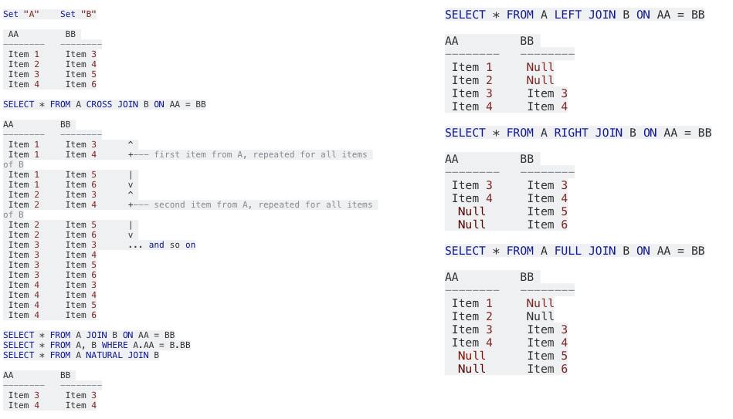
Inner, Outer, and Full Joins

Slide 79
Another SQL Query
List all students who are enrolled in courses.
List all students who are not enrolled in a course.

Slide 81
DIFFERENCE Operation
Subtract

Slide 82
SQL: EXCEPT/MINUS
The SQL EXCEPT clause/operator is used to combine two SELECT statements and returns rows from the first SELECT statement that are not returned by the second SELECT statement.
SELECT column1 [, column2 ]
  FROM table1 [, table2 ]
  [WHERE condition]
  EXCEPT
  SELECT column1 [, column2 ]
  FROM table1 [, table2 ]
  [WHERE condition]

Slide 83
SQL
SELECT sid
FROM student
MINUS
SELECT studentid
FROM enrolled

Slide 84
Mixed Practice
List student members of DeFrag and HerCTI.

Slide 85
Mixed Practice
List students that are members of both DeFrag and HerCTI.

Slide 86
Joins for comparison: Self Join
Joins the table to itself
SELECT …
TABLE1 as Alias1, TABLE as Alias2
ON Alias1.AttributeA = Alias2.AttributeB;

Slide 87
Self-Join
List students enrolled in two or more courses

Slide 88
Mixed practice
We only allow gaming students to join DeFrag; list students that violate this rule.
We require that all gaming students are members of DeFrag; list students that violate this rule.

Slide 89
Today
SQL
  Basic SQL on single table
  Basic SQL on two tables
  Nested subqueries

Slide 90
Subqueries
The result of one query may be needed by another to compute its result.

Slide 91
Writing subqueries
A subquery is nested (using parentheses) within an outer query
Outer query uses the result of the subquery, which can be either single value or a table
Outer query checks if a tuple in the outer query is within the inner query single value or table

Slide 92
Subquery check
Different ways of checking:
  Within the inner query set
  Not within the inner query set
  Against all members of the inner query set
  Against any one member of the inner query set
  Does the set exists

Slide 93
Set Membership
(6 in {2,4,6}) = TRUE
(5 in {2,4,6}) = FALSE
(5 not in {2,4,6}) = TRUE

Slide 94
SQL: IN
IN checks membership in a set
The set may be specified by a subquery or declared in the query
NOT IN check non-membership

Slide 95
The IN Operator
Conditions can contain IN for “element of”
SELECT LastName, FirstName
FROM student
WHERE started IN (2010, 2013, 2014);
SELECT LastName, FirstName
FROM student
WHERE started NOT IN (2010, 2013, 2014);
SELECT Department, CourseName
FROM Course
WHERE Department IN ('CSC' , 'IT', 'IS');

Slide 96
Running SQL Commands
Single SQL command
  Type on one line in center window, Execute (Ctrl-Enter)
Script (Sequence of SQL commands stored in a file)
  Type @X:\Path\File.sql in center window, Run Script (F5)
Any output will appear in bottom window under
Query Result or Script Output
Click on Save icon to save output window contents
to a text file (Click Clear icon first)

Slide 97
Working with SQL Scripts
Create file scriptname.sql in Notepad
  Be sure to use .sql extension
To add comments:
  -- for a single-line comment
  /* ... */ for a multi-line comment
Output full contents of table with
SELECT * FROM TABLE_NAME ;

Slide 98
Displaying Table Contents
SELECT * FROM TABLE_NAME ;
This will display the entire contents of the table TABLE_NAME (all rows and columns)
This is an example of a very simple query…

Slide 99
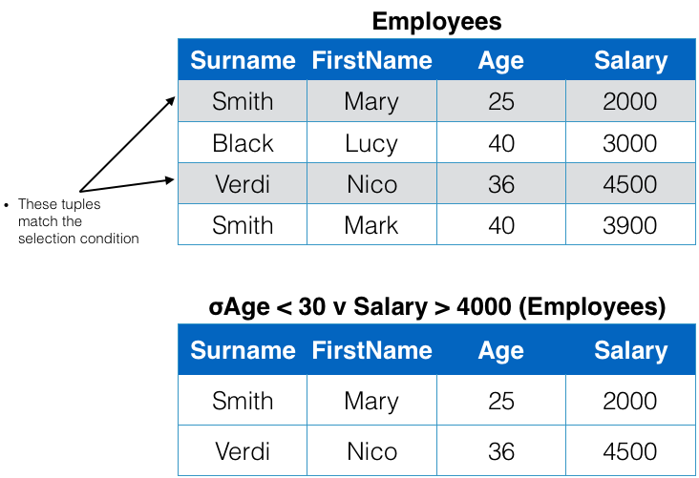
SELECT Operation

Slide 100
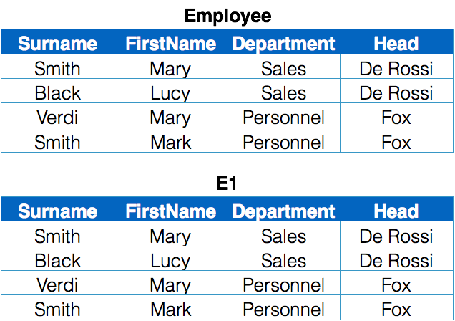
RENAME Operation

Slide 101
Practice
List students who live in ‘Evanston’ and started in ‘2010’
List students who live in ‘Evanston’ or started in ‘2010’
List students in ‘GAM’ and ‘IT’
Select all graduate students
Select students whose last initial is ‘B’ or ‘Y’
List courseids offered in Spring but not in Fall of 2013

Slide 102
List courseid in which there is no student enrolled
List courseids offered in Spring but not in Fall of 2013

Slide 103
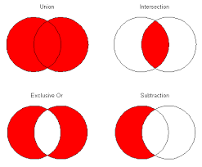
Set Operations

Slide 104
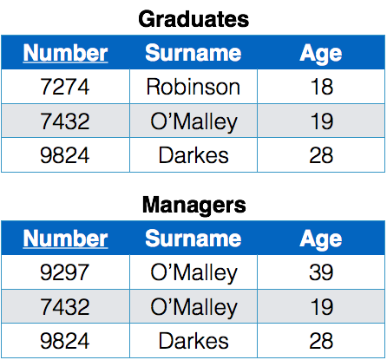
UNION Operation
Number | Surname | Age
9297 | O’Malley | 39
7432 | O’Malley | 19
9824 | Darkes | 28
7274 | Robinson | 18

Slide 105
SQL: UNION
The UNION operator is used to combine the result-set of two or more SELECT statements.
Each SELECT statement within UNION must have the same number of columns
The columns must also have similar data types
The columns in each SELECT statement must also be in the same order
SELECT column_name(s) FROM table1
UNION
SELECT column_name(s) FROM table2;

Slide 106
INTERSECT Operation
Number | Surname | Age
7432 | O’Malley | 19
9824 | Darkes | 28

Slide 107
SQL: Intersect
Combine two SELECT statements, but returns rows only from the first SELECT statement that are identical to a row in the second SELECT statement.
SELECT column1 [, column2 ]
FROM table1 [, table2 ]
[WHERE condition]
INTERSECT
SELECT column1 [, column2 ]
FROM table1 [, table2 ]
[WHERE condition]

Slide 108
DIFFERENCE Operation
Number | Surname | Age
7274 | Robinson | 18

Slide 109
SQL: EXCEPT/MINUS
The SQL EXCEPT clause/operator is used to combine two SELECT statements and returns rows from the first SELECT statement that are not returned by the second SELECT statement.
SELECT column1 [, column2 ]
  FROM table1 [, table2 ]
  [WHERE condition]
  EXCEPT
  SELECT column1 [, column2 ]
  FROM table1 [, table2 ]
  [WHERE condition]

Slide 110
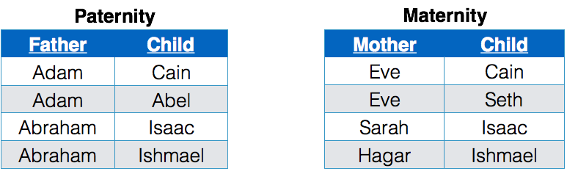
A meaningful but impossible union
Paternity ∪ Maternity = ?

Slide 111
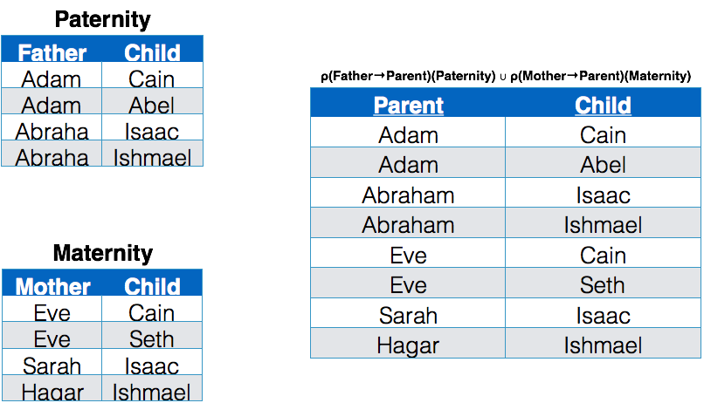
SELECT Father AS Parent, Child FROM Paternity
UNION
SELECT Mother AS Parent, Child FROM Maternity

Slide 112
Join Operator
Combines data distributed among linked tables into a single set of tuples using a join condition.
The tables are linked via foreign key references.
Different types joins, based on join condition.

Slide 113
Different Types of Joins
Cross-join: no join condition for combining tuples
Inner joins: equality condition for combining tuples
  equi-join, natural join
Theta joins: custom/user-defined criteria for combining tuples

Slide 114
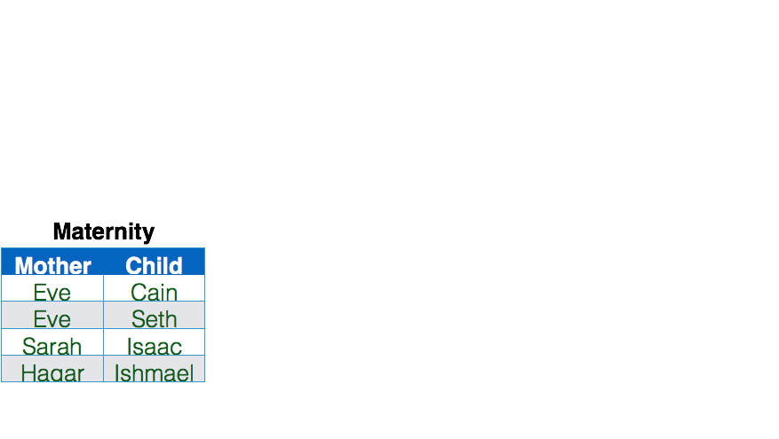
2 Linked Tables
Paternity
Father | Child
Adam | Cain
Adam | Abel
Abraham | Isaac
Abraham | Ishmael

Slide 115
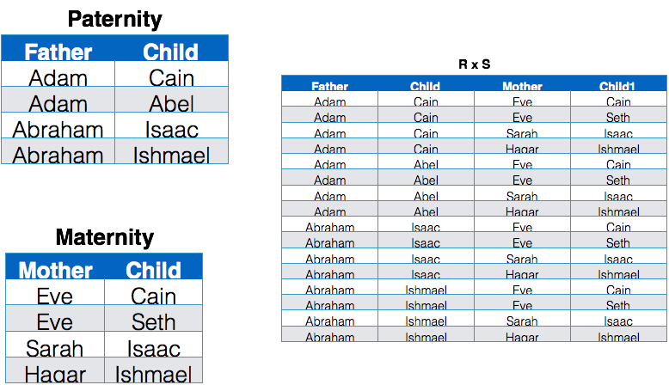
Cross Join (R X S)

Slide 116
SQL: Cross Join
SELECT [attribute list]
FROM Table1, Table2

Slide 117
Examples
List students that are not presidents of any group.
Select all students whether presidents or not
All Presidents (whether students or not) of Groups
Select all students, student presidents, and non-students who are presidents

