Slide 1

Aerospace Engineering Design
Unit 2: CAD Modeling, Parametric Design & 3D Printing
Student learning deck • LockwoodSTEM aerospace-aligned AED curriculum
Skills
Evidence
Challenge
Fusion setup, sketches, constraints, features, parametric edits, and slicer prep.
CAD screenshots, exported files, slicer settings, test prints, and revision notes.
Design and justify a 3D printed tolerance tester for rocket assembly.
Model • Print • Test • Revise

Slide 2
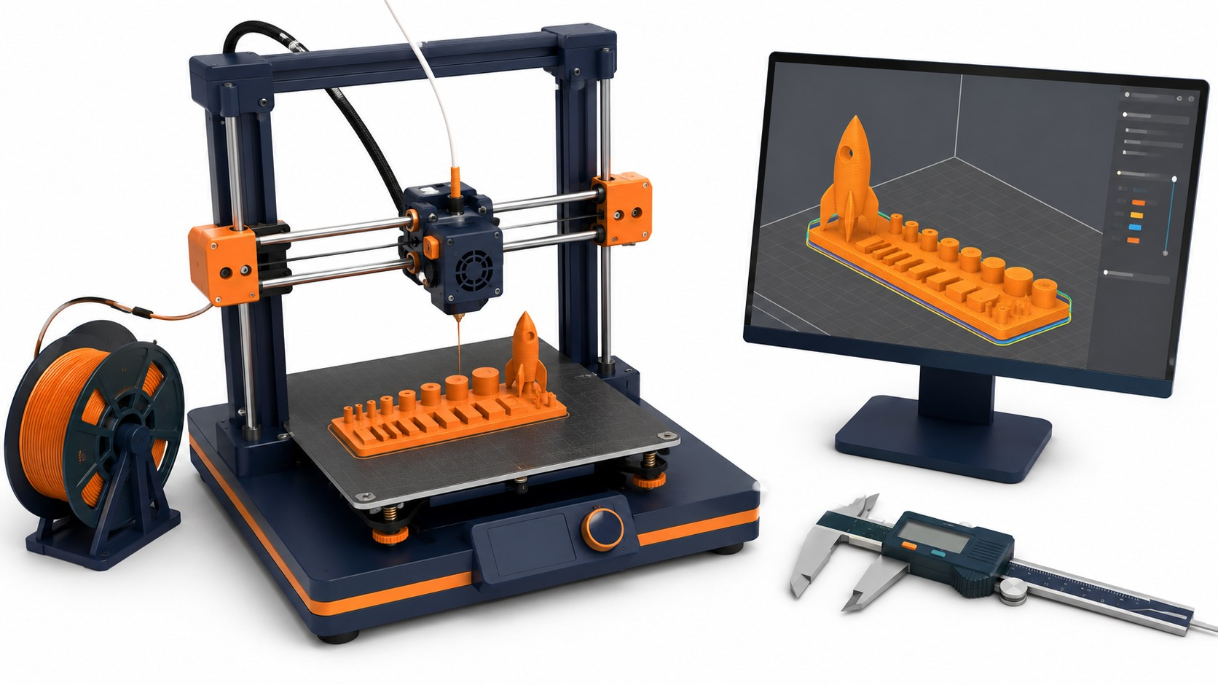
Unit 2
Unit 2 Learning Arc
CAD turns documented ideas into accurate, editable, printable models.
Start with evidence
Build controlled models
Prepare for printing
Use the print as data
Use sketches and measurements as inputs.
Use planes, constraints, dimensions, and features.
Check the CAD model and slicer setup.
Test fit and recommend clearances for Unit 3.
LockwoodSTEM | Aerospace Engineering Design | Unit 2

Slide 3
Lesson Unit 2
Unit 2 Deliverables Map
Track these artifacts as the unit develops.
CAD evidence
Fusion project setup
Constrained and dimensioned sketches
Extrudes, cuts, fillets, revolves, and patterns
Screenshots showing revisions
Print evidence
STL/exported files
Slicer preview and settings
Tolerance tester print
Fit test recommendation
Your deliverables should prove how your design decisions were made.
LockwoodSTEM | Aerospace Engineering Design | Unit 2

Slide 4
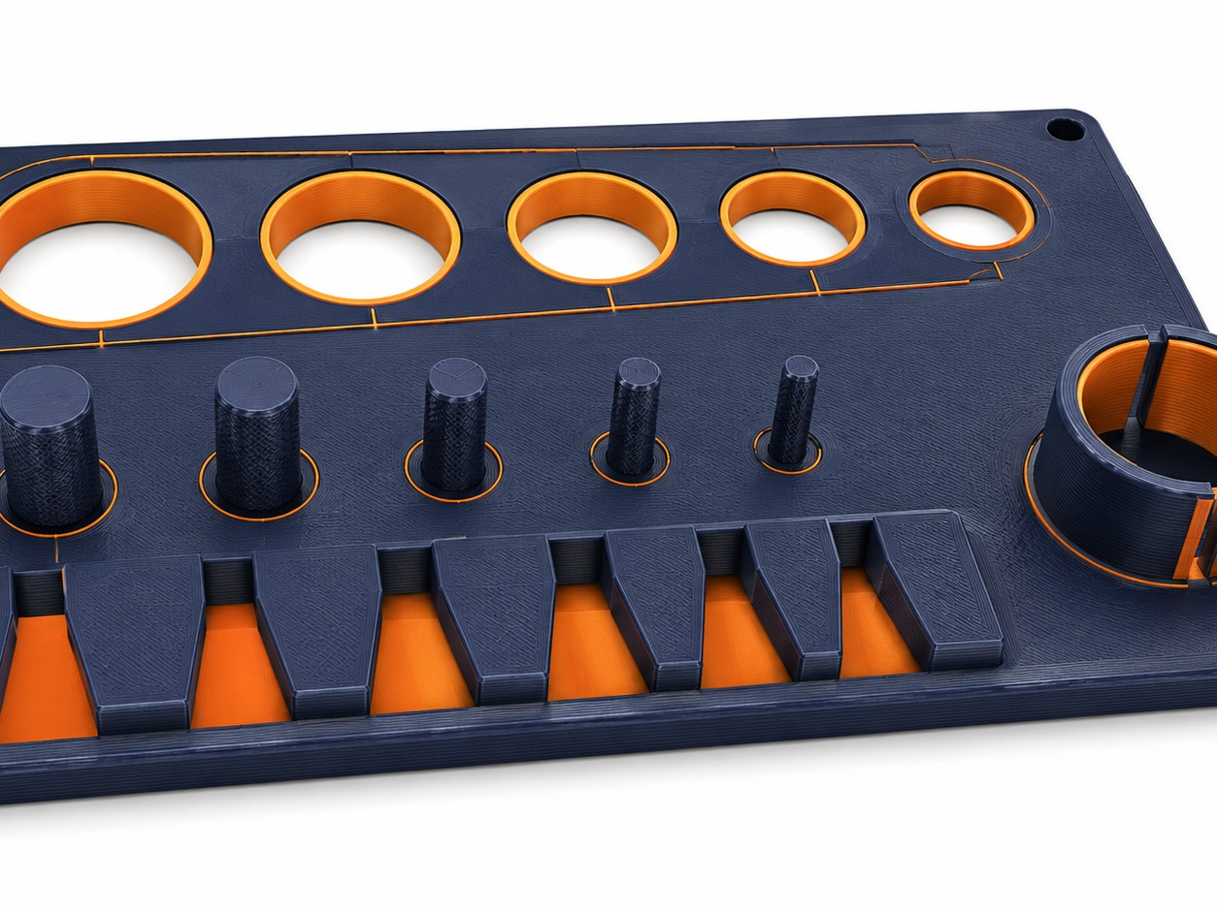
Unit 2
Unit 2 Project: Tolerance Tester
Your final print is a test tool, not just a decoration.
Purpose
Measure and compare fit between printed features and rocket assembly parts.
Evidence
Use repeated holes, pegs, slots, or couplers to identify reliable clearances.
Recommendation
Use test results to recommend a clearance for Unit 3 rocket assembly.
LockwoodSTEM | Aerospace Engineering Design | Unit 2

Slide 5
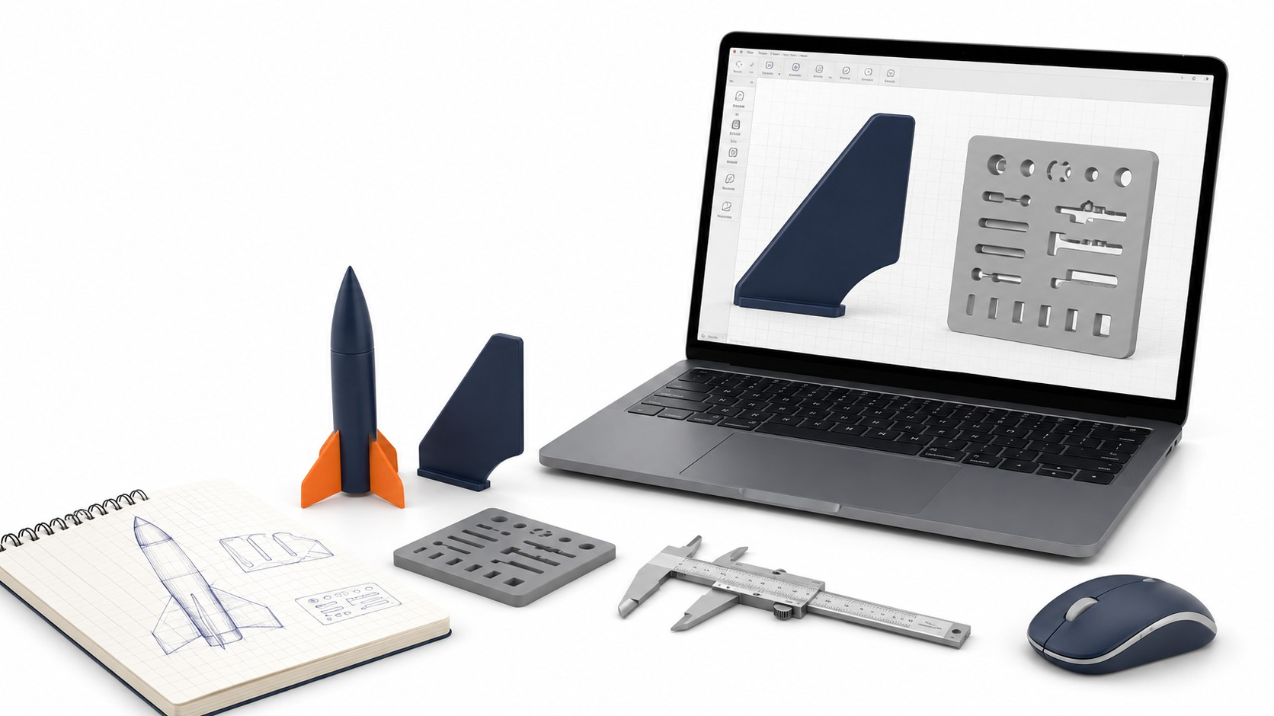
Lesson 2.1
Lesson 2.1
From Engineering Documentation to CAD
How do engineers turn sketches and measurements into digital models?
Lesson 2.1
From Engineering Documentation to CAD
Connect today's work to your Unit 2 CAD and 3D printing evidence.
LockwoodSTEM | Aerospace Engineering Design | Unit 2

Slide 6
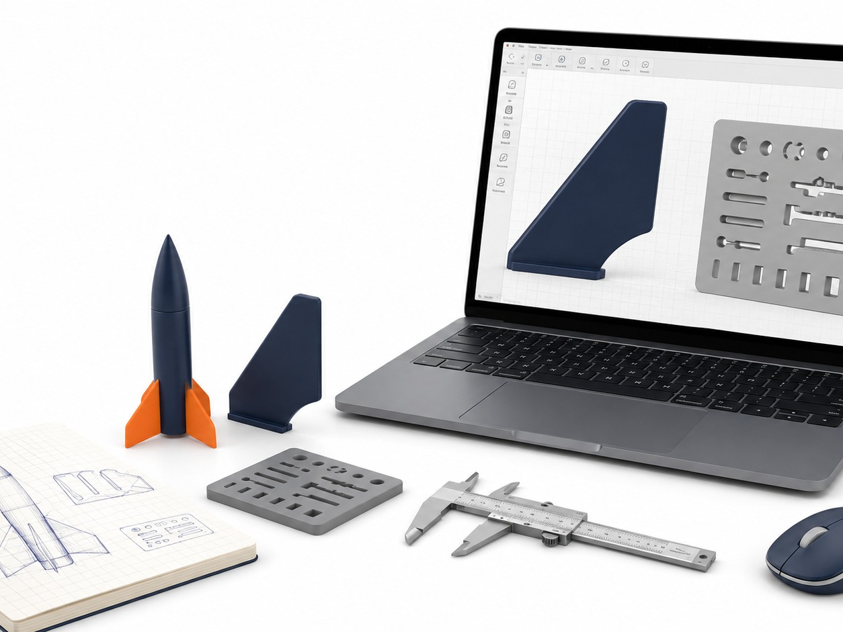
Lesson 2.1
From Engineering Documentation to CAD
Big ideas you should understand before you start the work
Big Ideas
1
CAD models should be based on documented measurements, not guesses.
2
Unit 1 sketches become a modeling plan.
3
Good planning prevents wrong-size digital parts.
Ask yourself: How does this CAD decision improve accuracy, editability, or printability?
LockwoodSTEM | Aerospace Engineering Design | Unit 2

Slide 7
Lesson 2.1
From Engineering Documentation to CAD
Use the lesson skill to make a more accurate, editable, or printable model.
Modeling moves
Use your sketch as the source, not your memory.
Identify which dimensions control the shape.
Name files so they can be found later.
Quality checks
Does the model match the intended measurements?
Can another student understand the feature?
Will the part be printable or testable?
Good CAD work is controlled enough to revise and clear enough to explain.
LockwoodSTEM | Aerospace Engineering Design | Unit 2

Slide 8
Lesson 2.1
From Engineering Documentation to CAD
Save the strongest artifact from today for your Unit 2 portfolio.
Deliverable checklist
Notebook entry connects sketch evidence to a planned CAD model.
CAD file or screenshot is saved with a clear name.
Model decisions are explained with measurements.
Portfolio evidence
Dated notebook entry
Screenshot or exported file
Short claim explaining what the evidence proves
Your final portfolio should show how the model improved across the unit.
LockwoodSTEM | Aerospace Engineering Design | Unit 2

Slide 9
Lesson 2.2
Lesson 2.2
Fusion 360 Interface and File Setup
How do engineers set up a CAD workspace so work is organized and accurate?
Lesson 2.2
Fusion 360 Interface and File Setup
Connect today's work to your Unit 2 CAD and 3D printing evidence.
LockwoodSTEM | Aerospace Engineering Design | Unit 2

Slide 10
Lesson 2.2
Fusion 360 Interface and File Setup
Big ideas you should understand before you start the work
Big Ideas
1
The interface is a tool system: browser, timeline, sketch tools, view cube, and units.
2
File setup affects every model made afterward.
3
A clean project folder prevents lost or duplicated work.
Ask yourself: How does this CAD decision improve accuracy, editability, or printability?
LockwoodSTEM | Aerospace Engineering Design | Unit 2

Slide 11
Lesson 2.2
Fusion 360 Interface and File Setup
Use the lesson skill to make a more accurate, editable, or printable model.
Modeling moves
Create/open the correct project location.
Set units before modeling.
Save early with a professional file name.
Quality checks
Does the model match the intended measurements?
Can another student understand the feature?
Will the part be printable or testable?
Good CAD work is controlled enough to revise and clear enough to explain.
LockwoodSTEM | Aerospace Engineering Design | Unit 2

Slide 12
Lesson 2.2
Fusion 360 Interface and File Setup
Save the strongest artifact from today for your Unit 2 portfolio.
Deliverable checklist
Fusion project is created or located.
Test file is saved correctly.
Student can identify key interface areas.
Portfolio evidence
Dated notebook entry
Screenshot or exported file
Short claim explaining what the evidence proves
Your final portfolio should show how the model improved across the unit.
LockwoodSTEM | Aerospace Engineering Design | Unit 2

Slide 13
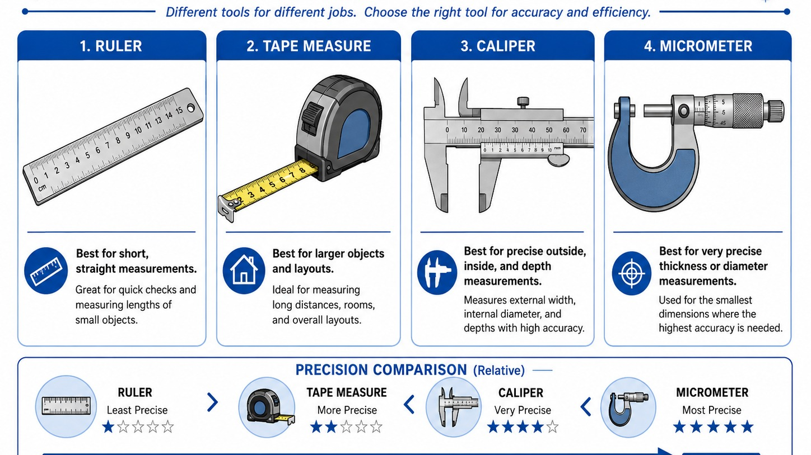
Lesson 2.3
Lesson 2.3
Sketch Planes and 2D Sketching
Why does every CAD model start with a carefully planned 2D sketch?
Lesson 2.3
Sketch Planes and 2D Sketching
Connect today's work to your Unit 2 CAD and 3D printing evidence.
LockwoodSTEM | Aerospace Engineering Design | Unit 2

Slide 14
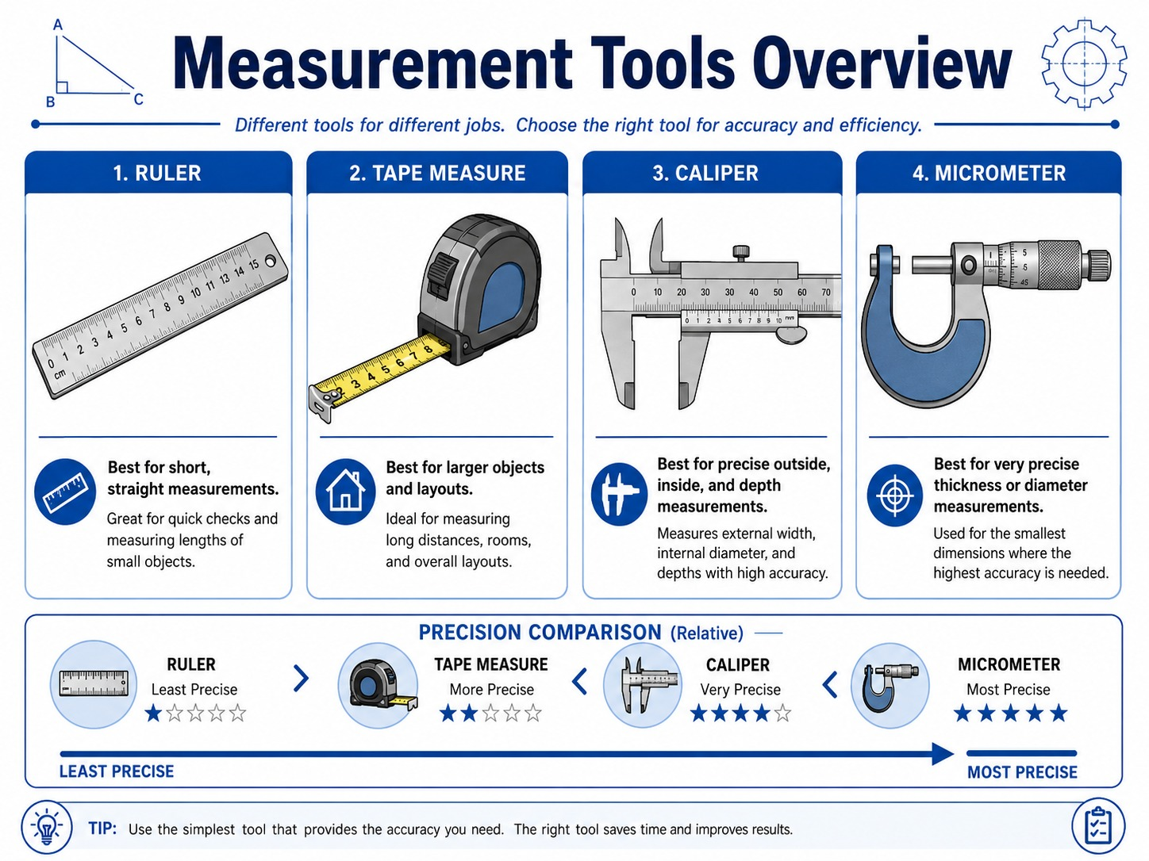
Lesson 2.3
Sketch Planes and 2D Sketching
Big ideas you should understand before you start the work
Big Ideas
1
The sketch plane controls where geometry begins.
2
2D sketches define the base shape of most 3D parts.
3
Poor sketch placement creates confusing models.
Ask yourself: How does this CAD decision improve accuracy, editability, or printability?
LockwoodSTEM | Aerospace Engineering Design | Unit 2

Slide 15
Lesson 2.3
Sketch Planes and 2D Sketching
Use the lesson skill to make a more accurate, editable, or printable model.
Modeling moves
Choose a plane that matches the intended view.
Start with simple geometry before details.
Keep sketches readable and organized.
Quality checks
Does the model match the intended measurements?
Can another student understand the feature?
Will the part be printable or testable?
Good CAD work is controlled enough to revise and clear enough to explain.
LockwoodSTEM | Aerospace Engineering Design | Unit 2

Slide 16
Lesson 2.3
Sketch Planes and 2D Sketching
Save the strongest artifact from today for your Unit 2 portfolio.
Deliverable checklist
Sketch plane is selected intentionally.
Base sketch is visible and understandable.
Student explains why the plane was chosen.
Portfolio evidence
Dated notebook entry
Screenshot or exported file
Short claim explaining what the evidence proves
Your final portfolio should show how the model improved across the unit.
LockwoodSTEM | Aerospace Engineering Design | Unit 2

Slide 17
Lesson 2.4
Lesson 2.4
Sketch Constraints
How do engineers control how a CAD sketch behaves when dimensions change?
Lesson 2.4
Sketch Constraints
Connect today's work to your Unit 2 CAD and 3D printing evidence.
LockwoodSTEM | Aerospace Engineering Design | Unit 2

Slide 18
Lesson 2.4
Sketch Constraints
Big ideas you should understand before you start the work
Big Ideas
1
Constraints describe relationships between sketch entities.
2
A fully defined sketch behaves predictably.
3
Uncontrolled sketches can shift unexpectedly.
Ask yourself: How does this CAD decision improve accuracy, editability, or printability?
LockwoodSTEM | Aerospace Engineering Design | Unit 2

Slide 19
Lesson 2.4
Sketch Constraints
Use the lesson skill to make a more accurate, editable, or printable model.
Modeling moves
Apply horizontal, vertical, parallel, perpendicular, tangent, and coincident constraints.
Watch how constraints change degrees of freedom.
Test the sketch by changing a dimension.
Quality checks
Does the model match the intended measurements?
Can another student understand the feature?
Will the part be printable or testable?
Good CAD work is controlled enough to revise and clear enough to explain.
LockwoodSTEM | Aerospace Engineering Design | Unit 2

Slide 20
Lesson 2.4
Sketch Constraints
Save the strongest artifact from today for your Unit 2 portfolio.
Deliverable checklist
Constrained sketch is saved.
At least three constraint types are identified.
Student explains why constraints improve model quality.
Portfolio evidence
Dated notebook entry
Screenshot or exported file
Short claim explaining what the evidence proves
Your final portfolio should show how the model improved across the unit.
LockwoodSTEM | Aerospace Engineering Design | Unit 2

Slide 21
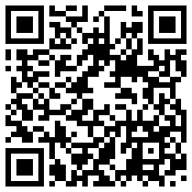
Lesson 2.4
Sketch Constraints
Optional video resource to reinforce the lesson ideas.
What to watch for
Fusion 360: Sketch Constraints
how constraints control sketch behavior
why fully defined sketches are more predictable
what happens when a dimension changes
Scan or open
Open Video
https://www.youtube.com/watch?v=J_2If5zVp84
LockwoodSTEM | Aerospace Engineering Design | Unit 2

Slide 22
Lesson 2.5
Lesson 2.5
Dimensioned CAD Sketches
How do dimensions turn a rough CAD sketch into an accurate engineering model?
Lesson 2.5
Dimensioned CAD Sketches
Connect today's work to your Unit 2 CAD and 3D printing evidence.
LockwoodSTEM | Aerospace Engineering Design | Unit 2

Slide 23
Lesson 2.5
Dimensioned CAD Sketches
Big ideas you should understand before you start the work
Big Ideas
1
Dimensions convert rough geometry into measurable engineering intent.
2
Key dimensions should come from sketches, requirements, or measured objects.
3
Over-dimensioning can make sketches hard to edit.
Ask yourself: How does this CAD decision improve accuracy, editability, or printability?
LockwoodSTEM | Aerospace Engineering Design | Unit 2

Slide 24
Lesson 2.5
Dimensioned CAD Sketches
Use the lesson skill to make a more accurate, editable, or printable model.
Modeling moves
Add dimensions to control size and spacing.
Use consistent units.
Revise dimensions when the design intent changes.
Quality checks
Does the model match the intended measurements?
Can another student understand the feature?
Will the part be printable or testable?
Good CAD work is controlled enough to revise and clear enough to explain.
LockwoodSTEM | Aerospace Engineering Design | Unit 2

Slide 25
Lesson 2.5
Dimensioned CAD Sketches
Save the strongest artifact from today for your Unit 2 portfolio.
Deliverable checklist
Sketch includes necessary dimensions.
Dimensions match documentation or requirements.
Student can identify controlling dimensions.
Portfolio evidence
Dated notebook entry
Screenshot or exported file
Short claim explaining what the evidence proves
Your final portfolio should show how the model improved across the unit.
LockwoodSTEM | Aerospace Engineering Design | Unit 2

Slide 26
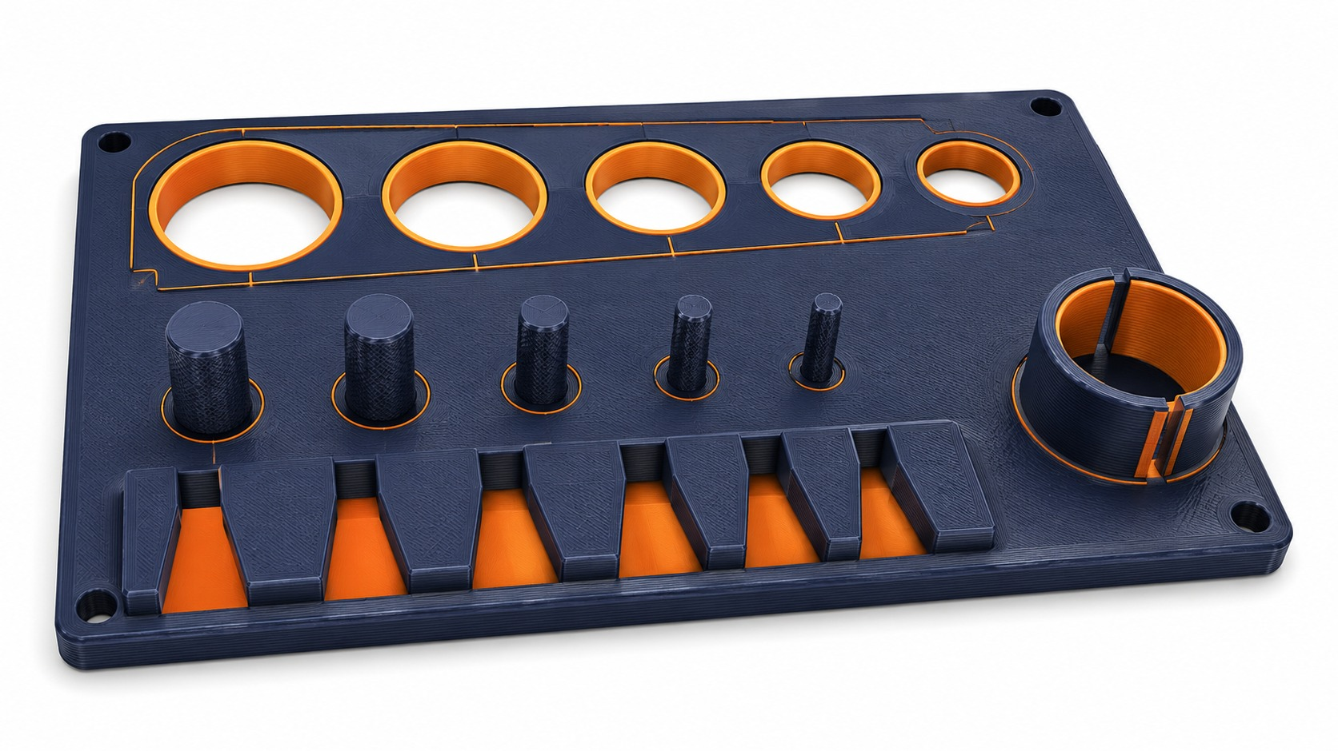
Lesson 2.6
Lesson 2.6
Extrude Basics
How does a 2D sketch become a 3D CAD model?
Lesson 2.6
Extrude Basics
Connect today's work to your Unit 2 CAD and 3D printing evidence.
LockwoodSTEM | Aerospace Engineering Design | Unit 2

Slide 27
Lesson 2.6
Extrude Basics
Big ideas you should understand before you start the work
Big Ideas
1
Extrude adds depth to a closed profile.
2
Extrude distance controls thickness, length, or height.
3
Extrude direction matters for assembly and print planning.
Ask yourself: How does this CAD decision improve accuracy, editability, or printability?
LockwoodSTEM | Aerospace Engineering Design | Unit 2

Slide 28
Lesson 2.6
Extrude Basics
Use the lesson skill to make a more accurate, editable, or printable model.
Modeling moves
Select a closed profile.
Choose join, new body, or cut intentionally.
Check the 3D view after the feature is created.
Quality checks
Does the model match the intended measurements?
Can another student understand the feature?
Will the part be printable or testable?
Good CAD work is controlled enough to revise and clear enough to explain.
LockwoodSTEM | Aerospace Engineering Design | Unit 2

Slide 29
Lesson 2.6
Extrude Basics
Save the strongest artifact from today for your Unit 2 portfolio.
Deliverable checklist
Basic extruded part is complete.
Feature is named or easy to identify.
Student can explain sketch-to-solid workflow.
Portfolio evidence
Dated notebook entry
Screenshot or exported file
Short claim explaining what the evidence proves
Your final portfolio should show how the model improved across the unit.
LockwoodSTEM | Aerospace Engineering Design | Unit 2

Slide 30
Lesson 2.7
Lesson 2.7
Cut Features and Holes
How do engineers remove material from a CAD model to create functional features?
Lesson 2.7
Cut Features and Holes
Connect today's work to your Unit 2 CAD and 3D printing evidence.
LockwoodSTEM | Aerospace Engineering Design | Unit 2

Slide 31
Lesson 2.7
Cut Features and Holes
Big ideas you should understand before you start the work
Big Ideas
1
Cuts create holes, slots, pockets, and clearance features.
2
Functional openings must be placed and dimensioned accurately.
3
Cut direction and depth affect whether the feature works.
Ask yourself: How does this CAD decision improve accuracy, editability, or printability?
LockwoodSTEM | Aerospace Engineering Design | Unit 2

Slide 32
Lesson 2.7
Cut Features and Holes
Use the lesson skill to make a more accurate, editable, or printable model.
Modeling moves
Sketch the removal area on the correct face.
Use cut distance or through-all when appropriate.
Inspect the model from multiple views.
Quality checks
Does the model match the intended measurements?
Can another student understand the feature?
Will the part be printable or testable?
Good CAD work is controlled enough to revise and clear enough to explain.
LockwoodSTEM | Aerospace Engineering Design | Unit 2

Slide 33
Lesson 2.7
Cut Features and Holes
Save the strongest artifact from today for your Unit 2 portfolio.
Deliverable checklist
Part includes at least one accurate cut feature.
Holes or slots are dimensioned.
Student checks that the feature goes where intended.
Portfolio evidence
Dated notebook entry
Screenshot or exported file
Short claim explaining what the evidence proves
Your final portfolio should show how the model improved across the unit.
LockwoodSTEM | Aerospace Engineering Design | Unit 2

Slide 34
Lesson 2.8
Lesson 2.8
Fillets, Chamfers, and Design Intent
Why do engineers modify sharp edges in a CAD model?
Lesson 2.8
Fillets, Chamfers, and Design Intent
Connect today's work to your Unit 2 CAD and 3D printing evidence.
LockwoodSTEM | Aerospace Engineering Design | Unit 2

Slide 35
Lesson 2.8
Fillets, Chamfers, and Design Intent
Big ideas you should understand before you start the work
Big Ideas
1
Fillets and chamfers can improve safety, strength, fit, and printability.
2
Edge treatment should support the function, not just appearance.
3
Design intent explains why a feature exists.
Ask yourself: How does this CAD decision improve accuracy, editability, or printability?
LockwoodSTEM | Aerospace Engineering Design | Unit 2

Slide 36
Lesson 2.8
Fillets, Chamfers, and Design Intent
Use the lesson skill to make a more accurate, editable, or printable model.
Modeling moves
Identify edges that need treatment.
Apply fillets or chamfers with reasonable sizes.
Avoid changing critical fit surfaces without a reason.
Quality checks
Does the model match the intended measurements?
Can another student understand the feature?
Will the part be printable or testable?
Good CAD work is controlled enough to revise and clear enough to explain.
LockwoodSTEM | Aerospace Engineering Design | Unit 2

Slide 37
Lesson 2.8
Fillets, Chamfers, and Design Intent
Save the strongest artifact from today for your Unit 2 portfolio.
Deliverable checklist
Part includes intentional edge treatment.
Student explains why each treatment was added.
Critical dimensions are still protected.
Portfolio evidence
Dated notebook entry
Screenshot or exported file
Short claim explaining what the evidence proves
Your final portfolio should show how the model improved across the unit.
LockwoodSTEM | Aerospace Engineering Design | Unit 2

Slide 38
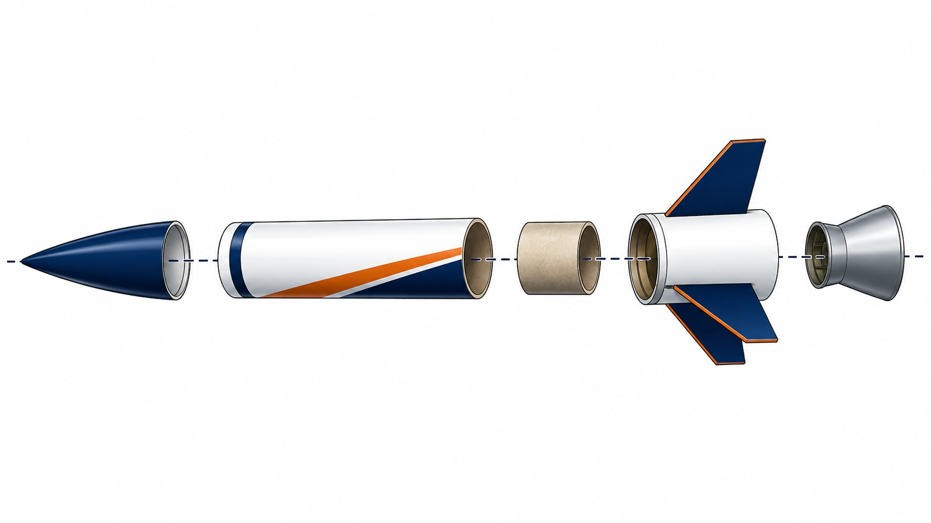
Lesson 2.9
Lesson 2.9
Revolve Features: Nose Cone and Nozzle
How can engineers create round 3D parts from a 2D sketch?
Lesson 2.9
Revolve Features: Nose Cone and Nozzle
Connect today's work to your Unit 2 CAD and 3D printing evidence.
LockwoodSTEM | Aerospace Engineering Design | Unit 2

Slide 39
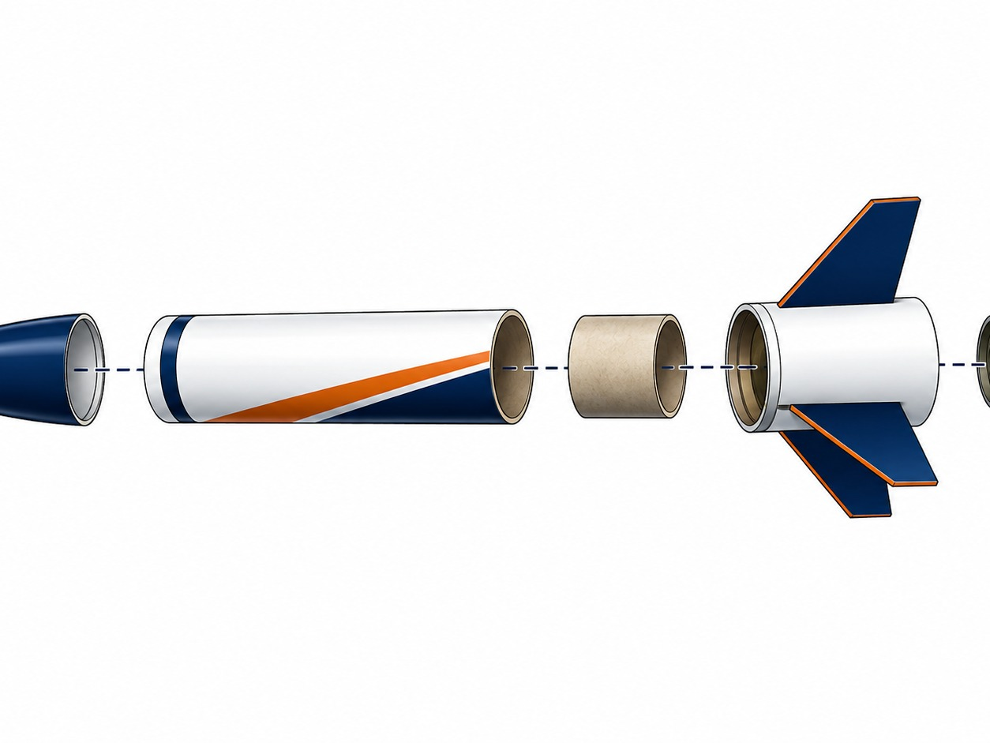
Lesson 2.9
Revolve Features: Nose Cone and Nozzle
Big ideas you should understand before you start the work
Big Ideas
1
Revolve creates circular parts from a profile and axis.
2
Profiles must be planned around the centerline.
3
Nose cones and nozzles are natural revolve examples.
Ask yourself: How does this CAD decision improve accuracy, editability, or printability?
LockwoodSTEM | Aerospace Engineering Design | Unit 2

Slide 40
Lesson 2.9
Revolve Features: Nose Cone and Nozzle
Use the lesson skill to make a more accurate, editable, or printable model.
Modeling moves
Sketch half of the profile.
Add a centerline or axis.
Use revolve angle to create the 3D body.
Quality checks
Does the model match the intended measurements?
Can another student understand the feature?
Will the part be printable or testable?
Good CAD work is controlled enough to revise and clear enough to explain.
LockwoodSTEM | Aerospace Engineering Design | Unit 2

Slide 41
Lesson 2.9
Revolve Features: Nose Cone and Nozzle
Save the strongest artifact from today for your Unit 2 portfolio.
Deliverable checklist
Revolved part is complete.
Axis and profile are visible or explainable.
Student connects the feature to a rocket component.
Portfolio evidence
Dated notebook entry
Screenshot or exported file
Short claim explaining what the evidence proves
Your final portfolio should show how the model improved across the unit.
LockwoodSTEM | Aerospace Engineering Design | Unit 2

Slide 42
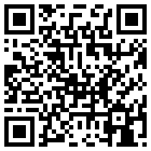
Lesson 2.9
Revolve Features: Nose Cone and Nozzle
Optional video resource to reinforce the lesson ideas.
What to watch for
Using the REVOLVE TOOL in Autodesk Fusion 360
how a 2D profile turns into a round part
where the revolve axis is selected
why nose cones and nozzles are good revolve examples
Scan or open
Open Video
https://www.youtube.com/watch?v=SY1fGI7XAz4
LockwoodSTEM | Aerospace Engineering Design | Unit 2

Slide 43
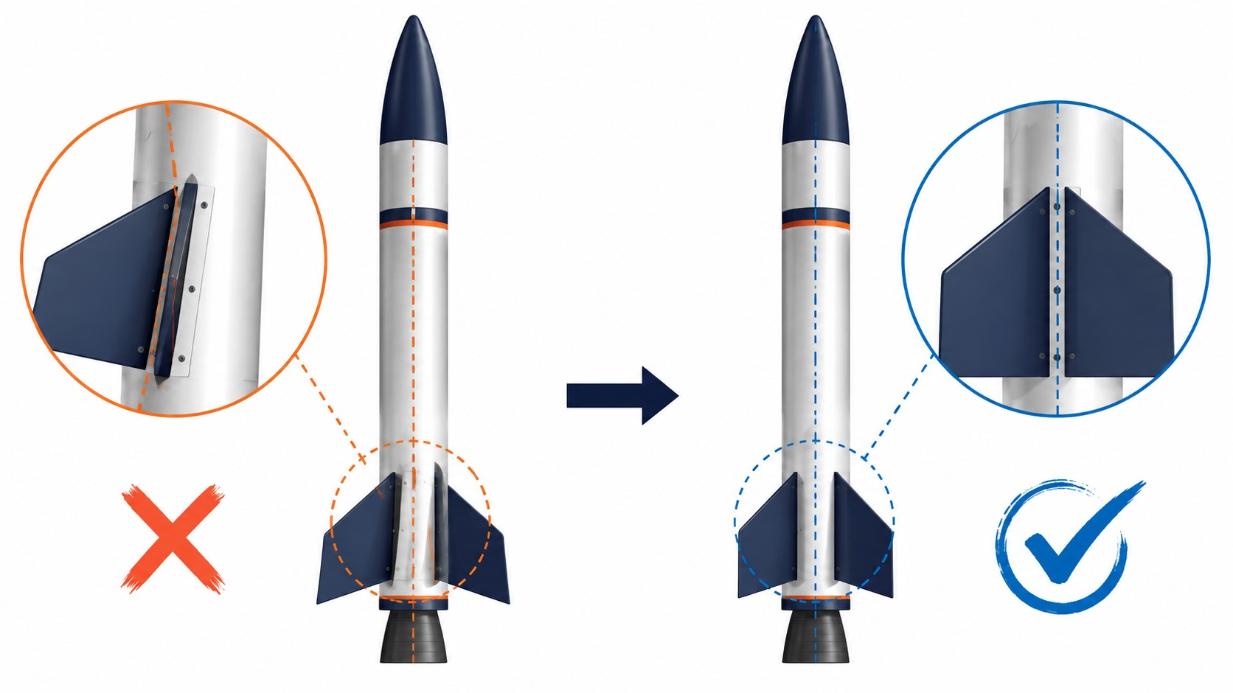
Lesson 2.10
Lesson 2.10
Patterns and Symmetry: Rocket Fins
How do engineers create repeated parts that are evenly spaced and aligned?
Lesson 2.10
Patterns and Symmetry: Rocket Fins
Connect today's work to your Unit 2 CAD and 3D printing evidence.
LockwoodSTEM | Aerospace Engineering Design | Unit 2

Slide 44
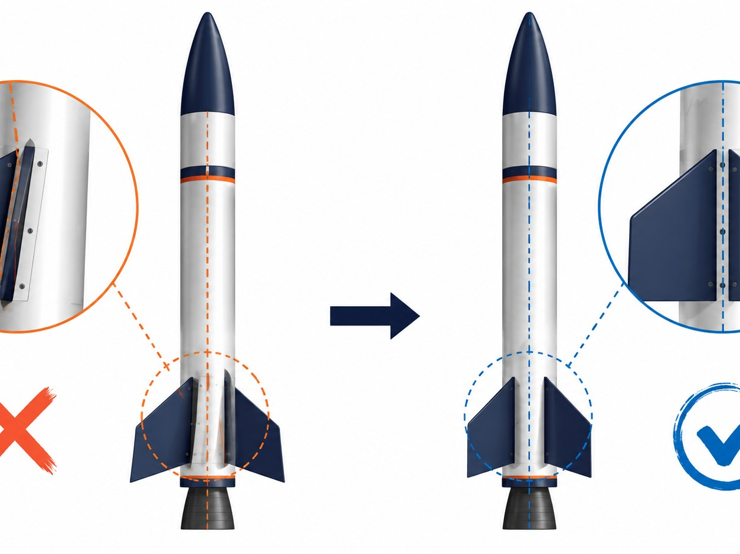
Lesson 2.10
Patterns and Symmetry: Rocket Fins
Big ideas you should understand before you start the work
Big Ideas
1
Patterns create consistent repeated features.
2
Symmetry improves alignment and reduces modeling errors.
3
Rocket fins must be evenly placed for balanced design.
Ask yourself: How does this CAD decision improve accuracy, editability, or printability?
LockwoodSTEM | Aerospace Engineering Design | Unit 2

Slide 45
Lesson 2.10
Patterns and Symmetry: Rocket Fins
Use the lesson skill to make a more accurate, editable, or printable model.
Modeling moves
Create or place one accurate fin feature first.
Use circular pattern when spacing around a centerline.
Check fin count, angle, and alignment.
Quality checks
Does the model match the intended measurements?
Can another student understand the feature?
Will the part be printable or testable?
Good CAD work is controlled enough to revise and clear enough to explain.
LockwoodSTEM | Aerospace Engineering Design | Unit 2

Slide 46
Lesson 2.10
Patterns and Symmetry: Rocket Fins
Save the strongest artifact from today for your Unit 2 portfolio.
Deliverable checklist
Fin pattern or symmetry model is complete.
Student explains the pattern method used.
Alignment is checked visually and with CAD tools.
Portfolio evidence
Dated notebook entry
Screenshot or exported file
Short claim explaining what the evidence proves
Your final portfolio should show how the model improved across the unit.
LockwoodSTEM | Aerospace Engineering Design | Unit 2

Slide 47
Lesson 2.11
Lesson 2.11
Parametric Rocket Part Modeling
How can engineers design CAD models so they are easy to change later?
Lesson 2.11
Parametric Rocket Part Modeling
Connect today's work to your Unit 2 CAD and 3D printing evidence.
LockwoodSTEM | Aerospace Engineering Design | Unit 2

Slide 48
Lesson 2.11
Parametric Rocket Part Modeling
Big ideas you should understand before you start the work
Big Ideas
1
Parameters allow key values to update the model.
2
A parametric model is easier to revise than a fixed model.
3
Useful parameters connect to real design requirements.
Ask yourself: How does this CAD decision improve accuracy, editability, or printability?
LockwoodSTEM | Aerospace Engineering Design | Unit 2

Slide 49
Lesson 2.11
Parametric Rocket Part Modeling
Use the lesson skill to make a more accurate, editable, or printable model.
Modeling moves
Identify values that may change later.
Use named dimensions or editable parameters.
Test by changing one value and observing the result.
Quality checks
Does the model match the intended measurements?
Can another student understand the feature?
Will the part be printable or testable?
Good CAD work is controlled enough to revise and clear enough to explain.
LockwoodSTEM | Aerospace Engineering Design | Unit 2

Slide 50
Lesson 2.11
Parametric Rocket Part Modeling
Save the strongest artifact from today for your Unit 2 portfolio.
Deliverable checklist
Model includes editable dimensions or parameters.
Student identifies which values control the design.
A quick revision test is documented.
Portfolio evidence
Dated notebook entry
Screenshot or exported file
Short claim explaining what the evidence proves
Your final portfolio should show how the model improved across the unit.
LockwoodSTEM | Aerospace Engineering Design | Unit 2

Slide 51
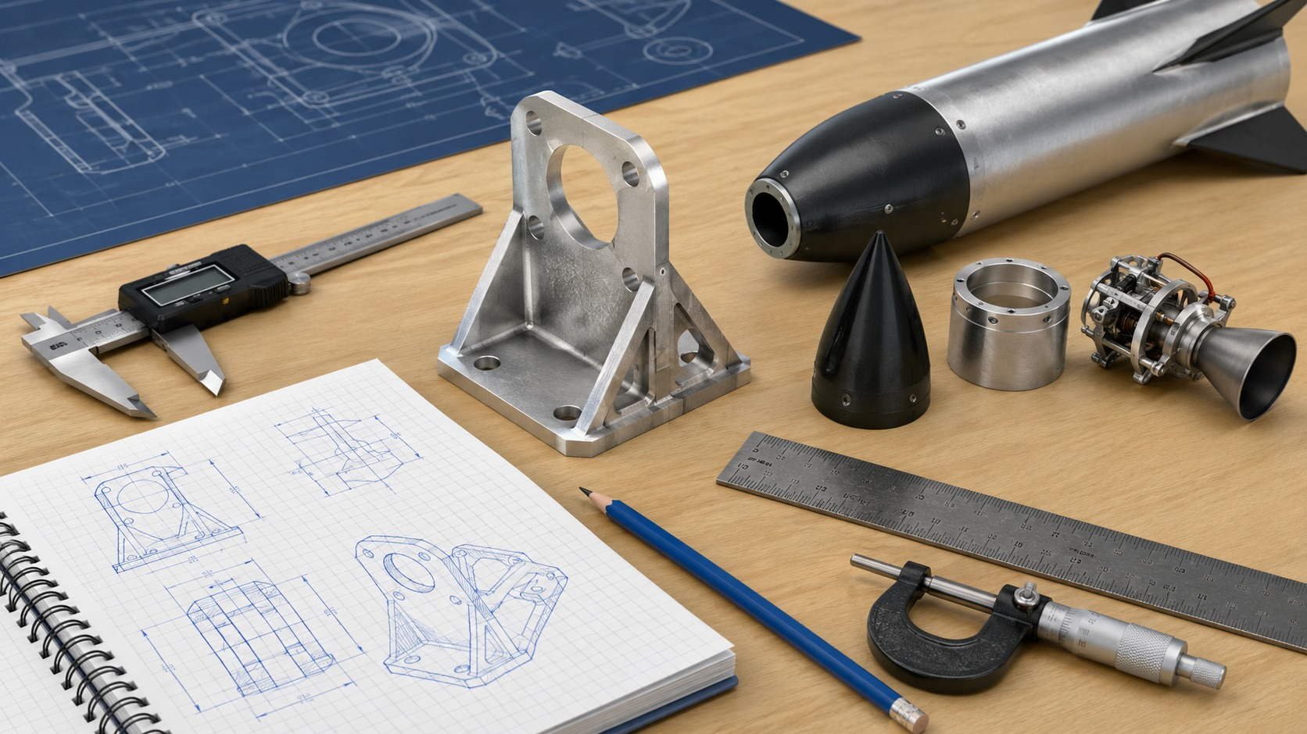
Lesson 2.12
Lesson 2.12
CAD Model Check and Revision
How do engineers check whether a CAD model is correct before moving forward?
Lesson 2.12
CAD Model Check and Revision
Connect today's work to your Unit 2 CAD and 3D printing evidence.
LockwoodSTEM | Aerospace Engineering Design | Unit 2

Slide 52
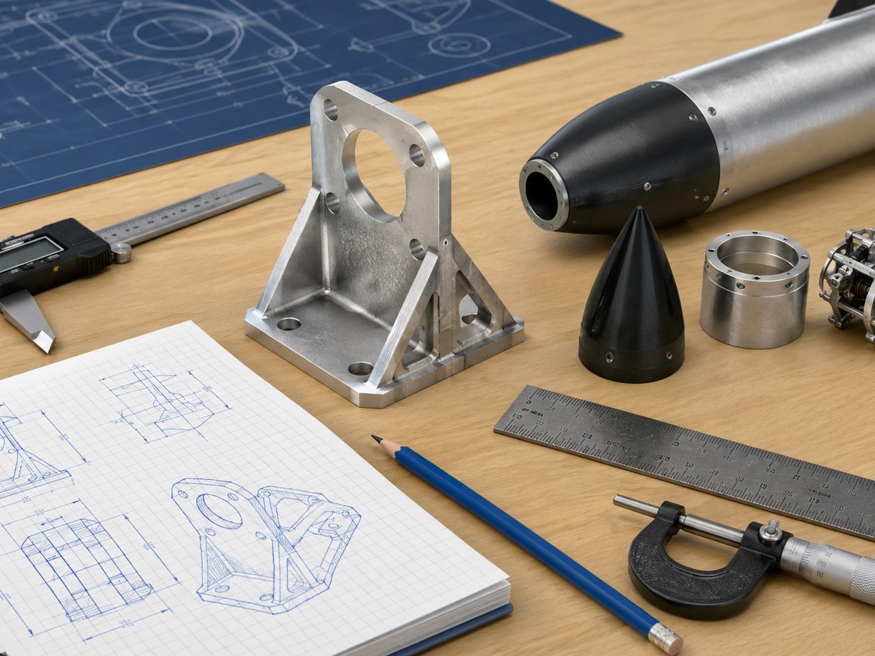
Lesson 2.12
CAD Model Check and Revision
Big ideas you should understand before you start the work
Big Ideas
1
CAD review prevents printing the wrong part.
2
Models should be checked for size, units, features, and printability.
3
Revision is normal engineering work.
Ask yourself: How does this CAD decision improve accuracy, editability, or printability?
LockwoodSTEM | Aerospace Engineering Design | Unit 2

Slide 53
Lesson 2.12
CAD Model Check and Revision
Use the lesson skill to make a more accurate, editable, or printable model.
Modeling moves
Inspect dimensions and units.
Compare the model to the design intent.
Revise the model before exporting.
Quality checks
Does the model match the intended measurements?
Can another student understand the feature?
Will the part be printable or testable?
Good CAD work is controlled enough to revise and clear enough to explain.
LockwoodSTEM | Aerospace Engineering Design | Unit 2

Slide 54
Lesson 2.12
CAD Model Check and Revision
Save the strongest artifact from today for your Unit 2 portfolio.
Deliverable checklist
CAD check list is complete.
At least one revision is documented.
Final screenshot shows the corrected model.
Portfolio evidence
Dated notebook entry
Screenshot or exported file
Short claim explaining what the evidence proves
Your final portfolio should show how the model improved across the unit.
LockwoodSTEM | Aerospace Engineering Design | Unit 2

Slide 55
Lesson 2.13
Lesson 2.13
Preparing CAD Files for 3D Printing
How do engineers prepare a CAD model so it can be printed reliably?
Lesson 2.13
Preparing CAD Files for 3D Printing
Connect today's work to your Unit 2 CAD and 3D printing evidence.
LockwoodSTEM | Aerospace Engineering Design | Unit 2

Slide 56
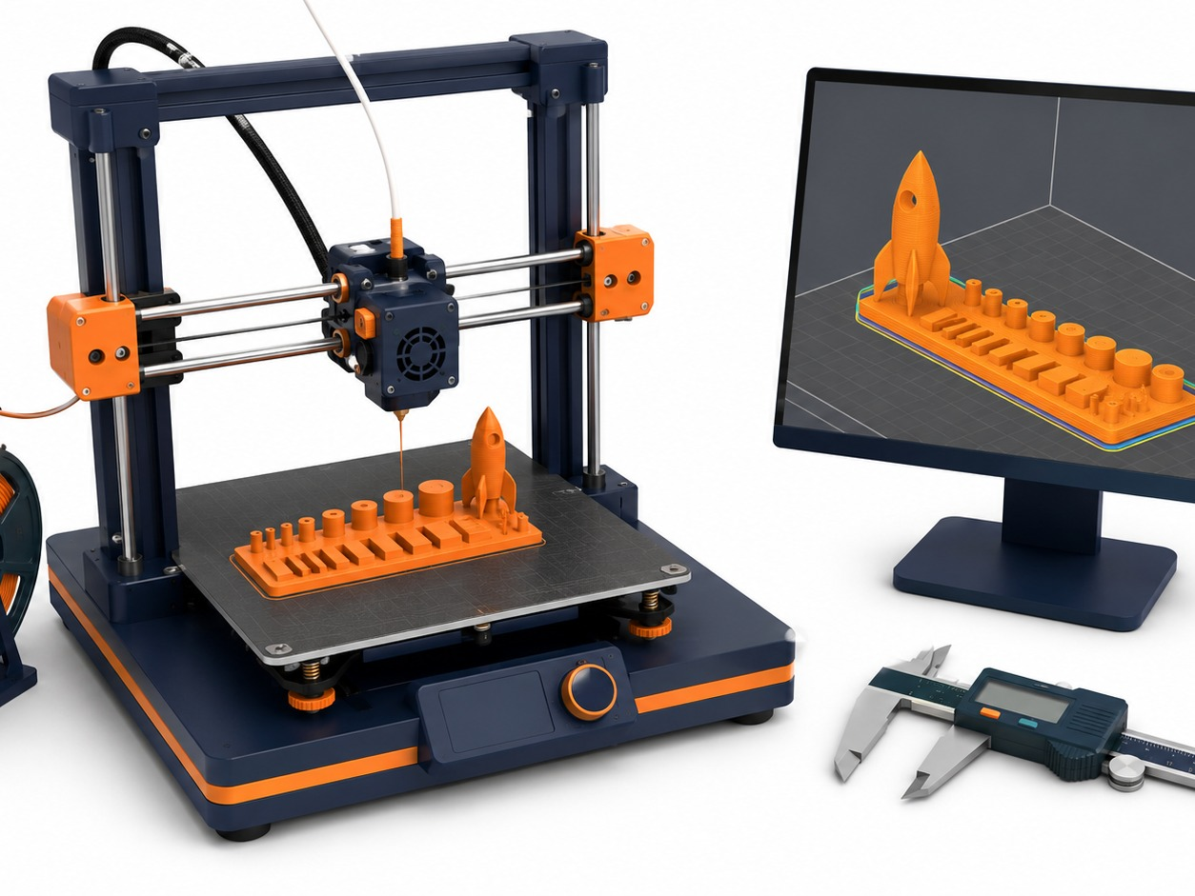
Lesson 2.13
Preparing CAD Files for 3D Printing
Big ideas you should understand before you start the work
Big Ideas
1
A printable model must be exported correctly.
2
Orientation and geometry affect support, strength, and surface quality.
3
STL files should represent the final checked design.
Ask yourself: How does this CAD decision improve accuracy, editability, or printability?
LockwoodSTEM | Aerospace Engineering Design | Unit 2

Slide 57
Lesson 2.13
Preparing CAD Files for 3D Printing
Use the lesson skill to make a more accurate, editable, or printable model.
Modeling moves
Inspect the model before export.
Export the correct body or component.
Use clear file naming for print submission.
Quality checks
Does the model match the intended measurements?
Can another student understand the feature?
Will the part be printable or testable?
Good CAD work is controlled enough to revise and clear enough to explain.
LockwoodSTEM | Aerospace Engineering Design | Unit 2

Slide 58
Lesson 2.13
Preparing CAD Files for 3D Printing
Save the strongest artifact from today for your Unit 2 portfolio.
Deliverable checklist
STL/export file is prepared.
Print orientation is considered.
Student can explain why the file is ready.
Portfolio evidence
Dated notebook entry
Screenshot or exported file
Short claim explaining what the evidence proves
Your final portfolio should show how the model improved across the unit.
LockwoodSTEM | Aerospace Engineering Design | Unit 2

Slide 59
Lesson 2.14
Lesson 2.14
Slicer Basics and Print Settings
How do slicer settings affect print success, time, material, and accuracy?
Lesson 2.14
Slicer Basics and Print Settings
Connect today's work to your Unit 2 CAD and 3D printing evidence.
LockwoodSTEM | Aerospace Engineering Design | Unit 2

Slide 60
Lesson 2.14
Slicer Basics and Print Settings
Big ideas you should understand before you start the work
Big Ideas
1
A slicer converts a model into machine instructions.
2
Layer height, infill, walls, and supports change print performance.
3
Preview mode helps catch problems before printing.
Ask yourself: How does this CAD decision improve accuracy, editability, or printability?
LockwoodSTEM | Aerospace Engineering Design | Unit 2

Slide 61
Lesson 2.14
Slicer Basics and Print Settings
Use the lesson skill to make a more accurate, editable, or printable model.
Modeling moves
Import and orient the model.
Check supports, estimated time, and material use.
Preview layers before submitting.
Quality checks
Does the model match the intended measurements?
Can another student understand the feature?
Will the part be printable or testable?
Good CAD work is controlled enough to revise and clear enough to explain.
LockwoodSTEM | Aerospace Engineering Design | Unit 2

Slide 62
Lesson 2.14
Slicer Basics and Print Settings
Save the strongest artifact from today for your Unit 2 portfolio.
Deliverable checklist
Slicer screenshot is captured.
Settings are recorded or justified.
Student explains one trade-off in the settings.
Portfolio evidence
Dated notebook entry
Screenshot or exported file
Short claim explaining what the evidence proves
Your final portfolio should show how the model improved across the unit.
LockwoodSTEM | Aerospace Engineering Design | Unit 2

Slide 63
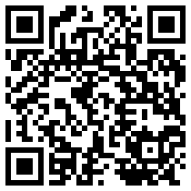
Lesson 2.14
Slicer Basics and Print Settings
Optional video resource to reinforce the lesson ideas.
What to watch for
PrusaSlicer Beginner Tutorial: Learn the Basics
how a model is imported and oriented
where print settings affect time and material
how preview helps catch problems before printing
Scan or open
Open Video
https://www.youtube.com/watch?v=_kIqMPNQNSw
LockwoodSTEM | Aerospace Engineering Design | Unit 2

Slide 64
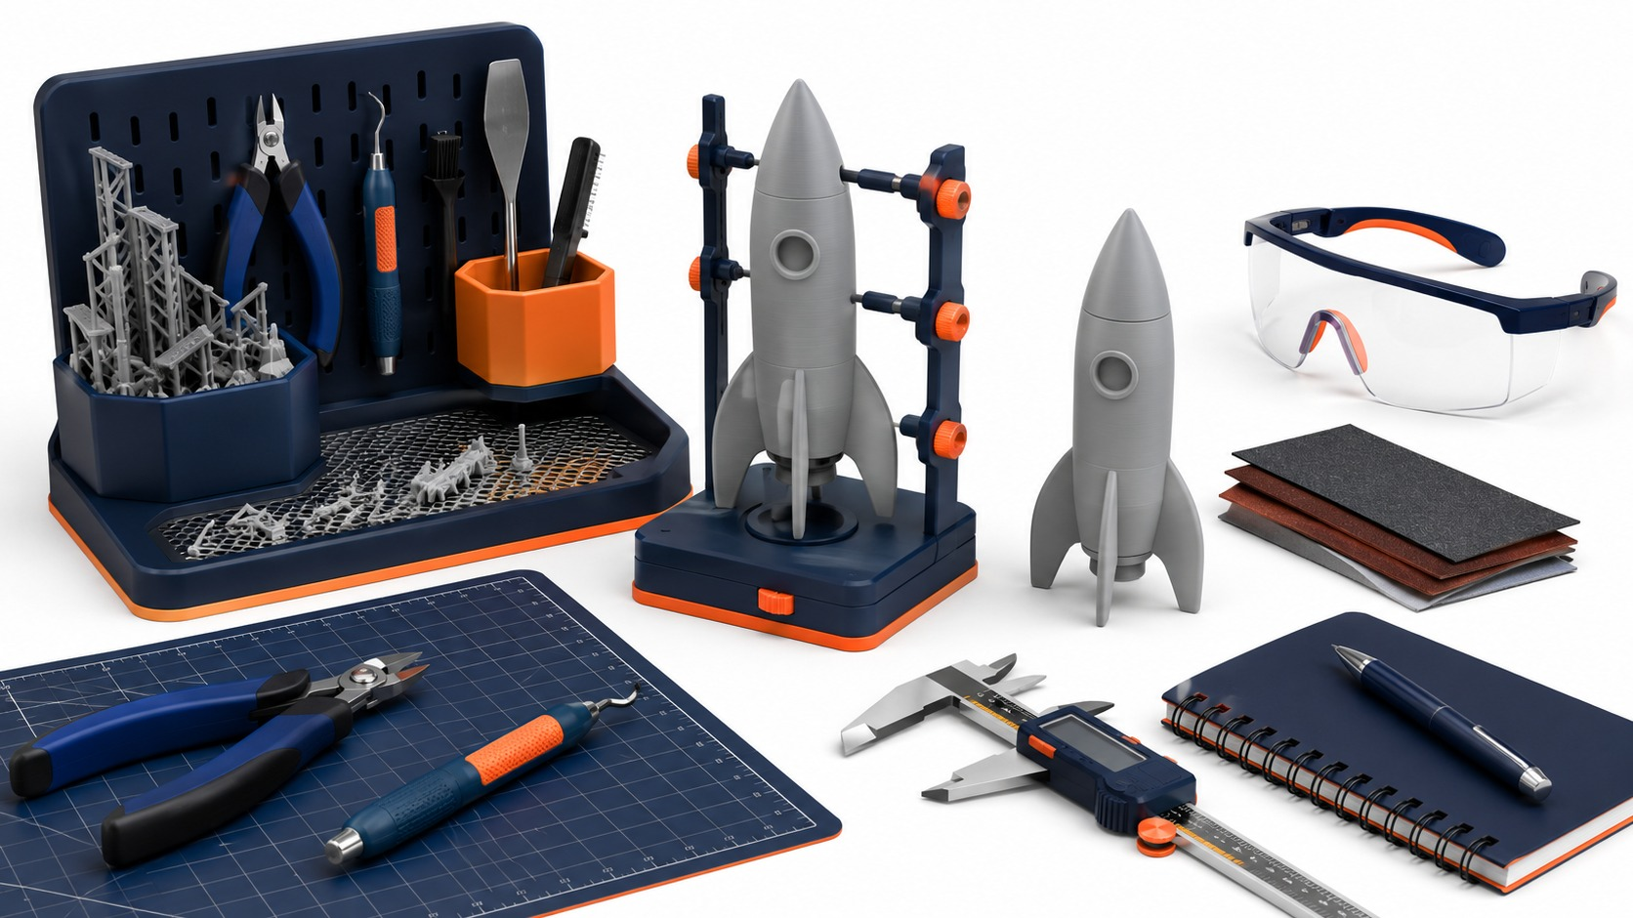
Lesson 2.15
Lesson 2.15
FabLab 3D Printer Certification
What must students know before using the 3D printers safely and responsibly?
Lesson 2.15
FabLab 3D Printer Certification
Connect today's work to your Unit 2 CAD and 3D printing evidence.
LockwoodSTEM | Aerospace Engineering Design | Unit 2

Slide 65
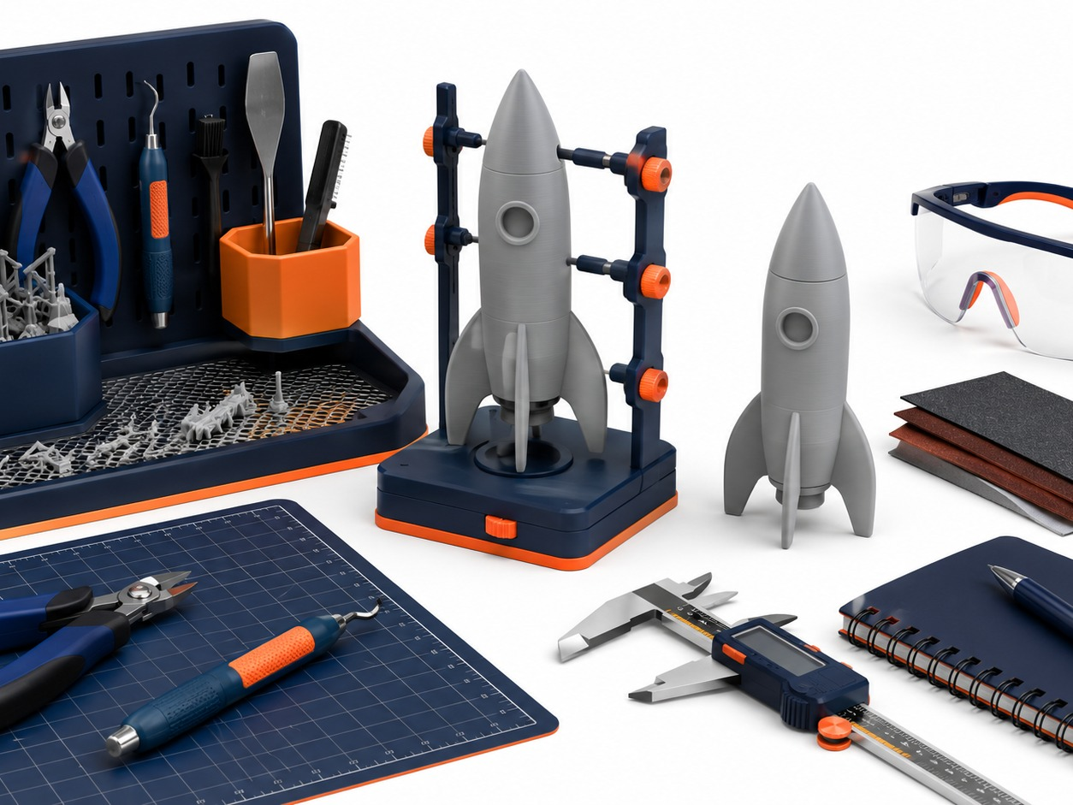
Lesson 2.15
FabLab 3D Printer Certification
Big ideas you should understand before you start the work
Big Ideas
1
Certification protects people, tools, and materials.
2
Safe printer use includes setup, monitoring, and cleanup.
3
Responsible use means respecting the queue and documenting prints.
Ask yourself: How does this CAD decision improve accuracy, editability, or printability?
LockwoodSTEM | Aerospace Engineering Design | Unit 2

Slide 66
Lesson 2.15
FabLab 3D Printer Certification
Use the lesson skill to make a more accurate, editable, or printable model.
Modeling moves
Review printer safety expectations.
Identify what to do before, during, and after a print.
Check print request or certification requirements.
Quality checks
Does the model match the intended measurements?
Can another student understand the feature?
Will the part be printable or testable?
Good CAD work is controlled enough to revise and clear enough to explain.
LockwoodSTEM | Aerospace Engineering Design | Unit 2

Slide 67
Lesson 2.15
FabLab 3D Printer Certification
Save the strongest artifact from today for your Unit 2 portfolio.
Deliverable checklist
Certification evidence is complete.
Student can describe safe printer behavior.
Student understands print queue expectations.
Portfolio evidence
Dated notebook entry
Screenshot or exported file
Short claim explaining what the evidence proves
Your final portfolio should show how the model improved across the unit.
LockwoodSTEM | Aerospace Engineering Design | Unit 2

Slide 68
Lesson 2.16
Lesson 2.16
Final 3D Printed Tolerance Tester Workday
How can a printed test tool help make better rocket assembly decisions?
Lesson 2.16
Final 3D Printed Tolerance Tester Workday
Connect today's work to your Unit 2 CAD and 3D printing evidence.
LockwoodSTEM | Aerospace Engineering Design | Unit 2

Slide 69
Lesson 2.16
Final 3D Printed Tolerance Tester Workday
Big ideas you should understand before you start the work
Big Ideas
1
Tolerance testers help compare real fits, not assumptions.
2
A useful tester includes multiple sizes or clear labeled features.
3
The print should produce data for the next design decision.
Ask yourself: How does this CAD decision improve accuracy, editability, or printability?
LockwoodSTEM | Aerospace Engineering Design | Unit 2

Slide 70
Lesson 2.16
Final 3D Printed Tolerance Tester Workday
Use the lesson skill to make a more accurate, editable, or printable model.
Modeling moves
Finalize the CAD model.
Check labels, clearances, and print orientation.
Submit or prepare the final print file.
Quality checks
Does the model match the intended measurements?
Can another student understand the feature?
Will the part be printable or testable?
Good CAD work is controlled enough to revise and clear enough to explain.
LockwoodSTEM | Aerospace Engineering Design | Unit 2

Slide 71
Lesson 2.16
Final 3D Printed Tolerance Tester Workday
Save the strongest artifact from today for your Unit 2 portfolio.
Deliverable checklist
Final tolerance tester file is ready or submitted.
Tester features are labeled or documented.
Student predicts what data the tester will provide.
Portfolio evidence
Dated notebook entry
Screenshot or exported file
Short claim explaining what the evidence proves
Your final portfolio should show how the model improved across the unit.
LockwoodSTEM | Aerospace Engineering Design | Unit 2

Slide 72
Lesson 2.17
Lesson 2.17
3D Printing Post-Processing
Why is a 3D print not always finished when it comes off the printer?
Lesson 2.17
3D Printing Post-Processing
Connect today's work to your Unit 2 CAD and 3D printing evidence.
LockwoodSTEM | Aerospace Engineering Design | Unit 2

Slide 73
Lesson 2.17
3D Printing Post-Processing
Big ideas you should understand before you start the work
Big Ideas
1
Supports, brim, stringing, and rough edges can affect the final part.
2
Post-processing can change dimensions and fit.
3
Cleanup should be documented as part of fabrication.
Ask yourself: How does this CAD decision improve accuracy, editability, or printability?
LockwoodSTEM | Aerospace Engineering Design | Unit 2

Slide 74
Lesson 2.17
3D Printing Post-Processing
Use the lesson skill to make a more accurate, editable, or printable model.
Modeling moves
Remove supports carefully.
Clean only what should be cleaned.
Measure again after cleanup if fit matters.
Quality checks
Does the model match the intended measurements?
Can another student understand the feature?
Will the part be printable or testable?
Good CAD work is controlled enough to revise and clear enough to explain.
LockwoodSTEM | Aerospace Engineering Design | Unit 2

Slide 75
Lesson 2.17
3D Printing Post-Processing
Save the strongest artifact from today for your Unit 2 portfolio.
Deliverable checklist
Post-processing steps are documented.
Part is inspected for damage or dimensional change.
Student records any cleanup that affects fit.
Portfolio evidence
Dated notebook entry
Screenshot or exported file
Short claim explaining what the evidence proves
Your final portfolio should show how the model improved across the unit.
LockwoodSTEM | Aerospace Engineering Design | Unit 2

Slide 76
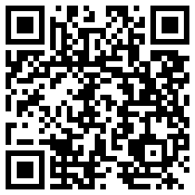
Lesson 2.17
3D Printing Post-Processing
Optional video resource to reinforce the lesson ideas.
What to watch for
How to Remove 3D Print Support Marks
how supports affect the final part
why sanding or cleanup can change dimensions
what should be documented after cleanup
Scan or open
Open Video
https://www.youtube.com/watch?v=iwFKuCesQiA
LockwoodSTEM | Aerospace Engineering Design | Unit 2

Slide 77
Lesson 2.18
Lesson 2.18
Final Tolerance Tester Review and Recommendation
What clearance should be recommended for the next rocket assembly project?
Lesson 2.18
Final Tolerance Tester Review and Recommendation
Connect today's work to your Unit 2 CAD and 3D printing evidence.
LockwoodSTEM | Aerospace Engineering Design | Unit 2

Slide 78
Lesson 2.18
Final Tolerance Tester Review and Recommendation
Big ideas you should understand before you start the work
Big Ideas
1
A recommendation should be based on fit evidence.
2
Testing should identify too tight, too loose, and acceptable fits.
3
The final conclusion connects Unit 2 to the rocket assembly unit.
Ask yourself: How does this CAD decision improve accuracy, editability, or printability?
LockwoodSTEM | Aerospace Engineering Design | Unit 2

Slide 79
Lesson 2.18
Final Tolerance Tester Review and Recommendation
Use the lesson skill to make a more accurate, editable, or printable model.
Modeling moves
Test each feature consistently.
Record observations and measurements.
Choose a recommended clearance with evidence.
Quality checks
Does the model match the intended measurements?
Can another student understand the feature?
Will the part be printable or testable?
Good CAD work is controlled enough to revise and clear enough to explain.
LockwoodSTEM | Aerospace Engineering Design | Unit 2

Slide 80
Lesson 2.18
Final Tolerance Tester Review and Recommendation
Save the strongest artifact from today for your Unit 2 portfolio.
Deliverable checklist
Final recommendation is written.
Evidence table or photos support the claim.
Student explains how the result will guide Unit 3.
Portfolio evidence
Dated notebook entry
Screenshot or exported file
Short claim explaining what the evidence proves
Your final portfolio should show how the model improved across the unit.
LockwoodSTEM | Aerospace Engineering Design | Unit 2

Slide 81
Unit 2 Close
CAD evidence becomes fabrication evidence.
Your tolerance tester should help make a real design recommendation for the next rocket assembly project.
Model
Print
Recommend
A controlled CAD model with meaningful features.
A test part prepared with documented settings.
A fit decision supported by evidence.

