Slide 1

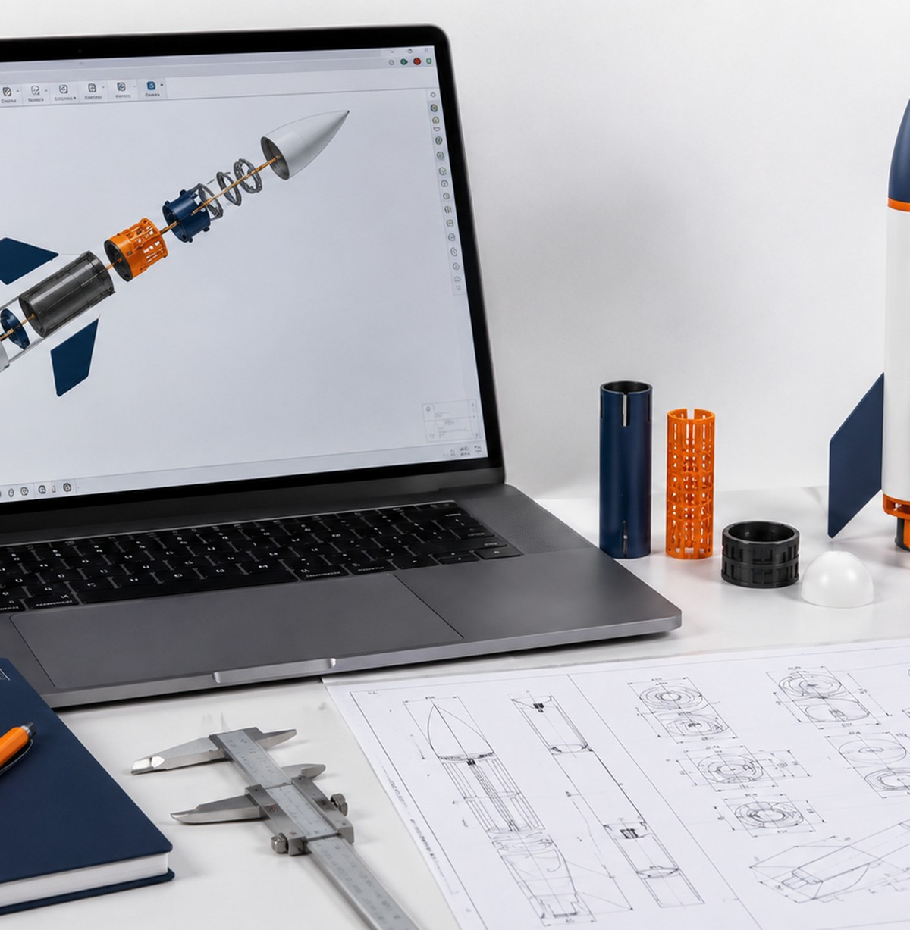

Aerospace Engineering Design
Unit 3
CAD Assemblies, Prototyping & Technical Drawings
Build a complete rocket assembly design package: CAD assembly, prototype evidence, exploded view, drawings, revisions, and final presentation.
Student learning deck • LockwoodSTEM aerospace-aligned AED curriculum

Slide 2
Unit 3
Unit 3 Learning Arc
You will move from tolerance evidence to a complete rocket assembly package.
1
2
3
4
Plan Fit Decisions
Build CAD Assembly
Prototype + Test
Document + Present
Use Unit 2 tolerance results to choose fits for couplers, fins, rings, inserts, and body sections.
Organize components, position parts, check alignment, apply relationships, and create an exploded view.
Export, slice, print, assemble, test, measure, photograph, and revise the physical rocket assembly.
Create part and assembly drawings, balloons, parts list, notes, revision table, and final presentation.
The final package should prove that your design choices were based on evidence, not guessing.
LockwoodSTEM | Aerospace Engineering Design

Slide 3
Unit 3
Unit 3 Deliverables Map
Every lesson produces evidence for the final rocket assembly design package.
CAD Evidence
Prototype Evidence
Drawing Evidence
Presentation Evidence
• organized components
• assembly layout
• alignment checks
• joints/relationships
• exploded view
• STL/export checks
• slicer screenshots
• printed parts
• fit testing photos
• revision notes
• part drawing
• assembly drawing
• views/dimensions
• balloons/parts list
• title block/revisions
• final assembly
• testing story
• design changes
• technical documentation
• next improvement
LockwoodSTEM | Aerospace Engineering Design

Slide 4
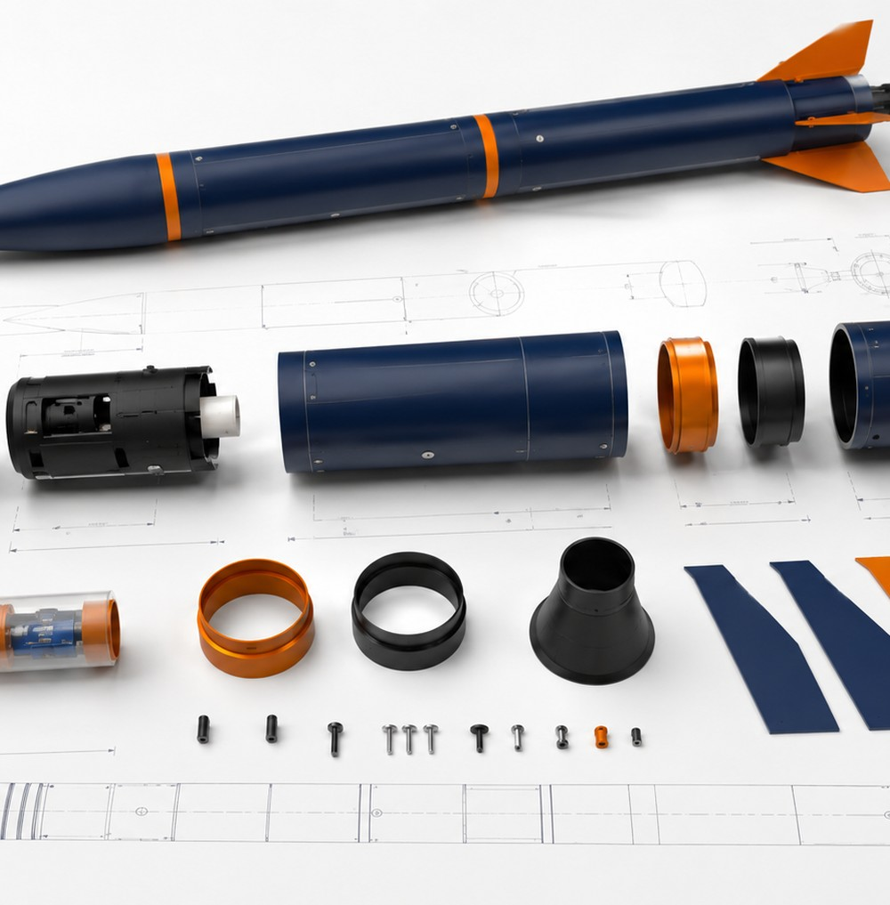
Unit 3
How Unit 3 Works
YOUR CORE CHALLENGE
Design, assemble, test, revise, and document a 3D printed rocket assembly using evidence from tolerance testing and prototype feedback.
WHAT “FINISHED” MEANS
Finished means the CAD, physical prototype, testing evidence, drawings, parts list, revision notes, and presentation all tell the same design story.
WHAT GOOD EVIDENCE LOOKS LIKE
Screenshots, photos, measurements, fit tables, revision notes, and clear drawings that show how your design changed and why.
ENGINEERING HABIT
Do not wait until the end to document. Each lesson creates part of your final package.
Unit 3 is about moving from digital assembly to documented prototype evidence.
LockwoodSTEM | Aerospace Engineering Design

Slide 5
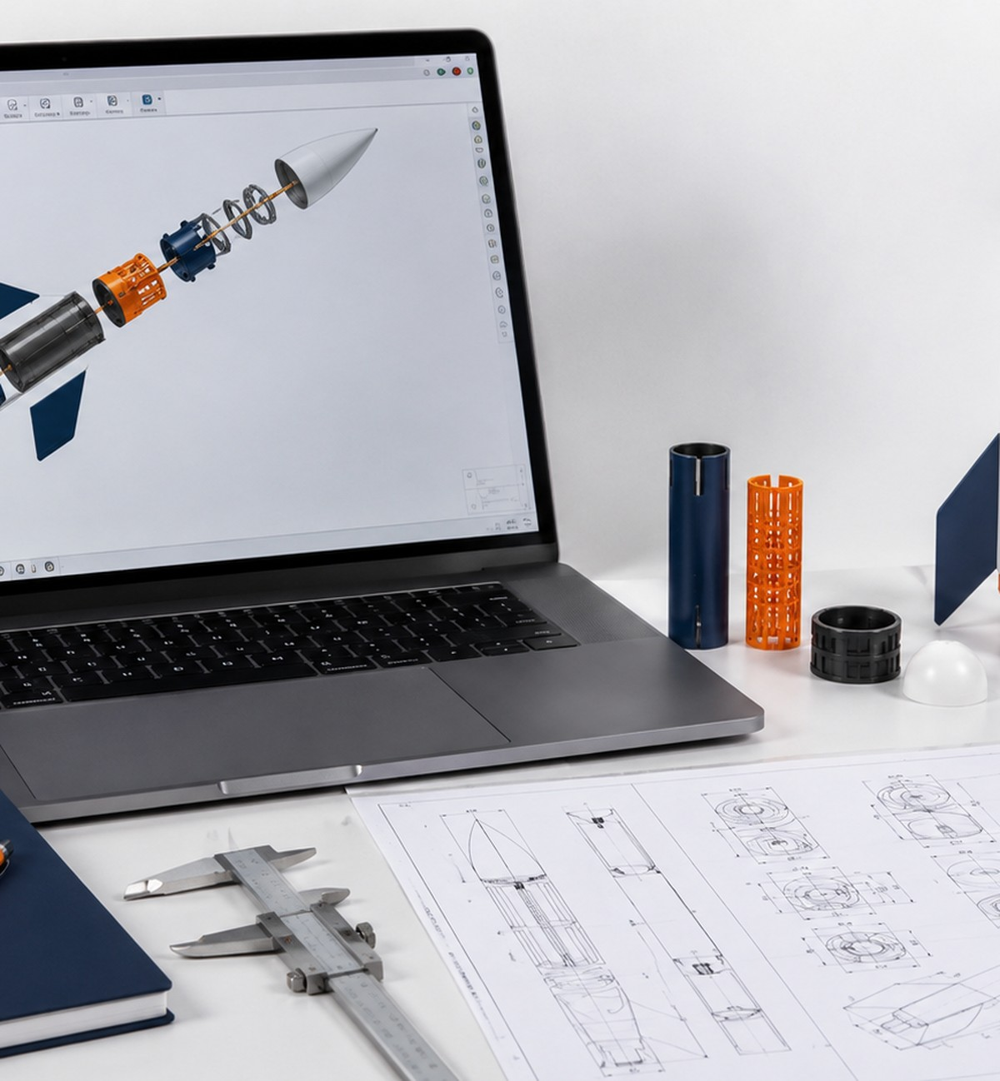
LOCKWOODSTEM AED • UNIT 3
Lesson 3.1
From Printed Testers to Rocket Assembly
How can evidence from a printed tolerance tester guide a larger assembly design?
CAD Assemblies, Prototyping & Technical Drawings

Slide 6

Lesson 3.1
From Printed Testers to Rocket Assembly
From Printed Testers to Rocket Assembly
How can evidence from a printed tolerance tester guide a larger assembly design?
LESSON GOAL
Students use Unit 2 tolerance tester evidence to begin planning a full rocket assembly.
STUDENT OBJECTIVE
I can use tolerance testing results to make fit decisions for a rocket assembly.
END PRODUCT
A Unit 3 rocket assembly plan that connects tolerance evidence to fit decisions.
Aerospace assembly work depends on fit, alignment, documentation, and testing evidence.
LockwoodSTEM | Aerospace Engineering Design

Slide 7
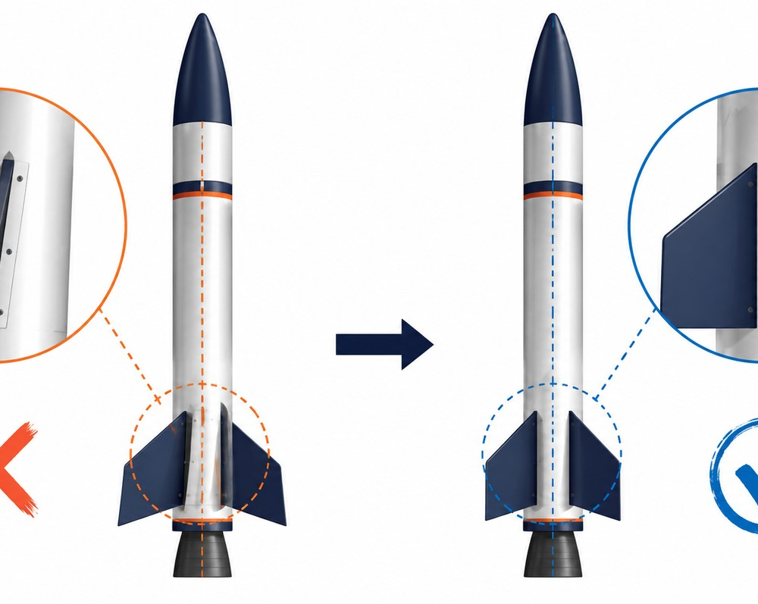
Lesson 3.1
From Printed Testers to Rocket Assembly
What you need to understand
These ideas guide the decisions you make during the lesson.
BIG IDEAS
• Tolerance testing gives evidence for real physical fits, not just ideal CAD dimensions.
• Rocket assemblies include repeated fit relationships such as couplers, fins, rings, inserts, and body sections.
• Assembly decisions should be supported by measurements, observations, and recommendations from Unit 2.
Inspect alignment, fit, symmetry, and component organization before fabrication.
LockwoodSTEM | Aerospace Engineering Design

Slide 8
Lesson 3.1
From Printed Testers to Rocket Assembly
What you will do
Use this workflow to produce lesson evidence for your final design package.
1
Review your Unit 2 tolerance tester results and recommendation.
2
Identify which rocket assembly connections need tight, snug, sliding, or loose fits.
3
List the major parts of your rocket assembly.
4
Create a fit decision table for nose cone, body, coupler, fins, nozzle, and optional payload insert.
5
Set up the Unit 3 section of your engineering notebook.
Save screenshots, photos, measurements, or notes before you move on.
LockwoodSTEM | Aerospace Engineering Design

Slide 9
Lesson 3.1
From Printed Testers to Rocket Assembly
Evidence checklist
Use this slide to check whether your lesson evidence is ready for the final package.
REQUIRED EVIDENCE
BEFORE MOVING ON
□ Lesson title and focus question
□ Summary of Unit 2 tester results
□ Recommended clearance or fit choice
□ Rocket part list
□ Fit decision table
□ Notes on where tolerance evidence will be used
Your work should be:
• saved in the correct file or folder
• named clearly enough to find later
• connected to a design decision
• useful for final drawings or presentation
• ready for another person to understand
A Unit 3 rocket assembly plan that connects tolerance evidence to fit decisions.
LockwoodSTEM | Aerospace Engineering Design

Slide 10
LOCKWOODSTEM AED • UNIT 3
Lesson 3.2
CAD Components and Assembly Files
Why does component organization matter in an assembly model?
CAD Assemblies, Prototyping & Technical Drawings

Slide 11
Lesson 3.2
CAD Components and Assembly Files
CAD Components and Assembly Files
Why does component organization matter in an assembly model?
LESSON GOAL
Students organize rocket parts as CAD components and set up the assembly file correctly.
STUDENT OBJECTIVE
I can organize rocket parts as components inside a CAD assembly file.
END PRODUCT
A rocket CAD assembly file with clearly named and organized components.
Aerospace assembly work depends on fit, alignment, documentation, and testing evidence.
LockwoodSTEM | Aerospace Engineering Design

Slide 12
Lesson 3.2
CAD Components and Assembly Files
What you need to understand
These ideas guide the decisions you make during the lesson.
BIG IDEAS
• Bodies are raw geometry; components represent parts that can be assembled, moved, named, and documented.
• Clear component names make drawings, exploded views, parts lists, and revision work easier.
• A well-organized assembly file reduces confusion later in the design package.
Inspect alignment, fit, symmetry, and component organization before fabrication.
LockwoodSTEM | Aerospace Engineering Design

Slide 13
Lesson 3.2
CAD Components and Assembly Files
What you will do
Use this workflow to produce lesson evidence for your final design package.
1
Create or open the file named U3_RocketAssembly_LastName.
2
Create components for nose cone, body, coupler, fins, nozzle, payload insert, and alignment features as needed.
3
Name components clearly in the browser.
4
Confirm sketches and bodies belong to the correct component.
5
Capture a browser screenshot showing organized components.
Save screenshots, photos, measurements, or notes before you move on.
LockwoodSTEM | Aerospace Engineering Design

Slide 14
Lesson 3.2
CAD Components and Assembly Files
Evidence checklist
Use this slide to check whether your lesson evidence is ready for the final package.
REQUIRED EVIDENCE
BEFORE MOVING ON
□ Notebook notes explaining component vs. body
□ Screenshot of organized CAD browser
□ List of rocket components
□ File naming confirmation
□ One note explaining why organization matters
Your work should be:
• saved in the correct file or folder
• named clearly enough to find later
• connected to a design decision
• useful for final drawings or presentation
• ready for another person to understand
A rocket CAD assembly file with clearly named and organized components.
LockwoodSTEM | Aerospace Engineering Design

Slide 15
LOCKWOODSTEM AED • UNIT 3
Lesson 3.3
Inserting and Positioning Rocket Parts
How do engineers begin turning individual parts into an organized assembly?
CAD Assemblies, Prototyping & Technical Drawings

Slide 16
Lesson 3.3
Inserting and Positioning Rocket Parts
Inserting and Positioning Rocket Parts
How do engineers begin turning individual parts into an organized assembly?
LESSON GOAL
Students insert or create rocket parts in the assembly and position them in approximate assembly order.
STUDENT OBJECTIVE
I can position rocket components so the assembly begins to represent the intended design.
END PRODUCT
A rough rocket assembly with all major components inserted and positioned for fit checks.
Aerospace assembly work depends on fit, alignment, documentation, and testing evidence.
LockwoodSTEM | Aerospace Engineering Design

Slide 17
Lesson 3.3
Inserting and Positioning Rocket Parts
What you need to understand
These ideas guide the decisions you make during the lesson.
BIG IDEAS
• Assembly layout starts with approximate placement before precise joints and fit checks.
• The main body should usually be used as the reference part.
• Components should be positioned logically enough to support later alignment, joints, and exploded views.
Inspect alignment, fit, symmetry, and component organization before fabrication.
LockwoodSTEM | Aerospace Engineering Design

Slide 18
Lesson 3.3
Inserting and Positioning Rocket Parts
What you will do
Use this workflow to produce lesson evidence for your final design package.
1
Open the rocket assembly file.
2
Position the body as the main reference component.
3
Place the nose cone, nozzle, coupler, fins, and optional payload insert in approximate locations.
4
Use move, rotate, and view tools carefully.
5
Capture screenshots showing the starting assembly layout.
Save screenshots, photos, measurements, or notes before you move on.
LockwoodSTEM | Aerospace Engineering Design

Slide 19
Lesson 3.3
Inserting and Positioning Rocket Parts
Evidence checklist
Use this slide to check whether your lesson evidence is ready for the final package.
REQUIRED EVIDENCE
BEFORE MOVING ON
□ Notebook title and focus question
□ Screenshot of rough rocket assembly
□ List of parts inserted or positioned
□ Notes identifying the main reference component
□ One issue to fix during alignment
Your work should be:
• saved in the correct file or folder
• named clearly enough to find later
• connected to a design decision
• useful for final drawings or presentation
• ready for another person to understand
A rough rocket assembly with all major components inserted and positioned for fit checks.
LockwoodSTEM | Aerospace Engineering Design

Slide 20
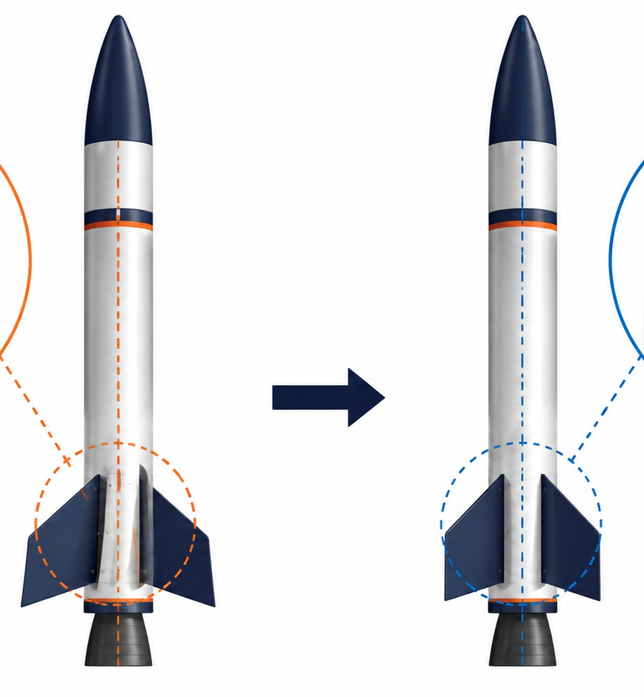
LOCKWOODSTEM AED • UNIT 3
Lesson 3.4
Assembly Alignment and Fit Checks
How can engineers tell whether an assembly is aligned before building it?
CAD Assemblies, Prototyping & Technical Drawings

Slide 21
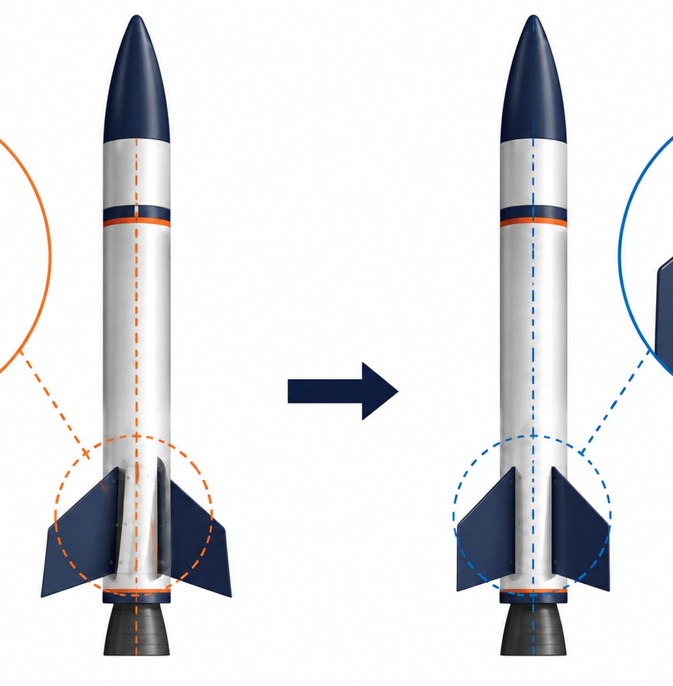
Lesson 3.4
Assembly Alignment and Fit Checks
Assembly Alignment and Fit Checks
How can engineers tell whether an assembly is aligned before building it?
LESSON GOAL
Students check whether rocket components are centered, aligned, and free of obvious interference.
STUDENT OBJECTIVE
I can inspect a CAD rocket assembly for alignment, gaps, overlaps, and fit problems.
END PRODUCT
An inspected rocket assembly with documented fit and alignment issues to revise.
Aerospace assembly work depends on fit, alignment, documentation, and testing evidence.
LockwoodSTEM | Aerospace Engineering Design

Slide 22
Lesson 3.4
Assembly Alignment and Fit Checks
What you need to understand
These ideas guide the decisions you make during the lesson.
BIG IDEAS
• Fit checks look for gaps, overlaps, interference, and alignment issues.
• Multiple views are needed because a problem may not be visible from one angle.
• Fit decisions should connect to Unit 2 tolerance data whenever possible.
Inspect alignment, fit, symmetry, and component organization before fabrication.
LockwoodSTEM | Aerospace Engineering Design

Slide 23
Lesson 3.4
Assembly Alignment and Fit Checks
What you will do
Use this workflow to produce lesson evidence for your final design package.
1
Check center axis alignment for the body, nose cone, coupler, and nozzle.
2
Inspect fin placement and connection points.
3
Look for floating parts, unwanted overlaps, or blocked sliding paths.
4
Complete an assembly fit check table.
5
Identify at least one revision to make.
Save screenshots, photos, measurements, or notes before you move on.
LockwoodSTEM | Aerospace Engineering Design

Slide 24
Lesson 3.4
Assembly Alignment and Fit Checks
Evidence checklist
Use this slide to check whether your lesson evidence is ready for the final package.
REQUIRED EVIDENCE
BEFORE MOVING ON
□ Fit check table
□ Screenshots showing alignment checks
□ Notes on gaps, overlaps, or interference
□ One tolerance-related decision
□ Revision notes for the next work period
Your work should be:
• saved in the correct file or folder
• named clearly enough to find later
• connected to a design decision
• useful for final drawings or presentation
• ready for another person to understand
An inspected rocket assembly with documented fit and alignment issues to revise.
LockwoodSTEM | Aerospace Engineering Design

Slide 25
LOCKWOODSTEM AED • UNIT 3
Lesson 3.5
Joints and Assembly Relationships
How do joints and assembly relationships help a CAD model behave like a real assembly?
CAD Assemblies, Prototyping & Technical Drawings

Slide 26
Lesson 3.5
Joints and Assembly Relationships
Joints and Assembly Relationships
How do joints and assembly relationships help a CAD model behave like a real assembly?
LESSON GOAL
Students use basic CAD assembly relationships to control how rocket parts connect or move.
STUDENT OBJECTIVE
I can apply assembly relationships to show which rocket parts are fixed, aligned, or movable.
END PRODUCT
A rocket assembly with basic relationships that support fit, alignment, or function.
Aerospace assembly work depends on fit, alignment, documentation, and testing evidence.
LockwoodSTEM | Aerospace Engineering Design

Slide 27
Lesson 3.5
Joints and Assembly Relationships
What you need to understand
These ideas guide the decisions you make during the lesson.
BIG IDEAS
• Some parts are fixed while others may slide, rotate, or be removed.
• Joints and relationships communicate function, not just location.
• A main reference component can be grounded so the rest of the assembly is built around it.
Inspect alignment, fit, symmetry, and component organization before fabrication.
LockwoodSTEM | Aerospace Engineering Design

Slide 28
Lesson 3.5
Joints and Assembly Relationships
What you will do
Use this workflow to produce lesson evidence for your final design package.
1
Identify fixed parts and removable or movable parts.
2
Ground or fix the main rocket body as the assembly reference.
3
Apply appropriate rigid, slider, or alignment relationships where useful.
4
Create a joint planning table.
5
Test whether relationships support the intended assembly function.
Save screenshots, photos, measurements, or notes before you move on.
LockwoodSTEM | Aerospace Engineering Design

Slide 29
Lesson 3.5
Joints and Assembly Relationships
Evidence checklist
Use this slide to check whether your lesson evidence is ready for the final package.
REQUIRED EVIDENCE
BEFORE MOVING ON
□ Fixed vs. movable parts list
□ Joint planning table
□ Screenshot of at least one relationship or positioned connection
□ Notes explaining one functional relationship
□ One revision needed if a relationship does not work
Your work should be:
• saved in the correct file or folder
• named clearly enough to find later
• connected to a design decision
• useful for final drawings or presentation
• ready for another person to understand
A rocket assembly with basic relationships that support fit, alignment, or function.
LockwoodSTEM | Aerospace Engineering Design

Slide 30
LOCKWOODSTEM AED • UNIT 3
Lesson 3.6
Fin Placement and Symmetry
Why does fin placement need to be accurate and symmetrical?
CAD Assemblies, Prototyping & Technical Drawings

Slide 31
Lesson 3.6
Fin Placement and Symmetry
Fin Placement and Symmetry
Why does fin placement need to be accurate and symmetrical?
LESSON GOAL
Students place fins evenly around the rocket body and verify symmetry and alignment.
STUDENT OBJECTIVE
I can position rocket fins evenly and check that they are symmetrical and aligned.
END PRODUCT
A rocket assembly with evenly spaced fins that are aligned, symmetrical, and documented.
Aerospace assembly work depends on fit, alignment, documentation, and testing evidence.
LockwoodSTEM | Aerospace Engineering Design

Slide 32
Lesson 3.6
Fin Placement and Symmetry
What you need to understand
These ideas guide the decisions you make during the lesson.
BIG IDEAS
• Fin symmetry affects assembly quality, appearance, stability, and documentation clarity.
• Three fins are commonly spaced at 120 degrees; four fins are commonly spaced at 90 degrees.
• Circular patterns, rotation, and top-view inspection help verify even spacing.
Inspect alignment, fit, symmetry, and component organization before fabrication.
LockwoodSTEM | Aerospace Engineering Design

Slide 33
Lesson 3.6
Fin Placement and Symmetry
What you will do
Use this workflow to produce lesson evidence for your final design package.
1
Choose a three-fin or four-fin layout.
2
Connect the layout to your Unit 2 fin slot or fit tester if applicable.
3
Use circular pattern or careful positioning to place fins evenly.
4
Check fin height, orientation, and contact with the body.
5
Complete a fin symmetry inspection table and revise as needed.
Save screenshots, photos, measurements, or notes before you move on.
LockwoodSTEM | Aerospace Engineering Design

Slide 34
Lesson 3.6
Fin Placement and Symmetry
Evidence checklist
Use this slide to check whether your lesson evidence is ready for the final package.
REQUIRED EVIDENCE
BEFORE MOVING ON
□ Layout choice with 120 degree or 90 degree spacing
□ Unit 2 tolerance recommendation if applicable
□ Completed symmetry inspection table
□ Screenshots of top and side views
□ Short note explaining one fin placement revision
Your work should be:
• saved in the correct file or folder
• named clearly enough to find later
• connected to a design decision
• useful for final drawings or presentation
• ready for another person to understand
A rocket assembly with evenly spaced fins that are aligned, symmetrical, and documented.
LockwoodSTEM | Aerospace Engineering Design

Slide 35
LOCKWOODSTEM AED • UNIT 3
Lesson 3.7
Rocket Assembly Revision Workday
How do engineers use review evidence to improve an assembly before final documentation?
CAD Assemblies, Prototyping & Technical Drawings

Slide 36
Lesson 3.7
Rocket Assembly Revision Workday
Rocket Assembly Revision Workday
How do engineers use review evidence to improve an assembly before final documentation?
LESSON GOAL
Students revise the rocket CAD assembly based on alignment checks, fin symmetry, fit issues, and tolerance recommendations.
STUDENT OBJECTIVE
I can revise a rocket CAD assembly to improve fit, alignment, symmetry, and assembly quality.
END PRODUCT
A revised rocket CAD assembly with improved fit, alignment, symmetry, and organization.
Aerospace assembly work depends on fit, alignment, documentation, and testing evidence.
LockwoodSTEM | Aerospace Engineering Design

Slide 37
Lesson 3.7
Rocket Assembly Revision Workday
What you need to understand
These ideas guide the decisions you make during the lesson.
BIG IDEAS
• Revision should be based on evidence, not guessing.
• Priority revisions should address the issues most likely to affect fit, build quality, or documentation.
• Before-and-after evidence helps prove that a design improved.
Inspect alignment, fit, symmetry, and component organization before fabrication.
LockwoodSTEM | Aerospace Engineering Design

Slide 38
Lesson 3.7
Rocket Assembly Revision Workday
What you will do
Use this workflow to produce lesson evidence for your final design package.
1
Review fit, joint, and symmetry notes from Lessons 3.4-3.6.
2
Identify priority issues such as misalignment, tight fits, loose fits, floating parts, or unclear component names.
3
Create a revision plan before editing.
4
Revise component geometry, placement, joints, or naming as needed.
5
Capture before-and-after screenshots and complete a peer review check.
Save screenshots, photos, measurements, or notes before you move on.
LockwoodSTEM | Aerospace Engineering Design

Slide 39
Lesson 3.7
Rocket Assembly Revision Workday
Evidence checklist
Use this slide to check whether your lesson evidence is ready for the final package.
REQUIRED EVIDENCE
BEFORE MOVING ON
□ Completed revision plan
□ Before-and-after screenshots
□ Explanation of one major revision
□ Notes showing how Unit 2 tolerance data influenced a decision
□ Peer review notes
Your work should be:
• saved in the correct file or folder
• named clearly enough to find later
• connected to a design decision
• useful for final drawings or presentation
• ready for another person to understand
A revised rocket CAD assembly with improved fit, alignment, symmetry, and organization.
LockwoodSTEM | Aerospace Engineering Design

Slide 40
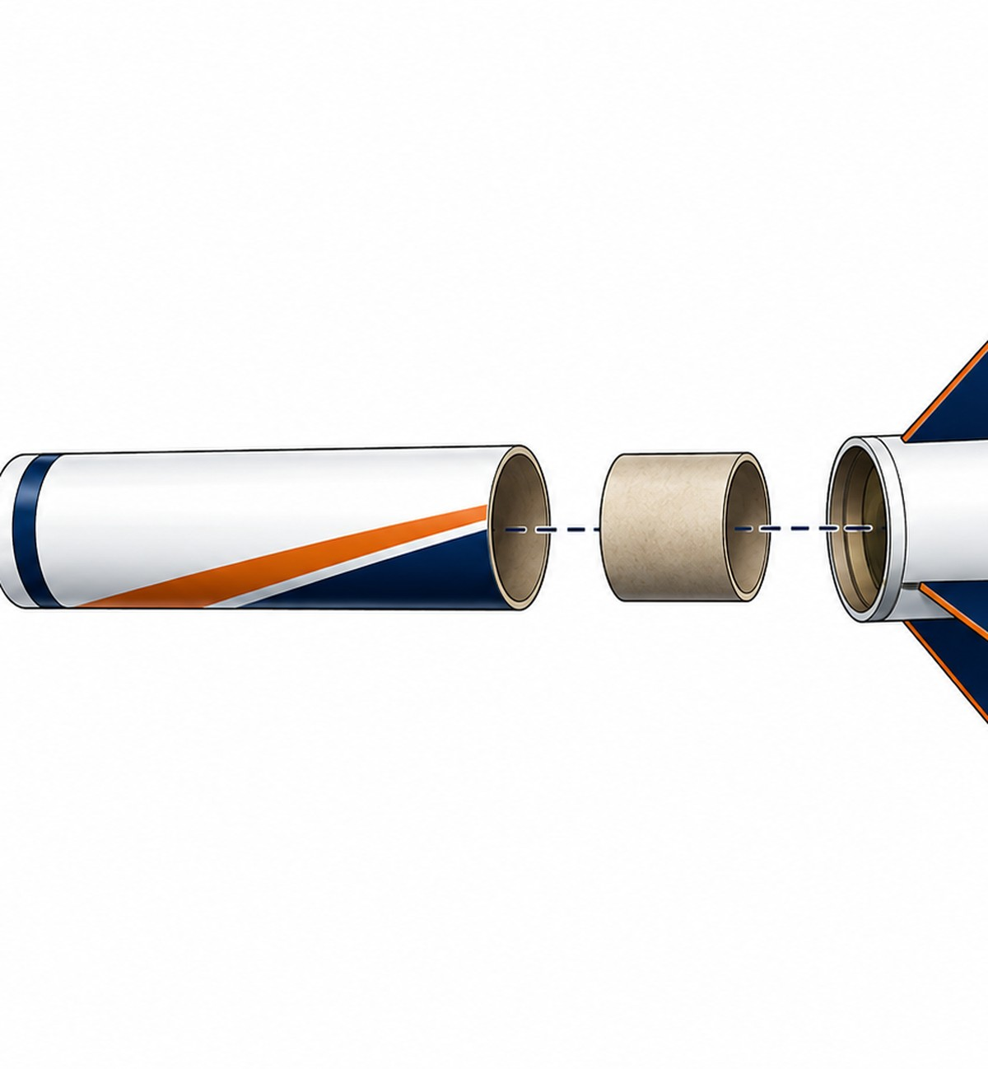
LOCKWOODSTEM AED • UNIT 3
Lesson 3.8
Exploded CAD Views
How can engineers show the parts of an assembly without hiding important details?
CAD Assemblies, Prototyping & Technical Drawings

Slide 41
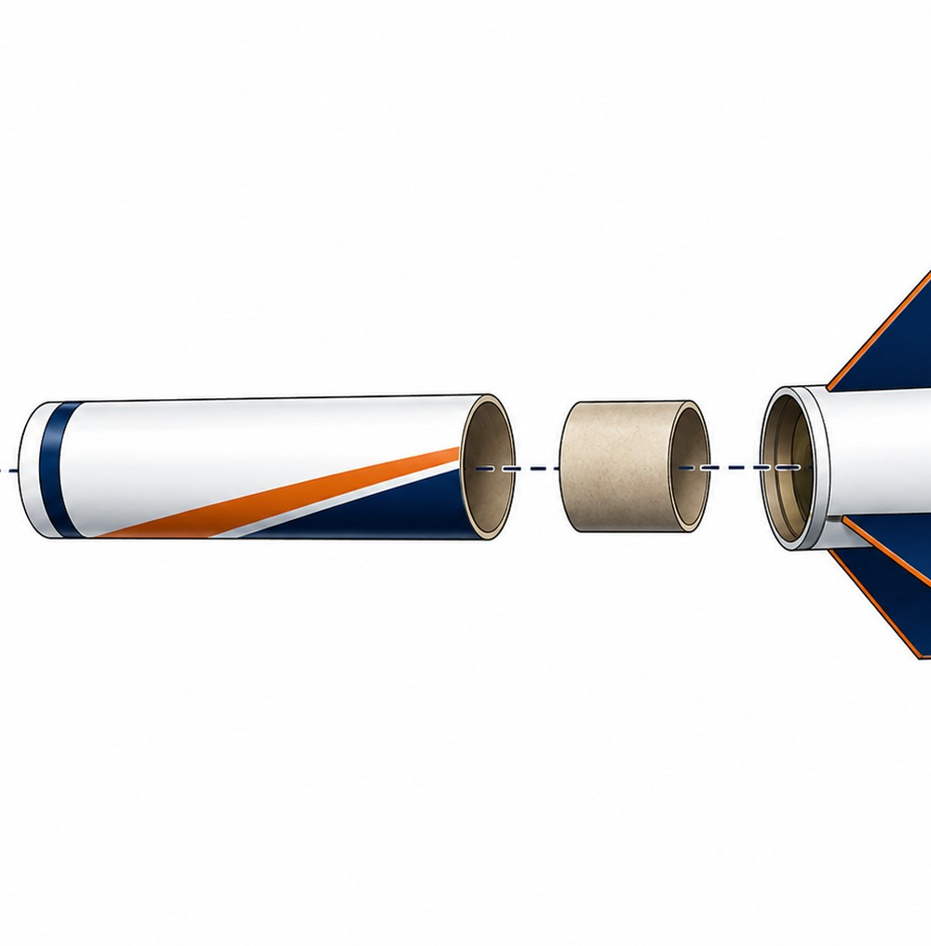
Lesson 3.8
Exploded CAD Views
Exploded CAD Views
How can engineers show the parts of an assembly without hiding important details?
LESSON GOAL
Students create an exploded view that separates rocket assembly parts in a clear and organized way.
STUDENT OBJECTIVE
I can create an exploded CAD view that shows how the rocket assembly parts fit together.
END PRODUCT
A clear exploded CAD view showing major rocket components separated, aligned, and easy to identify.
Aerospace assembly work depends on fit, alignment, documentation, and testing evidence.
LockwoodSTEM | Aerospace Engineering Design

Slide 42
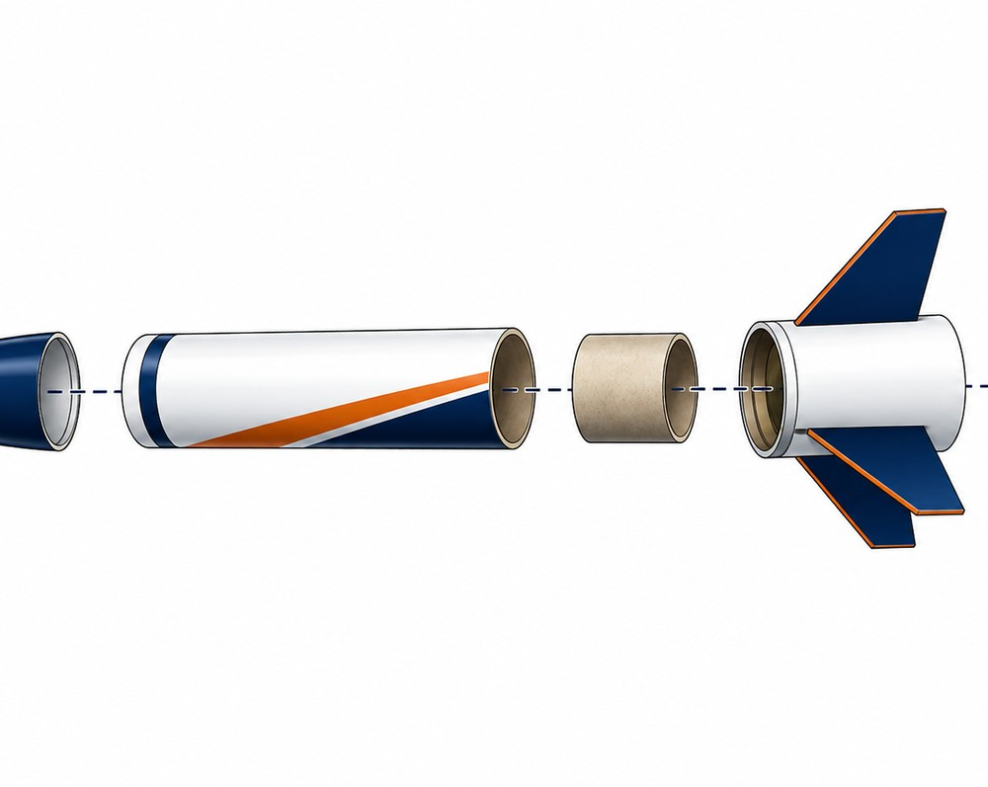
Lesson 3.8
Exploded CAD Views
What you need to understand
These ideas guide the decisions you make during the lesson.
BIG IDEAS
• Exploded views separate parts while keeping them aligned to their real assembly positions.
• They help show part relationships, assembly order, internal components, and hidden connections.
• Parts should be separated clearly, not scattered randomly.
Exploded views communicate how parts relate without hiding important geometry.
LockwoodSTEM | Aerospace Engineering Design

Slide 43
Lesson 3.8
Exploded CAD Views
What you will do
Use this workflow to produce lesson evidence for your final design package.
1
Identify which rocket parts should be separated in the exploded view.
2
Plan the direction each part should move.
3
Separate the nose cone, body, coupler, fins, nozzle, and optional internal parts.
4
Keep components aligned and spaced clearly.
5
Capture a full exploded view and one close-up of a connection area.
Save screenshots, photos, measurements, or notes before you move on.
LockwoodSTEM | Aerospace Engineering Design

Slide 44
Lesson 3.8
Exploded CAD Views
Evidence checklist
Use this slide to check whether your lesson evidence is ready for the final package.
REQUIRED EVIDENCE
BEFORE MOVING ON
□ List of components included
□ Notes explaining explosion directions
□ Screenshot of full exploded assembly
□ Screenshot of one detailed connection area
□ Short explanation of how the exploded view improves understanding
Your work should be:
• saved in the correct file or folder
• named clearly enough to find later
• connected to a design decision
• useful for final drawings or presentation
• ready for another person to understand
A clear exploded CAD view showing major rocket components separated, aligned, and easy to identify.
LockwoodSTEM | Aerospace Engineering Design

Slide 45
LOCKWOODSTEM AED • UNIT 3
Lesson 3.9
Assembly Motion and Functional Checks
How do engineers check that an assembly works the way it is supposed to, not just that it looks correct?
CAD Assemblies, Prototyping & Technical Drawings

Slide 46
Lesson 3.9
Assembly Motion and Functional Checks
Assembly Motion and Functional Checks
How do engineers check that an assembly works the way it is supposed to, not just that it looks correct?
LESSON GOAL
Students check whether removable, sliding, or adjustable parts in the rocket assembly behave as intended.
STUDENT OBJECTIVE
I can test functional relationships in a CAD rocket assembly and document whether parts move, fit, or connect correctly.
END PRODUCT
A documented functional check showing how key parts fit, move, or remain fixed before printing.
Aerospace assembly work depends on fit, alignment, documentation, and testing evidence.
LockwoodSTEM | Aerospace Engineering Design

Slide 47
Lesson 3.9
Assembly Motion and Functional Checks
What you need to understand
These ideas guide the decisions you make during the lesson.
BIG IDEAS
• A functional check evaluates whether parts do what they are supposed to do.
• Fixed parts, removable parts, and sliding parts have different fit expectations.
• CAD should reflect the same fit intent that will be tested in the physical prototype.
Exploded views communicate how parts relate without hiding important geometry.
LockwoodSTEM | Aerospace Engineering Design

Slide 48
Lesson 3.9
Assembly Motion and Functional Checks
What you will do
Use this workflow to produce lesson evidence for your final design package.
1
Identify fixed and removable parts.
2
Check nose cone, coupler, fins, payload insert, and nozzle function.
3
Look for interference, blocked motion, floating parts, and alignment problems.
4
Complete a functional check table.
5
Make one revision or record one recommended improvement.
Save screenshots, photos, measurements, or notes before you move on.
LockwoodSTEM | Aerospace Engineering Design

Slide 49
Lesson 3.9
Assembly Motion and Functional Checks
Evidence checklist
Use this slide to check whether your lesson evidence is ready for the final package.
REQUIRED EVIDENCE
BEFORE MOVING ON
□ Fixed vs. removable parts list
□ Completed functional check table
□ Screenshot showing one functional relationship
□ Notes connecting a fit decision to Unit 2 tolerance data
□ One revision or recommended improvement
Your work should be:
• saved in the correct file or folder
• named clearly enough to find later
• connected to a design decision
• useful for final drawings or presentation
• ready for another person to understand
A documented functional check showing how key parts fit, move, or remain fixed before printing.
LockwoodSTEM | Aerospace Engineering Design

Slide 50
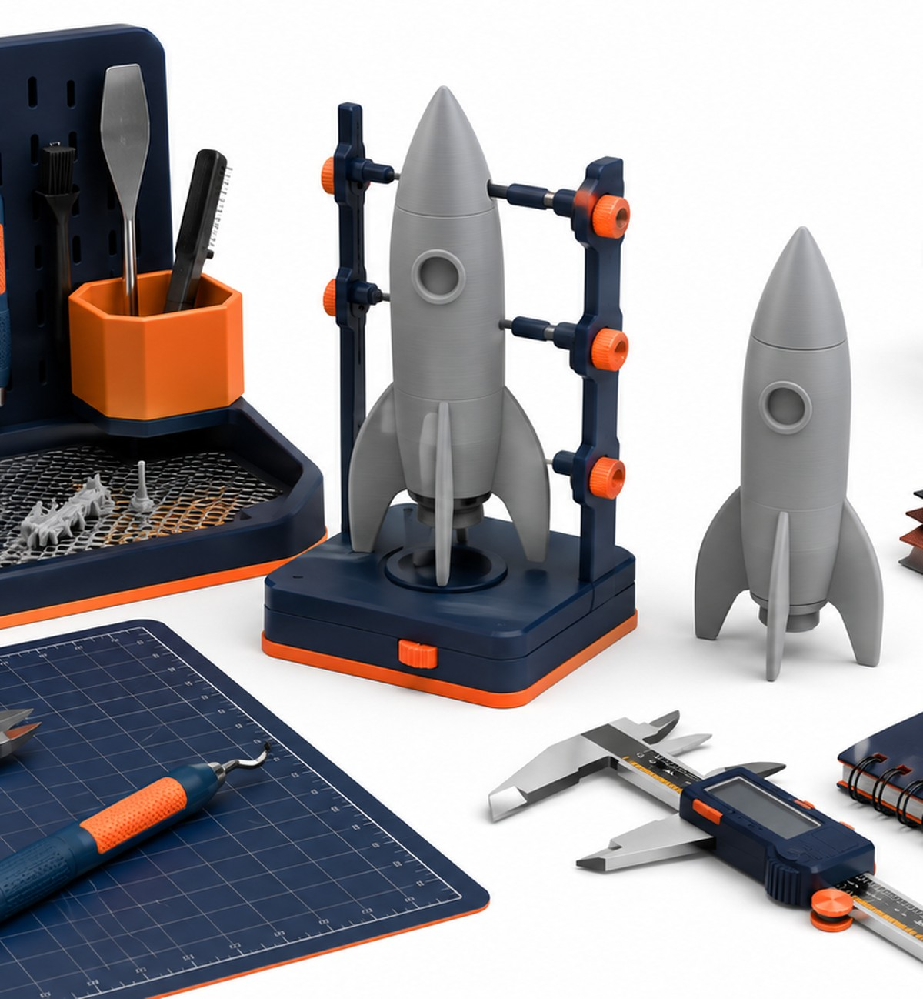
LOCKWOODSTEM AED • UNIT 3
Lesson 3.10
Export, Slice, and Submit Rocket Parts for 3D Printing
How do engineers prepare CAD parts so they can be manufactured accurately as physical prototypes?
CAD Assemblies, Prototyping & Technical Drawings

Slide 51
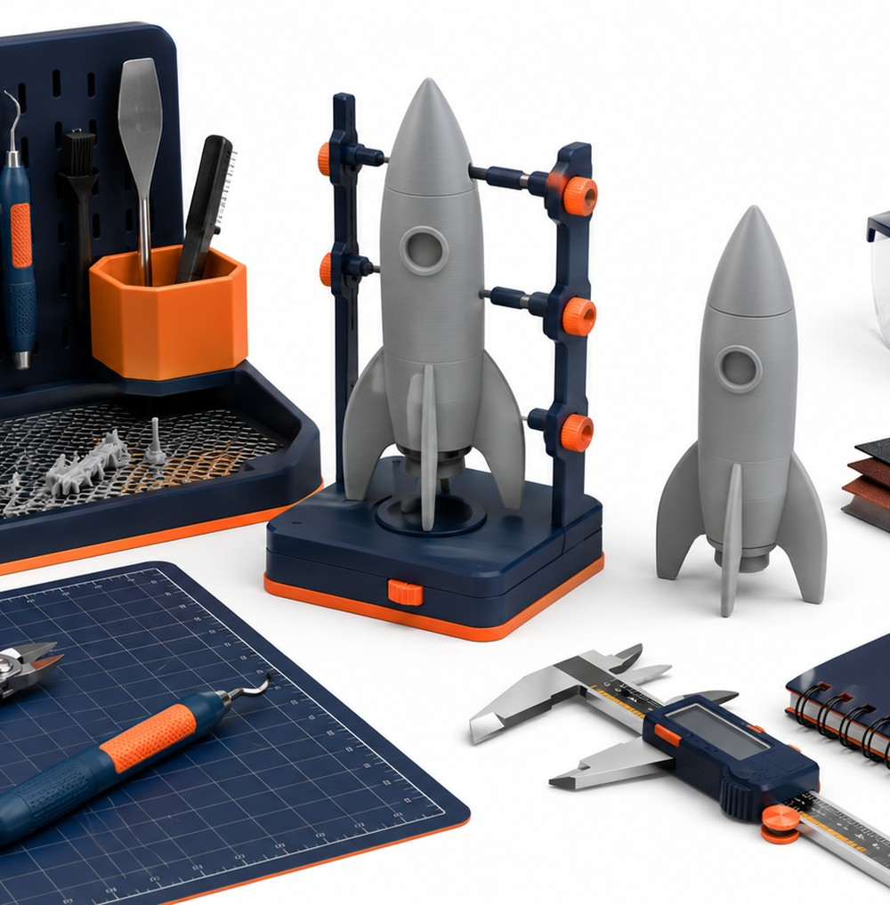
Lesson 3.10
Export, Slice, and Submit Rocket Parts for 3D Printing
Export, Slice, and Submit Rocket Parts for 3D Printing
How do engineers prepare CAD parts so they can be manufactured accurately as physical prototypes?
LESSON GOAL
Students prepare rocket components for 3D printing by exporting individual parts, checking print readiness, slicing parts, and submitting files.
STUDENT OBJECTIVE
I can prepare rocket assembly parts for 3D printing by exporting, slicing, checking settings, and submitting print-ready files.
END PRODUCT
Exported, sliced, checked, and submitted print-ready files for the rocket assembly prototype.
Aerospace assembly work depends on fit, alignment, documentation, and testing evidence.
LockwoodSTEM | Aerospace Engineering Design

Slide 52
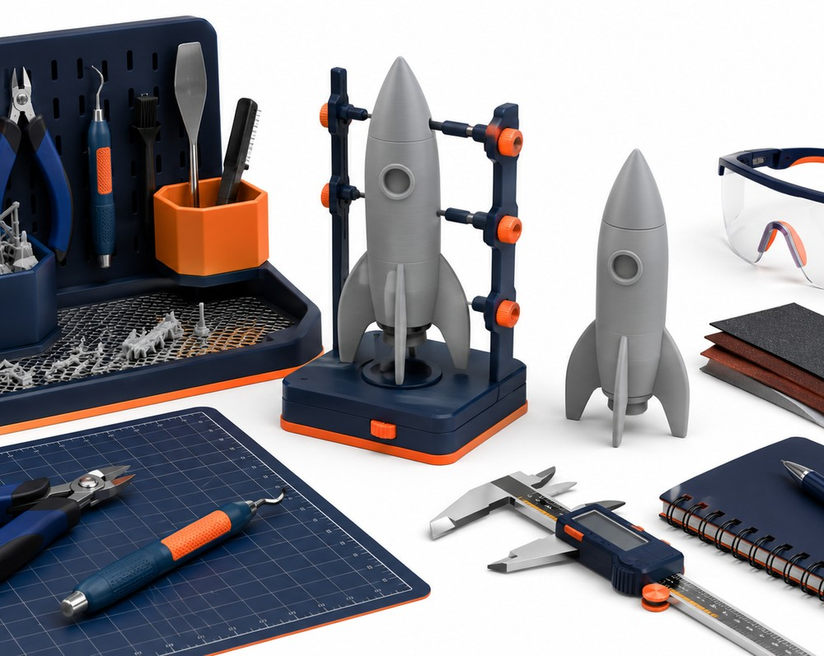
Lesson 3.10
Export, Slice, and Submit Rocket Parts for 3D Printing
What you need to understand
These ideas guide the decisions you make during the lesson.
BIG IDEAS
• A part should not be printed until the digital model has been checked for fit, alignment, and function.
• Each STL should represent one printable part with a clear file name.
• Slicer preview reveals manufacturing problems that may not be obvious in CAD.
Physical prints create evidence that CAD alone cannot provide.
LockwoodSTEM | Aerospace Engineering Design

Slide 53
Lesson 3.10
Export, Slice, and Submit Rocket Parts for 3D Printing
What you will do
Use this workflow to produce lesson evidence for your final design package.
1
Review functional check notes and confirm the design is ready for print preparation.
2
Identify which parts need to be printed and whether any should be combined or separated.
3
Complete a print-readiness check for size, thin features, supports, orientation, and build volume.
4
Export individual parts as STL files using clear names.
5
Import parts into the slicer, check scale/orientation, choose settings, preview, adjust, and submit print files.
6
Part Name
Save screenshots, photos, measurements, or notes before you move on.
LockwoodSTEM | Aerospace Engineering Design

Slide 54
Lesson 3.10
Export, Slice, and Submit Rocket Parts for 3D Printing
Evidence checklist
Use this slide to check whether your lesson evidence is ready for the final package.
REQUIRED EVIDENCE
BEFORE MOVING ON
□ List of parts selected for printing
□ Print-readiness notes
□ STL file names
□ Slicer screenshot
□ Print settings summary
□ Completed print queue documentation table
□ Notes explaining changes made before submitting
Your work should be:
• saved in the correct file or folder
• named clearly enough to find later
• connected to a design decision
• useful for final drawings or presentation
• ready for another person to understand
Exported, sliced, checked, and submitted print-ready files for the rocket assembly prototype.
LockwoodSTEM | Aerospace Engineering Design

Slide 55
LOCKWOODSTEM AED • UNIT 3
Lesson 3.11
Prototype Assembly Build Day
How well does a CAD rocket assembly translate into a physical 3D printed prototype?
CAD Assemblies, Prototyping & Technical Drawings

Slide 56
Lesson 3.11
Prototype Assembly Build Day
Prototype Assembly Build Day
How well does a CAD rocket assembly translate into a physical 3D printed prototype?
LESSON GOAL
Students assemble their 3D printed rocket parts into a physical prototype and document how well printed parts match the CAD assembly.
STUDENT OBJECTIVE
I can build a physical rocket assembly prototype from 3D printed parts and document fit, alignment, and assembly issues.
END PRODUCT
A physical 3D printed rocket assembly prototype, built or partially built, with documented fit and assembly evidence.
Aerospace assembly work depends on fit, alignment, documentation, and testing evidence.
LockwoodSTEM | Aerospace Engineering Design

Slide 57
Lesson 3.11
Prototype Assembly Build Day
What you need to understand
These ideas guide the decisions you make during the lesson.
BIG IDEAS
• The physical build tests the CAD model, tolerance decisions, slicer settings, and manufacturing process.
• Dry fitting catches problems before parts are permanently attached.
• Post-processing can change the fit of a part and should be documented.
Physical prints create evidence that CAD alone cannot provide.
LockwoodSTEM | Aerospace Engineering Design

Slide 58
Lesson 3.11
Prototype Assembly Build Day
What you will do
Use this workflow to produce lesson evidence for your final design package.
1
Collect printed rocket parts and review the CAD assembly and exploded view.
2
Inspect each print for defects, rough edges, missing features, or incorrect size.
3
Safely remove support, brim, raft, stringing, or rough edges as needed.
4
Lay out parts in assembly order and complete a dry fit.
5
Assemble the prototype using approved methods and document fit and alignment issues.
6
Part / Connection
Save screenshots, photos, measurements, or notes before you move on.
LockwoodSTEM | Aerospace Engineering Design

Slide 59
Lesson 3.11
Prototype Assembly Build Day
Evidence checklist
Use this slide to check whether your lesson evidence is ready for the final package.
REQUIRED EVIDENCE
BEFORE MOVING ON
□ Photo of printed parts before assembly
□ Initial print inspection notes
□ Post-processing notes
□ Completed fit and alignment table
□ Photo of dry fit or partial assembly
□ Photo of final assembled prototype
□ Notes describing one successful fit and one issue
Your work should be:
• saved in the correct file or folder
• named clearly enough to find later
• connected to a design decision
• useful for final drawings or presentation
• ready for another person to understand
A physical 3D printed rocket assembly prototype, built or partially built, with documented fit and assembly evidence.
LockwoodSTEM | Aerospace Engineering Design

Slide 60
LOCKWOODSTEM AED • UNIT 3
Lesson 3.12
Prototype Fit Testing and Revision Notes
How does testing a physical prototype help engineers improve a CAD assembly?
CAD Assemblies, Prototyping & Technical Drawings

Slide 61
Lesson 3.12
Prototype Fit Testing and Revision Notes
Prototype Fit Testing and Revision Notes
How does testing a physical prototype help engineers improve a CAD assembly?
LESSON GOAL
Students test the physical rocket prototype, compare it to CAD, and document revisions needed to improve fit, alignment, and assembly quality.
STUDENT OBJECTIVE
I can test a 3D printed rocket prototype and use evidence to recommend design revisions.
END PRODUCT
A tested rocket prototype with measurement evidence and revision notes for final drawings and presentation.
Aerospace assembly work depends on fit, alignment, documentation, and testing evidence.
LockwoodSTEM | Aerospace Engineering Design

Slide 62
Lesson 3.12
Prototype Fit Testing and Revision Notes
What you need to understand
These ideas guide the decisions you make during the lesson.
BIG IDEAS
• A prototype is evidence for improving the design, not just a finished object.
• Fit testing compares CAD intent to actual printed and assembled results.
• Strong revision recommendations identify the likely cause of a problem, not only the symptom.
Physical prints create evidence that CAD alone cannot provide.
LockwoodSTEM | Aerospace Engineering Design

Slide 63
Lesson 3.12
Prototype Fit Testing and Revision Notes
What you will do
Use this workflow to produce lesson evidence for your final design package.
1
Inspect the prototype visually for missing parts, gaps, warping, cracks, or misalignment.
2
Classify each major connection as too tight, snug, sliding, loose, misaligned, or does not fit.
3
Measure at least three important features with calipers or measuring tools.
4
Compare physical measurements to CAD dimensions where possible.
5
Identify root causes and create at least two revision recommendations.
6
Part / Connection
Save screenshots, photos, measurements, or notes before you move on.
LockwoodSTEM | Aerospace Engineering Design

Slide 64
Lesson 3.12
Prototype Fit Testing and Revision Notes
Evidence checklist
Use this slide to check whether your lesson evidence is ready for the final package.
REQUIRED EVIDENCE
BEFORE MOVING ON
□ Prototype testing photos
□ Completed prototype testing table
□ At least three measurement checks
□ Notes comparing prototype results to CAD intent
□ One successful fit
□ One issue and likely cause
□ At least two revision recommendations
Your work should be:
• saved in the correct file or folder
• named clearly enough to find later
• connected to a design decision
• useful for final drawings or presentation
• ready for another person to understand
A tested rocket prototype with measurement evidence and revision notes for final drawings and presentation.
LockwoodSTEM | Aerospace Engineering Design

Slide 65
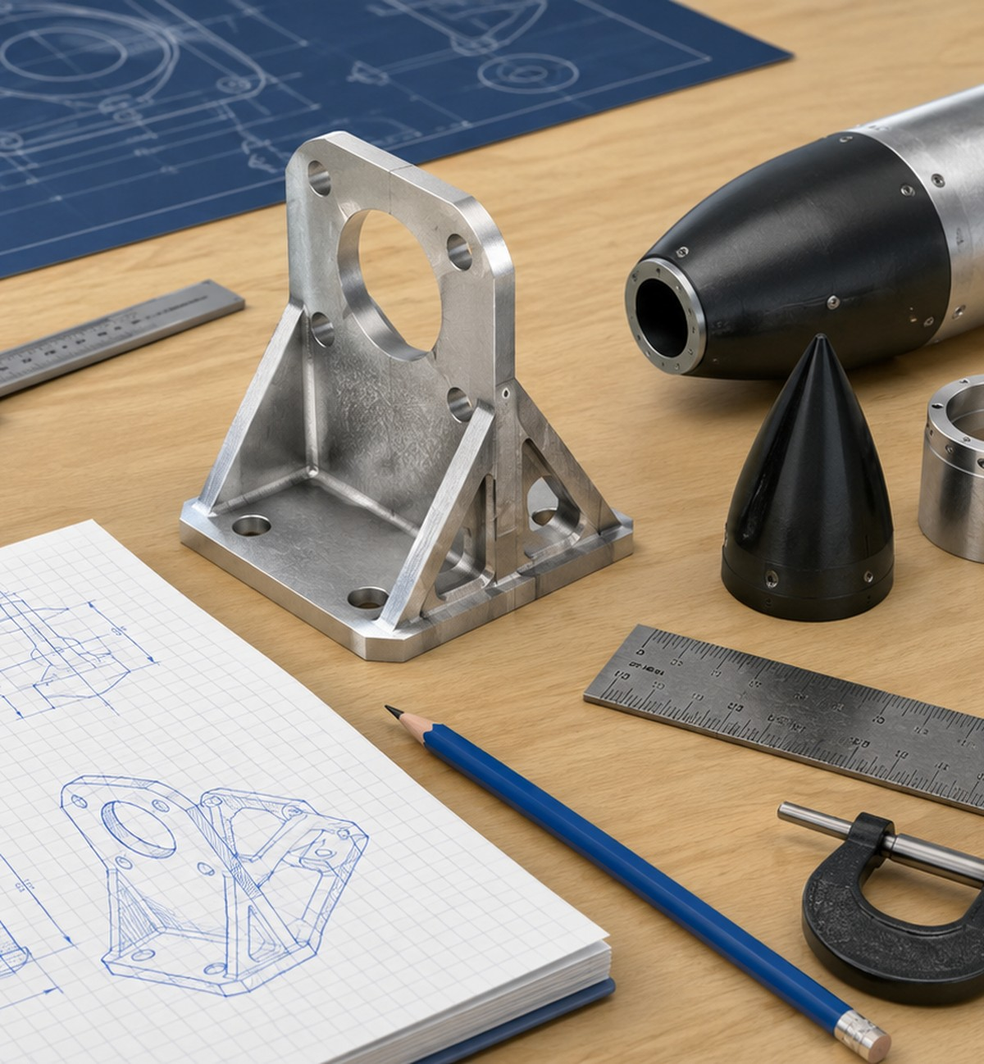
LOCKWOODSTEM AED • UNIT 3
Lesson 3.13
Introduction to Technical Drawing Sheets
How do engineers turn a tested prototype and CAD model into clear technical documentation?
CAD Assemblies, Prototyping & Technical Drawings

Slide 66
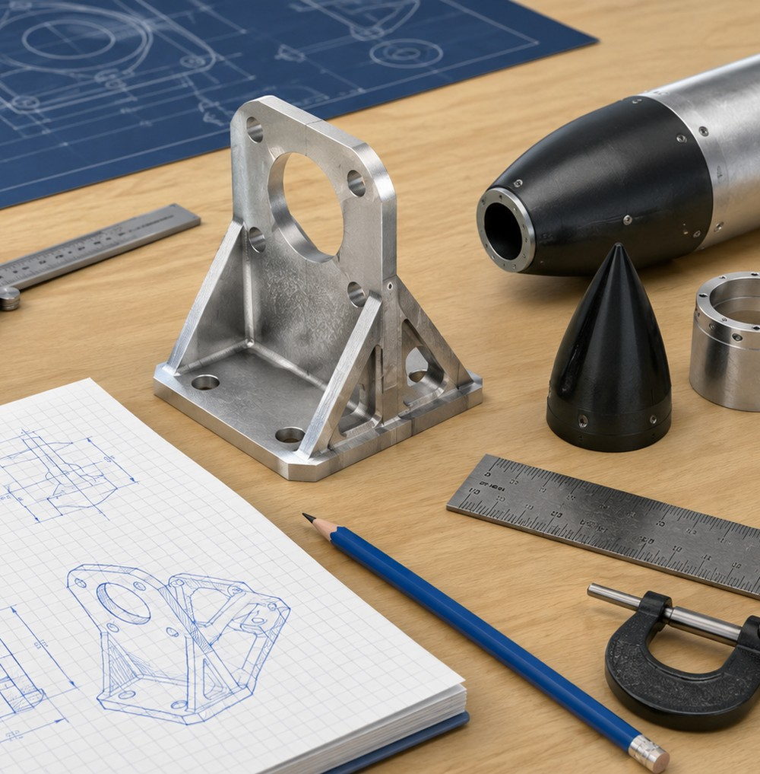
Lesson 3.13
Introduction to Technical Drawing Sheets
Introduction to Technical Drawing Sheets
How do engineers turn a tested prototype and CAD model into clear technical documentation?
LESSON GOAL
Students learn how CAD models and prototype testing results become technical drawing sheets that communicate the final rocket design.
STUDENT OBJECTIVE
I can explain the purpose of a technical drawing sheet and identify the information needed to document a rocket assembly design.
END PRODUCT
A started technical drawing sheet and a plan for documenting the tested rocket assembly.
Aerospace assembly work depends on fit, alignment, documentation, and testing evidence.
LockwoodSTEM | Aerospace Engineering Design

Slide 67
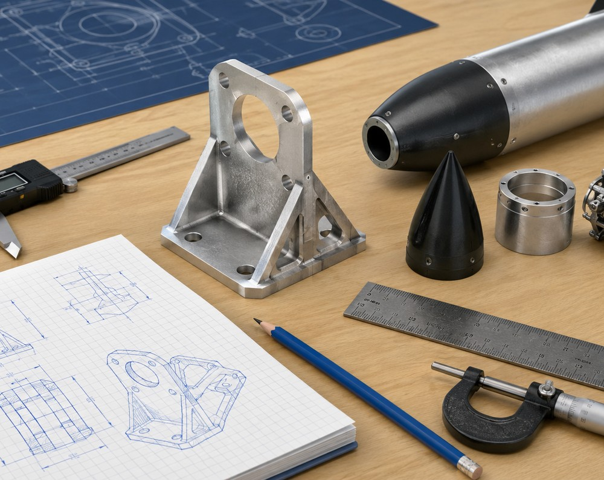
Lesson 3.13
Introduction to Technical Drawing Sheets
What you need to understand
These ideas guide the decisions you make during the lesson.
BIG IDEAS
• Technical drawings record final design information in a form another person can inspect, build from, or review.
• Drawings should reflect what was learned from CAD and physical prototype testing.
• Part drawings and assembly drawings serve different communication purposes.
Technical documentation turns design work into instructions others can understand.
LockwoodSTEM | Aerospace Engineering Design

Slide 68
Lesson 3.13
Introduction to Technical Drawing Sheets
What you will do
Use this workflow to produce lesson evidence for your final design package.
1
Review prototype testing evidence and revision notes.
2
Identify the parts of a drawing sheet, including border, title block, views, scale, units, notes, and revision level.
3
Compare part drawings and assembly drawings.
4
Identify one prototype result that should influence final documentation.
5
Create a basic drawing sheet from a rocket part or assembly.
Save screenshots, photos, measurements, or notes before you move on.
LockwoodSTEM | Aerospace Engineering Design

Slide 69
Lesson 3.13
Introduction to Technical Drawing Sheets
Evidence checklist
Use this slide to check whether your lesson evidence is ready for the final package.
REQUIRED EVIDENCE
BEFORE MOVING ON
□ Notes explaining what a technical drawing sheet is
□ Definitions of part drawing and assembly drawing
□ List of major drawing sheet parts
□ Screenshot of the first CAD drawing sheet
□ Views included
□ One prototype testing result that should influence final drawings
Your work should be:
• saved in the correct file or folder
• named clearly enough to find later
• connected to a design decision
• useful for final drawings or presentation
• ready for another person to understand
A started technical drawing sheet and a plan for documenting the tested rocket assembly.
LockwoodSTEM | Aerospace Engineering Design

Slide 70
LOCKWOODSTEM AED • UNIT 3
Lesson 3.14
Part and Assembly Drawing Views
How do engineers choose drawing views that clearly communicate both individual parts and full assemblies?
CAD Assemblies, Prototyping & Technical Drawings

Slide 71
Lesson 3.14
Part and Assembly Drawing Views
Part and Assembly Drawing Views
How do engineers choose drawing views that clearly communicate both individual parts and full assemblies?
LESSON GOAL
Students create technical drawing views for one rocket component and the full rocket assembly using clear view selection, dimensions, and basic annotations.
STUDENT OBJECTIVE
I can create part and assembly drawing views that clearly communicate the shape, size, and organization of my rocket design.
END PRODUCT
Started or completed part and assembly drawings with clear views, useful dimensions, and prototype-connected annotations.
Aerospace assembly work depends on fit, alignment, documentation, and testing evidence.
LockwoodSTEM | Aerospace Engineering Design

Slide 72
Lesson 3.14
Part and Assembly Drawing Views
What you need to understand
These ideas guide the decisions you make during the lesson.
BIG IDEAS
• A part drawing shows one component and includes useful dimensions.
• An assembly drawing shows how multiple components fit together and identifies major parts.
• The best views communicate important information without cluttering the sheet.
Technical documentation turns design work into instructions others can understand.
LockwoodSTEM | Aerospace Engineering Design

Slide 73
Lesson 3.14
Part and Assembly Drawing Views
What you will do
Use this workflow to produce lesson evidence for your final design package.
1
Choose one rocket component for a part drawing.
2
Create a main view, projected view, and isometric view for the part.
3
Add at least five useful dimensions.
4
Create a full rocket assembly drawing with main, isometric, and additional projected view.
5
Add basic annotations connected to fit, function, Unit 2 tolerance data, or prototype testing.
Save screenshots, photos, measurements, or notes before you move on.
LockwoodSTEM | Aerospace Engineering Design

Slide 74
Lesson 3.14
Part and Assembly Drawing Views
Evidence checklist
Use this slide to check whether your lesson evidence is ready for the final package.
REQUIRED EVIDENCE
BEFORE MOVING ON
□ Name of selected part
□ Screenshot of part drawing
□ List of part drawing views
□ At least five important dimensions
□ Screenshot of assembly drawing
□ List of assembly drawing views
□ At least two annotations or notes
Your work should be:
• saved in the correct file or folder
• named clearly enough to find later
• connected to a design decision
• useful for final drawings or presentation
• ready for another person to understand
Started or completed part and assembly drawings with clear views, useful dimensions, and prototype-connected annotations.
LockwoodSTEM | Aerospace Engineering Design

Slide 75
LOCKWOODSTEM AED • UNIT 3
Lesson 3.15
Parts List, Balloons, Notes, and Revisions
How do engineers make an assembly drawing complete, clear, and traceable?
CAD Assemblies, Prototyping & Technical Drawings

Slide 76
Lesson 3.15
Parts List, Balloons, Notes, and Revisions
Parts List, Balloons, Notes, and Revisions
How do engineers make an assembly drawing complete, clear, and traceable?
LESSON GOAL
Students complete the assembly drawing by adding balloons, a parts list, useful notes, title block information, and revision details.
STUDENT OBJECTIVE
I can complete an assembly drawing by identifying parts, adding documentation notes, and tracking design revisions.
END PRODUCT
An updated rocket assembly drawing with balloons, parts list, notes, title block, and revision documentation.
Aerospace assembly work depends on fit, alignment, documentation, and testing evidence.
LockwoodSTEM | Aerospace Engineering Design

Slide 77
Lesson 3.15
Parts List, Balloons, Notes, and Revisions
What you need to understand
These ideas guide the decisions you make during the lesson.
BIG IDEAS
• Balloons identify parts in the drawing and connect them to the parts list.
• Drawing notes communicate fit, function, assembly order, tolerance, and prototype evidence.
• Revision tables make design changes traceable.
Technical documentation turns design work into instructions others can understand.
LockwoodSTEM | Aerospace Engineering Design

Slide 78
Lesson 3.15
Parts List, Balloons, Notes, and Revisions
What you will do
Use this workflow to produce lesson evidence for your final design package.
1
Add balloons to each major rocket component.
2
Insert or update a parts list with item number, part name, quantity, material/process, and notes.
3
Add notes about fit, Unit 2 tolerance testing, prototype testing, and assembly order or function.
4
Complete title block information on part and assembly drawings.
5
Create a revision table documenting at least one meaningful design revision.
6
Revision
Save screenshots, photos, measurements, or notes before you move on.
LockwoodSTEM | Aerospace Engineering Design

Slide 79
Lesson 3.15
Parts List, Balloons, Notes, and Revisions
Evidence checklist
Use this slide to check whether your lesson evidence is ready for the final package.
REQUIRED EVIDENCE
BEFORE MOVING ON
□ Screenshot of assembly drawing with balloons
□ Parts list
□ At least four drawing notes
□ Completed title block information
□ Revision table with at least one meaningful revision
□ Notes explaining how prototype testing influenced documentation
Your work should be:
• saved in the correct file or folder
• named clearly enough to find later
• connected to a design decision
• useful for final drawings or presentation
• ready for another person to understand
An updated rocket assembly drawing with balloons, parts list, notes, title block, and revision documentation.
LockwoodSTEM | Aerospace Engineering Design

Slide 80
LOCKWOODSTEM AED • UNIT 3
Lesson 3.16
Final Rocket Assembly Design Package Workday
How do engineers organize design evidence into a final package that clearly communicates the completed assembly?
CAD Assemblies, Prototyping & Technical Drawings

Slide 81
Lesson 3.16
Final Rocket Assembly Design Package Workday
Final Rocket Assembly Design Package Workday
How do engineers organize design evidence into a final package that clearly communicates the completed assembly?
LESSON GOAL
Students organize, revise, and finalize CAD, prototype, drawing, testing, and documentation evidence into one complete rocket assembly design package.
STUDENT OBJECTIVE
I can prepare a complete rocket assembly design package that documents my CAD model, physical prototype, testing evidence, revisions, and final drawings.
END PRODUCT
A complete final rocket assembly design package ready to support the final presentation.
Aerospace assembly work depends on fit, alignment, documentation, and testing evidence.
LockwoodSTEM | Aerospace Engineering Design

Slide 82
Lesson 3.16
Final Rocket Assembly Design Package Workday
What you need to understand
These ideas guide the decisions you make during the lesson.
BIG IDEAS
• A strong design package shows the full engineering process from CAD to physical prototype to final documentation.
• Final documentation should include both successful evidence and revision evidence.
• The final package should prepare students to explain their assembly clearly during presentation.
Technical documentation turns design work into instructions others can understand.
LockwoodSTEM | Aerospace Engineering Design

Slide 83
Lesson 3.16
Final Rocket Assembly Design Package Workday
What you will do
Use this workflow to produce lesson evidence for your final design package.
1
Check the final CAD assembly for parts, alignment, symmetry, fit decisions, and clear names.
2
Organize prototype photos and measurement evidence.
3
Check the exploded view, part drawing, assembly drawing, parts list, balloons, notes, title block, and revision table.
4
Complete a final design package checklist.
5
Revise weak areas and draft the final design explanation.
6
Package Item
Save screenshots, photos, measurements, or notes before you move on.
LockwoodSTEM | Aerospace Engineering Design

Slide 84
Lesson 3.16
Final Rocket Assembly Design Package Workday
Evidence checklist
Use this slide to check whether your lesson evidence is ready for the final package.
REQUIRED EVIDENCE
BEFORE MOVING ON
□ Completed final design package checklist
□ Screenshot of final CAD assembly
□ Screenshot of exploded view
□ Prototype photos
□ Screenshot of part drawing
□ Screenshot of assembly drawing
□ Final revision notes
Your work should be:
• saved in the correct file or folder
• named clearly enough to find later
• connected to a design decision
• useful for final drawings or presentation
• ready for another person to understand
A complete final rocket assembly design package ready to support the final presentation.
LockwoodSTEM | Aerospace Engineering Design

Slide 85
LOCKWOODSTEM AED • UNIT 3
Lesson 3.17
Final Rocket Assembly Presentation
How well did your CAD design translate into a physical rocket assembly prototype?
CAD Assemblies, Prototyping & Technical Drawings

Slide 86
Lesson 3.17
Final Rocket Assembly Presentation
Final Rocket Assembly Presentation
How well did your CAD design translate into a physical rocket assembly prototype?
LESSON GOAL
Students present the final rocket assembly and explain how CAD modeling, 3D printing, testing, revision, and documentation support the completed design.
STUDENT OBJECTIVE
I can present my final rocket assembly and explain how CAD modeling, prototyping, testing, and documentation were used to improve the design.
END PRODUCT
A completed final rocket assembly presentation supported by the physical prototype, CAD model, testing evidence, revisions, and technical documentation.
Aerospace assembly work depends on fit, alignment, documentation, and testing evidence.
LockwoodSTEM | Aerospace Engineering Design

Slide 87
Lesson 3.17
Final Rocket Assembly Presentation
What you need to understand
These ideas guide the decisions you make during the lesson.
BIG IDEAS
• The final presentation should explain the engineering process, not just show the finished rocket.
• Students should connect the physical prototype to CAD, tolerance data, drawings, testing evidence, and revisions.
• A strong presentation uses evidence to explain what worked, what changed, and what should improve next.
Technical documentation turns design work into instructions others can understand.
LockwoodSTEM | Aerospace Engineering Design

Slide 88
Lesson 3.17
Final Rocket Assembly Presentation
What you will do
Use this workflow to produce lesson evidence for your final design package.
1
Show the physical 3D printed rocket assembly prototype.
2
Explain the final CAD assembly and exploded view.
3
Connect Unit 2 tolerance testing to at least one fit decision.
4
Discuss prototype testing results, including one successful fit and one issue.
5
Show the part drawing, assembly drawing, parts list, balloons, notes, title block, and revision table.
6
Conclude with the strongest design feature and one next-version improvement.
Save screenshots, photos, measurements, or notes before you move on.
LockwoodSTEM | Aerospace Engineering Design

Slide 89
Lesson 3.17
Final Rocket Assembly Presentation
Evidence checklist
Use this slide to check whether your lesson evidence is ready for the final package.
REQUIRED EVIDENCE
BEFORE MOVING ON
□ Physical rocket assembly prototype
□ Final CAD assembly
□ Exploded view
□ Unit 2 tolerance connection
□ Prototype fit testing evidence
□ One successful fit and one issue
□ Part and assembly drawings
Your work should be:
• saved in the correct file or folder
• named clearly enough to find later
• connected to a design decision
• useful for final drawings or presentation
• ready for another person to understand
A completed final rocket assembly presentation supported by the physical prototype, CAD model, testing evidence, revisions, and techni…
LockwoodSTEM | Aerospace Engineering Design

Slide 90
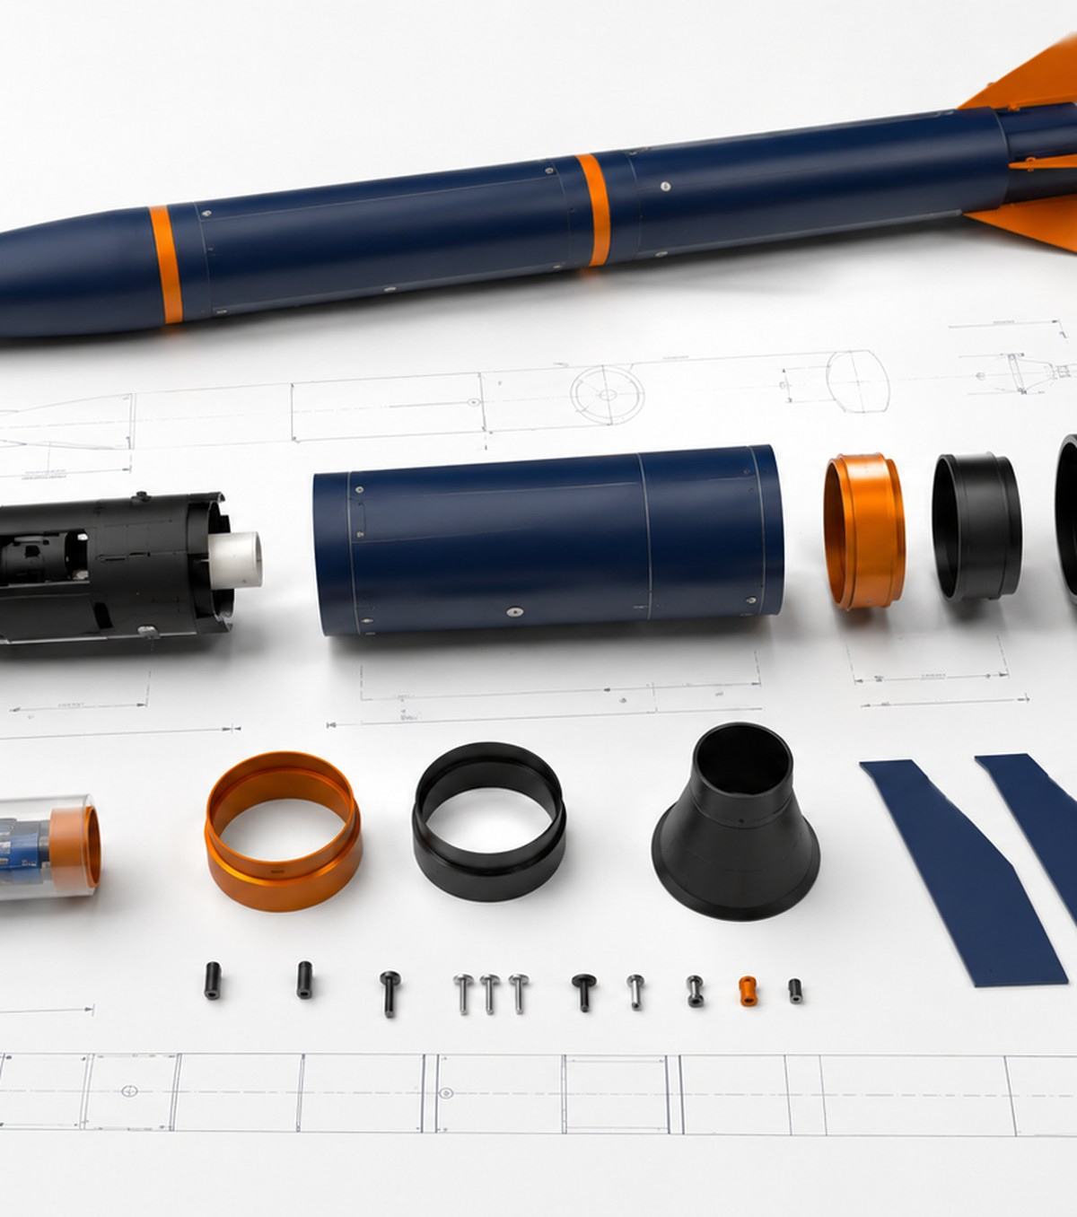
Unit 3 Close
From CAD Assembly to Design Package
A strong final package tells the story of how your rocket assembly was planned, modeled, tested, revised, documented, and presented.
FINAL MINDSET
A finished prototype is not the end of engineering — it is evidence for the next better version.

