Slide 1

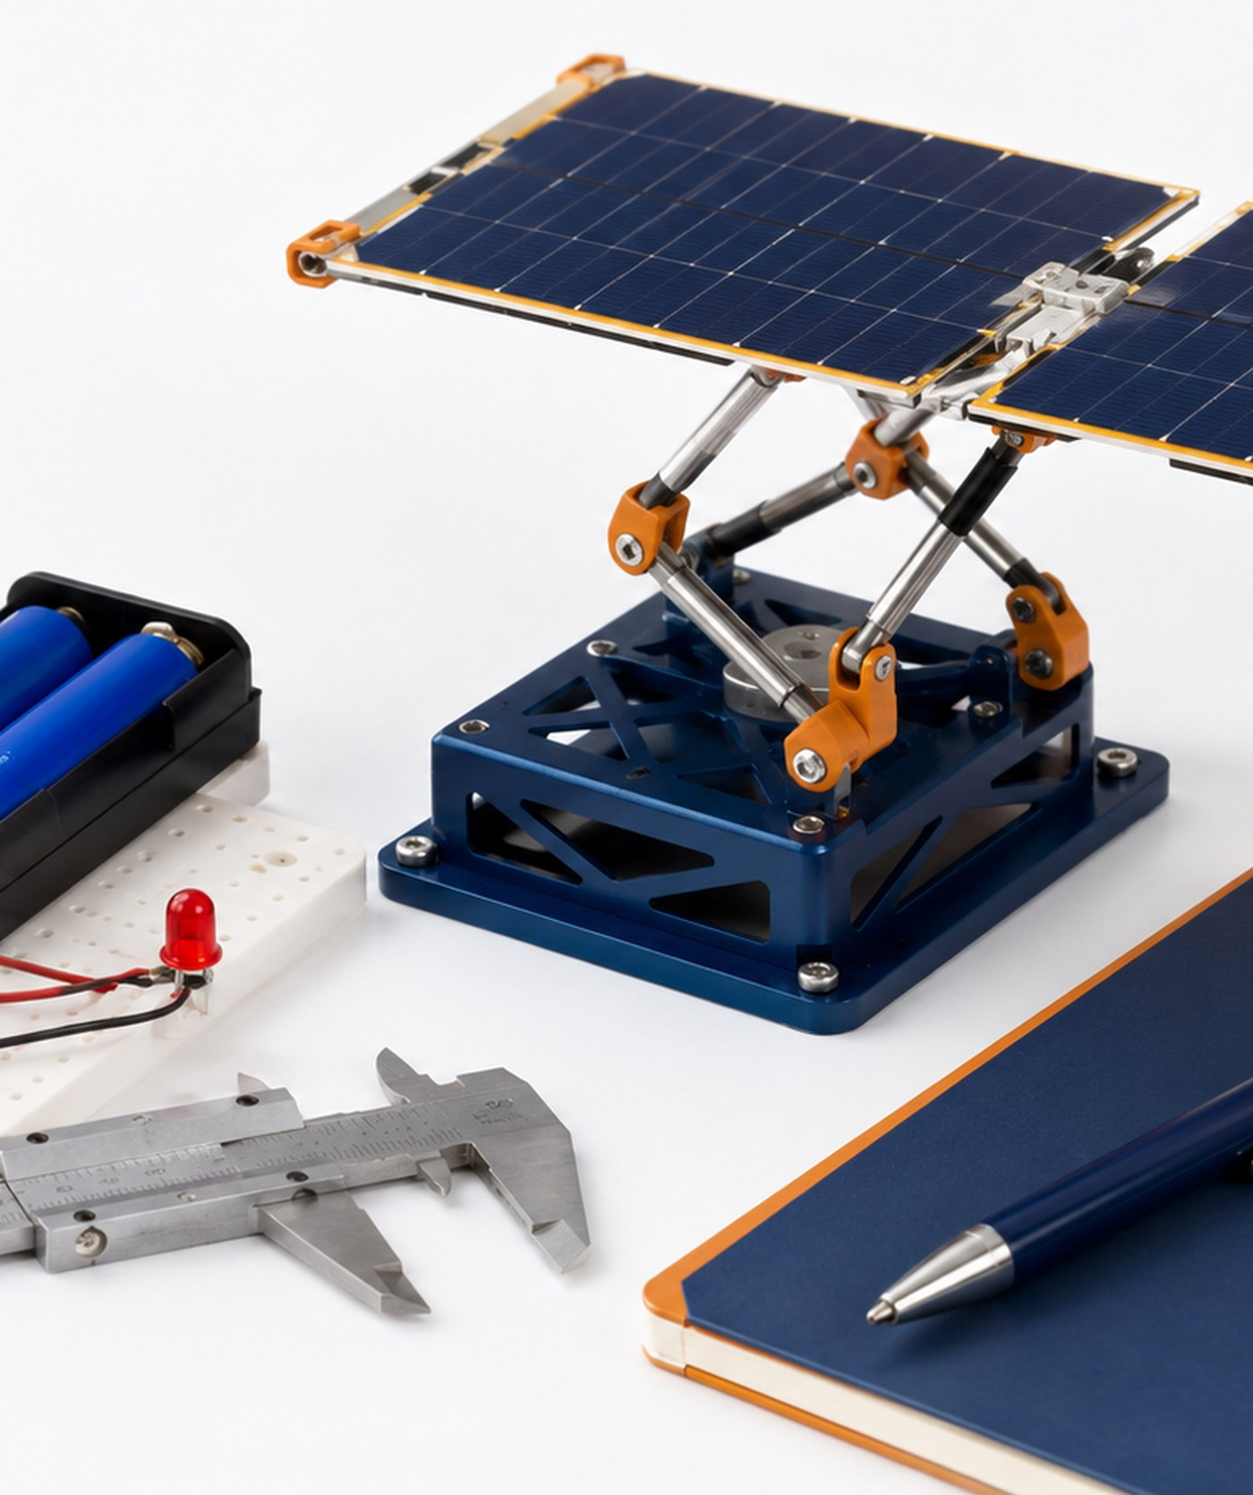
Aerospace Engineering Design
Unit 4
Aerospace Mechanisms, Materials & Electromechanical Systems
Design, build, test, analyze, and revise a working aerospace-inspired system using material evidence, mechanism behavior, electrical integration, and data.
Student learning deck • LockwoodSTEM aerospace-aligned AED curriculum

Slide 2
Unit 4
Unit 4 Learning Arc
You will combine technical subsystems into one working prototype.
1
2
3
4
Select Materials
Control Motion
Integrate Power
Test + Revise
Compare material properties and test samples before committing to a design choice.
Explore mechanisms, motion types, force, friction, and system behavior.
Use simple circuits and motors safely when the prototype needs electromechanical motion.
Collect data, graph results, draw conclusions, and improve the prototype.
The final demonstration should prove the system works and explain the evidence behind each major decision.
LockwoodSTEM | Aerospace Engineering Design

Slide 3
Unit 4
Unit 4 Deliverables Map
Each lesson creates part of the final technical demonstration package.
Materials Evidence
Mechanism Evidence
System Evidence
Testing Evidence
• property comparison
• test data
• statistics/error notes
• material recommendation
• tradeoff statement
• motion classification
• mechanism exploration
• friction analysis
• motion graph
• decision matrix
• architecture diagram
• CAD layout
• prototype build photos
• circuit/motor diagram
• integration notes
• test protocol
• data table
• graph/conclusion
• revision evidence
• technical demo reflection
LockwoodSTEM | Aerospace Engineering Design

Slide 4
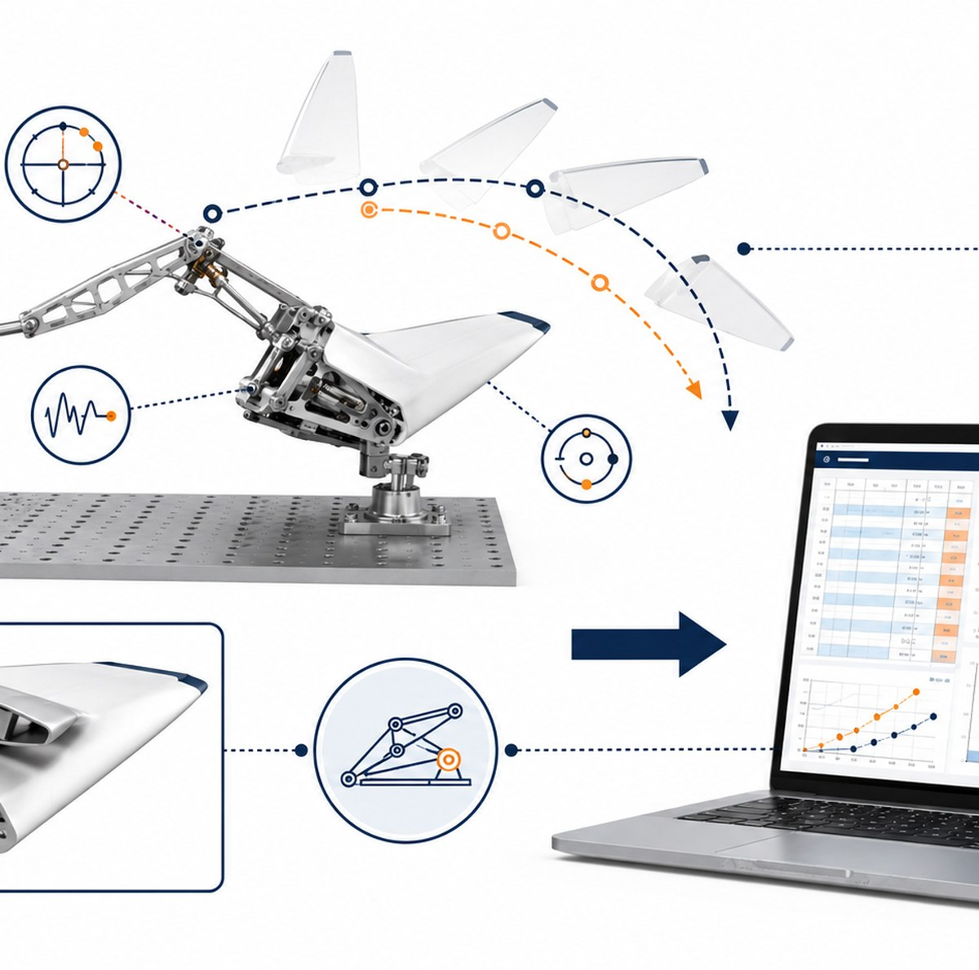
Unit 4
How Unit 4 Works
YOUR CORE CHALLENGE
Create an aerospace-inspired mechanism or electromechanical system prototype that moves, performs a function, and can be tested with data.
WHAT “WORKING” MEANS
Working means the system is safe, reliable enough to demonstrate, and supported by material, mechanism, circuit, and testing evidence.
WHAT GOOD EVIDENCE LOOKS LIKE
Material test data, motion observations, circuit diagrams, test protocols, graphs, revision notes, and photos that show how the design improved.
ENGINEERING HABIT
Build only after you know what the system must do and how you will test success.
Unit 4 is about building a functional system and proving performance with evidence.
LockwoodSTEM | Aerospace Engineering Design

Slide 5
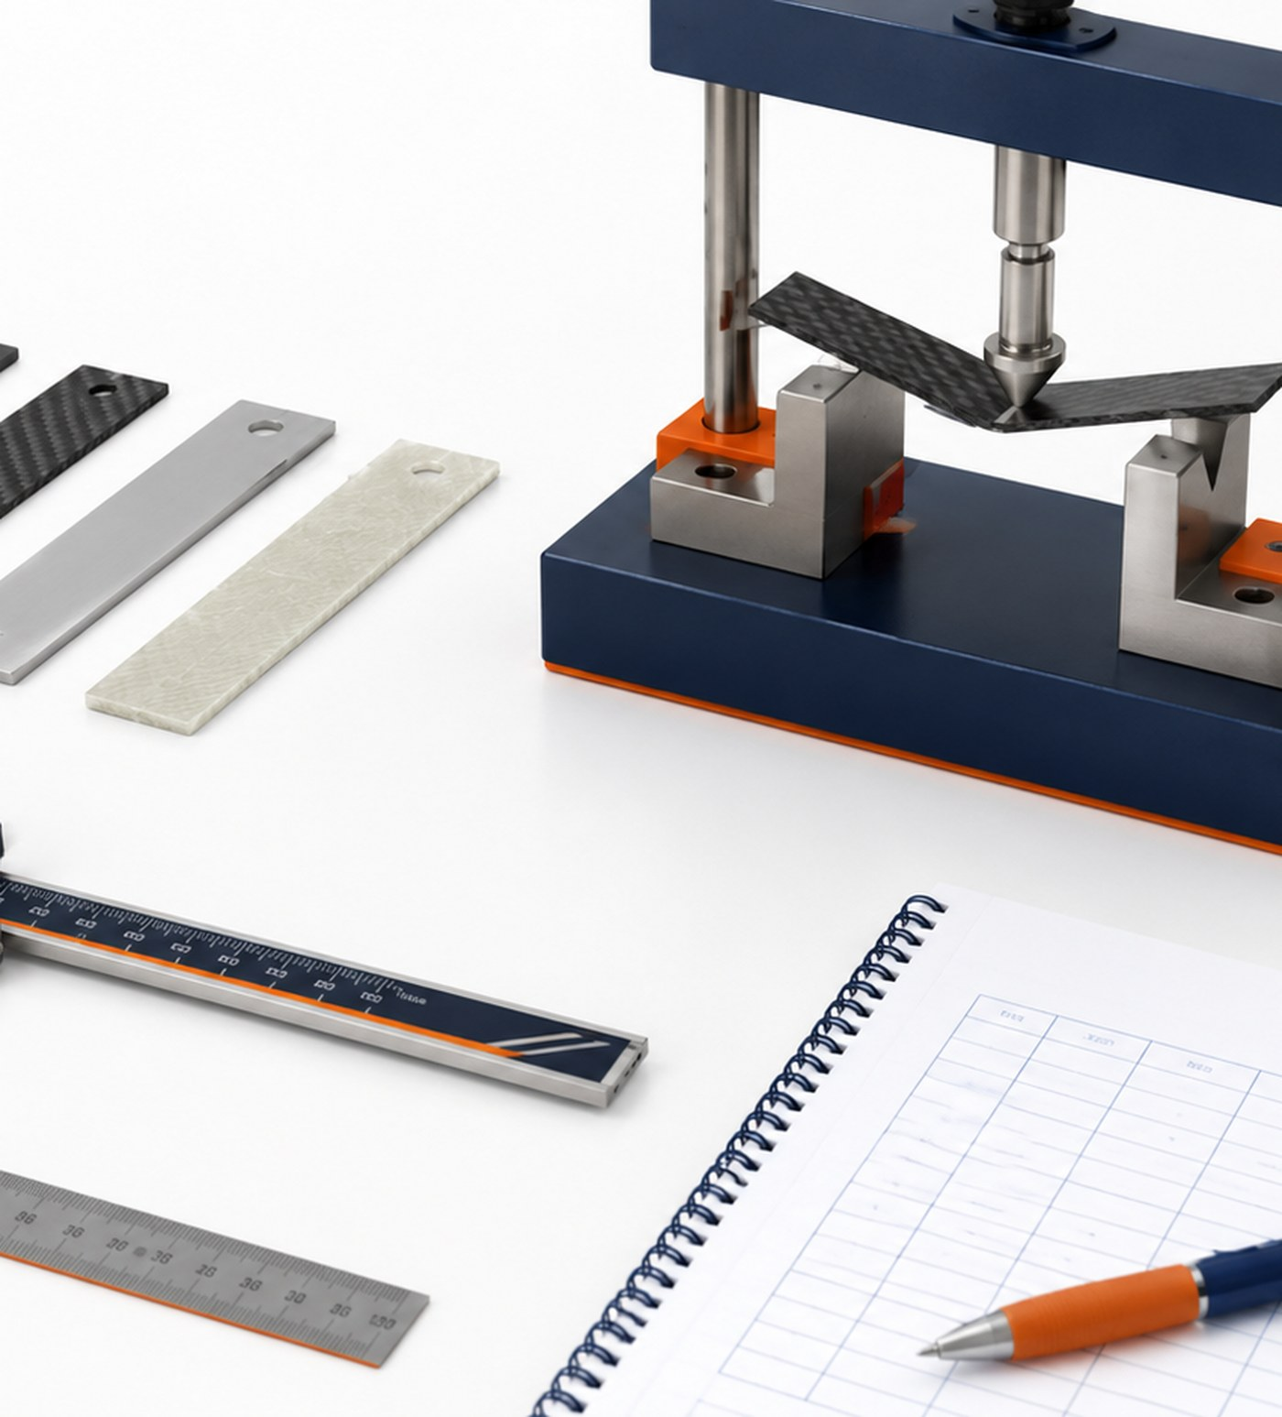
LOCKWOODSTEM AED • UNIT 4
Lesson 4.1
Unit 4 Challenge Launch: Aerospace Mechanisms, Materials & Electromechanical Systems
How can materials, mechanisms, circuits, and data work together in an aerospace system?
Aerospace Mechanisms, Materials & Electromechanical Systems

Slide 6
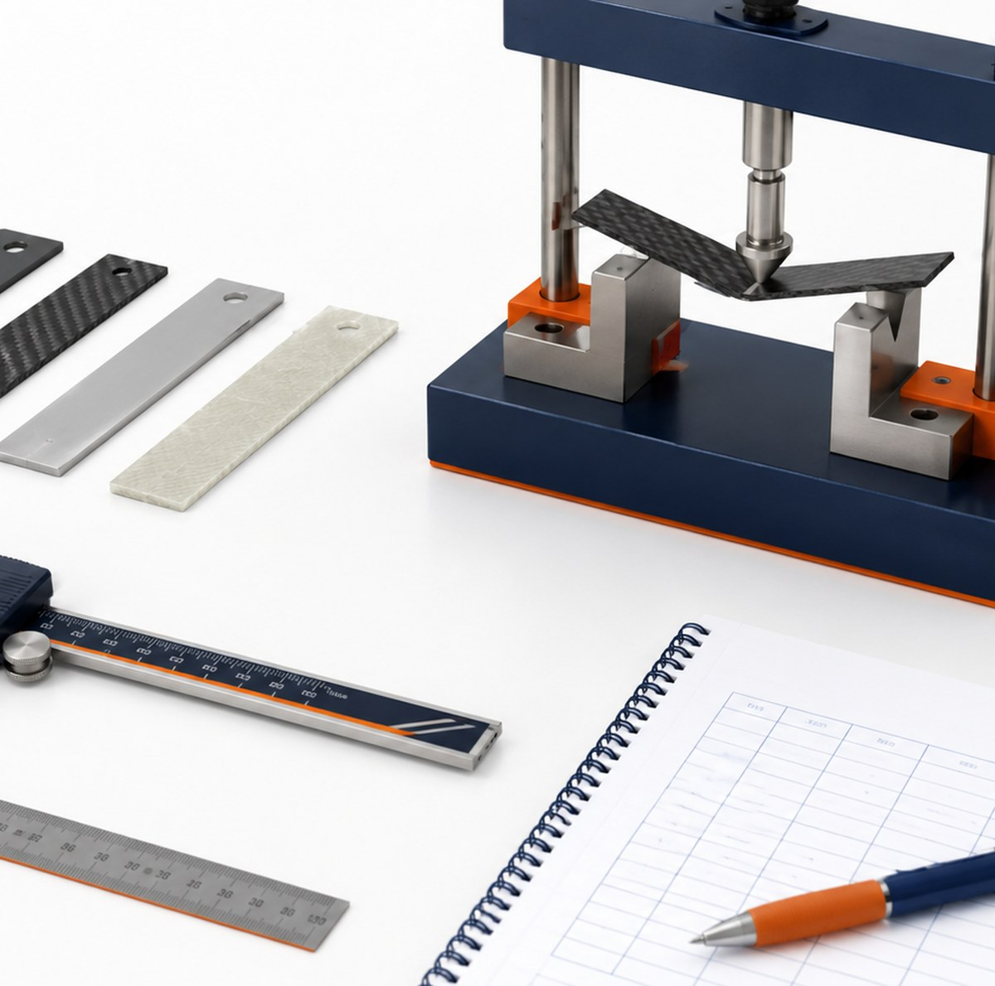
Lesson 4.1
Unit 4 Challenge Launch
Unit 4 Challenge Launch: Aerospace Mechanisms, Materials & Electromechanical Systems
How can materials, mechanisms, circuits, and data work together in an aerospace system?
LESSON GOAL
Understand the Unit 4 aerospace system challenge and how materials, mechanisms, circuits, and data combine into one working prototype.
STUDENT OBJECTIVE
I can explain the challenge, identify system requirements, and describe the evidence my team will need to collect.
END PRODUCT
Challenge brief annotated with early criteria, constraints, subsystem ideas, and questions.
Technical systems require evidence from materials, motion, circuits, testing, and revision.
LockwoodSTEM | Aerospace Engineering Design

Slide 7
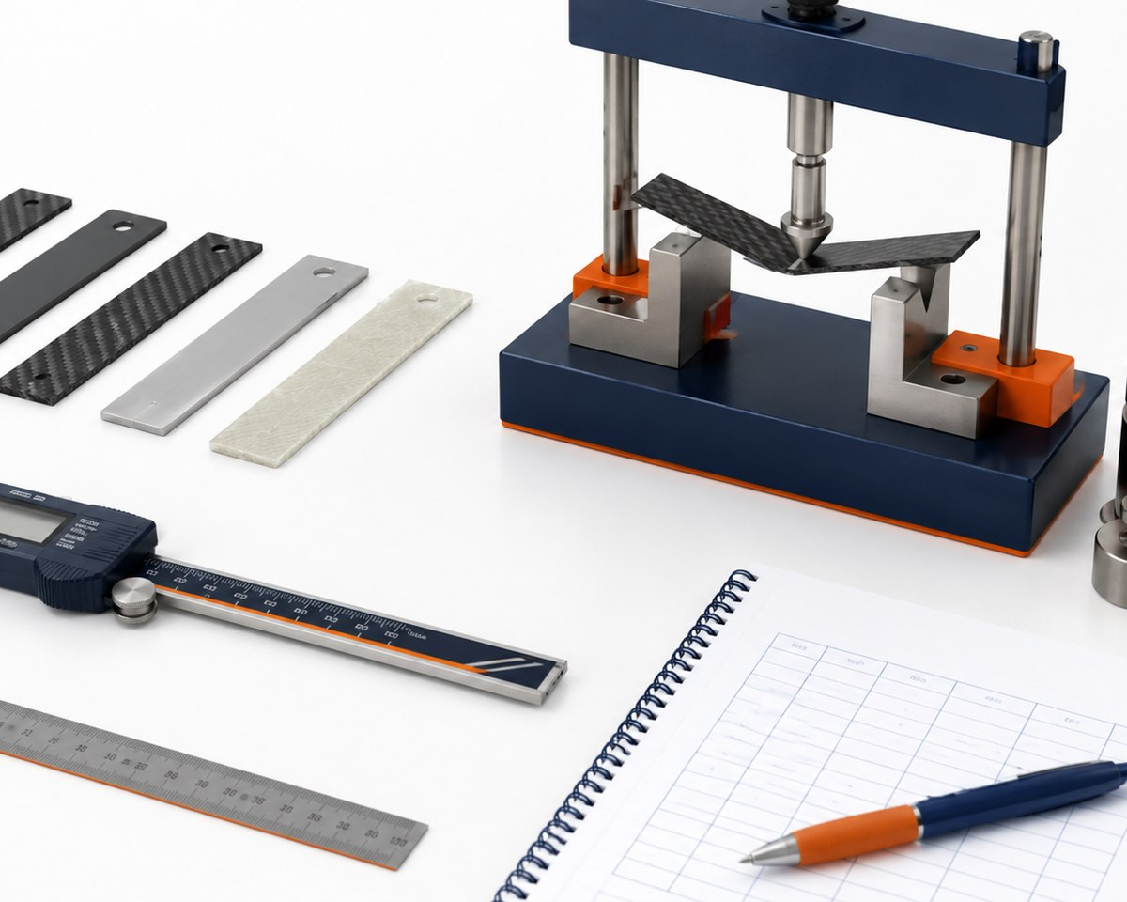
Lesson 4.1
Unit 4 Challenge Launch
What you need to understand
These ideas guide today’s technical decisions.
BIG IDEAS
• Unit 4 connects several engineering topics into one functional system.
• A system is made of interacting subsystems: structure, mechanism, power/control, and testing.
• Aerospace designs must balance mass, strength, motion, reliability, safety, and evidence.
• The final demonstration must show how the prototype works and how data supports design decisions.
Material choices are stronger when supported by testing, measurement, and data.
LockwoodSTEM | Aerospace Engineering Design

Slide 8
Lesson 4.1
Unit 4 Challenge Launch
What you will do
Follow this workflow to create evidence for the final technical demonstration.
1
Read and annotate the Unit 4 challenge brief.
2
Identify required functions and system constraints.
3
List possible aerospace applications such as deployment, positioning, release, or motion control.
4
Sketch early subsystem ideas and questions.
5
Begin a team evidence plan for materials, mechanism, circuit, and data.
Document the decision while the evidence is still fresh.
LockwoodSTEM | Aerospace Engineering Design

Slide 9
Lesson 4.1
Unit 4 Challenge Launch
Evidence checklist
Check whether today’s evidence is ready for the Unit 4 technical package.
REQUIRED EVIDENCE
BEFORE MOVING ON
□ Annotated challenge brief
□ Initial criteria and constraints list
□ Subsystem brainstorm sketch
□ Early evidence plan
□ Notebook reflection on the most important technical risk
Your work should be:
• connected to the original challenge requirements
• clear enough for another team to understand
• based on measured data or a documented observation
• saved in the correct file, notebook, or project folder
• useful for the final technical demonstration
Challenge brief annotated with early criteria, constraints, subsystem ideas, and questions.
LockwoodSTEM | Aerospace Engineering Design

Slide 10
LOCKWOODSTEM AED • UNIT 4
Lesson 4.2
Aerospace Materials and Material Properties
How do material properties influence aerospace design decisions?
Aerospace Mechanisms, Materials & Electromechanical Systems

Slide 11
Lesson 4.2
Aerospace Materials and Material Properties
Aerospace Materials and Material Properties
How do material properties influence aerospace design decisions?
LESSON GOAL
Compare material properties that influence aerospace design choices.
STUDENT OBJECTIVE
I can connect material properties to design tradeoffs such as weight, stiffness, flexibility, durability, and manufacturability.
END PRODUCT
Material property comparison table and preliminary material recommendation.
Technical systems require evidence from materials, motion, circuits, testing, and revision.
LockwoodSTEM | Aerospace Engineering Design

Slide 12
Lesson 4.2
Aerospace Materials and Material Properties
What you need to understand
These ideas guide today’s technical decisions.
BIG IDEAS
• Materials are selected based on properties, not appearance.
• Useful properties include density, stiffness, strength, flexibility, toughness, conductivity, cost, and manufacturability
• Aerospace systems often prioritize strength-to-weight ratio and reliability.
• Different parts of the same prototype may require different materials.
Material choices are stronger when supported by testing, measurement, and data.
LockwoodSTEM | Aerospace Engineering Design

Slide 13
Lesson 4.2
Aerospace Materials and Material Properties
What you will do
Follow this workflow to create evidence for the final technical demonstration.
1
Compare classroom-approved materials using property categories.
2
Match materials to possible prototype parts or functions.
3
Identify at least two tradeoffs for each possible material.
4
Choose a preliminary material recommendation for one subsystem.
5
Record why the material choice fits the challenge requirements.
Document the decision while the evidence is still fresh.
LockwoodSTEM | Aerospace Engineering Design

Slide 14
Lesson 4.2
Aerospace Materials and Material Properties
Evidence checklist
Check whether today’s evidence is ready for the Unit 4 technical package.
REQUIRED EVIDENCE
BEFORE MOVING ON
□ Material comparison table
□ At least three material-property observations
□ Preliminary material recommendation
□ Tradeoff statement
□ Notebook reflection on material selection risk
Your work should be:
• connected to the original challenge requirements
• clear enough for another team to understand
• based on measured data or a documented observation
• saved in the correct file, notebook, or project folder
• useful for the final technical demonstration
Material property comparison table and preliminary material recommendation.
LockwoodSTEM | Aerospace Engineering Design

Slide 15
LOCKWOODSTEM AED • UNIT 4
Lesson 4.3
Material Testing Lab
How can engineers test materials before choosing them for a prototype?
Aerospace Mechanisms, Materials & Electromechanical Systems

Slide 16
Lesson 4.3
Material Testing Lab
Material Testing Lab
How can engineers test materials before choosing them for a prototype?
LESSON GOAL
Conduct a simple material test and use the results to support a design decision.
STUDENT OBJECTIVE
I can collect material test data and explain how the data affects a prototype decision.
END PRODUCT
Material test data table with a recommendation supported by evidence.
Technical systems require evidence from materials, motion, circuits, testing, and revision.
LockwoodSTEM | Aerospace Engineering Design

Slide 17
Lesson 4.3
Material Testing Lab
What you need to understand
These ideas guide today’s technical decisions.
BIG IDEAS
• Material testing helps engineers avoid guessing.
• A fair test controls variables so results are comparable.
• Deflection, failure, mass, and repeatability can help describe material performance.
• Test evidence is strongest when procedure, data, and conclusion are documented clearly.
Material choices are stronger when supported by testing, measurement, and data.
LockwoodSTEM | Aerospace Engineering Design

Slide 18
Lesson 4.3
Material Testing Lab
What you will do
Follow this workflow to create evidence for the final technical demonstration.
1
Set up a fair material test using approved classroom materials.
2
Measure the same variable for each material or sample.
3
Record raw data in a table.
4
Compare material performance using the test results.
5
Write a short evidence-based recommendation.
Document the decision while the evidence is still fresh.
LockwoodSTEM | Aerospace Engineering Design

Slide 19
Lesson 4.3
Material Testing Lab
Evidence checklist
Check whether today’s evidence is ready for the Unit 4 technical package.
REQUIRED EVIDENCE
BEFORE MOVING ON
□ Material test setup sketch or photo
□ Raw data table
□ Controlled variables noted
□ Material performance comparison
□ Recommendation supported by data
Your work should be:
• connected to the original challenge requirements
• clear enough for another team to understand
• based on measured data or a documented observation
• saved in the correct file, notebook, or project folder
• useful for the final technical demonstration
Material test data table with a recommendation supported by evidence.
LockwoodSTEM | Aerospace Engineering Design

Slide 20
LOCKWOODSTEM AED • UNIT 4
Lesson 4.4
Statistics and Measurement Error
How can statistics help engineers trust and interpret test results?
Aerospace Mechanisms, Materials & Electromechanical Systems

Slide 21
Lesson 4.4
Statistics and Measurement Error
Statistics and Measurement Error
How can statistics help engineers trust and interpret test results?
LESSON GOAL
Use basic statistics to interpret material or prototype test data.
STUDENT OBJECTIVE
I can calculate and interpret mean, range, variation, and measurement uncertainty in an engineering test.
END PRODUCT
Statistics summary for a test dataset with a reliability statement.
Technical systems require evidence from materials, motion, circuits, testing, and revision.
LockwoodSTEM | Aerospace Engineering Design

Slide 22
Lesson 4.4
Statistics and Measurement Error
What you need to understand
These ideas guide today’s technical decisions.
BIG IDEAS
• One measurement rarely tells the whole story.
• Repeated trials help reveal variation and possible error.
• Mean describes a typical value; range shows spread.
• Measurement tools, human reading, setup differences, and sample variation can create error.
• Engineers use statistics to decide how much confidence to place in data.
Material choices are stronger when supported by testing, measurement, and data.
LockwoodSTEM | Aerospace Engineering Design

Slide 23
Lesson 4.4
Statistics and Measurement Error
What you will do
Follow this workflow to create evidence for the final technical demonstration.
1
Review a small set of test data.
2
Calculate mean and range for repeated trials.
3
Identify possible sources of measurement error.
4
Decide whether the results are consistent enough to use.
5
Write a conclusion that mentions data reliability.
Document the decision while the evidence is still fresh.
LockwoodSTEM | Aerospace Engineering Design

Slide 24
Lesson 4.4
Statistics and Measurement Error
Evidence checklist
Check whether today’s evidence is ready for the Unit 4 technical package.
REQUIRED EVIDENCE
BEFORE MOVING ON
□ Completed statistics calculations
□ Error source list
□ Reliability statement
□ Revised data conclusion
□ Notebook reflection on how uncertainty affects decisions
Your work should be:
• connected to the original challenge requirements
• clear enough for another team to understand
• based on measured data or a documented observation
• saved in the correct file, notebook, or project folder
• useful for the final technical demonstration
Statistics summary for a test dataset with a reliability statement.
LockwoodSTEM | Aerospace Engineering Design

Slide 25
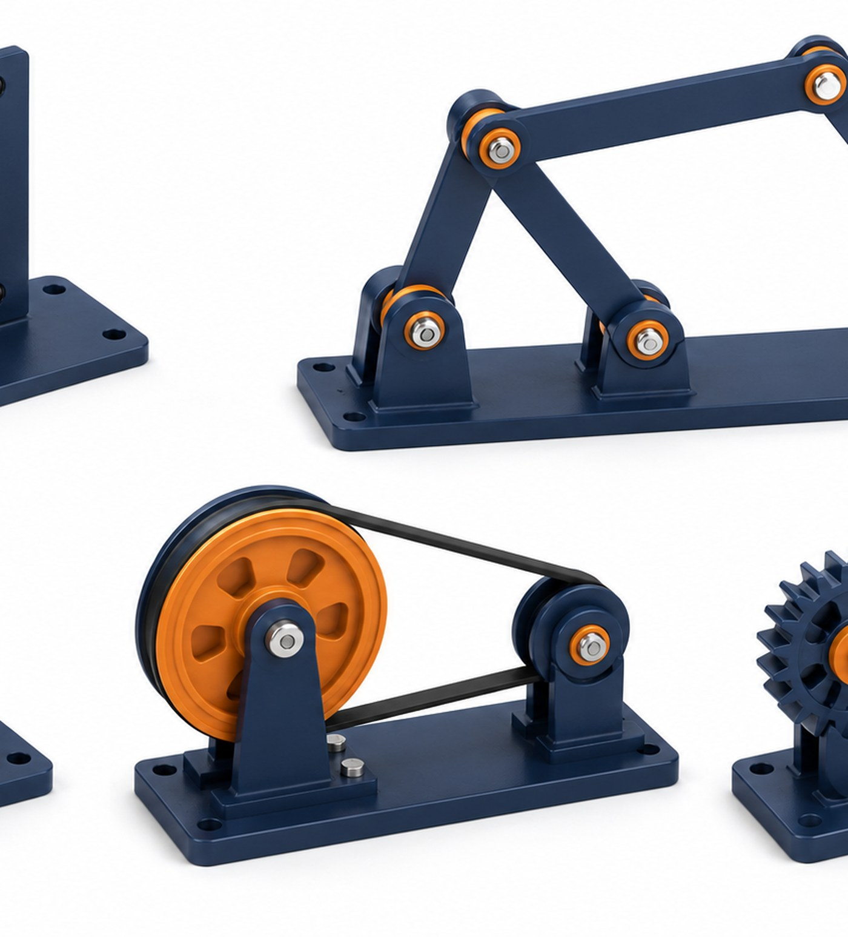
LOCKWOODSTEM AED • UNIT 4
Lesson 4.5
Mechanisms and Types of Motion
How do mechanisms change or control motion in aerospace systems?
Aerospace Mechanisms, Materials & Electromechanical Systems

Slide 26
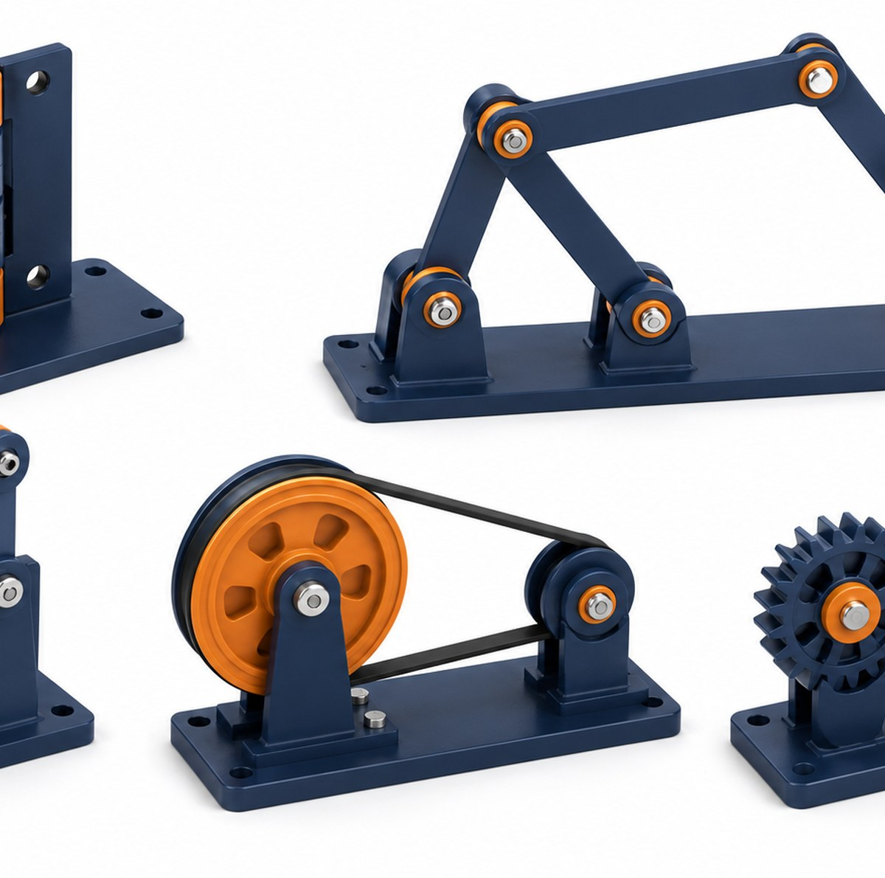
Lesson 4.5
Mechanisms and Types of Motion
Mechanisms and Types of Motion
How do mechanisms change or control motion in aerospace systems?
LESSON GOAL
Identify common mechanisms and describe how they change motion.
STUDENT OBJECTIVE
I can describe rotary, linear, reciprocating, and oscillating motion and connect them to mechanism examples.
END PRODUCT
Mechanism motion notes with aerospace application examples.
Technical systems require evidence from materials, motion, circuits, testing, and revision.
LockwoodSTEM | Aerospace Engineering Design

Slide 27
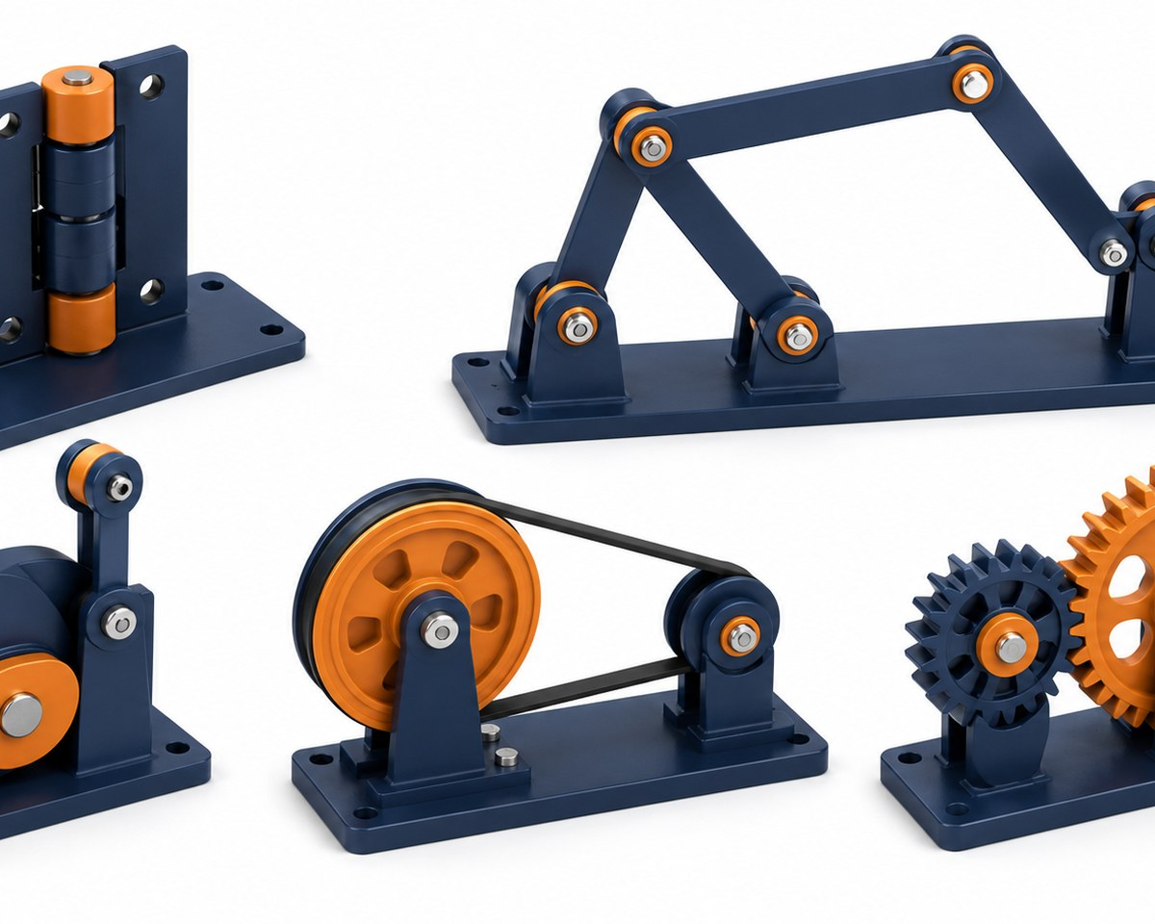
Lesson 4.5
Mechanisms and Types of Motion
What you need to understand
These ideas guide today’s technical decisions.
BIG IDEAS
• Mechanisms transfer, change, or control motion.
• Common motion types include rotary, linear, reciprocating, and oscillating motion.
• Inputs and outputs may have different motion types, directions, speeds, or forces.
• Aerospace examples include doors, antennas, clamps, landing gear, deployable panels, and release systems.
Mechanisms depend on geometry, motion type, force, friction, and reliable interfaces.
LockwoodSTEM | Aerospace Engineering Design

Slide 28
Lesson 4.5
Mechanisms and Types of Motion
What you will do
Follow this workflow to create evidence for the final technical demonstration.
1
Observe mechanism examples or diagrams.
2
Label input motion and output motion.
3
Classify motion type for each mechanism.
4
Identify where the mechanism could be used in an aerospace prototype.
5
Sketch one mechanism concept for the Unit 4 challenge.
Document the decision while the evidence is still fresh.
LockwoodSTEM | Aerospace Engineering Design

Slide 29
Lesson 4.5
Mechanisms and Types of Motion
Evidence checklist
Check whether today’s evidence is ready for the Unit 4 technical package.
REQUIRED EVIDENCE
BEFORE MOVING ON
□ Motion type notes
□ Input-output labels
□ Mechanism sketch
□ Aerospace application example
□ Notebook reflection on mechanism choice
Your work should be:
• connected to the original challenge requirements
• clear enough for another team to understand
• based on measured data or a documented observation
• saved in the correct file, notebook, or project folder
• useful for the final technical demonstration
Mechanism motion notes with aerospace application examples.
LockwoodSTEM | Aerospace Engineering Design

Slide 30
LOCKWOODSTEM AED • UNIT 4
Lesson 4.6
Mechanism Exploration: Linkages, Hinges, Cams, Gears, and Pulleys
How can physical mechanism exploration reveal design possibilities and limitations?
Aerospace Mechanisms, Materials & Electromechanical Systems

Slide 31
Lesson 4.6
Mechanism Exploration
Mechanism Exploration: Linkages, Hinges, Cams, Gears, and Pulleys
How can physical mechanism exploration reveal design possibilities and limitations?
LESSON GOAL
Explore mechanism examples to understand how geometry and constraints affect motion.
STUDENT OBJECTIVE
I can test or observe several mechanisms and identify advantages, limitations, and possible uses.
END PRODUCT
Mechanism exploration table with selected concept direction.
Technical systems require evidence from materials, motion, circuits, testing, and revision.
LockwoodSTEM | Aerospace Engineering Design

Slide 32
Lesson 4.6
Mechanism Exploration
What you need to understand
These ideas guide today’s technical decisions.
BIG IDEAS
• Mechanisms work because of geometry, constraints, and contact between parts.
• Linkages can guide motion through connected bars and pivots.
• Hinges allow rotation around an axis.
• Cams can convert rotary motion into repeated motion.
• Gears and pulleys can change speed, torque, direction, or force path.
Mechanisms depend on geometry, motion type, force, friction, and reliable interfaces.
LockwoodSTEM | Aerospace Engineering Design

Slide 33
Lesson 4.6
Mechanism Exploration
What you will do
Follow this workflow to create evidence for the final technical demonstration.
1
Explore linkages, hinges, cams, gears, or pulleys.
2
Record what motion each mechanism creates.
3
Identify one strength and one limitation for each mechanism.
4
Connect at least one mechanism to your Unit 4 prototype idea.
5
Choose one mechanism type to investigate further.
Document the decision while the evidence is still fresh.
LockwoodSTEM | Aerospace Engineering Design

Slide 34
Lesson 4.6
Mechanism Exploration
Evidence checklist
Check whether today’s evidence is ready for the Unit 4 technical package.
REQUIRED EVIDENCE
BEFORE MOVING ON
□ Mechanism exploration table
□ Input/output motion notes
□ Strength and limitation notes
□ Prototype connection statement
□ Selected mechanism direction
Your work should be:
• connected to the original challenge requirements
• clear enough for another team to understand
• based on measured data or a documented observation
• saved in the correct file, notebook, or project folder
• useful for the final technical demonstration
Mechanism exploration table with selected concept direction.
LockwoodSTEM | Aerospace Engineering Design

Slide 35
LOCKWOODSTEM AED • UNIT 4
Lesson 4.7
Friction, Force, and Mechanism Performance
How does friction affect whether a mechanism works reliably?
Aerospace Mechanisms, Materials & Electromechanical Systems

Slide 36
Lesson 4.7
Friction, Force, and Mechanism Performance
Friction, Force, and Mechanism Performance
How does friction affect whether a mechanism works reliably?
LESSON GOAL
Analyze how friction and force affect mechanism reliability.
STUDENT OBJECTIVE
I can identify places where friction helps or hurts a mechanism and suggest design improvements.
END PRODUCT
Friction and force analysis for a mechanism concept.
Technical systems require evidence from materials, motion, circuits, testing, and revision.
LockwoodSTEM | Aerospace Engineering Design

Slide 37
Lesson 4.7
Friction, Force, and Mechanism Performance
What you need to understand
These ideas guide today’s technical decisions.
BIG IDEAS
• Friction can prevent motion, waste energy, create wear, or help parts grip.
• Mechanisms need enough force or torque to overcome friction and move the load.
• Contact surfaces, alignment, material choice, and lubrication can change friction.
• A reliable prototype must move consistently under expected conditions.
Mechanisms depend on geometry, motion type, force, friction, and reliable interfaces.
LockwoodSTEM | Aerospace Engineering Design

Slide 38
Lesson 4.7
Friction, Force, and Mechanism Performance
What you will do
Follow this workflow to create evidence for the final technical demonstration.
1
Identify contact points in a mechanism concept.
2
Predict where friction may help or hurt motion.
3
Test or simulate how force affects movement.
4
Propose ways to reduce unwanted friction or increase useful grip.
5
Update the design notes based on friction analysis.
Document the decision while the evidence is still fresh.
LockwoodSTEM | Aerospace Engineering Design

Slide 39
Lesson 4.7
Friction, Force, and Mechanism Performance
Evidence checklist
Check whether today’s evidence is ready for the Unit 4 technical package.
REQUIRED EVIDENCE
BEFORE MOVING ON
□ Mechanism contact-point sketch
□ Friction helps/hurts notes
□ Force or torque observation
□ Improvement recommendation
□ Notebook reflection on reliability risk
Your work should be:
• connected to the original challenge requirements
• clear enough for another team to understand
• based on measured data or a documented observation
• saved in the correct file, notebook, or project folder
• useful for the final technical demonstration
Friction and force analysis for a mechanism concept.
LockwoodSTEM | Aerospace Engineering Design

Slide 40
LOCKWOODSTEM AED • UNIT 4
Lesson 4.8
Motion Graphs and System Behavior
How can graphs help engineers understand system behavior over time?
Aerospace Mechanisms, Materials & Electromechanical Systems

Slide 41
Lesson 4.8
Motion Graphs and System Behavior
Motion Graphs and System Behavior
How can graphs help engineers understand system behavior over time?
LESSON GOAL
Use motion graphs to describe how a mechanism or system behaves.
STUDENT OBJECTIVE
I can interpret simple position, time, speed, or angle data and connect the graph to prototype behavior.
END PRODUCT
Motion graph with written interpretation and design implication.
Technical systems require evidence from materials, motion, circuits, testing, and revision.
LockwoodSTEM | Aerospace Engineering Design

Slide 42
Lesson 4.8
Motion Graphs and System Behavior
What you need to understand
These ideas guide today’s technical decisions.
BIG IDEAS
• Graphs reveal patterns that are hard to see from a single observation.
• Motion data may include distance, angle, time, speed, or repeat count.
• A graph can show delays, inconsistent movement, overshoot, or improvement after revision.
• Engineers use graphs to compare system performance before and after a design change.
Mechanisms depend on geometry, motion type, force, friction, and reliable interfaces.
LockwoodSTEM | Aerospace Engineering Design

Slide 43
Lesson 4.8
Motion Graphs and System Behavior
What you will do
Follow this workflow to create evidence for the final technical demonstration.
1
Collect or review motion data from a simple system.
2
Create a graph that matches the measured variable.
3
Identify the trend or pattern in the data.
4
Connect the graph to a real behavior of the prototype.
5
Write one design implication from the graph.
Document the decision while the evidence is still fresh.
LockwoodSTEM | Aerospace Engineering Design

Slide 44
Lesson 4.8
Motion Graphs and System Behavior
Evidence checklist
Check whether today’s evidence is ready for the Unit 4 technical package.
REQUIRED EVIDENCE
BEFORE MOVING ON
□ Motion data table
□ Motion graph
□ Trend statement
□ System behavior explanation
□ Design implication based on data
Your work should be:
• connected to the original challenge requirements
• clear enough for another team to understand
• based on measured data or a documented observation
• saved in the correct file, notebook, or project folder
• useful for the final technical demonstration
Motion graph with written interpretation and design implication.
LockwoodSTEM | Aerospace Engineering Design

Slide 45
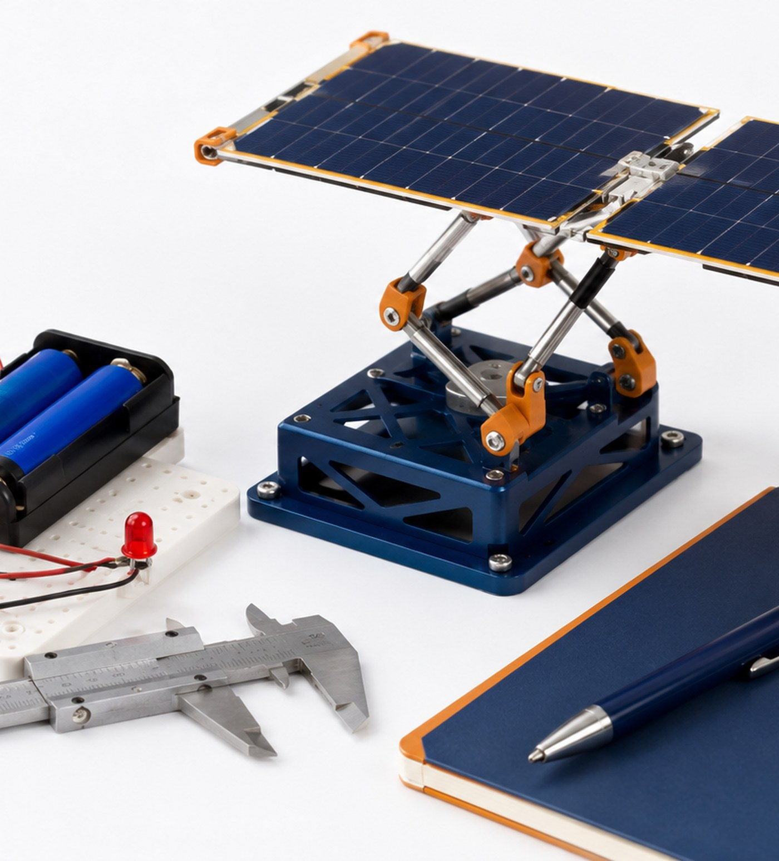
LOCKWOODSTEM AED • UNIT 4
Lesson 4.9
Electrical Safety and Simple Circuits
How can simple circuits safely support an engineering prototype?
Aerospace Mechanisms, Materials & Electromechanical Systems

Slide 46
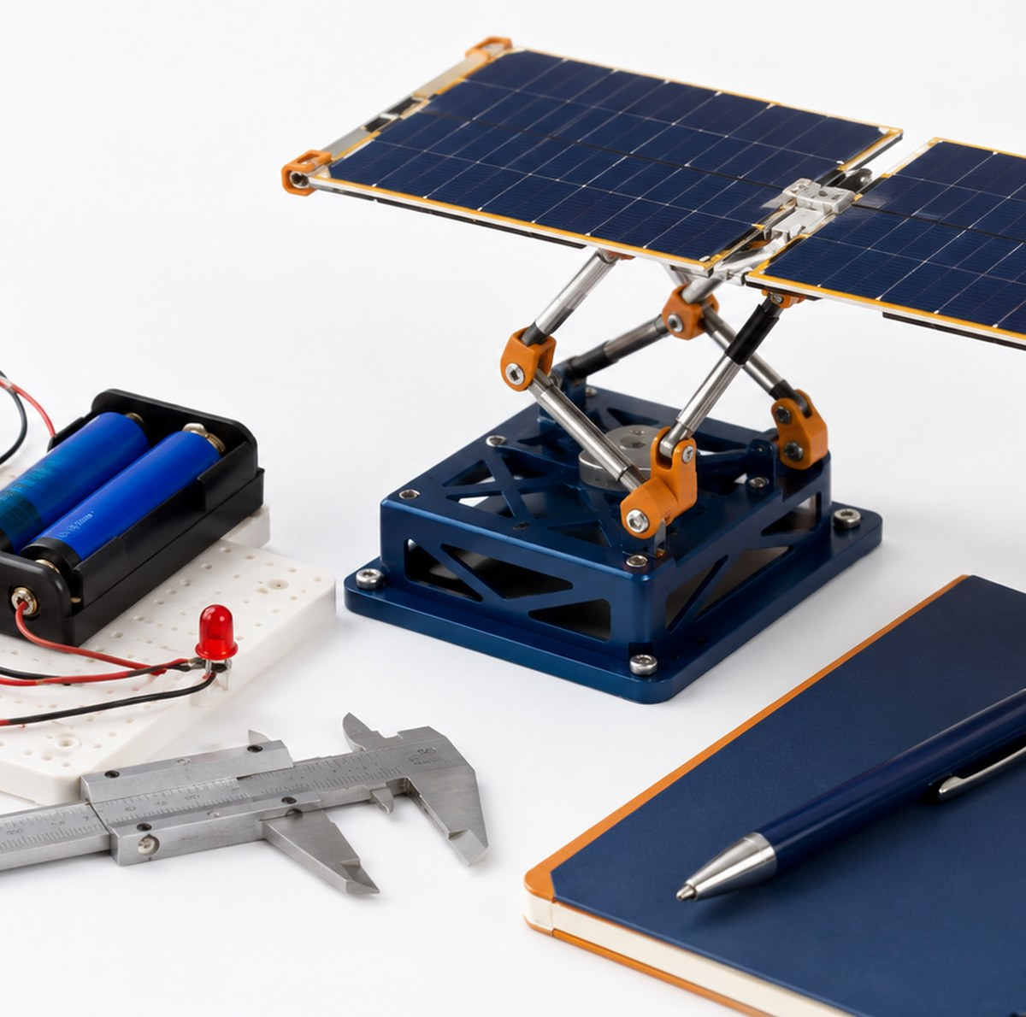
Lesson 4.9
Electrical Safety and Simple Circuits
Electrical Safety and Simple Circuits
How can simple circuits safely support an engineering prototype?
LESSON GOAL
Understand basic electrical safety and simple circuit components.
STUDENT OBJECTIVE
I can build or diagram a simple safe circuit using a power source, load, switch, and conductors.
END PRODUCT
Simple circuit diagram with safety notes and component labels.
Technical systems require evidence from materials, motion, circuits, testing, and revision.
LockwoodSTEM | Aerospace Engineering Design

Slide 47
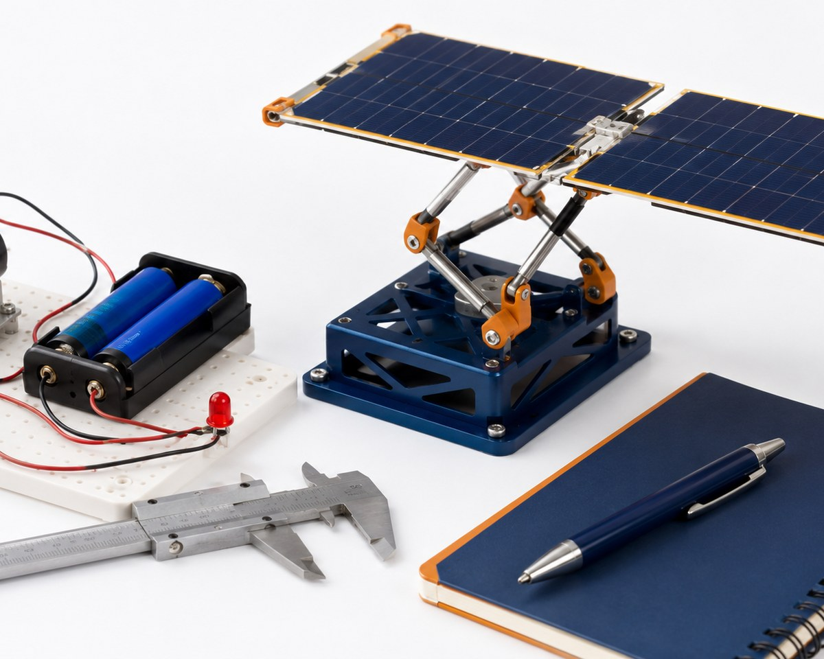
Lesson 4.9
Electrical Safety and Simple Circuits
What you need to understand
These ideas guide today’s technical decisions.
BIG IDEAS
• Circuits require a complete path for current to flow.
• Basic components include power source, wires, switch, load, and sometimes resistors or connectors.
• A short circuit can create heat and damage components.
• Prototype circuits should be low-voltage, organized, and easy to inspect.
• Safety includes correct connections, secure wires, and removing power when changing the circuit.
Electromechanical systems must be safe, organized, powered, mounted, and tested.
LockwoodSTEM | Aerospace Engineering Design

Slide 48
Lesson 4.9
Electrical Safety and Simple Circuits
What you will do
Follow this workflow to create evidence for the final technical demonstration.
1
Identify circuit components and their symbols.
2
Build or diagram a simple LED, motor, or switch circuit.
3
Trace current path through the circuit.
4
Check for possible short circuits or loose connections.
5
Record safe setup and shutdown expectations.
Document the decision while the evidence is still fresh.
LockwoodSTEM | Aerospace Engineering Design

Slide 49
Lesson 4.9
Electrical Safety and Simple Circuits
Evidence checklist
Check whether today’s evidence is ready for the Unit 4 technical package.
REQUIRED EVIDENCE
BEFORE MOVING ON
□ Labeled circuit diagram
□ Component list
□ Current path marked
□ Safety checklist notes
□ Notebook reflection on circuit risk
Your work should be:
• connected to the original challenge requirements
• clear enough for another team to understand
• based on measured data or a documented observation
• saved in the correct file, notebook, or project folder
• useful for the final technical demonstration
Simple circuit diagram with safety notes and component labels.
LockwoodSTEM | Aerospace Engineering Design

Slide 50
LOCKWOODSTEM AED • UNIT 4
Lesson 4.10
Motors and Electromechanical Motion
How can electrical energy create useful mechanical motion?
Aerospace Mechanisms, Materials & Electromechanical Systems

Slide 51
Lesson 4.10
Motors and Electromechanical Motion
Motors and Electromechanical Motion
How can electrical energy create useful mechanical motion?
LESSON GOAL
Connect motors to mechanical outputs in a prototype system.
STUDENT OBJECTIVE
I can explain how a motor produces motion and how that motion can be controlled or transferred.
END PRODUCT
Motor-to-mechanism concept sketch with input/output explanation.
Technical systems require evidence from materials, motion, circuits, testing, and revision.
LockwoodSTEM | Aerospace Engineering Design

Slide 52
Lesson 4.10
Motors and Electromechanical Motion
What you need to understand
These ideas guide today’s technical decisions.
BIG IDEAS
• Electromechanical systems convert electrical energy into mechanical motion.
• Motors create rotary motion that can drive wheels, gears, cams, linkages, spools, or arms.
• Motor speed and torque must match the load and function.
• Mounting, alignment, wiring, and power supply affect reliability.
• Not every mechanism needs a motor; choose based on requirements.
Electromechanical systems must be safe, organized, powered, mounted, and tested.
LockwoodSTEM | Aerospace Engineering Design

Slide 53
Lesson 4.10
Motors and Electromechanical Motion
What you will do
Follow this workflow to create evidence for the final technical demonstration.
1
Observe or test a motor and simple load.
2
Identify input energy and output motion.
3
Sketch how motor motion could drive a mechanism.
4
Consider speed, torque, mounting, and safety concerns.
5
Choose whether your prototype needs manual or powered motion.
Document the decision while the evidence is still fresh.
LockwoodSTEM | Aerospace Engineering Design

Slide 54
Lesson 4.10
Motors and Electromechanical Motion
Evidence checklist
Check whether today’s evidence is ready for the Unit 4 technical package.
REQUIRED EVIDENCE
BEFORE MOVING ON
□ Motor test notes or observation
□ Input/output explanation
□ Motor-to-mechanism sketch
□ Power and mounting considerations
□ Manual vs powered decision
Your work should be:
• connected to the original challenge requirements
• clear enough for another team to understand
• based on measured data or a documented observation
• saved in the correct file, notebook, or project folder
• useful for the final technical demonstration
Motor-to-mechanism concept sketch with input/output explanation.
LockwoodSTEM | Aerospace Engineering Design

Slide 55
LOCKWOODSTEM AED • UNIT 4
Lesson 4.11
Concept Generation and Decision Matrix
How can engineers choose a mechanism concept using evidence and criteria?
Aerospace Mechanisms, Materials & Electromechanical Systems

Slide 56
Lesson 4.11
Concept Generation and Decision Matrix
Concept Generation and Decision Matrix
How can engineers choose a mechanism concept using evidence and criteria?
LESSON GOAL
Generate multiple system concepts and select one using a decision matrix.
STUDENT OBJECTIVE
I can compare mechanism concepts using criteria, constraints, and early evidence.
END PRODUCT
Decision matrix with selected mechanism or system concept.
Technical systems require evidence from materials, motion, circuits, testing, and revision.
LockwoodSTEM | Aerospace Engineering Design

Slide 57
Lesson 4.11
Concept Generation and Decision Matrix
What you need to understand
These ideas guide today’s technical decisions.
BIG IDEAS
• A decision matrix helps teams make choices based on agreed criteria.
• Concepts should be compared before the team commits to one build direction.
• Criteria may include reliability, safety, mass, buildability, material use, motion quality, and data collection
• Scores should be justified with evidence or reasoning.
• A good selected concept can still be revised later.
Mechanisms depend on geometry, motion type, force, friction, and reliable interfaces.
LockwoodSTEM | Aerospace Engineering Design

Slide 58
Lesson 4.11
Concept Generation and Decision Matrix
What you will do
Follow this workflow to create evidence for the final technical demonstration.
1
Generate at least three mechanism or system concepts.
2
Choose criteria that match the challenge requirements.
3
Score each concept using the decision matrix.
4
Discuss score differences and assumptions.
5
Select the best concept direction and explain why.
Document the decision while the evidence is still fresh.
LockwoodSTEM | Aerospace Engineering Design

Slide 59
Lesson 4.11
Concept Generation and Decision Matrix
Evidence checklist
Check whether today’s evidence is ready for the Unit 4 technical package.
REQUIRED EVIDENCE
BEFORE MOVING ON
□ Three concept sketches or descriptions
□ Decision matrix
□ Criteria list
□ Selected concept justification
□ Team notes on tradeoffs
Your work should be:
• connected to the original challenge requirements
• clear enough for another team to understand
• based on measured data or a documented observation
• saved in the correct file, notebook, or project folder
• useful for the final technical demonstration
Decision matrix with selected mechanism or system concept.
LockwoodSTEM | Aerospace Engineering Design

Slide 60
LOCKWOODSTEM AED • UNIT 4
Lesson 4.12
System Architecture and Subsystem Planning
How do subsystems work together in an aerospace prototype?
Aerospace Mechanisms, Materials & Electromechanical Systems

Slide 61
Lesson 4.12
System Architecture and Subsystem Planning
System Architecture and Subsystem Planning
How do subsystems work together in an aerospace prototype?
LESSON GOAL
Plan the architecture of the prototype as a system of interacting subsystems.
STUDENT OBJECTIVE
I can identify subsystem roles, interfaces, inputs, outputs, and dependencies.
END PRODUCT
System architecture diagram with subsystem responsibilities.
Technical systems require evidence from materials, motion, circuits, testing, and revision.
LockwoodSTEM | Aerospace Engineering Design

Slide 62
Lesson 4.12
System Architecture and Subsystem Planning
What you need to understand
These ideas guide today’s technical decisions.
BIG IDEAS
• A system is easier to build when it is broken into subsystems.
• Subsystems may include structure, mechanism, power/control, materials, user interaction, and testing.
• Interfaces are where subsystems connect physically, electrically, or functionally.
• Many prototype failures happen at subsystem interfaces.
• A clear architecture diagram helps the team coordinate work.
Mechanisms depend on geometry, motion type, force, friction, and reliable interfaces.
LockwoodSTEM | Aerospace Engineering Design

Slide 63
Lesson 4.12
System Architecture and Subsystem Planning
What you will do
Follow this workflow to create evidence for the final technical demonstration.
1
List the major subsystems in your selected concept.
2
Define the job of each subsystem.
3
Identify physical or electrical interfaces.
4
Mark dependencies and risks between subsystems.
5
Assign next steps for CAD, materials, circuit, and testing planning.
Document the decision while the evidence is still fresh.
LockwoodSTEM | Aerospace Engineering Design

Slide 64
Lesson 4.12
System Architecture and Subsystem Planning
Evidence checklist
Check whether today’s evidence is ready for the Unit 4 technical package.
REQUIRED EVIDENCE
BEFORE MOVING ON
□ System architecture diagram
□ Subsystem responsibility list
□ Interface notes
□ Risk/dependency list
□ Team next-step assignments
Your work should be:
• connected to the original challenge requirements
• clear enough for another team to understand
• based on measured data or a documented observation
• saved in the correct file, notebook, or project folder
• useful for the final technical demonstration
System architecture diagram with subsystem responsibilities.
LockwoodSTEM | Aerospace Engineering Design

Slide 65
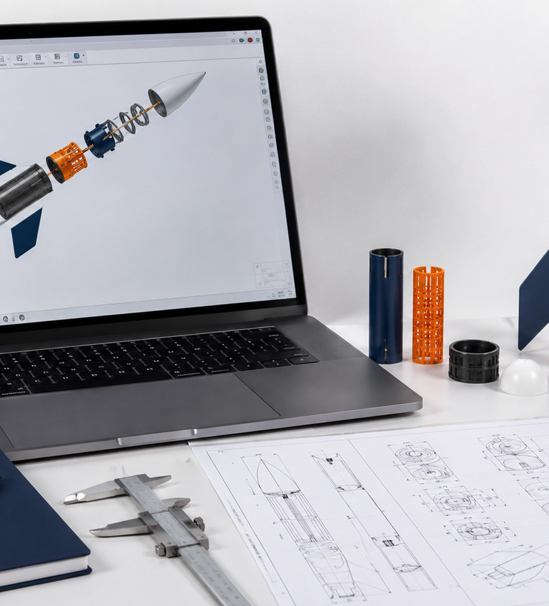
LOCKWOODSTEM AED • UNIT 4
Lesson 4.13
CAD Planning and Assembly Layout
How can CAD planning prepare a mechanism for physical construction?
Aerospace Mechanisms, Materials & Electromechanical Systems

Slide 66
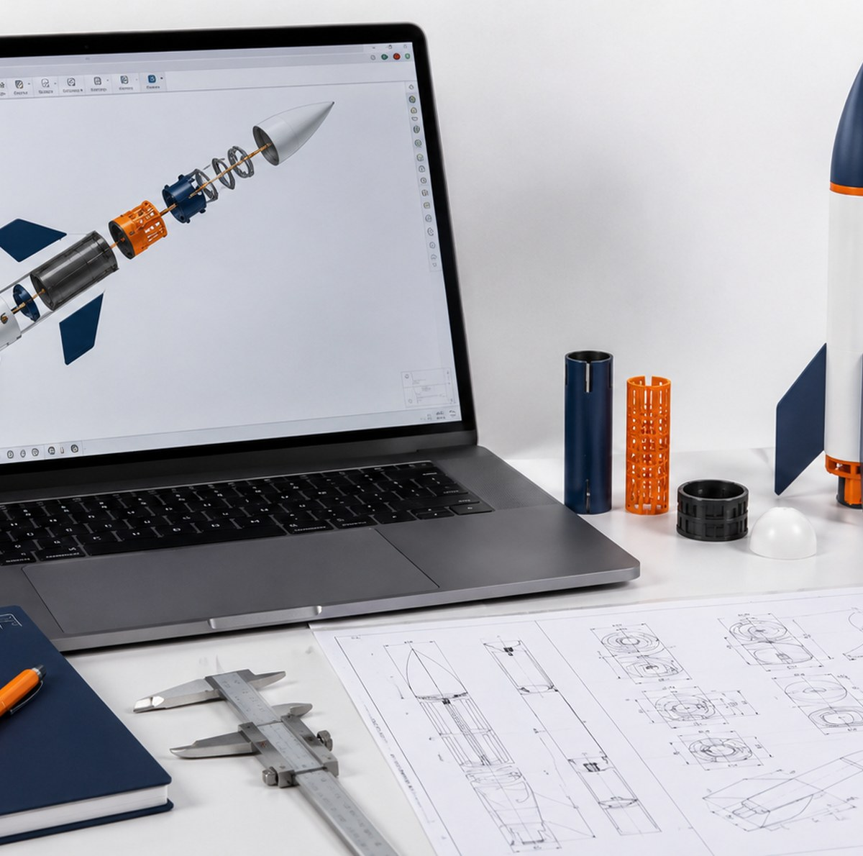
Lesson 4.13
CAD Planning and Assembly Layout
CAD Planning and Assembly Layout
How can CAD planning prepare a mechanism for physical construction?
LESSON GOAL
Plan the CAD layout for a mechanism or electromechanical prototype.
STUDENT OBJECTIVE
I can use sketches, dimensions, and layout constraints to prepare CAD work.
END PRODUCT
CAD planning sketch with key dimensions, components, and fit concerns.
Technical systems require evidence from materials, motion, circuits, testing, and revision.
LockwoodSTEM | Aerospace Engineering Design

Slide 67
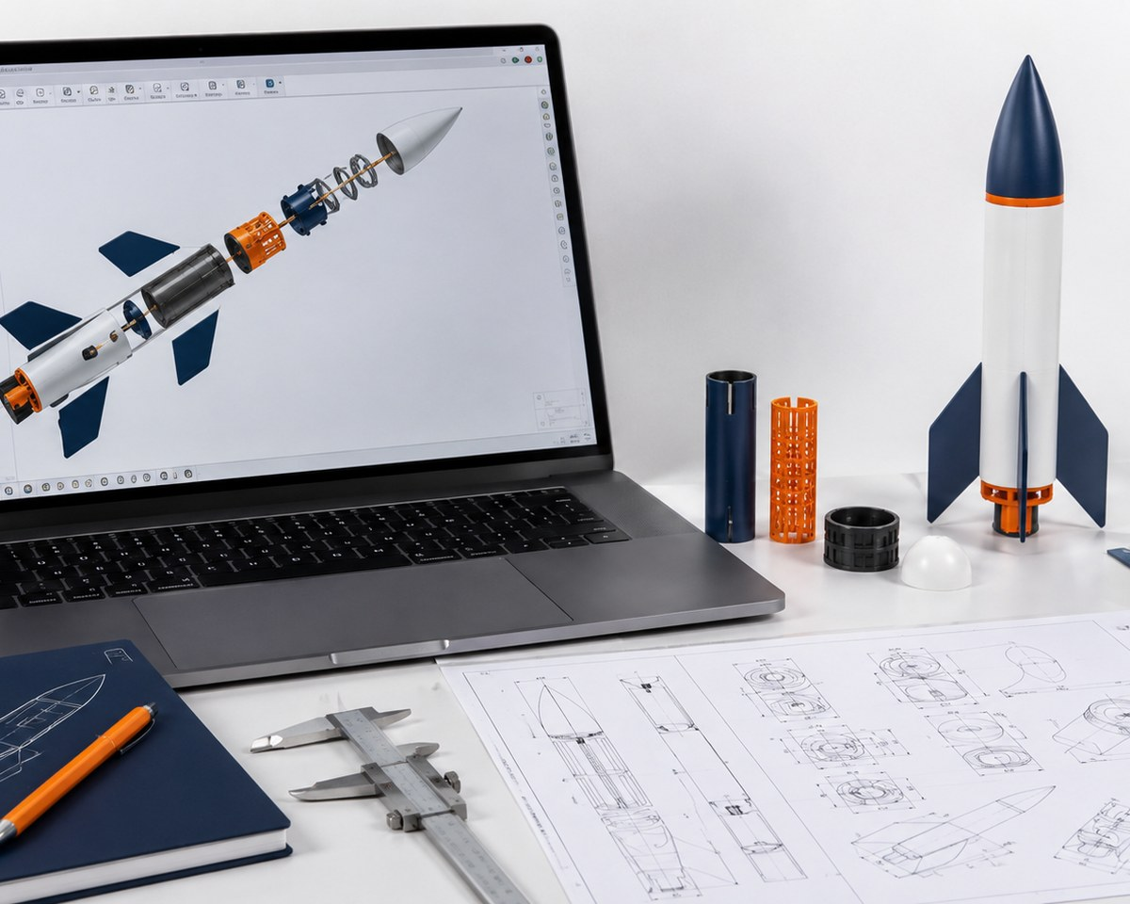
Lesson 4.13
CAD Planning and Assembly Layout
What you need to understand
These ideas guide today’s technical decisions.
BIG IDEAS
• CAD planning begins before modeling detailed parts.
• Layouts should show key dimensions, motion path, pivot locations, clearances, and mounting points.
• A planned assembly reduces wasted printing, cutting, or rebuilding time.
• CAD should reflect real materials, fasteners, and available fabrication methods.
• Mechanism CAD must consider moving parts and required space.
Materials, mechanisms, circuits, and data work together to create reliable aerospace systems.
LockwoodSTEM | Aerospace Engineering Design

Slide 68
Lesson 4.13
CAD Planning and Assembly Layout
What you will do
Follow this workflow to create evidence for the final technical demonstration.
1
Create a layout sketch for the selected system.
2
Mark key dimensions, pivots, paths, and clearances.
3
Identify parts that will be printed, cut, built, or purchased.
4
Check the layout against material and fabrication limits.
5
Prepare a CAD task list for the next workday.
Document the decision while the evidence is still fresh.
LockwoodSTEM | Aerospace Engineering Design

Slide 69
Lesson 4.13
CAD Planning and Assembly Layout
Evidence checklist
Check whether today’s evidence is ready for the Unit 4 technical package.
REQUIRED EVIDENCE
BEFORE MOVING ON
□ CAD planning sketch
□ Key dimensions and clearances
□ Fabrication method notes
□ Parts/task list
□ Fit or motion risk notes
Your work should be:
• connected to the original challenge requirements
• clear enough for another team to understand
• based on measured data or a documented observation
• saved in the correct file, notebook, or project folder
• useful for the final technical demonstration
CAD planning sketch with key dimensions, components, and fit concerns.
LockwoodSTEM | Aerospace Engineering Design

Slide 70
LOCKWOODSTEM AED • UNIT 4
Lesson 4.14
CAD Modeling Workday: Components, Motion, and Fit
How do engineers model and check parts before building?
Aerospace Mechanisms, Materials & Electromechanical Systems

Slide 71
Lesson 4.14
CAD Modeling Workday: Components, Motion, and Fit
CAD Modeling Workday: Components, Motion, and Fit
How do engineers model and check parts before building?
LESSON GOAL
Model the components needed for the Unit 4 mechanism or system prototype.
STUDENT OBJECTIVE
I can create or revise CAD parts while checking fit, motion, and fabrication constraints.
END PRODUCT
Updated CAD files with screenshots showing component design and fit checks.
Technical systems require evidence from materials, motion, circuits, testing, and revision.
LockwoodSTEM | Aerospace Engineering Design

Slide 72
Lesson 4.14
CAD Modeling Workday: Components, Motion, and Fit
What you need to understand
These ideas guide today’s technical decisions.
BIG IDEAS
• CAD models should support a real build, not just look complete on screen.
• Each component should have a clear function in the system.
• Motion and fit checks help reveal interference before fabrication.
• Simple models with correct dimensions are better than detailed models that cannot be built.
• Screenshots create evidence of design intent and revision.
Materials, mechanisms, circuits, and data work together to create reliable aerospace systems.
LockwoodSTEM | Aerospace Engineering Design

Slide 73
Lesson 4.14
CAD Modeling Workday: Components, Motion, and Fit
What you will do
Follow this workflow to create evidence for the final technical demonstration.
1
Model or revise key components in CAD.
2
Check dimensions, clearances, and part relationships.
3
Use assembly positioning or simple motion checks where possible.
4
Prepare parts for fabrication or prototyping.
5
Capture screenshots showing important design decisions.
Document the decision while the evidence is still fresh.
LockwoodSTEM | Aerospace Engineering Design

Slide 74
Lesson 4.14
CAD Modeling Workday: Components, Motion, and Fit
Evidence checklist
Check whether today’s evidence is ready for the Unit 4 technical package.
REQUIRED EVIDENCE
BEFORE MOVING ON
□ Updated CAD file
□ Component screenshots
□ Fit or motion check evidence
□ Fabrication-ready part notes
□ Design decision explanation
Your work should be:
• connected to the original challenge requirements
• clear enough for another team to understand
• based on measured data or a documented observation
• saved in the correct file, notebook, or project folder
• useful for the final technical demonstration
Updated CAD files with screenshots showing component design and fit checks.
LockwoodSTEM | Aerospace Engineering Design

Slide 75
LOCKWOODSTEM AED • UNIT 4
Lesson 4.15
Prototype Build Day 1: Structure and Mechanism
How do engineers build the structure and core mechanism of a prototype?
Aerospace Mechanisms, Materials & Electromechanical Systems

Slide 76
Lesson 4.15
Prototype Build Day 1: Structure and Mechanism
Prototype Build Day 1: Structure and Mechanism
How do engineers build the structure and core mechanism of a prototype?
LESSON GOAL
Begin building the physical structure and core mechanism of the prototype.
STUDENT OBJECTIVE
I can safely build and assemble the mechanical portion of the system while documenting progress.
END PRODUCT
Partially built prototype with structure/mechanism evidence and build notes.
Technical systems require evidence from materials, motion, circuits, testing, and revision.
LockwoodSTEM | Aerospace Engineering Design

Slide 77
Lesson 4.15
Prototype Build Day 1: Structure and Mechanism
What you need to understand
These ideas guide today’s technical decisions.
BIG IDEAS
• Build days should follow the plan but still allow evidence-based adjustments.
• Structure provides support, alignment, and stability for the mechanism.
• Mechanism quality depends on pivots, clearances, friction, and secure mounting.
• Teams should test motion early instead of waiting for the full system.
• Documentation during the build prevents lost decisions.
Mechanisms depend on geometry, motion type, force, friction, and reliable interfaces.
LockwoodSTEM | Aerospace Engineering Design

Slide 78
Lesson 4.15
Prototype Build Day 1: Structure and Mechanism
What you will do
Follow this workflow to create evidence for the final technical demonstration.
1
Gather approved materials and fabricated parts.
2
Build the main structure or base.
3
Assemble the core mechanical components.
4
Check alignment, motion, and clearance during assembly.
5
Photograph progress and record build issues.
Document the decision while the evidence is still fresh.
LockwoodSTEM | Aerospace Engineering Design

Slide 79
Lesson 4.15
Prototype Build Day 1: Structure and Mechanism
Evidence checklist
Check whether today’s evidence is ready for the Unit 4 technical package.
REQUIRED EVIDENCE
BEFORE MOVING ON
□ Build progress photos
□ Structure/mechanism assembly notes
□ Alignment or clearance observations
□ Build issue list
□ Next build priorities
Your work should be:
• connected to the original challenge requirements
• clear enough for another team to understand
• based on measured data or a documented observation
• saved in the correct file, notebook, or project folder
• useful for the final technical demonstration
Partially built prototype with structure/mechanism evidence and build notes.
LockwoodSTEM | Aerospace Engineering Design

Slide 80
LOCKWOODSTEM AED • UNIT 4
Lesson 4.16
Prototype Build Day 2: Electrical or Electromechanical Integration
How can electrical or electromechanical features be integrated safely into a prototype?
Aerospace Mechanisms, Materials & Electromechanical Systems

Slide 81
Lesson 4.16
Prototype Build Day 2
Prototype Build Day 2: Electrical or Electromechanical Integration
How can electrical or electromechanical features be integrated safely into a prototype?
LESSON GOAL
Integrate the electrical, motor, or control elements needed for the prototype.
STUDENT OBJECTIVE
I can connect and test low-voltage electrical or electromechanical components safely.
END PRODUCT
Integrated prototype subsystem with circuit/motor evidence and safety notes.
Technical systems require evidence from materials, motion, circuits, testing, and revision.
LockwoodSTEM | Aerospace Engineering Design

Slide 82
Lesson 4.16
Prototype Build Day 2
What you need to understand
These ideas guide today’s technical decisions.
BIG IDEAS
• Electrical integration should be organized, low-voltage, and easy to inspect.
• Wires, switches, motors, batteries, and LEDs must be secured and protected.
• Electrical components must not interfere with moving mechanisms.
• Testing should begin with small, controlled checks.
• A functional circuit is only useful if it is safe and reliable.
Electromechanical systems must be safe, organized, powered, mounted, and tested.
LockwoodSTEM | Aerospace Engineering Design

Slide 83
Lesson 4.16
Prototype Build Day 2
What you will do
Follow this workflow to create evidence for the final technical demonstration.
1
Review circuit or motor plan before powering anything.
2
Connect components using safe low-voltage practices.
3
Secure wires and check for interference with moving parts.
4
Test one electrical function at a time.
5
Record results, issues, and revisions.
Document the decision while the evidence is still fresh.
LockwoodSTEM | Aerospace Engineering Design

Slide 84
Lesson 4.16
Prototype Build Day 2
Evidence checklist
Check whether today’s evidence is ready for the Unit 4 technical package.
REQUIRED EVIDENCE
BEFORE MOVING ON
□ Circuit/motor integration photo
□ Updated circuit diagram
□ Safety check notes
□ Subsystem test result
□ Revision or troubleshooting notes
Your work should be:
• connected to the original challenge requirements
• clear enough for another team to understand
• based on measured data or a documented observation
• saved in the correct file, notebook, or project folder
• useful for the final technical demonstration
Integrated prototype subsystem with circuit/motor evidence and safety notes.
LockwoodSTEM | Aerospace Engineering Design

Slide 85
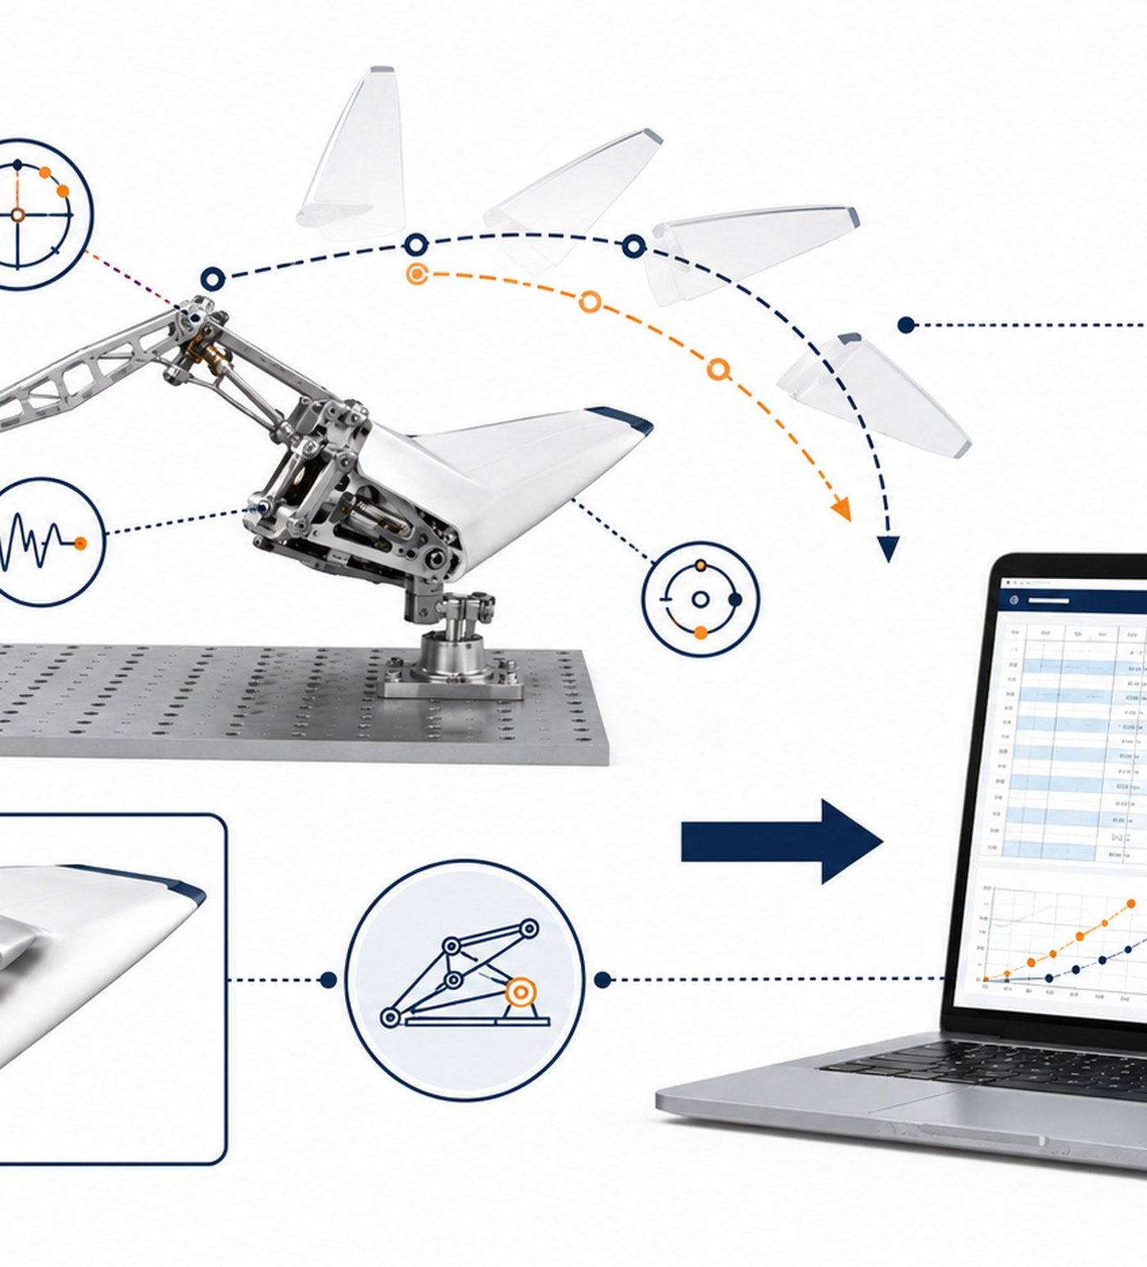
LOCKWOODSTEM AED • UNIT 4
Lesson 4.17
Testing Protocol Development
How do engineers design fair tests to evaluate whether a prototype works?
Aerospace Mechanisms, Materials & Electromechanical Systems

Slide 86
Lesson 4.17
Testing Protocol Development
Testing Protocol Development
How do engineers design fair tests to evaluate whether a prototype works?
LESSON GOAL
Create a fair testing protocol for the Unit 4 prototype.
STUDENT OBJECTIVE
I can define variables, procedures, success criteria, and data collection methods for a prototype test.
END PRODUCT
Testing protocol ready for prototype data collection.
Technical systems require evidence from materials, motion, circuits, testing, and revision.
LockwoodSTEM | Aerospace Engineering Design

Slide 87
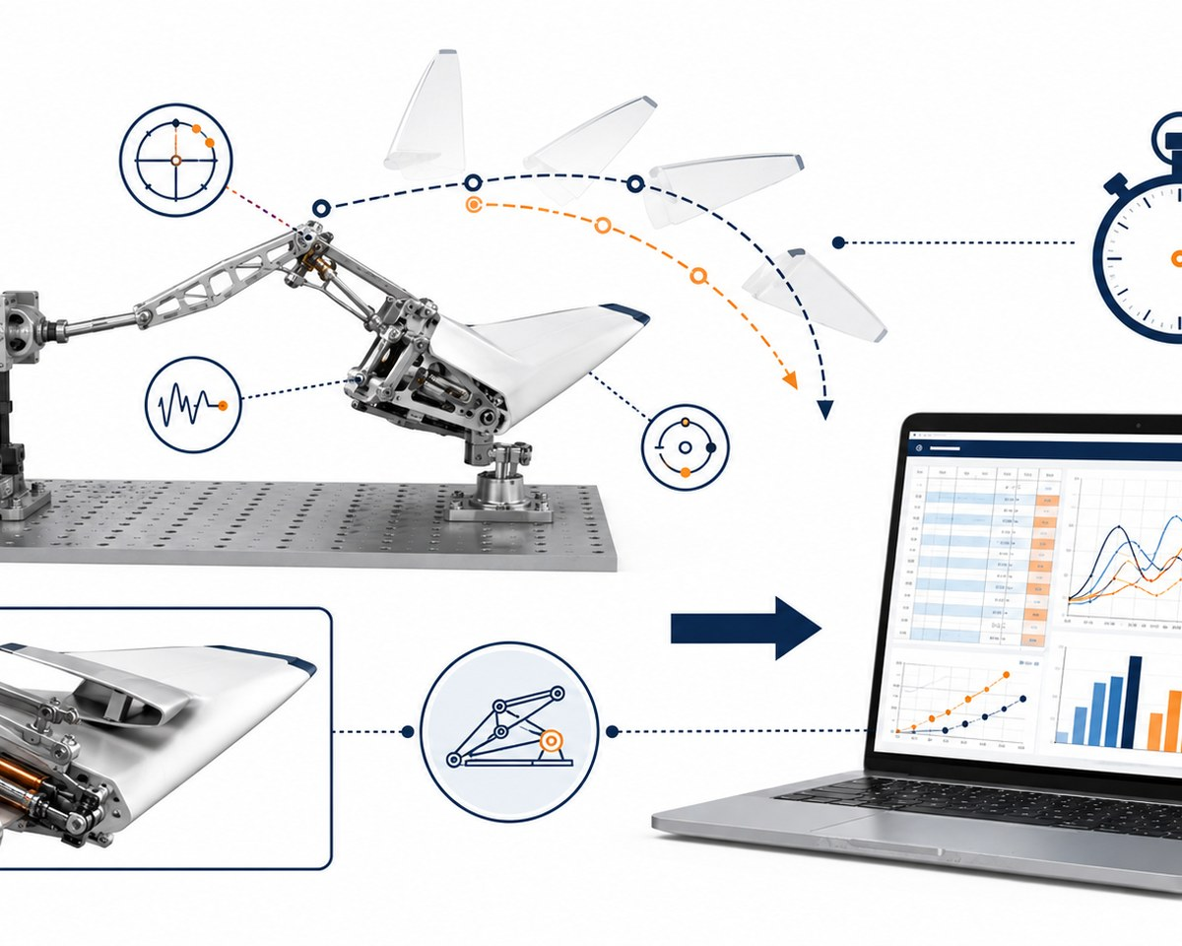
Lesson 4.17
Testing Protocol Development
What you need to understand
These ideas guide today’s technical decisions.
BIG IDEAS
• A testing protocol turns a prototype trial into usable engineering evidence.
• Fair tests identify what changes, what stays the same, and what is measured.
• Success criteria should connect to the original challenge requirements.
• Data collection methods should be realistic and repeatable.
• A protocol makes results easier to compare after revision.
Testing and analysis turn prototype behavior into evidence for revision.
LockwoodSTEM | Aerospace Engineering Design

Slide 88
Lesson 4.17
Testing Protocol Development
What you will do
Follow this workflow to create evidence for the final technical demonstration.
1
Define the function being tested.
2
Identify independent, dependent, and controlled variables.
3
Write step-by-step test procedure.
4
Decide how many trials to run and what data to record.
5
Create a data table before testing begins.
Document the decision while the evidence is still fresh.
LockwoodSTEM | Aerospace Engineering Design

Slide 89
Lesson 4.17
Testing Protocol Development
Evidence checklist
Check whether today’s evidence is ready for the Unit 4 technical package.
REQUIRED EVIDENCE
BEFORE MOVING ON
□ Testable question or purpose
□ Variable list
□ Step-by-step procedure
□ Success criteria
□ Prepared data table
Your work should be:
• connected to the original challenge requirements
• clear enough for another team to understand
• based on measured data or a documented observation
• saved in the correct file, notebook, or project folder
• useful for the final technical demonstration
Testing protocol ready for prototype data collection.
LockwoodSTEM | Aerospace Engineering Design

Slide 90
LOCKWOODSTEM AED • UNIT 4
Lesson 4.18
Prototype Testing and Data Collection
How can engineers collect useful data from a prototype test?
Aerospace Mechanisms, Materials & Electromechanical Systems

Slide 91
Lesson 4.18
Prototype Testing and Data Collection
Prototype Testing and Data Collection
How can engineers collect useful data from a prototype test?
LESSON GOAL
Run the testing protocol and collect reliable prototype data.
STUDENT OBJECTIVE
I can collect, organize, and document prototype test data using a planned procedure.
END PRODUCT
Completed prototype data table with test photos and observations.
Technical systems require evidence from materials, motion, circuits, testing, and revision.
LockwoodSTEM | Aerospace Engineering Design

Slide 92
Lesson 4.18
Prototype Testing and Data Collection
What you need to understand
These ideas guide today’s technical decisions.
BIG IDEAS
• Testing should follow the protocol as closely as possible.
• Repeated trials help distinguish pattern from accident.
• Observations are important, but data is stronger when measured.
• Unexpected behavior should be documented instead of ignored.
• Photos and notes help explain the context of the data.
Testing and analysis turn prototype behavior into evidence for revision.
LockwoodSTEM | Aerospace Engineering Design

Slide 93
Lesson 4.18
Prototype Testing and Data Collection
What you will do
Follow this workflow to create evidence for the final technical demonstration.
1
Set up the prototype using the testing protocol.
2
Run the planned number of trials.
3
Measure and record data consistently.
4
Capture photos or short notes from the test setup.
5
Record failures, unexpected results, and possible causes.
Document the decision while the evidence is still fresh.
LockwoodSTEM | Aerospace Engineering Design

Slide 94
Lesson 4.18
Prototype Testing and Data Collection
Evidence checklist
Check whether today’s evidence is ready for the Unit 4 technical package.
REQUIRED EVIDENCE
BEFORE MOVING ON
□ Completed data table
□ Test setup photo
□ Trial observations
□ Failure or issue notes
□ Initial data pattern statement
Your work should be:
• connected to the original challenge requirements
• clear enough for another team to understand
• based on measured data or a documented observation
• saved in the correct file, notebook, or project folder
• useful for the final technical demonstration
Completed prototype data table with test photos and observations.
LockwoodSTEM | Aerospace Engineering Design

Slide 95
LOCKWOODSTEM AED • UNIT 4
Lesson 4.19
Data Analysis, Graphing, and Design Conclusions
How can data help engineers decide whether a prototype was successful?
Aerospace Mechanisms, Materials & Electromechanical Systems

Slide 96
Lesson 4.19
Data Analysis, Graphing, and Design Conclusions
Data Analysis, Graphing, and Design Conclusions
How can data help engineers decide whether a prototype was successful?
LESSON GOAL
Analyze prototype test data and draw evidence-based design conclusions.
STUDENT OBJECTIVE
I can create a graph, identify patterns, and explain what the data means for the design.
END PRODUCT
Graph and written conclusion showing prototype performance.
Technical systems require evidence from materials, motion, circuits, testing, and revision.
LockwoodSTEM | Aerospace Engineering Design

Slide 97
Lesson 4.19
Data Analysis, Graphing, and Design Conclusions
What you need to understand
These ideas guide today’s technical decisions.
BIG IDEAS
• Data analysis turns raw numbers into engineering meaning.
• Graphs help compare trials, materials, versions, or system performance.
• A conclusion should connect data back to success criteria.
• Engineers should honestly report limitations and uncertainty.
• Data can support keeping, revising, or replacing a design feature.
Testing and analysis turn prototype behavior into evidence for revision.
LockwoodSTEM | Aerospace Engineering Design

Slide 98
Lesson 4.19
Data Analysis, Graphing, and Design Conclusions
What you will do
Follow this workflow to create evidence for the final technical demonstration.
1
Review collected test data for completeness.
2
Calculate summary values if needed.
3
Create a clear graph that matches the question.
4
Identify trends, outliers, or performance limits.
5
Write a conclusion tied to criteria and constraints.
Document the decision while the evidence is still fresh.
LockwoodSTEM | Aerospace Engineering Design

Slide 99
Lesson 4.19
Data Analysis, Graphing, and Design Conclusions
Evidence checklist
Check whether today’s evidence is ready for the Unit 4 technical package.
REQUIRED EVIDENCE
BEFORE MOVING ON
□ Clean data table
□ Graph
□ Summary calculations if needed
□ Data conclusion
□ Statement of limitations or uncertainty
Your work should be:
• connected to the original challenge requirements
• clear enough for another team to understand
• based on measured data or a documented observation
• saved in the correct file, notebook, or project folder
• useful for the final technical demonstration
Graph and written conclusion showing prototype performance.
LockwoodSTEM | Aerospace Engineering Design

Slide 100
LOCKWOODSTEM AED • UNIT 4
Lesson 4.20
Iteration and Prototype Revision
How do engineers decide what to change after testing a prototype?
Aerospace Mechanisms, Materials & Electromechanical Systems

Slide 101
Lesson 4.20
Iteration and Prototype Revision
Iteration and Prototype Revision
How do engineers decide what to change after testing a prototype?
LESSON GOAL
Use test data and observations to revise the prototype.
STUDENT OBJECTIVE
I can choose a revision based on evidence and explain how it should improve system performance.
END PRODUCT
Prototype revision plan and revised prototype evidence.
Technical systems require evidence from materials, motion, circuits, testing, and revision.
LockwoodSTEM | Aerospace Engineering Design

Slide 102
Lesson 4.20
Iteration and Prototype Revision
What you need to understand
These ideas guide today’s technical decisions.
BIG IDEAS
• Iteration should be based on evidence from testing.
• A revision can change geometry, material, alignment, friction, circuit layout, or test procedure.
• Changing too many variables at once can make improvement harder to understand.
• A good revision targets the most important failure mode or performance gap.
• Before-and-after evidence shows engineering progress.
Testing and analysis turn prototype behavior into evidence for revision.
LockwoodSTEM | Aerospace Engineering Design

Slide 103
Lesson 4.20
Iteration and Prototype Revision
What you will do
Follow this workflow to create evidence for the final technical demonstration.
1
Review data, photos, and observations from testing.
2
Identify the highest-priority problem to fix.
3
Choose one or two focused revisions.
4
Update the prototype or CAD plan.
5
Document before/after evidence and expected improvement.
Document the decision while the evidence is still fresh.
LockwoodSTEM | Aerospace Engineering Design

Slide 104
Lesson 4.20
Iteration and Prototype Revision
Evidence checklist
Check whether today’s evidence is ready for the Unit 4 technical package.
REQUIRED EVIDENCE
BEFORE MOVING ON
□ Problem diagnosis from data
□ Revision plan
□ Before/after sketch or photo
□ Updated prototype evidence
□ Expected improvement statement
Your work should be:
• connected to the original challenge requirements
• clear enough for another team to understand
• based on measured data or a documented observation
• saved in the correct file, notebook, or project folder
• useful for the final technical demonstration
Prototype revision plan and revised prototype evidence.
LockwoodSTEM | Aerospace Engineering Design

Slide 105
LOCKWOODSTEM AED • UNIT 4
Lesson 4.21
Final Technical Documentation: Mechanism, Circuit, Data, and Revision
How do engineers document a functional system so others can understand, test, build, or improve it?
Aerospace Mechanisms, Materials & Electromechanical Systems

Slide 106
Lesson 4.21
Final Technical Documentation
Final Technical Documentation: Mechanism, Circuit, Data, and Revision
How do engineers document a functional system so others can understand, test, build, or improve it?
LESSON GOAL
Prepare final documentation that explains the prototype system, evidence, and revisions.
STUDENT OBJECTIVE
I can organize mechanism, circuit, data, and revision evidence into a clear technical record.
END PRODUCT
Final Unit 4 technical documentation package.
Technical systems require evidence from materials, motion, circuits, testing, and revision.
LockwoodSTEM | Aerospace Engineering Design

Slide 107
Lesson 4.21
Final Technical Documentation
What you need to understand
These ideas guide today’s technical decisions.
BIG IDEAS
• Technical documentation should make a system understandable to someone who was not on the team.
• Important documentation includes mechanism description, circuit diagram, materials, test data, graph, and revision history
• A strong package connects requirements, design choices, evidence, and final performance.
• Limitations should be reported honestly.
• Clear documentation helps others rebuild, test, improve, or evaluate the prototype.
Testing and analysis turn prototype behavior into evidence for revision.
LockwoodSTEM | Aerospace Engineering Design

Slide 108
Lesson 4.21
Final Technical Documentation
What you will do
Follow this workflow to create evidence for the final technical demonstration.
1
Organize mechanism and subsystem diagrams.
2
Include material choices and circuit or motor documentation.
3
Add final test data, graph, and conclusion.
4
Summarize revisions and why they were made.
5
Check that the documentation supports the final demonstration.
Document the decision while the evidence is still fresh.
LockwoodSTEM | Aerospace Engineering Design

Slide 109
Lesson 4.21
Final Technical Documentation
Evidence checklist
Check whether today’s evidence is ready for the Unit 4 technical package.
REQUIRED EVIDENCE
BEFORE MOVING ON
□ Mechanism/system diagram
□ Circuit or motor documentation
□ Final data and graph
□ Revision summary
□ Technical documentation package
Your work should be:
• connected to the original challenge requirements
• clear enough for another team to understand
• based on measured data or a documented observation
• saved in the correct file, notebook, or project folder
• useful for the final technical demonstration
Final Unit 4 technical documentation package.
LockwoodSTEM | Aerospace Engineering Design

Slide 110
LOCKWOODSTEM AED • UNIT 4
Lesson 4.22
Unit 4 Technical Demonstration and Reflection
How can engineers use a technical demonstration to communicate how a system works and how it improved?
Aerospace Mechanisms, Materials & Electromechanical Systems

Slide 111
Lesson 4.22
Unit 4 Technical Demonstration and Reflection
Unit 4 Technical Demonstration and Reflection
How can engineers use a technical demonstration to communicate how a system works and how it improved?
LESSON GOAL
Demonstrate the prototype and explain how evidence shaped the final design.
STUDENT OBJECTIVE
I can present a functional system, describe its subsystems, and use data to explain performance and improvement.
END PRODUCT
Technical demonstration and final reflection for Unit 4.
Technical systems require evidence from materials, motion, circuits, testing, and revision.
LockwoodSTEM | Aerospace Engineering Design

Slide 112
Lesson 4.22
Unit 4 Technical Demonstration and Reflection
What you need to understand
These ideas guide today’s technical decisions.
BIG IDEAS
• A technical demonstration shows both function and engineering reasoning.
• The audience should understand what the system does, how it works, and what evidence supports it.
• Strong presentations include both success and limitations.
• Data and revision history make the design story credible.
• Reflection helps prepare for the human-centered capstone in Unit 5.
Testing and analysis turn prototype behavior into evidence for revision.
LockwoodSTEM | Aerospace Engineering Design

Slide 113
Lesson 4.22
Unit 4 Technical Demonstration and Reflection
What you will do
Follow this workflow to create evidence for the final technical demonstration.
1
Prepare the prototype for demonstration.
2
Explain materials, mechanism, circuit/motor, and data evidence.
3
Demonstrate the system safely and clearly.
4
Describe one important revision and its impact.
5
Complete a reflection on technical growth and next steps.
Document the decision while the evidence is still fresh.
LockwoodSTEM | Aerospace Engineering Design

Slide 114
Lesson 4.22
Unit 4 Technical Demonstration and Reflection
Evidence checklist
Check whether today’s evidence is ready for the Unit 4 technical package.
REQUIRED EVIDENCE
BEFORE MOVING ON
□ Technical demonstration
□ Prototype/system explanation
□ Data-supported performance statement
□ Revision impact statement
□ Final Unit 4 reflection
Your work should be:
• connected to the original challenge requirements
• clear enough for another team to understand
• based on measured data or a documented observation
• saved in the correct file, notebook, or project folder
• useful for the final technical demonstration
Technical demonstration and final reflection for Unit 4.
LockwoodSTEM | Aerospace Engineering Design

Slide 115

Unit 4 Close
From Prototype System to Technical Evidence
A successful prototype is not just something that moves. It is a system whose materials, motion, power, data, and revisions can be explained with evidence.
FINAL MINDSET
The best design story connects what you built, how you tested it, what failed, and how evidence made it better.

