Slide 1


LOCKWOODSTEM
IED 0.4
Launch Pad Challenge
Define the problem. Learn the process. Begin the first design concepts.
Students complete the Engineering Design Process organizer and Criteria & Constraints worksheet as we go.
Deliverable: Design brief + three annotated concept sketches
LockwoodSTEM | Introduction to Engineering Design | Unit 0
01
Notes:
Open with the challenge: students are designing a tabletop launch-support structure for the provided rocket. Have students place both worksheets on their desk before starting.

Slide 2
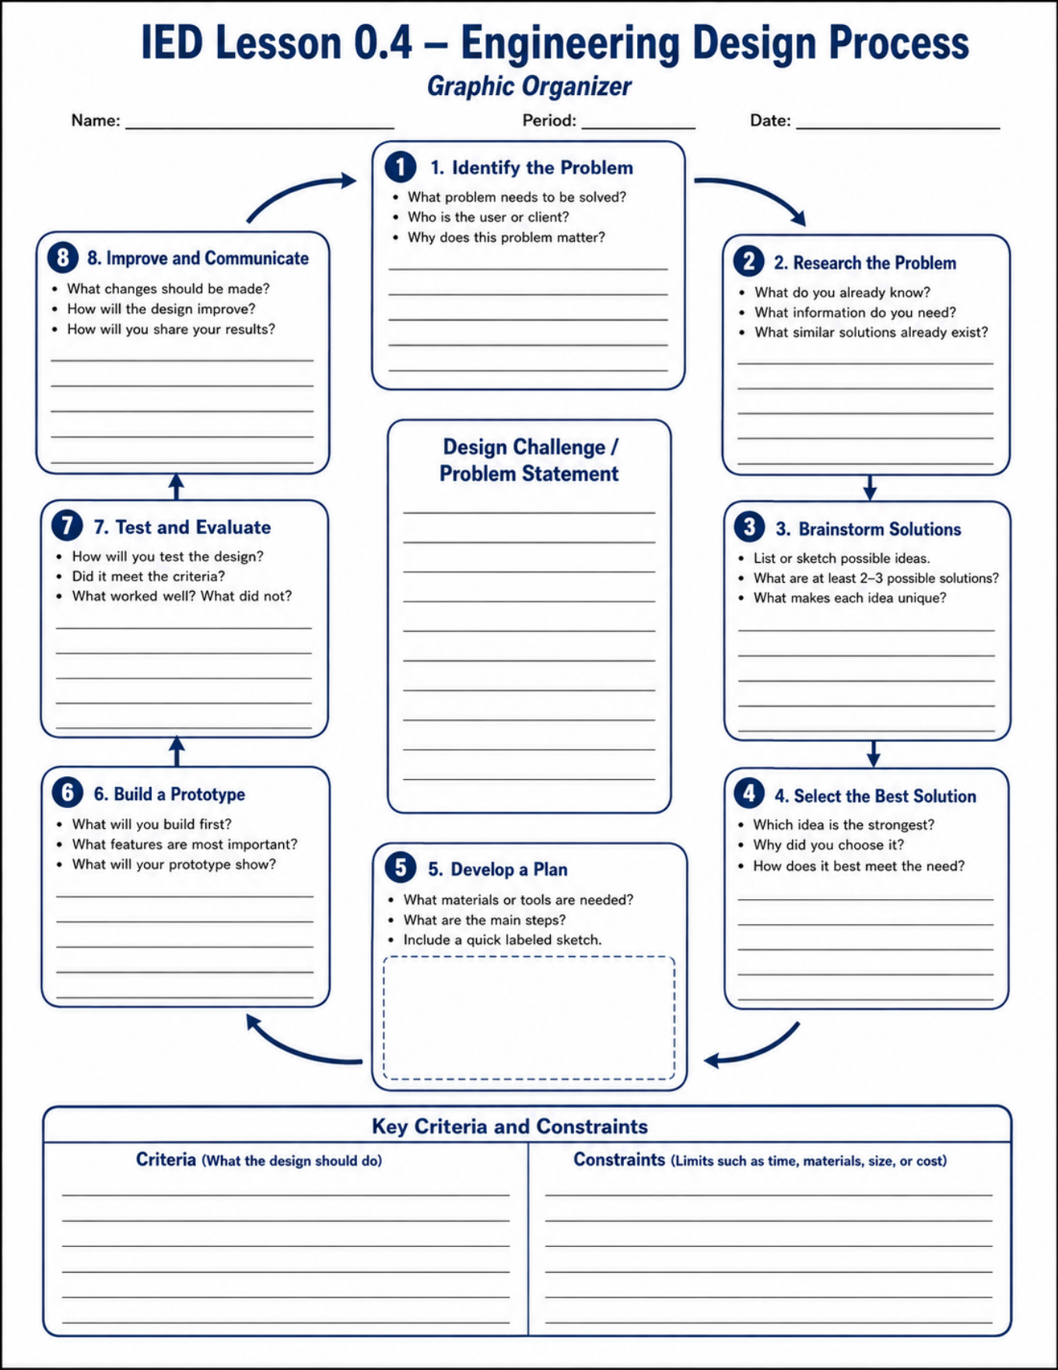
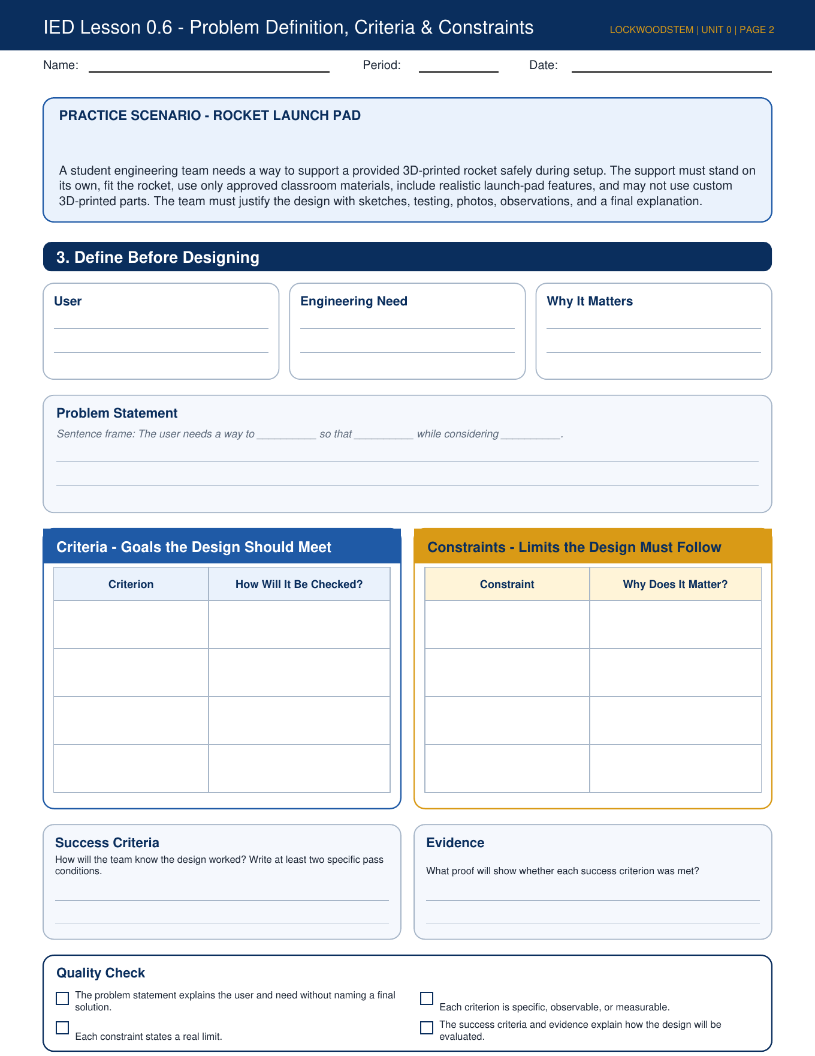
LOCKWOODSTEM
Get both sheets ready
We will fill sections during the presentation.
Engineering Design Process organizer
Problem Definition, Criteria & Constraints
LockwoodSTEM | Introduction to Engineering Design | Unit 0
02
Notes:
Students complete the EDP organizer first as a roadmap, then the criteria/constraints worksheet for the actual launch pad problem.

Slide 3
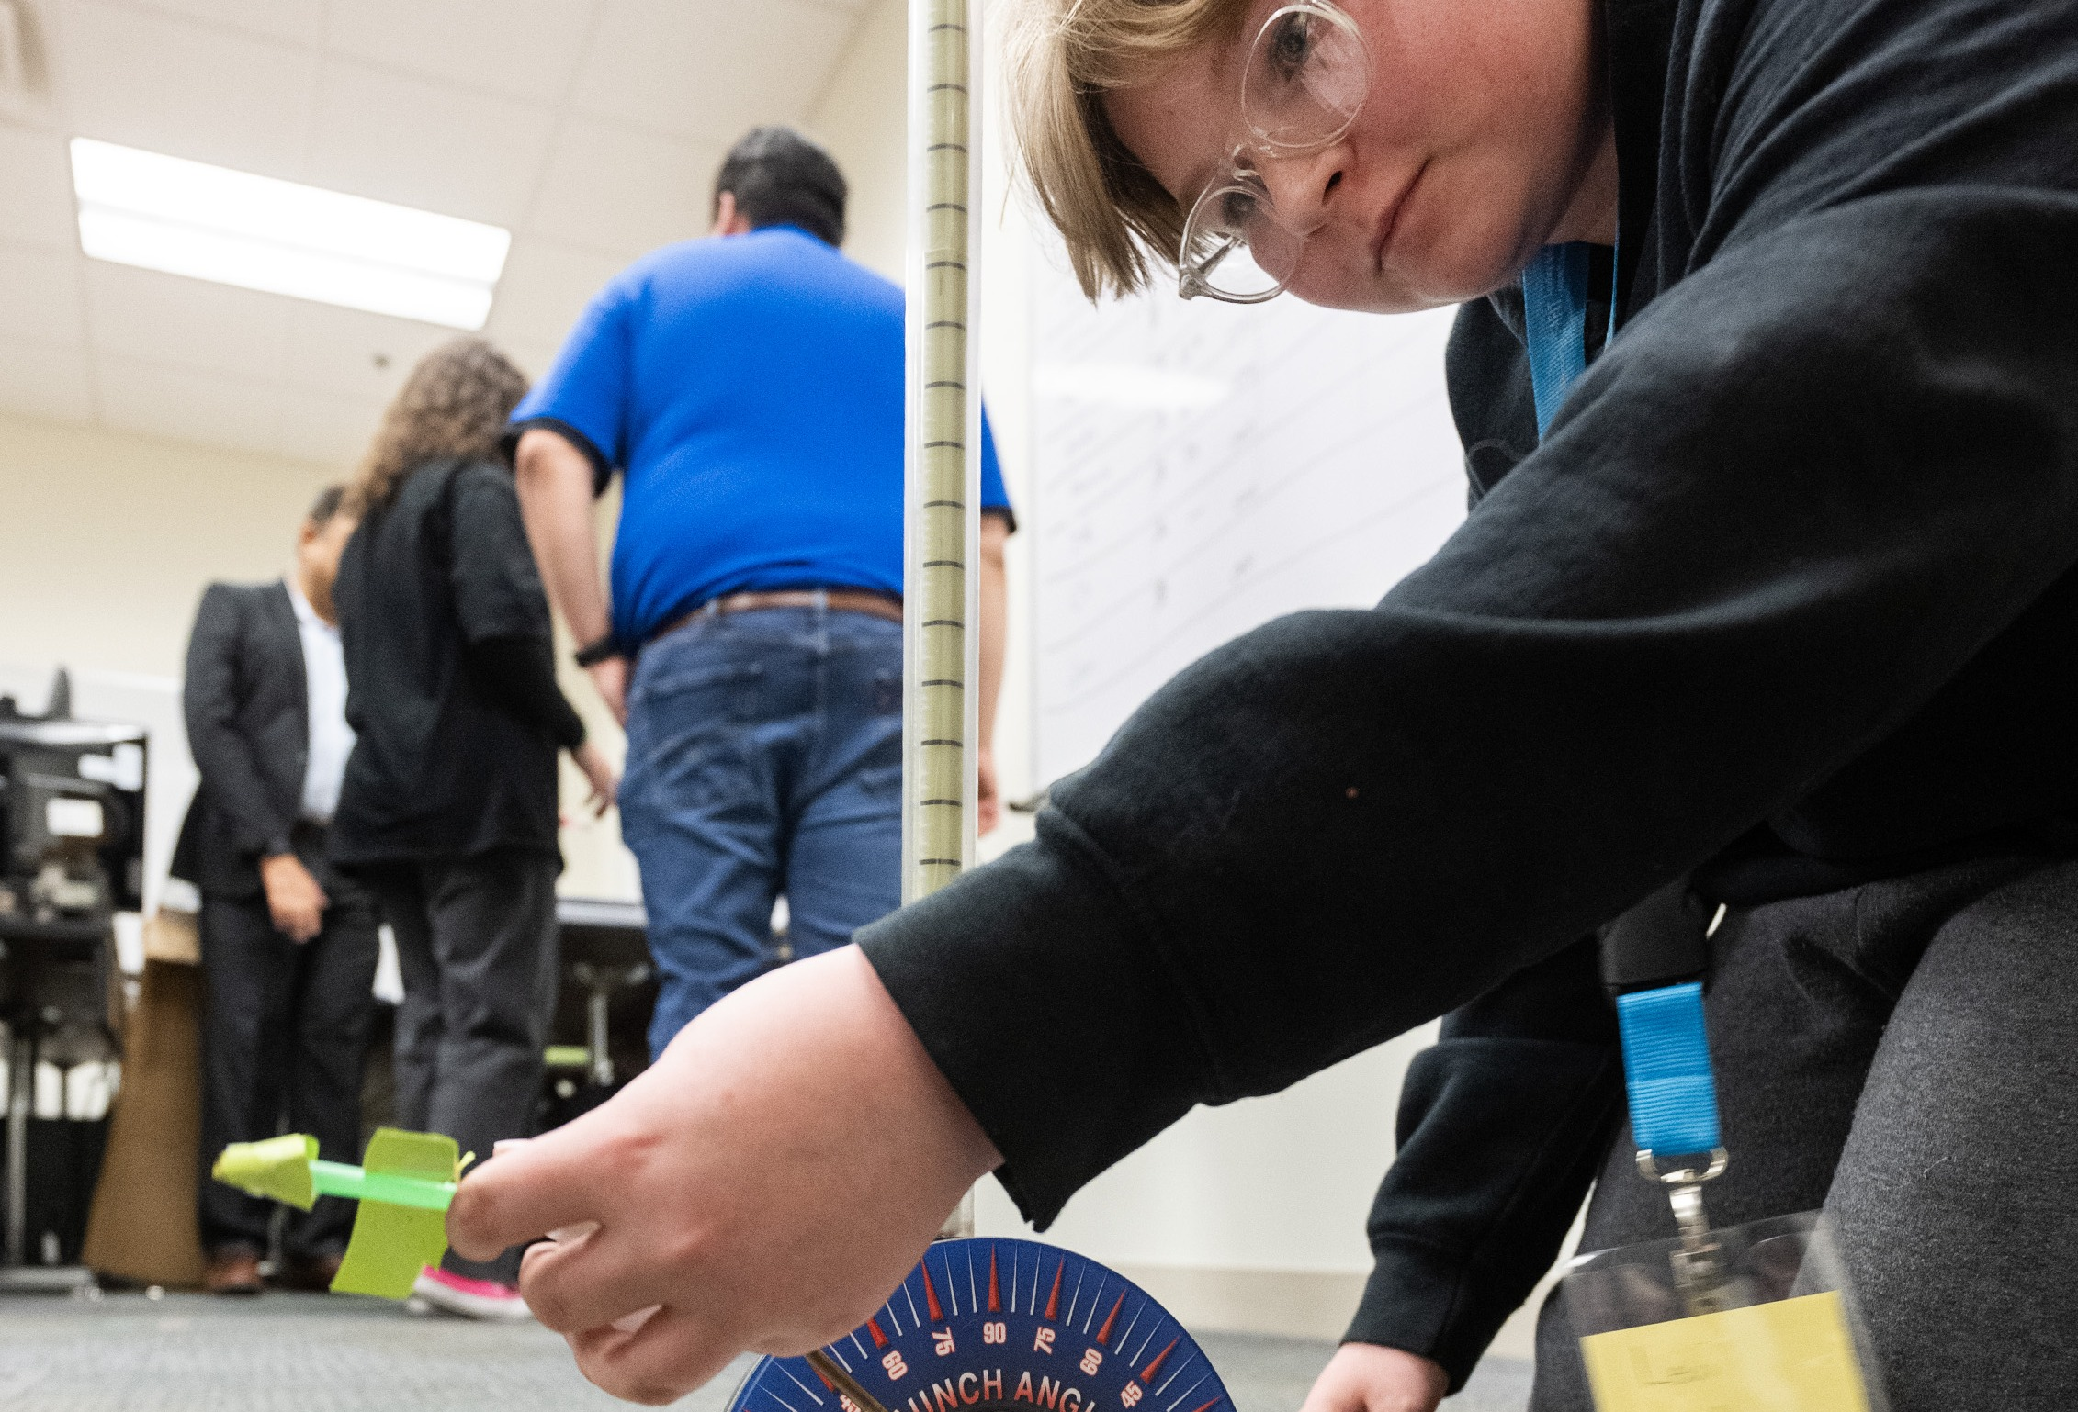
LOCKWOODSTEM
Challenge reveal
You are designing the ground-support structure.
Design and build a tabletop launch pad that securely supports the instructor-provided rocket in an upright launch position and remains stable during qualification testing.
What it is
A launch-support pad for setup and testing. It does not launch anything.
What it must do
Hold the provided rocket upright, stable, and removable.
What matters
Stability, compactness, material use, and usability.
What matters later
Testing evidence and design communication.
LockwoodSTEM | Introduction to Engineering Design | Unit 0
03
Notes:
Use the real provided rocket if available. Students should write the challenge/problem statement in the center of the EDP organizer.

Slide 4
LOCKWOODSTEM
Fill the center + Step 1
Worksheet: Engineering Design Process organizer
Design Challenge / Problem Statement
The team needs a way to support the provided rocket so it stays upright and stable during setup and testing while using only the approved materials.
1. Identify the problem
Who needs this? What must be solved? Why does it matter?
Write this
User: student engineering team
Need: stable rocket support
Reason: safe setup + testing
Do not name a final solution yet. “Build a tower” is a solution; “support the rocket safely” is the problem.
LockwoodSTEM | Introduction to Engineering Design | Unit 0
04
Notes:
Students fill the center box and Step 1 on the graphic organizer. Stress that the problem statement should not lock in a design too early.

Slide 5
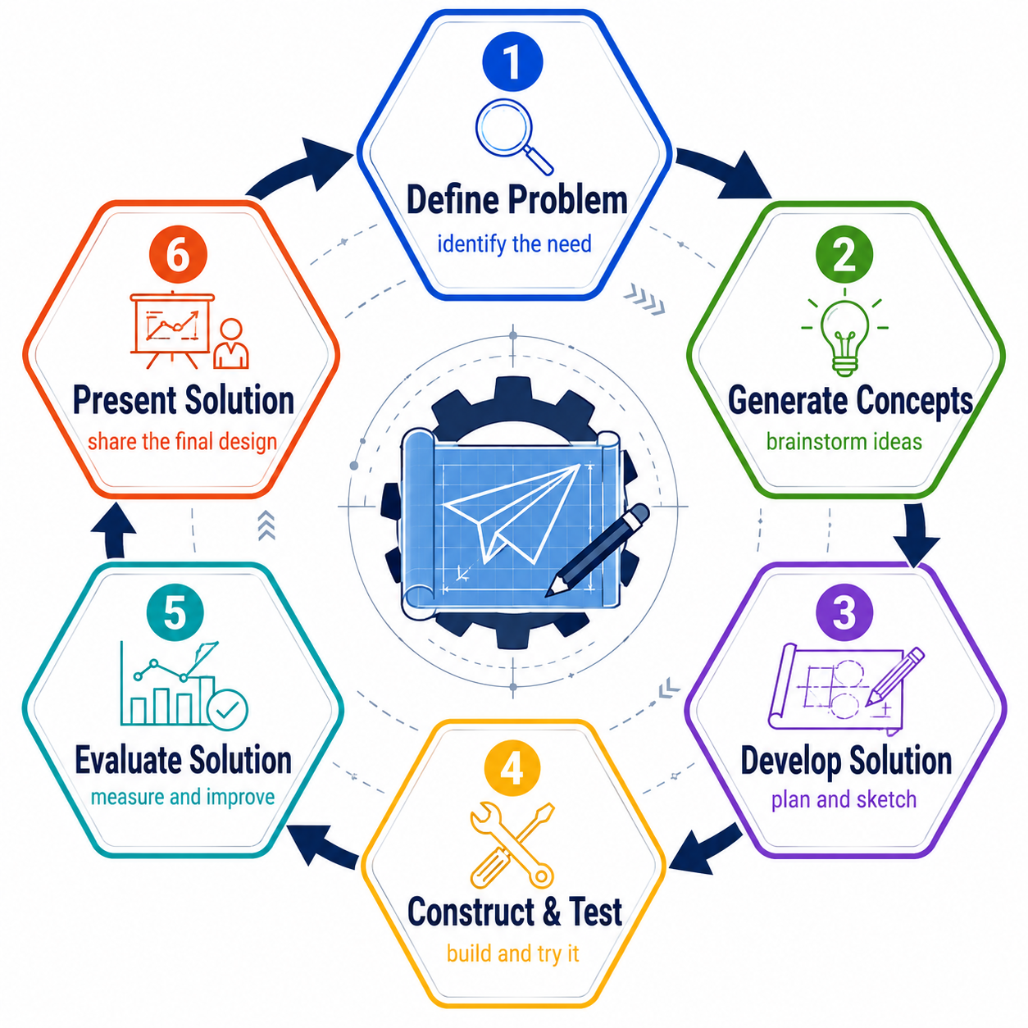
LOCKWOODSTEM
The process is the project
Each step becomes a project milestone.
Define
What must the pad accomplish?
Research
What patterns do real supports use?
Imagine
What are three possible concepts?
Select
Which concept best meets the need?
Develop
What exactly will we build?
Build
How accurately can we fabricate it?
Test
Did it meet the criteria?
Improve + Communicate
What changed, and what evidence supports it?
LockwoodSTEM | Introduction to Engineering Design | Unit 0
05
Notes:
Students can briefly fill the EDP organizer boxes as you preview the project. Emphasize that the design process is iterative, but this short Unit 0 cycle moves linearly for time.

Slide 6
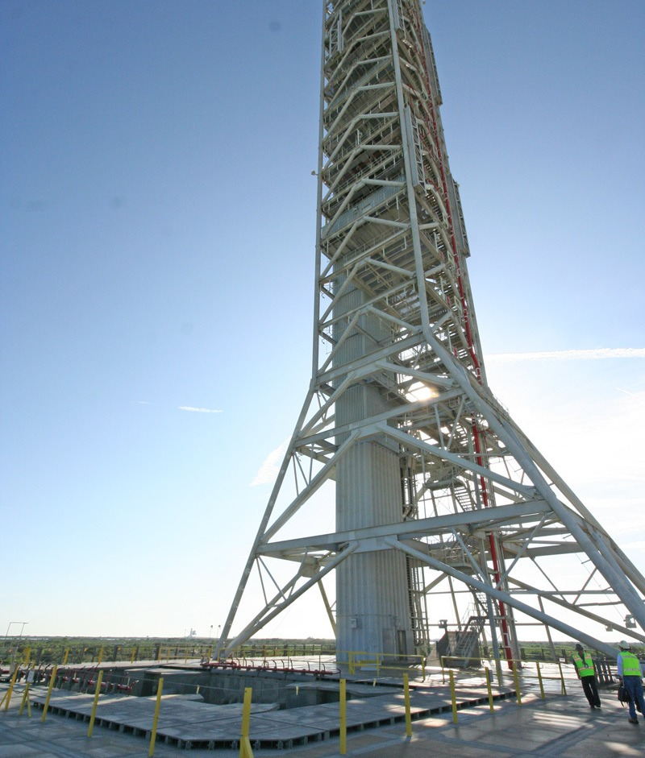
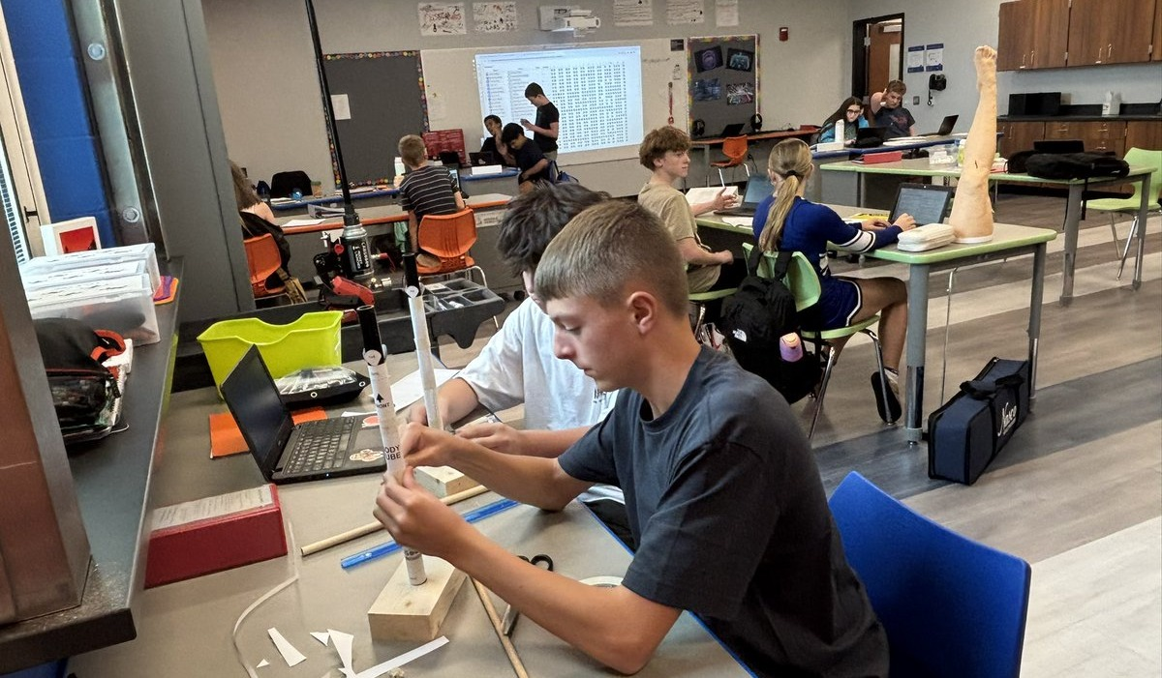
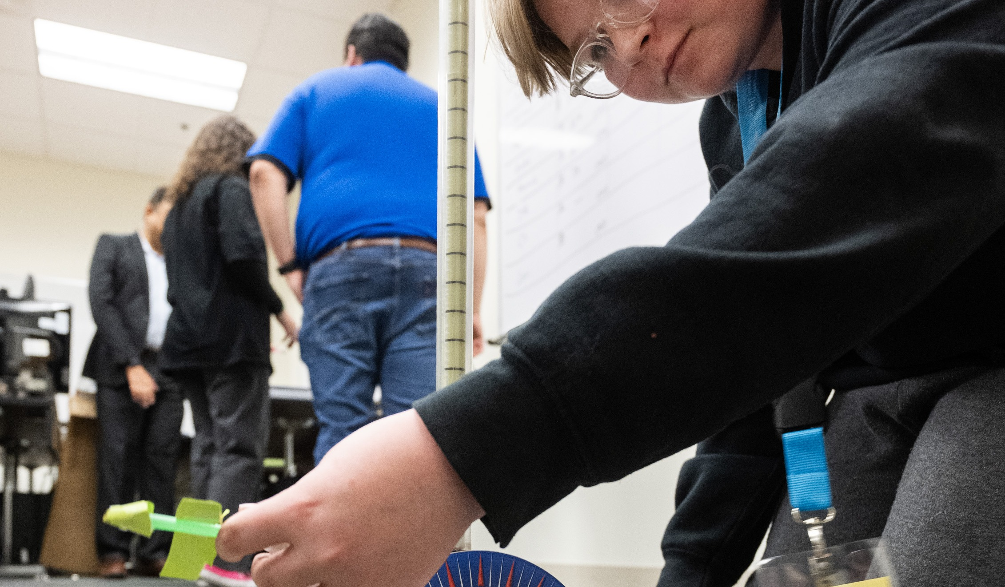
LOCKWOODSTEM
Inspiration: real launch-support structures
Look for design patterns, not things to copy.
Notice:
Wide bases improve stability
Braces redirect forces
Support points are deliberate
Access matters: the rocket must be removable
Simple geometry can perform well
Worksheet connection: Step 2 — Research the Problem
LockwoodSTEM | Introduction to Engineering Design | Unit 0
06
Notes:
Have students record 2–3 observations in Step 2 on the EDP organizer. Ask: What repeated geometry do you see? Where does the structure resist tipping or bending?

Slide 7
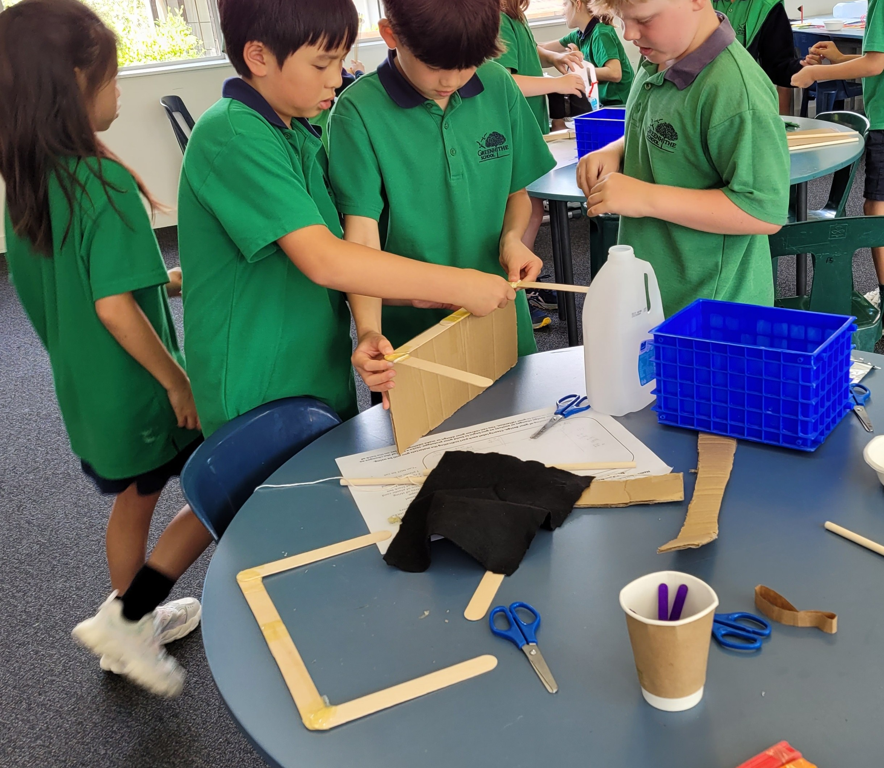
LOCKWOODSTEM
Your material kit
Every team gets the same supplies.
1 sheet
12" × 18" foam board
20
craft sticks
10
straws
48"
string
Hot glue
as needed for joining
You are not required to use every material. Use materials only when they make the design better.
Worksheet connection: these belong in the Constraints section.
LockwoodSTEM | Introduction to Engineering Design | Unit 0
07
Notes:
Students add the material kit to the constraints section on the criteria/constraints worksheet. Stress that mass is not a competition metric.

Slide 8
LOCKWOODSTEM
Non-negotiable requirements
These are constraints, not suggestions.
Provided rocket
Use the instructor-provided rocket; do not modify it.
Freestanding
The launch pad must hold the rocket without being held.
Removable
Rocket must install and remove without damage.
Materials only
Use only the provided kit and hot glue.
Size limit
Pad must fit the teacher-defined footprint and height limits.
Safety
Follow FabLab/PPE and tool rules.
LockwoodSTEM | Introduction to Engineering Design | Unit 0
08
Notes:
Students continue filling constraints. If you have a specific footprint/height requirement, state it here and have students record it. The deck leaves it teacher-defined unless you provide a final number.

Slide 9
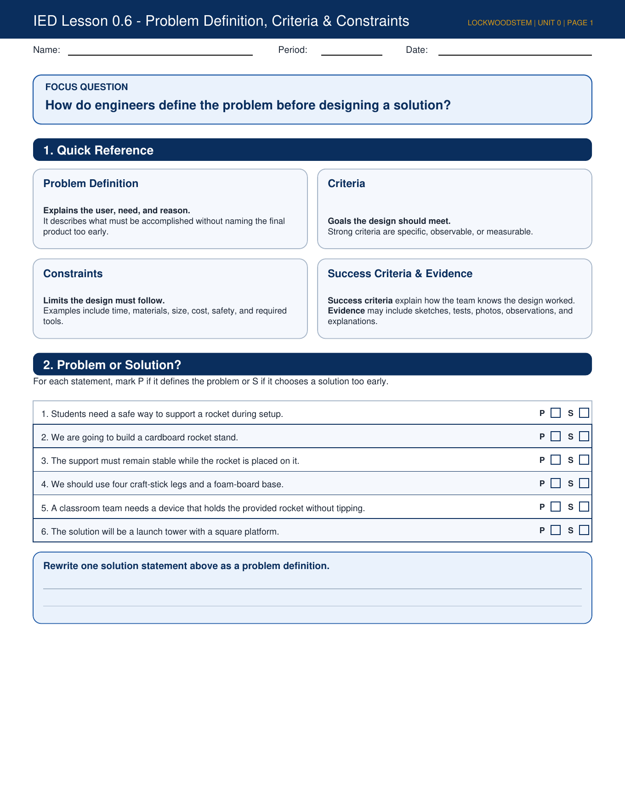
LOCKWOODSTEM
Criteria vs. constraints
Worksheet: Problem Definition, Criteria & Constraints
Criteria
Goals the design should meet. They can be optimized or improved.
Constraints
Rules or limits the design must follow. They cannot be ignored.
For this challenge, examples include:
Criteria examples
stable; compact; easy to build; easy to install/remove rocket; efficient material use
Constraint examples
provided rocket; no rocket modification; provided kit only; tool safety; time limit
Fill the Quick Reference and begin sorting rules into criteria or constraints.
LockwoodSTEM | Introduction to Engineering Design | Unit 0
09
Notes:
Use page 1 of the worksheet. Students fill the Quick Reference from the slide, then prepare to mark problem vs solution statements.

Slide 10
LOCKWOODSTEM
Problem or solution?
Do not choose a final product too early.
Problem statement: “A classroom team needs a device that holds the provided rocket without tipping.”
Solution statement: “We should use four craft-stick legs and a foam-board base.”
A problem names the user, need, and reason.
A solution names a specific design before evidence supports it.
Engineers define before they design.
LockwoodSTEM | Introduction to Engineering Design | Unit 0
10
Notes:
Have students complete Section 2 of the worksheet. Ask them to rewrite one solution as a problem definition.

Slide 11
LOCKWOODSTEM
Define before designing
Worksheet page 2: Rocket Launch Pad scenario
User
student engineering team
Need
support the provided rocket safely
Why it matters
setup and testing should be stable and repeatable
Sentence frame: The user needs a way to ______ so that ______ while considering ______.
Fill the User, Engineering Need, Why It Matters, and Problem Statement boxes.
LockwoodSTEM | Introduction to Engineering Design | Unit 0
11
Notes:
Students use page 2 of the criteria/constraints worksheet. Encourage concise writing. The problem statement should not say “stand” or “tower” unless you are okay with narrowing them early.

Slide 12

LOCKWOODSTEM
How will we know it worked?
Success criteria require evidence.
Success condition
Rocket stands upright for 60 seconds without being held.
Evidence
Observation + photo/video + pass/fail test record.
Success condition
Rocket can be installed and removed without damaging the pad.
Evidence
Teacher check + team notes on fit and usability.
Success condition
Launch pad remains stable during the required tilt/disturbance tests.
Evidence
Angle passed + direction tested + failure notes.
Fill the Success Criteria and Evidence boxes at the bottom of page 2.
LockwoodSTEM | Introduction to Engineering Design | Unit 0
12
Notes:
Students fill success criteria and evidence. The goal is to show how each requirement will be verified, not just state “it works.”

Slide 13

LOCKWOODSTEM
Think like a structural designer
Before sketching, predict load paths and tipping risks.
Where does the rocket touch the support?
How wide is the base compared with the rocket height?
Which parts resist tipping?
Where can triangles or braces help?
What joints might fail first?
Required design idea: include at least one intentional brace or triangular structural feature.
Worksheet connection: Step 3 — Brainstorm Solutions.
LockwoodSTEM | Introduction to Engineering Design | Unit 0
13
Notes:
Talk briefly about center of gravity and base width qualitatively. Students should not start drawing decorative shapes before thinking about how the rocket will be supported.

Slide 14
LOCKWOODSTEM
Three concept sketches
Three different approaches, not three cosmetic changes.
Concept A
Stability-focused
Wider base, more bracing, conservative support.
Concept B
Compact-focused
Smaller footprint, simpler structure, careful support points.
Concept C
Balanced
Practical compromise between stability, material use, and usability.
Every sketch must show:
provided rocket location
base shape and approximate dimensions
support method and bracing
materials used
where hot glue joints will be
why each major feature exists
Fill Step 3 on the organizer and begin sketching concepts.
LockwoodSTEM | Introduction to Engineering Design | Unit 0
14
Notes:
Students begin concept sketching. Encourage quick, labeled sketches rather than art. The next lesson will evaluate concepts using a decision matrix.

Slide 15
LOCKWOODSTEM
Today’s deliverable
Submit a launch document your team can build from later.
IED 0.4 Launch Pad Challenge: Design Brief + Three Annotated Concept Sketches
Design brief
problem statement, criteria, constraints, success criteria, evidence
Concept A
stability-focused launch pad sketch
Concept B
compact/material-efficient launch pad sketch
Concept C
balanced launch pad sketch
Initial recommendation
which design direction seems strongest right now and why
Minimum expectation: another team should understand each concept without you standing there explaining it.
LockwoodSTEM | Introduction to Engineering Design | Unit 0
15
Notes:
Use this slide as a quality gate before students submit or continue to next class.

Slide 16

LOCKWOODSTEM
Exit check
What problem are we solving?
Which constraints cannot change?
What criteria should we optimize?
What evidence will show the design worked?
What are your three concept directions?
Next lesson: evaluate your concepts and select a design direction.
LockwoodSTEM | Introduction to Engineering Design | Unit 0
Notes:
Close with a quick share-out. Ask one group for a constraint, one for a criterion, and one for a promising concept direction.

