Slide 1
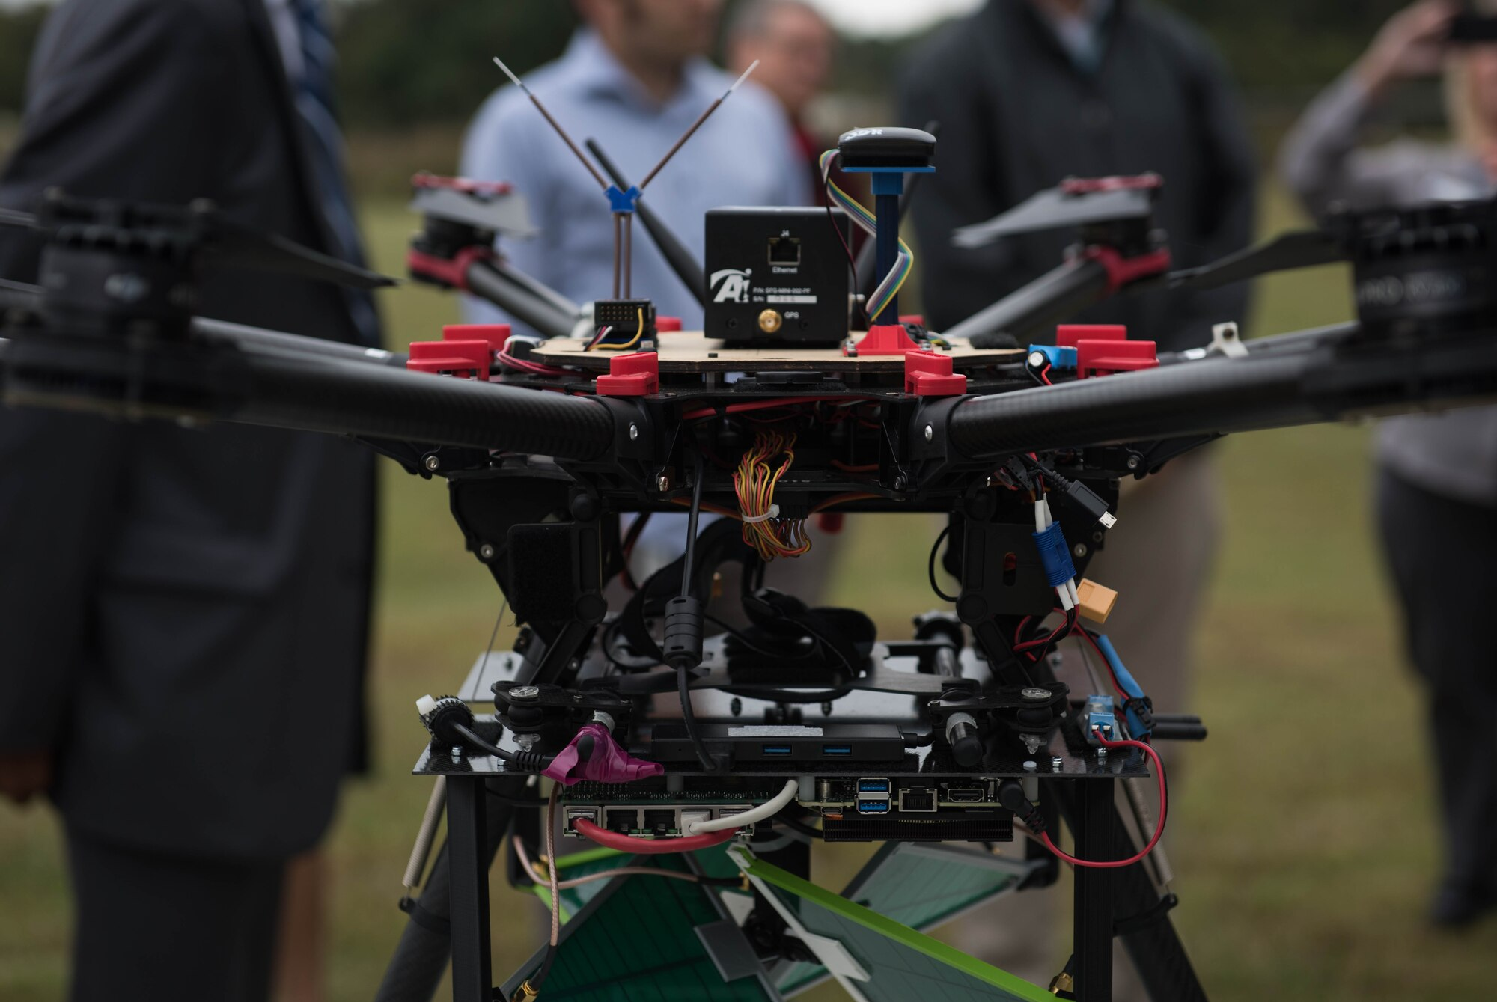
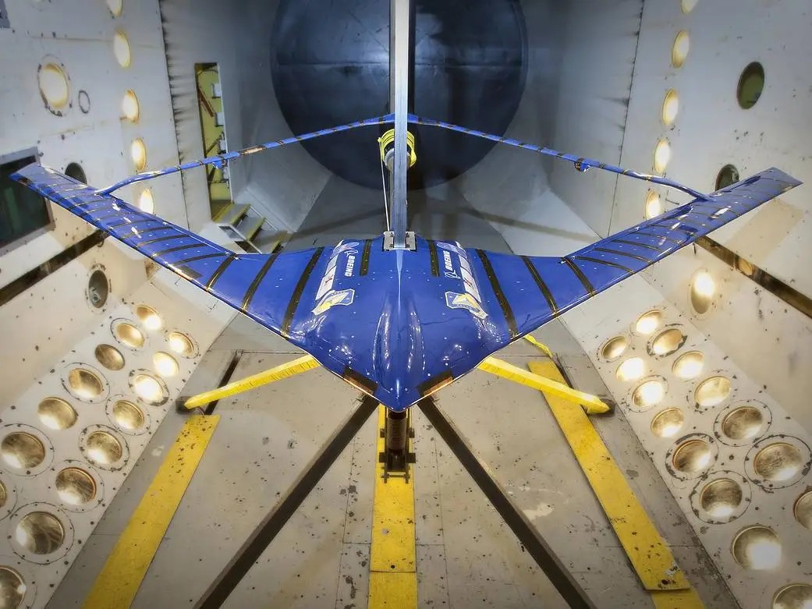
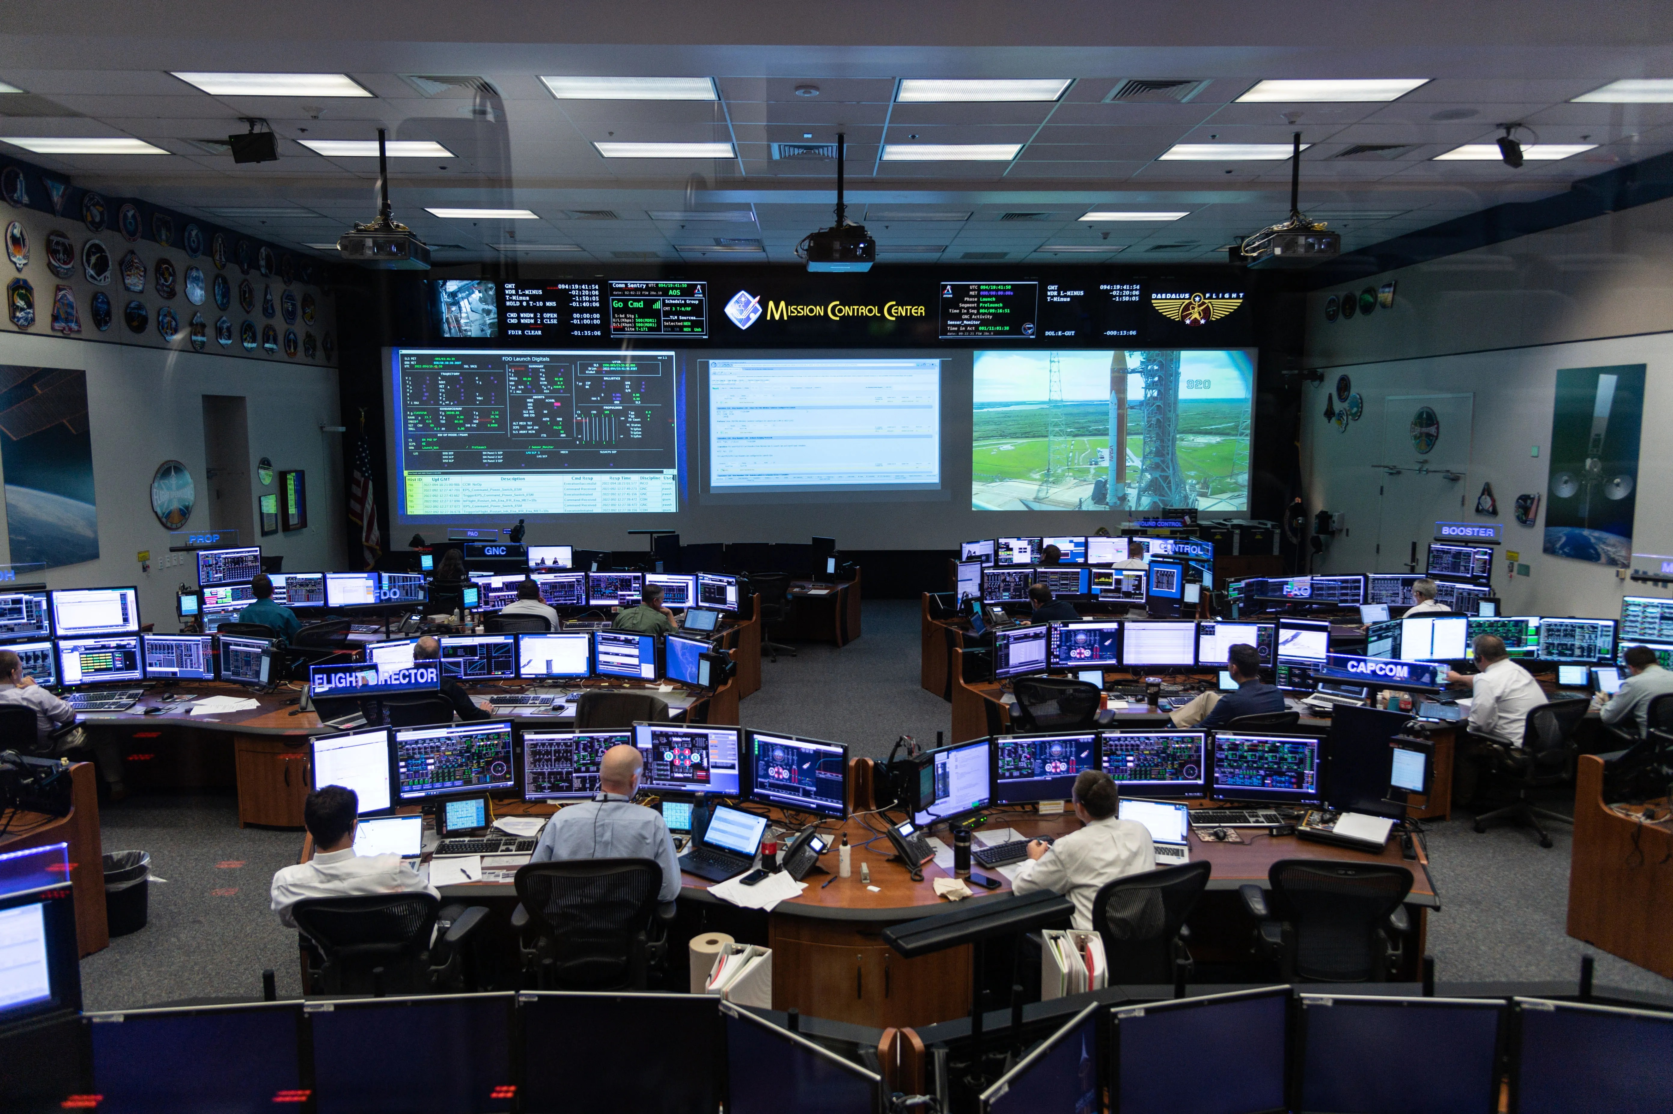
LOCKWOODSTEM
POE 0.1
Engineering
for the Mission
How do mechanisms, structures, controls, and data systems work together to make an aerospace mission successful?
START → BUILD / ANALYZE → CLOSE
Analyze aerospace systems • Map POE to mission needs • Build a one-page course learning map
LockwoodSTEM | Principles of Engineering | Unit 0
01
Notes:
Open the lesson by framing POE as a systems course. Students are not learning isolated topics; they are learning how real engineering systems support mission success.

Slide 2
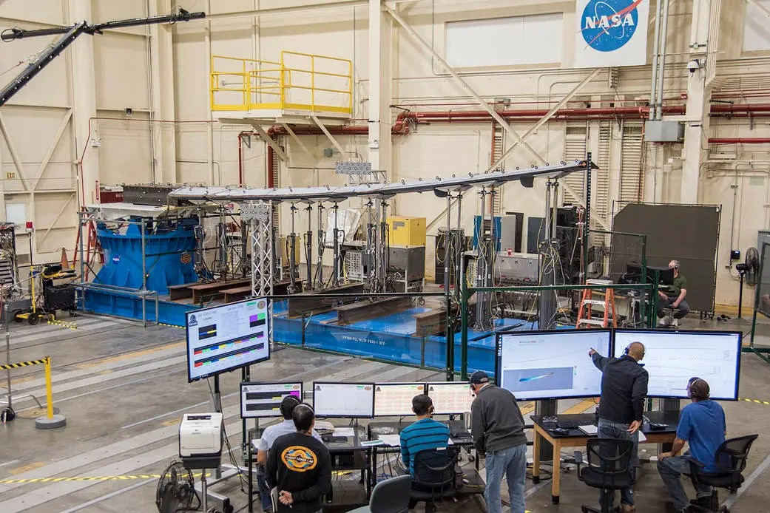
LOCKWOODSTEM
Lesson focus
Use the aerospace mission lens to organize today’s work.
FOCUS QUESTION
How do different engineering systems work together to make an aerospace mission successful?
BY THE END
Classify aerospace examples as mechanisms, structures, controls, or data systems.
Connect POE units to real mission needs.
Explain how engineers document and defend decisions.
Create a one-page POE Course Learning Map.
NASA wing calibration testing: structures + sensors + data
LockwoodSTEM | Principles of Engineering | Unit 0
02
Notes:
Preview the deliverable early so students know every discussion should feed into their course learning map.

Slide 3
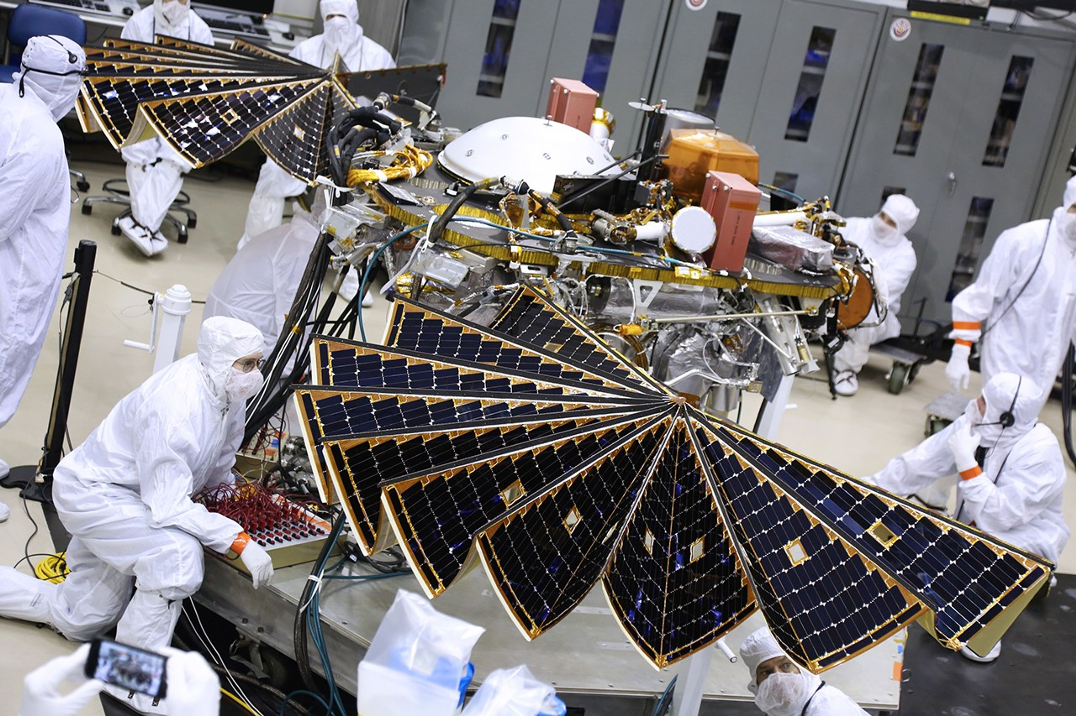
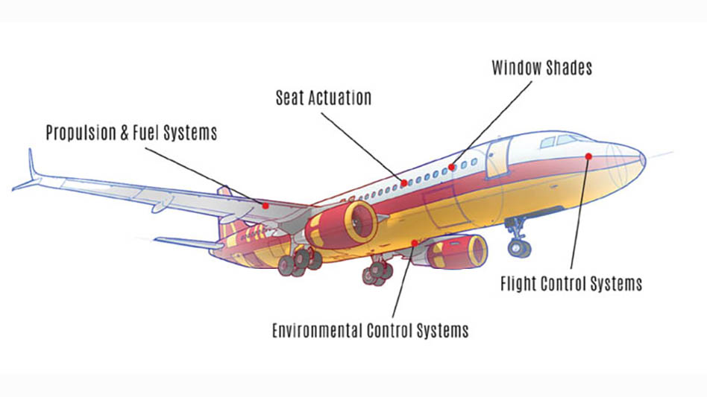
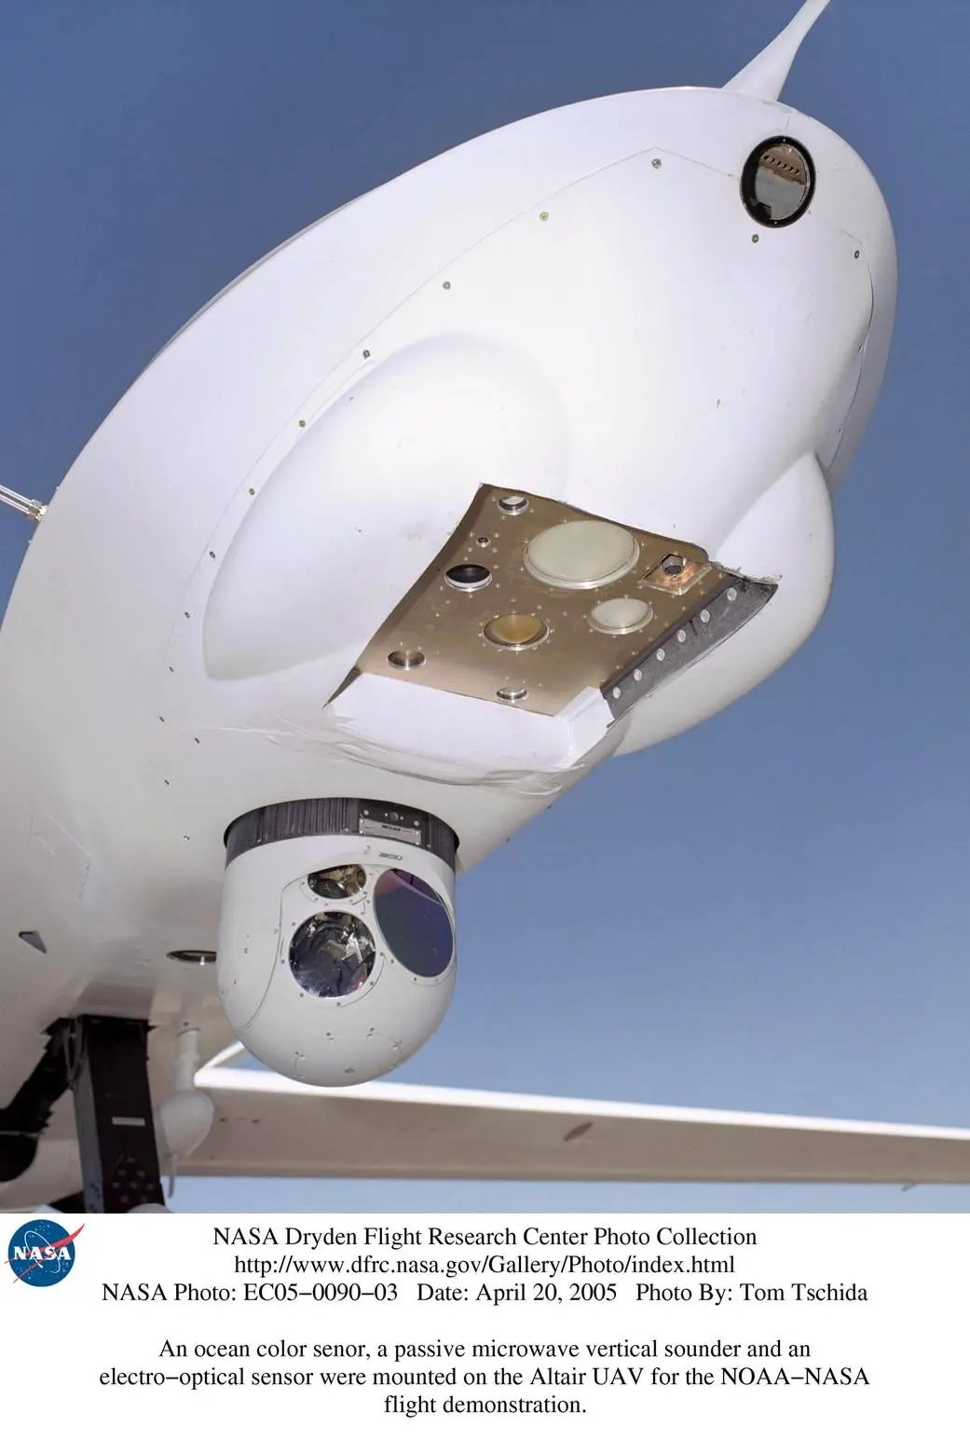
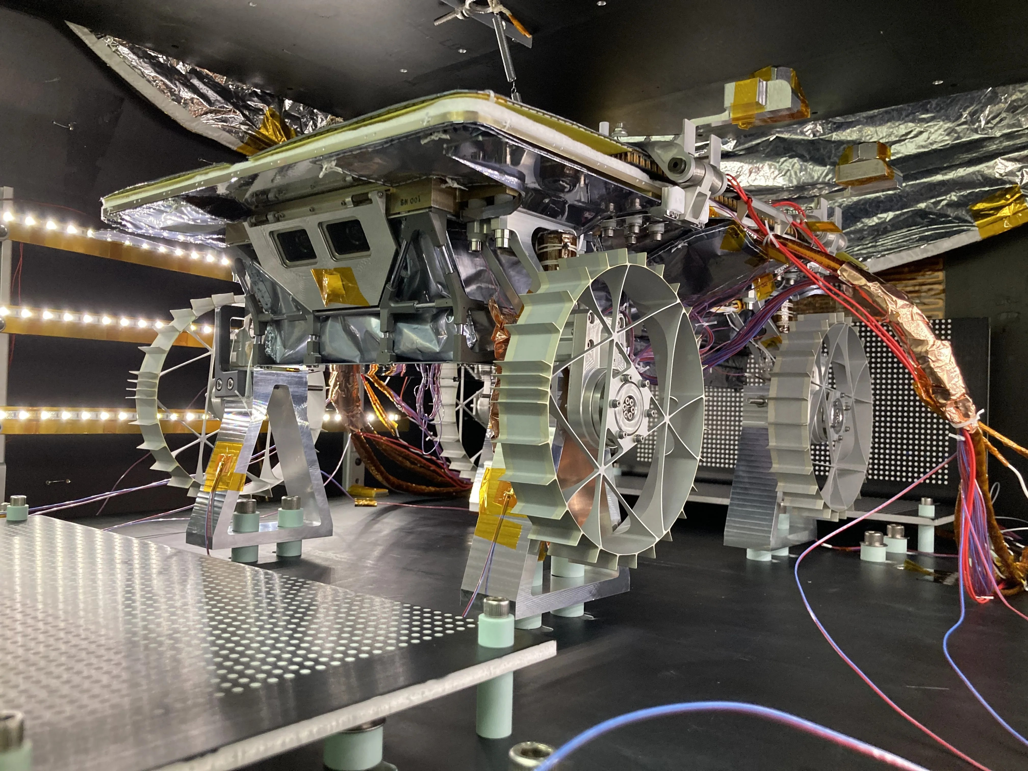
LOCKWOODSTEM
START: system hunt
Look first. Label second. Defend your choices.
THINK-PAIR-SHARE
What has to work correctly for this mission to succeed?
For each image, identify at least one:
Structure
Mechanism
Control
Data system
Be ready to explain what you saw that supports your label.
Solar arrays, actuation, sensor payloads, and robotic exploration systems
LockwoodSTEM | Principles of Engineering | Unit 0
03
Notes:
Give students two minutes individually and two minutes with a partner. Ask for evidence-based labels, not guesses.

Slide 4
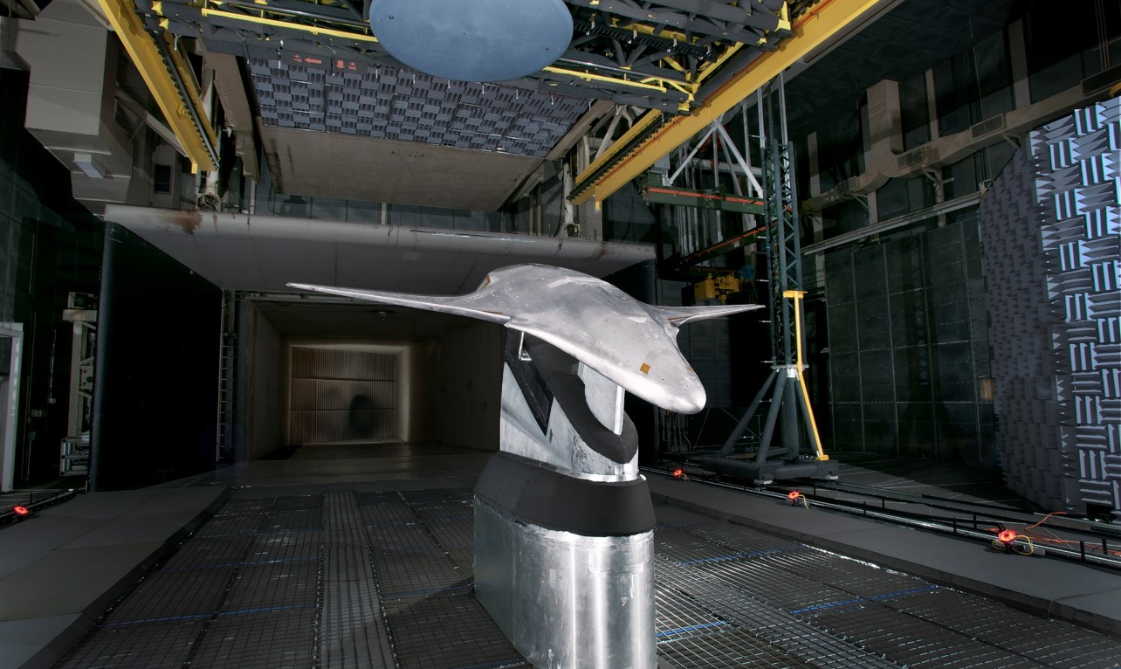
LOCKWOODSTEM
Structures carry mission loads
Every aerospace mission starts with forces that must be survived.
Wind tunnel models let engineers measure performance before full-scale flight.
What forces might act on these designs?
Lift • drag • weight • vibration • bending • impact • fatigue
LockwoodSTEM | Principles of Engineering | Unit 0
04
Notes:
Connect structures to the idea of supporting loads with minimal mass. Ask students what data engineers would need before trusting a new wing design.

Slide 5
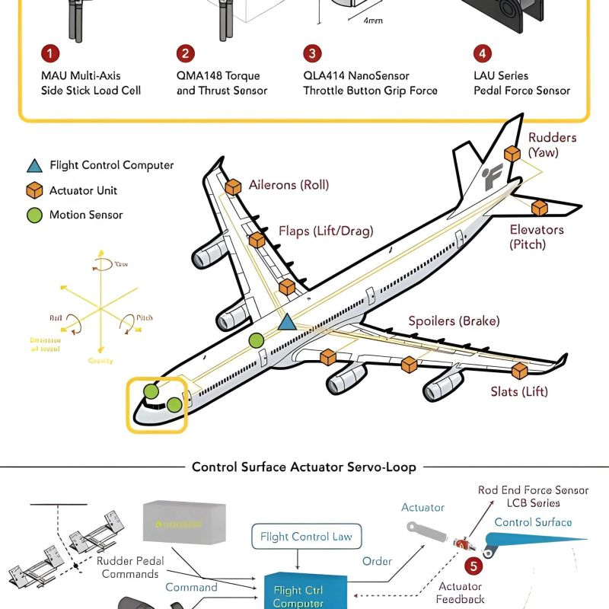
LOCKWOODSTEM
Mechanisms create motion
Moving parts must be predictable, controlled, and reliable.
MECHANISM EXAMPLES
Landing gear
Flaps, slats, ailerons, elevators, rudders
Solar array deployment
Camera gimbals and robotic arms
Payload doors, latches, and linkages
ANALYSIS PROMPT
A mechanism is only useful if engineers can predict the motion, forces, and failure points.
LockwoodSTEM | Principles of Engineering | Unit 0
05
Notes:
Use the diagrams to show that mechanisms are not just visible moving parts; they include actuators, sensors, and feedback loops that make motion usable.

Slide 6
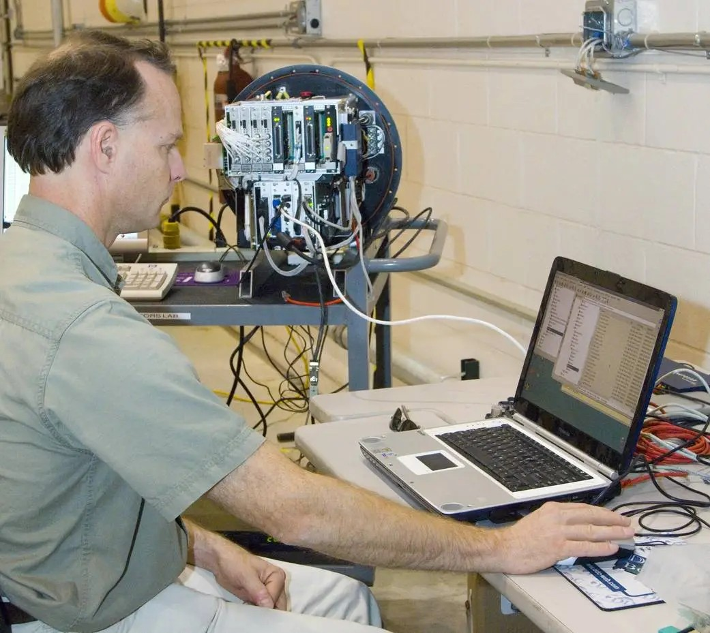
LOCKWOODSTEM
Controls and data guide decisions
Modern missions depend on signals moving to the right place at the right time.
Mission control, sensor check, and remote sensing payload examples
Control system
Data system
Engineering question
Uses inputs, logic, and outputs to regulate behavior.
Collects, processes, communicates, and stores information.
What data would prove the system is doing the right thing?
LockwoodSTEM | Principles of Engineering | Unit 0
06
Notes:
Emphasize the difference between raw data and engineering evidence. Data becomes evidence when it helps support or reject a decision.

Slide 7
LOCKWOODSTEM
Mission brief
Your team is planning an unmanned environmental monitoring aircraft.
Aerospace mission systems: aircraft platform, sensing payload, mission operations
Mission need: Monitor a remote area and return useful data without losing the aircraft.
Team target: Map each POE unit to one mission need it could support.
LockwoodSTEM | Principles of Engineering | Unit 0
07
Notes:
Use this scenario as the anchor for the worksheet. Students should think broadly: power, structure, mechanisms, controls, sensors, testing, and documentation.

Slide 8
LOCKWOODSTEM
POE units support mission needs
Connect course concepts to real engineering work.
Energy & Power
Mechanisms
Structures
Controls
Provide, store, transfer energy
Create or transfer motion
Survive forces with low mass
Regulate behavior automatically
SUCCESSFUL
AEROSPACE
MISSION
Engineering Analysis
Design & Testing
Robotics / Automation
Sensors & Data
Predict and justify choices
Improve through evidence
Operate with limited human input
Measure and communicate
Learning map rule: every branch connects a POE concept to a specific mission need.
LockwoodSTEM | Principles of Engineering | Unit 0
08
Notes:
This slide models what their learning map should do: connect topics to mission needs. Students do not need to copy this layout, but every branch needs a clear relationship.

Slide 9
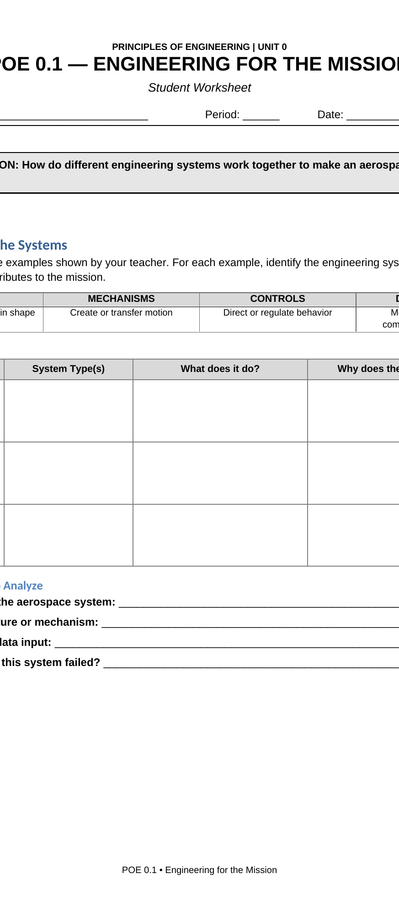
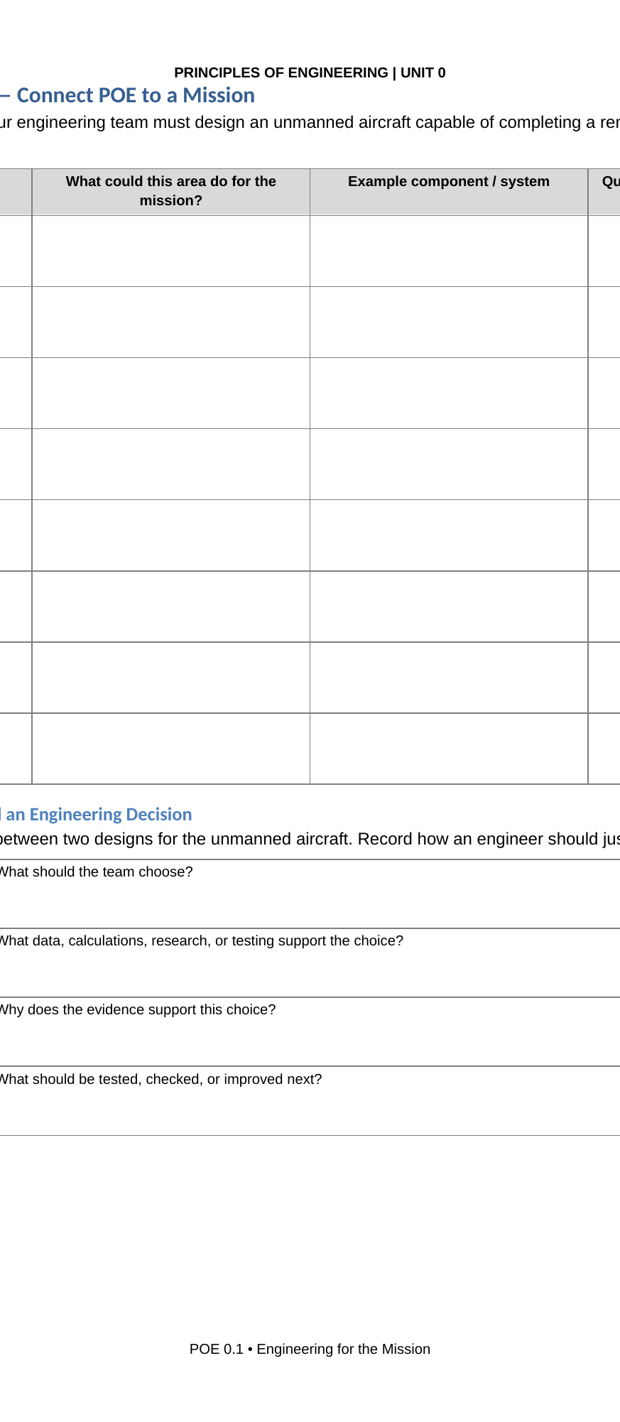
LOCKWOODSTEM
BUILD / ANALYZE: team mapping
Use the worksheet to turn the mission into POE connections.
TEAM WORKFLOW
For each major POE area, decide:
What mission need does it support?
What aerospace example shows that idea?
What question would an engineer need to answer?
What evidence would help defend the decision?
Write enough that a teammate could continue your thinking without asking you to explain everything verbally.
Worksheet pages guide the system analysis before the final learning map.
LockwoodSTEM | Principles of Engineering | Unit 0
09
Notes:
Move around the room and ask teams to make their connections more specific. For example, “power” is vague; “battery capacity for a 30-minute flight” is better.

Slide 10
LOCKWOODSTEM
Document and defend decisions
Engineering decisions are stronger when another person can trace the reasoning.
DECISION CHAIN
DECISION → EVIDENCE → REASONING → NEXT STEP
Engineering documentation should answer four questions:
What did we decide?
What evidence supports the decision?
Why does that evidence matter?
What should we test or improve next?
A finished design without evidence is only a claim.
LockwoodSTEM | Principles of Engineering | Unit 0
10
Notes:
Introduce the D-E-R-N format. Tie it to notebooks, design reviews, and team accountability. Students should use this language throughout POE.

Slide 11
LOCKWOODSTEM
Example: defend the choice
The goal is not just to choose; the goal is to explain why the choice fits the mission.
SAMPLE DECISION DEFENSE
Decision
Use a deployable solar array for extended mission endurance.
Evidence
Mission duration is longer than onboard battery-only capacity.
Reasoning
Solar power reduces the risk of losing data before the mission ends.
Next step
Test deployment reliability, power output, mass, and control impact.
Your turn: choose one mission decision and write a stronger explanation using this same pattern.
LockwoodSTEM | Principles of Engineering | Unit 0
11
Notes:
Use this as a model response. Students can copy the structure, but they should create their own decision related to the mission map.

Slide 12
LOCKWOODSTEM
Quality gate before submitting
Check clarity before you turn in the learning map.
SUBMIT WHEN YOUR MAP...
Includes all eight POE areas.
Uses specific aerospace examples.
Explains the mission need for each area.
Asks an engineering question for each area.
Is clear enough for another student to understand.
Ask yourself: “Could someone use this map to understand what POE is really about?”
NASA rover testing shows how evidence and mission requirements guide engineering confidence.
LockwoodSTEM | Principles of Engineering | Unit 0
13
Notes:
Use this as a final self-check. Tell students to improve vague branches before submission.

Slide 13
CLOSE
Engineering systems are connected.
Exit statement
A successful aerospace system depends on multiple engineering disciplines because…
Share one branch from your learning map with a partner before turning it in.
LockwoodSTEM | Principles of Engineering | Unit 0
14
Notes:
End with a share-out. Ask for a few examples where a student can explain how a course unit connects to a mission need.

