Slide 1
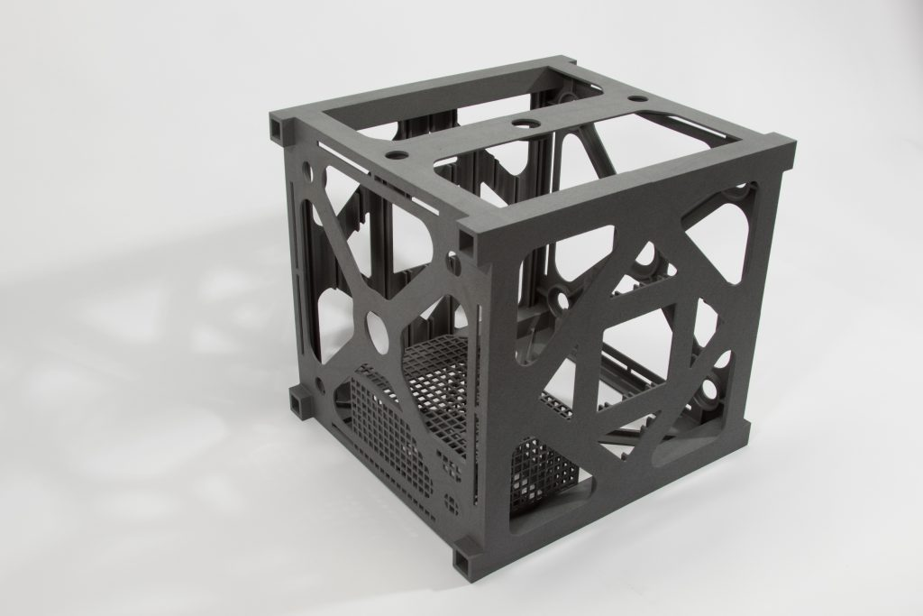
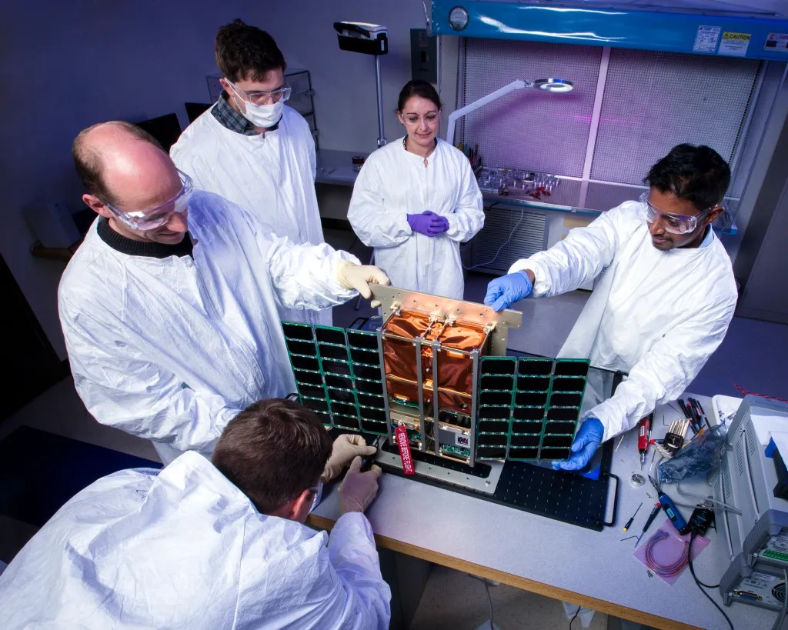
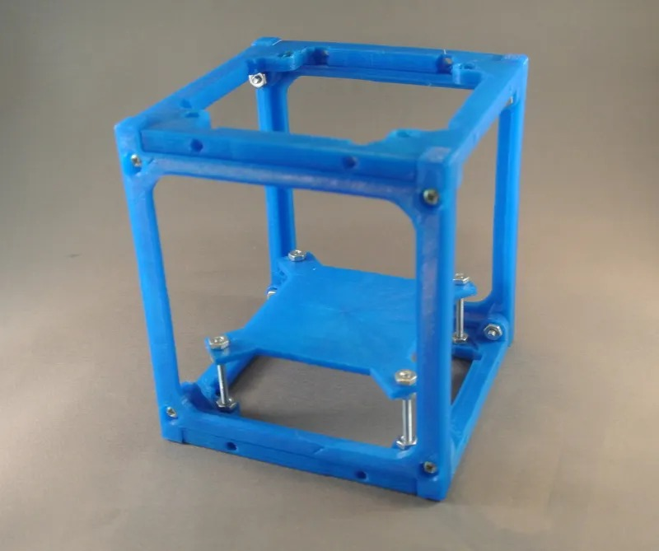
LOCKWOODSTEM
POE 0.4
CubeSat
Challenge
Define & Design
Design the lightest 4-inch CubeSat frame that survives final qualification testing.
Deliverable: design brief + three annotated concept sketches
LockwoodSTEM | Principles of Engineering | Unit 0
01
Notes:
Open by emphasizing that the class is now moving from course foundations into a real engineering challenge. The target is a lightweight, structurally sound CubeSat frame, not a decorative model.

Slide 2

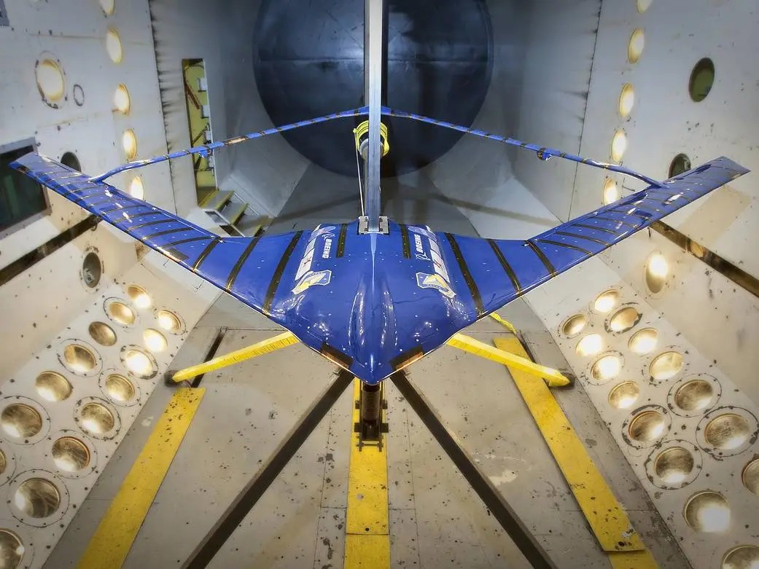
LOCKWOODSTEM
Today’s mission
What students need to understand before they start designing.
By the end of today, your team will:
Explain the CubeSat challenge objective and fixed constraints.
Separate design criteria from design constraints.
Predict major structural and manufacturing challenges.
Create a team design brief.
Begin three concept paths: strong, light, balanced.
Main idea: aerospace structures are not designed to be as strong as possible. They are designed to be strong enough at the lowest practical mass.
LockwoodSTEM | Principles of Engineering | Unit 0
02
Notes:
Preview the two-day lesson. Day 1 focuses on the project rules and design brief. Day 2 focuses on the three concept sketches and initial recommendation.

Slide 3
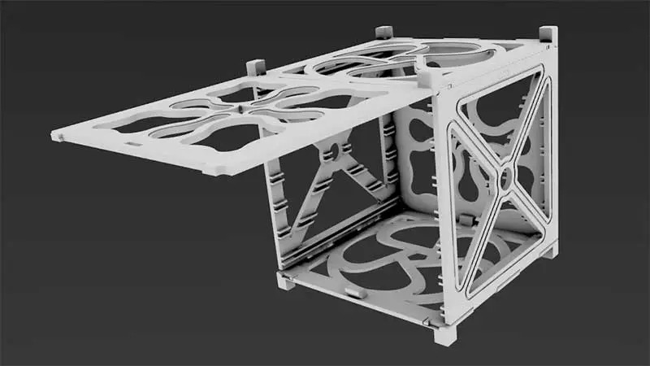
LOCKWOODSTEM
Inspiration: lightweight spacecraft structures
Notice the open frames, cutouts, repeated geometry, and careful interfaces.
What all of these designs have in common:
Your CubeSat will be simpler, but the engineering tradeoff is the same: strength + access + low mass.
Material is placed where loads need to travel.
Large open regions preserve access and reduce mass.
Fastener locations are reinforced and repeatable.
Manufacturing constraints shape the final geometry.
Look for design patterns you can adapt—not copy.
LockwoodSTEM | Principles of Engineering | Unit 0
03
Notes:
Ask students what they notice before naming features. Guide them toward material removal, corner reinforcement, open frames, interfaces, and assembly access.

Slide 4
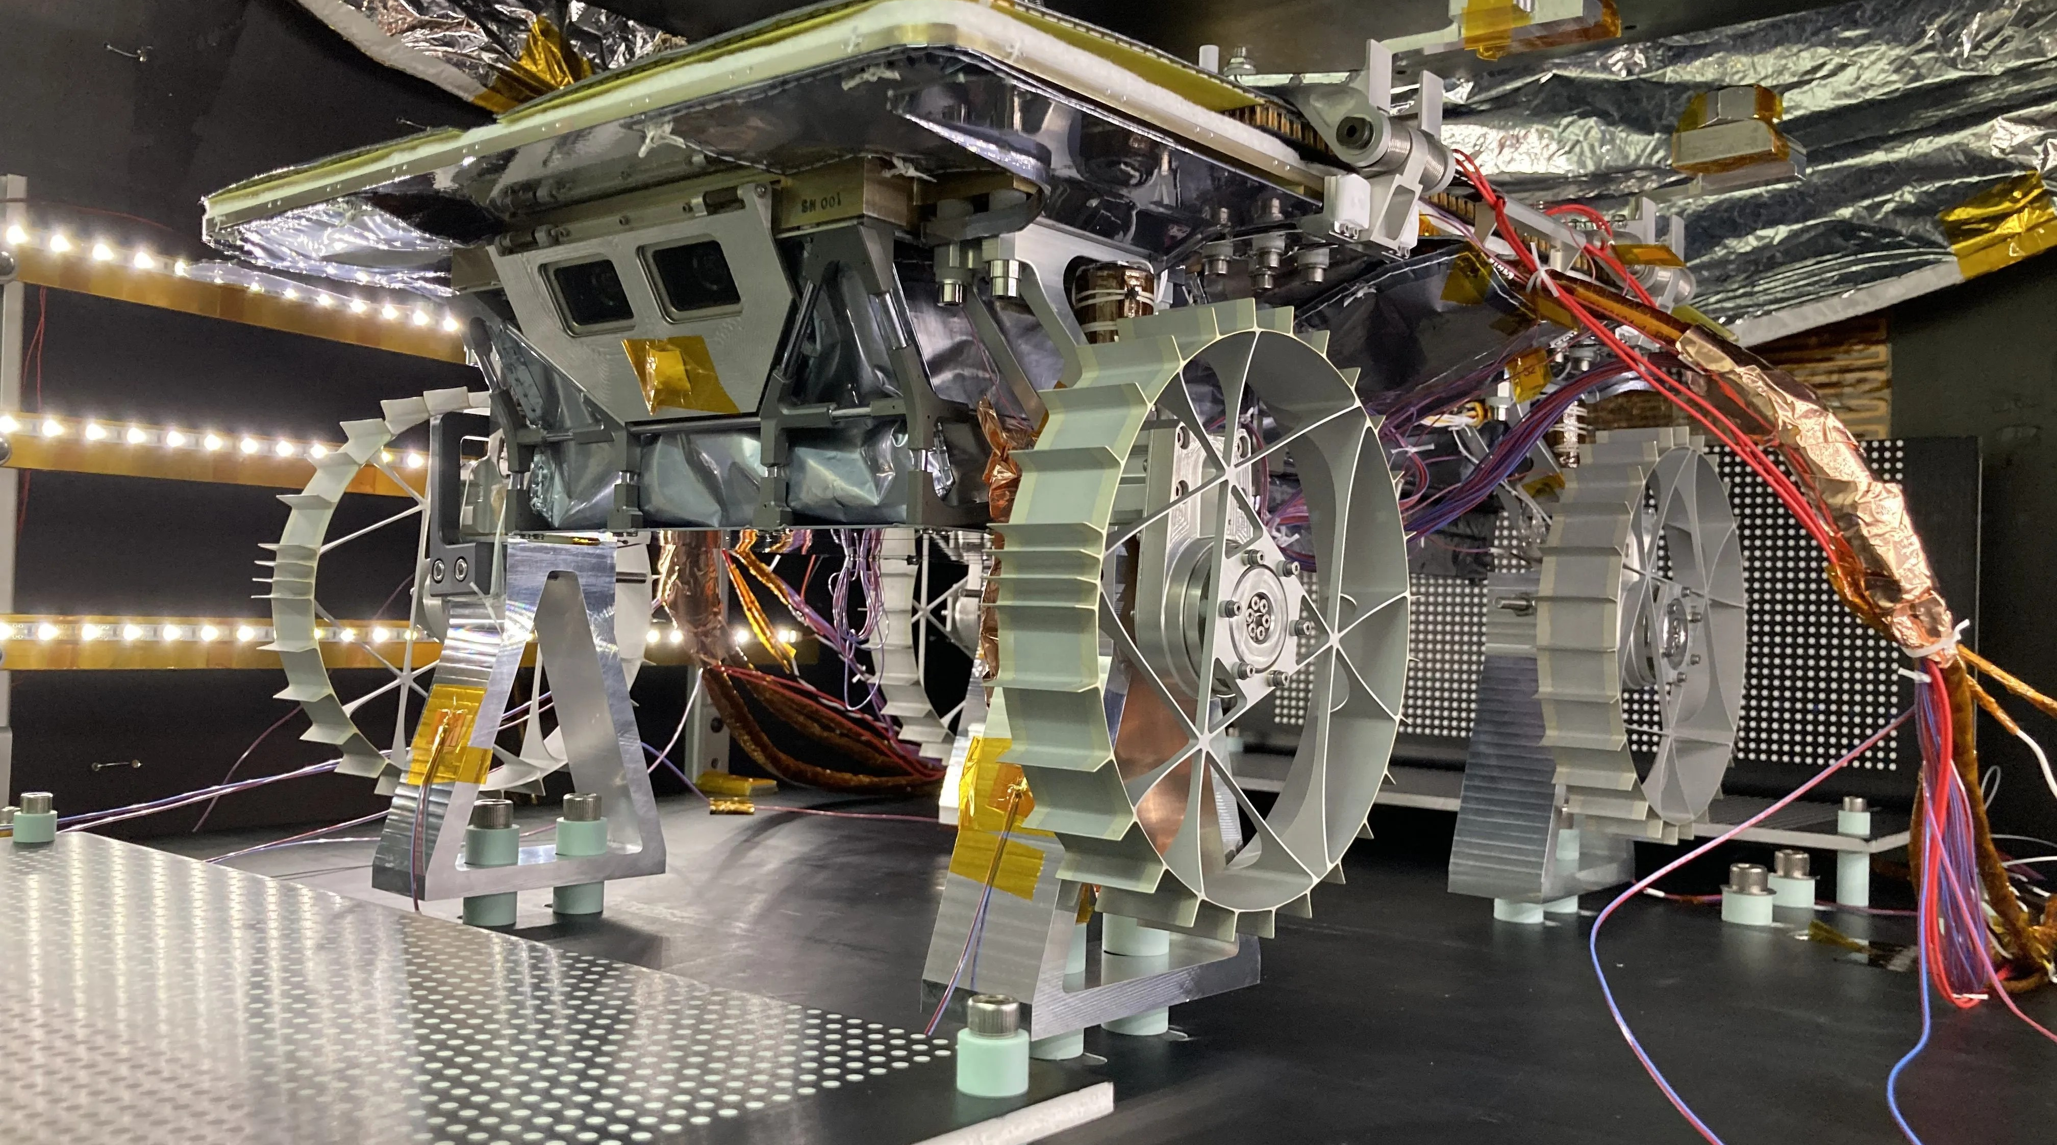
LOCKWOODSTEM
The challenge
The competition is simple: qualifying structures are ranked by mass.
Design and build the lightest CubeSat structure that passes every required qualification test.
Passing comes first. Mass only matters after the design qualifies.
A design qualifies if it…
A design loses if it…
fits the 4-inch cube envelope
uses the required materials and hardware
survives the structural load test
remains functional after testing
is light but breaks
uses unapproved materials
needs glue for structure
cannot be assembled or inspected
LockwoodSTEM | Principles of Engineering | Unit 0
04
Notes:
Make the pass/fail nature explicit. A heavier structure that passes beats a lighter structure that fails.

Slide 5
LOCKWOODSTEM
Required architecture
Everyone builds the same type of system. Teams compete through better engineering decisions.
Your CubeSat must include:
Laser-cut top plate
Laser-cut bottom plate
3D-printed structural frame
Open sides
M3 screws for primary structural connections
Disassemblable construction
Not allowed: side panels, structural glue, hidden reinforcement, or alternate materials.
Design question: What geometry gives the best strength-to-mass performance?
LockwoodSTEM | Principles of Engineering | Unit 0
05
Notes:
Stress that the project is intentionally constrained. The class is not deciding what to build; teams are optimizing how to build it.

Slide 6
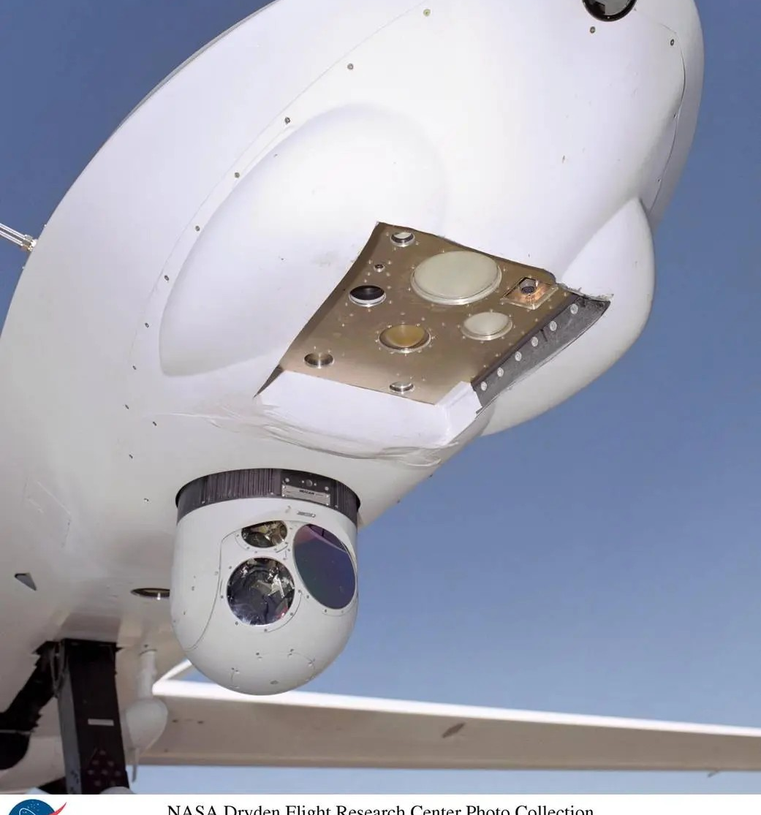
LOCKWOODSTEM
Non-negotiable constraints
These rules cannot be changed by any team.
Complete assembly fits inside 4 in × 4 in × 4 in.
Top and bottom are laser cut from 1/8 in acrylic.
Each team gets one 4 in × 12 in acrylic sheet.
Frame is 3D printed using the class filament.
M3 screws are used for primary structural assembly.
No structural adhesive is permitted.
The 4-inch envelope includes screw heads, nuts, inserts, washers, plates, printed parts, and any other hardware.
If it sticks out, it counts.
LockwoodSTEM | Principles of Engineering | Unit 0
06
Notes:
Use this slide to prevent common mistakes: top + bottom thickness count in the 4 inches, and M3 hardware also counts.

Slide 7
LOCKWOODSTEM
What your team controls
The constraints are fixed. The engineering choices are still wide open.
Optimize these variables:
Corner-post cross section and wall thickness
Ribs, gussets, fillets, and reinforcement zones
Acrylic lightening-hole pattern
M3 fastener locations and access
Print orientation, wall count, infill, and pattern
Usable interior volume and open-side access
Total mass of plates + frame + M3 hardware
The winning design removes material only where it is not doing useful work.
LockwoodSTEM | Principles of Engineering | Unit 0
07
Notes:
Make it clear that teams can and should make different decisions. A lightening pattern may help on the acrylic, but holes near fasteners could cause failure.

Slide 8
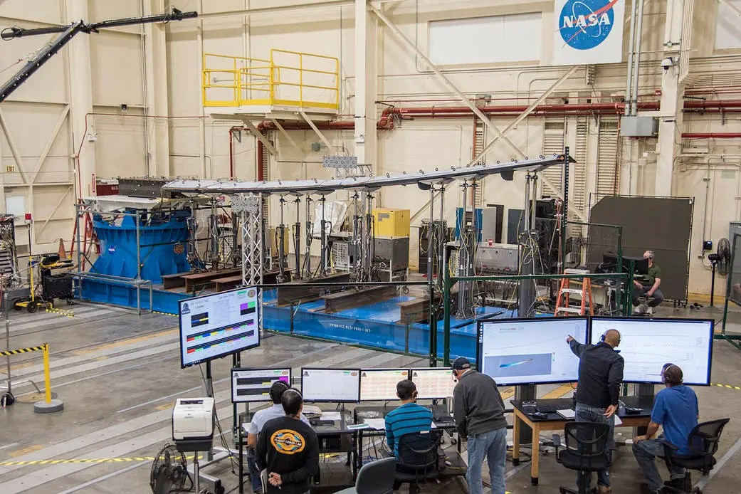
LOCKWOODSTEM
Think like a structures engineer
Before sketching shapes, predict how forces travel through the system.
When the top is loaded, ask:
Where does the force enter the structure?
Which parts carry compression?
Where might bending occur?
Where are stress concentrations likely?
What happens at the M3 connection points?
What material can be removed safely?
Sketch load paths before you sketch decorative cutouts.
LockwoodSTEM | Principles of Engineering | Unit 0
08
Notes:
Use the wind tunnel/testing imagery to connect to aerospace validation. Students do not need formal stress analysis yet, but they should reason about load paths.

Slide 9
LOCKWOODSTEM
Design brief: criteria vs. constraints
Your first deliverable begins by defining the problem clearly.
Criteria: goals you can optimize
Constraints: rules you must satisfy
4 in cube maximum
open sides
3D-printed frame
1/8 in acrylic top and bottom
4 in × 12 in acrylic limit
M3 screws, no structural glue
low total mass
structural stiffness
usable interior space
easy assembly
efficient material use
good print reliability
Engineering happens when criteria compete under fixed constraints.
LockwoodSTEM | Principles of Engineering | Unit 0
09
Notes:
Ask students to identify a rule and decide whether it is a criterion or constraint. Emphasize that constraints are not optional.

Slide 10
LOCKWOODSTEM
Manufacturing rules you need today
These details belong in your design brief and sketches.
Standard materials
Same filament type for every team
Same 1/8 in acrylic for every team
Same 4 in × 12 in acrylic allocation
M3 hardware counts toward final mass
Print settings must be documented later
layer height, wall count, infill %, infill pattern
print orientation, estimated print time, filament use
wall count and infill are variables your team can optimize
LockwoodSTEM | Principles of Engineering | Unit 0
10
Notes:
Do not over-teach slicing yet. Students only need to understand that manufacturing choices will become part of the design evidence later.

Slide 11
LOCKWOODSTEM
Deliverable: design brief
Keep it concise. It is a launch document, not a full report.
Your design brief must include:
Problem statement: what are we designing?
Competition objective: how is success measured?
Criteria: what should the design do well?
Constraints: what rules cannot change?
Predicted engineering challenges: what will be difficult?
Initial design priorities: what matters most to your team?
Use precise language. “Make it strong” is not as useful as “survive the vertical load test without fracture or separation.”
LockwoodSTEM | Principles of Engineering | Unit 0
11
Notes:
Students may work in teams. The goal is to launch documentation habits and define the problem before sketching.

Slide 12
LOCKWOODSTEM
Deliverable: three concept sketches
Three variations of the same CubeSat architecture.
Concept A: strength-focused
Concept B: mass-focused
Concept C: balanced
Heavier, more conservative, more reinforcement near load paths and fasteners.
Material removed aggressively; riskier geometry and more dependence on print settings.
A practical compromise between mass, strength, interior space, and manufacturability.
Every sketch must include dimensions, M3 locations, plate geometry, frame geometry, and notes explaining the design logic.
LockwoodSTEM | Principles of Engineering | Unit 0
12
Notes:
Students should not draw three unrelated projects. They are drawing three structural strategies for the required CubeSat architecture.

Slide 13
LOCKWOODSTEM
What a good concept sketch shows
A sketch is an engineering communication tool.
Required annotations:
overall 4 in cube boundary
top and bottom acrylic plates
3D-printed frame geometry
M3 screw locations and access
lightening holes or material-removal areas
reinforcement near likely stress points
how the structure can be assembled/disassembled
Avoid “mystery boxes.” Label why each major feature exists.
Minimum expectation: another team should understand your design without you standing there explaining it.
LockwoodSTEM | Principles of Engineering | Unit 0
13
Notes:
Students often draw too vaguely. Use this slide as the quality gate before submission.

Slide 14
LOCKWOODSTEM
Exit check
Before you leave, your team should be able to answer:
What is the main objective of the challenge?
Which constraints cannot change?
What are the three concept directions your team will develop?
What tradeoff seems hardest right now?
Next lesson: prove which concept deserves to move forward.
LockwoodSTEM | Principles of Engineering | Unit 0
15
Notes:
End with a quick share-out. Ask one team to share a predicted engineering challenge and one team to share an early concept direction.

