Slide 1
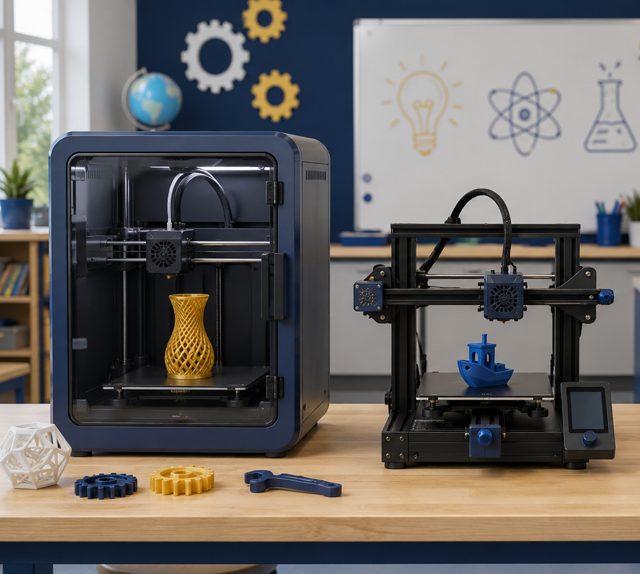
POE 0.7
Additive
Manufacturing
From print strategy to print-ready CubeSat frame components
Deliverable
3D printer certification + Print Settings Record + print-ready frame files
Notes:
Open by connecting this lesson directly to the CubeSat Lightweight Structure Challenge. Students are not just printing parts; they are making manufacturing decisions that affect strength, mass, time, and reliability.

Slide 2

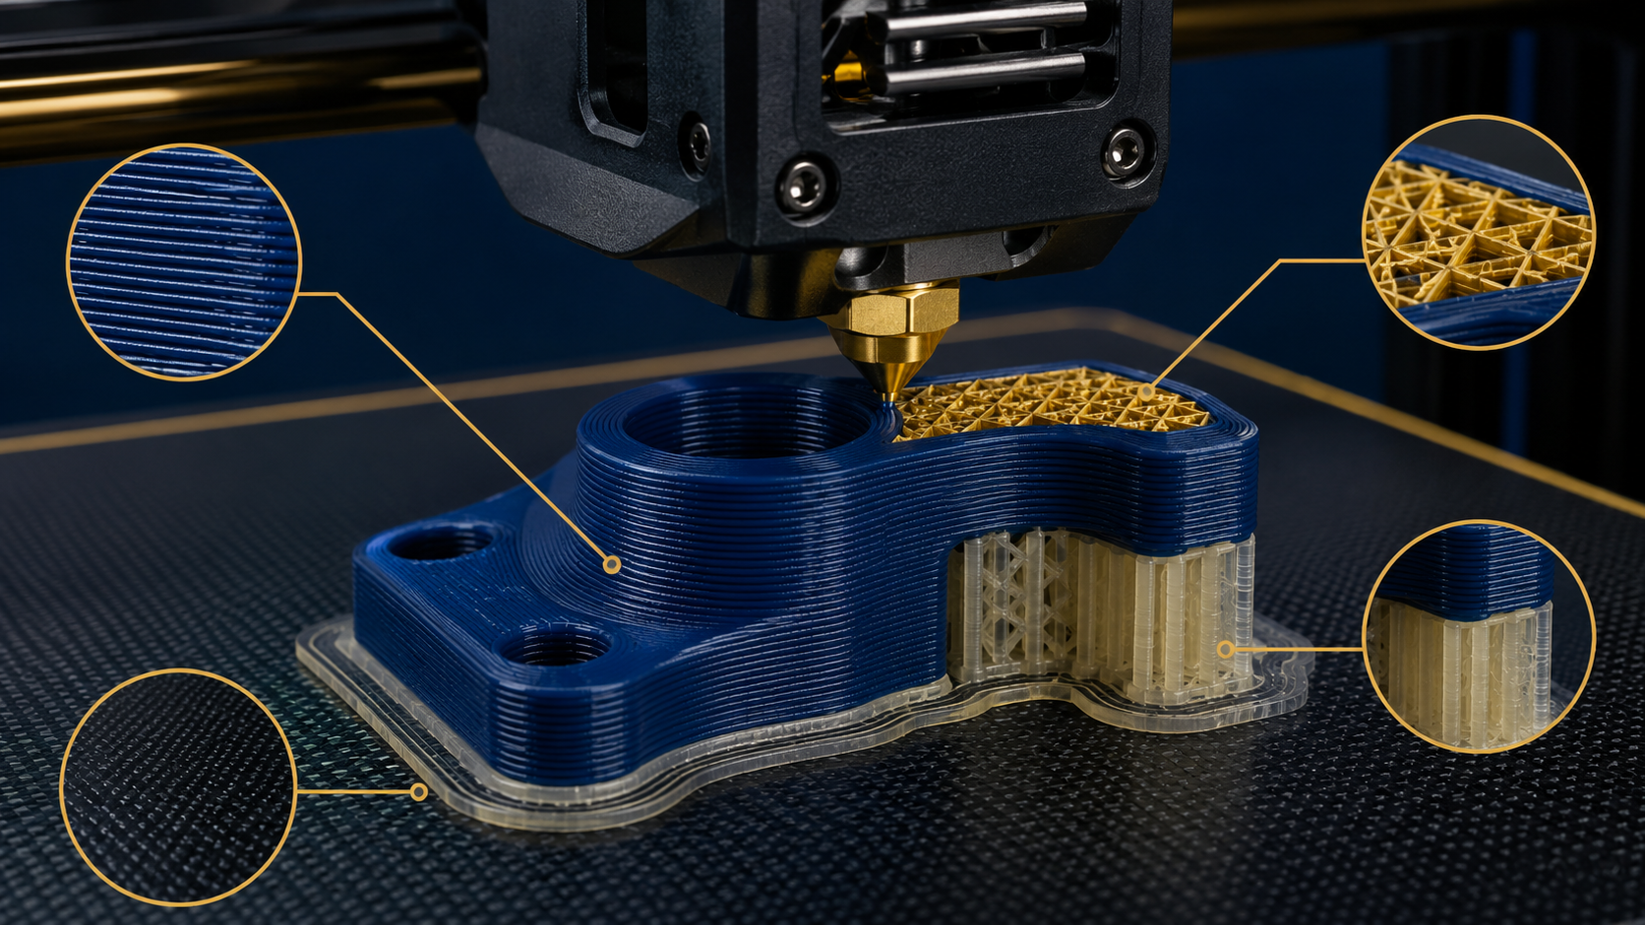
Lesson Mission
Today’s mission
Make additive manufacturing choices like engineers, not just printer users.
Explain several major additive manufacturing processes.
Connect FDM design decisions to strength, supports, time, and mass.
Read a slicer preview before committing to a print.
Choose print settings for CubeSat frame components and justify them.
Key idea
The printer makes the part; the engineer controls whether it is printable, strong enough, and worth the material.
LockwoodSTEM | Principles of Engineering | Unit 0
02
Notes:
Preview what students will do today: certify, slice, document settings, and prepare frame files for the CubeSat project.

Slide 3
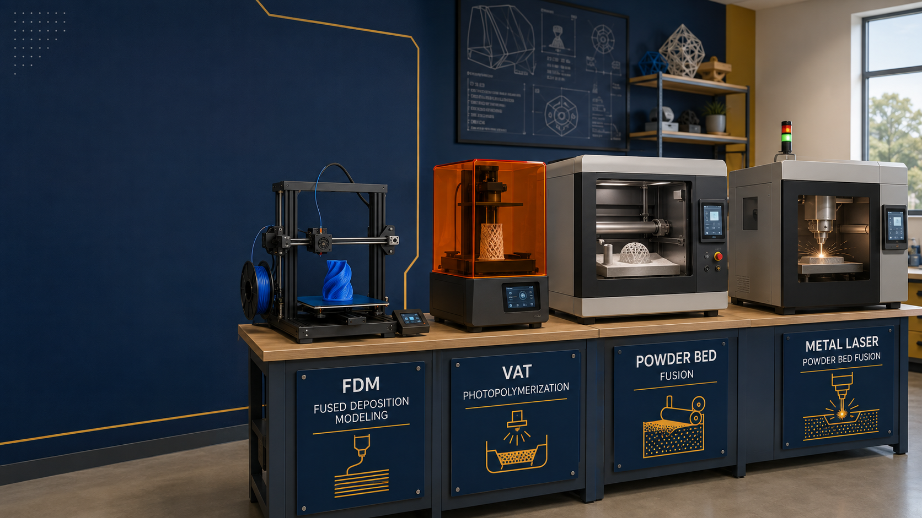
Big Picture
Additive manufacturing is a family of processes
Different machines build parts by adding material in very different ways.
Material extrusion
Vat photopolymerization
Powder bed fusion
Jetting / DED
FDM/FFF filament through a heated nozzle
Light cures liquid resin layer by layer
Heat, laser, or binder works inside a powder bed
Droplets or fed material build, coat, or repair parts
LockwoodSTEM | Principles of Engineering | Unit 0
03
Notes:
Do not spend too long on industrial processes. Students just need to recognize that FDM is one member of a larger additive manufacturing family.

Slide 4
FDM Process
FDM turns a 3D model into stacked paths
The slicer turns geometry into toolpaths the printer can follow.
1
Filament feeds into the hot end
2
Nozzle deposits molten plastic
3
Each layer bonds to the one below
4
Shells, infill, supports, and travel moves are planned by the slicer
Important: the part is not equally strong in every direction.
LockwoodSTEM | Principles of Engineering | Unit 0
05
Notes:
Use the macro image to point out layers, walls, infill, support material, and surface texture.

Slide 5
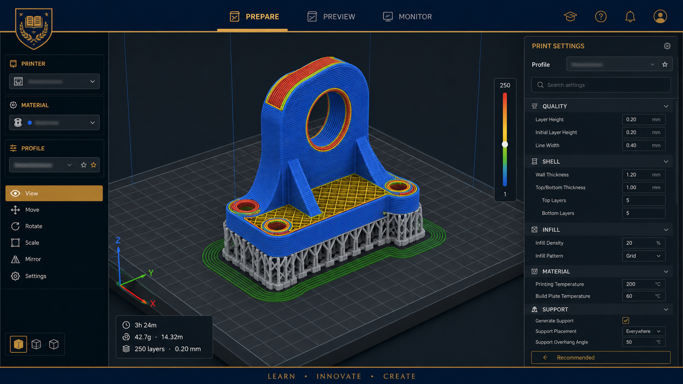
Design Considerations
Orientation is a strength decision
Where the part “looks good” is not always where it prints best.
Ask before slicing
CubeSat frame lens
Where will load enter the part?
Which direction could split along layers?
Which surfaces need to look clean?
Which orientation reduces supports?
Can screws or inserts be installed later?
Corner posts must resist compression and lateral bending.
M3 holes need enough surrounding material.
Tall skinny prints may need a brim or different orientation.
Weak layer bonds can fail during the final load test.
LockwoodSTEM | Principles of Engineering | Unit 0
06
Notes:
Discuss FDM anisotropy qualitatively. Students do not need formal stress analysis, but they must connect orientation to expected forces.

Slide 6
Design Considerations
Overhangs, supports, and bridges cost time
A printable design is not just a strong design—it is a manufacturable design.
Overhangs
Large angles may sag unless supported.
Supports
Useful when necessary, but add time, material, and cleanup.
Bridges
Short spans can print unsupported if cooling and geometry cooperate.
Contact area
Small/tall parts may need a brim or raft to stay attached.
LockwoodSTEM | Principles of Engineering | Unit 0
07
Notes:
Show students that supports are not “bad,” but they are evidence of geometry that may need redesign or a different orientation.

Slide 7
Design Considerations
Walls usually matter more than infill
Infill fills space; perimeters often carry loads at the outside of the part.
Shell / walls
Infill
For the CubeSat
Increase bending stiffness
Protect holes and edges
Make fastener regions stronger
Add mass and print time
Supports top surfaces
Affects compression and crush behavior
Pattern changes stiffness direction
Too much infill can be wasted mass
Document your wall count
Document your infill percentage and pattern
Explain why the settings match the load path
Do not print “maximum strength” by default
LockwoodSTEM | Principles of Engineering | Unit 0
08
Notes:
Students often raise infill to 100% as a default. Push them to think about where material actually helps: around outside surfaces, interfaces, and fastener zones.

Slide 8
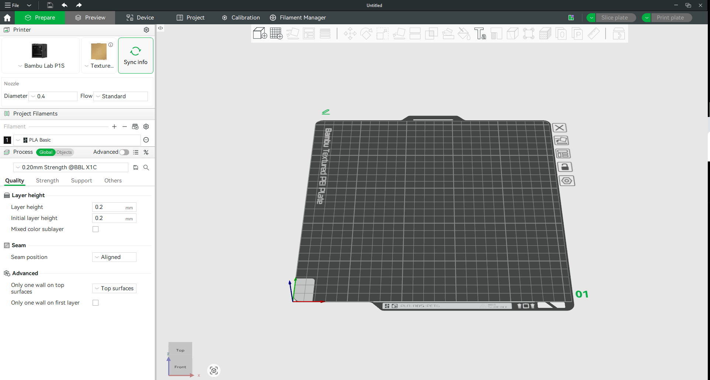
Slicers
A slicer is your manufacturing plan
It converts a model into toolpaths, estimates, and risks before you print.
Before sending a print, inspect the preview layer by layer: walls, infill, supports, travel moves, estimated time, and filament use.
LockwoodSTEM | Principles of Engineering | Unit 0
09
Notes:
Define slicer as the bridge between CAD and printer. Students should look for surprises in preview, not simply click print.

Slide 9
Slicer Settings
Settings to record for this lesson
Your settings are part of the engineering evidence.
Layer height
Surface quality vs. time
Your justification should connect settings to the project goal:
Wall / perimeter count
Strength around the outside
Strong enough to pass qualification
Low enough mass to compete
Reasonable print time
Reliable first attempt
Clean interfaces for M3 hardware
Infill %
Internal material use
Infill pattern
Stiffness direction and print time
Print orientation
Strength, supports, surface quality
Estimated print time
Machine scheduling
Do not leave the slicer as a black box.
Estimated filament use
Mass and material planning
LockwoodSTEM | Principles of Engineering | Unit 0
10
Notes:
This slide can be left up while students fill out the Print Settings Record.

Slide 10
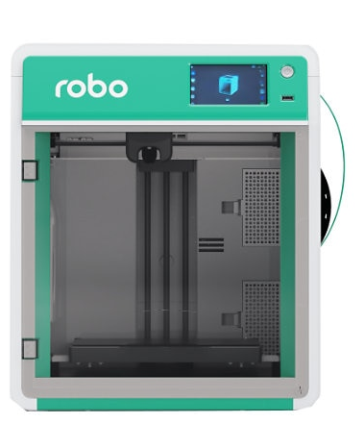
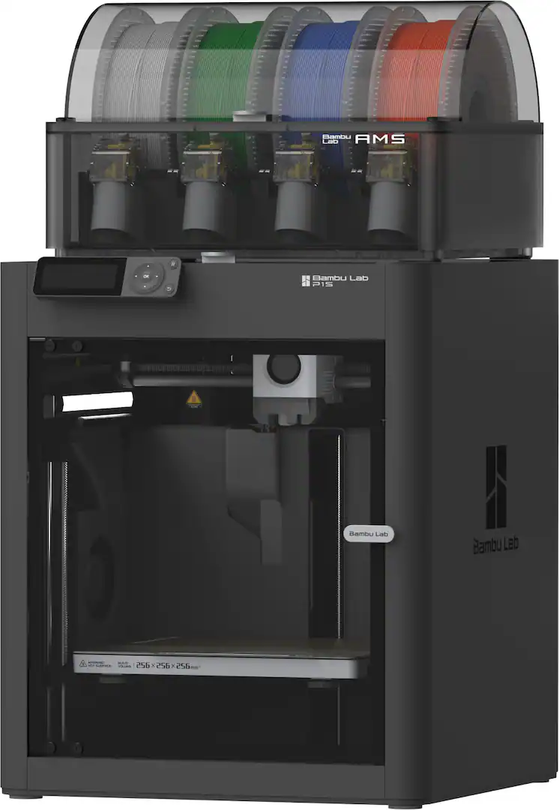
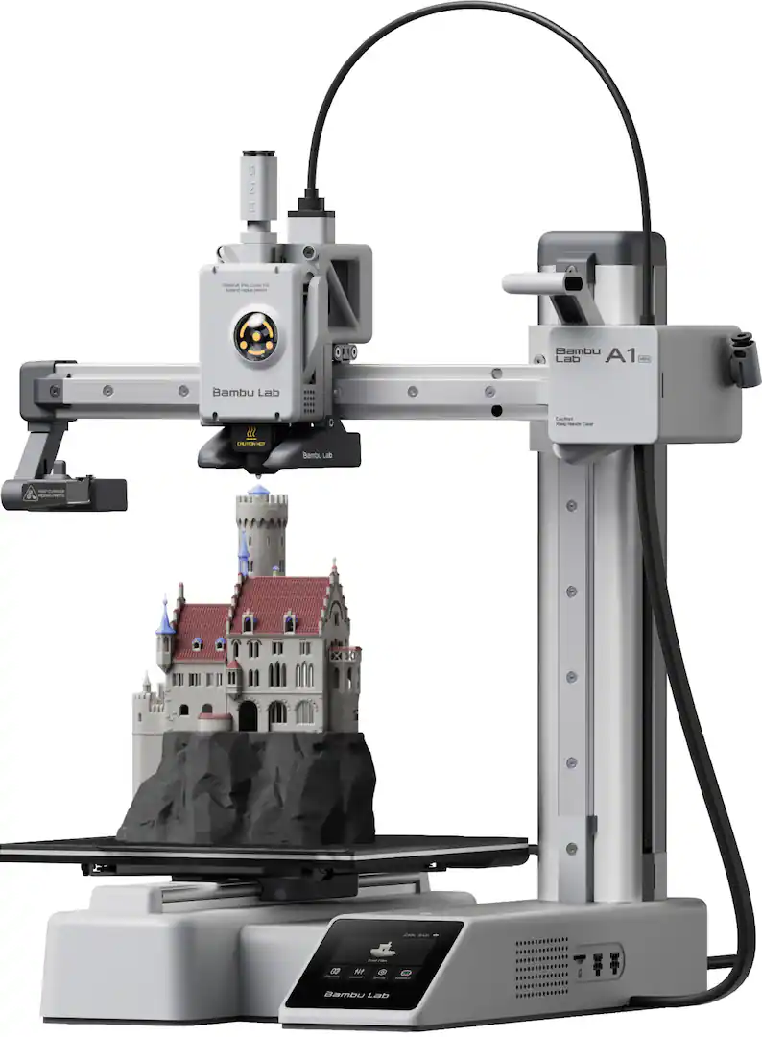
Our Printer Fleet
Know which printer matches the job
Different machines support different levels of speed, reliability, enclosure, and material control.
Bambu P1S (PLA or PETG)
Bambu A1 Mini (PLA Only)
Robo E4 (TPU Only)
Enclosed for fast, reliable parts and higher-temp filament options
Compact open-frame printer for smaller PLA parts and quick iteration
Stronger nozzle for more specialized materials. Slower than Bambu, but prints with TPU are better.
LockwoodSTEM | Principles of Engineering | Unit 0
11
Notes:
The image is representative of the printer types and classroom use cases. Review which machines students will use and your local queue rules.

Slide 11
Printer Profile
Bambu P1S: enclosed, fast, advanced
Good when speed and enclosure matter for a full-size print.
Key specs
Build volume: 256 × 256 × 256 mm
Enclosed plastic/glass shell
Max hot end: 300 °C; bed: 100 °C
Max toolhead speed: 500 mm/s
LockwoodSTEM | Principles of Engineering | Unit 0
12
Notes:
Specs from Bambu Lab P1S official product page. Reinforce local classroom rules: materials and queues may be restricted even if the printer can physically handle them.

Slide 12
Printer Profile
Bambu A1 Mini: compact, quick, open-frame
Good for small parts, fast checks, and iteration.
Key specs
Build volume: 180 × 180 × 180 mm
Open-frame bedslinger
Max hot end: 300 °C; bed: 80 °C
Max toolhead speed: 500 mm/s
LockwoodSTEM | Principles of Engineering | Unit 0
13
Notes:
Specs from Bambu Lab A1 mini official product page. Emphasize that the open frame means some higher-temperature materials are not appropriate for this printer.

Slide 13
Printer Profile
Robo E4: classroom workflow and safety focus
Good for shared classroom use and student certification workflows.
Key specs
Build volume: 8.7 × 8.7 × 8.7 in
Fully enclosed design with HEPA filtration
Heated removable print bed
Quick-change nozzle and Wi‑Fi connectivity
LockwoodSTEM | Principles of Engineering | Unit 0
14
Notes:
Specs from Robo E4 official product page. Mention any specific classroom checkout/certification steps for these machines.

Slide 14
Work Time
Before you print: prove your plan
Your teacher should be able to see the manufacturing logic before the machine starts.
1
Certification
3D printer certification verified
2
Model review
Frame geometry fits the CubeSat and M3 strategy
3
Slicer preview
No surprise supports, weak walls, or risky orientation
4
Settings record
Layer height, walls, infill, orientation, time, filament use
5
Teacher approval
Print-ready files queued or launched
End of lesson deliverable: approved print-ready frame files + Print Settings Record.
LockwoodSTEM | Principles of Engineering | Unit 0
15
Notes:
Use this slide to transition into work time. Students should not print until the settings record and preview have been reviewed.

Slide 15
Sources
Reference sources
Specifications and product details used for this presentation.
Bambu Lab P1S official product page
Build volume, enclosure, temperatures, speed, acceleration, supported materials.
Bambu Lab A1 mini official product page
Build volume, temperatures, speed, sensors, materials, physical dimensions.
Robo E4 official product page
Classroom-focused features, enclosure, HEPA filtration, build volume, speed, training/certification support.
ASTM/ISO additive manufacturing process families
Used as a reference for general additive manufacturing process categories.
LockwoodSTEM | Principles of Engineering | Unit 0
16
Notes:
Use this slide to distinguish official specifications from representative visuals.

