Slide 1
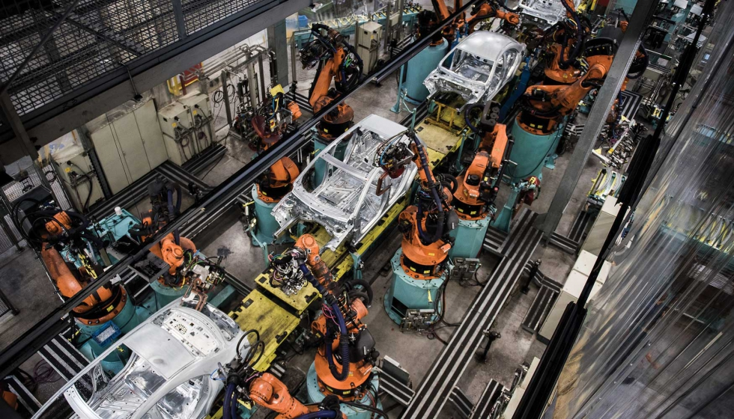

ADM 1.1.1
Assembly
Line
How do assembly lines organize work to improve consistency, efficiency, and repeatability?
START → BUILD / ANALYZE → CLOSE
Analyze line examples • Build a process map • Identify bottlenecks • Defend an improvement
LockwoodSTEM | Advanced Manufacturing | Unit 1
01
Notes:
Open by connecting today to real manufacturing. Explain that students will study how work is organized into a repeatable system, then create a process map and improvement defense.

Slide 2
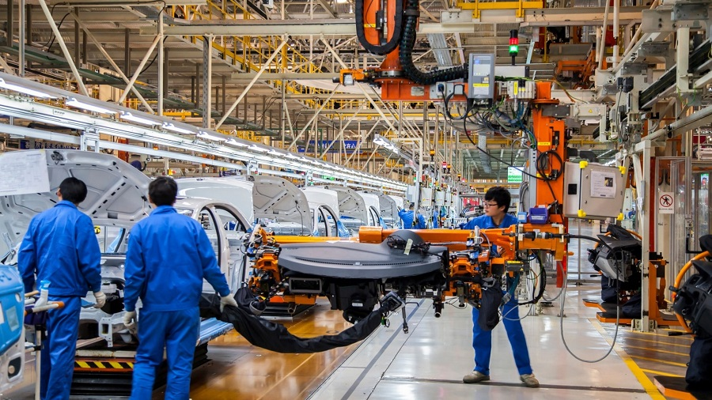
Lesson focus
Organize work like an engineer, not just like a builder.
FOCUS QUESTION
How can a production process be designed so each station improves the final product?
BY THE END
Explain how assembly lines divide work into stations.
Identify inputs, outputs, sequence, bottlenecks, and quality checks.
Use evidence to recommend one process improvement.
Submit a process map, evidence of progress, and a short reflection.
A line turns repeated work into a system that can be studied and improved.
LockwoodSTEM | Advanced Manufacturing | Unit 1
02
Notes:
Preview the deliverable early. Students should know that every observation during the activity can become evidence for their process map and reflection.

Slide 3
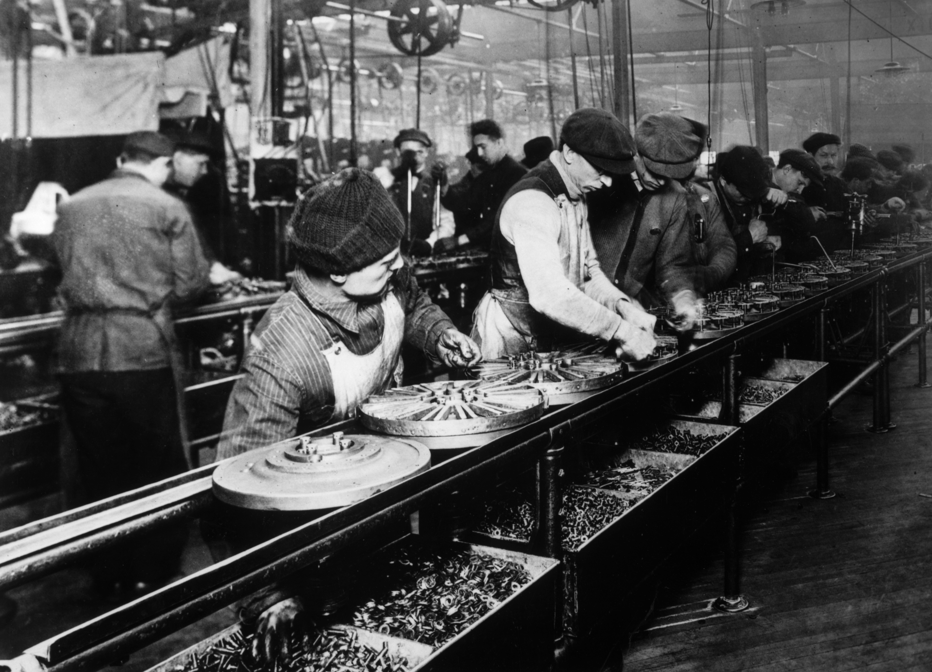
START: compare the systems
Two production models. Same goal. Different workflow.
Historical moving line: workers and parts are organized into a repeated sequence.
Modern automated line: robots, conveyors, sensors, and humans coordinate station work.
Look for: station roles • part movement • repeated tasks • quality checks • waiting time
LockwoodSTEM | Advanced Manufacturing | Unit 1
03
Notes:
Give students a few minutes to identify what stayed the same between the old and modern examples. Guide them toward repeatability, sequence, and quality.

Slide 4
What makes it an assembly line?
An assembly line is a process design, not just a conveyor belt.
CORE IDEA
The product moves through a planned sequence. Each station adds value, checks quality, or prepares the next step.
A line works only when station tasks, timing, materials, and quality expectations are clear.
Input
Station 1
Station 2
Station 3
Output
Parts, materials, info
One clear task
Next task
Check or finish
Finished product
LockwoodSTEM | Advanced Manufacturing | Unit 1
04
Notes:
Use the diagram to define input, station, output, and sequence. Emphasize that this is a process map, not a picture of a factory.

Slide 5
Vocabulary that makes the system visible
Engineers improve what they can name, measure, and explain.
Station
Where one defined task happens.
Cycle time
Time for one station to complete its task.
Throughput
Good units produced over time.
WIP
Partially finished items waiting between stations.
Bottleneck
The slowest constraint that limits the line.
Quality check
Inspection that catches errors before they continue.
Use these words in your process map and reflection.
LockwoodSTEM | Advanced Manufacturing | Unit 1
05
Notes:
These terms give students the language they need for evidence-based discussion.

Slide 6
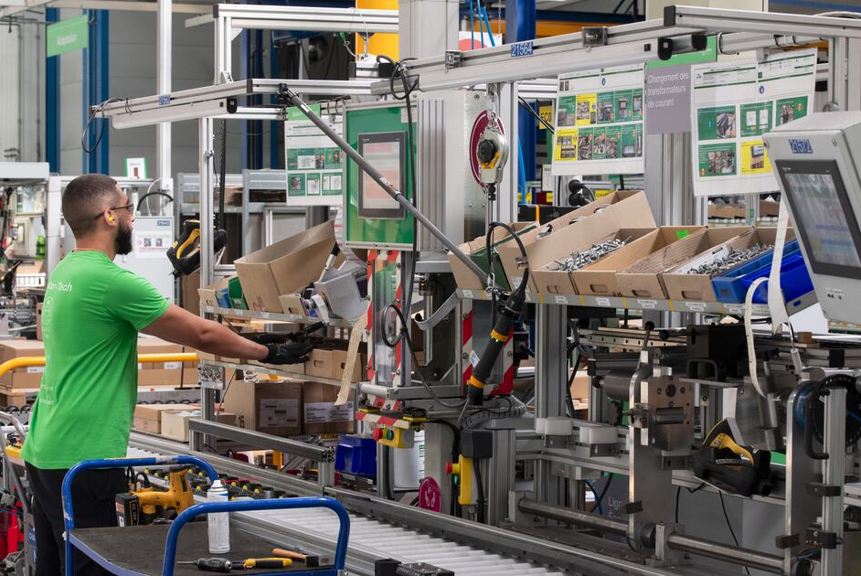
Anatomy of a workcell
A good station has everything needed to do the task the same way each time.
LOOK FOR
Parts and tools are within reach.
The task has a clear start and stop point.
The operator knows the quality standard.
Output moves smoothly to the next station.
Problems are visible quickly.
Good layout reduces wasted motion and makes mistakes easier to find.
A workcell keeps tools, parts, instructions, and quality checks close to the task.
LockwoodSTEM | Advanced Manufacturing | Unit 1
06
Notes:
Connect this to the classroom. Students should treat their own table or build station as a workcell.

Slide 7
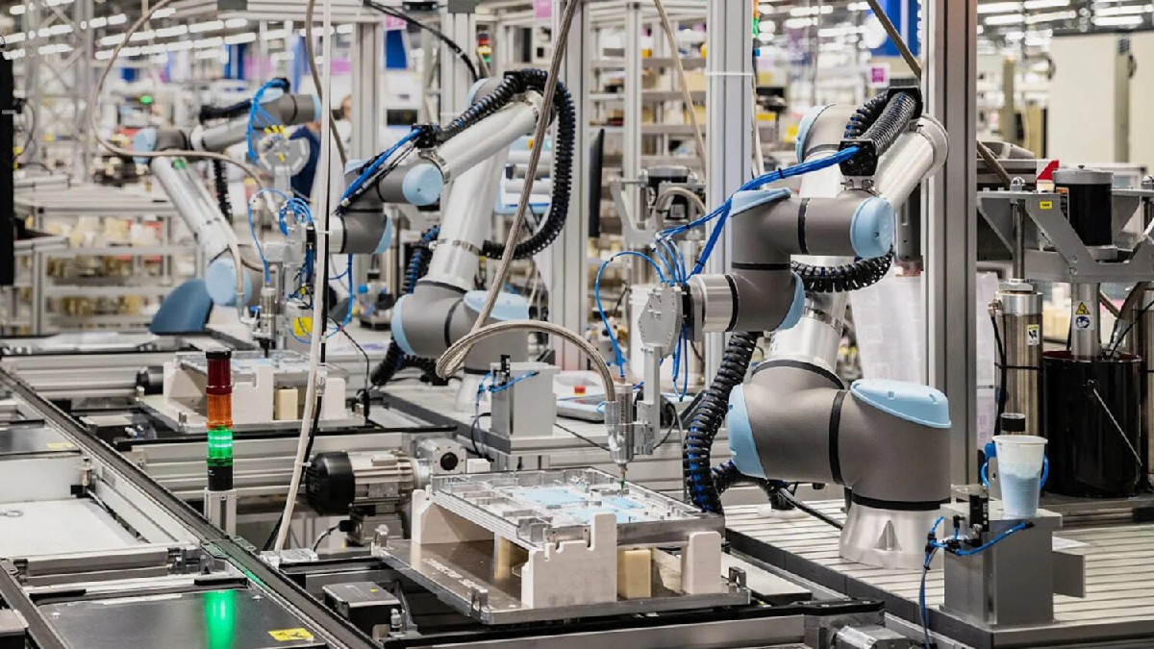
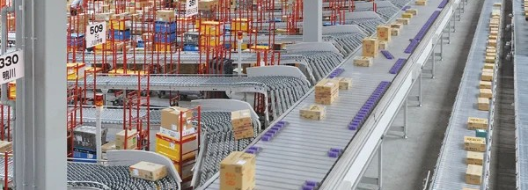
People, machines, and data all have jobs
Automation changes the work, but engineering decisions still matter.
Human operator
Sets up, monitors, responds, improves
Robot / machine
Repeats controlled motion or process
Sensor / camera
Measures position, defect, count, or status
Controller
Uses logic to decide the next action
Documentation
Preserves the process so it can be repeated
Question: Which jobs should be automatic, and which jobs should stay human-controlled?
Sensors and automated lines still require setup, monitoring, and improvement.
LockwoodSTEM | Advanced Manufacturing | Unit 1
07
Notes:
Ask students where automation helps and where human judgment is still important.

Slide 8
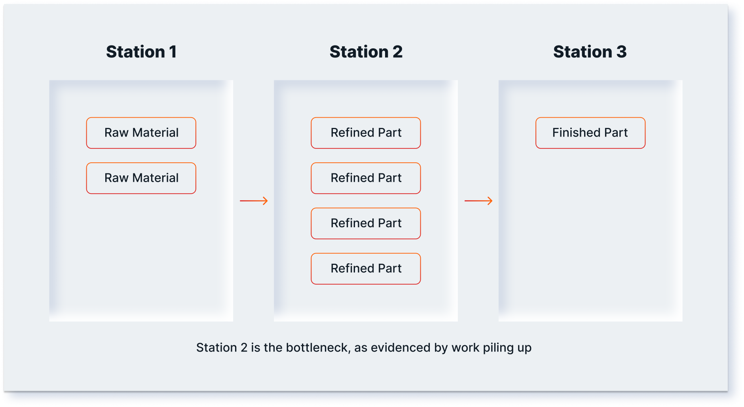
Bottlenecks control the whole line
The slowest step determines how fast the system can produce good output.
QUICK DIAGNOSIS
A station may be the bottleneck if…
Parts pile up before it.
Workers after it wait.
It has the longest cycle time.
Small delays there slow everyone else.
Quality errors from that station repeat downstream.
Work piling up before one station is evidence of a constraint.
Improvement target: remove the constraint without creating a new problem.
LockwoodSTEM | Advanced Manufacturing | Unit 1
08
Notes:
Students should use the bottleneck idea during the activity. The point is to use evidence, not guesses.

Slide 9
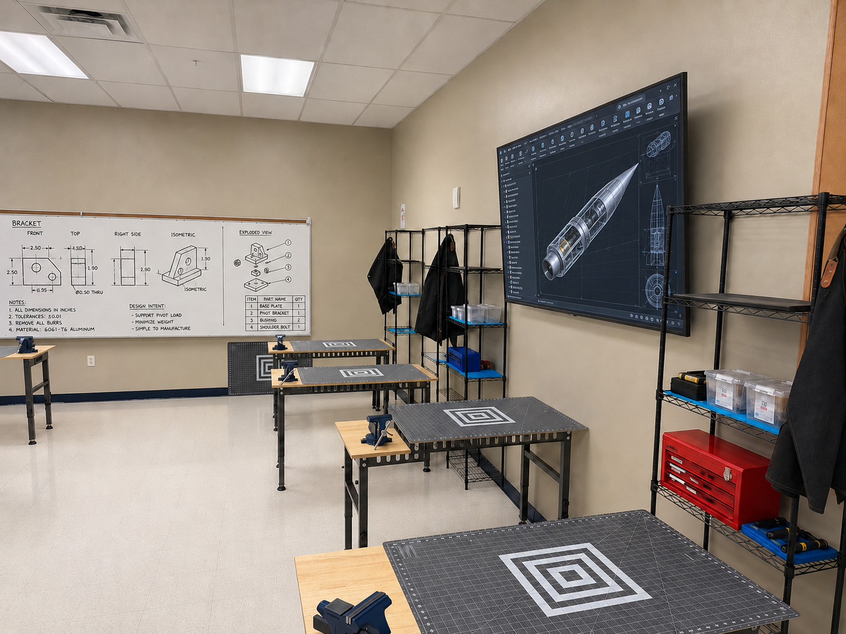
BUILD: run a simple production line
Your goal is not just to build. Your goal is to study the process.
TEAM TASK
Design a line that can produce a repeated classroom product with consistent quality.
ROUND 1: BASELINE
Assign station roles.
Run the line once without optimizing.
Record cycle time, defects, and waiting points.
Build evidence from the process, not just from the final product.
ROUND 2: IMPROVE
Change one thing, then test again.
LockwoodSTEM | Advanced Manufacturing | Unit 1
09
Notes:
This can support a paper airplane line, a sorting task, a packaging task, or any simple classroom material.

Slide 10
ANALYZE: collect evidence as the line runs
A claim about improvement needs data, not vibes.
Run
Units started
Good units
Defects
Slowest station
Evidence note
Run 1
Run 2
Run 3
Run 4
Use observation + numbers together.
Numbers show the pattern.
Observations explain why the pattern happened.
Photos/sketches prove how the line was arranged.
In industry, sensors often record the same evidence you collect by hand today.
LockwoodSTEM | Advanced Manufacturing | Unit 1
10
Notes:
Tell students to gather enough evidence to make a decision, not every possible measurement.

Slide 11
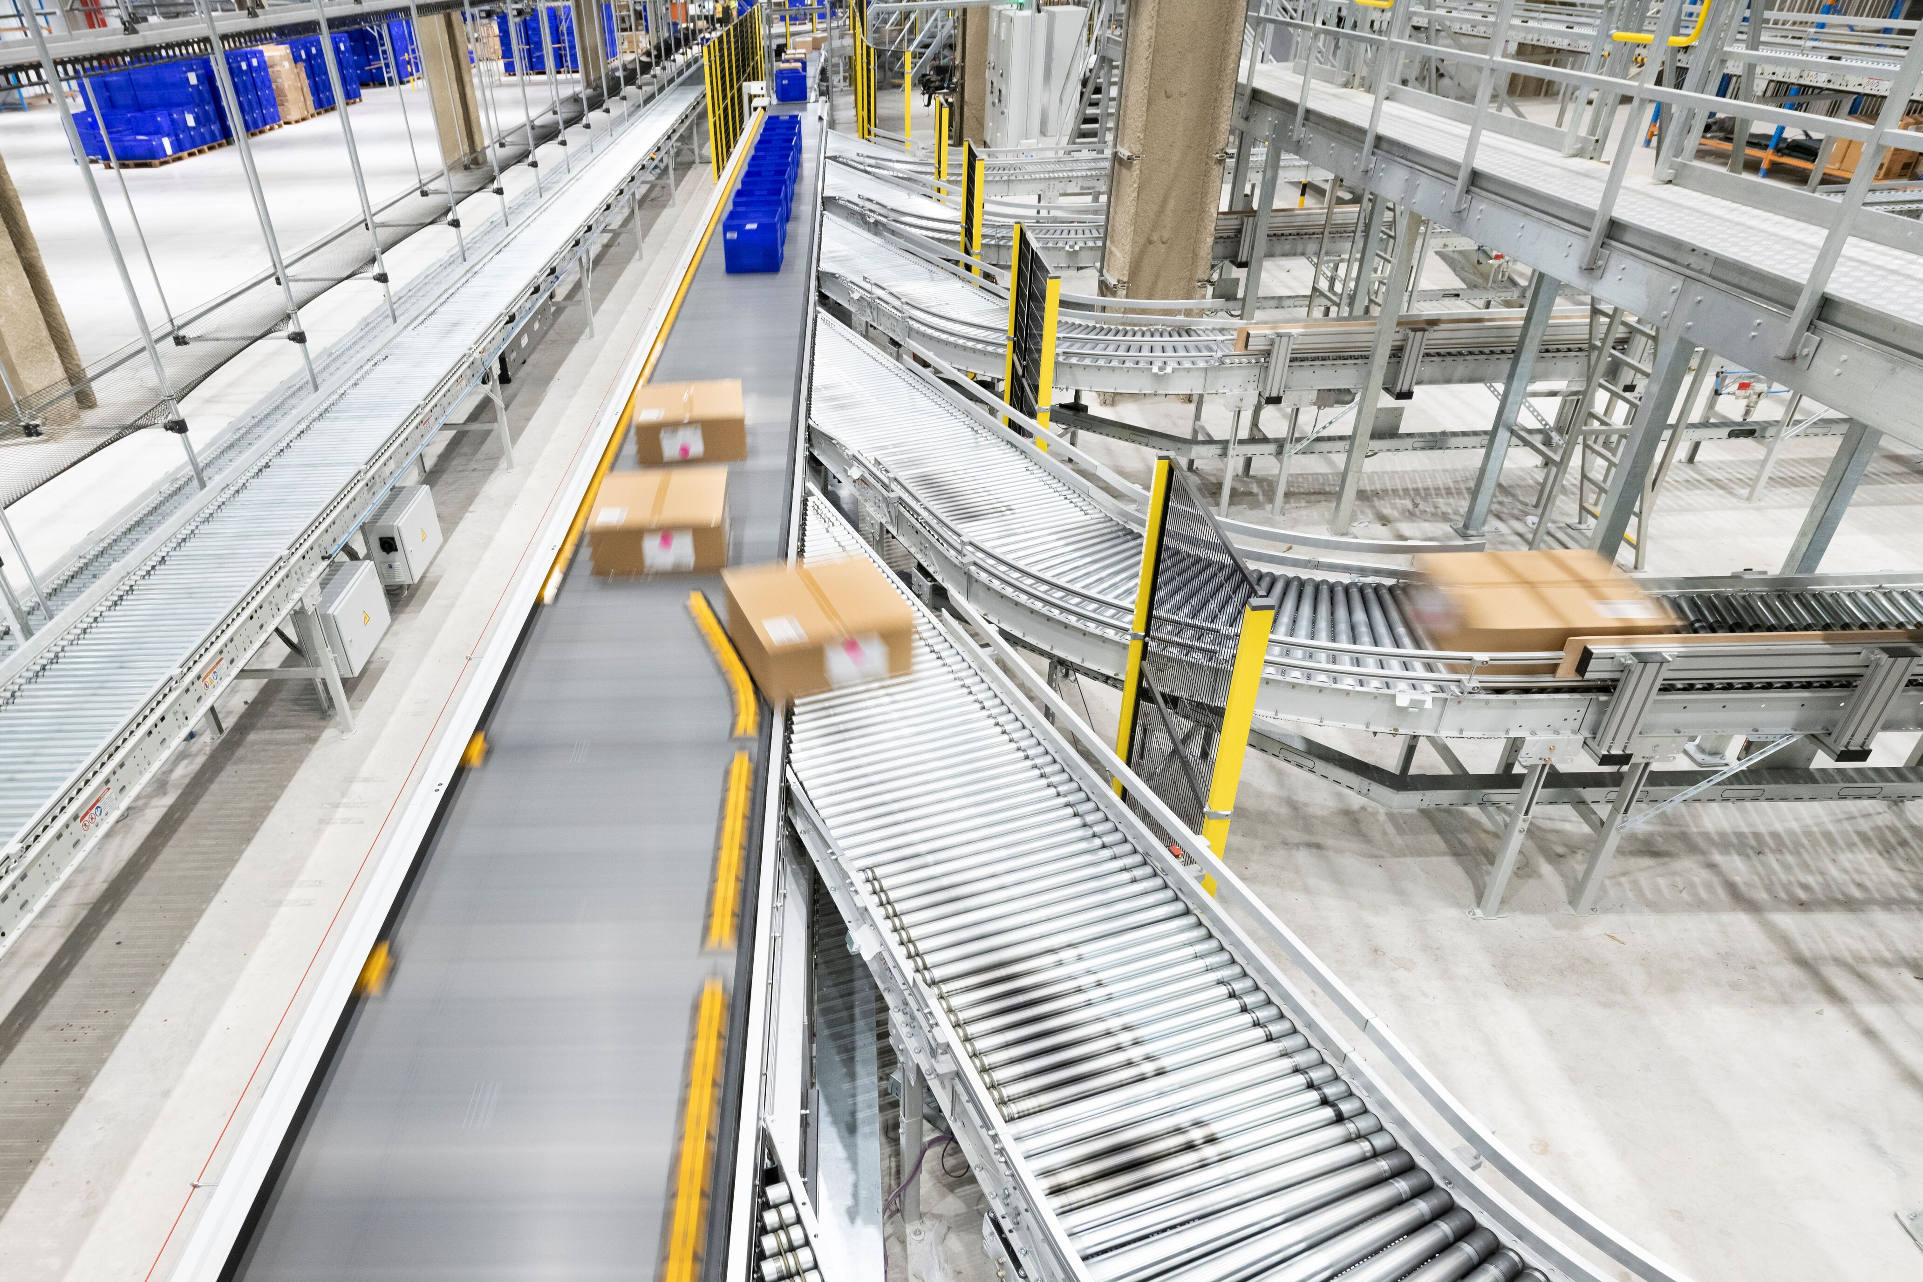
Improve one variable at a time
Process changes should be testable and reversible.
POSSIBLE IMPROVEMENTS
Rebalance station tasks.
Move tools or materials closer to the operator.
Add a quality check before errors travel downstream.
Change the order of steps.
Create a clearer standard work instruction.
Use a simple jig, fixture, or alignment guide.
Material handling systems improve through small, tested changes—not random redesigns.
Before changing the line, predict what evidence should improve.
LockwoodSTEM | Advanced Manufacturing | Unit 1
11
Notes:
Encourage students not to change everything at once. One change makes cause and effect easier to defend.

Slide 12
Document the line so someone else can run it
If it cannot be repeated, it is not yet a reliable process.
Material
Station A
Station B
Inspect
Pack / Submit
DELIVERABLE STRUCTURE
Your process map should show:
Station sequence
Inputs and outputs
Quality check location
Where WIP or waiting appeared
The improvement you tested
Add enough labels that a new student could understand the process without listening to your explanation.
LockwoodSTEM | Advanced Manufacturing | Unit 1
12
Notes:
Students can complete this in notebooks or on paper. Focus on clear labels and repeatable instructions.

Slide 13
Defend the improvement
A better process is one you can explain with evidence.
DECISION CHAIN
Decision
What change did your team make?
Evidence
What data or observation supports the change?
Reasoning
Why does the evidence prove it helped?
Next step
What should be checked or improved next?
Quality systems turn process data into defensible manufacturing decisions.
A finished product shows what you made. A defended process shows how you think.
LockwoodSTEM | Advanced Manufacturing | Unit 1
13
Notes:
Students should use this structure in the final reflection.

Slide 14
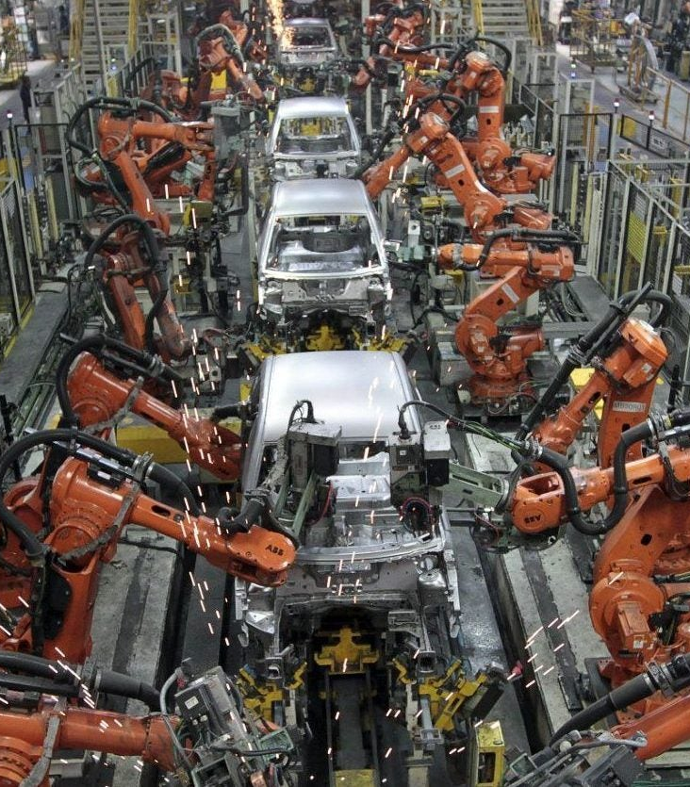
CLOSE
A production line is an engineered system.
Submit before you leave
Process map of your assembly line
Evidence from at least one run
One defended improvement
Short reflection: What made the line more consistent, efficient, or repeatable?
Exit statement: Assembly lines improve manufacturing because…
LockwoodSTEM | Advanced Manufacturing | Unit 1
14
Notes:
End with a quick share-out. Ask teams to state their improvement and the evidence that supports it.

