Slide 1

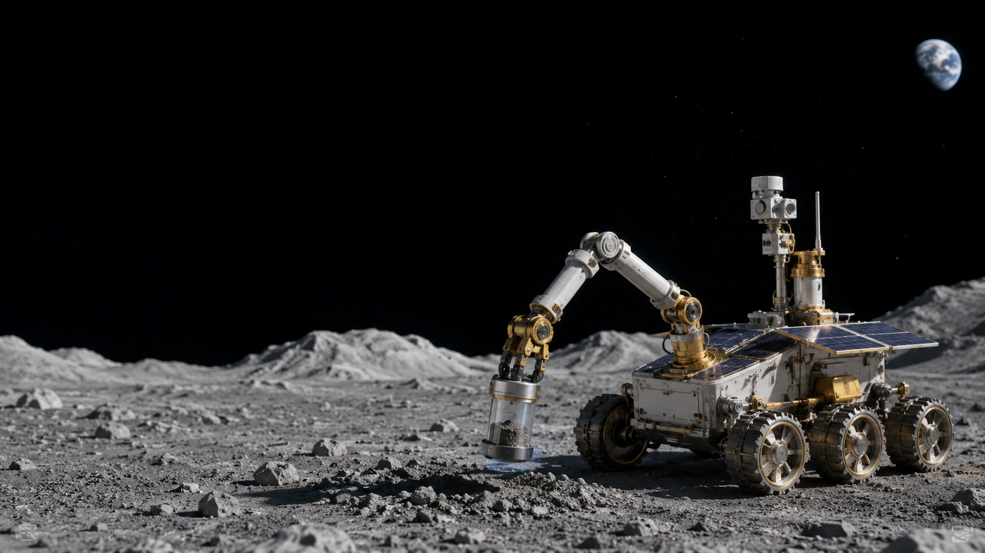
POE 1.1
Unit Launch:
Mechanisms for
Space Missions
How do mechanisms support aerospace missions by changing force, motion, energy, or power?
Student deliverable
POE 1.1 Unit Launch Worksheet
Notes:
Open by telling students that Unit 1 is about mechanisms as mission-critical engineering systems, not just parts that move. Students will use the worksheet throughout the presentation.

Slide 2

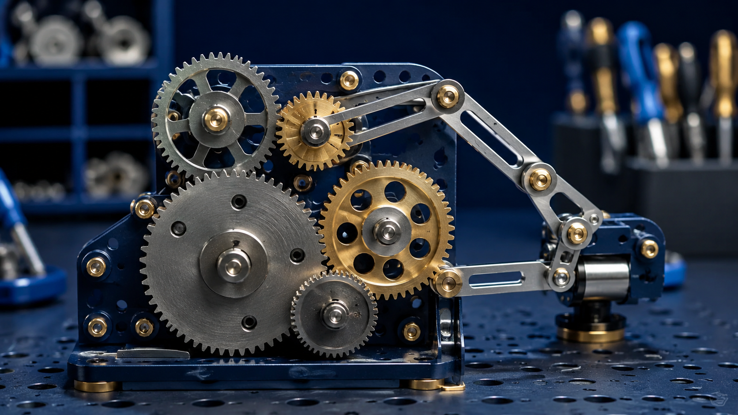
Lesson Mission
Today’s mission
Launch Unit 1 by thinking like aerospace mechanism engineers.
Read and annotate the rover mission scenario.
Define the system need before choosing a mechanism.
Rank stakeholder priorities and justify tradeoffs.
Predict what makes a mechanism successful.
A mechanism is only successful if it changes motion in a way that supports the mission.
Key idea
LockwoodSTEM | Principles of Engineering | Unit 1
02
Notes:
Have students turn to the worksheet and fill in the focus question before starting the mission brief.

Slide 3
Worksheet Roadmap
Use the worksheet as the lesson guide
Each section captures one piece of your engineering thinking.
A–C
D–F
G
H–I
Mission need + priorities
Prior knowledge + snapshots
Questions Unit 1 must answer
Initial claim + exit check
Write as you go. Do not wait until the end.
Short answers can be quick. Longer boxes should show complete engineering reasoning.
LockwoodSTEM | Principles of Engineering | Unit 1
03
Notes:
Tell students they will use this worksheet during the presentation, discussion, and exit check.

Slide 4
Mission Brief
Lunar sample-handling rover
Read, annotate, and underline what the system must accomplish.
A small lunar rover must collect a sealed sample container and move it into protected storage.
Limited electrical power
Strict mass budget
Controlled, reliable motion
Dust and small misalignments
No sudden motion that damages the sample
Part A
Mission Brief: read + annotate
LockwoodSTEM | Principles of Engineering | Unit 1
04
Notes:
Pause after students read. Ask: Which words describe what the system must do? Which words describe constraints or priorities?

Slide 5
Define Before Designing
What does the system need to accomplish?
Do not jump straight to gears, arms, or motors.
Good system need statement
User / operator
Who depends on this system?
The rover needs a way to move a sealed sample into protected storage so the mission can preserve the sample without damage, wasted power, or unreliable motion.
Need
What must the system do?
Why it matters
How does it support the mission?
Part B
Define the System Need
LockwoodSTEM | Principles of Engineering | Unit 1
05
Notes:
Have students complete Part B. Emphasize that a need statement defines the problem, not the chosen solution.

Slide 6
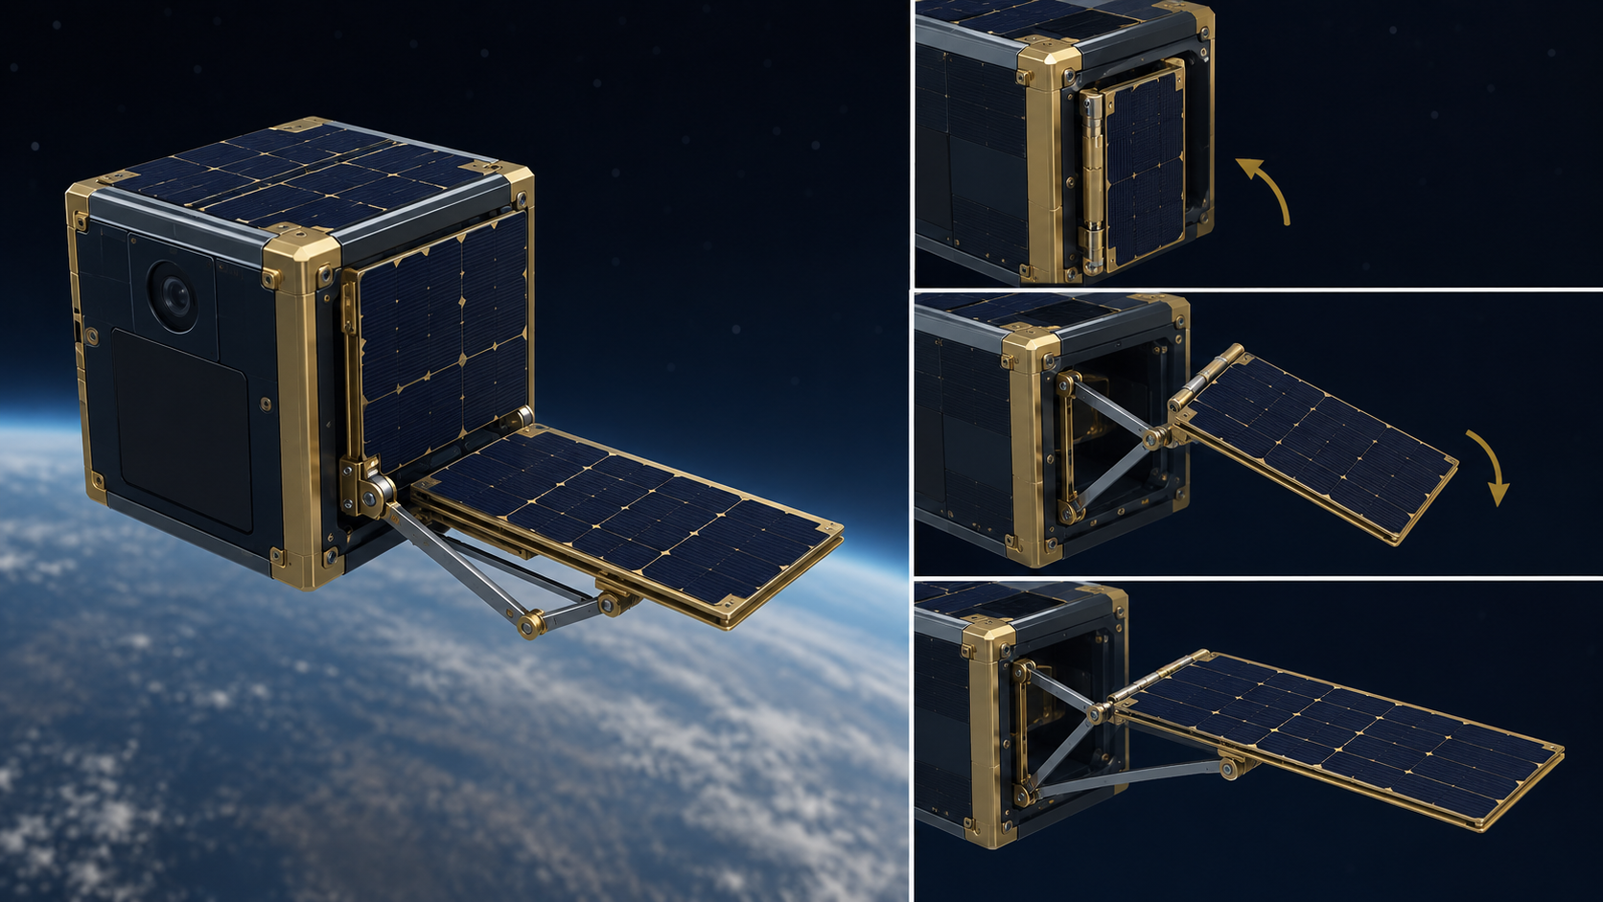
Stakeholder Priorities
Rank what matters most
Aerospace mechanisms always involve tradeoffs.
Priority
Why it could matter
1
Reliability
Must work when repair is difficult
2
Low mass
Every gram competes with payload
3
Low power
Energy is limited
4
Speed
Mission time matters
5
Precision
Motion must be controlled
6
Maintenance
Simple systems are easier to inspect
Discussion prompt
Which priority would you rank #1 for the lunar sample rover? Why?
Part C
Stakeholder Priorities
LockwoodSTEM | Principles of Engineering | Unit 1
06
Notes:
Students rank priorities individually first, then compare with a partner. There is no single correct ranking as long as reasoning is mission-based.

Slide 7
Mechanism Thinking
Mechanisms change something useful
The question is not “Does it move?” It is “What changes from input to output?”
INPUT
MECHANISM
OUTPUT
force • motion • energy
changes or transfers
new force • speed • direction
Mechanisms may change force, speed, torque, direction, distance, timing, or type of motion.
Part D
Prior Knowledge Inventory
LockwoodSTEM | Principles of Engineering | Unit 1
07
Notes:
Introduce the mechanism thinking vocabulary before students complete prior-knowledge inventory and mechanism snapshots.

Slide 8
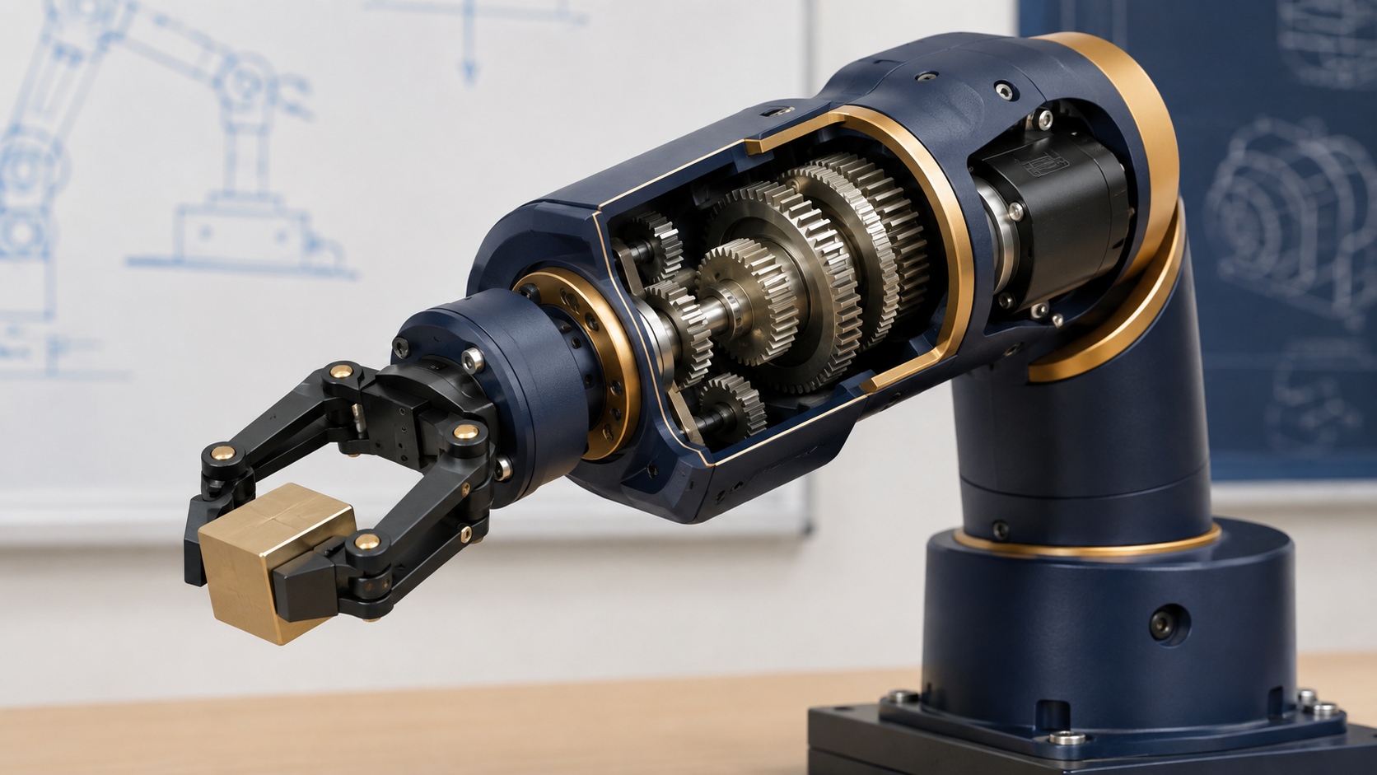
Mechanism Snapshots
Four aerospace mechanisms
For each snapshot, identify the input, output, and main tradeoff.
Rover Drive
Solar Array Deployment
Landing Gear Actuator
Robotic Arm Joint
Motor + gear train turns wheels
Hinge/linkage unfolds panel
Motor + screw extends support
Gears rotate a payload
As you listen, fill in Part E. Focus on what changes from input to output.
Part E
Mechanism Snapshots
LockwoodSTEM | Principles of Engineering | Unit 1
08
Notes:
Move quickly through the four snapshots. Students should describe inputs/outputs in simple words, not formal equations.

Slide 9
Analyze the Change
What changes from input to output?
Use the same pattern for every mechanism.
INPUT
MECHANISM
OUTPUT + TRADEOFF
What starts
the motion?
changes
What useful motion appears?
What did the design sacrifice?
Example: Motor rotation → gear train → slower wheel rotation with greater torque
Part F
Mechanism Thinking Questions
LockwoodSTEM | Principles of Engineering | Unit 1
09
Notes:
Have students use Part F to compare snapshots: which changes direction/type of motion, and which trades speed for torque or force?

Slide 10
Questions Unit 1 Must Answer
What do engineers need to know before choosing a mechanism?
Write one strong question in each category.
Force / mechanical advantage
Speed / motion
Energy / power
How much force must the mechanism provide?
How fast or how far should the output move?
How much energy can the system use?
Reliability / efficiency
Testing / evidence
What failure or loss would hurt the mission most?
How will we prove the mechanism works?
Part G
Questions This Unit Must Answer
LockwoodSTEM | Principles of Engineering | Unit 1
10
Notes:
Students should not write answers yet; they should write questions that Unit 1 will help them answer.

Slide 11
Initial Claim
Make a prediction you can revisit
Your claim will probably improve as you learn more.
A successful aerospace mechanism must…
because…
Support your claim with evidence from the mission brief, priorities, or mechanism snapshots.
Part H
Initial Claim / Prediction
LockwoodSTEM | Principles of Engineering | Unit 1
11
Notes:
Encourage students to use a complete thought. It is okay if their claim changes after Unit 1.

Slide 12
Exit Check
Before you submit today
Finish the worksheet sections that match today’s lesson.
Exit Check
Turn in
Define a mechanism in your own words.
Name one quantity or behavior a mechanism can change.
Identify one idea you expect to learn more about in Unit 1.
Add The POE 1.1 Unit Launch Worksheet To Your ENB
Keep the unit questions and initial claim. We will revisit them as mechanisms become more mathematical.
LockwoodSTEM | Principles of Engineering | Unit 1
12
Notes:
Collect or have students upload the completed worksheet. Preview next lesson: simple machines in aerospace systems.

