Slide 1

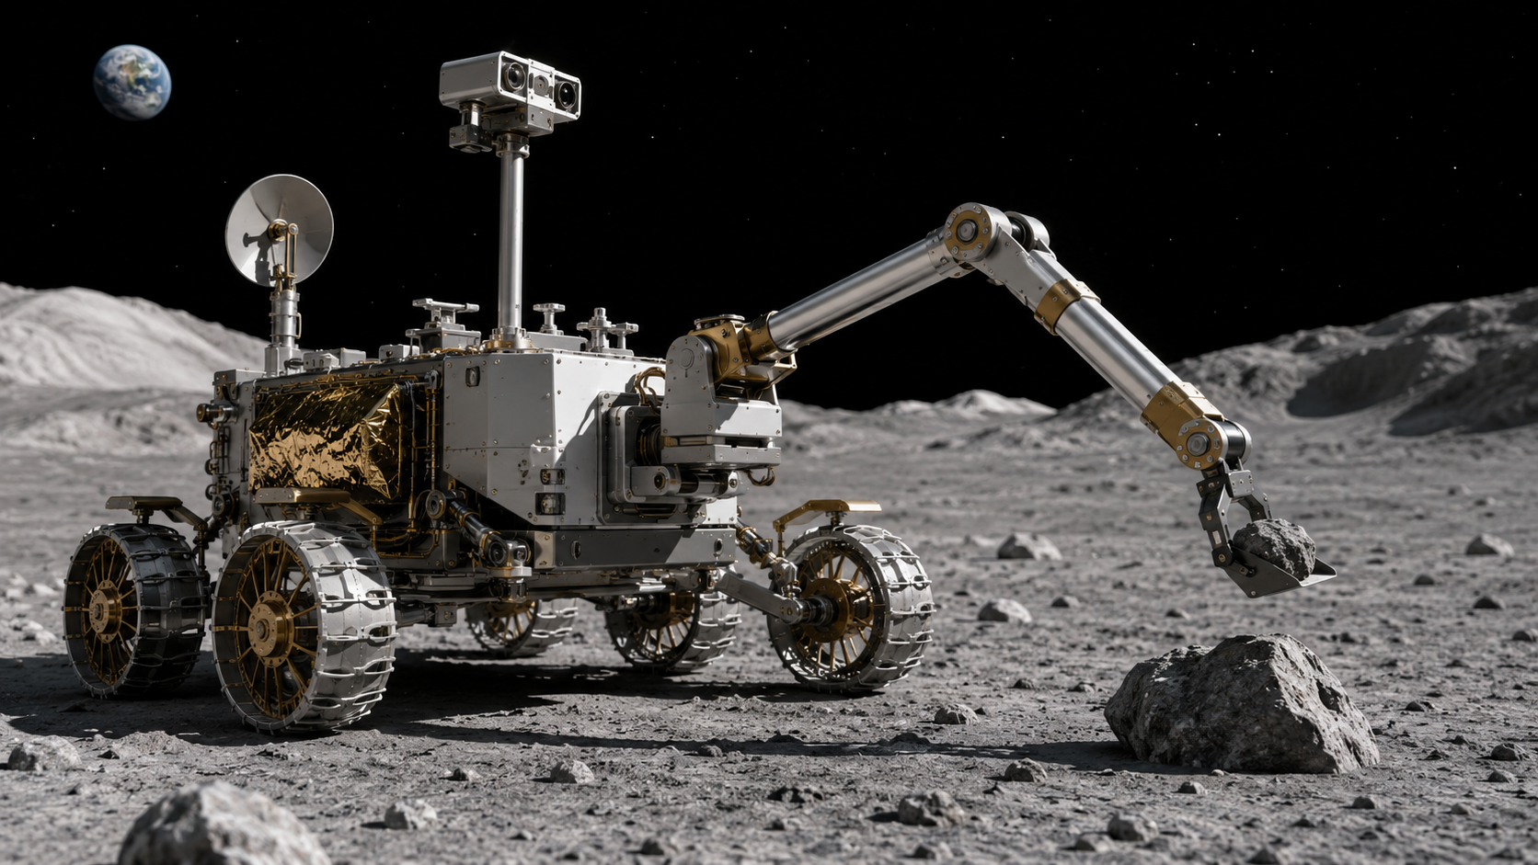
POE 1.2
Simple Machines
in Aerospace Systems
How do simple machines change force, distance, direction, or motion in aerospace applications?

Slide 2

Lesson Mission
Today’s mission
Identify simple machines in aerospace mechanisms and explain what useful change each one creates.
By the end, you should be able to…
• Name the six simple machines.
• Connect each one to an aerospace mechanism.
• Describe the input → output change.
• Create a concept sketch that explains the change.
Key idea
Simple machines do not create energy. They change how force or motion is applied.
LockwoodSTEM | Principles of Engineering | Unit 1
02

Slide 3
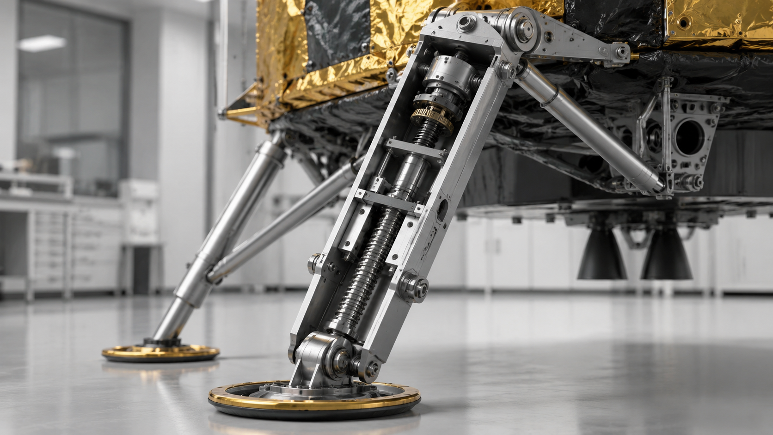
Part A: The Six Simple Machines
Simple machines change something useful
They trade force, distance, direction, or motion so a mechanism can complete a task.
INPUT
SIMPLE
MACHINE
OUTPUT
force / motion enters
change happens
useful result
LockwoodSTEM | Principles of Engineering | Unit 1
04

Slide 4
Part A: Reference Set
The six simple machines
Use these as your answer bank for Part B.
Lever
Pulley
Wheel & axle
1
2
3
rotates about a fulcrum
changes pull direction
changes torque, force, or speed
Inclined plane
Wedge
Screw
4
5
6
trades distance for lower input force
separates, cuts, or locks
turns rotation into linear motion
LockwoodSTEM | Principles of Engineering | Unit 1
05

Slide 5
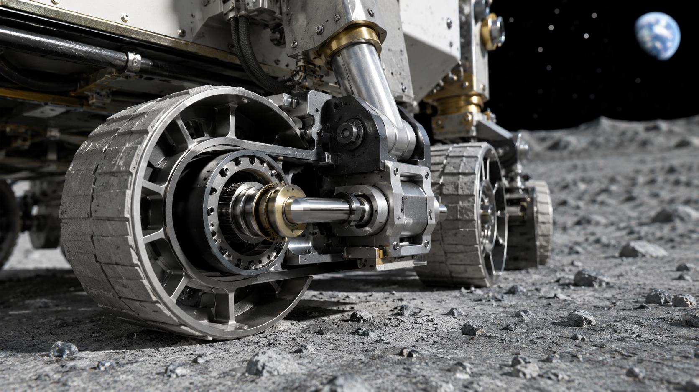
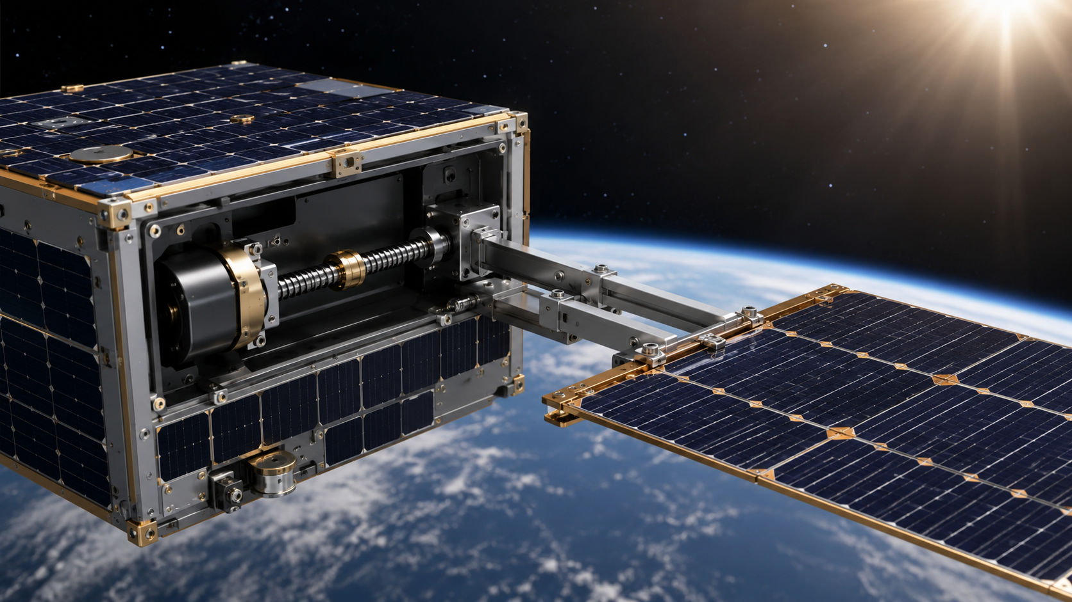
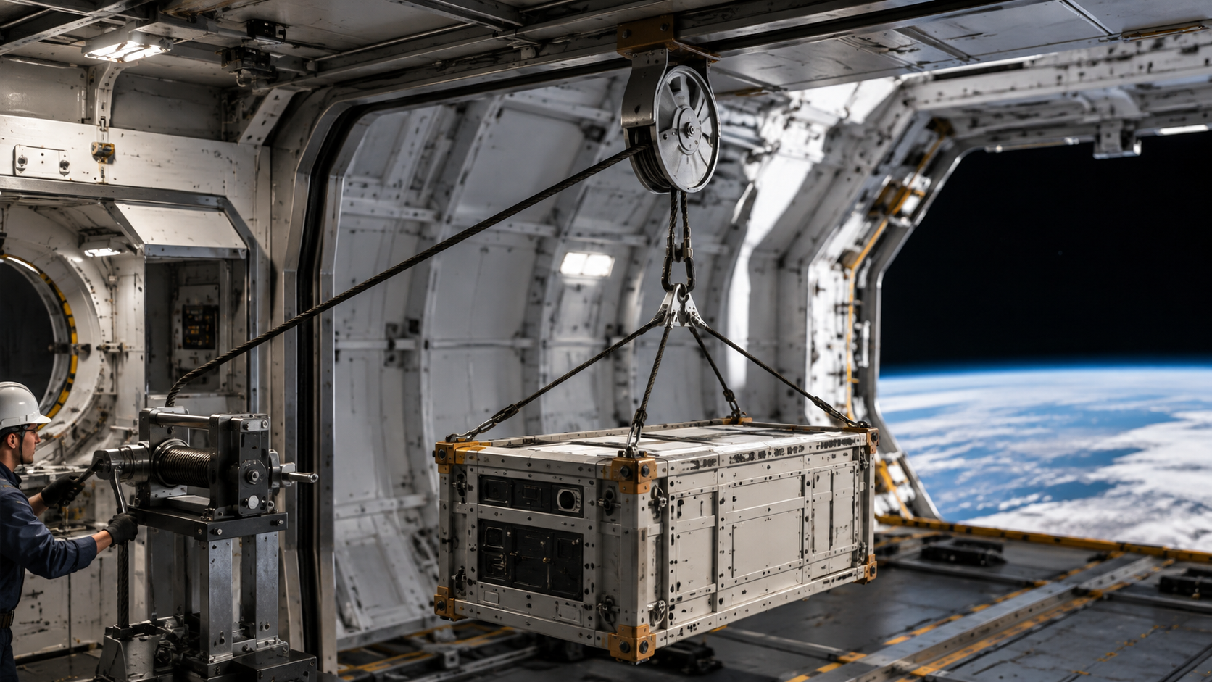
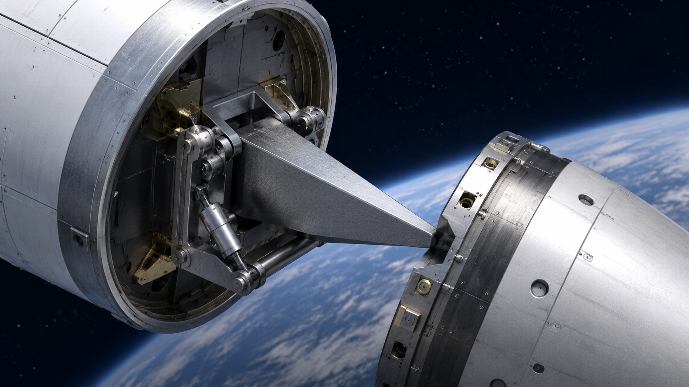
Part B: Identify the Simple Machine
Mechanism snapshots
For each one, ask: What goes in? What changes? Why is that useful?
Wheel & axle
Screw
Rover drive
Solar panel deployment
Input → machine → output
Input → machine → output
Pulley
Wedge / lever
Cargo bay hoist
Separation or release
Input → machine → output
Input → machine → output
LockwoodSTEM | Principles of Engineering | Unit 1
06

Slide 6
Part C: Ideal Mechanical Advantage
IMA compares useful geometry
In Part C and Part D, you use ideal geometry and ignore friction.
Lever
Pulley
Wheel & axle
IMA = effort arm / resistance arm
IMA = supporting rope segments
IMA = wheel radius / axle radius
Inclined plane
Wedge
Screw
IMA = ramp length / height
IMA = wedge length / thickness
IMA = circumference / lead
Key idea
Higher IMA usually means more force advantage, but it also requires a distance or speed tradeoff.
LockwoodSTEM | Principles of Engineering | Unit 1
07

Slide 7
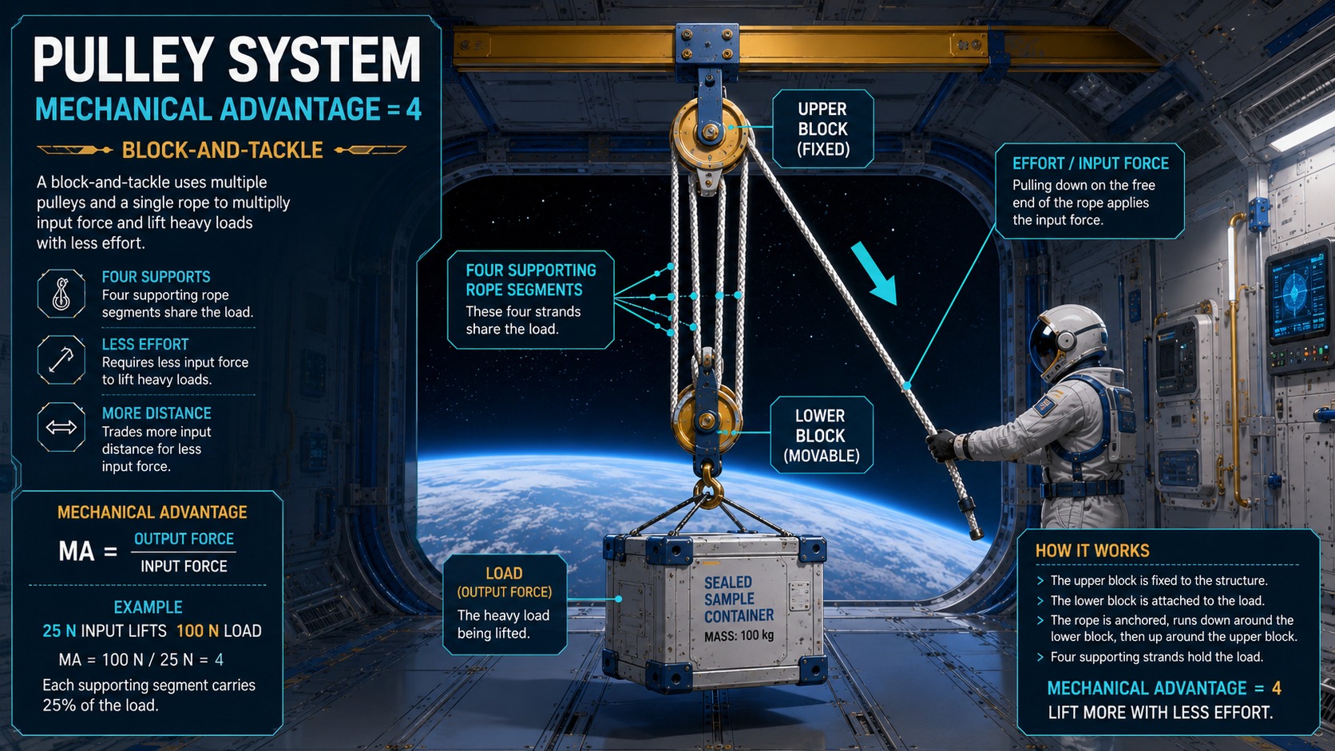
Part C: Ideal Mechanical Advantage
LockwoodSTEM | Principles of Engineering | Unit 1
07

Slide 8
Part D: Guided IMA Examples
Set up the calculation before solving
These match the first three calculation types on the worksheet.
Lever
Pulley
Wheel & axle
Access hatch handle
Instrument hoist
Rover drive
IMA = effort arm / resistance arm
IMA = 0.48 m / 0.12 m = 4
IMA = supporting rope segments
IMA = 4
IMA = wheel radius / axle radius
IMA = 0.18 m / 0.03 m = 6
LockwoodSTEM | Principles of Engineering | Unit 1
08

Slide 9
Part D: More IMA Examples
Distance tradeoffs show up in different ways
Look carefully at which dimensions belong in the ratio.
Inclined plane
Wedge
Screw
Payload ramp
Separation tool
Precision actuator
IMA = ramp length / height
IMA = 2.40 m / 0.60 m = 4
IMA = wedge length / thickness
IMA = 80 mm / 20 mm = 4
IMA = 2πr / lead
IMA = 2π(40 mm) / 2.0 mm ≈ 126
LockwoodSTEM | Principles of Engineering | Unit 1
09

Slide 10
Part E: Input, Output, and Tradeoffs
Describe what changes
Your worksheet responses should connect motion to a mission need.
Input
What force or motion enters the mechanism?
Output
What useful force or motion leaves the mechanism?
Tradeoff
What is gained, and what is sacrificed?
Key idea
Use words like force, torque, speed, distance, direction, linear motion, or rotation.
LockwoodSTEM | Principles of Engineering | Unit 1
10

Slide 11
Part F: Mission Need Matching
Choose the best starting mechanism
Justify the match by naming the tradeoff.
A
Move a heavy package into a test stand
B
Extend a landing support slowly
Limited input force → inclined plane or pulley
Precision + high force → screw
Explain why it fits.
Explain why it fits.
C
Drive a rover over rough terrain
D
Change cable direction around structure
Torque at ground → wheel & axle
Route force safely → pulley
Explain why it fits.
Explain why it fits.
LockwoodSTEM | Principles of Engineering | Unit 1
11

Slide 12
Part G: Recommendation Evidence
Recommend a mechanism using evidence
Your final response combines identification, IMA, and engineering reasoning.
Mission scenario
A lunar rover must lift a sealed 12 kg sample container 0.30 m into protected storage. The mechanism must be compact, predictable, and avoid sudden motion.
Your evidence should include:
• recommended simple machine
• input and desired output
• one IMA calculation
• one tradeoff or test needed
LockwoodSTEM | Principles of Engineering | Unit 1
12

Slide 13
Part H: Exit Check
Before you submit today
Use this checklist to verify your worksheet is complete.
Exit check
Turn in
1. Define ideal mechanical advantage.
2. Name the best simple machine for precise linear motion.
3. Explain why higher IMA usually requires a tradeoff.
Completed 1.2 Worksheet Added To ENB
LockwoodSTEM | Principles of Engineering | Unit 1
13

