Slide 1


POE 1.3
Force, Distance,
Work, and
Mechanical Advantage
How can measured force and distance data help us compare mechanism designs?
Student deliverable
POE 1.3 Worksheet
LockwoodSTEM | Principles of Engineering | Unit 1
01

Slide 2

POE 1.3 | Unit 1 Lesson 1.3
Today’s mission
Use force and distance data to calculate work and compare mechanism options.
Learning targets
Calculate work using W = F × d.
Find measured mechanical advantage using MA = Fout ÷ Fin.
Use evidence from a data table to justify a design decision.
LockwoodSTEM | Principles of Engineering | Unit 1
02

Slide 3
POE 1.3 | Unit 1 Lesson 1.3
Core ideas: force, distance, work, and mechanical advantage
Aligns with worksheet Parts A–C.
Vocabulary quick check
force
distance
work
input side
output side
mechanical advantage
Work
W = F × d
Energy transferred when a force moves an object.
Measured MA
MA = Fout ÷ Fin
Compares useful output force to input force.
Tradeoff
Less input force usually means more input distance.
How to use the worksheet data
1. Identify the input force and input distance.
2. Calculate input work: Win = Fin × din.
3. Identify the output force and output distance.
4. Calculate measured MA: MA = Fout ÷ Fin.
5. Compare the mechanisms using evidence, not guesses.
W = F × d | MA = Fout ÷ Fin
LockwoodSTEM | Principles of Engineering | Unit 1
03

Slide 4
POE 1.3 | Unit 1 Lesson 1.3
Part D: calculate work
Aligns with worksheet Part D.
Remember
Work is measured force × measured distance. Always show units.
1. Lever hatch test
F = 15 N, d = 0.25 m
W =
2. Payload ramp push
F = 24 N, d = 1.00 m
W =
3. Cable pull for a small lift
F = 25 N, d = 0.75 m
W =
4. Screw actuator handle motion
F = 12 N, d = 2.40 m
W =
Part E: interpret work
Which setup required the most work?
How do you know?
Which setup might feel easiest even if the distance is longer?
5. Sample door movement
F = 8 N, d = 0.60 m
W =
LockwoodSTEM | Principles of Engineering | Unit 1
04

Slide 5

POE 1.3 | Unit 1 Lesson 1.3
Example mechanisms: inclined plane
Key idea: more distance can reduce the force needed.
LockwoodSTEM | Principles of Engineering | Unit 1
05

Slide 6

POE 1.3 | Unit 1 Lesson 1.3
Example mechanisms: lever
Key idea: a longer input arm can multiply the useful output force.
LockwoodSTEM | Principles of Engineering | Unit 1
05

Slide 7

POE 1.3 | Unit 1 Lesson 1.3
More mechanism examples: screw
Notice how each mechanism changes motion in a different way.
Screw actuators trade speed for precise, controlled lifting.
LockwoodSTEM | Principles of Engineering | Unit 1
06

Slide 8
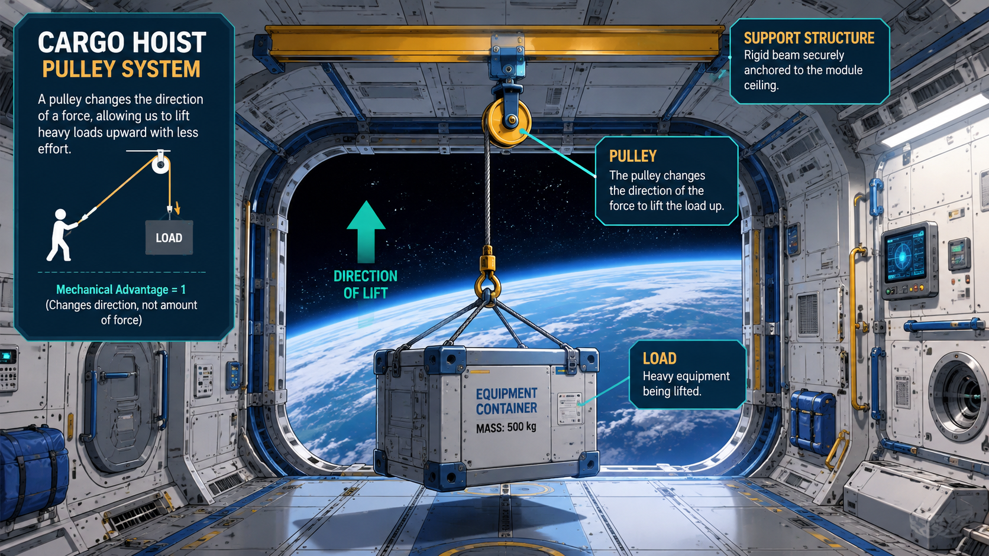
POE 1.3 | Unit 1 Lesson 1.3
More mechanism examples: pulley
Notice how each mechanism changes motion in a different way.
Pulleys can change direction and can be arranged to increase mechanical advantage.
LockwoodSTEM | Principles of Engineering | Unit 1
06

Slide 9
POE 1.3 | Unit 1 Lesson 1.3
Parts F & G: data table and measured mechanical advantage
Mechanism | Fin (N) | din (m) | Fout (N) | dout (m)
Lever test | 15 | 0.40 | 45 | 0.12
Ramp test | 28 | 2.00 | 70 | 0.75
Pulley test | 20 | 0.90 | 38 | 0.42
Screw test | 10 | 3.00 | 180 | 0.15
Questions to answer from the data
Which mechanism has the greatest measured mechanical advantage?
Choose one mechanism where the input distance is larger than the output distance. Explain the tradeoff.
Why is output work often less than input work in a real mechanism?
Model one calculation
Example: lever test measured MA = Fout ÷ Fin = 45 ÷ 15 = 3.0
Then compare that value with the other mechanisms.
LockwoodSTEM | Principles of Engineering | Unit 1
07

Slide 10
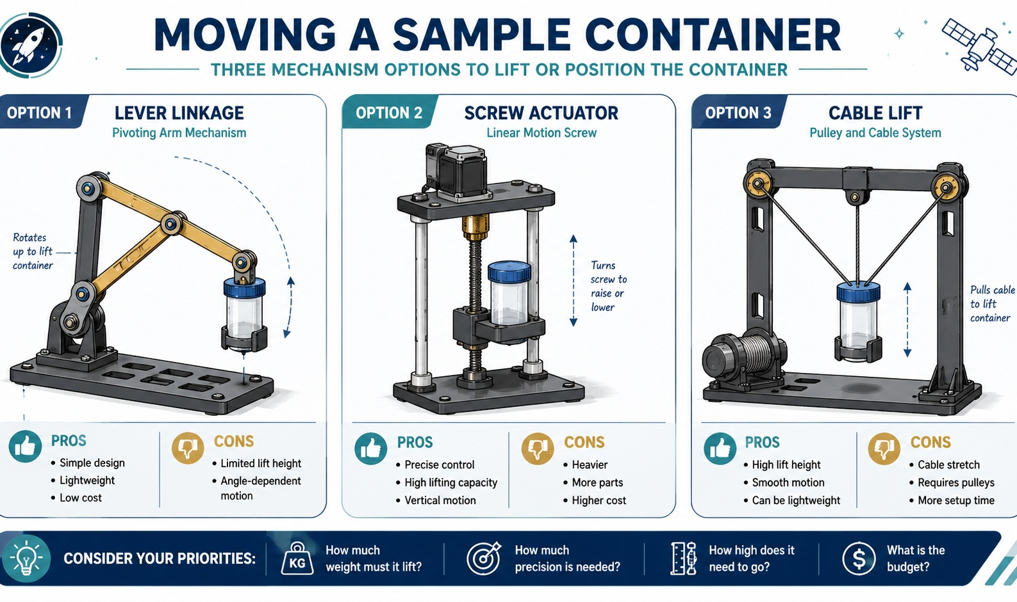
POE 1.3 | Unit 1 Lesson 1.3
Part H: engineering decision
Mission scenario
A lunar rover must lift a sealed sample container into a storage bay.
Questions 10–12
Recommend an option, describe one tradeoff, and name one more test you would run before building the final design.
LockwoodSTEM | Principles of Engineering | Unit 1
08

Slide 11
POE 1.3 | Unit 1 Lesson 1.3
Exit check and preview
Wrap up the worksheet and get ready for Lesson 1.4.
Exit check
A mechanism has input force 12 N and output force 48 N.
What is the measured mechanical advantage?
Show the setup: MA = Fout ÷ Fin
Answer check
MA = 48 ÷ 12 = 4
A mechanical advantage of 4 means the output force is four times the input force.
Summary
Work tells us how much energy is transferred through motion. Mechanical advantage helps us compare how effectively a mechanism multiplies force.
LockwoodSTEM | Principles of Engineering | Unit 1
09

