Slide 1
Chapter 3
The Fundamentals:
Algorithms
The Integers

Slide 2
Objectives
Algorithms
The Growth of Functions
Complexity of Algorithms
The Integers and Division
Primes and Greatest Common Divisors
Integers and Algorithms

Slide 3
3.1- Algorithms
An algorithm is a finite set of precise instructions for performing a computation or for solving a problem.
Specifying an algorithm: natural language/ pseudocode
Notes:
An algorithm can also be described using a computer language → difficult to understand and difficult to choose one particular language among so many programming languages → a form of pseudocode will be used to describe an algorithm.

Slide 4
Properties of an algorithm
Input
Output
Definiteness
Correctness
Effectiveness
Generality
Notes:
- There are several properties that algorithms generally share.

Slide 5
Finding the Maximum Element in a Finite Sequence
Procedure max (a₁,a₂,a₃,…,a_{n}: integers)
max:=a₁
for i:=2 to n
if max < a_{i} then max:= a_{i}
{max is the largest element}

Slide 6
The Linear Search
Procedure linear search (x: integer, a₁,a₂,…,a_{n} :distinct integers)
i:=1
while i ≤ n and x ≠ a_{i}
i:=i+1
if i ≤ n then location:= i
else location:=0
{location is the subscript of the term that equals x, or is 0 if x is not found}
Notes:
- The algorithm begins by comparing x and a₁, when x=a₁, the solution is the position of a₁, namely, 1. When xa₁, compare x and a₂. When x=a₂, the solution is the position of a₂, namely, 2. And so on. If the entire list has been searched without locating x, the solution is 0.

Slide 7
The Binary Search
procedure binary search ( x:integer, a₁,a₂,…,a_{n} : increasing integers)
i:=1 { i is left endpoint of search interval}
j:=n { j is right endpoint of search interval}
while i<j
begin
m:= ⎣(i+j)/2⎦
if x>a_{m} then i:=m+1
else j:= m
end
if x=a_{i} then location := i
else location:= 0
{location is the subscript of the term that equals x, or is 0 if x is not found}
Notes:
This algorithm can be used when the list has terms occurring in order of increasing size.
The binary search algorithm is much more efficient than the linear search algorithm.

Slide 8
Sorting
Putting elements into a list in which the elements are in increasing order.
There are some sorting algorithms
Bubble sort
Insertion sort
Selection sort (exercise p. 178)
Binary insertion sort (exercise p. 179)
Shaker sort (exercise p.259)
Merge sort and quick sort (section 4.4)
Tournament sort (10.2)
Notes:
- Some sorting algorithms in the book.

Slide 9
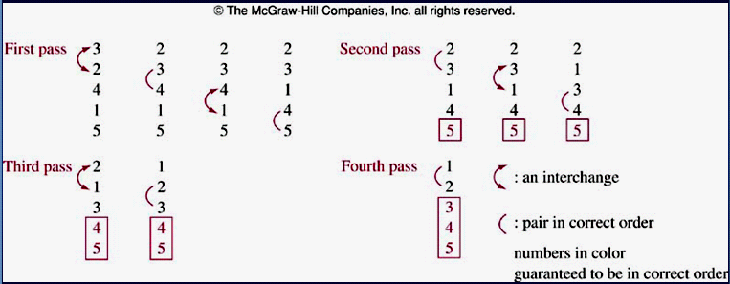
Bubble Sort
procedure buble sort (a₁,a₂,…,a_{n} :real numbers with n ≥ 2)
for i:= 1 to n-1
for j:=1 to n- i
if a_{j} > a_{j+1} then interchange a_{j} and a_{j+1}
{a₁,a₂,…,a_{n} are sorted}
Notes:
In the bubble sort, the smaller elements "bubble" to the top as they are interchanged with larger elements. The larger elements "sink" to the bottom.
The bubble sort is one of the simplest sorting algorithms, but not one of the most efficient. The number of comparisons (a_{j} > a_{j+1}) is n(n-1)/2, where n is the number of elements.

Slide 10
Insertion Sort
procedure insertion sort (a₁,a₂,…,a_{n} :real numbers with n ≥ 2)
for j:= 2 to n { j: position of the examined element }
begin
{ finding out the right position of a_{j} }
i:=1
while a_{j} > a_{i} i:= i+1
m:=a_{j} { save a_{j} }
{ moving j-i elements backward }
for k:=0 to j-i-1 a_{j-k}:=a_{j-k-1}
{move a_{j} to the position i}
a_{i}:= m
end
{a₁,a₂,…,a_{n} are sorted} It is usually not the most efficient
a: 1 2 3 6 7 8 5 9 12 11
j= 7
i=4
m=5
a: 1 2 3 6 7 8 5 9 12 11
a: 1 2 3 6 6 7 8 9 12 11
a: 1 2 3 5 6 7 8 9 12 11
Notes:
- The insertion sort is a simple sorting algorithm, but it is usually not the most efficient.

Slide 11
Greedy Algorithm
They are usually used to solve optimization problems: Finding out a solution to the given problem that either minimizes or maximizes the value of some parameter.
Selecting the best choice at each step, instead of considering all sequences of steps that may lead to an optimal solution.
Some problems:
  Finding a route between two cities with smallest total mileage ( number of miles that a person passed).
  Determining a way to encode messages using the fewest bits possible.
  Finding a set of fiber links between network nodes using the least amount of fiber.

Slide 12
3.2- The Growth of Functions
The complexity of an algorithm that acts on a sequence depends on the number of elements of sequence.
The growth of a function is an approach that help selecting the right algorithm to solve a problem among some of them.
Big-O notation is a mathematical representation of the growth of a function.

Slide 13
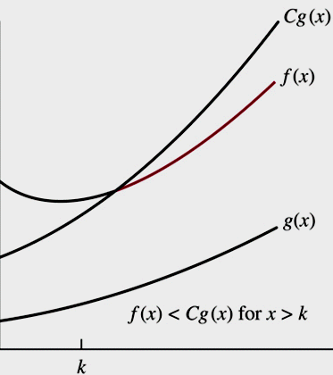
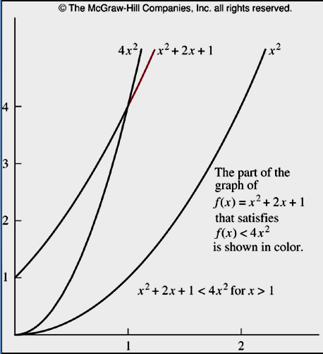
3.2.1-Big-O Notation
Definition:
Let f and g be functions from the set of integers or the set of real numbers to the set of real numbers. We say that f(x) is O(g(x)) if there are constants C and k such that |f(x)| ≤ C|g(x)| whenever x>k
Example: Show that f(x)=x² + 2x +1 is O(x²)
Examine with x>1 ➔ x² >x
➔ f(x)=x² + 2x +1 < x² + 2x² + x²
➔ f(x) < 4x²
➔ Let g(x)= x²
➔ C=4, k=1, |f(x)| ≤ C|g(x)|
➔f(x) is O(x²)
Notes:
The numbers C and k are NOT unique.
The constant in the big-oh estimate can be very large. For example, if an algorithm has running time O(n), then it might take 10¹⁰⁰n steps, a very huge number of steps, even for small value of n.

Slide 14
Big-O: Theorem 1
Let f(x)=a_{n}x^{n} + a_{n-1}x^{n-1}+…+a₁x+a₀, where a₀,a₁,…,a_{n} are real number, then f(x) is O(x^{n})
If x>1
|f(x)| =| a_{n}x^{n} + a_{n-1}x^{n-1}+…+a₁x+a₀|
≤ | a_{n}x^{n} |+|a_{n-1}x^{n-1}|+…+|a₁x|+|a₀| { triangle inequality }
≤ x^{n} (| a_{n} |+|a_{n-1}x^{n-1}/x^{n}|+…+|a₁x/x^{n}|+|a₀/x^{n}|)
≤ x^{n} (| a_{n} |+|a_{n-1}/x|+…+|a₁/x^{n-1}|+|a₀/x^{n}|)
≤ x^{n} (| a_{n} |+|a_{n-1}|+…+|a₁|+|a₀|)
Let C= | a_{n} |+|a_{n-1}|+…+|a₁|+|a₀|
|f(x)| ≤ Cx^{n}
➔ f(x) = O (x^{n})

Slide 15
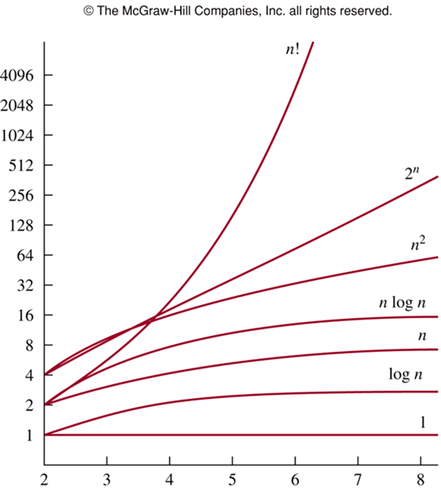
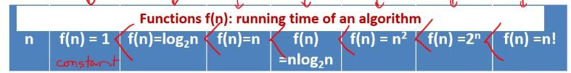
The Growth of Combinations of Functions
Notes:
Big- O notation is used to estimate the number of operations needed to solve a problem using a specified procedure or algorithm. The functions used in these estimates often include the following: 1, logn, n, nlogn, n², 2^{n}, n!
If n is large enough, 1 < logn < n < nlogn < n² < 2^{n} < n!
Note that (logn)¹⁰⁰ < n^{1/2} for large values of n. So, (logn)¹⁰⁰ is O(n^{1/2}).

Slide 16
Big-O : Theorems
Theorem 2:
f₁(x)=O(g₁(x)) ^ f₂(x)=O(g₂(x))
→ (f₁+f₂)(x) = O(max(|g₁(x)|,|g₂(x)|))
Theorem 3:
f₁(x)=O(g₁(x)) ^ f₂(x)=O(g₂(x))
→ (f₁f₂)(x) = O(g₁g₂(x)))
Corollary 1:
f₁(x)=O(g (x)) ^ f₂(x)=O(g (x)) → (f₁+f₂)(x) = O(g(x))

Slide 17
3.2.2- Big-Omega and Big-Theta Notation
Big-O does not provide the lower bound for the size of f(x)
Big-Ω, Big- θ were introduced by Donald Knuth in the 1970s
Big-Ω provides the lower bound for the size of f(x)
Big- θ provides the upper bound and lower bound on the size of f(x)

Slide 18
Big-Omega and Big-Theta Notation
Definitions
  ∃c>0,k x ≥ k ^ |f(x)| ≥ C|(g(x)| → |f(x)| = Ω(g(x))
  f(x)= O(g(x)) ^ f(x)= Ω(g(x)) → f(x) = θ(g(x))
  If f(x) = θ(g(x)) then f(x) is of order g(x)
Show that f(x)=1+2+…+n is θ(n²)
Examining x>0
f(x)=1+2+…+n = n(n+1)/2 = (n² +n) /2
f(x) ≤ (2n²)/2
f(x) ≤ n²
Let c₁=1/2, c₂=1, g(x)= n²
c₁g(x) ≤ f(x) ≤ c₂g(x)
f(x) = θ (n²) with x>0
Notes:
If f(x) is NOT O(g(x)), then f(x) is NOT θ(g(x))
If f(x) is NOT Ω(g(x)), then f(x) is NOT θ(g(x))

Slide 19
Big-Omega and Big-Theta Notation
Theorem 4
  Let f(x)=a_{n}x^{n} + a_{n-1}x^{n-1}+…+a₁x+a₀, where a₀,a₁,…,a_{n} are real number, then f(x) is of order x^{n}

Slide 20
3.3- Complexity of Algorithms
Computational complexity = Time complexity + space complexity.
Time complexity can be expressed in terms of the number of operations used by the algorithm.
  Average-case complexity
  Worst-case complexity
Space complexity will not be considered.

Slide 21
Demo 1
Describe the time complexity of the algorithm for finding the largest element in a set:
Procedure max ( a₁,a₂,…,a_{n} : integers)
max:= a₁
for i:=2 to n
If max < a_{i} then max:= a_{i}
i | Number of comparisons
2 | 2
3 | 2
… | 2
n | 2
n+1 | 1, max< a_{i} is omitted
2(n-1) +1 = 2n-1
comparisions
Time Complexity is θ(n)

Slide 22
Demo 2
Describe the average-case time complexity of the linear-search algorithm :
Procedure linear search (x: integer, a₁,a₂,…,a_{n} :distinct integers)
i:=1
while (i ≤ n and x ≠ a_{i}) i:=i+1
if i ≤ n then location:= i
else location:=0
i | Number of comparisons done
1 | 2
2 | 4
…
n | 2n
n+1 | 1, x ≠ a_{i} is omitted
Avg-Complexity= [(2+4+6+…+2n) ]/n +1 +1
= [2(1+2+3+…+n) /n+2
= [2n(n+1)/2]/n + 2
=[n(n+1)]/n + 2
= n+1 + 2 = n+3
= θ(n)
See demonstrations about the worst-case complexity: Examples 5,6 pages 195, 196

Slide 23
Understanding the Complexity of Algorithms
Complexity | Terminology | Problem class
Θ(1) | Constant complexity | Tractable (dễ), class P
Θ(log n) | Logarithmic complexity | Class P
Θ(n) | Linear complexity | Class P
Θ(n logn) | n log n complexity | Class P
Θ(n^{b}) , b1, integer | Polynominal complexity | Intractable, class NP
Θ(b^{n}), b>1 | Exponential complexity
Θ(n!) | Factorial complexity
NP : Non-deterministic Polynomial time
Notes:
- NP vs P problem:
Many solvable problems are believed to have the property that no algorithm with polynomial worst-case time complexity solves them, but that a solution, if known, can be checked in polynomial time. Problems for which a solution can be checked in polynomial time are said to belong to the class NP.
NP-complete problems: the class of problems with the property that if any of these problems can be solved by a polynomial worst-case time algorithm, then all problems in the class NP can be solved by polynomial worst-case time algorithms.
- NP vs P problem says that no NP-complete problem can be solved in polynomial time.

Slide 24
3.4- The Integers and Division
Definition: If a and b are integers with a ≠ 0, we say that a divides b if there is an integer c such that b=ac.
When a divides b, we say that:
a is a factor of b
b is a multiple of a
Notation: a|b : a divides b ałb : a does not divide b
Example:
3ł7 because 7/3 is not an integer
3|12 because 12/3=4 , remainder=0
Corollary 1:
a|b ^ a|c → a|(mb+nc), m,n are integers
Notes:
No confusion between a | b and a/b. The first is a relation, the second is a operation and the result is a number.
Students sometimes misunderstand the notation a | b. The sometimes write a | b when they mean b | a. It is true that 3 | 6, but it is not true that 6 | 3.

Slide 25
The Division Algorithm
Theorem 2: Division Algorithm: Let a be an integer and d a positive integer. Then there are unique integers q and r, with 0 ≤ r<d, such that a=dq+r
d: divisor , r : remainder, q: quotient (thương số)
Note: r can not be negative
Definition: a=dq+r
a: dividend d: divisor
q: quotient r : remainder,
q= a div d r = a mod d
Example:
101 is divided by 11 :101 = 11.9 + 2 ➔ q=9, r=2
-11 is divided by 3 : 3(-4)+ 1 ➔ q=-4, r=1
No OK : -11 is divided by 3 : 3(-3)-2 ➔ q=-3, r = -2
Notes:
Note that the remainder in a division can not be negative. For example, -23 mod 5 is 2, not -3.

Slide 26
Modular Arithmetic
Definition: a, b: integers, m: positive integer.
a is called congruent to b modulo m if m|a-b
Notations:
a ≡ b (mod m), a is congruent to b modulo m
a ≠ b (mod m), a is not congruent to b mod m
Examples:
15 is congruent to 6 modulo 3 because 3|15-6
15 is not congruent to 7 modulo 3 because 3 ł15-7

Slide 27
Modular Arithmetic
Theorem 3
a,b: integers, m: positive integer
a ≡ b (mod m) ↔ a mod m = b mod m
Proof
(1) a ≡ b (mod m) → a mod m = b mod m
a ≡ b (mod m) → m| a-b → a-b= km→ a=b + km
→ a mod m = (b + km) mod m
→ a mod m = b mod m { km mod m = 0 }
(2) a mod m = b mod m → a ≡ b (mod m)
a = k1m + c ^ b=k2m + c → a-b = (k1-k2) m { suppose a>b)
= km { k= k1-k2}
→ m| a-b ➔ a= b (mod m)

Slide 28
Modular Arithmetic…
Theorem 4
a,b: integers, m: positive integer
a and b are congruent modulo m if and only if there is an integer k such that a = b + km
Proof
(1) a ≡ b (mod m) → a = b + km
a ≡ b (mod m) → m| a-b → a-b= km { from definition of division}
(2) a = b + km → a ≡ b (mod m)
a = b + km → a-b=km → m | a-b → a ≡ b (mod m)

Slide 29
Modular Arithmetic…
Theorem 5
m: positive integer
a ≡ b (mod m) ^ c ≡ d (mod m) →
a+c ≡ b+d (mod m) ^ ac ≡ bd (mod m)
Proof : See page 204
Corollary 2:
m : positive integer, a,b : integers
(a+b) mod m = ((a mod m) + (b mod m)) mod m
ab mod m = ((a mod m)(b mod m)) mod m
Proof: page 205
Notes:
Be careful! Some properties we may expect to be true are not valid. For example, if ac ≡ bc (mod m), the congruence a ≡ b (mod m) may be false. Similarly, if a ≡ b (mod m) and c ≡ d (mod m), the congruence a^{c} ≡ b^{d} (mod m) may be false.

Slide 30
Applications of Congruences
Hashing Function: H(k) = k mod m
Using in searching data tin memory.
k: data searched, m : memory block
Examples:
H(064212848) mod 111= 14
H(037149212) mod 111= 65
Collision: H(k₁) = H(k₂). For example, H(107405723) = 14
Notes:
How to resolve a collision?
One way to resolve a collision is to assign the first free location following the occupied memory location assigned by the hashing function.

Slide 31
Applications of Congruences
Pseudo-random Numbers x_{n+1}=(ax_{n}+c) mod m
a: multiplier, c: increment, x₀: seed
with 2 ≤ a<m, 0 ≤ c<m, 0 ≤ x₀<m
Examples:
m=9 ➔ random numbers: 0..8
a= 7, c=4, x₀=3
Result: Page 207
Notes:
Because numbers generated by systematic methods are not truly random, they are called pseudorandom numbers.
The pseudorandom numbers is recursively defined.

Slide 32
Applications of Congruences
Cryptography: letter 1 → letter 2
Examples: shift cipher with k f(p) =(p+k) mod 26
→ f⁻¹(p)=(p-k) mod 26
Sender: (encoding)
Message: “ABC” , k=3
Using f(p) = (p+3) mod 26 // 26 characters
ABC ➔ 0 1 2 → 3 4 5 ➔ DEF
Receiver: (decoding)
DEF ➔ 3 4 5
Using f⁻¹(p) = (p-3) mod 26
3 4 5 ➔ 0 1 2 ➔ ABC
Notes:
Caesar cipher: f(p) = (p + 3) mod 26.
Caesar's method and shift ciphers do not provide a high level of security → using f(p) = (ap + b) mod 26, where a and b are integers, chosen such that f is a bijection.

Slide 33
3.5- Primes and Greatest Common Divisors
Definition 1:
A positive integer p greater than 1 is called prime if the only positive factors are 1 and p
A positive integer that is greater than 1 and is not prime is called composite
Examples:
Primes: 2 3 5 7 11
Composites: 4 6 8 9
Finding very large primes: tests for supercomputers
Notes:
Primes have become essential in modern cryptographic systems.
The largest known prime: 2^{57,885,161} − 1 , which has 17,425,170 digits was found in January 25, 2013 (wiki).
It is false to say that “1 is prime number”.

Slide 34
Primes…
Theorem 1- The fundamental theorem of arithmetic:
Every positive integer greater than 1 can be written uniquely as a prime or as the product of two or more primes where the prime factors are written in order of nondecreasing size
Examples:
Primes: 37
Composite: 100 = 2.2.5.5 = 2²5²
999 = 3.3.3.37 = 3³37

Slide 35
Primes…
Converting a number to prime factors
Examples: 7007
Try it to 2,3,5 : 7007 can not divided by 2,3,5
7007 : 7
1001 : 7
143: 11
13: 13
0
➔ 7007 = 7².11.13

Slide 36
Primes…
Theorem 2: If n is a composite, then n has a prime divisor less than or equal to √ ̅̅n
Proof:
n is a composite ➔ n = ab in which a or b is a prime
If (a> √ ̅̅n ^ b> √ ̅̅n) → ab>n ➔ false
➔ Prime divisor of n less than or equal to √ ̅̅n

Slide 37
Primes…
Theorem 3: There are infinite many primes
Proof: page 212
Theorem 4: The prime number theorem:
The ratio of the number of primes not exceeding x and x/ln x approaches 1 and grows with bound ( ln x: natural logarithm of x)
See page 213
Example:
x= 10¹⁰⁰⁰ → The odds that an integer near 10¹⁰⁰⁰ is prime are approximately 1/ln 10¹⁰⁰⁰ ~ 1/2300

Slide 38
Conjectures and Open Problems About Primes
See pages: 214, 215
3x + 1 conjecture
Twin prime conjecture: there are infinitely many twin primes
Notes:
- The world's record for twin primes, as of early 2011, consists of the numbers 3756801695685 × 2⁶⁶⁶⁶⁶⁹ ± 1 with 200,700 decimal digits.

Slide 39
Greatest Common Divisors and Least Common Multiples
Definition 2:
Let a, b be integers, not both zero. The largest integer d such that d|a and d|b is called the greatest common divisor of a and b.
Notation: gcd(a,b)
Example: gcd(24,36)=?
Divisors of 24: 2 3 4 6 8 12 = 2³3¹
Divisors of 36: 2 3 4 6 9 12 18 = 2²3²
gcd(24,36)=12 = 2²3¹ // Get factors having minimum power
Notes:
- Note that all integers are divisors of 0. That means, m | 0 for all integers m. Therefore, gcd(0, a) = a for all positive integers a.

Slide 40
Greatest Common Divisors and Least Common Multiples
Definition 3:
The integers a, b are relatively prime if their greatest common divisor is 1
Example:
gcd(3,7)=1 ➔ 3,7 are relatively prime
gcd (17,22)=1 ➔ 17,22 are relatively prime
gcd(17,34) = 17 ➔ 17, 34 are not relatively prime
Notes:
- A more efficient method of finding greatest common divisors is Euclidean algorithm, which will be given in the later of the chapter.

Slide 41
Greatest Common Divisors and Least Common Multiples
Definition 4:
The integers a₁,a₂,a₃,…,a_{n} are pairwise relatively prime if gcd(a_{i},a_{j})=1 whenever 1 ≤ i<j ≤ n
Example:
7 10 11 17 23 are pairwise relatively prime
7 10 11 16 24 are not pairwise relatively prime
➔ Adjacent number of every composite in sequence must be a prime.

Slide 42
Greatest Common Divisors and Least Common Multiples
Definition 5:
The Least common multiple of the positive integer a and b is the smallest integer that is divisible by both a and b
Notation: lcm(a,b)
Example:
lcm(12,36) = 36 lcm(7,11) = 77
lcm (2³3⁵7², 2⁴3³) = 2⁴3⁵7²
2³3⁵7², 2⁴3³7⁰ ➔ 2⁴3⁵7² // get maximum power

Slide 43
Greatest Common Divisors and Least Common Multiples
Theorem 5:
Let a, b be positive integers then
ab= gcd(a,b). lcm(a,b)
Example: gcd(8, 12) = 4 lcm(8,12)=24 ➔ 8.12 = 4.24
Proof: Based on analyzing a, b to prime factors to get gcd(a,b) and lcm(a,b)
➔ ab=gcd(a,b). lcm(a,b)

Slide 44
3.6- Integers and Algorithms
Representations of Integers
Algorithms for Integer Operations
Modular Exponentiation
Euclid Algorithm

Slide 45
Representations of Integers
Theorem 1:
Let b be a positive integer greater than 1. Then if n is a positive integer, it can be expressed uniquely in the form
n= a_{k}b^{k} + a_{k-1}b^{k-1}+ … + a₁b + a₀
Where k is a nonnegative integer, a₀,a₁,a₂,…,a_{k} are nonnegative integers less than b and a_{k} ≠ 0
Proof: page 219
Example: (245)₈= 2.8² + 4.8+5 = 165
Common Bases Expansions: Binary, Octal, Decimal, Hexadecimal
Finding expansion of an integer: Pages 219, 220, 221
Notes:
The representation of n given in Theorem 1 is called the base b expansion of n.
b =2 : binary expansion; b = 8: octal expansion; b = 16: hexadecimal expansion; b =10: decimal expansion.

Slide 46
Algorithm 1: Constructing Base b Expansions
Procedure base b expansion ( n: positive integer)
q:=n
k:=0
while q ≠ 0
begin
a_{k} :=q mod b
q := ⎣q/b⎦
k := k +1
end { The base b expansion of n is (a_{k-1}a_{k-2}…a₁a₀)}

Slide 47
Algorithms for Integer Operations
Algorithm 2: Addition integers in binary format
Algorithm 3: Multiplying integers in binary format
Algorithm 4: Computing div and mod integers
Algorithm 5: Modular Exponentiation

Slide 48
Algorithm 2: Adding of Integers
Complexity: O (n)
procedure add ( a,b: integers)
{ a: (a_{n-1}a_{n-2}…a₁a₀)₂ b: (b_{n-1}b_{n-2}…b₁b₀)₂ }
c:=0
for j:=0 to n-1
Begin
d:= ⎣(a_{j}+b_{j}+c)/2⎦ // next carry of next step
s_{j}= a_{j}+b_{j}+c - 2d // result bit
c:=d // updating new carry to next step
End
s_{n}= c // rightmost bit of result
{ The binary of expansion of the sum is (s_{n}s_{n-1}…s₁s₀)}
1 1 1 0 0
1 1 1 0 (a)
+ 1 0 1 1 (b)
1 1 0 0 1 (s)
Notes:
- Two integers are added by successively adding pairs of bits and, when it occurs, a carry. Adding each pair of bits and the carry requires three or fewer additions of bits. Thus, the total number of additions of bits used is less than three times the number of bits in the expansion. Hence, the number of additions of bits used by Algorithm 2 to add two n-bit integers is O(n).

Slide 49
Algorithm 3: Multiplying Integers
Complexity: O (n²)
procedure multiply ( a,b: integer)
{ a: (a_{n-1}a_{n-2}…a₁a₀)₂ b: (b_{n-1}b_{n-2}…b₁b₀)₂ }
for j:= 0 to n-1
begin
if b_{j} =1 then c_{j} := a shifted j places
end
{ c₀, c₁, …, c_{n-1} are the partial products }
p := 0
for j:= 0 to n-1
p:=p+c_{j}
{p is the value of ab}
1 1 0 (a)
X 1 0 1 (b)
1 1 0
+ 0 0 0 0
1 1 0 0 0
1 1 1 1 0 (p)
Complexity: O (n)
Notes:
Number of shifts: at most 0 + 1 + 2 + … + n-1 = (n-1)n/2, that is O(n²).
Number of additions of bits required: To add the integers ab_{j} from j = 0 to j = n - 1 requires the addition of an n-bit integer, an (n + 1)-bit integer, ... , and a (2n -1)-bit integer. Each of these additions requires O(n) additions of bits. Consequently, a total of O(n²) additions of bits are required for all n additions.

Slide 50
Algorithm 4: Computing div and mod
procedure division ( a: integer; d: positive integer)
q:=0
r:= |a|
while r ≥ d {quotient= number of times of successive subtractions}
begin
r:= r-d
q := q+1
end
If a<0 and r>0 then {updating remainder when a<0}
begin
r:= d-r
q := -(q+1)
end
{ q = a div d is the quotient, r=a mod d is the remainder}

Slide 51
Algorithm 5: Modular Exponentiation
{ b^{n} mod m = ? . Ex: 3⁶⁴⁴ mod 645 = 36 }
procedure mod_ex ( b: integer, n=(a_{k-1}a_{k-2}…a₁a₀)₂, m: positive integer)
x:=1
power := b mod m
for i:=0 to k-1
begin
if a_{i}=1 then x:= (x.power) mod m
power := (power.power) mod m
end
{ x equals b^{n} mod m }
Corollary 2: ab mod m = ((a mod m)(b mod m)) mod m
b^{n} mod m = result of successive factor_{i} mod m
Notes:
- Algorithm 5 is the most efficient algorithm available to compute values of the mod function.

Slide 52
The Euclidean Algorithm
Lemma: Proof: page 228
Let a= bq+r, where a, b, q, r are integers. Then gcd(a,b) = gcd(b,r)
Example: 287 = 91.3 + 14 ➔gcd(287,91) =gcd(91,14)= 7
procedure gcd(a,b: positive integer)
x:=a
y:=b
while y ≠ 0
begin
r := x mod y
x:=y
y:= r
end {gcd(a,b) is x}
Notes:
- The algorithm has been known since ancient times. It is named after the ancient Greek mathematician Euclid, who included a description of this algorithm in his book The Elements.

Slide 53
Summary
Algorithms
The Growth of Functions
Complexity of Algorithms
The Integers and Division
Primes and Greatest Common Divisors
Integers and Algorithms

Slide 54
Thanks

