Slide 1







Business Forecast & Fundrasing
DolphinGroup

Slide 2
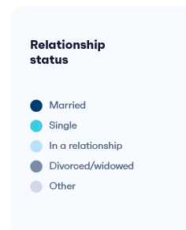


AGENDA
BUSINESS FORECAST
2023 forecast
2024 forecast
2025 forecast
Consolidation
FUNDRASING
Case study
Startup valuation
Capital plan
Q&A
Ending

Slide 3

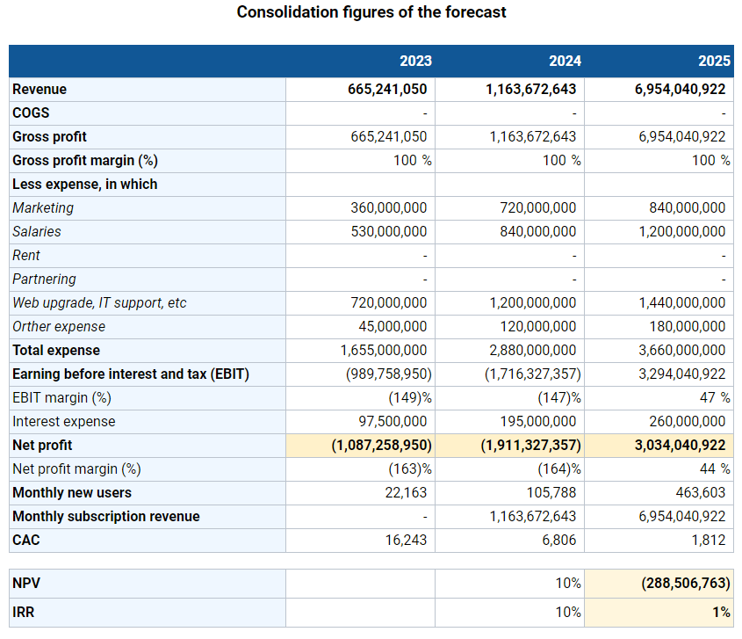


References
Type the url or scan this QR to access the sheets
bit.ly/tetu_biz_forecast
Notes:
Simples is best, less is more

Slide 4
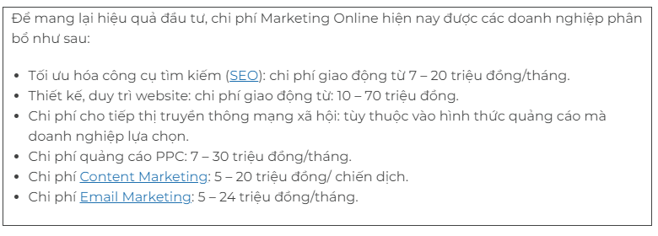
Expense refs
Marketing expenses
gobrading.com
IT infrastructure expense
AWS services pricing plan
Notes:
Simples is best, less is more

Slide 5
Assumptions for 2023
Total loans | 3,000,000,000đ
Interest rate (yearly) | 6.5%
Total monthly salary | 30%
Total monthly marketing | 20%
Total partnering expense | 0%
Web/app upgrading, IT support, maintenance, etc. | 40%
Other expenses | 10%
Refer to BIDV's business loan interest rate
AWS service fees and deployment fees
Notes:
Simples is best, less is more

Slide 6
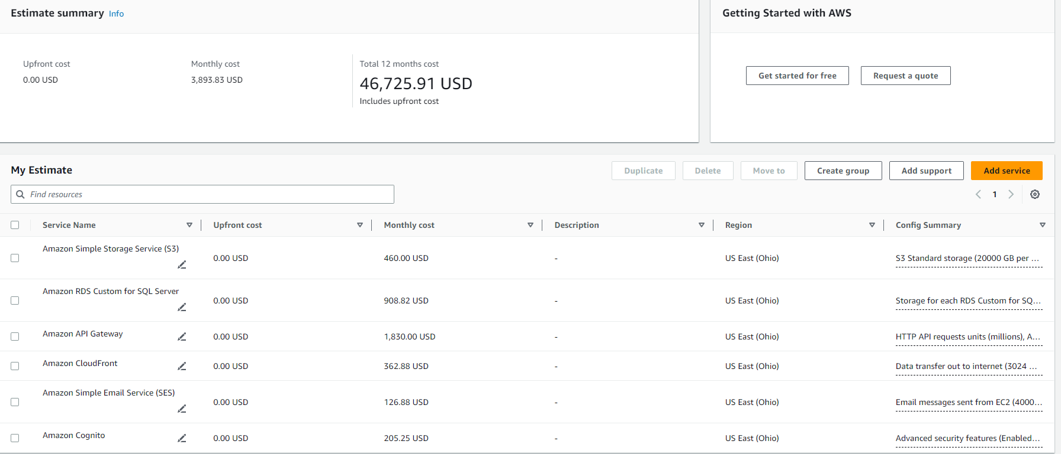
Assumptions for 2023
IT infrastructure expenses
Notes:
Simples is best, less is more

Slide 7
Forecast for 2023
 | Apr-23 | May-23 | Jun-23 | Jul-23 | Aug-23 | Sep-23 | Oct-23 | Nov-23 | Dec-23 | Total
Revenue | - | - | - | - | - | 23,791,613 | 26,646,606 | 29,844,199 | 33,425,503 | 113,707,921
COGS | - | - | - | - | - | - | - | - | - | -
Gross profit | - | - | - | - | - | 23,791,613 | 26,646,606 | 29,844,199 | 33,425,503 | 113,707,921
Gross profit margin (%) | 0% | 0% | 0% | 0% | 0% | 100% | 100% | 100% | 100% | 100%
Less expense, in which
Marketing | 40,000,000 | 40,000,000 | 40,000,000 | 40,000,000 | 40,000,000 | 40,000,000 | 40,000,000 | 40,000,000 | 40,000,000 | 360,000,000
Salaries | 40,000,000 | 40,000,000 | 40,000,000 | 40,000,000 | 40,000,000 | 50,000,000 | 50,000,000 | 50,000,000 | 50,000,000 | 400,000,000
Rent | - | - | - | - | - | - | - | - | - | -
Partnering | - | - | - | - | - | - | - | - | - | -
IT infra, maintenance, etc. | 80,000,000 | 80,000,000 | 80,000,000 | 80,000,000 | 80,000,000 | 80,000,000 | 80,000,000 | 80,000,000 | 80,000,000 | 720,000,000
Other expenses | 5,000,000 | 5,000,000 | 5,000,000 | 5,000,000 | 5,000,000 | 5,000,000 | 5,000,000 | 5,000,000 | 5,000,000 | 45,000,000
Total expenses | 165,000,000 | 165,000,000 | 165,000,000 | 165,000,000 | 165,000,000 | 175,000,000 | 175,000,000 | 175,000,000 | 175,000,000 | 1,525,000,000
EBIT | (165,000,000) | (165,000,000) | (165,000,000) | (165,000,000) | (165,000,000) | (151,208,387) | (148,353,394) | (145,155,801) | (141,574,497) | (1,411,292,079)
EBIT margin (%) | - | - | - | - | - | (636)% | (557)% | (486)% | (424)% | (1,241)%
Interest expenses | 16,250,000 | 16,250,000 | 16,250,000 | 16,250,000 | 16,250,000 | 16,250,000 | 16,250,000 | 16,250,000 | 16,250,000 | 146,250,000
Net profit | (181,250,000) | (181,250,000) | (181,250,000) | (181,250,000) | (181,250,000) | (167,458,387) | (164,603,394) | (161,405,801) | (157,824,497) | (1,557,542,079)
Net profit margin (%) | - | - | - | - | - | (704)% | (618)% | (541)% | (472)% | (1,370)%
Monthly users’ growth rate | 12%
New users/month | 1,500 | 1,680 | 1,882 | 2,107 | 2,360 | 2,644 | 2,961 | 3,316 | 3,714 | 22,163
Net accumulative users |  | 3,180 | 5,062 | 7,169 | 9,529 | 12,173 | 15,134 | 18,450 | 22,163
Monthly fees/user | - | - | - | - | - | 9,000 | 9,000 | 9,000 | 9,000 | 36,000
Monthly subscription revenue | - | - | - | - | - | 23,791,613 | 26,646,606 | 29,844,199 | 33,425,503 | 113,707,921
Other revenues | - | - | - | - | - | - | - | - | - | -
Total revenue | - | - | - | - | - | 23,791,613 | 26,646,606 | 29,844,199 | 33,425,503 | 113,707,921
Notes:
Simples is best, less is more

Slide 8

Assumptions for 2024
Total loans | 1,500,000,000đ
Interest rate (yearly) | 6.5%
Total monthly salary | 25%
Total monthly marketing | 25%
Total partnering expense | 0%
Web/app upgrading, IT support, maintenance, etc. | 40%
Other expenses | 10%
1,500,000,000đ
2023
Meeting & sharing event, coworking space, bonding activities, etc.
Notes:
Simples is best, less is more

Slide 9
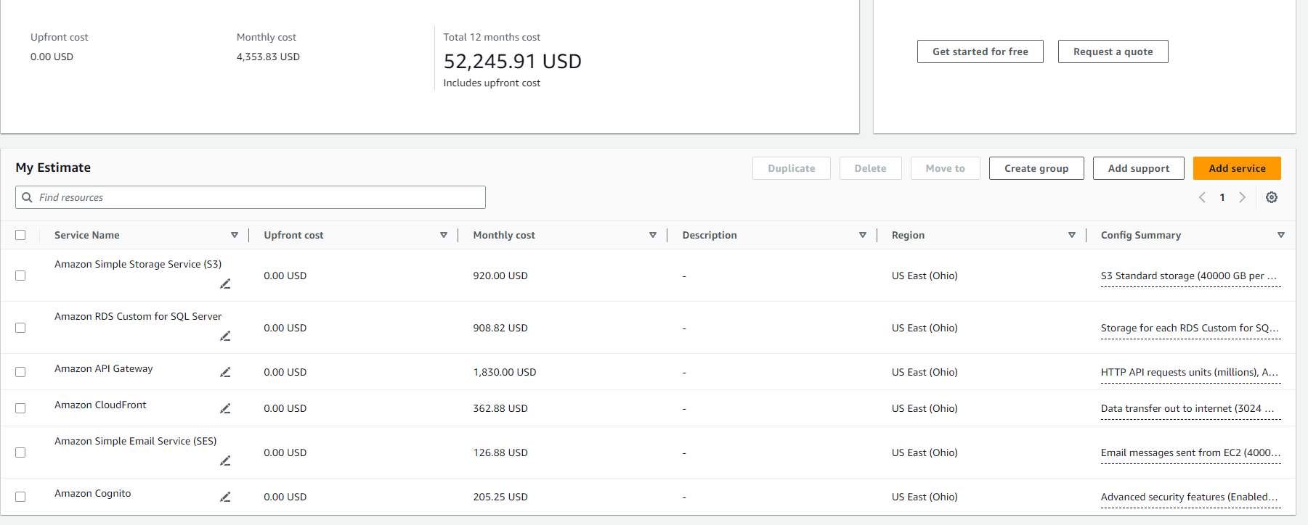
Assumptions for 2024
IT infrastructure expenses
Notes:
Simples is best, less is more

Slide 10
Forecast for 2024
 | Jan-24 | Feb-24 | Mar-24 | Apr-24 | May-24 | Jun-24 | Jul-24 | Aug-24 | Sep-24 | Oct-24 | Nov-24 | Dec-24 | Total
Revenue | 50,000,000 | 56,750,000 | 64,411,250 | 73,106,769 | 82,976,183 | 94,177,967 | 106,891,993 | 121,322,412 | 137,700,937 | 156,290,564 | 177,389,790 | 201,337,412 | 1,322,355,276
COGS | - | - | - | - | - | - | - | - | - | - | - | - | -
Gross profit | 50,000,000 | 56,750,000 | 64,411,250 | 73,106,769 | 82,976,183 | 94,177,967 | 106,891,993 | 121,322,412 | 137,700,937 | 156,290,564 | 177,389,790 | 201,337,412 | 1,322,355,276
Gross profit margin (%) | 100.0% | 100.0% | 100.0% | 100.0% | 100.0% | 100.0% | 100.0% | 100.0% | 100.0% | 100.0% | 100.0% | 100.0% | 100%
Less expenses, in which
Marketing | 50,000,000 | 50,000,000 | 50,000,000 | 50,000,000 | 50,000,000 | 50,000,000 | 50,000,000 | 50,000,000 | 50,000,000 | 50,000,000 | 50,000,000 | 50,000,000 | 600,000,000
Salaries | 50,000,000 | 50,000,000 | 50,000,000 | 50,000,000 | 50,000,000 | 50,000,000 | 50,000,000 | 50,000,000 | 50,000,000 | 50,000,000 | 50,000,000 | 50,000,000 | 600,000,000
Rent | - | - | - | - | - | - | - | - | - | - | - | - | -
Partnering | - | - | - | - | - | - | - | - | - | - | - | - | -
IT infra, maintenance, etc. | 100,000,000 | 100,000,000 | 100,000,000 | 100,000,000 | 100,000,000 | 100,000,000 | 100,000,000 | 100,000,000 | 100,000,000 | 100,000,000 | 100,000,000 | 100,000,000 | 1,200,000,000
Other expenses | 7,000,000 | 7,000,000 | 7,000,000 | 7,000,000 | 7,000,000 | 7,000,000 | 7,000,000 | 7,000,000 | 7,000,000 | 7,000,000 | 7,000,000 | 7,000,000 | 84,000,000
Total expenses | 207,000,000 | 207,000,000 | 207,000,000 | 207,000,000 | 207,000,000 | 207,000,000 | 207,000,000 | 207,000,000 | 207,000,000 | 207,000,000 | 207,000,000 | 207,000,000 | 2,484,000,000
EBIT | (157,000,000) | (150,250,000) | (142,588,750) | (133,893,231) | (124,023,817) | (112,822,033) | (100,108,007) | (85,677,588) | (69,299,063) | (50,709,436) | (29,610,210) | (5,662,588) | (1,161,644,724)
EBIT margin (%) | (314)% | (265)% | (221)% | (183)% | (149)% | (120)% | (94)% | (71)% | (50)% | (32)% | (17)% | (3)% | (88)%
Interest expenses | 16,250,000 | 16,250,000 | 16,250,000 | 16,250,000 | 16,250,000 | 16,250,000 | 16,250,000 | 16,250,000 | 16,250,000 | 16,250,000 | 16,250,000 | 16,250,000 | 195,000,000
Net profit | (165,125,000) | (158,375,000) | (150,713,750) | (142,018,231) | (132,148,817) | (120,947,033) | (108,233,007) | (93,802,588) | (77,424,063) | (58,834,436) | (37,735,210) | (13,787,588) | (1,259,144,724)
Net profit margin (%) | (330)% | (279)% | (234)% | (194)% | (159)% | (128)% | (101)% | (77)% | (56)% | (38)% | (21)% | (7)% | (95)%
Monthly users' growth rate | 13.5%
New users/month | 4,000 | 4,540 | 5,153 | 5,849 | 6,638 | 7,534 | 8,551 | 9,706 | 11,016 | 12,503 | 14,191 | 16,107 | 105,788
Net accumulative uesrs |  | 8,540 | 13,693 | 19,541 | 26,180 | 33,714 | 42,265 | 51,971 | 62,987 | 75,490 | 89,681 | 105,788
Monthly fees/users | 12,500 | 12,500 | 12,500 | 12,500 | 12,500 | 12,500 | 12,500 | 12,500 | 12,500 | 12,500 | 12,500 | 12,500 | 150,000
Monthly subscription revenue | 50,000,000 | 56,750,000 | 64,411,250 | 73,106,769 | 82,976,183 | 94,177,967 | 106,891,993 | 121,322,412 | 137,700,937 | 156,290,564 | 177,389,790 | 201,337,412 | 1,322,355,276
Other revenues | - | - | - | - | - | - | - | - | - | - | - | - | -
Total revenue | 50,000,000 | 56,750,000 | 64,411,250 | 73,106,769 | 82,976,183 | 94,177,967 | 106,891,993 | 121,322,412 | 137,700,937 | 156,290,564 | 177,389,790 | 201,337,412 | 1,322,355,276
Notes:
Simples is best, less is more

Slide 11
Assumptions for 2025
Total loans | 1,000,000,000đ
Interest rate (yearly) | 6.5%
Total monthly salary | 30%
Total monthly marketing | 20%
Total partnering expense | 0%
Web/app upgrading, IT support, maintenance, etc. | 40%
Other expenses | 10%
500,000,000đ
2024
Meeting & sharing event, coworking space, bonding activities, etc.
Notes:
Simples is best, less is more

Slide 12

Assumptions for 2025
IT infrastructure expenses
Notes:
Simples is best, less is more

Slide 13
Forecast for 2025
 | Jan-24 | Feb-24 | Mar-24 | Apr-24 | May-24 | Jun-24 | Jul-24 | Aug-24 | Sep-24 | Oct-24 | Nov-24 | Dec-24 | Total
Revenue | 255,000,000 | 291,975,000 | 334,311,375 | 382,786,524 | 438,290,570 | 501,842,703 | 574,609,895 | 657,928,330 | 753,327,938 | 862,560,489 | 987,631,760 | 1,130,838,365 | 7,171,102,948
COGS | - | - | - | - | - | - | - | - | - | - | - | - | -
Gross profit | 255,000,000 | 291,975,000 | 334,311,375 | 382,786,524 | 438,290,570 | 501,842,703 | 574,609,895 | 657,928,330 | 753,327,938 | 862,560,489 | 987,631,760 | 1,130,838,365 | 7,171,102,948
Gross profit margin (%) | 100% | 100% | 100% | 100% | 100% | 100% | 100% | 100% | 100% | 100% | 100% | 100% | 100%
Less expenses, in which
Marketing | 70,000,000 | 70,000,000 | 70,000,000 | 70,000,000 | 70,000,000 | 70,000,000 | 70,000,000 | 70,000,000 | 70,000,000 | 70,000,000 | 70,000,000 | 70,000,000 | 840,000,000
Salaries | 80,000,000 | 80,000,000 | 80,000,000 | 80,000,000 | 80,000,000 | 80,000,000 | 80,000,000 | 80,000,000 | 80,000,000 | 80,000,000 | 80,000,000 | 80,000,000 | 960,000,000
Rent | - | - | - | - | - | - | - | - | - | - | - | - | -
Partnering | - | - | - | - | - | - | - | - | - | - | - | - | -
IT infra, maintenance, etc. | 120,000,000 | 120,000,000 | 120,000,000 | 120,000,000 | 120,000,000 | 120,000,000 | 120,000,000 | 120,000,000 | 120,000,000 | 120,000,000 | 120,000,000 | 120,000,000 | 1,440,000,000
Other expenses | 15,000,000 | 15,000,000 | 15,000,000 | 15,000,000 | 15,000,000 | 15,000,000 | 15,000,000 | 15,000,000 | 15,000,000 | 15,000,000 | 15,000,000 | 15,000,000 | 180,000,000
Total expenses | 285,000,000 | 285,000,000 | 285,000,000 | 285,000,000 | 285,000,000 | 285,000,000 | 285,000,000 | 285,000,000 | 285,000,000 | 285,000,000 | 285,000,000 | 285,000,000 | 3,420,000,000
EBIT | (30,000,000) | 6,975,000 | 49,311,375 | 97,786,524 | 153,290,570 | 216,842,703 | 289,609,895 | 372,928,330 | 468,327,938 | 577,560,489 | 702,631,760 | 845,838,365 | 3,751,102,948
EBIT margin (%) | (12)% | 2 % | 15 % | 26 % | 35 % | 43 % | 50 % | 57 % | 62 % | 67 % | 71 % | 75 % | 52 %
Interest expenses | 5,416,667 | 5,416,667 | 5,416,667 | 5,416,667 | 5,416,667 | 5,416,667 | 5,416,667 | 5,416,667 | 5,416,667 | 5,416,667 | 5,416,667 | 5,416,667 | 65,000,000
Net profit | (35,416,667) | 1,558,333 | 43,894,708 | 92,369,858 | 147,873,904 | 211,426,036 | 284,193,228 | 367,511,663 | 462,911,271 | 572,143,822 | 697,215,093 | 840,421,698 | 3,686,102,948
Net profit margin (%) | (14)% | 1 % | 13 % | 24 % | 34 % | 42 % | 49 % | 56 % | 61 % | 66 % | 71 % | 74 % | 51 %
Monthly user' growth rate | 14.5%
New users/month | 17,000 | 19,465 | 22,287 | 25,519 | 29,219 | 33,456 | 38,307 | 43,862 | 50,222 | 57,504 | 65,842 | 75,389 | 478,074
Net accumulative uesrs |  | 36,465 | 58,752 | 84,272 | 113,491 | 146,947 | 185,254 | 229,116 | 279,338 | 336,842 | 402,684 | 478,074
Monthly fees/users | 15,000 | 15,000 | 15,000 | 15,000 | 15,000 | 15,000 | 15,000 | 15,000 | 15,000 | 15,000 | 15,000 | 15,000 | 180,000
Monthly subscription revenue | 255,000,000 | 291,975,000 | 334,311,375 | 382,786,524 | 438,290,570 | 501,842,703 | 574,609,895 | 657,928,330 | 753,327,938 | 862,560,489 | 987,631,760 | 1,130,838,365 | 7,171,102,948
Other revenues | - | - | - | - | - | - | - | - | - | - | - | - | -
Total revenue | 255,000,000 | 291,975,000 | 334,311,375 | 382,786,524 | 438,290,570 | 501,842,703 | 574,609,895 | 657,928,330 | 753,327,938 | 862,560,489 | 987,631,760 | 1,130,838,365 | 7,171,102,948
Notes:
Simples is best, less is more

Slide 14
Consolidation
 | 2023 | 2024 | 2025
Revenue | 113,707,921 | 1,322,355,276 | 7,171,102,948
COGS | - | - | -
Gross profit | 113,707,921 | 1,322,355,276 | 7,171,102,948
Gross profit margin (%) | 100 % | 100 % | 100 %
Less expense, in which
Marketing | 360,000,000 | 600,000,000 | 840,000,000
Salaries | 400,000,000 | 600,000,000 | 960,000,000
Rent | - | - | -
Partnering | - | - | -
Web upgrade, IT infra, maintenance, etc | 720,000,000 | 1,200,000,000 | 1,440,000,000
Orther expense | 45,000,000 | 84,000,000 | 180,000,000
Total expense | 1,525,000,000 | 2,484,000,000 | 3,420,000,000
EBIT | (1,411,292,079) | (1,161,644,724) | 3,751,102,948
EBIT margin (%) | (1,241)% | (88)% | 52 %
Interest expense | 146,250,000 | 97,500,000 | 65,000,000
Net profit | (1,557,542,079) | (1,259,144,724) | 3,686,102,948
Net profit margin (%) | (1,370)% | (95)% | 51 %
Monthly new users | 22,163 | 105,788 | 478,074
Monthly subscription revenue | 113,707,921 | 1,322,355,276 | 7,171,102,948
CAC | 16,243 | 5,672 | 1,757
NPV |  | 10% | 312,860,884
IRR |  | 10% | 19%
NPV is > 0, IRR > benchmark 10%
Until the end of 2024 will still suffer losses.
Decreasing costs
Increasing revenue, users
Opportunities for development & gain more profit in the next periods
Notes:
Simples is best, less is more

Slide 15



Case study
 | Notion | Evernote | ClickUp
Launch | 2013 | 2008 | 2017
Users | 1M | 500,000 (2009) | 4M (2021)
Revenue | ~ $11M (2019) | $650,000 | $30M
Valuation | $60M | $80M | $200M
Raised | $18.2M (2019) – Series A | $26M (2009) – Series A | $35M (2020) – Series A
Valuation / Revenue | ~ 5.5 times | ~ 12.5 times | ~ 2.67 times
- crunchbase, techcrunch & getlatka -

Slide 16


Startup Valuation
 | ClickUp | Tetu
Launch | 2017 | 2023
Monthly users | over 340k (2021) | Over 70k (2025)
Revenue | $30M | $302,957
Valuation | $200M | $900,000 (~21,303,319,000đ)
Valuation / Revenue | ~ 2.67 times | ~ 3 times
Shares offer
10%
2,100,000,000 VND
(2 billions 1 hundred millions dongs)
Compare with ClickUp figures and consider tetu intrinsic growth rate

Slide 17
Capital plan
Money raised
6,000,000,000đ
Plan for 1 year
FY2026
 | Weight | Expense | Note
IT infrastructure | 40% | 2,400,000 đ | 100k MAU
Marketing & Customer acquisition | 15% | 900,000 đ | Promote digital marketing, ads & KOL booking
Salary | 20% | 1,200,000,000 đ | Offer competitive salaries to attract and retain talent
Research & development | 10% | 600,000 đ | Improve the app's functionality and usability, deveolop advance features
Legal | 5% | 300,000 đ | Allocate funds towards hiring legal counsel and consultants
Others | 10% | 600,000 đ | Bonding activites, internal events, etc.

Slide 18

THANK YOU!
If you have any questions?
Don’t hesitate to ask us
or contact us
dolphin.team111@gmail.com
DolphinGroup

