Slide 1
Jagged stock investment strategy
Prof. Dr. Loc Nguyen PhD, PostDoc
International Engineering and Technology Institute (IETI), Vietnam
Email: ng_phloc@yahoo.com
Homepage: www.locnguyen.net

Slide 2
Abstract
There are many investment ways such as bank depositing, enterprise business, and stock investment. Bank depositing is a safe and easy way to invest and hence, it is known as reference tool to compare or make decision on other investment methods. Alternately, stock investment is preferred method with good feeling about its preeminence. However, according to mathematical model, stock investment and bank depositing have the same benefit if their growth rate and interest rate are the same. Therefore, I propose a so-called jagged stock investment (JSI) strategy in which the chain of buying stock in the given time interval is modeled as a saw with expectation that JSI strategy gets frequently profitable.

Slide 3
Table of contents
Stock investment
Bank depositing and jagged stock investment
Conclusions

Slide 4
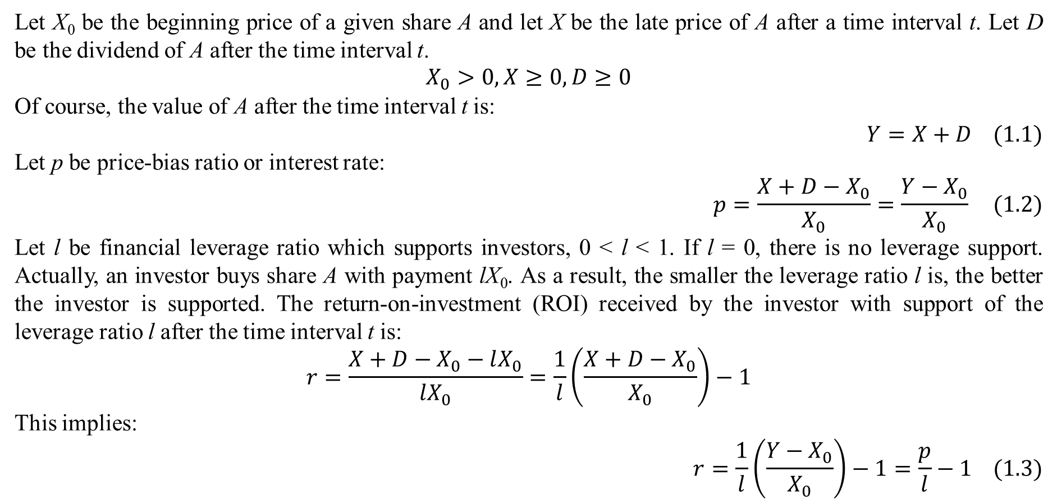
1. Stock investment
Let X₀ be the beginning price of a given share A and let X be the late price of A after a time interval t. Let D be the dividend of A after the time interval t.
$$\begin{matrix}X_{0}>0,X≥0,D≥0\end{matrix}$$
Of course, the value of A after the time interval t is:
$$Y=X+D (1.1)$$
Let p be price-bias ratio or interest rate:
$$p=\frac{X+D−X_{0}}{X_{0}}=\frac{Y−X_{0}}{X_{0}} (1.2)$$
Let l be financial leverage ratio which supports investors, 0 < l < 1. If l = 0, there is no leverage support. Actually, an investor buys share A with payment lX₀. As a result, the smaller the leverage ratio l is, the better the investor is supported. The return-on-investment (ROI) received by the investor with support of the leverage ratio l after the time interval t is:
$$r=\frac{X+D−X_{0}−lX_{0}}{lX_{0}}=\frac{1}{l}\left(\frac{X+D−X_{0}}{X_{0}}\right)−1$$
This implies:
$$r=\frac{1}{l}\left(\frac{Y−X_{0}}{X_{0}}\right)−1=\frac{p}{l}−1 (1.3)$$

Slide 5
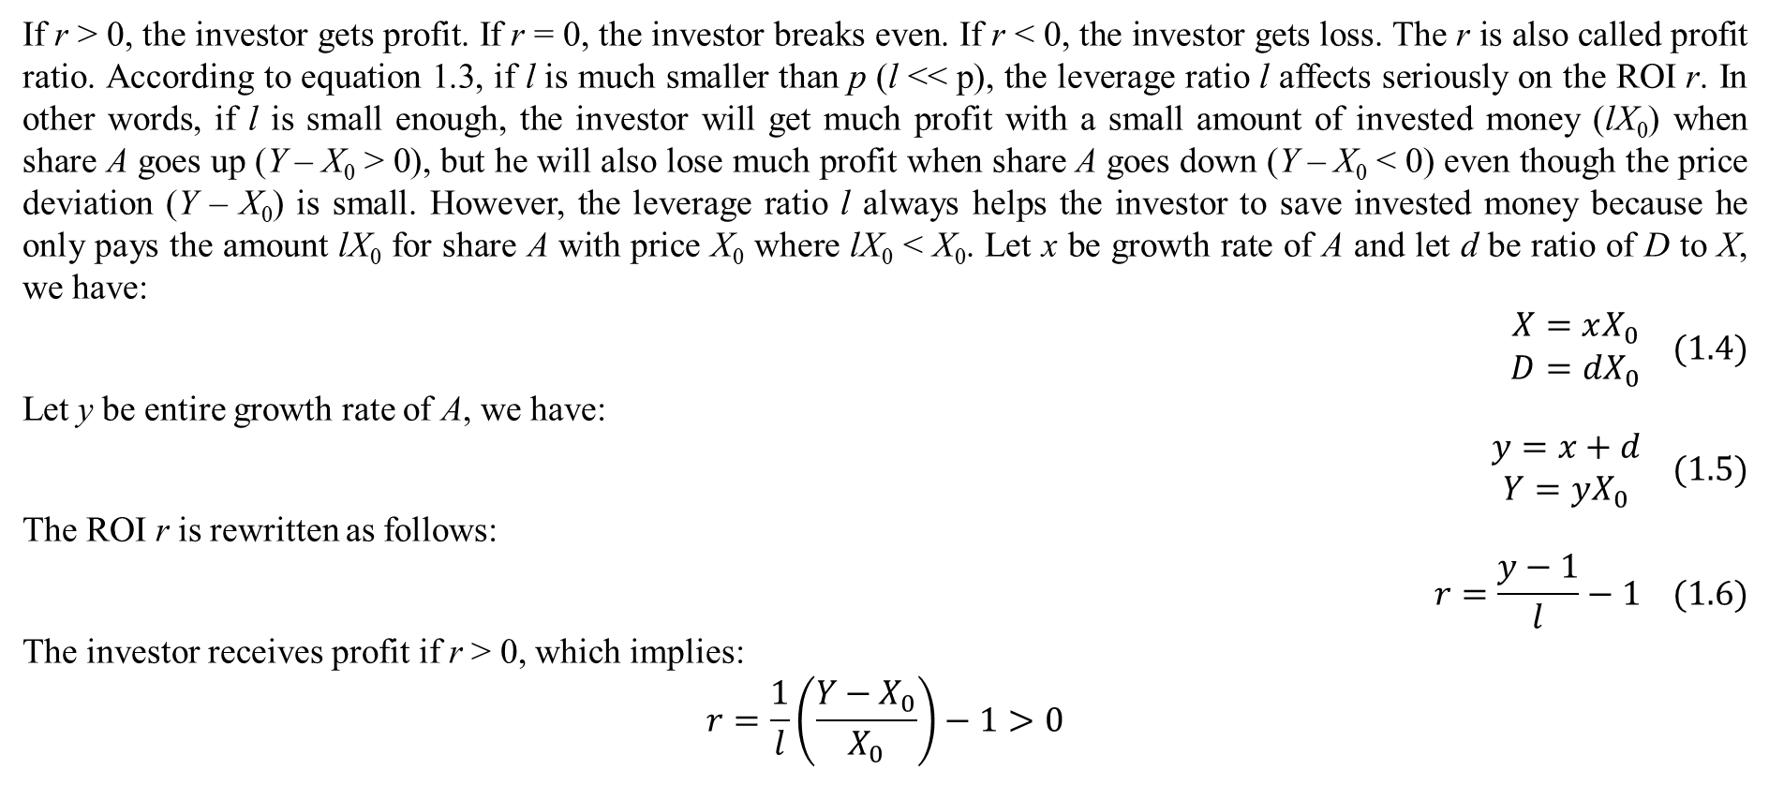
1. Stock investment
If r > 0, the investor gets profit. If r = 0, the investor breaks even. If r < 0, the investor gets loss. The r is also called profit ratio. According to equation 1.3, if l is much smaller than p (l << p), the leverage ratio l affects seriously on the ROI r. In other words, if l is small enough, the investor will get much profit with a small amount of invested money (lX₀) when share A goes up (Y – X₀ > 0), but he will also lose much profit when share A goes down (Y – X₀ < 0) even though the price deviation (Y – X₀) is small. However, the leverage ratio l always helps the investor to save invested money because he only pays the amount lX₀ for share A with price X₀ where lX₀ < X₀. Let x be growth rate of A and let d be ratio of D to X, we have:
$$\begin{matrix}X=xX_{0} \\ D=dX_{0}\end{matrix} (1.4)$$
Let y be entire growth rate of A, we have:
$$\begin{matrix}y=x+d \\ Y=yX_{0}\end{matrix} (1.5)$$
The ROI r is rewritten as follows:
$$r=\frac{y−1}{l}−1 (1.6)$$
The investor receives profit if r > 0, which implies:
$$r=\frac{1}{l}\left(\frac{Y−X_{0}}{X_{0}}\right)−1>0$$

Slide 6
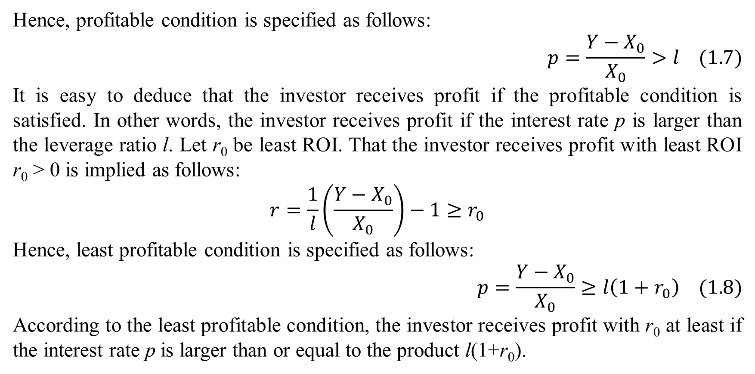
1. Stock investment
Hence, profitable condition is specified as follows:
$$p=\frac{Y−X_{0}}{X_{0}}>l (1.7)$$
It is easy to deduce that the investor receives profit if the profitable condition is satisfied. In other words, the investor receives profit if the interest rate p is larger than the leverage ratio l. Let r₀ be least ROI. That the investor receives profit with least ROI r₀ > 0 is implied as follows:
$$r=\frac{1}{l}\left(\frac{Y−X_{0}}{X_{0}}\right)−1≥r_{0}$$
Hence, least profitable condition is specified as follows:
$$p=\frac{Y−X_{0}}{X_{0}}≥l\left(1+r_{0}\right) (1.8)$$
According to the least profitable condition, the investor receives profit with r₀ at least if the interest rate p is larger than or equal to the product l(1+r₀).

Slide 7
1. Stock investment
Although the leverage ratio l helps the investor to save invested money, there is a question that whether it causes high pressure on investment. By reviewing equation 1.7 without the leverage ratio l, the profitable condition is p > 0 whose pressure is lower due to r₀ = 0 < l, obviously. Hence, the leverage ratio increases pressure on investment when r₀ = 0. By reviewing equation 1.8 without the leverage ratio l, the least profitable condition is p ≥ r₀ with note that r₀ > 0. In this case, the pressure on investment will be lower if r₀ < l/(1-l) such that r₀ < l(1+r₀). However, the inequality r₀ < l/(1-l) does not occur if r₀ is too large or l is too small. Hence, the leverage ratio decreases pressure on investment when it is small enough. Anyway, a small enough leverage ratio is always good for both saving invested money and decreasing pressure on investment if the investor manages well risk of falling share price. Of course, a so large r₀ (> 0) is always not good.

Slide 8
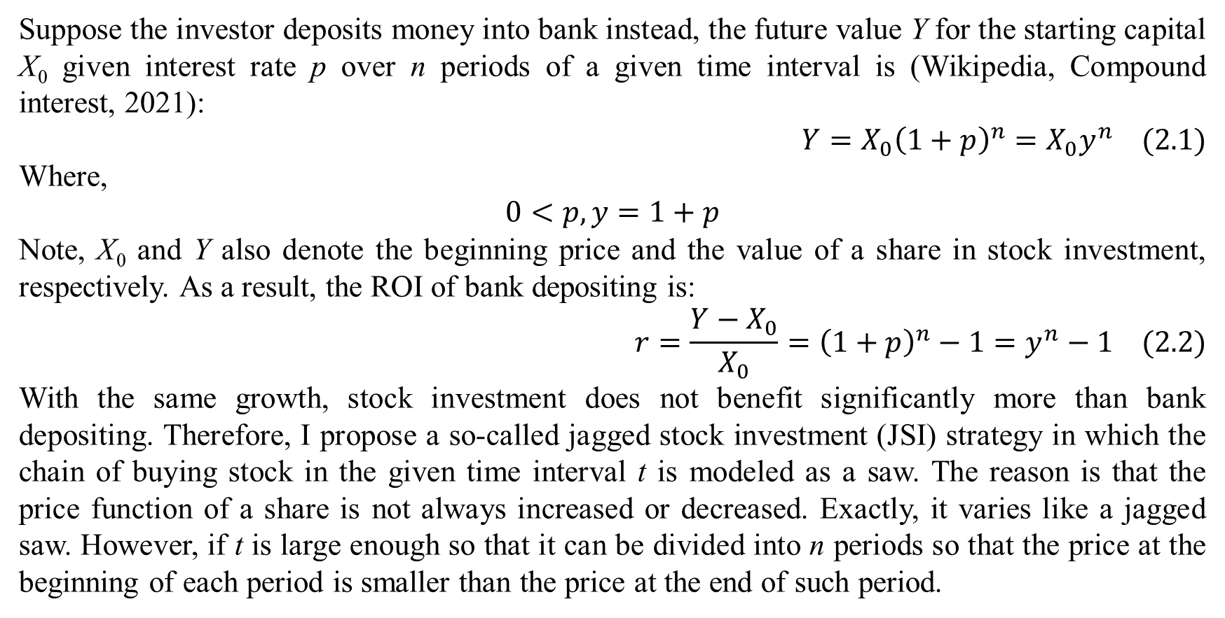
2. Bank depositing and jagged stock investment
Suppose the investor deposits money into bank instead, the future value Y for the starting capital X₀ given interest rate p over n periods of a given time interval is (Wikipedia, Compound interest, 2021):
$$Y=X_{0}{\left(1+p\right)}^{n}=X_{0}y^{n} (2.1)$$
Where,
$$\begin{matrix}0<p,y=1+p\end{matrix}$$
Note, X₀ and Y also denote the beginning price and the value of a share in stock investment, respectively. As a result, the ROI of bank depositing is:
$$r=\frac{Y−X_{0}}{X_{0}}={\left(1+p\right)}^{n}−1=y^{n}−1 (2.2)$$
With the same growth, stock investment does not benefit significantly more than bank depositing. Therefore, I propose a so-called jagged stock investment (JSI) strategy in which the chain of buying stock in the given time interval t is modeled as a saw. The reason is that the price function of a share is not always increased or decreased. Exactly, it varies like a jagged saw. However, if t is large enough so that it can be divided into n periods so that the price at the beginning of each period is smaller than the price at the end of such period.

Slide 9
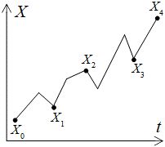
2. Bank depositing and jagged stock investment
For instance, suppose t is split into n periods with n+1 time points t₀, t₁, t₂,…, t_{n} along with n+1 prices X₀, X₁, X₂,…, X_{n}. According to JSI strategy, the share A is bought repeatedly and consequently at t₁, t₂,…, t_{n–1} so that X_{i} > X_{i–1} for all i. It is possible that many prices after X_{i–1} and before X_{i} are larger than X_{i}. Moreover, many prices after X_{i–1} and before X_{i} may be smaller than X_{i–1}. This JSI strategy is first order JSI strategy in which A is only bought at the first level in the chain t₁, t₂, t_{n–1} with note that the starting purchase (X₀) is excluded because it is default. In other words, given the chain t₁, t₂, t_{n–1}, there are n–1 lines of bought replications of A. Note, JSI strategy assumes that in the overview, stock price is increased when the own company gets profitable in the time interval t. Figure 1 illustrates JSI strategy.
Figure 1. JSI strategy

Slide 10
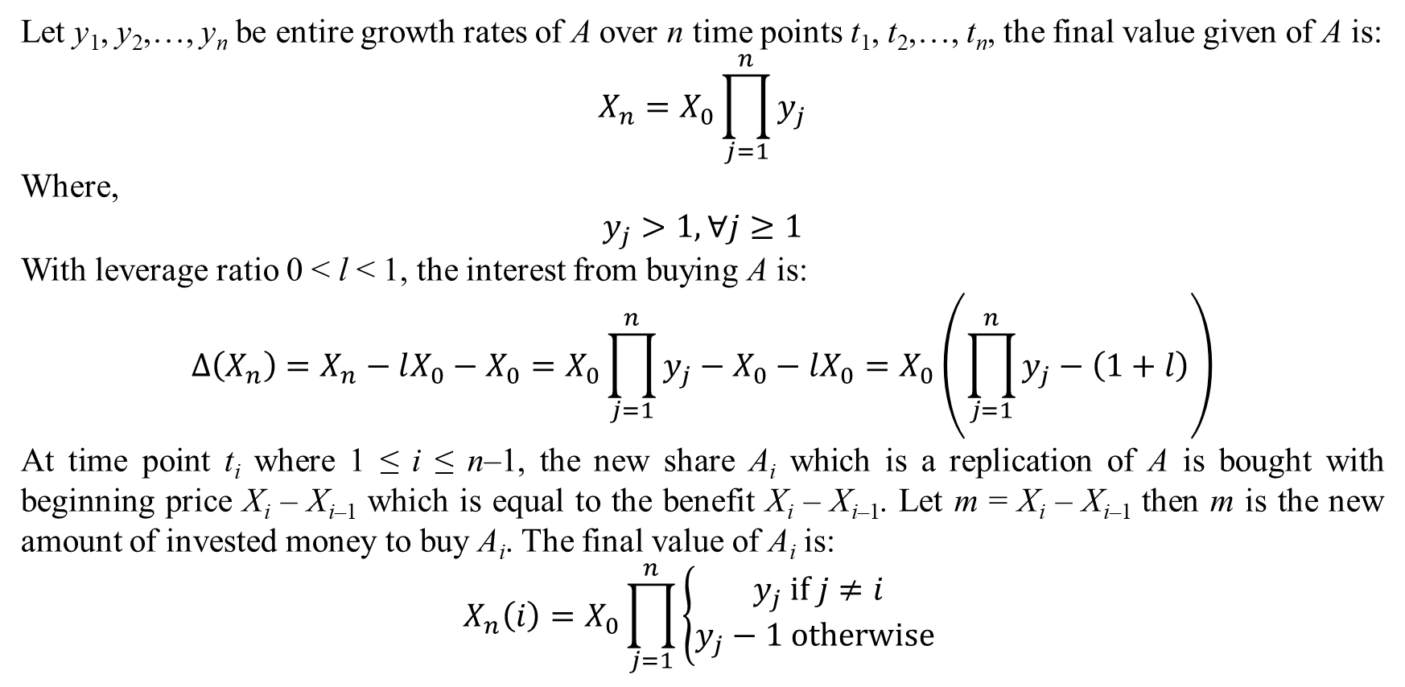
2. Bank depositing and jagged stock investment
Let y₁, y₂,…, y_{n} be entire growth rates of A over n time points t₁, t₂,…, t_{n}, the final value given of A is:
$$X_{n}=X_{0}\prod_{j=1}^{n}{y_{j}}$$
Where,
$$y_{j}>1,∀j≥1$$
With leverage ratio 0 < l < 1, the interest from buying A is:
$$∆\left(X_{n}\right)=X_{n}−lX_{0}−X_{0}=X_{0}\prod_{j=1}^{n}{y_{j}}−X_{0}−lX_{0}=X_{0}\left(\prod_{j=1}^{n}{y_{j}}−\left(1+l\right)\right)$$
At time point t_{i} where 1 ≤ i ≤ n–1, the new share A_{i} which is a replication of A is bought with beginning price X_{i} – X_{i–1} which is equal to the benefit X_{i} – X_{i–1}. Let m = X_{i} – X_{i–1} then m is the new amount of invested money to buy A_{i}. The final value of A_{i} is:
$$X_{n}\left(i\right)=X_{0}\prod_{j=1}^{n}{\left\{\begin{matrix}y_{j} if j≠i \\ y_{j}−1 otherwise \end{matrix}\right.}$$

Slide 11
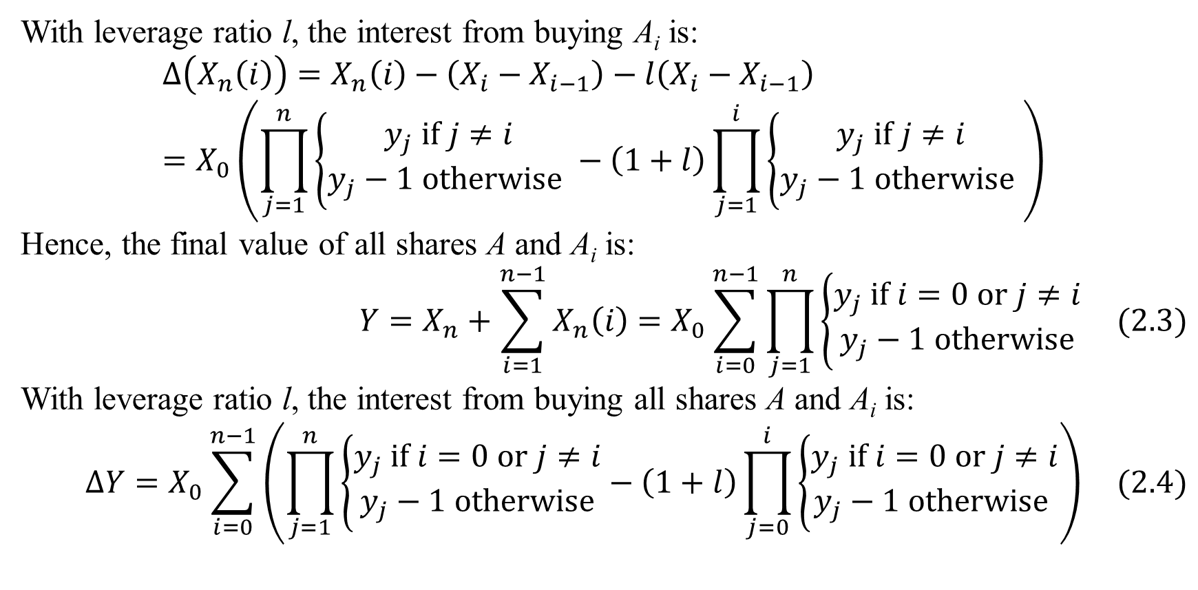
2. Bank depositing and jagged stock investment
With leverage ratio l, the interest from buying A_{i} is:
$$∆\left(X_{n}\left(i\right)\right)=X_{n}\left(i\right)−\left(X_{i}−X_{i−1}\right)−l\left(X_{i}−X_{i−1}\right)=X_{0}\left(\prod_{j=1}^{n}{\left\{\begin{matrix}y_{j} if j≠i \\ y_{j}−1 otherwise \end{matrix}\right.}−\left(1+l\right)\prod_{j=1}^{i}{\left\{\begin{matrix}y_{j} if j≠i \\ y_{j}−1 otherwise \end{matrix}\right.}\right)$$
Hence, the final value of all shares A and A_{i} is:
$$Y=X_{n}+\sum_{i=1}^{n−1}{X_{n}\left(i\right)}=X_{0}\sum_{i=0}^{n−1}{\prod_{j=1}^{n}{\left\{\begin{matrix}y_{j} if i=0 or j≠i \\ y_{j}−1 otherwise\end{matrix}\right.}} (2.3)$$
With leverage ratio l, the interest from buying all shares A and A_{i} is:
$$∆Y=X_{0}\sum_{i=0}^{n−1}{\left(\prod_{j=1}^{n}{\left\{\begin{matrix}y_{j} if i=0 or j≠i \\ y_{j}−1 otherwise\end{matrix}\right.}−\left(1+l\right)\prod_{j=0}^{i}{\left\{\begin{matrix}y_{j} if i=0 or j≠i \\ y_{j}−1 otherwise \end{matrix}\right.}\right)} (2.4)$$

Slide 12
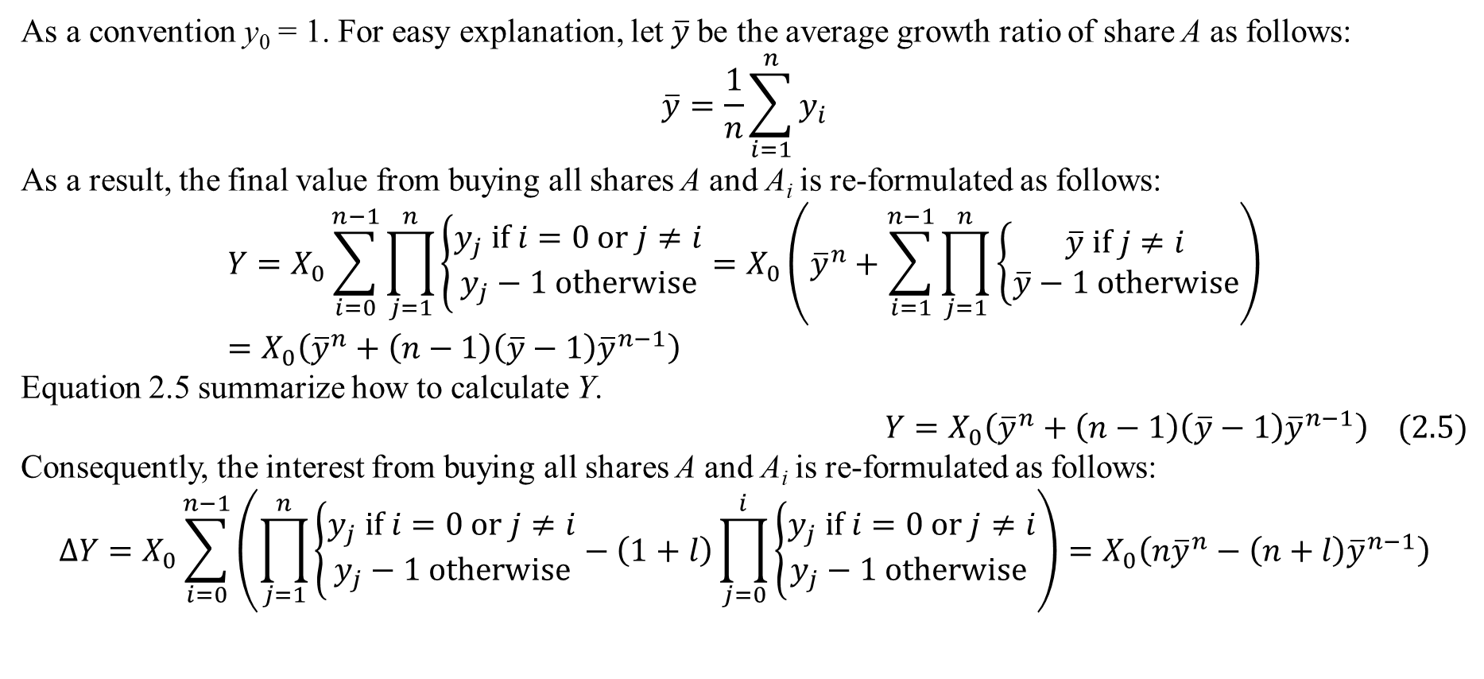
2. Bank depositing and jagged stock investment
As a convention y₀ = 1. For easy explanation, let $\overline{y}$be the average growth ratio of share A as follows:
$$\overline{y}=\frac{1}{n}\sum_{i=1}^{n}{y_{i}}$$
As a result, the final value from buying all shares A and A_{i} is re-formulated as follows:
$$Y=X_{0}\sum_{i=0}^{n−1}{\prod_{j=1}^{n}{\left\{\begin{matrix}y_{j} if i=0 or j≠i \\ y_{j}−1 otherwise\end{matrix}\right.}}=X_{0}\left({\overline{y}}^{n}+\sum_{i=1}^{n−1}{\prod_{j=1}^{n}{\left\{\begin{matrix}\overline{y} if j≠i \\ \overline{y}−1 otherwise\end{matrix}\right.}}\right)=X_{0}\left({\overline{y}}^{n}+\left(n−1\right)\left(\overline{y}−1\right){\overline{y}}^{n−1}\right)$$
Equation 2.5 summarize how to calculate Y.
$$Y=X_{0}\left({\overline{y}}^{n}+\left(n−1\right)\left(\overline{y}−1\right){\overline{y}}^{n−1}\right) (2.5)$$
Consequently, the interest from buying all shares A and A_{i} is re-formulated as follows:
$$∆Y=X_{0}\sum_{i=0}^{n−1}{\left(\prod_{j=1}^{n}{\left\{\begin{matrix}y_{j} if i=0 or j≠i \\ y_{j}−1 otherwise\end{matrix}\right.}−\left(1+l\right)\prod_{j=0}^{i}{\left\{\begin{matrix}y_{j} if i=0 or j≠i \\ y_{j}−1 otherwise \end{matrix}\right.}\right)}=X_{0}\left(n{\overline{y}}^{n}−\left(n+l\right){\overline{y}}^{n−1}\right)$$

Slide 13
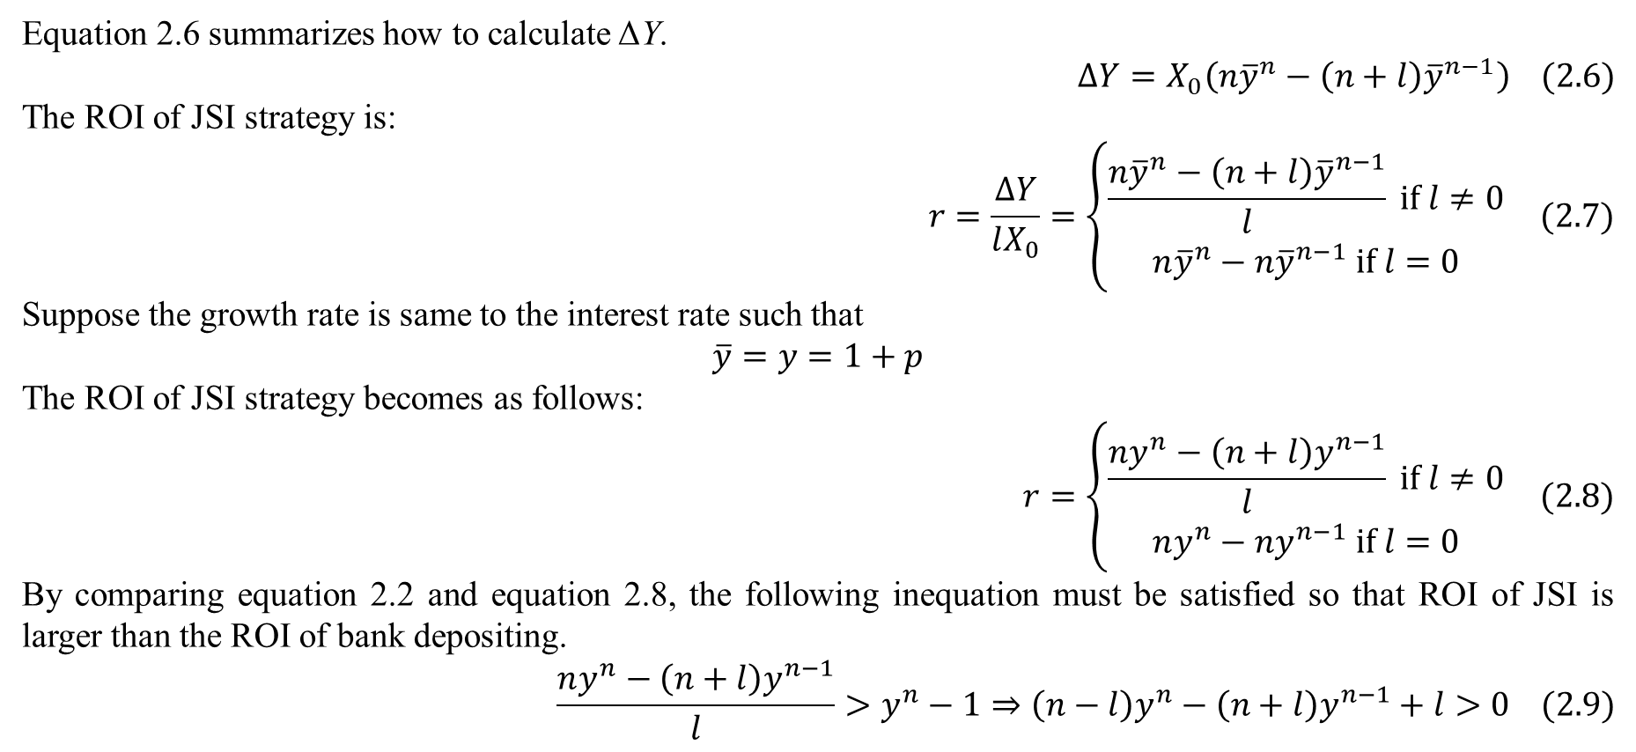
2. Bank depositing and jagged stock investment
Equation 2.6 summarizes how to calculate ΔY.
$$∆Y=X_{0}\left(n{\overline{y}}^{n}−\left(n+l\right){\overline{y}}^{n−1}\right) (2.6)$$
The ROI of JSI strategy is:
$$r=\frac{∆Y}{lX_{0}}=\left\{\begin{matrix}\frac{n{\overline{y}}^{n}−\left(n+l\right){\overline{y}}^{n−1}}{l} if l≠0 \\ n{\overline{y}}^{n}−n{\overline{y}}^{n−1} if l=0\end{matrix}\right. (2.7)$$
Suppose the growth rate is same to the interest rate such that
$$\overline{y}=y=1+p$$
The ROI of JSI strategy becomes as follows:
$$r=\left\{\begin{matrix}\frac{ny^{n}−\left(n+l\right)y^{n−1}}{l} if l≠0 \\ ny^{n}−ny^{n−1} if l=0\end{matrix}\right. (2.8)$$
By comparing equation 2.2 and equation 2.8, the following inequation must be satisfied so that ROI of JSI is larger than the ROI of bank depositing.
$$\frac{ny^{n}−\left(n+l\right)y^{n−1}}{l}>y^{n}−1⇒\left(n−l\right)y^{n}−\left(n+l\right)y^{n−1}+l>0 (2.9)$$

Slide 14
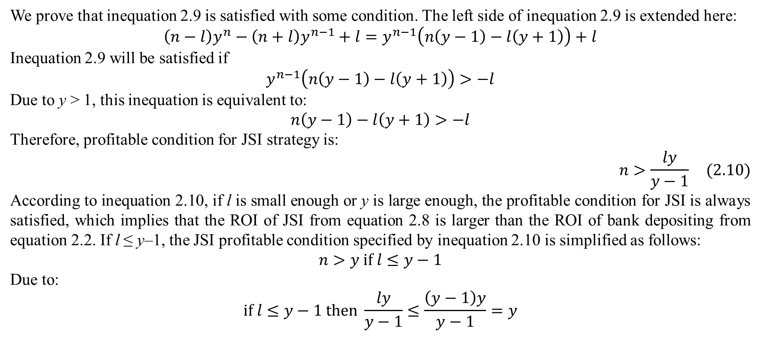
2. Bank depositing and jagged stock investment
We prove that inequation 2.9 is satisfied with some condition. The left side of inequation 2.9 is extended here:
$$\left(n−l\right)y^{n}−\left(n+l\right)y^{n−1}+l=y^{n−1}\left(n\left(y−1\right)−l\left(y+1\right)\right)+l$$
Inequation 2.9 will be satisfied if
$$y^{n−1}\left(n\left(y−1\right)−l\left(y+1\right)\right)>−l$$
Due to y > 1, this inequation is equivalent to:
$$n\left(y−1\right)−l\left(y+1\right)>−l$$
Therefore, profitable condition for JSI strategy is:
$$n>\frac{ly}{y−1} (2.10)$$
According to inequation 2.10, if l is small enough or y is large enough, the profitable condition for JSI is always satisfied, which implies that the ROI of JSI from equation 2.8 is larger than the ROI of bank depositing from equation 2.2. If l ≤ y–1, the JSI profitable condition specified by inequation 2.10 is simplified as follows:
$$n>y if l≤y−1$$
Due to:
$$if l≤y−1 then \frac{ly}{y−1}≤\frac{\left(y−1\right)y}{y−1}=y$$

Slide 15
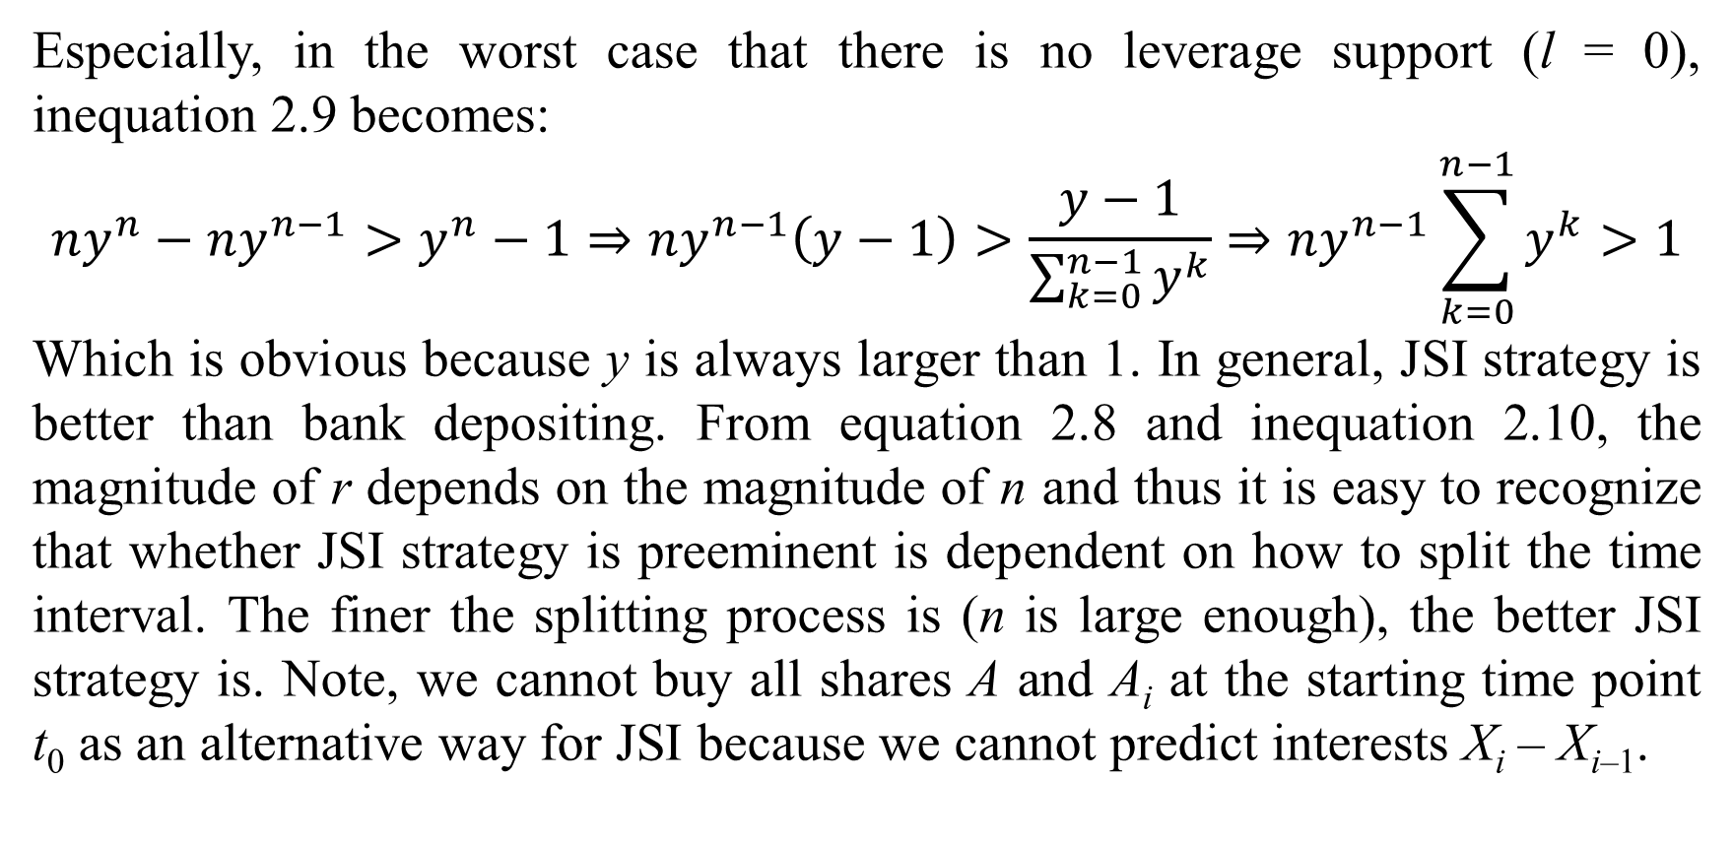
2. Bank depositing and jagged stock investment
Especially, in the worst case that there is no leverage support (l = 0), inequation 2.9 becomes:
$$ny^{n}−ny^{n−1}>y^{n}−1⇒ny^{n−1}\left(y−1\right)>\frac{y−1}{\sum_{k=0}^{n−1}{y^{k}}}⇒ny^{n−1}\sum_{k=0}^{n−1}{y^{k}}>1$$
Which is obvious because y is always larger than 1. In general, JSI strategy is better than bank depositing. From equation 2.8 and inequation 2.10, the magnitude of r depends on the magnitude of n and thus it is easy to recognize that whether JSI strategy is preeminent is dependent on how to split the time interval. The finer the splitting process is (n is large enough), the better JSI strategy is. Note, we cannot buy all shares A and A_{i} at the starting time point t₀ as an alternative way for JSI because we cannot predict interests X_{i} – X_{i–1}.

Slide 16
4. Conclusions
In theory, stock investment and bank depositing have the same benefit because they share the same interest rate (growth rate) in mathematical model. However, stock investment often has the growth rate which is higher than interest rate unless the own company is unprofitable. Remind that the fine splitting time interval is most important to JSI strategy in order to get always profitable. The solution for this problem is not so difficult because it is totally possible to determine the vicinity of the bottom of a given share price with acceptable error rate. Note that we only predict such vicinity and so it is not necessary to determine exactly the bottom price in some interval. The JSI strategy here is the first order one in which the share A is only bought at the first level in the chain t₁, t₂, t_{n–1}. It is not difficult to develop k^{th} JSI strategy where replications A_{i} are in turn replicated till (k–1)^{th} time. If we deposit repeatedly and continuously many money items into bank by the same way of jagged strategy, we can get benefits like JSI. Unfortunately, banking interest rate is constant whereas share growth rate varies, which is the reason that bank depositing is stable but has not many profitable chances.

Slide 17
References
Wikipedia. (2021, March 30). Compound interest. (Wikimedia Foundation) Retrieved April 1, 2021, from Wikipedia website: https://en.wikipedia.org/wiki/Compound_interest.

Slide 18
Thank you for listening

