Slide 1
Advanced cosine measures for collaborative filtering
Prof. Loc Nguyen PhD, MD, MBA
International Engineering and Technology Institute (IETI), Vietnam
Email: ng_phloc@yahoo.com
Homepage: www.locnguyen.net

Slide 2
Abstract
Cosine similarity is an important measure to compare two vectors for many researches in data mining and information retrieval. In this research, cosine measure and its advanced variants for collaborating filtering (CF) are evaluated. Cosine measure is effective but it has a drawback that there may be two end points of two vectors which are far from each other according to Euclidean distance, but their cosine is high. This is negative effect of Euclidean distance which decreases accuracy of cosine similarity. Therefore, a so-called triangle area (TA) measure is proposed as an improved version of cosine measure. TA measure uses ratio of basic triangle area to whole triangle area as reinforced factor for Euclidean distance so that it can alleviate negative effect of Euclidean distance whereas it keeps simplicity and effectiveness of both cosine measure and Euclidean distance in making similarity of two vectors. TA is considered as an advanced cosine measure. TA and other advanced cosine measures are tested with other similarity measures. From experimental results, TA is not a preeminent measure but it is better than traditional cosine measures in most cases and it is also adequate to real-time application. Moreover, its formula is simple too.

Slide 3
Table of contents
Introduction
Methodologies
Results and Discussions
Conclusions

Slide 4
1. Introduction
Introduction 1.
Introduction 2.
Introduction 3

Slide 5
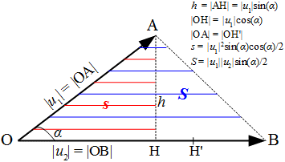
2. Methodologies
Let u₁ = OA and u₂ = OB be two rating vectors and let α be the angle formed by u₁ and u₂. Such two vectors form the triangle OAB.
Cosine measure has a drawback that there may be two points like A and B which are far from each other according to Euclidean distance, but their cosine is high.
For example, given three vectors u₁ = (1, 1), u₂ = (9, 9), and u₃ = (10, 10), although their cosine is 1, Euclidean distance still affects negatively because obviously u₂ = (9, 9) is nearer to u₃ = (10, 10) than the u₁ = (1, 1).
The so-called triangle area (TA) measure is proposed to alleviate the negative effect of Euclidean distance

Slide 6
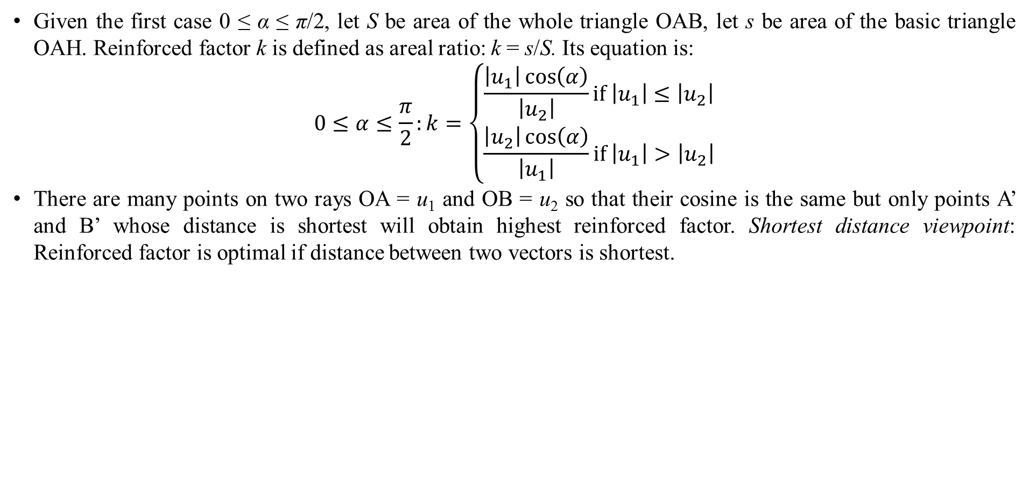
2. Methodologies
Given the first case 0 ≤ α ≤ π/2, let S be area of the whole triangle OAB, let s be area of the basic triangle OAH. Reinforced factor k is defined as areal ratio: k = s/S. Its equation is:
$$0≤α≤\frac{π}{2}:k=\left\{\begin{matrix}\frac{\left|u_{1}\right|\cos\left(α\right)}{\left|u_{2}\right|}if \left|u_{1}\right|≤\left|u_{2}\right| \\ \frac{\left|u_{2}\right|\cos\left(α\right)}{\left|u_{1}\right|}if \left|u_{1}\right|>\left|u_{2}\right|\end{matrix}\right.$$
There are many points on two rays OA = u₁ and OB = u₂ so that their cosine is the same but only points A’ and B’ whose distance is shortest will obtain highest reinforced factor. Shortest distance viewpoint: Reinforced factor is optimal if distance between two vectors is shortest.

Slide 7
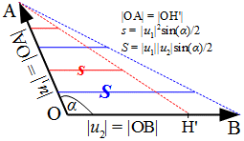
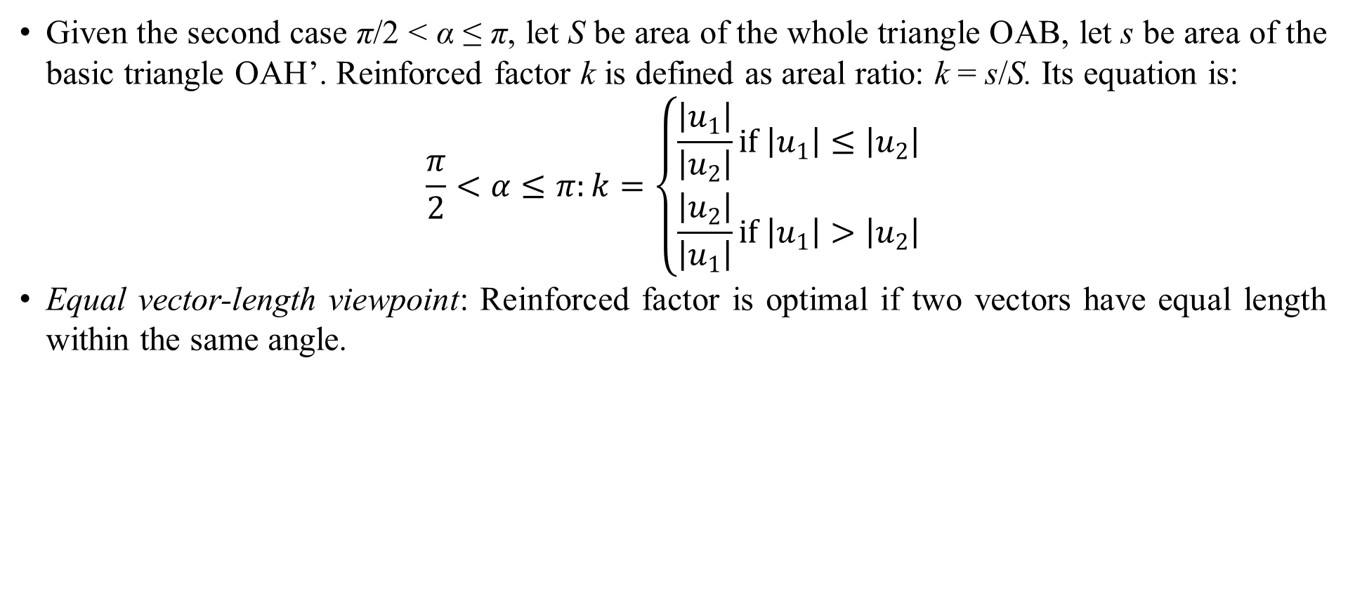
2. Methodologies
Given the second case π/2 < α ≤ π, let S be area of the whole triangle OAB, let s be area of the basic triangle OAH’. Reinforced factor k is defined as areal ratio: k = s/S. Its equation is:
$$\frac{π}{2}<α≤π:k=\left\{\begin{matrix}\frac{\left|u_{1}\right|}{\left|u_{2}\right|}if \left|u_{1}\right|≤\left|u_{2}\right| \\ \frac{\left|u_{2}\right|}{\left|u_{1}\right|}if \left|u_{1}\right|>\left|u_{2}\right|\end{matrix}\right.$$
Equal vector-length viewpoint: Reinforced factor is optimal if two vectors have equal length within the same angle.

Slide 8
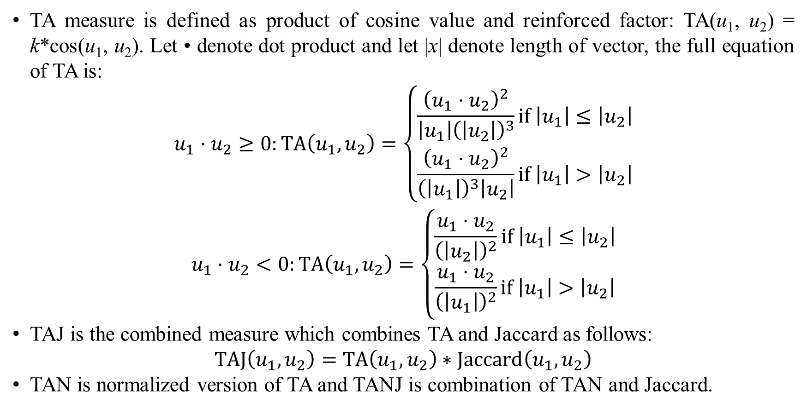
2. Methodologies
TA measure is defined as product of cosine value and reinforced factor: TA(u₁, u₂) = k*cos(u₁, u₂). Let • denote dot product and let |x| denote length of vector, the full equation of TA is:
$$\begin{matrix}u_{1}⋅u_{2}≥0:TA\left(u_{1},u_{2}\right)=\left\{\begin{matrix}\frac{{\left(u_{1}⋅u_{2}\right)}^{2}}{\left|u_{1}\right|{\left(\left|u_{2}\right|\right)}^{3}}if \left|u_{1}\right|≤\left|u_{2}\right| \\ \frac{{\left(u_{1}⋅u_{2}\right)}^{2}}{{\left(\left|u_{1}\right|\right)}^{3}\left|u_{2}\right|}if \left|u_{1}\right|>\left|u_{2}\right|\end{matrix}\right. \\ u_{1}⋅u_{2}<0:TA\left(u_{1},u_{2}\right)=\left\{\begin{matrix}\frac{u_{1}⋅u_{2}}{{\left(\left|u_{2}\right|\right)}^{2}}if \left|u_{1}\right|≤\left|u_{2}\right| \\ \frac{u_{1}⋅u_{2}}{{\left(\left|u_{1}\right|\right)}^{2}}if \left|u_{1}\right|>\left|u_{2}\right|\end{matrix}\right.\end{matrix}$$
TAJ is the combined measure which combines TA and Jaccard as follows:
$$TAJ\left(u_{1},u_{2}\right)=TA\left(u_{1},u_{2}\right)∗Jaccard\left(u_{1},u_{2}\right)$$
TAN is normalized version of TA and TANJ is combination of TAN and Jaccard.

Slide 9
3. Results and Discussions
Result 1.
Result 2.
Result 3.
Discussion 1.
Discussion 2.
Discussion 3.

Slide 10
4. Conclusions
Conclusion 1.
Conclusion 2.
Conclusion 3.

Slide 11
Thank you for attention

Slide 12
References
Reference 1
Reference 2.
Reference 3.

