Slide 1
Advanced cosine measures for collaborative filtering
Prof. Loc Nguyen, PhD
Loc Nguyen’s Academic Network, Vietnam
Email: ng_phloc@yahoo.com
Homepage: www.locnguyen.net

Slide 2
Abstract
Cosine similarity is an important measure to compare two vectors for many researches in data mining and information retrieval. In this research, cosine measure and its advanced variants for collaborating filtering (CF) are evaluated. Cosine measure is effective but it has a drawback that there may be two end points of two vectors which are far from each other according to Euclidean distance, but their cosine is high. This is negative effect of Euclidean distance which decreases accuracy of cosine similarity. Therefore, a so-called triangle area (TA) measure is proposed as an improved version of cosine measure. TA measure uses ratio of basic triangle area to whole triangle area as reinforced factor for Euclidean distance so that it can alleviate negative effect of Euclidean distance whereas it keeps simplicity and effectiveness of both cosine measure and Euclidean distance in making similarity of two vectors. TA is considered as an advanced cosine measure. TA and other advanced cosine measures are tested with other similarity measures. From experimental results, TA is not a preeminent measure but it is better than traditional cosine measures in most cases and it is also adequate to real-time application. Moreover, its formula is simple too.

Slide 3
Table of contents
Introduction
Methodologies
Results and discussions
Conclusions

Slide 4
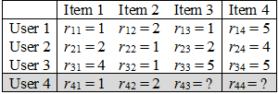
1. Introduction
Recommendation system is a system which recommends items to users among many existing items in database. There are two main approaches for recommendation such as content-based filtering (CBF) and collaborative filtering (CF). One of popular algorithms in CF is nearest neighbors (NN) algorithm. The essence of NN algorithm [1] is to find out nearest neighbors of active user and then to recommend active user items that these neighbors may like.
Let U = {u₁, u₂,…, u_{m}} be the set of users and let V = {v₁, v₂,…, v_{n}} be the set of items. User-based rating matrix is the matrix in which rows indicate users and columns indicate items and each cell is a rating. Let, rating vectors u₁ = (r₁₁, r₁₂,…, r_{1n}) and u₂ = (r₂₁, r₂₂,…, r_{2n}) of user 1 and user 2, in which some r_{ij} can be missing (empty).
Suppose the active rating vector is u₄, NN algorithm will find out nearest neighbors of u₄ and then compute the predictive values for r₄₃ and r₄₄ based on similarities between these neighbors and u₄.

Slide 5
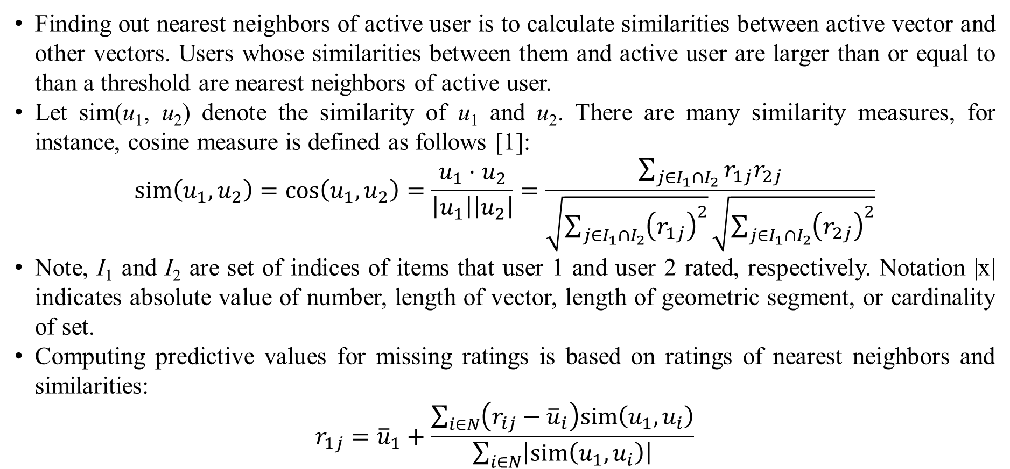
1. Introduction
Finding out nearest neighbors of active user is to calculate similarities between active vector and other vectors. Users whose similarities between them and active user are larger than or equal to than a threshold are nearest neighbors of active user.
Let sim(u₁, u₂) denote the similarity of u₁ and u₂. There are many similarity measures, for instance, cosine measure is defined as follows [1]:
$$sim\left(u_{1},u_{2}\right)=\cos\left(u_{1},u_{2}\right)=\frac{u_{1}⋅u_{2}}{\left|u_{1}\right|\left|u_{2}\right|}=\frac{\sum_{j∈I_{1}∩I_{2}}{r_{1j}r_{2j}}}{\sqrt{\sum_{j∈I_{1}∩I_{2}}{{\left(r_{1j}\right)}^{2}}}\sqrt{\sum_{j∈I_{1}∩I_{2}}{{\left(r_{2j}\right)}^{2}}}}$$
Note, I₁ and I₂ are set of indices of items that user 1 and user 2 rated, respectively. Notation |x| indicates absolute value of number, length of vector, length of geometric segment, or cardinality of set.
Computing predictive values for missing ratings is based on ratings of nearest neighbors and similarities:
$$r_{1j}={\overline{u}}_{1}+\frac{\sum_{i∈N}{\left(r_{ij}−{\overline{u}}_{i}\right)sim\left(u_{1},u_{i}\right)}}{\sum_{i∈N}{\left|sim\left(u_{1},u_{i}\right)\right|}}$$

Slide 6
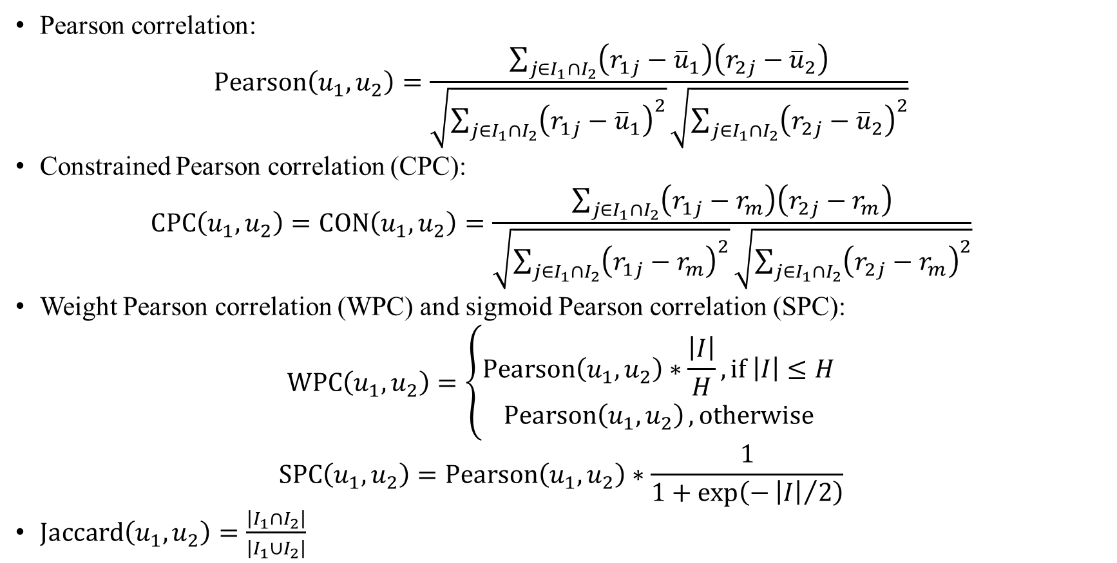
1. Introduction
Pearson correlation:
$$\operatorname{Pearson}\left(u_{1},u_{2}\right)=\frac{\sum_{j∈I_{1}∩I_{2}}{\left(r_{1j}−{\overline{u}}_{1}\right)\left(r_{2j}−{\overline{u}}_{2}\right)}}{\sqrt{\sum_{j∈I_{1}∩I_{2}}{{\left(r_{1j}−{\overline{u}}_{1}\right)}^{2}}}\sqrt{\sum_{j∈I_{1}∩I_{2}}{{\left(r_{2j}−{\overline{u}}_{2}\right)}^{2}}}}$$
Constrained Pearson correlation (CPC):
$$\operatorname{CPC}\left(u_{1},u_{2}\right)=\operatorname{CON}\left(u_{1},u_{2}\right)=\frac{\sum_{j∈I_{1}∩I_{2}}{\left(r_{1j}−r_{m}\right)\left(r_{2j}−r_{m}\right)}}{\sqrt{\sum_{j∈I_{1}∩I_{2}}{{\left(r_{1j}−r_{m}\right)}^{2}}}\sqrt{\sum_{j∈I_{1}∩I_{2}}{{\left(r_{2j}−r_{m}\right)}^{2}}}}$$
Weight Pearson correlation (WPC) and sigmoid Pearson correlation (SPC):
$$\operatorname{WPC}\left(u_{1},u_{2}\right)=\left\{\begin{matrix}\operatorname{Pearson}\left(u_{1},u_{2}\right)∗\frac{\left|I\right|}{H},if \left|I\right|≤H \\ \operatorname{Pearson}\left(u_{1},u_{2}\right),otherwise\end{matrix}\right.$$
$$\operatorname{SPC}\left(u_{1},u_{2}\right)=\operatorname{Pearson}\left(u_{1},u_{2}\right)∗\frac{1}{1+\exp\left(−{\left|I\right|}/2\right)}$$
$Jaccard\left(u_{1},u_{2}\right)=\frac{\left|I_{1}∩I_{2}\right|}{\left|I_{1}∪I_{2}\right|}$

Slide 7
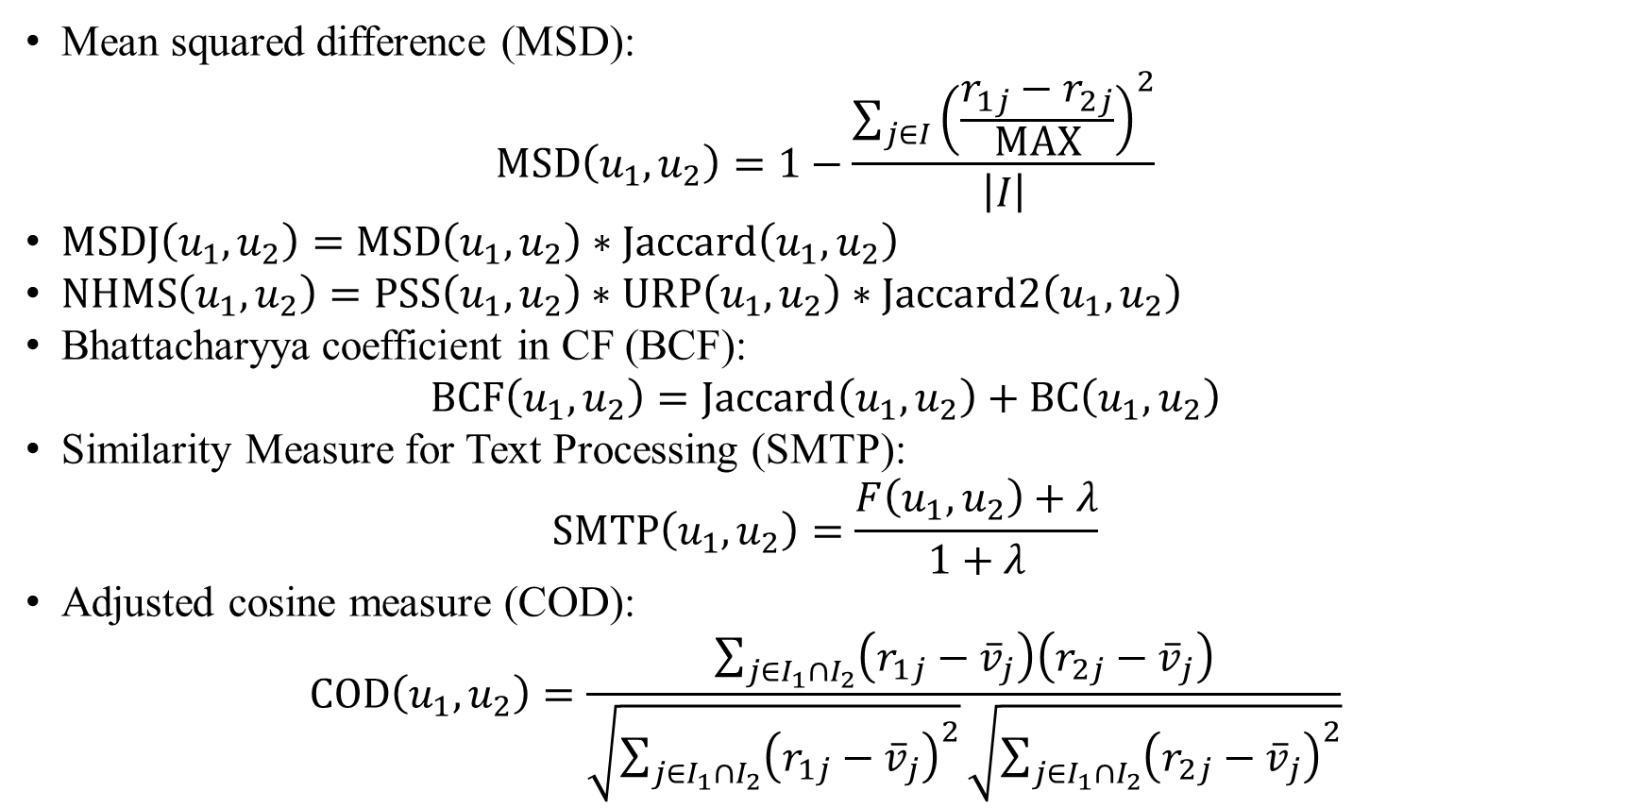
1. Introduction
Mean squared difference (MSD):
$$MSD\left(u_{1},u_{2}\right)=1−\frac{\sum_{j∈I}{{\left(\frac{r_{1j}−r_{2j}}{MAX}\right)}^{2}}}{\left|I\right|}$$
$MSDJ\left(u_{1},u_{2}\right)=MSD\left(u_{1},u_{2}\right)∗Jaccard\left(u_{1},u_{2}\right)$
$NHMS\left(u_{1},u_{2}\right)=PSS\left(u_{1},u_{2}\right)∗URP\left(u_{1},u_{2}\right)∗Jaccard2\left(u_{1},u_{2}\right)$
Bhattacharyya coefficient in CF (BCF):
$$BCF\left(u_{1},u_{2}\right)=Jaccard\left(u_{1},u_{2}\right)+BC\left(u_{1},u_{2}\right)$$
Similarity Measure for Text Processing (SMTP):
$$SMTP\left(u_{1},u_{2}\right)=\frac{F\left(u_{1},u_{2}\right)+λ}{1+λ}$$
Adjusted cosine measure (COD):
$$\operatorname{COD}\left(u_{1},u_{2}\right)=\frac{\sum_{j∈I_{1}∩I_{2}}{\left(r_{1j}−{\overline{v}}_{j}\right)\left(r_{2j}−{\overline{v}}_{j}\right)}}{\sqrt{\sum_{j∈I_{1}∩I_{2}}{{\left(r_{1j}−{\overline{v}}_{j}\right)}^{2}}}\sqrt{\sum_{j∈I_{1}∩I_{2}}{{\left(r_{2j}−{\overline{v}}_{j}\right)}^{2}}}}$$

Slide 8
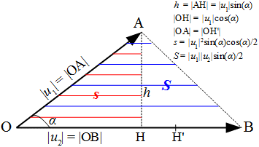
2. Methodologies
Let u₁ = OA and u₂ = OB be two rating vectors and let α be the angle formed by u₁ and u₂. Such two vectors form the triangle OAB.
Cosine measure has a drawback that there may be two points like A and B which are far from each other according to Euclidean distance, but their cosine is high.
For example, given three vectors u₁ = (1, 1), u₂ = (9, 9), and u₃ = (10, 10), although their cosine is 1, Euclidean distance still affects negatively because obviously u₂ = (9, 9) is nearer to u₃ = (10, 10) than the u₁ = (1, 1).
The so-called triangle area (TA) measure is proposed to alleviate the negative effect of Euclidean distance

Slide 9
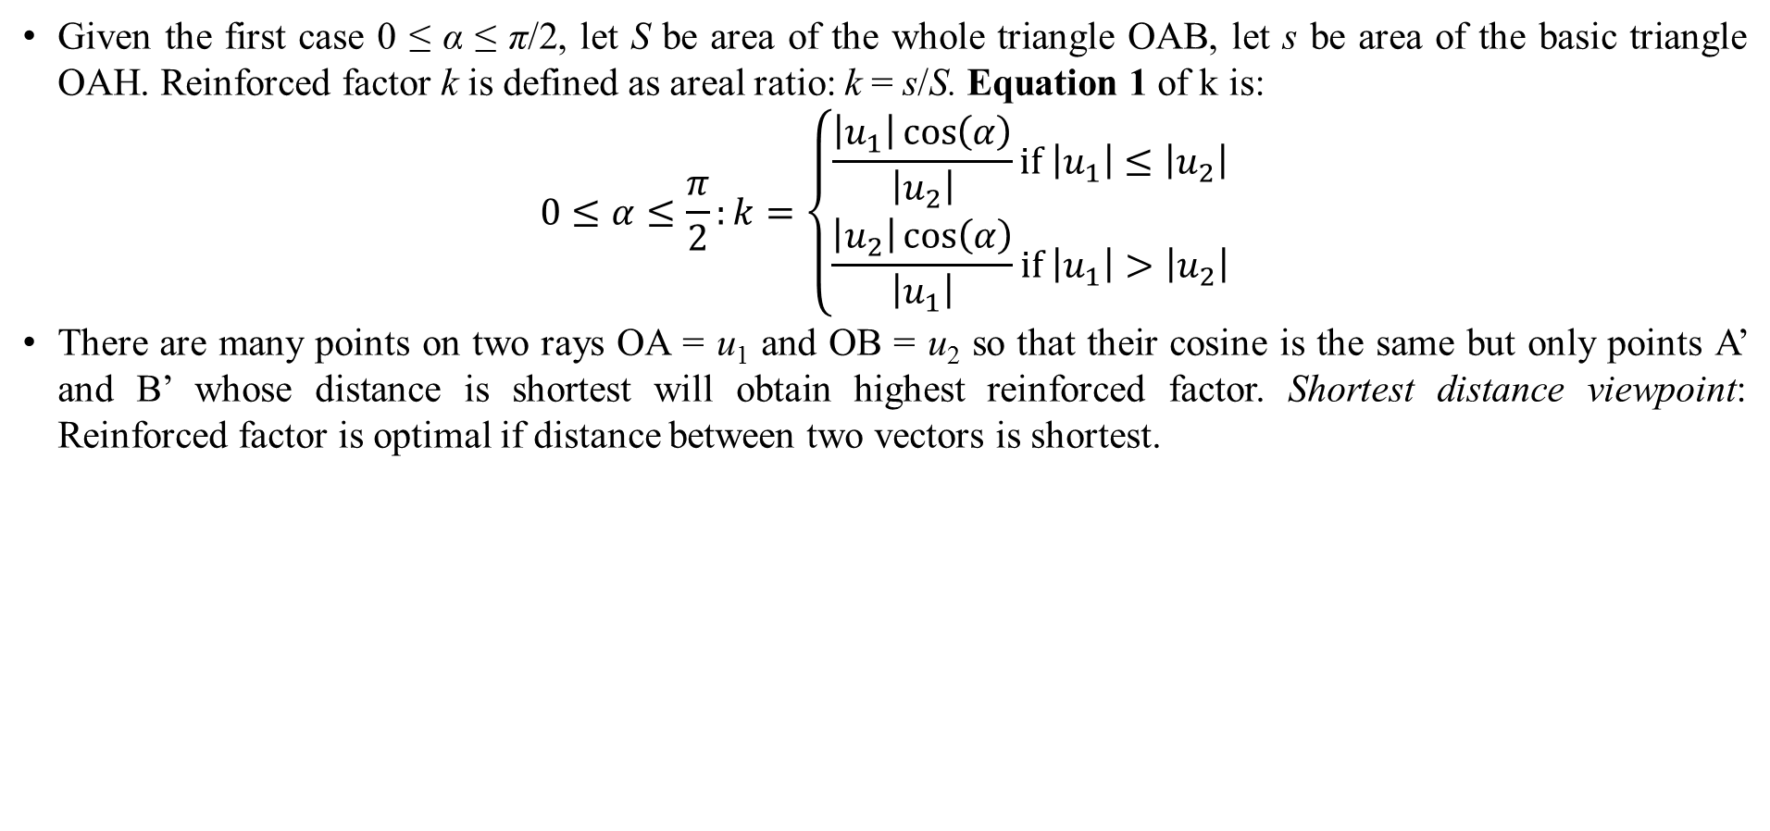
2. Methodologies
Given the first case 0 ≤ α ≤ π/2, let S be area of the whole triangle OAB, let s be area of the basic triangle OAH. Reinforced factor k is defined as areal ratio: k = s/S. Equation 1 of k is:
$$0≤α≤\frac{π}{2}:k=\left\{\begin{matrix}\frac{\left|u_{1}\right|\cos\left(α\right)}{\left|u_{2}\right|}if \left|u_{1}\right|≤\left|u_{2}\right| \\ \frac{\left|u_{2}\right|\cos\left(α\right)}{\left|u_{1}\right|}if \left|u_{1}\right|>\left|u_{2}\right|\end{matrix}\right.$$
There are many points on two rays OA = u₁ and OB = u₂ so that their cosine is the same but only points A’ and B’ whose distance is shortest will obtain highest reinforced factor. Shortest distance viewpoint: Reinforced factor is optimal if distance between two vectors is shortest.

Slide 10
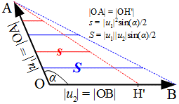
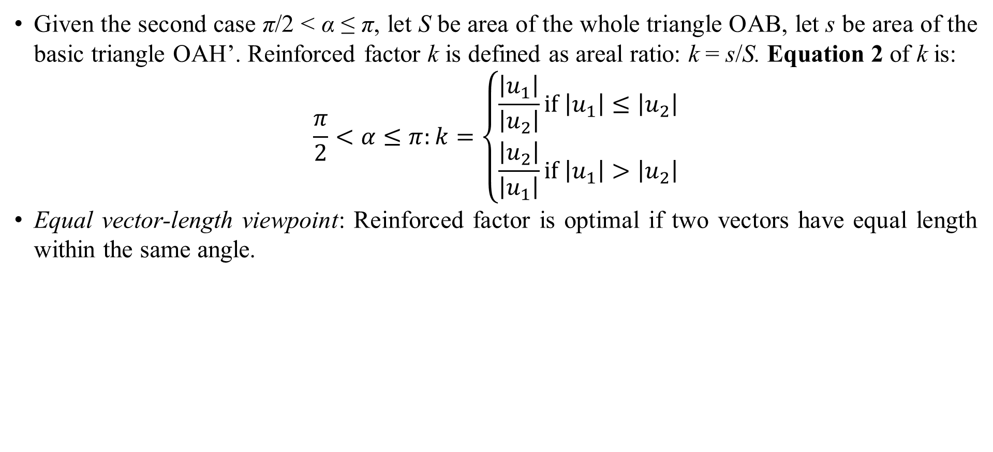
2. Methodologies
Given the second case π/2 < α ≤ π, let S be area of the whole triangle OAB, let s be area of the basic triangle OAH’. Reinforced factor k is defined as areal ratio: k = s/S. Equation 2 of k is:
$$\frac{π}{2}<α≤π:k=\left\{\begin{matrix}\frac{\left|u_{1}\right|}{\left|u_{2}\right|}if \left|u_{1}\right|≤\left|u_{2}\right| \\ \frac{\left|u_{2}\right|}{\left|u_{1}\right|}if \left|u_{1}\right|>\left|u_{2}\right|\end{matrix}\right.$$
Equal vector-length viewpoint: Reinforced factor is optimal if two vectors have equal length within the same angle.

Slide 11
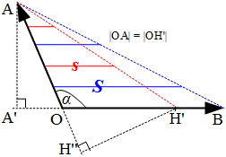
2. Methodologies
The equal vector-length viewpoint is relative to the shortest distance viewpoint. Let A’ and H’’ be projections of A and H’ on lines OB and OA, respectively. So, |AA’| is distance from A to the line OB and |H’H’’| is distance from H’ to the line OA with note that |OA| = |OH’|. We have |AA’| = |H’H’’|.
The condition of equal vector length only assures that two distances from every point to its dual line are equal (|AA’| = |H’H’’|) but |AH’| is not shortest distance due to |AA’| = |H’H’’| < |AH’|. So, the condition of equal vector-length (equation 2) is weaker than the condition of shortest distance (equation 1).

Slide 12
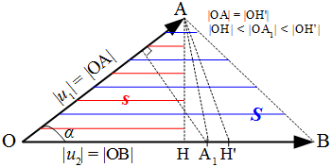
2. Methodologies
Suppose A₁ is an approximative projection of A on the ray OB so that A₁ is near to H (|AA₁| ≈ |AH| = |u₁|cos(α)) according to the shortest distance viewpoint and we have |AH’| = |u₁| according to the equal vector-length viewpoint.
When A₁ is the optimal point of equation 1 in practice and H’ is the optimal point of equation 2 then, equation 1 is better than equation 2 because A₁ is between H and H’ and |OH| < |OA₁| < |OH’|. The best A₁ occurs if and only if H ≡ A₁ ≡ H’ when A ≡ B and the triangle OAB degrades into segment OA (cos(α)=1 and |AB|=0). So, equation 1 balances length of vectors and distance between vectors (points).

Slide 13
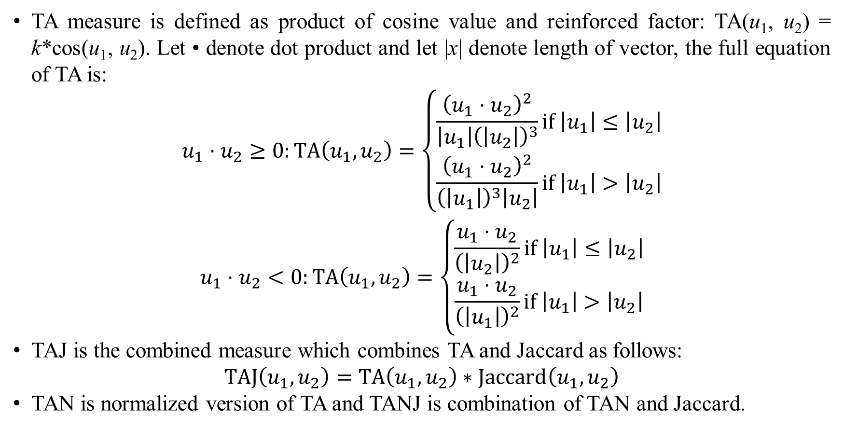
2. Methodologies
TA measure is defined as product of cosine value and reinforced factor: TA(u₁, u₂) = k*cos(u₁, u₂). Let • denote dot product and let |x| denote length of vector, the full equation of TA is:
$$\begin{matrix}u_{1}⋅u_{2}≥0:TA\left(u_{1},u_{2}\right)=\left\{\begin{matrix}\frac{{\left(u_{1}⋅u_{2}\right)}^{2}}{\left|u_{1}\right|{\left(\left|u_{2}\right|\right)}^{3}}if \left|u_{1}\right|≤\left|u_{2}\right| \\ \frac{{\left(u_{1}⋅u_{2}\right)}^{2}}{{\left(\left|u_{1}\right|\right)}^{3}\left|u_{2}\right|}if \left|u_{1}\right|>\left|u_{2}\right|\end{matrix}\right. \\ u_{1}⋅u_{2}<0:TA\left(u_{1},u_{2}\right)=\left\{\begin{matrix}\frac{u_{1}⋅u_{2}}{{\left(\left|u_{2}\right|\right)}^{2}}if \left|u_{1}\right|≤\left|u_{2}\right| \\ \frac{u_{1}⋅u_{2}}{{\left(\left|u_{1}\right|\right)}^{2}}if \left|u_{1}\right|>\left|u_{2}\right|\end{matrix}\right.\end{matrix}$$
TAJ is the combined measure which combines TA and Jaccard as follows:
$$TAJ\left(u_{1},u_{2}\right)=TA\left(u_{1},u_{2}\right)∗Jaccard\left(u_{1},u_{2}\right)$$
TAN is normalized version of TA and TANJ is combination of TAN and Jaccard.

Slide 14
3. Results and discussions
TA family (TA, TAJ, TAN, TANJ) is tested with traditional cosine family (cosine, COJ, CON, COD) and other well-known measures such as Pearson family (Pearson, WPC, SPC), Jaccard, MSD family (MSD, MSDJ), NHSM, BCF, and SMTP.
Two metrics used to test measures are MAE (mean absolute error) and CC (correlation coefficient). The smaller MAE is, the better the measures are. The larger CC is, the better the measures are.
All measures are tested with NN algorithm. NN algorithm for user-based rating matrix becomes user-based NN algorithm and NN algorithm for item-based rating matrix becomes item-based NN algorithm
Dataset Movielens [8] is used for evaluation, which has 100,000 ratings from 943 users on 1682 movies (items). It is divided into 5 folders and each folder includes training set and testing set. Training set and testing set in the same folder are disjoint sets. The ratio of testing set over the whole dataset depends on the testing parameter r = 0.1, 0.2, 0.3, 0.4, 0.5, 0.6, 0.7, 0.8, 0.9.

Slide 15
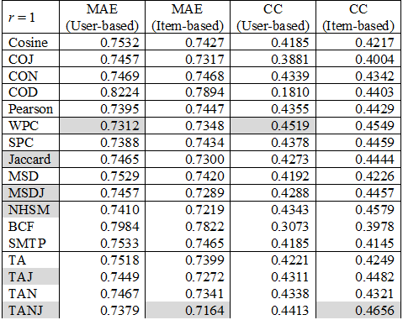
3. Results and discussions
With r=0.1, TANJ is the best with lowest item-based MAE and highest item-based CC whereas WPC is the best with lowest user-based MAE and highest user-based CC.
In general, top-5 measures according to item-based MAE are TANJ (1), NHSM (2), TAJ (3), MSDJ (4), and Jaccard (5). However, top-5 measures according to item-based CC are TANJ, NHSM, WPC, TAJ, and SPC. Top-5 measures according to user-based MAE and user-based CC are WPC, TANJ, SPC, Pearson, and NHSM.
Anyway, TANJ is always in top-5 measures and TA family is better than cosine family.

Slide 16
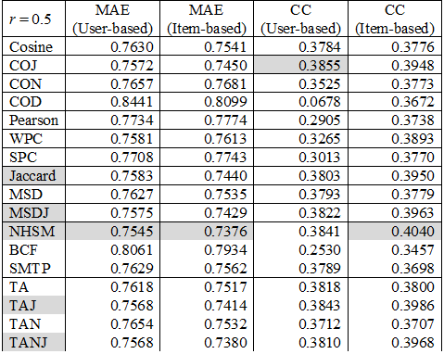
3. Results and discussions
With r=0.5, NHSM is the best with lowest item-based MAE, highest item-based CC, and lowest user-based MAE. COJ is the best with highest user-based CC.
In general, top-5 measures according to item-based MAE are NHSM (1), TANJ (2), TAJ (3), MSDJ (4), and Jaccard (5). However, top-5 measures according to item-based CC are NHSM, TAJ, TANJ, MSDJ, and Jaccard. Top-5 measures according to user-based MAE are NHSM, TANJ, TAJ, cosine, and MSDJ. Top-5 measures according to user-based CC are COJ, TAJ, NHSM, MSDJ, and TA.
Anyway, TA family is always in top-5 measures and it is better than cosine family.

Slide 17
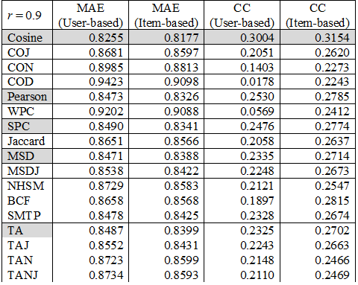
3. Results and discussions
With r=0.9, results are unexpected because the parameter r=0.9 makes noise NN algorithm when the training set is not large enough. Cosine is the best with lowest MAE and highest CC.
In general, top-5 measures according to item-based MAE are cosine (1), Pearson (2), SPC (3), MSD (4), and TA (5). However, top-5 measures according to item-based CC are cosine, BCF, Pearson, SPC, and MSD. Top-5 measures according to user-based MAE are cosine, MSD, Pearson, SMTP, and TA. Top-5 measures according to user-based CC are cosine, Pearson, SPC, MSD, and SMTP.
Although TA is in top-5 measures with user-based MAE, it is worse than pure cosine and hence, TA family is not better than cosine family.

Slide 18
3. Results and discussions
With two parameter values r=0.1 and r=0.5, TA family is better than cosine family and NHSM is the best measure when item-based MAE is selected as the main referred metric because item-based NN algorithm is always better than user-based NN algorithm.
Three values of r such as 0.1, 0.5, and 0.9 are enough for us to survey all measures because these values are key values. For instance, the minimum value r=0.1 implies large real-time database, the medium value r=0.5 implies testing database, and the maximum value r=0.9 implies unexpectedly small database.
However, it is not possible to draw which measures are the best in general yet. So, all measures need to be tested with all values of r: 0.1, 0.2, 0.3, 0.4, 0.5, 0.6, 0.7, 0.8, 0.9 and then average item-based MAE for each measure is calculated in order to determine best measures.

Slide 19
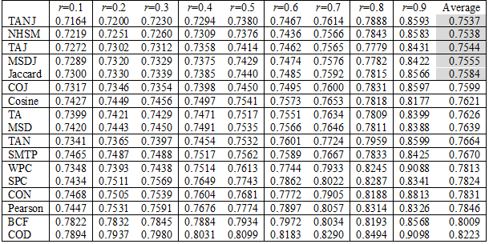
3. Results and discussions
Item-based MAE of all measures over all values of r

Slide 20
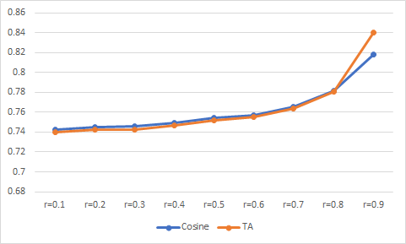
3. Results and discussions
For all r values, general top-5 measures are TANJ, NHSM, TAJ, MSDJ, and Jaccard whose average item-based MAE values are 0.7537, 0.7538, 0.7544, 0.7555, and 0.7584, respectively in which TANJ is the dominant measure.
Because TA measure in TA family does not combine with Jaccard, comparison of pure TA and pure cosine is necessary. In general, TA (average MAE = 0.7626) is worse than cosine (average MAE = 0.7621). However, for most r = 0.1, 0.2, 0.3, 0.4, 0.5, 0.6, 0.7, and 0.8, TA is better than cosine.
With only r=0.9, TA (MAE=0.8399) is unexpectedly worse than cosine (MAE=0.8177). The reason is that the parameter r=0.9 implies training set is too small to train NN algorithm and so, strong point of TA which alleviates negative effect of Euclidean distance is broken by lack of information in small training set.

Slide 21
4. Conclusions
There is no doubt that TA family is better than traditional cosine family in most cases (r = 0.1, 0.2, 0.3, 0.4, 0.5, 0.6, 0.7, 0.8) although pure TA measure is not preeminent like TANJ measure. Moreover, the general top-5 measures are TANJ, NHSM, TAJ, MSDJ, and Jaccard, in which variants of TA as TANJ and TAJ are in such top-5 list.
TA is more suitable to real applications than cosine because values of r which are smaller 0.5 indicate large rating databases in real applications. Moreover, formula of TA is still simple
Jaccard is itself not a preeminent measure, but it is an important factor to improve any measure. In fact, good measures such as TANJ, NHSM, TAJ, MSDJ combine themselves with Jaccard. The reason is that numerical measures except Jaccard are calculated with respect to rating values of common items on which both users rated and hence, these numerical measures ignore items which are rated uniquely by each user whereas Jaccard implies accuracy of these measures because Jaccard is the ratio of the number of common items to the number of all items. As a result, putting Jaccard into another measure is to adjust accuracy of such measure.
In future trend, we try our best to improve TA so that it follows the ideology of Jaccard measure instead of combining TA and Jaccard as usual.

Slide 22
Thank you for attention

Slide 23
References
R. D. Torres Júnior, "Combining Collaborative and Content-based Filtering to Recommend Research Paper," Universidade Federal do Rio Grande do Sul, Porto Alegre, 2004.
M.-P. T. Do, D. V. Nguyen and L. Nguyen, "Model-based Approach for Collaborative Filtering," in Proceedings of The 6th International Conference on Information Technology for Education (IT@EDU2010), Ho Chi Minh, 2010.
B. Sarwar, G. Karypis, J. Konstan and J. Riedl, "Item-based Collaborative Filtering Recommendation Algorithms," in Proceedings of the 10th international conference on World Wide Web, Hong Kong, 2001.
H. Liu, Z. Hu, A. Mian, H. Tian and X. Zhu, "A new user similarity model to improve the accuracy of collaborative filtering," Knowledge-Based Systems, vol. 56, no. 2014, pp. 156-166, 20 November 2013.
B. K. Patra, R. Launonen, V. Ollikainen and S. Nandi, "A new similarity measure using Bhattacharyya coefficient for collaborative filtering in sparse data," Knowledge-Based Systems, vol. 82, pp. 163-177, 1 March 2015.
Y.-S. Lin, J.-Y. Jiang and S.-J. Lee, "A Similarity Measure for Text Classification and Clustering," IEEE Transactions on Knowledge and Data Engineering, vol. 26, no. 7, pp. 1575-1590, 25 January 2013.
J. L. Herlocker, J. A. Konstan, L. G. Terveen and J. T. Riedl, "Evaluating Collaborative Filtering Recommender Systems," ACM Transactions on Information Systems (TOIS), vol. 22, no. 1, pp. 5-53, 2004.
GroupLens, "MovieLens datasets," GroupLens Research Project, University of Minnesota, USA, 22 April 1998. [Online]. Available: http://grouplens.org/datasets/movielens. [Accessed 3 August 2012].

