Slide 1
A general framework of particle swarm optimization
Prof. Dr. Loc Nguyen
Independent scholar, Vietnam
Email: ng_phloc@yahoo.com
Homepage: www.locnguyen.net

Slide 2
Abstract
Particle swarm optimization (PSO) is an effective algorithm to solve the optimization problem in case that derivative of target function is inexistent or difficult to be determined. Because PSO has many parameters and variants, I propose a general framework of PSO called GPSO which aggregates important parameters and generalizes important variants so that researchers can customize PSO easily. Moreover, two main properties of PSO are exploration and exploitation. The exploration property aims to avoid premature converging so as to reach global optimal solution whereas the exploitation property aims to motivate PSO to converge as fast as possible. These two aspects are equally important. Therefore, GPSO also aims to balance the exploration and the exploitation. It is expected that GPSO supports users to tune parameters for not only solving premature problem but also fast convergence.

Slide 3
Table of contents
Introduction
GPSO with probabilistic constriction
Experimental results
Conclusions

Slide 4
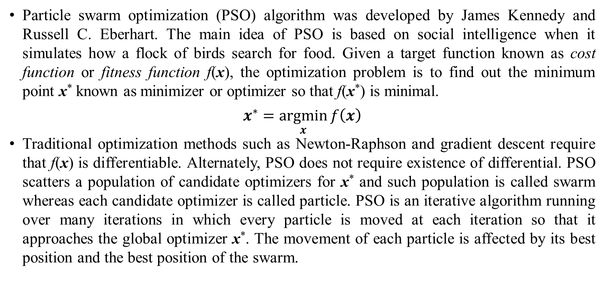
1. Introduction
Particle swarm optimization (PSO) algorithm was developed by James Kennedy and Russell C. Eberhart. The main idea of PSO is based on social intelligence when it simulates how a flock of birds search for food. Given a target function known as cost function or fitness function f(x), the optimization problem is to find out the minimum point x* known as minimizer or optimizer so that f(x*) is minimal.
$$x^{∗}=\underset{x}{argmin}{f\left(x\right)}$$
Traditional optimization methods such as Newton-Raphson and gradient descent require that f(x) is differentiable. Alternately, PSO does not require existence of differential. PSO scatters a population of candidate optimizers for x* and such population is called swarm whereas each candidate optimizer is called particle. PSO is an iterative algorithm running over many iterations in which every particle is moved at each iteration so that it approaches the global optimizer x*. The movement of each particle is affected by its best position and the best position of the swarm.

Slide 5
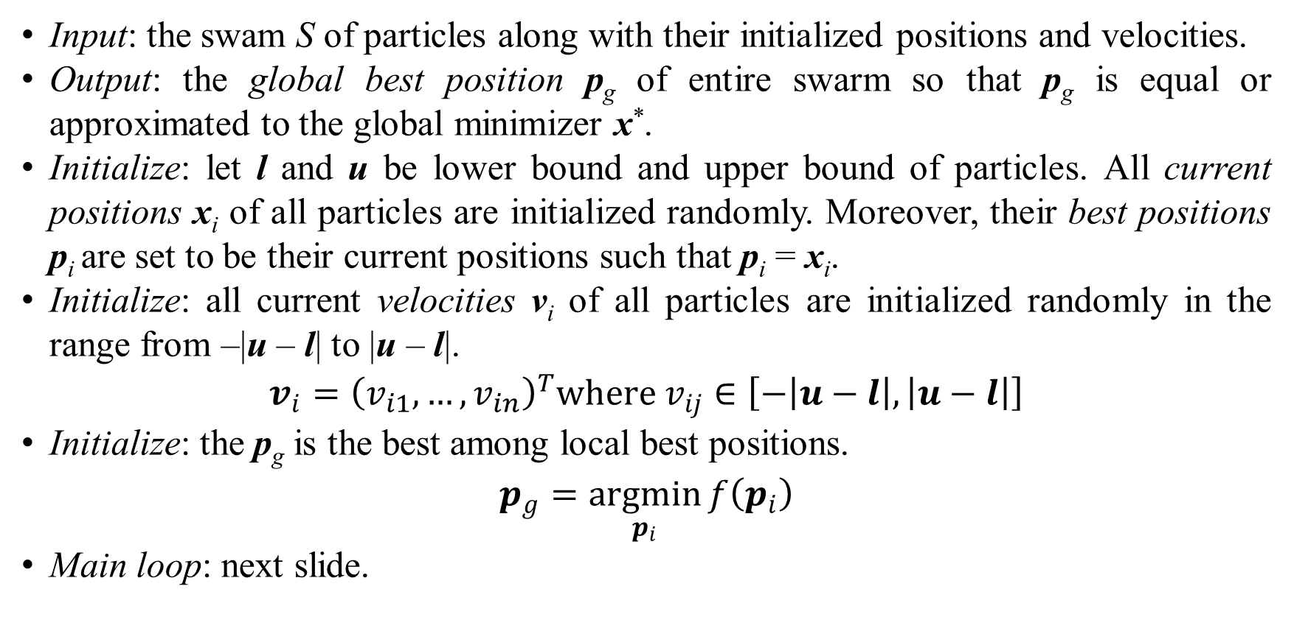
1. Introduction
Input: the swam S of particles along with their initialized positions and velocities.
Output: the global best position p_{g} of entire swarm so that p_{g} is equal or approximated to the global minimizer x*.
Initialize: let l and u be lower bound and upper bound of particles. All current positions x_{i} of all particles are initialized randomly. Moreover, their best positions p_{i} are set to be their current positions such that p_{i} = x_{i}.
Initialize: all current velocities v_{i} of all particles are initialized randomly in the range from –|u – l| to |u – l|.
$$v_{i}={\left(v_{i1},…,v_{in}\right)}^{T}where v_{ij}∈\left[−\left|u−l\right|,\left|u−l\right|\right]$$
Initialize: the p_{g} is the best among local best positions.
$$p_{g}=\underset{p_{i}}{argmin}{f\left(p_{i}\right)}$$
Main loop: next slide.

Slide 6
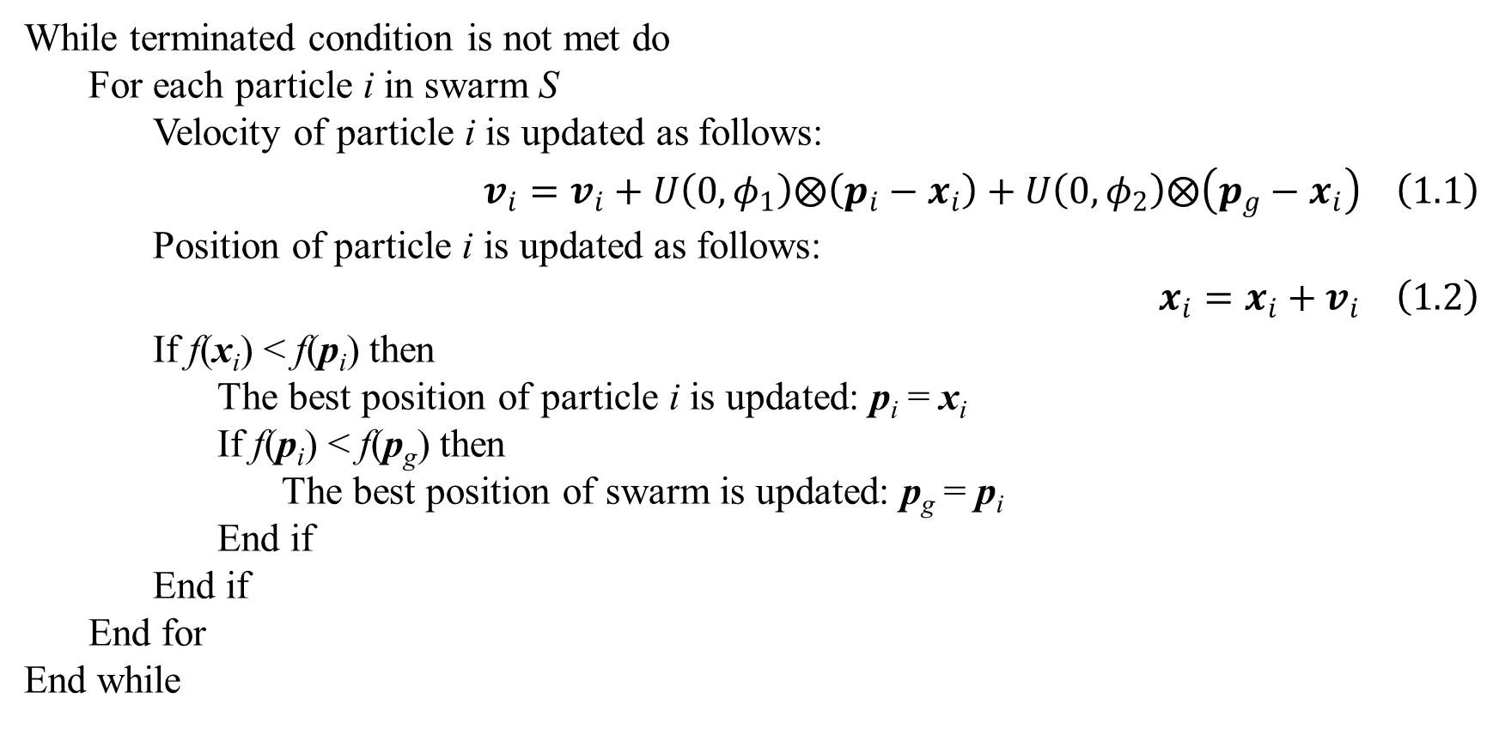
1. Introduction
While terminated condition is not met do
For each particle i in swarm S
Velocity of particle i is updated as follows:
$$v_{i}=v_{i}+U\left(0,φ_{1}\right)⨂\left(p_{i}−x_{i}\right)+U\left(0,φ_{2}\right)⨂\left(p_{g}−x_{i}\right) \left(1.1\right)$$
Position of particle i is updated as follows:
$$x_{i}=x_{i}+v_{i} \left(1.2\right)$$
If f(x_{i}) < f(p_{i}) then
The best position of particle i is updated: p_{i} = x_{i}
If f(p_{i}) < f(p_{g}) then
The best position of swarm is updated: p_{g} = p_{i}
End if
End if
End for
End while

Slide 7
1. Introduction
Equation 1.1 is the heart of PSO, which is velocity update rule. Equation 1.2 is position update rule.
Two most popular terminated conditions are that the cost function at p_{g} which is evaluated as f(p_{g}) is small enough or PSO ran over a large enough number of iterations.
Functions U(0, ϕ₁) and U(0, ϕ₂) generate random vector whose elements are random numbers in ranges [0, ϕ₁] and [0, ϕ₁], respectively.
The operator ⨂ denotes component-wise multiplication of two points [2, p. 3].

Slide 8
2. GPSO with probabilistic constriction
Method 1.
Method 2.
Method 3.

Slide 9
3. Experimental results
Result 1.
Result 2.
Result 3.
Discussion 1.
Discussion 2.
Discussion 3.

Slide 10
4. Conclusions
Conclusion 1.
Conclusion 2.
Conclusion 3.

Slide 11
Thank you for attention

Slide 12
References
Reference 1
Reference 2.
Reference 3.

