Slide 1
Combination of Jaccard Measure and Other Numerical Measures for Collaborative Filtering
Prof. Loc Nguyen PhD
Loc Nguyen’s Academic Network, Vietnam
Email: ng_phloc@yahoo.com
Homepage: www.locnguyen.net

Slide 2
Abstract
Collaborative filtering (CF) is an important approach for recommendation system. One of popular algorithms in CF is nearest neighbors (NN) algorithm, in which similarity measures are used to determine nearest neighbors of a user. Jaccard is a similarity measure which concerns existence of ratings whereas other numeric measures like cosine and Pearson concern magnitude of ratings. Each of them has own strong points and drawbacks. Jaccard is itself not a dominant measure but it is an important factor to improve any measure. Therefore, the research focuses on combination of Jaccard and other numeric measures in order to derive advanced similarities which take advantages of both. Experimental results show that combined measures are preeminent ones.

Slide 3
Table of contents
Introduction
Methodologies
Results and discussions
Conclusions

Slide 4
1. Introduction
Recommendation system is a system which recommends items to users among many existing items in database. Item is anything which users consider, such as product, book, and newspaper. There are two main approaches for recommendation such as content-based filtering (CBF) and collaborative filtering (CF). CF recommends an item to a user if her/his neighbors are interested in such item.
One of popular algorithms in CF is nearest neighbors (NN) algorithm. NN algorithm [1] aims to find out nearest neighbors of a regarded user (called active user) and then to recommend active user items that these neighbors may like. Hence, the essence of NN algorithm is to use similarity measures in order to find out nearest neighbors of an active rating vector. This research focuses on similarity measures for CF.
The most popular similarity measures are cosine and Pearson.

Slide 5
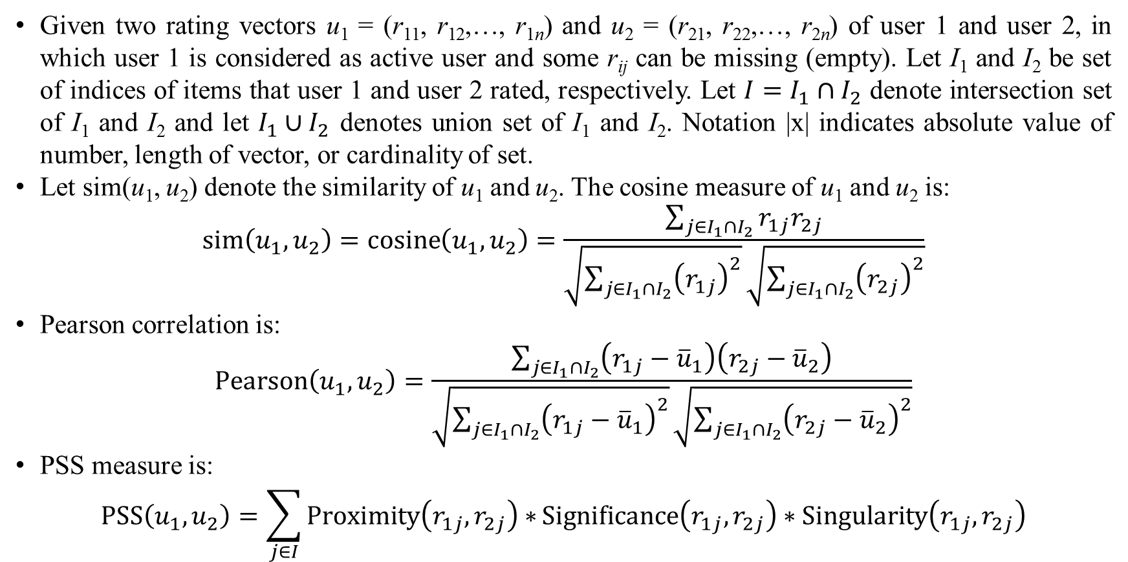
1. Introduction
Given two rating vectors u₁ = (r₁₁, r₁₂,…, r_{1n}) and u₂ = (r₂₁, r₂₂,…, r_{2n}) of user 1 and user 2, in which user 1 is considered as active user and some r_{ij} can be missing (empty). Let I₁ and I₂ be set of indices of items that user 1 and user 2 rated, respectively. Let $I=I_{1}∩I_{2}$ denote intersection set of I₁ and I₂ and let $I_{1}∪I_{2}$ denotes union set of I₁ and I₂. Notation |x| indicates absolute value of number, length of vector, or cardinality of set.
Let sim(u₁, u₂) denote the similarity of u₁ and u₂. The cosine measure of u₁ and u₂ is:
$$sim\left(u_{1},u_{2}\right)=\operatorname{cosine}\left(u_{1},u_{2}\right)=\frac{\sum_{j∈I_{1}∩I_{2}}{r_{1j}r_{2j}}}{\sqrt{\sum_{j∈I_{1}∩I_{2}}{{\left(r_{1j}\right)}^{2}}}\sqrt{\sum_{j∈I_{1}∩I_{2}}{{\left(r_{2j}\right)}^{2}}}}$$
Pearson correlation is:
$$\operatorname{Pearson}\left(u_{1},u_{2}\right)=\frac{\sum_{j∈I_{1}∩I_{2}}{\left(r_{1j}−{\overline{u}}_{1}\right)\left(r_{2j}−{\overline{u}}_{2}\right)}}{\sqrt{\sum_{j∈I_{1}∩I_{2}}{{\left(r_{1j}−{\overline{u}}_{1}\right)}^{2}}}\sqrt{\sum_{j∈I_{1}∩I_{2}}{{\left(r_{2j}−{\overline{u}}_{2}\right)}^{2}}}}$$
PSS measure is:
$$PSS\left(u_{1},u_{2}\right)=\sum_{j∈I}{Proximity\left(r_{1j},r_{2j}\right)∗}Significance\left(r_{1j},r_{2j}\right)∗Singularity\left(r_{1j},r_{2j}\right)$$

Slide 6
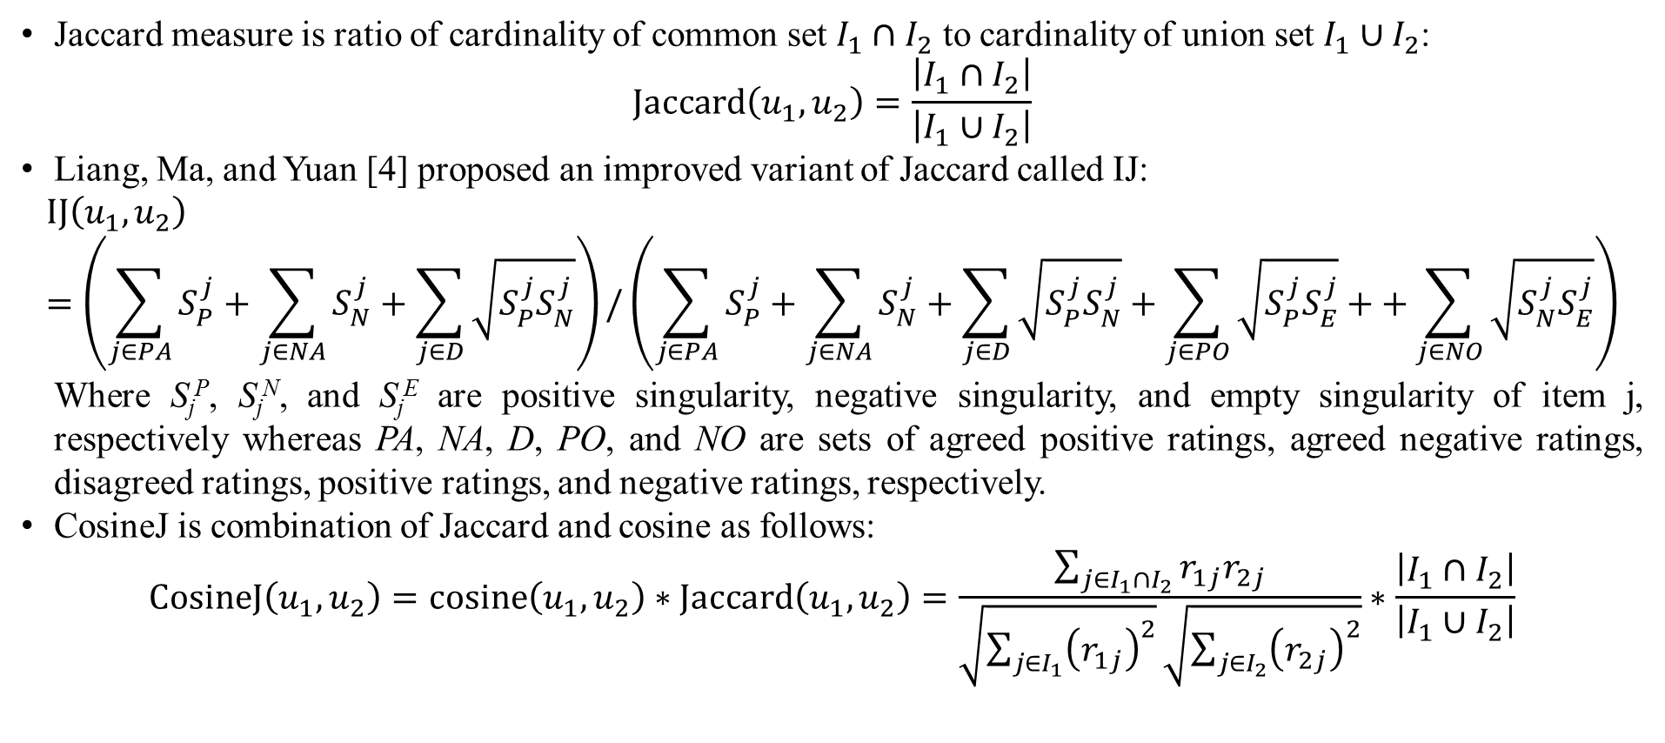
1. Introduction
Jaccard measure is ratio of cardinality of common set $I_{1}∩I_{2}$ to cardinality of union set $I_{1}∪I_{2}$:
$$Jaccard\left(u_{1},u_{2}\right)=\frac{\left|I_{1}∩I_{2}\right|}{\left|I_{1}∪I_{2}\right|}$$
Liang, Ma, and Yuan [4] proposed an improved variant of Jaccard called IJ:
$$IJ\left(u_{1},u_{2}\right)=\left(\sum_{j∈PA}{S_{P}^{j}}+\sum_{j∈NA}{S_{N}^{j}}+\sum_{j∈D}{\sqrt{S_{P}^{j}S_{N}^{j}}}\right)/\left(\sum_{j∈PA}{S_{P}^{j}}+\sum_{j∈NA}{S_{N}^{j}}+\sum_{j∈D}{\sqrt{S_{P}^{j}S_{N}^{j}}}+\sum_{j∈PO}{\sqrt{S_{P}^{j}S_{E}^{j}}}++\sum_{j∈NO}{\sqrt{S_{N}^{j}S_{E}^{j}}}\right)$$
Where S_{j}^{P}, S_{j}^{N}, and S_{j}^{E} are positive singularity, negative singularity, and empty singularity of item j, respectively whereas PA, NA, D, PO, and NO are sets of agreed positive ratings, agreed negative ratings, disagreed ratings, positive ratings, and negative ratings, respectively.
CosineJ is combination of Jaccard and cosine as follows:
$$\operatorname{CosineJ}\left(u_{1},u_{2}\right)=cosine\left(u_{1},u_{2}\right)∗Jaccard\left(u_{1},u_{2}\right)=\frac{\sum_{j∈I_{1}∩I_{2}}{r_{1j}r_{2j}}}{\sqrt{\sum_{j∈I_{1}}{{\left(r_{1j}\right)}^{2}}}\sqrt{\sum_{j∈I_{2}}{{\left(r_{2j}\right)}^{2}}}}∗\frac{\left|I_{1}∩I_{2}\right|}{\left|I_{1}∪I_{2}\right|}$$

Slide 7
2. Methodologies
Jaccard improves especially accuracy of similarity of rating vectors in rating matrix because rating dataset has a lot of missing values whereas other measures depend on existence of ratings. Actually, Jaccard concerns both existence and inexistence of ratings when missing values in incomplete rating dataset imply inexistence of ratings. The more missing values the dataset has, the more accurate the Jaccard is. However, Jaccard does not concern magnitude of ratings. In other words, Jaccard does not concern real numbers. As a result, if rating dataset has enough rating values, Jaccard will be less accurate than other numeric measures.
In general, Jaccard is itself not a dominant measure but it is an important factor to improve any measure. Therefore, I combine Jaccard measures and other numeric measures in order to taking advantages of both existence and quantity of rating values.

Slide 8
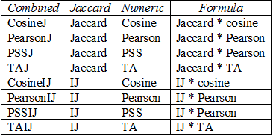
2. Methodologies
The combination is mutual and not resonant and hence, I use multiplicative combination of Jaccard and other numeric measures such as cosine, Pearson, PSS, and TA. These numeric measures are typical with many variants. The advanced version of Jaccard IJ [4] is also combined with cosine, Pearson, PSS, and TA in comparison with Jaccard.
In general, the 8 combined measures such as CosineJ, PearsonJ, PSSJ, TAJ, cosineIJ, PearsonIJ, PSSIJ, and TAIJ are tested and compared with single and numeric measures cosine, Pearson, PSS, and TA.

Slide 9
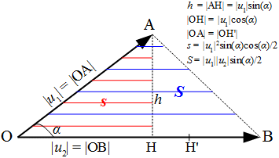
2. Methodologies
It is necessary to describe TA measure here. Cosine measure is effective but it has a drawback that there may be two end points of two vectors which are far from each other according to Euclidean distance, but their cosine is high. This is negative effect of Euclidean distance which decreases accuracy of cosine similarity. Therefore, a so-called triangle area (TA) measure [5] is proposed as an improved version of cosine measure.
TA measure uses ratio of basic triangle area to whole triangle area as reinforced factor for Euclidean distance so that it can alleviate negative effect of Euclidean distance whereas it keeps simplicity and effectiveness of both cosine measure and Euclidean distance in making similarity of two vectors.

Slide 10
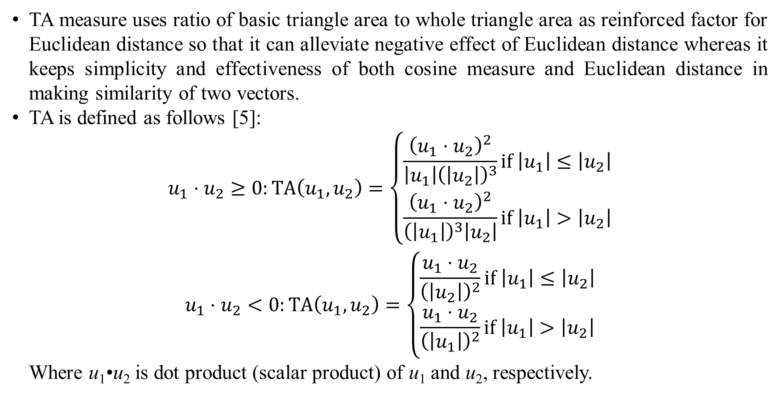
2. Methodologies
TA measure uses ratio of basic triangle area to whole triangle area as reinforced factor for Euclidean distance so that it can alleviate negative effect of Euclidean distance whereas it keeps simplicity and effectiveness of both cosine measure and Euclidean distance in making similarity of two vectors.
TA is defined as follows [5]:
$$\begin{matrix}u_{1}⋅u_{2}≥0:TA\left(u_{1},u_{2}\right)=\left\{\begin{matrix}\frac{{\left(u_{1}⋅u_{2}\right)}^{2}}{\left|u_{1}\right|{\left(\left|u_{2}\right|\right)}^{3}}if \left|u_{1}\right|≤\left|u_{2}\right| \\ \frac{{\left(u_{1}⋅u_{2}\right)}^{2}}{{\left(\left|u_{1}\right|\right)}^{3}\left|u_{2}\right|}if \left|u_{1}\right|>\left|u_{2}\right|\end{matrix}\right. \\ u_{1}⋅u_{2}<0:TA\left(u_{1},u_{2}\right)=\left\{\begin{matrix}\frac{u_{1}⋅u_{2}}{{\left(\left|u_{2}\right|\right)}^{2}}if \left|u_{1}\right|≤\left|u_{2}\right| \\ \frac{u_{1}⋅u_{2}}{{\left(\left|u_{1}\right|\right)}^{2}}if \left|u_{1}\right|>\left|u_{2}\right|\end{matrix}\right.\end{matrix}$$
Where u₁•u₂ is dot product (scalar product) of u₁ and u₂, respectively.

Slide 11
3. Results and discussions
Dataset Movielens [6] is used for evaluation, which has 100,000 ratings from 943 users on 1682 movies (items). Every rating ranges from 1 to 5. In the experiments, dataset Movielens is divided into 5 folders and each folder includes training set and testing set. Training set and testing set in the same folder are disjoint sets.
The ratio of testing set over the whole dataset depends on the testing parameter r. For instance, if r = 0.1, the testing set covers 10% the dataset, which means that the testing set has 10,000 = 10%*100,000 ratings and of course the training set has 90,000 ratings. In the experimental design, parameter r has nine values 0.1, 0.2, 0.3, 0.4, 0.5, 0.6, 0.7, 0.8, and 0.9. The smaller r is, the more accurate measures are because training set gets large if r gets small with note that NN algorithm is executed on training set.

Slide 12
3. Results and discussions
Popular metrics to assess CF algorithms are mean absolute error (MAE), recall, and precision.
MAE indicates accuracy of measures. The smaller MAE is, the more accurate the measures are and so the better the algorithm is.
Precision and recall are quality metrics that measure quality of recommended list – how much the recommendation list reflects user’s preferences. The larger quality metric is, the better the algorithm is.
Quality of a CF algorithm like NN algorithm depends on both estimation and recommendation. Estimation ability is ability to estimate or predict exactly missing values. Recommendation is ability to provide list of recommended items which is as suitable as possible to users. Here, different metrics (MAE, recall, precision) are used for different evaluation processes (estimation and recommendation). This independent evaluation allows us to test measures more objectively, in which estimation process focused on accuracy of CF algorithm and recommendation process focuses on quality of CF algorithm.
In general, MAE is used for estimation whereas recall and precision are used for recommendation process.

Slide 13
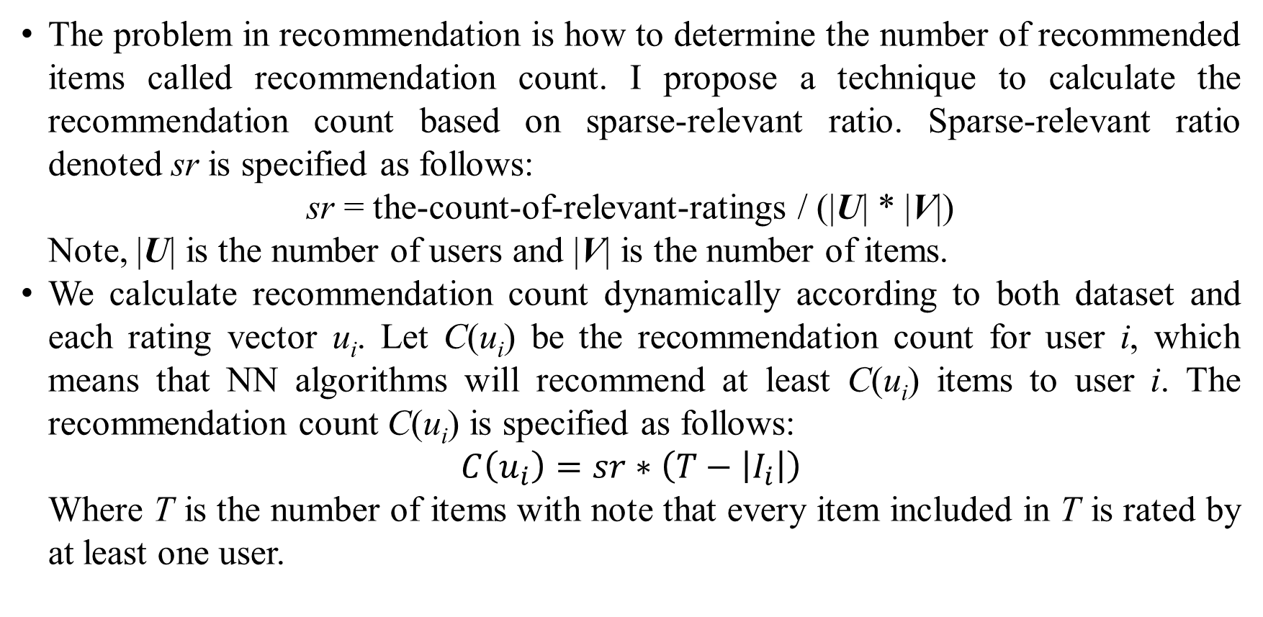
3. Results and discussions
The problem in recommendation is how to determine the number of recommended items called recommendation count. I propose a technique to calculate the recommendation count based on sparse-relevant ratio. Sparse-relevant ratio denoted sr is specified as follows:
sr = the-count-of-relevant-ratings / (|U| * |V|)
Note, |U| is the number of users and |V| is the number of items.
We calculate recommendation count dynamically according to both dataset and each rating vector u_{i}. Let C(u_{i}) be the recommendation count for user i, which means that NN algorithms will recommend at least C(u_{i}) items to user i. The recommendation count C(u_{i}) is specified as follows:
$$C\left(u_{i}\right)=sr∗\left(T−\left|I_{i}\right|\right)$$
Where T is the number of items with note that every item included in T is rated by at least one user.

Slide 14
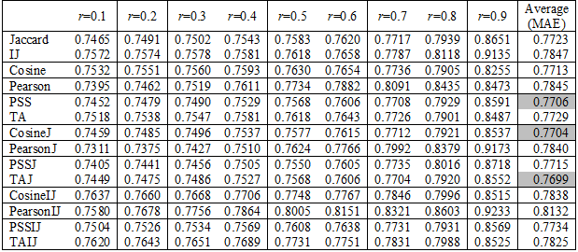
3. Results and discussions
MAE metric of all measures about all r within estimation process.
Top-3 measures according to MAE metric within estimation process are TAJ, CosineJ, and PSS whose average MAE metrics are 0.7699, 0.7704, and 0.7706, respectively.

Slide 15
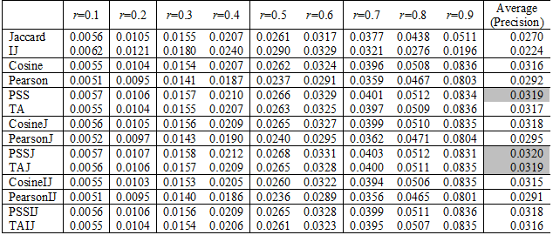
3. Results and discussions
Precision metric of all measures about all r within estimation process.
Top-3 measures according to precision metric within recommendation process are PSSJ, PSS, and TAJ, whose average precision metrics are 0.0320, 0.0319, and 0.0319, respectively. From r=0.1 to r=0.5, IJ is the best measure with precision metric but it is no longer preeminent from r=0.6 to r=0.9. With r=0.9, IJ is worse unexpectedly. This implies IJ needs a large amount of training data more than other measures

Slide 16
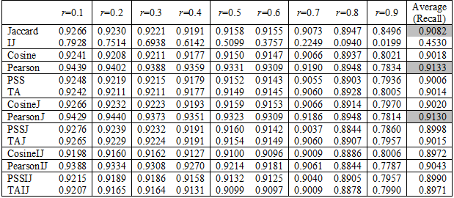
3. Results and discussions
Recall metric of all measures about all r within recommendation process.
Top-3 measures according to recall metric within recommendation process are Pearson, PearsonJ, Jaccard, whose average recall metrics are 0.9133, 0.9130, and 0.9082, respectively.

Slide 17
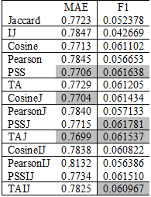
3. Results and discussions
F1 metric [8] assembles precision and recall together. The larger F1 is, the better measures are. Table below shows average MAE and F1 of all measures.
Top-3 measures according to F1 metric within recommendation process are PSSJ, PSS, and TAJ whose average recall metrics are 0.061781, 0.061638, and 0.061537, respectively.
In general, two top-3 sets of good measures are {TAJ, CosineJ, PSS}, and {PSSJ, PSS, TAJ}. The preeminent measures are determined as members of the intersection of such three sets which are TAJ and PSS.

Slide 18

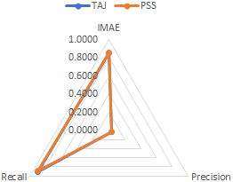
3. Results and discussions
It is useful to compare TAJ and PSS but it is impossible to unify metrics MAE and precision / recall together. However, we can compare them by radar chart but some transformations are necessary. Let IMAE be inverse of normalized MAE. The larger the IMAE is, the better the measures are.
TAJ is better than PSS overall whereas PSS is better than TA with MAE and precision. The reason is that TAJ is combined measure of TA and Jaccard. However, it is interesting that TAJ is better than PSSJ overall although PSSJ is also a combined measure. The possible reason is that there is overfitting problem when accuracies among good measures are not so different.
As seen in this figure, lines of TAJ and PSS are nearly overlapped.

Slide 19
4. Conclusions
From experimental results, in general combined measures are preeminent ones which takes advantages of data existence and data magnitude. A combined measure has two built-in measures such as Jaccard and a numeric measure. With the built-in Jaccard, missing values are not ignored and they also contribute to accuracy of recommendation process. With the built-in numeric measure, real number values reflex exactly user favorites.
Given numeric measure A, suppose the combined measure of A and Jaccard is called A+. Of course, A+ is often better than A but it is not asserted that A+ is better than another numeric measure like B, for example. In other words, whether A+ is better than B is dependent on measure A itself. Similarly, IJ is better than traditional Jaccard from r=0.1 to r=0.6 but PSSIJ is worse than PSSJ from r=0.1 to r=0.6 with precision metric (see Table 3) because preeminence of the combined measures PSSIJ and PSSJ depends on PSS itself mainly. It is possible that we develop a numeric measure as well as possible and then combine it with Jaccard or variants of Jaccard.
However, in practice when A and B are not far different in accuracy, A+ is often better than B. Especially, rating data is always incomplete, in which Jaccard is proved with its good accuracy. Therefore, research on improvement of Jaccard is necessary as aforementioned that Jaccard is an important factor to enhance any numeric measures.

Slide 20
Thank you for attention

Slide 21
References
R. D. Torres Júnior, "Combining Collaborative and Content-based Filtering to Recommend Research Paper," Universidade Federal do Rio Grande do Sul, Porto Alegre, 2004.
B. Sarwar, G. Karypis, J. Konstan and J. Riedl, "Item-based Collaborative Filtering Recommendation Algorithms," in Proceedings of the 10th international conference on World Wide Web, Hong Kong, 2001.
H. Liu, Z. Hu, A. Mian, H. Tian and X. Zhu, "A new user similarity model to improve the accuracy of collaborative filtering," Knowledge-Based Systems, vol. 56, no. 2014, pp. 156-166, 20 November 2013.
S. Liang, L. Ma and F. Yuan, "A singularity-based user similarity measure for recommender systems," International Journal of Innovative Computing Information and Control, vol. 11, no. 5, pp. 1629-1638, 10 2015.
L. Nguyen and A. A. Amer, "Advanced Cosine Measures for Collaborative Filtering," Adaptation and Personalization (ADP), vol. 1, no. 1, pp. 21-41, 17 October 2019.
GroupLens, "MovieLens datasets," GroupLens Research Project, University of Minnesota, USA, 22 April 1998. [Online]. Available: http://grouplens.org/datasets/movielens. [Accessed 3 August 2012].
J. L. Herlocker, J. A. Konstan, L. G. Terveen and J. T. Riedl, "Evaluating Collaborative Filtering Recommender Systems," ACM Transactions on Information Systems (TOIS), vol. 22, no. 1, pp. 5-53, 2004.
J. L. Herlocker, J. A. Konstan, L. G. Terveen and J. T. Riedl, "Evaluating Collaborative Filtering Recommender Systems," ACM Transactions on Information Systems (TOIS), vol. 22, no. 1, pp. 5-53, 2004.

