Slide 1
Specification Table Schema
Relationship property
Proposal

Slide 2
1 – Requirement
Quarter : [ T1, T2, T2, T1, T2, T1 ] (a)
Month : [ jan, apr, jun, feb, may, jan] (b)
jan
feb
Apr
May
jun
0
1
2
3
4
Specify the relationship between two fields
Three main link categories (see right):
derived, coupled, crossed
Example :
Field « quarter » is derived from « month »
Field « name » is coupled to field « nickname »
Field « year » is crossed with field « semester »
Validation :
Simple function (see below)
Requires all data
Test possible with each new input (derived and coupled) and not possible with crossed
0
1
T1
T2
derived
if dist == len(set(b))
and dist > len(set(a))
Name : [ john, paul, leah, paul ] (a)
Nickname : [ jock, paulo, lili, paulo ] (b)
jock
paulo
lili
0
1
2
0
1
2
john
paul
leah
coupled
If dist == len(set(b))
and dist == len(set(a))
Year : [ 2020, 2020, 2021, 2021 ] (a)
Semester : [ S1, S2, S1, S2 ] (b)
How to measure the link (see implementation example in last slide) ?
The evaluation is made by calculating dist = len(set(zip(a,b))) where a and b are array of the two fields (python langage)
dist >= max(len(set(a)), len(set(b)))
dist <= len(set(a)) * len(set(b))
0
1
2020
2021
0
1
crossed
S1
S2
If dist == len(set(a)) * len(set(b))

Slide 3
2 – Implementation (three options)
1 – New Field descriptor
« name »: « quarter »
« relationship » : {
« parent » : « month »,
« link » : « derived »
}
2 – New Constraints descriptor
« name »: « quarter »
« constraints » : {
« relationship » : {
« parent » : « month »,
« link » : « derived »
}
}
3 – New Table descriptor (other properties)
« relationship » : [
{
« fields »: « quarter »
« parent » : « month »,
« link » : « derived »
} …
]
Pros
No mixing with other descriptors
Consistent with a field view
Cons
New descriptor
Pros
The « constraints » property is consistent with the point
Cons
The « crossed » link can’t be validate at the data entry
Need to add a level in the properties tree
Pros
New independant descriptor
Cons
Relationships are described field by field
Option 1 seems to be the most suitable

Slide 4
3 – Text Proposal
Relationship
The relationship property MAY be used to define the dependency between another field. The relationship descriptor, if present, MUST be a JSON object and MUST contain two properties :
parent : the property name of the field linked to
link : the nature of the relationship between them
The link property value MUST be one of the three following :
derived :
The field values are dependant on the values of parent field (a value in the parent field is associated with a single field value).
E.g. The « Quarter » field [ T1, T2, T2, T1, T2, T1 ] is derived from the « month » field [ jan, apr, jun, feb, may, jan]
i.e. if a new entry ‘jun’ is added, the corresponding « quarter » value must be ‘T2’.
coupled :
The field values are associated to the values of parent field (both fields are derived from each other).
E.g. The « Nickname” field [ jock, paulo, lili, paulo ] is coupled to the “name” field [ john, paul, leah, paul ]
i.e. if a new entry ‘lili’ is added, the corresponding « Name » value must be ‘leah’ just as if a new entry ‘leah’ is added, the corresponding « nickname » value must be ‘lili’.
crossed :
This relationship means that all the different values of the field are associated with all the different values of another field.
E.g. the “Year” Field [ 2020, 2020, 2021, 2021] is crossed to the “Semester” Field [ S1, S2, S1, S2 ]
i.e the year 2020 is associated to semesters s1 and s2, just as the semester s1 is associated with years 2020 and 2021

Slide 5
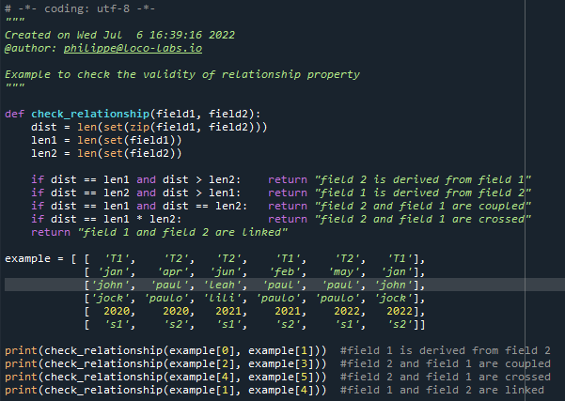
4 - Check implementation Example

Slide 6
Appendix – Indexed List
https://github.com/loco-philippe/Environnemental-Sensing/blob/main/documentation/Ilist_technical.pdf
https://loco-philippe.github.io/ES/ilist.html

