Slide 1
How to convert any csv to an Xarray with chosen dimension ?

Slide 2
1 - CSV data -> Ilist data
columns
index
result
iindex
result
0
1
1
2
1
0
0
0
1
0
0
0
rows
Example :
iindex
result
Name | City | Age | Subject | score
Paul | Paris | 16 | Math | 10
Lea | Paris | 15 | Math | 12
Lea | Paris | 15 | English | 15
Name
1
0
0
City
0
0
0
Age
0
1
1
Subject
1
1
0
score
10
12
15

Slide 3
2 - Ilist -> Canonical format
I5
Example :
unique
city
I4
Age
unique
I6
I1
crossed
linked
unique
coupled
Name
derived
Primary
indexes
I3
I2
Primary
indexes
linked
linked
Subject
I7
I9
coupled
derived
I8
coupled
Explanation : See Appendix

Slide 4
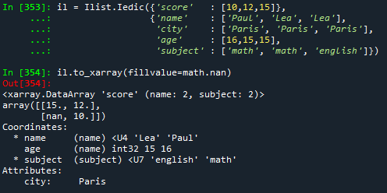
3 - Xarray generation
I5
I5
unique
unique
I4
Primary indexes
-> Xarray dims
Derived/coupled indexes
-> Xarray coords
Indexed value
-> Xarray data
Unique index
-> Xarray attrs
I6
I1
I4
I6
I1
crossed
crossed
crossed
unique
derived
linked
unique
derived
Primary
indexes
Primary
indexes
I3
I3
I2
I2
Full
crossed
linked
I7
I9
I7
I9
coupled
coupled
I8
derived
I8
derived
coupled
coupled
Example :
city
Age
unique
coupled
Name
Primary
indexes
linked
Subject

Slide 5
Appendix – Indexed List
0 – Ilist Principles
1 - Index analysis
2 - Matrix generation
3 - Aggregation
4 – Format, storage
https://loco-philippe.github.io/ES/ilist.html

Slide 6
0 - Ilist (Indexed list)
List of values :
+
Name | city | Age
Paul | Paris | 12
John | Metz | 28
Lea | Rennes | 39
Cat | Bollène | 58
Age : [12, 28, 39, 58]
List of indexes :
Name : [Paul, John, Lea, Cat]
City : [Paris, Metz, Rennes, Bollène]
….
Example : csv file, measurement, log
Note : indexed values and index values can be every kind of object

Slide 7
0 – Data structure
Red : static value
Black : dynamic value
n : number of indexes
m : number of values
Name
(string)
valname
idxname[0]
idxname[n-1]
1
Two levels
External values
Internal keys
(no duplication)
External value
(object)
extval
extidx[0]
…
extidx[n-1]
m
Codec
(int / ext)
setval
setidx[0]
setidx[n-1]
Internal key (integer)
ival
iidx[0]
iidx[n-1]
m
Indexed values
IndexSet
External value
Internal key
score
name
age
subject
10 | 12 | 15
Paul | Lea | Lea
16 | 15 | 15
math | math | english
val
0 | 1 | 2
1 | 0 | 0
0 | 1 | 1
1 | 1 | 0
Example
idx
valname, idxname
extval, extidx
ival, iidx

Slide 8
1 - Index categories
External Value
[ Anne, Paul, John]
[ Anne, Anne, Anne]
[ Anne, Paul, Anne]
v
Internal key
i
0
1
2
0
0
1
M = len(v)
m = 1
x = len(i)
Type
complete
unique
mixte
Rate : (M – x) / (M – m)
Dist to min : x - m
Dist to max : M - x
Property
Rate : 1
Disttomax : 0
Rate : 0
Disttomin : 0
0 < Rate < 1
m < dist < M

Slide 9
1 - linking categories
External value
v1
v2
[ Anne, Paul, John, Lea ]
[25, 26, 15, 35]
[ Anne, Paul, John, Lea ]
[25, 25, 25, 12 ]
[ Anne, Paul, Anne, Paul ]
[25, 25, 12, 12 ]
[ Anne, Paul, Anne, Lea ]
[25, 25, 12, 12 ]
Internal key
0
1
2
3
0
1
2
3
0
1
2
3
0
1
0
1
0
1
0
1
2
0
1
i1 i2
M = len(i1) * len(i2)
m = max(len(i1), len(i2)
x = len(index(v1, v2))
Type
coupled
(asymmetrical)
derived
(asymmetrical)
crossed
linked
Property
Rate : 0
Disttomin : 0
Rate : 0
Disttomin : 0
Rate : 1
Disttomax : 0
0 < Rate < 1
m < dist < M
Rate : (x - m) / (M – m)
Dist to min : x - m
Dist to max : M - x
Properties
If one index is complete, all the indexes are derived from it
If one index is unique, it is derived from all other indexes
If A is derived (coupled) from B and B is derived (coupled) from C, A is derived (coupled) from C
If A is coupled from B, all the relationships with other indexes are identical

Slide 10
1 - Global properties
IndexSet
Set of index with the same value lenght
Index definition
An index is derived if it’s derived from at least one other index
An index is coupled if it’s coupled from at least one other index
An Index is primary if it’s not coupled, not derived and not unique
Indexset definition
Dimension : number of primary indexes
Complete : An indexSet is complete if all the non coupled indexes are crossed with each other non coupled index
Full : An indexSet is full if all the primary indexes are crossed with each other primary index
Properties
A derived or coupled index is derived or coupled from a single primary index
The number of values of a full indexset is the product of the primary indexes length
A full indexSet is complete
A full IndexSet can be transformed in a Matrix with the dimension of the indexset
A complete Indexset can be expressed in a flat list of values (with order)

Slide 11
1 – Canonical format
I5
unique
Primary indexes
Linked or crossed whit each other
Derived or coupled indexes
Associated with a single primary index
Unique indexes
Not associated
I4
I6
I1
crossed
linked
unique
derived
Primary
indexes
I3
I2
I7
linked
I9
coupled
derived
I8
coupled

Slide 12
1 - Example
37% almost derived or linked
83% almost crossed
IndexSet
Data
first name | last name | full name | surname | group | course | year | examen | score
Anne | White | Anne White | skyler | gr1 | math | 2021 | t1 | 11
Anne | White | Anne White | skyler | gr1 | math | 2021 | t2 | 13
Anne | White | Anne White | skyler | gr1 | math | 2021 | t3 | 15
Anne | White | Anne White | skyler | gr1 | english | 2021 | t2 | 10
Anne | White | Anne White | skyler | gr1 | english | 2021 | t3 | 12
Philippe | White | Philippe White | heisenberg | gr2 | math | 2021 | t1 | 15
Philippe | White | Philippe White | heisenberg | gr2 | english | 2021 | t2 | 8
Camille | Red | Camille Red | saul | gr3 | software | 2021 | t3 | 17
Camille | Red | Camille Red | saul | gr3 | software | 2021 | t2 | 18
Camille | Red | Camille Red | saul | gr3 | english | 2021 | t1 | 2
Camille | Red | Camille Red | saul | gr3 | english | 2021 | t2 | 4
Philippe | Black | Philippe Black | gus | gr3 | software | 2021 | t3 | 18
Philippe | Black | Philippe Black | gus | gr3 | english | 2021 | t1 | 6
3 columns are linked
Full name
Course
Examen
3 columns are derived
First name
Last name
Group
1 column is coupled
Surname
1 column is unique
Year
ratio
Name – Course : 37,5 %
Name – Examen : 62,5 %
Course – Examen : 83,7 %
coupled
unique
derived

Slide 13
1 - Functions
[ Anne, Paul, John, Lea ]
[25, 25, 25, 12 ]
[ Anne, Paul, John, Lea ]
[25, 25, 25, 12 ]
0
1
2
3
0
1
2
3
0
1
2
3
25
25
25
12
Derived to coupled
Duplication of index key
Index merging
Index A and B are derived from Index (A,B)
-> eg replace two primary indexes by one
Linked to crossed
Add link
(Link number = distmax)
Derived (coupled) extension
Link propagation
0
1
[ Anne, Paul, Anne, Lea ]
[25, 25, 12, 12 ]
0,0
0,1
1,0
2,1
0
1
2
0
1
0
1
2
0
1
[ Anne, Paul, Anne, Lea ]
[25, 25, 12, 12 ]
[ Anne, Paul, Lea, Anne, Paul, Lea ]
[25, 25, 25, 12, 12, 12 ]
0
1
2
0
1
0
1
2
0
1
Matrix (2 x 3)
[ White, Grey, White, Grey ]
[ Anne, Paul, Anne, Lea ]
[25, 25, 12, 12 ]
[ White, Grey, Grey, White, Grey, Grey ]
[ Anne, Paul, Lea, Anne, Paul, Lea ]
[25, 25, 25, 12, 12, 12 ]
0
1
0
1
2
0
1
0
1
0
1
2
0
1

Slide 14
2 - Matrix generation process
matrix generation process from Ilist
Index characterization
Identification of primary indexes
Association of coupled and derived indexes to primary indexes
Dimension reduction (if necessary)
Primary index merging (rather low rate)
Matrix generation
Full indexes conversion
Linked to crossed (primary indexes)
Extension (derived and coupled indexes)
Conversion
E.g. Xarray
Primary indexes -> dims
Derived/coupled indexes -> coords
Indexed value -> values
Unique index -> attrs
Ilist
index characterization
Primary
Index
Dimension réduction
Low rate
High rate
coupled
Index
derived
Index
primary
Index
unique
Index
Matrix generation
Derived coupled
Derived coupled
unique
primary
unique
Matrix (e. g. Xarray)

Slide 15
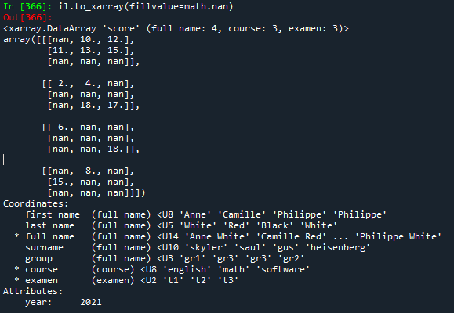
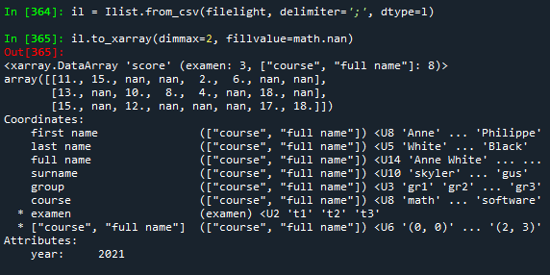
2 - Example
first name | last name | full name | surname | group | course | year | examen | score
Anne | White | Anne White | skyler | gr1 | english | 2021 | t1 | -
Anne | White | Anne White | skyler | gr1 | english | 2021 | t2 | 10
Anne | White | Anne White | skyler | gr1 | english | 2021 | t3 | 12
Anne | White | Anne White | skyler | gr1 | math | 2021 | t1 | 11
Anne | White | Anne White | skyler | gr1 | math | 2021 | t2 | 13
Anne | White | Anne White | skyler | gr1 | math | 2021 | t3 | 15
Anne | White | Anne White | skyler | gr1 | software | 2021 | t1 | -
Anne | White | Anne White | skyler | gr1 | software | 2021 | t2 | -
Anne | White | Anne White | skyler | gr1 | software | 2021 | t3 | -
Full function :
Axes are completed
Dimension :
Canonical : 3
Reduction : 2 (merge course, full name)
completed
coupled
unique
derived

Slide 16
3 - Aggregation process
All child indexes
index | index | data
value | value | ilist3
value | value | ilist4
Merge
index | index | index | index | index | data
value | value | value | value | value | value
value | value | value | value | value | value
value | value | value | value | value | value
value | value | value | value | value | value
(recursive function)
All child data
Ilist 5
data
ilist1
ilist2
add information
Data use
Ilist 4
Process adapted to organizations
Add information without altering
Separation of management and use
index | data
value | value
index | data
value | value
value | value
index | data
value | value
Ilist 1
Ilist 3
Ilist 2
Data management

Slide 17
3 - Example
first name | last name | full name | surname | group | file
Anne | White | Anne White | skyler | gr1 | aw
Philippe | White | Philippe White | heisenberg | gr2 | pw
Camille | Red | Camille Red | saul | gr3 | cr
Philippe | Black | Philippe Black | gus | gr3 | pb
total
IndexSet
Data
course | year | examen | score
math | 2021 | t1 | 11
math | 2021 | t2 | 13
math | 2021 | t3 | 15
english | 2021 | t2 | 10
english | 2021 | t3 | 12
aw
total.merge()
course | year | examen | score
math | 2021 | t1 | 15
english | 2021 | t2 | 8
first name | last name | full name | surname | group | course | year | examen | score
Anne | White | Anne White | skyler | gr1 | math | 2021 | t1 | 11
Anne | White | Anne White | skyler | gr1 | math | 2021 | t2 | 13
Anne | White | Anne White | skyler | gr1 | math | 2021 | t3 | 15
Anne | White | Anne White | skyler | gr1 | english | 2021 | t2 | 10
Anne | White | Anne White | skyler | gr1 | english | 2021 | t3 | 12
Philippe | White | Philippe White | heisenberg | gr2 | math | 2021 | t1 | 15
Philippe | White | Philippe White | heisenberg | gr2 | english | 2021 | t2 | 8
Camille | Red | Camille Red | saul | gr3 | software | 2021 | t3 | 17
Camille | Red | Camille Red | saul | gr3 | software | 2021 | t2 | 18
Camille | Red | Camille Red | saul | gr3 | english | 2021 | t1 | 2
Camille | Red | Camille Red | saul | gr3 | english | 2021 | t2 | 4
Philippe | Black | Philippe Black | gus | gr3 | software | 2021 | t3 | 18
Philippe | Black | Philippe Black | gus | gr3 | english | 2021 | t1 | 6
pw
course | year | examen | score
software | 2021 | t3 | 17
software | 2021 | t2 | 18
english | 2021 | t1 | 2
english | 2021 | t2 | 4
cr
pb
course | year | examen | score
software | 2021 | t3 | 18
english | 2021 | t1 | 6

Slide 18
4 – format
Tabular format (csv)
Easy to read, duplication data, text only
Json format
Easy to read, text only
Not duplication data
Compatible with NoSQL Database
Bson format
Compatible with json format
Binary, structured data (eg datetime)
Binary format
CBOR (Concise Binary Object Representation)
Compatible with json format
Binary, numerical, text, structured (eg datetime, coordinates)
Ilist format
Dict + Array

Slide 19
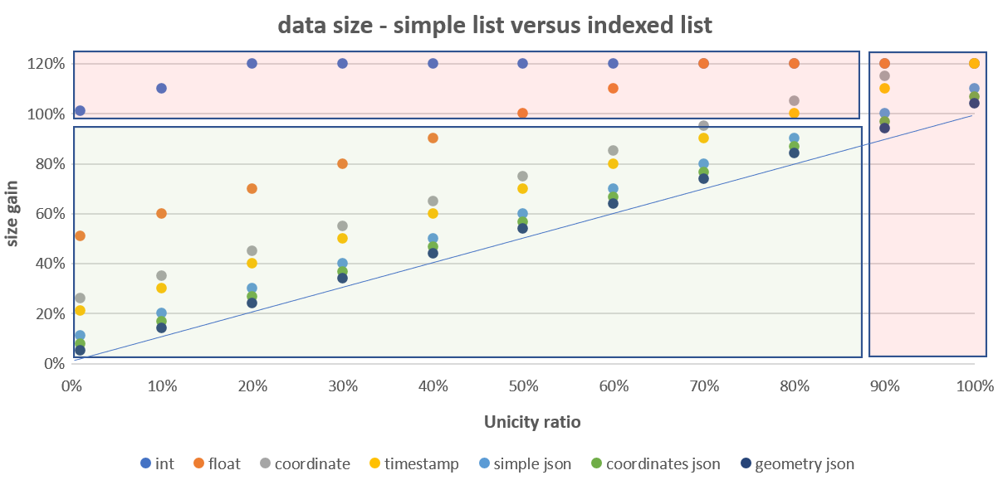
4 – list size
Simple list size = n * l
n : number of values
l : mean value size
Indexed list size = n * i + nx * l
i : integer size
nx : number of different values
Indexed list size / list size = i / l (object lightness) + nx / n (unicity level)
Properties
If object lightness and unicity level are low, the indexed list size is lower than simple list size
e.g. : i / l = 0.1 , nx / n = 0.4 => indexed list size = 0.5 * list size
In a Ilist with data more complex than numerical data, the json (or binary) format has a smaller size than a tabular format
Object lightness | l | i / l
int | 2 | 1,00
float, int32 | 4 | 0,50
coordinate | 8 | 0,25
string(10) (eg. timestamp) | 10 | 0,20
simple json element (eg key/value) | 20 | 0,10
structured json element (eg coordinates) | 30 | 0,07
complex json element (eg geometry) | 50 | 0,04
E.g. previous example :
csv : 2 418 bytes
json : 1 496 bytes
binary (CBOR) : 697 bytes

Slide 20
Analysis of the structure of a csv file makes it possible to transform it automatically or manually into a matrix of the chosen dimension while retaining all the information (see attachment) .
This property seems very interesting to me because it makes it easy to generate Xarrays. Conversely, it allows to generate csv files which preserve the Xarray structure.
A first version of this module is now available, and I would like to have your feedback (and also use cases) to validate this solution which contributes to making Xarray “an even more flexible and powerful tool for multidimensional data analysis”.

