Slide 1
Environnemental Sensing
Ilist
Concepts and principles

Slide 2
0 - Principles
1 - Index analysis
2 - Matrix generation
3 - Aggregation
4 – Format, storage

Slide 3
0 - Ilist (Indexed list)
List of values :
+
Name | city | Age
Paul | Paris | 12
John | Metz | 28
Lea | Rennes | 39
Cat | Bollène | 58
Age : [12, 28, 39, 58]
List of indexes :
Name : [Paul, John, Lea, Cat]
City : [Paris, Metz, Rennes, Bollène]
….
Example : csv file, measurement, log, matrix
Note : indexed values and index values can be every kind of object

Slide 4
0 – Data structure
Red : static value
Black : dynamic value
n : number of indexes
m : number of values
variable
Index[0]
Index[n-1]
Two levels
External values
Internal keys
(no duplication)
Name
(string)
name
name
name
1
External value
(object)
values
values
…
values
m
Codec
(int / ext)
codec
codec
codec
Internal key (integer)
keys
keys
keys
m
Indexed values
IndexSet
External value
Internal key
score
name
age
subject
10 | 12 | 15
Paul | Lea | Lea
16 | 15 | 15
math | math | english
0 | 1 | 2
1 | 0 | 0
0 | 1 | 1
1 | 1 | 0
codec
Example
name
values
keys

Slide 5
1 - Index categories
Values
[ Anne, Paul, Anne]
[ Anne, Anne, Anne]
[ Anne, Paul, Anne]
v
Codec
(row)
i
0
1
2
0
0
1
Max = len(values)
min = 1
x = len(codec)
Type
complete
unique
mixte
Rate : (M – x) / (M – m)
Dist to min : x - m
Dist to max : M - x
Property
Rate : 1
Disttomax : 0
Rate : 0
Disttomin : 0
0 < Rate < 1
m < dist < M
Definition
Default codec : list of differents values
Full codec : list of values
Properties
An index with full codec is complete
Any index have a default codec and a full codec
Default codec is the shortest, full codec is the longest
A codec defines the correspondence between values and keys (e.g.) :
1 : Anne
0 : Paul
2 : John
A codec may not be bijective (e.g.) :
0 : Anne
1 : Paul
2 : Anne

Slide 6
1 - linking categories
Values
v1
v2
[ Anne, Paul, John, Lea ]
[25, 26, 15, 35]
[ Anne, Paul, John, Lea ]
[25, 25, 25, 12 ]
[ Anne, Paul, Anne, Paul ]
[25, 25, 12, 12 ]
[ Anne, Paul, Anne, Lea ]
[25, 25, 12, 12 ]
Codec
(row)
0
1
2
3
0
1
2
3
0
1
2
3
0
1
0
1
0
1
0
1
2
0
1
i1 i2
Max = len(i1) * len(i2)
min = max(len(i1), len(i2)
diff = abs(len(i1) – len(i2))
x = len(index(v1, v2))
I2 coupled to i1
I2 derived from i1
Type
coupled
(asymmetrical)
derived
(asymmetrical)
crossed
linked
Rate : (x – m) / (M – m)
Dist to min : x - m
Dist to max : M - x
Property
Rate : 0
Disttomin : 0
diff : 0
Rate : 0
Disttomin : 0
0 < diff < min
Rate : 1
Disttomax : 0
0 < Rate < 1
min < dist < Max
Properties
Indicators are independant of values (length or value)
If one index is complete, all the indexes are derived from it
If one index is unique, it is derived from all other indexes
If A is derived (coupled) from B and B is derived (coupled) from C, A is derived (coupled) from C
If A is coupled to B, all the relationships with other indexes are identical

Slide 7
1 - Example
37% almost derived or linked
83% almost crossed
IndexSet
Data
first name | last name | full name | surname | group | course | year | examen | score
Anne | White | Anne White | skyler | gr1 | math | 2021 | t1 | 11
Anne | White | Anne White | skyler | gr1 | math | 2021 | t2 | 13
Anne | White | Anne White | skyler | gr1 | math | 2021 | t3 | 15
Anne | White | Anne White | skyler | gr1 | english | 2021 | t2 | 10
Anne | White | Anne White | skyler | gr1 | english | 2021 | t3 | 12
Philippe | White | Philippe White | heisenberg | gr2 | math | 2021 | t1 | 15
Philippe | White | Philippe White | heisenberg | gr2 | english | 2021 | t2 | 8
Camille | Red | Camille Red | saul | gr3 | software | 2021 | t3 | 17
Camille | Red | Camille Red | saul | gr3 | software | 2021 | t2 | 18
Camille | Red | Camille Red | saul | gr3 | english | 2021 | t1 | 2
Camille | Red | Camille Red | saul | gr3 | english | 2021 | t2 | 4
Philippe | Black | Philippe Black | gus | gr3 | software | 2021 | t3 | 18
Philippe | Black | Philippe Black | gus | gr3 | english | 2021 | t1 | 6
3 columns are linked
Full name
Course
Examen
3 columns are derived
First name
Last name
Group
1 column is coupled
Surname
1 column is unique
Year
ratio
Name – Course : 37,5 %
Name – Examen : 62,5 %
Course – Examen : 83,7 %
coupled
derived
unique

Slide 8
1 – Codec extension
[ Anne, Paul, John, Lea ]
[25, 25, 25, 12 ]
[ Anne, Paul, John, Lea ]
[25, 25, 25, 12 ]
Derived to coupled
Extension of index codec
0
1
2
3
0
1
2
3
0
1
2
3
25
25
25
12
0
1
Derived to derived
Minimale extension with all keys information (see next slide)
1
Coupling (linked to coupled)
Index A and B are derived from Index (A,B)
-> eg replace two primary indexes by one
[ Anne, Paul, Anne, Lea ]
[25, 25, 12, 12 ]
0,0
0,1
1,0
2,1
Anne
Anne
Paul
Lea
0
1
2
3
0
1
2
3
25
12
25
12
Anne
Paul
Lea
0
1
2
0
1
0
1
2
0
1
2
1
Properties
All indexes can be transformed into coupled index (codec extension)
csv data is all composed of coupled indexes
A derived index is defined only by his extended codec (no duplication)
An index derived from multiple indexes has minimal codec if the dist_to_max is minimal

Slide 9
1 – Derived to derived
i1
i4
i3
i2
0
1
2
3
4
5
0
1
2
3
4
5
0
1
2
3
0
1
2
Method
Keys can be generated with codec and reference to parent index
First derived index is convert in coupled index
Codec is minimal
I1 : [d1, d1, d2, d3, d4, d5, d6]
[0, 0, 1, 2, 3, 4, 5]
[d1, d2, d3, d4, d5, d6]
I4 : [ j, j, f, f, m, s, s]
[0, 0, 1, 1, 2, 3, 3]
[ j, f, m, s]
I3 : [t1, t1, t1, t1, t2, t3, t3]
[0, 0, 0, 0, 1, 2, 2]
[t1, t2, t3]
I2 : [s1, s1, s1, s1, s1, s2, s2]
[0, 0, 0, 0, 0, 1, 1]
[s1, s2]
[d1, d1, d2, d3, d4, d5, d6]
[0, 0, 1, 2, 3, 4, 5]
[d1, d2, d3, d4, d5, d6]
[d1, d1, d2, d3, d4, d5, d6]
[0, 0, 1, 2, 3, 4, 5]
[d1, d2, d3, d4, d5, d6]
Derived
E = 2
Coupled
E = 0
[ j, j, f, f, m, s, s]
[0, 0, 1, 2, 3, 4, 5]
[ j, f, f, m, s, s]
[ j, j, f, f, m, s, s]
[0, 0, 1, 2, 3, 4, 5]
[ j, f, f, m, s, s]
3
1
Derived
E = 1
Derived
E = 2
[t1, t1, t1, t1, t2, t3, t3]
[0, 0, 1, 1, 2, 3, 3]
[t1, t1, t2, t3]
[t1, t1, t1, t1, t2, t3, t3]
[0, 0, 1, 1, 2, 3, 3]
[t1, t1, t2, t3]
2
2
Derived
E = 1
Derived
E = 1
[s1, s1, s1, s1, s1, s2, s2]
[0, 0, 0, 0, 1, 2, 2]
[s1, s1, s2]
[s1, s1, s1, s1, s1, s2, s2]
[0, 0, 0, 0, 1, 2, 2]
[s1, s1, s2]
1
3
Default codec
Calculation of the extended codec
Calculation of keys
Reset index

Slide 10
1 – Variable extension
[ Anne, Paul, Anne, Lea ]
[25, 25, 12, 12 ]
[ Anne, Paul, Lea, Anne, Paul, Lea ]
[25, 25, 25, 12, 12, 12 ]
Linked (derived, coupled) to crossed
Add link (Variable extension)
(Link number = dist to max)
Derived (coupled) extension
Link propagation is obtain with « derived to coupled » function
0
1
2
0
1
0
1
2
0
1
Matrix (2 x 3)
[ White, Grey, White, Grey ]
[ Anne, Paul, Anne, Lea ]
[25, 25, 12, 12 ]
[ White, Grey, Grey, White, Grey, Grey ]
[ Anne, Paul, Lea, Anne, Paul, Lea ]
[25, 25, 25, 12, 12, 12 ]
white
grey
0
1
0
1
2
0
1
0
1
0
1
2
0
1
Properties
Link propagation is available for all derived or coupled indexes
All indexes can be transformed into crossed index (add values in Variable)
Extension is impossible with linked index
matrix data is equivalent to crossed indexes

Slide 11
1 – Representation
Example : ‘name’
[ ‘Anne’, ‘Anne’, ‘John’, ‘Paul’, ‘John’]
If length(array) <= len(index) + 1
only codec
If length(array) > len(index) + 1
keys + codec
JSON Array
Full format (standalone)
[ ‘name’, ‘Anne’, ‘Anne’ ‘John’, ‘Paul’, ‘John’]
-> Full codec (e.g. csv format)
First value
Keys (optional)
codec
Default format (standalone)
[ {‘name’: 5}, 0,0,1,2,1,‘Anne’, ‘John’, ‘Paul’]
-> Default codec, keys
name
Default format (Ilist - not complete)
[ ‘name’, 0,0,1,2,1,‘Anne’, ‘John’, ‘Paul’]
-> Default codec, keys
or
Name : code
type : typevalue
(optional)
Default format (Ilist - primary)
[ ‘name’, ‘Anne’, ‘John’, ‘Paul’]
-> Default codec, variable extension
Ilist representation :
parent number
(order in the Ilist)
default : itself
standalone representation :
Index length
default : length(array)-1
Extended format (Ilist – derived or coupled)
[ {‘name’: 2}, ‘Anne’, ‘John’, ‘Paul’, ‘John’]
-> Extended codec, derived index
Format
Text (json), Binary (CBOR)

Slide 12
2 – IndexSet (list of indexes)
Index definition
An index is derived if it’s derived from at least one other index
An index is coupled if it’s coupled from at least one other index
An Index is primary if it’s not coupled, not derived and not unique
The parent index is the index with the lowest diff number in the list of coupling or derivating indexes (or itself if the index is primary)
The precursor index is the Primary index in the indexing tree
IndexSet definition
Dimension : number of primary indexes
Complete : An indexSet is complete if all the primary indexes are crossed with each other primary index
Properties
The number of values of a full indexset is the product of the primary indexes length
A complete IndexSet can be transformed in a Matrix with the dimension of the indexset
Keys data is unnecessary in a complete indexset if derived codec are extended
Dimension can be reduced by index extension
Dimension can be increased by variable extension

Slide 13
2 – Format
I5
I5
I5
unique
unique
unique
I6
I1
I4
I6
I1
I4
I6
I1
I4
crossed
crossed
crossed
derived
linked
unique
derived
crossed
unique
derived
crossed
unique
Primary
indexes
Primary
indexes
Primary
indexes
I3
I2
I3
I2
I3
I2
linked
crossed
crossed
I7
I9
I7
I9
I7
I9
coupled
I8
derived
coupled
I8
derived
coupled
I8
derived
derived
derived
derived
Canonical format
Complete
(parent indexes)
Complete
(precursor indexes)
Properties
Each indexset has a canonical format (at least one primary index)
Complete data is obtained by crossing all the primary indexes (variable extension)
Exchange format can contains only extended codec data
Complete indexset can be transformed in Matrix
Csv format is a canonical format with one primary index and any coupled indexes, all indexes have full codec

Slide 14
2 - Matrix generation process
matrix generation process from Ilist
Index characterization
Identification of primary indexes
Association of coupled and derived indexes to primary indexes
Dimension reduction (if necessary)
Primary index merging (rather low rate)
Matrix generation
Full indexes conversion
Linked to crossed (primary indexes)
Extension (derived and coupled indexes)
Conversion
E.g. Xarray
Primary indexes -> dims
Derived/coupled indexes -> coords
Indexed value -> data
Unique index -> attrs
Ilist
index characterization
Primary
Index
Dimension réduction
Low rate
High rate
coupled
Index
derived
Index
primary
Index
unique
Index
Matrix generation
Derived coupled
Derived coupled
unique
primary
unique
Matrix (e. g. Xarray)

Slide 15
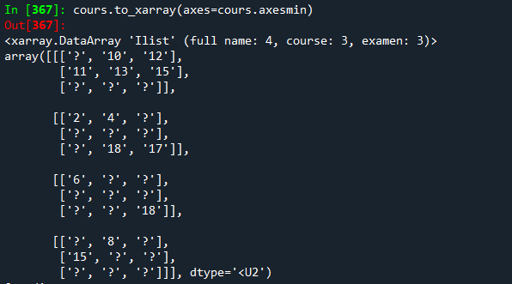
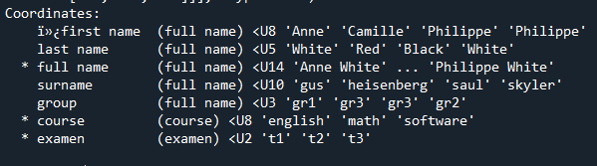
2 - Example
first name | last name | full name | surname | group | course | year | examen | score
Anne | White | Anne White | skyler | gr1 | english | 2021 | t1 | -
Anne | White | Anne White | skyler | gr1 | english | 2021 | t2 | 10
Anne | White | Anne White | skyler | gr1 | english | 2021 | t3 | 12
Anne | White | Anne White | skyler | gr1 | math | 2021 | t1 | 11
Anne | White | Anne White | skyler | gr1 | math | 2021 | t2 | 13
Anne | White | Anne White | skyler | gr1 | math | 2021 | t3 | 15
Anne | White | Anne White | skyler | gr1 | software | 2021 | t1 | -
Anne | White | Anne White | skyler | gr1 | software | 2021 | t2 | -
Anne | White | Anne White | skyler | gr1 | software | 2021 | t3 | -
Full function :
Primary are completed
Derived are full codec
completed
derived
coupled
unique

Slide 16
3 - Aggregation process
All child indexes
index | index | data
value | value | ilist3
value | value | ilist4
Merge
index | index | index | index | index | data
value | value | value | value | value | value
value | value | value | value | value | value
value | value | value | value | value | value
value | value | value | value | value | value
(recursive function)
All child data
Ilist 5
data
ilist1
ilist2
add information
Data use
Ilist 4
Process adapted to organizations
Add information without altering
Separation of management and use
index | data
value | value
index | data
value | value
value | value
index | data
value | value
Ilist 1
Ilist 3
Ilist 2
Data management

Slide 17
3 - Example
first name | last name | full name | surname | group | file
Anne | White | Anne White | skyler | gr1 | aw
Philippe | White | Philippe White | heisenberg | gr2 | pw
Camille | Red | Camille Red | saul | gr3 | cr
Philippe | Black | Philippe Black | gus | gr3 | pb
total
IndexSet
Data
course | year | examen | score
math | 2021 | t1 | 11
math | 2021 | t2 | 13
math | 2021 | t3 | 15
english | 2021 | t2 | 10
english | 2021 | t3 | 12
aw
total.merge()
course | year | examen | score
math | 2021 | t1 | 15
english | 2021 | t2 | 8
first name | last name | full name | surname | group | course | year | examen | score
Anne | White | Anne White | skyler | gr1 | math | 2021 | t1 | 11
Anne | White | Anne White | skyler | gr1 | math | 2021 | t2 | 13
Anne | White | Anne White | skyler | gr1 | math | 2021 | t3 | 15
Anne | White | Anne White | skyler | gr1 | english | 2021 | t2 | 10
Anne | White | Anne White | skyler | gr1 | english | 2021 | t3 | 12
Philippe | White | Philippe White | heisenberg | gr2 | math | 2021 | t1 | 15
Philippe | White | Philippe White | heisenberg | gr2 | english | 2021 | t2 | 8
Camille | Red | Camille Red | saul | gr3 | software | 2021 | t3 | 17
Camille | Red | Camille Red | saul | gr3 | software | 2021 | t2 | 18
Camille | Red | Camille Red | saul | gr3 | english | 2021 | t1 | 2
Camille | Red | Camille Red | saul | gr3 | english | 2021 | t2 | 4
Philippe | Black | Philippe Black | gus | gr3 | software | 2021 | t3 | 18
Philippe | Black | Philippe Black | gus | gr3 | english | 2021 | t1 | 6
pw
course | year | examen | score
software | 2021 | t3 | 17
software | 2021 | t2 | 18
english | 2021 | t1 | 2
english | 2021 | t2 | 4
cr
pb
course | year | examen | score
software | 2021 | t3 | 18
english | 2021 | t1 | 6

Slide 18
4 – format
Tabular format (csv)
Easy to read, duplication data, text only
Json format
Easy to read, text only
Not duplication data
Compatible with NoSQL Database
Bson format
Compatible with json format
Binary, structured data (eg datetime)
Binary format
CBOR (Concise Binary Object Representation)
Compatible with json format
Binary, numerical, text, structured (eg datetime, coordinates)
Ilist format
Dict + Array

Slide 19
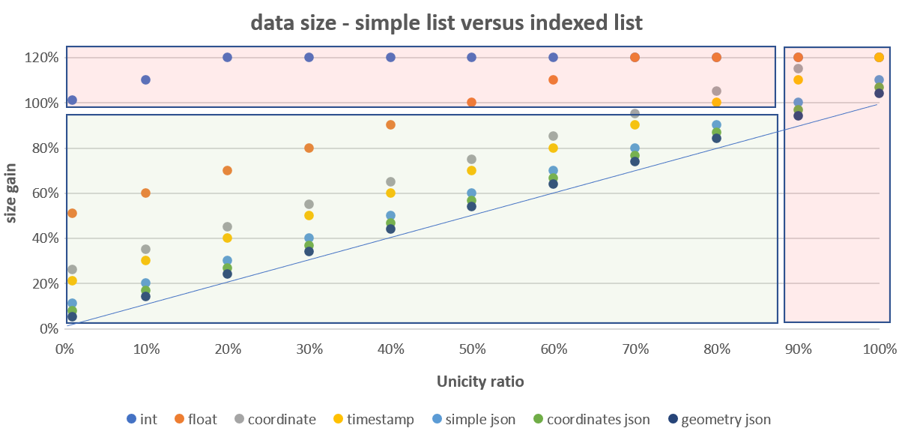
4 – list size
Simple list size = n * l
n : number of values
l : mean value size
Indexed list size = n * i + nx * l
i : integer size
nx : number of different values
Indexed list size / list size = i / l (object lightness) + nx / n (unicity level)
Properties
If object lightness and unicity level are low, the indexed list size is lower than simple list size
e.g. : i / l = 0.1 , nx / n = 0.4 => indexed list size = 0.5 * list size
In a Ilist with data more complex than numerical data, the json (or binary) format has a smaller size than a tabular format
Object lightness | l | i / l
int | 2 | 1,00
float, int32 | 4 | 0,50
coordinate | 8 | 0,25
string(10) (eg. timestamp) | 10 | 0,20
simple json element (eg key/value) | 20 | 0,10
structured json element (eg coordinates) | 30 | 0,07
complex json element (eg geometry) | 50 | 0,04
E.g. previous example :
csv : 2 418 bytes
json : 1 496 bytes
binary (CBOR) : 697 bytes

Slide 20
1 – Derived indexes
I1 : [d1, d1, d2, d3, d4, d5, d6]
[0, 0, 1, 2, 3, 4, 5]
[d1, d2, d3, d4, d5, d6]
I4 : [ j, j, f, f, m, s, s]
[0, 0, 1, 1, 2, 3, 3]
[ j, f, m, s]
I3 : [t1, t1, t2, t2, t3, t4, t4]
[0, 0, 1, 1, 2, 3, 3]
[t1, t2, t3, t4]
[d1, d1, d2, d3, d4, d5, d6]
[0, 0, 1, 2, 3, 4, 5]
[d1, d2, d3, d4, d5, d6]
[d1, d1, d2, d3, d4, d5, d6]
[0, 0, 1, 2, 3, 4, 5]
[d1, d2, d3, d4, d5, d6]
Derived
E = 2
Coupled
E = 0
[ j, j, f, f, m, s, s]
[0, 0, 1, 2, 3, 4, 5]
[ j, f, f, m, s, s]
[ j, j, f, f, m, s, s]
[0, 0, 1, 2, 3, 4, 5]
[ j, f, f, m, s, s]
Coupled
E = 0
Coupled
E = 0
[t1, t1, t2, t2, t3, t4, t4]
[0, 0, 1, 1, 2, 3, 3]
[t1, t2, t3, t4]
[t1, t1, t1, t1, t2, t3, t3]
[0, 0, 1, 1, 2, 3, 3]
[t1, t1, t2, t3]
Default codec
Calculation of the extended codec
Calculation of keys

