Slide 1
How to convert any csv to an Xarray with chosen dimension ?

Slide 2
1 - CSV data -> Ilist data
columns
index
result
iindex
result
0
1
1
2
1
0
0
0
1
0
0
0
rows
Example :
iindex
result
Name | City | Age | Subject | score
Paul | Paris | 16 | Math | 10
Lea | Paris | 15 | Math | 12
Lea | Paris | 15 | English | 15
Name
1
0
0
City
0
0
0
Age
0
1
1
Subject
1
1
0
score
10
12
15

Slide 3
2 - Ilist -> Canonical format
I5
Example :
unique
city
I4
Age
unique
I6
I1
crossed
linked
unique
coupled
Name
derived
Primary
indexes
I3
I2
Primary
indexes
linked
linked
Subject
I7
I9
coupled
derived
I8
coupled
Explanation : See Appendix

Slide 4
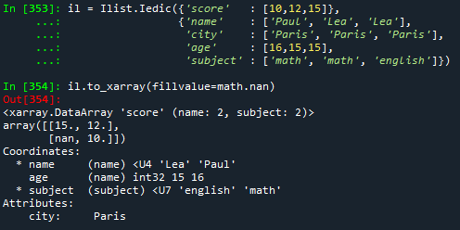
3 - Xarray generation
I5
I5
unique
unique
I4
Primary indexes
-> Xarray dims
Derived/coupled indexes
-> Xarray coords
Indexed value
-> Xarray data
Unique index
-> Xarray attrs
I6
I1
I4
I6
I1
crossed
crossed
crossed
unique
derived
linked
unique
derived
Primary
indexes
Primary
indexes
I3
I3
I2
I2
Full
crossed
linked
I7
I9
I7
I9
coupled
coupled
I8
derived
I8
derived
coupled
coupled
Example :
city
Age
unique
coupled
Name
Primary
indexes
linked
Subject

Slide 5
Appendix – Indexed List
https://github.com/loco-philippe/Environnemental-Sensing/blob/main/documentation/Ilist_technical.pdf
https://loco-philippe.github.io/ES/ilist.html

