Slide 1

Lecture 15
ALGORITHMS & DATA STRUCTURES
DEPARTMENT OF COMPUTING
Please, download Worksheet Lecture 15 available at learn.gold
February 11, 2019

Slide 2
Outline
Review of last week & Essay assignment
Random Numbers
Comparison sorts
Shuffling

Slide 3
Outline
Review of last week & Essay assignment
Random Numbers
Comparison sorts
Shuffling

Slide 4
Implicit Data Structures (closed)
Final marks: 30+70*(score/10)²
127 students attempted the quiz
16 (13%) students got over 90 & 59 (46%) over 70 ☺
This quiz closed at 4PM on Friday 8th February

Slide 5
Heap Lab. Submission (closed)
123 final submissions
63% of submission over 70 ☺
This lab. submission closed at 4PM on Friday 8th February

Slide 6
Graphs Quiz (still open)
81 students (out of 142) have not made any attempt yet
Just 5 students over 70
This lab submission closes at 4PM on Friday 15th February

Slide 7
Graphs Lab Submission (still open)
122 students (out of 142) have not made any attempt yet
9 students over 70 already ☺
This lab submission closes at 4PM on Friday 15th February

Slide 8
Schedule Term2 (first half)
Mon Tue Wed Thu Fri
Week 11
14-Jan 15-Jan 16-Jan 17-Jan 18-Jan
Lecture 11
Week 12
21-Jan 22-Jan 23-Jan 24-Jan 25-Jan
Lecture 12 Lab.12 Lab.12 Hashing quiz
Lab. Submission Binary Search
Office hours 2-4pm
Week 13
28-Jan 29-Jan 30-Jan 31-Jan 01-Feb
Lecture 13 Lab.13 Lab.13 Binary Search quiz
Office hours 2-4pm
Week 14
04-Feb 05-Feb 06-Feb 07-Feb 08-Feb
Lecture 14 Lab.14 Lab.14 Implicit Data Structures quiz
Lab. Sub.Heap, Heapsort
Office hours 2-4pm
Week 15
11-Feb 12-Feb 13-Feb 14-Feb 15-Feb
Lecture 15 Lab.15 Lab.15 Graphs quiz
Lab. Submission Graphs
ESSAY, Assignment
YOU ARE HERE
Office hours 2-4pm
READING WEEK (18-Feb-24Feb)

Slide 9
Essay Assignment
You must research and write short summaries on one algorithm and one data structure
You are not required to implement them (though you may wish to in order to help your understanding)
Each of the summaries should be no more than two sides of A4 paper, including any diagrams, pictures or pseudocode (you loose points for not meeting this condition).
You must submit a PDF file (you loose points for not meeting this condition).

Slide 10
Essay Assignment
In your summary you must include:
ALGORITHM | DATA STRUCTURE
1. Description of the problem solved by the algorithm | 1. Description of the operations the data structure supports
2. Description of how the algorithm operates (natural language + pseudocode + diagram) | 2. Description of how to construct the data structure
3. An example of a situation where the algorithm could be applied | 3. An example of a situation where the data structure is applicable
4. An algorithm you have learnt about in this module that you think is is most closely related | 4. A data structure you have learnt about in this module that you think is is most closely related
5. One multiple-choice or numerical-answer question related to the algorithm (on-line quiz style) | 5. One multiple-choice or numerical-answer question related to the algorithm (on-line quiz style)
Remember: “The best way to score 0 points is to miss something out” (C. Rhodes)

Slide 11
Essay Assignment: Algorithm
The algorithm you must write about depends on the second letter of your college identifier (e.g. for the identifier abegh001, the second letter is b; for ma101cr, the second letter is a).
Look up your second letter in the following table to determine which algorithm to write about.
LETTER | ALGORITHM
a,b | Reservoir sampling
c,d,e,f | Modular exponentiation by repeated squaring
g,h,i,j | Horner’s method for polynomial evaluation
k,l,m | Dynamic time warping
n,o,p,q,r | C3 linearization
s,t,u,v,w,x,y,z | Alpha-beta pruning

Slide 12
Essay Assignment: Data Structure
The data structure you must write about depends on the last letter of your college identifier (e.g. for the identifier abegh001, the last letter is h; for ma101cr, the last letter is r).
Look up your last letter in the following table to determine which data structure to write about.
LETTER | DATA STRUCTURE
a,b,c,d | Rope
e,f,g,h | Merkle tree
i,j,k,l | Disjoint set
m,n | Bloom filter
o,p,q,r | Bi-parental heap
s,t,u,v,w,x,y,z | AVL tree

Slide 13
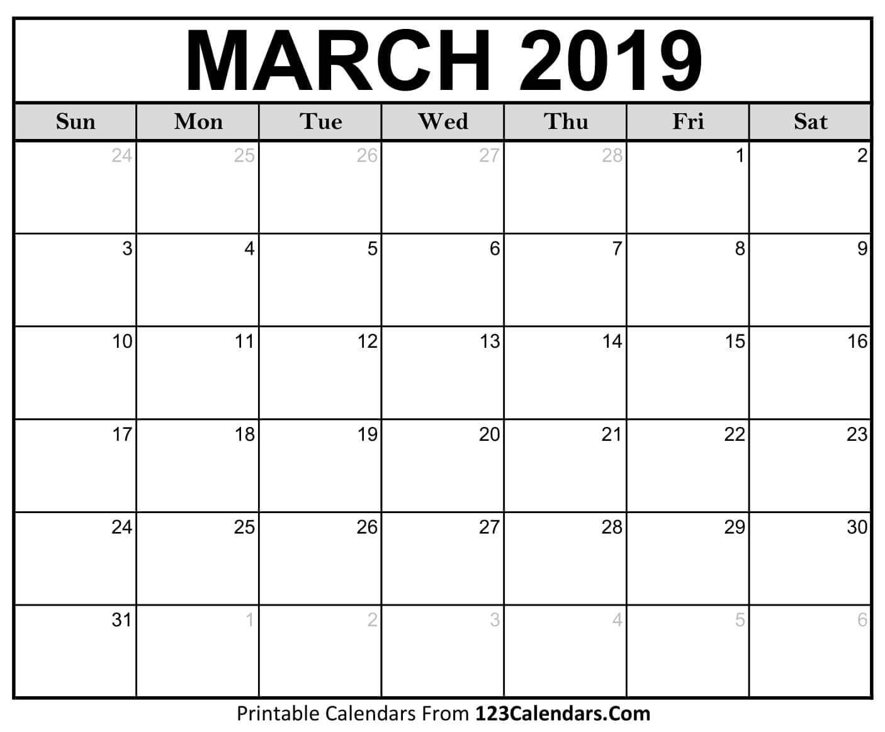
Essay Assignment: Important Dates
6th March, 9AM: First draft submission opens
15th March, 4PM: First draft submission closes
15th March, 4PM: Peer-assessment opens
22nd March, 4PM: Peer-assessment closes
29th March, 4PM: Final submission closes

Slide 14
Essay Assignment: Important Tips
Construct your own images and diagrams: no points for copied/copy & paste images
Be thoughtful about selecting the best medium to convey information: sometimes a pseudocode + diagram + biref explanation makes understanding much easier than only complicated prose.
Place citations to your sources where they are most relevant in your text, instead of simply listing them at the end (or not listing them at all!)
Failure to submit first draft/do your peer assessment: You get 0 points in 4% of final mark

Slide 15
Last lecture: Path Finding
Greedy Best-First Search
Dijkstra
A* (A star)
Leeds
Manchester
45
72
86
Nottingham
58
Cromer
Birmigham
Peterborough
23
64
Norwich
41
120
45
Cambridge
Oxford
55
Ipswich
Bristol
73
Watford
42
82
14
Bath
97
22
20
84
Basingtoke
Slough
23
London
51
Southampton
33
64
42
76
Dover
Exeter
Crawley
23
22
86
Portsmouth
48
Brighton

Slide 16
Download
Please, download Worksheet Lecture 15 available at learn.gold

Slide 17
Outline
Review of last week & Essay assignment
Random Numbers
Comparison sort
Shuffling

Slide 18
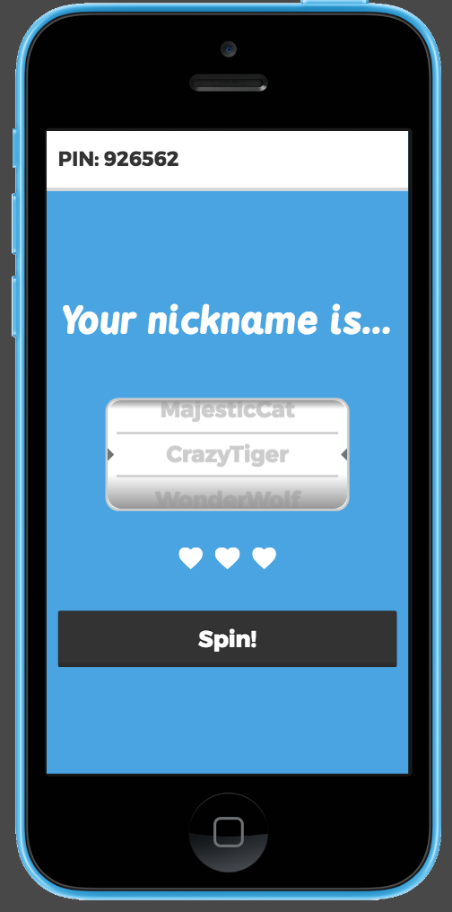
Example of use
How does Kahoot! name generator work?
(worksheet 1.1)

Slide 19
Example of Use
Kahoot! name generator
“Silly” | “Swift” | “Brave” | “Wonder” | “Big” | “Broke” | “Spiritual” | “Glorius” | “Galactic”
[0] [1] [2] [3] [4] [5] [6] [7] [8]
“Coyote” | “Sphinx” | “Iguana” | “Wolf” | “Goat” | “Eagle” | “Cat” | “Fox” | “Mole”
[0] [1] [2] [3] [4] [5] [6] [7] [8]

Slide 20
Example of Use
Kahoot! name generator
“Silly” | “Swift” | “Brave” | “Wonder” | “Big” | “Broke” | “Spiritual” | “Glorius” | “Galactic”
[0] [1] [2] [3] [4] [5] [6] [7] [8]
“Coyote” | “Sphinx” | “Iguana” | “Wolf” | “Goat” | “Eagle” | “Cat” | “Fox” | “Mole”
[0] [1] [2] [3] [4] [5] [6] [7] [8]
Create array with adjectives
Create array with animals
Generate a random number in [0,8] and store it in i1
Generate a random number in [0,8] and store it in i2
Print adjectives[i1]+animals[i2]

Slide 21
Example of Use
Kahoot! name generator
“Silly” | “Swift” | “Brave” | “Wonder” | “Big” | “Broke” | “Spiritual” | “Glorius” | “Galactic”
[0] [1] [2] [3] [4] [5] [6] [7] [8]
“Coyote” | “Sphinx” | “Iguana” | “Wolf” | “Goat” | “Eagle” | “Cat” | “Fox” | “Mole”
[0] [1] [2] [3] [4] [5] [6] [7] [8]
Create array with adjectives
Create array with animals
Generate a random number in [0,8] and store it in i1
Generate a random number in [0,8] and store it in i2
Print adjectives[i1]+animals[i2]
How can we generate a randomness with a computer?
(worksheet 1.2)

Slide 22
Generating randomness in a computer

Slide 23
Linear Congruential Generator (1951)
X_{i}=(aX_{i-1}+c) mod m

Slide 24
Linear Congruential Generator (1951)
X_{i}=(aX_{i-1}+c) mod m
seed
X₁=(aX₀+c) mod m
X₂=(aX₁+c) mod m
X₃=(aX₂+c) mod m
m>0 a,c,X₀<m

Slide 25
Linear Congruential Generator (1951)
X_{i}=(aX_{i-1}+c) mod m
seed
EXAMPLE:
X₁=(aX₀+c) mod m
a=31 c=13 m=20 X₀=1
X₂=(aX₁+c) mod m
X₁=(31*1+13) mod 20 = 4
X₂=(31*4+13) mod 20 = 17
X₃= (31*17+13) mod 20 = 0
X₄= (31*0+13) mod 20 = 13
X₃=(aX₂+c) mod m

Slide 26
Linear Congruential Generator (1951)
X_{i}=(aX_{i-1}+c) mod m
What happens with these values?
a=11 c=0 m=8 X₀=3
(worksheet 1.3)

Slide 27
Kahoot! Name Generator
adjectives={"Silly","Swift","Brave","Wonder","Broke","Spiritual","Glorius","Galactic","Majestic"};
animals={"Mole","Fox","Cat","Eagle","Goat","Wolf","Iguana","Sphinx","Coyote"};
X0<-3
function die()
int X;
X<-(11*X0)%8;
X0<-X;
return X;
end function
function main()
answer<-"Yes";
while(answer==”Yes”)
r1=die();
r2=die();
print(adjectives[r1]+animals[r2]);
print("Spin again? Yes/No");
answer=ReadInput();
end while
print("Let's go then "+adjectives[r1]+animals[r2]+"!");
end function
bad parameters choice

Slide 28
Criteria for full period [0,m-1]
Hull & Dobel established, in 1962, the criteria for a LCG to generate numbers in the full period:
m and c must be relatively prime. That is, the only positive integer that (exactly) divides both m and c is 1
if q is a prime number that divides m, then q divides (a-1)
if m is divisible by 4, then (a-1) must be divisible by 4
(worksheet 1.4)

Slide 29
The 4 basic rules of a random number generator
Full & long period
Evenly distributed numbers
Independent numbers*
Fast
* There are very sophisticated test batteries to check this

Slide 30
Problem with low-order bits
(worksheet 1.5)

Slide 31
One solution to the low-order bit problem
Generate a number with many bits and return to the user only the high-end bits
For example in Java, random numbers of 48 bits are generated, but only the highest 32 are returned to the user:
b₄₇ b₄₆ b₄₅ b₄₄ b₄₃ b₄₂ b₄₁ b₄₀ b₃₉ b₃₈ b₃₇ b₃₆ b₃₅ b₃₄ b₃₃ b₃₂ b₃₁ b₃₀
b₄ b₃ b₂ b₁ b₀
The number made of bits b₄₇-b₁₆ are returned to the user
Bits b₁₅-b₀ are dropped

Slide 32
Summary of drawbacks of LCG
Choice of parameters affect the statistical quality of the numbers generated
Low period of low order bits and other independency aspects
There are ways of finding out the values of parameters with 3 consecutive numbers (not good for cryptographic applications)

Slide 33
Examples of typical values
Language | a | c | m | Bits returned
Borland C/C++ | 2³² | 22695477 | 1 | b₃₀ - b₁₆ in rand() b₃₀ - b₀ in lrand()
Java’s java.util.Random | 2⁴⁸ | 25214903917 | 11 | b₄₇ - b₁₆
Glibc (used by GCC) | 2³¹ | 1103515245 | 12345 | b₃₀-b₀
https://en.wikipedia.org/wiki/Linear_congruential_generator#cite_note-1

Slide 34
Operations of a random number generator
seed(k): set the initial state (X₀) to k
next(): return the next random number and update the generator state

Slide 35
Alternative random number generators
Mersenne Twister 19937
Period 2¹⁹⁹³⁷-1
Number of bits : 19937
Not for cryptographic applications, pathological zero states
Xorshift, xoroshiro
Maximum period 2¹²⁸-1
Number of bits : up to 128
Fast, independent numbers (not correlated outputs)
Not for cryptographic applications
ISAAC, arc4random
Cryptographically secure

Slide 36
Xorshift (2003)
function xorshift(a,b,c,seed)
y=seed
y=y xor (y<<a)
y=y xor (y>>b)
y=y xor (y<<c)
return y
end function

Slide 37
Xorshift (2003)
function xorshift(a,b,c,seed)
y=seed
y=y xor (y<<a)
y=y xor (y>>b)
y=y xor (y<<c)
return y
end function
EXAMPLE:
xorshift(3,5,2,4) using a 8-bit word:

Slide 38
Xorshift (2003)
function xorshift(a,b,c,seed)
y=seed
y=y xor (y<<a)
y=y xor (y>>b)
y=y xor (y<<c)
return y
end function
EXAMPLE:
xorshift(3,5,2,4) using a 8-bit word:
y
4
0 | 0 | 0 | 0 | 0 | 1 | 0 | 0

Slide 39
Xorshift (2003)
function xorshift(a,b,c,seed)
y=seed
y=y xor (y<<a)
y=y xor (y>>b)
y=y xor (y<<c)
return y
end function
EXAMPLE:
xorshift(3,5,2,4) using a 8-bit word:
y
4
0 | 0 | 0 | 0 | 0 | 1 | 0 | 0
y<<3
32
0 | 0 | 1 | 0 | 0 | 0 | 0 | 0
y xor (y<<3)
New value of y
36
0 | 0 | 1 | 0 | 0 | 1 | 0 | 0

Slide 40
Xorshift (2003)
function xorshift(a,b,c,seed)
y=seed
y=y xor (y<<a)
y=y xor (y>>b)
y=y xor (y<<c)
return y
end function
EXAMPLE:
xorshift(3,5,2,4) using a 8-bit word:
y
36
0 | 0 | 1 | 0 | 0 | 1 | 0 | 0
y>>5
1
0 | 0 | 0 | 0 | 0 | 0 | 0 | 1
y xor (y>>5)
New value of y
37
0 | 0 | 1 | 0 | 0 | 1 | 0 | 1

Slide 41
Xorshift (2003)
function xorshift(a,b,c,seed)
y=seed
y=y xor (y<<a)
y=y xor (y>>b)
y=y xor (y<<c)
return y
end function
EXAMPLE:
xorshift(3,5,2,4) using a 8-bit word:
y
37
0 | 0 | 1 | 0 | 0 | 1 | 0 | 1
y<<2
148
1 | 0 | 0 | 1 | 0 | 1 | 0 | 0
y xor (y>>5)
New value of y
177
1 | 0 | 1 | 1 | 0 | 0 | 0 | 1
Generated random number: 177

Slide 42
Xorshift (2003)
function xorshift(a,b,c,seed)
y=seed
y=y xor (y<<a)
y=y xor (y>>b)
y=y xor (y<<c)
return y
end function
EXAMPLE:
xorshift(3,5,2,4) using a 8-bit word:
New value of y
177
1 | 0 | 1 | 1 | 0 | 0 | 0 | 1
177 is returned
(worksheet 1.6)

Slide 43
Outline
Review of last week & Essay assignment
Random Numbers
Comparison sorts
Shuffling

Slide 44
Comparison Sorts
Algorithms that use a comparison operator to decide which element of a pair should precede the other.
The operator must obey two properties:
If a ≤ b and b ≤ c then a ≤ c (transitivity)
For all a and b, either a ≤ b or b ≤ a (totality)
Sequence of objects
Comparison Sort
Sorted sequence of objects
s₀ , s₁ , …, s_{N-1}
𝑠′₀ ≤ 𝑠′₁ ≤ 𝑠′₂ ≤ ... ≤ 𝑠′_{𝑁−1}

Slide 45
Examples of comparison sorts
Bogosort
Bubble sort
Selection sort
Insertion sort
Odd-even sort
Mergesort
Quicksort
We’ll work on the red ones today. Check the rest at home

Slide 46
Bogosort (also known as Stupidsort)
function sorted(array b)
for 0 ≤ i ≤ (n-2) do
if b[i]>b[i+1] then
return FALSE
end if
end for
return TRUE
end function
function random_permute(array b)
for 0 ≤ i ≤ (n-2) do
j<-random(i,n)
swap(b[i],b[j])
end for
end function
function bogosort(array s)
while(sorted(s)==FALSE)
random_permute(s)
end while
return s
end function
(worksheet 2.1)

Slide 47
Bogosort
function sorted(array b)
for 0 ≤ i ≤ (n-2) do
if b[i]>b[i+1] then
return FALSE
end if
end for
return TRUE
end function
function random_permute(array b)
for 0 ≤ i ≤ (n-2) do
j<-random(i,n)
swap(b[i],b[j])
end for
end function
function bogosort(array s)
while(sorted(s)==FALSE)
random_permute(s)
end while
return s
end function
TIME COMPLEXITY
There are N! different permutations of N elements
If a different permutation is obtained in every attempt and the right one happens at the end: Ω(N!)

Slide 48
INSERTION SORT
function insertion (array s)
for 1 ≤ j < length(s) do
key ← s[j]
i ← j−1
while i ≥ 0 ∧ s[i] > key do
s[i+1] ← s[i]
i ← i - 1
end while
s[i+1] ← key
end for
end function
(worksheet 2.2)
Repeatedly insert the next unsorted element into its
correct place in the sorted sequence.

Slide 49
INSERTION SORT
function insertion (array s)
for 1 ≤ j < length(s) do
key ← s[j]
i ← j−1
while i ≥ 0 ∧ s[i] > key do
s[i+1] ← s[i]
i ← i - 1
end while
s[i+1] ← key
end for
end function
s
7 | 2 | 9 | 3 | 5
[0] [1] [2] [3] [4]

Slide 50
INSERTION SORT
j
function insertion (array s)
for 1 ≤ j < length(s) do
key ← s[j]
i ← j−1
while i ≥ 0 ∧ s[i] > key do
s[i+1] ← s[i]
i ← i - 1
end while
s[i+1] ← key
end for
end function
s
j=1
7 | 2 | 9 | 3 | 5
[0] [1] [2] [3] [4]

Slide 51
INSERTION SORT
j
function insertion (array s)
for 1 ≤ j < length(s) do
key ← s[j]
i ← j−1
while i ≥ 0 ∧ s[i] > key do
s[i+1] ← s[i]
i ← i - 1
end while
s[i+1] ← key
end for
end function
s
j=1
7 | 2 | 9 | 3 | 5
[0] [1] [2] [3] [4]
key
2

Slide 52
INSERTION SORT
i
j
function insertion (array s)
for 1 ≤ j < length(s) do
key ← s[j]
i ← j−1
while i ≥ 0 ∧ s[i] > key do
s[i+1] ← s[i]
i ← i - 1
end while
s[i+1] ← key
end for
end function
s
j=1
7 | 2 | 9 | 3 | 5
[0] [1] [2] [3] [4]
key
2

Slide 53
INSERTION SORT
i
j
function insertion (array s)
for 1 ≤ j < length(s) do
key ← s[j]
i ← j−1
while i ≥ 0 ∧ s[i] > key do
s[i+1] ← s[i]
i ← i - 1
end while
s[i+1] ← key
end for
end function
s
j=1
7 | 2 | 9 | 3 | 5
[0] [1] [2] [3] [4]
key
2

Slide 54
INSERTION SORT
i
j
function insertion (array s)
for 1 ≤ j < length(s) do
key ← s[j]
i ← j−1
while i ≥ 0 ∧ s[i] > key do
s[i+1] ← s[i]
i ← i - 1
end while
s[i+1] ← key
end for
end function
s
j=1
7 | 7 | 9 | 3 | 5
[0] [1] [2] [3] [4]
key
2

Slide 55
INSERTION SORT
i
j
function insertion (array s)
for 1 ≤ j < length(s) do
key ← s[j]
i ← j−1
while i ≥ 0 ∧ s[i] > key do
s[i+1] ← s[i]
i ← i - 1
end while
s[i+1] ← key
end for
end function
j=1
7 | 7 | 9 | 3 | 5
[0] [1] [2] [3] [4]
key
2

Slide 56
INSERTION SORT
i
j
function insertion (array s)
for 1 ≤ j < length(s) do
key ← s[j]
i ← j−1
while i ≥ 0 ∧ s[i] > key do
s[i+1] ← s[i]
i ← i - 1
end while
s[i+1] ← key
end for
end function
j=1
7 | 7 | 9 | 3 | 5
[0] [1] [2] [3] [4]
key
2

Slide 57
INSERTION SORT
i
j
function insertion (array s)
for 1 ≤ j < length(s) do
key ← s[j]
i ← j−1
while i ≥ 0 ∧ s[i] > key do
s[i+1] ← s[i]
i ← i - 1
end while
s[i+1] ← key
end for
end function
j=1
7 | 7 | 9 | 3 | 5
[0] [1] [2] [3] [4]
key
2

Slide 58
INSERTION SORT
i
j
function insertion (array s)
for 1 ≤ j < length(s) do
key ← s[j]
i ← j−1
while i ≥ 0 ∧ s[i] > key do
s[i+1] ← s[i]
i ← i - 1
end while
s[i+1] ← key
end for
end function
j=1
2 | 7 | 9 | 3 | 5
[0] [1] [2] [3] [4]
key
2
END OF 1st FOR-LOOP ITERATION

Slide 59
INSERTION SORT
i
j
function insertion (array s)
for 1 ≤ j < length(s) do
key ← s[j]
i ← j−1
while i ≥ 0 ∧ s[i] > key do
s[i+1] ← s[i]
i ← i - 1
end while
s[i+1] ← key
end for
end function
j=2
2 | 7 | 9 | 3 | 5
[0] [1] [2] [3] [4]
key
2

Slide 60
INSERTION SORT
i
j
function insertion (array s)
for 1 ≤ j < length(s) do
key ← s[j]
i ← j−1
while i ≥ 0 ∧ s[i] > key do
s[i+1] ← s[i]
i ← i - 1
end while
s[i+1] ← key
end for
end function
j=2
2 | 7 | 9 | 3 | 5
[0] [1] [2] [3] [4]
key
9

Slide 61
INSERTION SORT
i
j
function insertion (array s)
for 1 ≤ j < length(s) do
key ← s[j]
i ← j−1
while i ≥ 0 ∧ s[i] > key do
s[i+1] ← s[i]
i ← i - 1
end while
s[i+1] ← key
end for
end function
j=2
2 | 7 | 9 | 3 | 5
[0] [1] [2] [3] [4]
key
9

Slide 62
INSERTION SORT
i
j
function insertion (array s)
for 1 ≤ j < length(s) do
key ← s[j]
i ← j−1
while i ≥ 0 ∧ s[i] > key do
s[i+1] ← s[i]
i ← i - 1
end while
s[i+1] ← key
end for
end function
j=2
2 | 7 | 9 | 3 | 5
[0] [1] [2] [3] [4]
key
9

Slide 63
INSERTION SORT
i
j
function insertion (array s)
for 1 ≤ j < length(s) do
key ← s[j]
i ← j−1
while i ≥ 0 ∧ s[i] > key do
s[i+1] ← s[i]
i ← i - 1
end while
s[i+1] ← key
end for
end function
j=2
2 | 7 | 9 | 3 | 5
[0] [1] [2] [3] [4]
key
9

Slide 64
INSERTION SORT
i
j
function insertion (array s)
for 1 ≤ j < length(s) do
key ← s[j]
i ← j−1
while i ≥ 0 ∧ s[i] > key do
s[i+1] ← s[i]
i ← i - 1
end while
s[i+1] ← key
end for
end function
j=2
2 | 7 | 9 | 3 | 5
[0] [1] [2] [3] [4]
key
9
END OF 2nd FOR-LOOP ITERATION

Slide 65
INSERTION SORT
i
j
function insertion (array s)
for 1 ≤ j < length(s) do
key ← s[j]
i ← j−1
while i ≥ 0 ∧ s[i] > key do
s[i+1] ← s[i]
i ← i - 1
end while
s[i+1] ← key
end for
end function
j=3
2 | 7 | 9 | 3 | 5
[0] [1] [2] [3] [4]
key
9

Slide 66
INSERTION SORT
i
j
function insertion (array s)
for 1 ≤ j < length(s) do
key ← s[j]
i ← j−1
while i ≥ 0 ∧ s[i] > key do
s[i+1] ← s[i]
i ← i - 1
end while
s[i+1] ← key
end for
end function
j=3
2 | 7 | 9 | 3 | 5
[0] [1] [2] [3] [4]
key
3

Slide 67
INSERTION SORT
i
j
function insertion (array s)
for 1 ≤ j < length(s) do
key ← s[j]
i ← j−1
while i ≥ 0 ∧ s[i] > key do
s[i+1] ← s[i]
i ← i - 1
end while
s[i+1] ← key
end for
end function
j=3
2 | 7 | 9 | 3 | 5
[0] [1] [2] [3] [4]
key
3

Slide 68
INSERTION SORT
i
j
function insertion (array s)
for 1 ≤ j < length(s) do
key ← s[j]
i ← j−1
while i ≥ 0 ∧ s[i] > key do
s[i+1] ← s[i]
i ← i - 1
end while
s[i+1] ← key
end for
end function
j=3
2 | 7 | 9 | 3 | 5
[0] [1] [2] [3] [4]
key
3

Slide 69
INSERTION SORT
i
j
function insertion (array s)
for 1 ≤ j < length(s) do
key ← s[j]
i ← j−1
while i ≥ 0 ∧ s[i] > key do
s[i+1] ← s[i]
i ← i - 1
end while
s[i+1] ← key
end for
end function
j=3
2 | 7 | 9 | 9 | 5
[0] [1] [2] [3] [4]
key
3

Slide 70
INSERTION SORT
i
j
function insertion (array s)
for 1 ≤ j < length(s) do
key ← s[j]
i ← j−1
while i ≥ 0 ∧ s[i] > key do
s[i+1] ← s[i]
i ← i - 1
end while
s[i+1] ← key
end for
end function
j=3
2 | 7 | 9 | 9 | 5
[0] [1] [2] [3] [4]
key
3

Slide 71
INSERTION SORT
i
j
function insertion (array s)
for 1 ≤ j < length(s) do
key ← s[j]
i ← j−1
while i ≥ 0 ∧ s[i] > key do
s[i+1] ← s[i]
i ← i - 1
end while
s[i+1] ← key
end for
end function
j=3
2 | 7 | 9 | 9 | 5
[0] [1] [2] [3] [4]
key
3

Slide 72
INSERTION SORT
i
j
function insertion (array s)
for 1 ≤ j < length(s) do
key ← s[j]
i ← j−1
while i ≥ 0 ∧ s[i] > key do
s[i+1] ← s[i]
i ← i - 1
end while
s[i+1] ← key
end for
end function
j=3
2 | 7 | 7 | 9 | 5
[0] [1] [2] [3] [4]
key
3

Slide 73
INSERTION SORT
i
j
function insertion (array s)
for 1 ≤ j < length(s) do
key ← s[j]
i ← j−1
while i ≥ 0 ∧ s[i] > key do
s[i+1] ← s[i]
i ← i - 1
end while
s[i+1] ← key
end for
end function
j=3
2 | 7 | 7 | 9 | 5
[0] [1] [2] [3] [4]
key
3

Slide 74
INSERTION SORT
i
j
function insertion (array s)
for 1 ≤ j < length(s) do
key ← s[j]
i ← j−1
while i ≥ 0 ∧ s[i] > key do
s[i+1] ← s[i]
i ← i - 1
end while
s[i+1] ← key
end for
end function
j=3
2 | 7 | 7 | 9 | 5
[0] [1] [2] [3] [4]
key
3

Slide 75
INSERTION SORT
i
j
function insertion (array s)
for 1 ≤ j < length(s) do
key ← s[j]
i ← j−1
while i ≥ 0 ∧ s[i] > key do
s[i+1] ← s[i]
i ← i - 1
end while
s[i+1] ← key
end for
end function
j=3
2 | 7 | 7 | 9 | 5
[0] [1] [2] [3] [4]
key
3

Slide 76
INSERTION SORT
i
j
function insertion (array s)
for 1 ≤ j < length(s) do
key ← s[j]
i ← j−1
while i ≥ 0 ∧ s[i] > key do
s[i+1] ← s[i]
i ← i - 1
end while
s[i+1] ← key
end for
end function
j=3
2 | 3 | 7 | 9 | 5
[0] [1] [2] [3] [4]
key
3
END OF 3rd FOR-LOOP ITERATION

Slide 77
INSERTION SORT
i
j
function insertion (array s)
for 1 ≤ j < length(s) do
key ← s[j]
i ← j−1
while i ≥ 0 ∧ s[i] > key do
s[i+1] ← s[i]
i ← i - 1
end while
s[i+1] ← key
end for
end function
j=4
2 | 3 | 7 | 9 | 5
[0] [1] [2] [3] [4]
key
3

Slide 78
INSERTION SORT
i
j
function insertion (array s)
for 1 ≤ j < length(s) do
key ← s[j]
i ← j−1
while i ≥ 0 ∧ s[i] > key do
s[i+1] ← s[i]
i ← i - 1
end while
s[i+1] ← key
end for
end function
j=4
2 | 3 | 7 | 9 | 5
[0] [1] [2] [3] [4]
key
5

Slide 79
INSERTION SORT
i
j
function insertion (array s)
for 1 ≤ j < length(s) do
key ← s[j]
i ← j−1
while i ≥ 0 ∧ s[i] > key do
s[i+1] ← s[i]
i ← i - 1
end while
s[i+1] ← key
end for
end function
j=4
2 | 3 | 7 | 9 | 5
[0] [1] [2] [3] [4]
key
5

Slide 80
INSERTION SORT
i
j
function insertion (array s)
for 1 ≤ j < length(s) do
key ← s[j]
i ← j−1
while i ≥ 0 ∧ s[i] > key do
s[i+1] ← s[i]
i ← i - 1
end while
s[i+1] ← key
end for
end function
j=4
2 | 3 | 7 | 9 | 5
[0] [1] [2] [3] [4]
key
5

Slide 81
INSERTION SORT
i
j
function insertion (array s)
for 1 ≤ j < length(s) do
key ← s[j]
i ← j−1
while i ≥ 0 ∧ s[i] > key do
s[i+1] ← s[i]
i ← i - 1
end while
s[i+1] ← key
end for
end function
j=4
2 | 3 | 7 | 9 | 9
[0] [1] [2] [3] [4]
key
5

Slide 82
INSERTION SORT
i
j
function insertion (array s)
for 1 ≤ j < length(s) do
key ← s[j]
i ← j−1
while i ≥ 0 ∧ s[i] > key do
s[i+1] ← s[i]
i ← i - 1
end while
s[i+1] ← key
end for
end function
j=4
2 | 3 | 7 | 9 | 9
[0] [1] [2] [3] [4]
key
5

Slide 83
INSERTION SORT
i
j
function insertion (array s)
for 1 ≤ j < length(s) do
key ← s[j]
i ← j−1
while i ≥ 0 ∧ s[i] > key do
s[i+1] ← s[i]
i ← i - 1
end while
s[i+1] ← key
end for
end function
j=4
2 | 3 | 7 | 9 | 9
[0] [1] [2] [3] [4]
key
5

Slide 84
INSERTION SORT
i
j
function insertion (array s)
for 1 ≤ j < length(s) do
key ← s[j]
i ← j−1
while i ≥ 0 ∧ s[i] > key do
s[i+1] ← s[i]
i ← i - 1
end while
s[i+1] ← key
end for
end function
j=4
2 | 3 | 7 | 7 | 9
[0] [1] [2] [3] [4]
key
5

Slide 85
INSERTION SORT
i
j
function insertion (array s)
for 1 ≤ j < length(s) do
key ← s[j]
i ← j−1
while i ≥ 0 ∧ s[i] > key do
s[i+1] ← s[i]
i ← i - 1
end while
s[i+1] ← key
end for
end function
j=4
2 | 3 | 7 | 7 | 9
[0] [1] [2] [3] [4]
key
5

Slide 86
INSERTION SORT
i
j
function insertion (array s)
for 1 ≤ j < length(s) do
key ← s[j]
i ← j−1
while i ≥ 0 ∧ s[i] > key do
s[i+1] ← s[i]
i ← i - 1
end while
s[i+1] ← key
end for
end function
j=4
2 | 3 | 7 | 7 | 9
[0] [1] [2] [3] [4]
key
5

Slide 87
INSERTION SORT
i
j
function insertion (array s)
for 1 ≤ j < length(s) do
key ← s[j]
i ← j−1
while i ≥ 0 ∧ s[i] > key do
s[i+1] ← s[i]
i ← i - 1
end while
s[i+1] ← key
end for
end function
j=4
2 | 3 | 7 | 7 | 9
[0] [1] [2] [3] [4]
key
5

Slide 88
INSERTION SORT
i
j
function insertion (array s)
for 1 ≤ j < length(s) do
key ← s[j]
i ← j−1
while i ≥ 0 ∧ s[i] > key do
s[i+1] ← s[i]
i ← i - 1
end while
s[i+1] ← key
end for
end function
j=4
2 | 3 | 5 | 7 | 9
[0] [1] [2] [3] [4]
key
5
END OF 4th FOR-LOOP ITERATION

Slide 89
INSERTION SORT
i
j
function insertion (array s)
for 1 ≤ j < length(s) do
key ← s[j]
i ← j−1
while i ≥ 0 ∧ s[i] > key do
s[i+1] ← s[i]
i ← i - 1
end while
s[i+1] ← key
end for
end function
j=4
2 | 3 | 5 | 7 | 9
[0] [1] [2] [3] [4]
key
5

Slide 90
INSERTION SORT
i
j
function insertion (array s)
for 1 ≤ j < length(s) do
key ← s[j]
i ← j−1
while i ≥ 0 ∧ s[i] > key do
s[i+1] ← s[i]
i ← i - 1
end while
s[i+1] ← key
end for
end function
j=4
2 | 3 | 5 | 7 | 9
[0] [1] [2] [3] [4]
key
5

Slide 91
INSERTION SORT
function insertion (array s)
for 1 ≤ j < length(s) do
key ← s[j]
i ← j−1
while i ≥ 0 ∧ s[i] > key do
s[i+1] ← s[i]
i ← i - 1
end while
s[i+1] ← key
end for
end function
2 | 3 | 5 | 7 | 9
[0] [1] [2] [3] [4]
TIME COMPLEXITY
External loop (j) executes (N-1) times
Internal loop (i) makes up to j memory writes
=> Θ (N²)

Slide 92
Work
Reading
CLRS, sections 2.1, 2.2
Investigate other quadratic sorting algorithms, for example:
selection sort
bubble sort
odd-even sort.
What advantages and disadvantages do they have relative to insertion sort?
3. Questions from CLRS
2-2 Correctness of bubblesort

Slide 93
Merge (vector)
Require: a,b :: Vector
2. function merge(a,b)
3. al ← length(a); bl ← length(b); cl ← al + bl
4. c ← new Vector(cl)
5. ai ← bi ← ci ← 0
6. while ci < cl do
7. if ai = al then
8. c[ci] ← b[bi]; bi ← bi + 1
9. else if bi = bl ∨ a[ai] ≤ b[bi] then
10. c[ci] ← a[ai]; ai ← ai + 1
11. else
12. c[ci] ← b[bi]; bi ← bi + 1
13. end if
14. ci ← ci + 1
15. end while
16. return c
17. end function

Slide 94
Merge (vector)
Require: a,b :: Vector
2. function merge(a,b)
3. al ← length(a); bl ← length(b); cl ← al + bl
4. c ← new Vector(cl)
5. ai ← bi ← ci ← 0
6. while ci < cl do
7. if ai = al then
8. c[ci] ← b[bi]; bi ← bi + 1
9. else if bi = bl ∨ a[ai] ≤ b[bi] then
10. c[ci] ← a[ai]; ai ← ai + 1
11. else
12. c[ci] ← b[bi]; bi ← bi + 1
13. end if
14. ci ← ci + 1
15. end while
16. return c
17. end function
al
bl
ai
bi
cl
ci

Slide 95
Merge (vector)
Require: a,b :: Vector
2. function merge(a,b)
3. al ← length(a); bl ← length(b); cl ← al + bl
4. c ← new Vector(cl)
5. ai ← bi ← ci ← 0
6. while ci < cl do
7. if ai = al then
8. c[ci] ← b[bi]; bi ← bi + 1
9. else if bi = bl ∨ a[ai] ≤ b[bi] then
10. c[ci] ← a[ai]; ai ← ai + 1
11. else
12. c[ci] ← b[bi]; bi ← bi + 1
13. end if
14. ci ← ci + 1
15. end while
16. return c
17. end function
al
bl
3
5
ai
bi
cl
ci

Slide 96
Merge (vector)
Require: a,b :: Vector
2. function merge(a,b)
3. al ← length(a); bl ← length(b); cl ← al + bl
4. c ← new Vector(cl)
5. ai ← bi ← ci ← 0
6. while ci < cl do
7. if ai = al then
8. c[ci] ← b[bi]; bi ← bi + 1
9. else if bi = bl ∨ a[ai] ≤ b[bi] then
10. c[ci] ← a[ai]; ai ← ai + 1
11. else
12. c[ci] ← b[bi]; bi ← bi + 1
13. end if
14. ci ← ci + 1
15. end while
16. return c
17. end function
al
bl
3
5
ai
bi
cl
ci

Slide 97
Merge (vector)
Require: a,b :: Vector
2. function merge(a,b)
3. al ← length(a); bl ← length(b); cl ← al + bl
4. c ← new Vector(cl)
5. ai ← bi ← ci ← 0
6. while ci < cl do
7. if ai = al then
8. c[ci] ← b[bi]; bi ← bi + 1
9. else if bi = bl ∨ a[ai] ≤ b[bi] then
10. c[ci] ← a[ai]; ai ← ai + 1
11. else
12. c[ci] ← b[bi]; bi ← bi + 1
13. end if
14. ci ← ci + 1
15. end while
16. return c
17. end function
al
bl
3
5
ai
bi
cl
3
ci
(worksheet 2.3)

Slide 98
Merge (vector)
2 | 5 | 7
1 | 3 | 9 | 12 | 15
1 | 2 | 3 | 5 | 7 | 9 | 12 | 15
Two ordered arrays are merged into another sorted one

Slide 99
Mergesort
function mergesort(s)
sl ← length(s)
if sl ≤ 1 then
return s
else
mid ← floor(sl/2)
left ← mergesort(s[0...mid-1))
right ← mergesort(s[mid...sl-1))
return merge(left,right)
end if
end function

Slide 100
Mergesort
function mergesort(s)
sl ← length(s)
if sl ≤ 1 then
return s
else
mid ← floor(sl/2)
left ← mergesort(s[0...mid-1))
right ← mergesort(s[mid...sl-1))
return merge(left,right)
end if
end function
s
5 | 3 | 13 | 2

Slide 101
Mergesort
function mergesort(s)
sl ← length(s)
if sl ≤ 1 then
return s
else
mid ← floor(sl/2)
left ← mergesort(s[0...mid-1))
right ← mergesort(s[mid...sl-1))
return merge(left,right)
end if
end function
s
5 | 3 | 13 | 2
sl

Slide 102
Mergesort
function mergesort(s)
sl ← length(s)
if sl ≤ 1 then
return s
else
mid ← floor(sl/2)
left ← mergesort(s[0...mid-1))
right ← mergesort(s[mid...sl-1))
return merge(left,right)
end if
end function
s
5 | 3 | 13 | 2
sl

Slide 103
Mergesort
mid
function mergesort(s)
sl ← length(s)
if sl ≤ 1 then
return s
else
mid ← floor(sl/2)
left ← mergesort(s[0...mid-1))
right ← mergesort(s[mid...sl-1))
return merge(left,right)
end if
end function
s
5 | 3 | 13 | 2
sl

Slide 104
Mergesort
mid
function mergesort(s)
sl ← length(s)
if sl ≤ 1 then
return s
else
mid ← floor(sl/2)
left ← mergesort(s[0...mid-1))
right ← mergesort(s[mid...sl-1))
return merge(left,right)
end if
end function
s
5 | 3 | 13 | 2
sl
left
5 | 3

Slide 105
Mergesort (for 1st left)
mid
function mergesort(s)
sl ← length(s)
if sl ≤ 1 then
return s
else
mid ← floor(sl/2)
left ← mergesort(s[0...mid-1))
right ← mergesort(s[mid...sl-1))
return merge(left,right)
end if
end function
s
5 | 3 | 13 | 2
sl
left
5 | 3
sl

Slide 106
Mergesort (for 1st left)
mid
function mergesort(s)
sl ← length(s)
if sl ≤ 1 then
return s
else
mid ← floor(sl/2)
left ← mergesort(s[0...mid-1))
right ← mergesort(s[mid...sl-1))
return merge(left,right)
end if
end function
s
5 | 3 | 13 | 2
sl
left
5 | 3

Slide 107
Mergesort (for 1st left)
mid
function mergesort(s)
sl ← length(s)
if sl ≤ 1 then
return s
else
mid ← floor(sl/2)
left ← mergesort(s[0...mid-1))
right ← mergesort(s[mid...sl-1))
return merge(left,right)
end if
end function
s
5 | 3 | 13 | 2
sl
left
mid
5 | 3

Slide 108
Mergesort (for 1st left)
mid
function mergesort(s)
sl ← length(s)
if sl ≤ 1 then
return s
else
mid ← floor(sl/2)
left ← mergesort(s[0...mid-1))
right ← mergesort(s[mid...sl-1))
return merge(left,right)
end if
end function
s
5 | 3 | 13 | 2
sl
left
mid
5 | 3
left
5

Slide 109
Mergesort (for 1st left)
mid
function mergesort(s)
sl ← length(s)
if sl ≤ 1 then
return s
else
mid ← floor(sl/2)
left ← mergesort(s[0...mid-1))
right ← mergesort(s[mid...sl-1))
return merge(left,right)
end if
end function
s
5 | 3 | 13 | 2
sl
left
mid
5 | 3
left
5
sl

Slide 110
Mergesort (for 1st left)
mid
function mergesort(s)
sl ← length(s)
if sl ≤ 1 then
return s
else
mid ← floor(sl/2)
left ← mergesort(s[0...mid-1))
right ← mergesort(s[mid...sl-1))
return merge(left,right)
end if
end function
s
5 | 3 | 13 | 2
sl
left
mid
5 | 3
left
5
sl
Etc…
(worksheet 2.4)

Slide 111
Mergesort
s
5 | 3 | 13 | 2
left
right
5 | 3
13 | 2
left
right
left
right
5
3
13
2
merge(left,right)
merge(left,right)
3 | 5
2 | 13
merge(left,right)
2 | 3 | 5 | 13

Slide 112
Quicksort
low
high
function quicksort(s,low,high)
if low < high then
p ← partition(s,low,high)
quicksort(s,low,p-1)
quicksort(s,p+1,high)
end if
end function
43 | 2 | 27 | 14 | 3 | 9 | 12
Partition selects a number and puts it in the right position (all lower numbers to the left and higher numbers to the right)

Slide 113
Quicksort
low
high
function quicksort(s,low,high)
if low < high then
p ← partition(s,low,high)
quicksort(s,low,p-1)
quicksort(s,p+1,high)
end if
end function
43 | 2 | 27 | 14 | 3 | 9 | 12
Partition selects a number and puts it in the right position (all lower numbers to the left and higher numbers to the right)

Slide 114
Quicksort
low
high
function quicksort(s,low,high)
if low < high then
p ← partition(s,low,high)
quicksort(s,low,p-1)
quicksort(s,p+1,high)
end if
end function
43 | 7 | 27 | 14 | 3 | 9 | 12
New content of array
7 | 3 | 9 | 12 | 43 | 27 | 14
p
Partition selects a number and puts it in the right position (all lower numbers to the left and higher numbers to the right)

Slide 115
Quicksort
function quicksort(s,low,high)
if low < high then
p ← partition(s,low,high)
quicksort(s,low,p-1)
quicksort(s,p+1,high)
end if
end function
function partition(s,low,high)
pivot ← s[high]
i ← low
for i ≤ j < high do
if s[j] ≤ pivot then
swap(s[i],s[j])
i ← i + 1
end if
end for
swap(s[high],s[i])
return i
end function
(worksheet 2.5)
Partition selects a number and puts it in the right position (all lower numbers to the left and higher numbers to the right)

Slide 116
Quicksort
function quicksort(s,low,high)
if low < high then
p ← partition(s,low,high)
quicksort(s,low,p-1)
quicksort(s,p+1,high)
end if
end function
function partition(s,low,high)
pivot ← s[high]
i ← low
for i ≤ j < high do
if s[j] ≤ pivot then
swap(s[i],s[j])
i ← i + 1
end if
end for
swap(s[high],s[i])
return i
end function
TIME COMPLEXITY OF PARTITION:
N swaps => Θ (N)
TIME COMPLEXITY OF QUICKSORT:
𝑇 (𝑁 ) = 𝑇 (𝑁 − 𝑝) + 𝑇 (𝑝 − 1) + Θ(𝑁 )

Slide 117
Complexity bounds
How efficient can comparison sorts be?
• how many possible permutations are there of a sequence of 𝑁
distinct elements?
• how many of those possible permutations are sorted?
• how much information does a single comparison give?

Slide 118
Work
1.Reading
CLRS, section 2.3; CLRS, chapter 7
Jon Bentley, Programming Pearls, Column 11: sorting
2. Questions from CLRS
Exercises 2.1-1, 2.1-2, 2.2-2, 2.3-1

Slide 119
Outline
Review of last week & Essay assignment
Random Numbers
Comparison sorts
Shuffling

Slide 120
Shuffling
[A,B,C,…,X,Y,Z]
shuffling
[M,K,A,…,F,P,C]
Given a linear collection of items, shuffling returns the collection reordered according to a uniformly random permutation

Slide 121
Bad Shuffle1
function RandomComparison(x,y)
return random() − 0.5
end function
function BadShuffle1(A)
return sort(A,RandomComparison)
end function
BadShuffle1: Modify the comparison operator of any sorting algorithm.

Slide 122
Bad Shuffle1
NORMAL INSERTION SORT
function insertion (array s)
for 1 ≤ j < length(s) do
key ← s[j]
i ← j−1
while i ≥ 0 ∧ s[i] > key do
s[i+1] ← s[i]
i ← i - 1
end while
s[i+1] ← key
end for
end function
RC(a,b) returns a number between -0.5 and 0.5
SHUFFLING BY INSERTION SORT
function insertion (array s)
for 1 ≤ j < length(s) do
key ← s[j]
i ← j−1
while i ≥ 0 ∧ RC(s[i],key)>0 do
s[i+1] ← s[i]
i ← i - 1
end while
s[i+1] ← key
end for
end function
BadShuffle1: Modify the comparison operator of any sorting algorithm.

Slide 123
Bad Shuffle1
NORMAL INSERTION SORT
function insertion (array s)
for 1 ≤ j < length(s) do
key ← s[j]
i ← j−1
while i ≥ 0 ∧ s[i] > key do
s[i+1] ← s[i]
i ← i - 1
end while
s[i+1] ← key
end for
end function
RC(a,b) returns a number between -0.5 and 0.5
SHUFFLING BY INSERTION SORT
function insertion (array s)
for 1 ≤ j < length(s) do
key ← s[j]
i ← j−1
while i ≥ 0 ∧ RC(s[i],key)>0 do
s[i+1] ← s[i]
i ← i - 1
end while
s[i+1] ← key
end for
end function
The problem?
The resulting collection IS NOT uniformly distributed
BadShuffle1: Modify the comparison operator of any sorting algorithm.

Slide 124
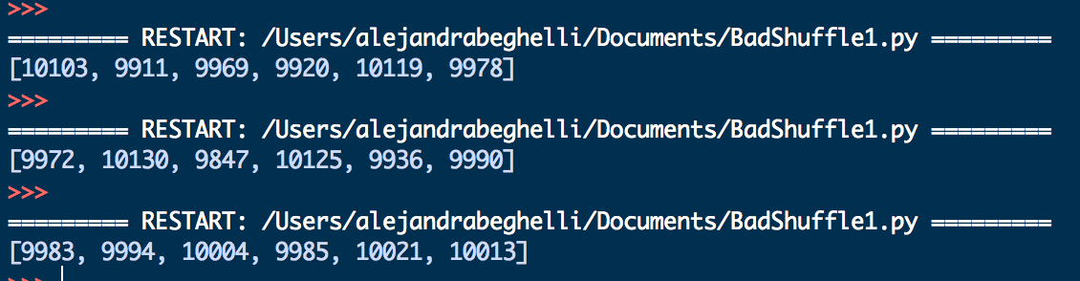
Bad Shuffle1
SHUFFLING BY INSERTION SORT
function insertion (array s)
for 1 ≤ j < length(s) do
key ← s[j]
i ← j−1
while i ≥ 0 ∧ RC(s[i],key)>0 do
s[i+1] ← s[i]
i ← i - 1
end while
s[i+1] ← key
end for
end function
count=[0,0,0,0,0,0]
a1=[1,2,3]
a2=[1,3,2]
a3=[2,3,1]
a4=[2,1,3]
a5=[3,1,2]
a6=[3,2,1]
Results with 60000 shuffles:
Shuffled collections not uniformly distributed

Slide 125
Bad Shuffle 2
SHUFFLING BY SWAP
function BadShuffle2(A)
N ← length(A)
for 0 ≤ i < L do
r ← random()
j ← ⌊N × r⌋
swap(A[i],A[j])
end for
end function
BadShuffle2: Swap randomly

Slide 126
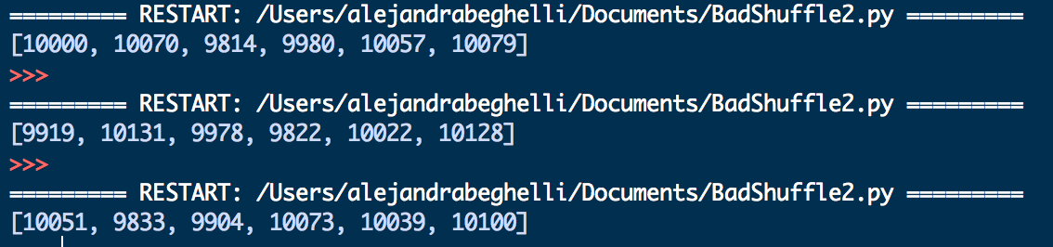
Bad Shuffle 2
SHUFFLING BY SWAP
function BadShuffle2(A)
N ← length(A)
for 0 ≤ i < L do
r ← random()
j ← floor(N × r)
swap(A[i],A[j])
end for
end function
count=[0,0,0,0,0,0]
a1=[1,2,3]
a2=[1,3,2]
a3=[2,3,1]
a4=[2,1,3]
a5=[3,1,2]
a6=[3,2,1]
Results with 60000 shuffles:
Shuffled collections not uniformly distributed

Slide 127
(Good) Fisher-Yates Shuffle
SHUFFLING BY FISHER-YATES
function FisherYates(A)
for N > i > 0 do
r ← random()
j ← floor((i+1) × r)
swap(A[i],A[j])
end for
end function
Avoid multiple swaps

Slide 128
(Good) Fisher-Yates Shuffle
SHUFFLING BY FISHER-YATES
function FisherYates(A)
for N > i > 0 do
r ← random()
j ← floor((i+1) × r)
swap(A[i],A[j])
end for
end function

Slide 129
Comparison of Shuffling Algorithms
A test with small arrays ([1,2,3], suggested by Christophe at the end of his slides) shows no difference:
F-Y | Freq. |  | BS-2 | Freq. |  | BS-1 | Freq.
166288 | 0.166 |  | 166631 | 0.167 |  | 167159 | 0.167
166484 | 0.166 |  | 166320 | 0.166 |  | 165796 | 0.166
167102 | 0.167 |  | 166293 | 0.166 |  | 167047 | 0.167
166648 | 0.167 |  | 168043 | 0.168 |  | 166267 | 0.166
167208 | 0.167 |  | 166175 | 0.166 |  | 166986 | 0.167
166270 | 0.166 |  | 166538 | 0.167 |  | 166745 | 0.167
All shuffling algorithms approach to the theoretical value of 0.167 when shuffling the array [1,2,3]. But…. try with bigger arrays

Slide 130
Comparison of Shuffling Algorithms
Check on these visualization exercises:
https://bost.ocks.org/mike/algorithms
http://datagenetics.com/blog/november42014/index.html/

Slide 131
Upload
Please, upload your complete worksheet at learn.gold
(unmarked activity, I just want to know how much you understood)

Slide 132
1-minute feedback
Things (already done) that help you to understand the course topics
Things (already done) that do not help you to understand the course topics
Things (to be done) that might help you to understand the course topics

